Slide 1
Adaptive Packet Routing with Deep Reinforcement Learning
Topology generalization · multi-objective trade-offs · robustness · continual adaptation
Vaibhav Rathod

Slide 2
The problem
Why learn to route?
• Classical routing (OSPF/Dijkstra, ECMP) reacts to congestion and failures only via periodic metric updates — it does not learn.
• Reinforcement learning can learn a forwarding policy that optimizes long-horizon delay and delivery directly from link state.
• But the RL-routing literature is fragmented:
– one algorithm, one topology, one objective, one aggregate number.
– rarely answered together: generalization, trade-offs, robustness, continual adaptation, fairness.
• This project studies all of them on one simulator with one set of agents — honestly.

Slide 3
Contributions
• Reproducible multi-seed comparison: 5 learners + 3 classical baselines, bootstrap CIs, 73-test suite.
• Zero-shot scalability: a GNN policy transfers route quality to graphs 5× larger than training.
• Multi-objective Pareto view — across algorithms and within one learner (reward-weight sweep).
• Adversarial robustness: worst-case (critical-link) vs. random failures.
• Continual learning: quantify catastrophic forgetting in routing + two remedies.
• All code, tests, and result artifacts released.

Slide 4
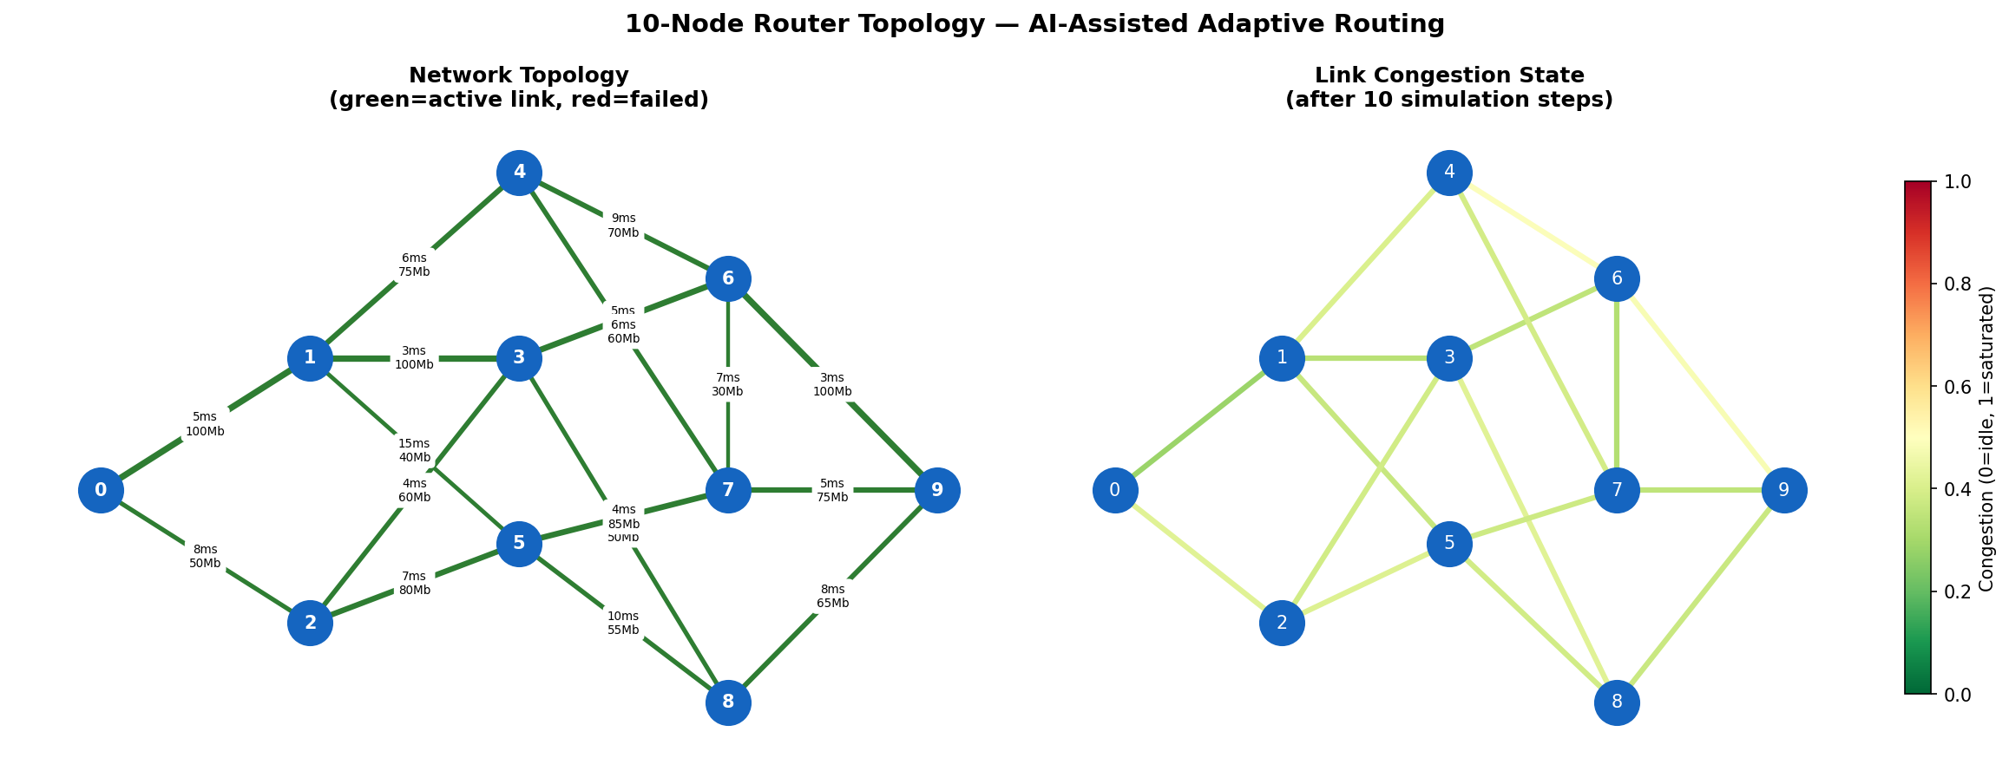
System model
10-node network, realistic dynamics
• M/M/1 queuing-delay model: delay diverges as utilization → 1.
• AR(1) bursty congestion; RED-like loss; Markov link failure/recovery.
• Observation: 4 features/link (congestion, delay, loss, up/down) + src/dst.
• Agents: DQN, Rainbow, GNN-DQN, Q-Routing (+ continual variant).
• Baselines: Dijkstra (OSPF), ECMP, random.

Slide 5
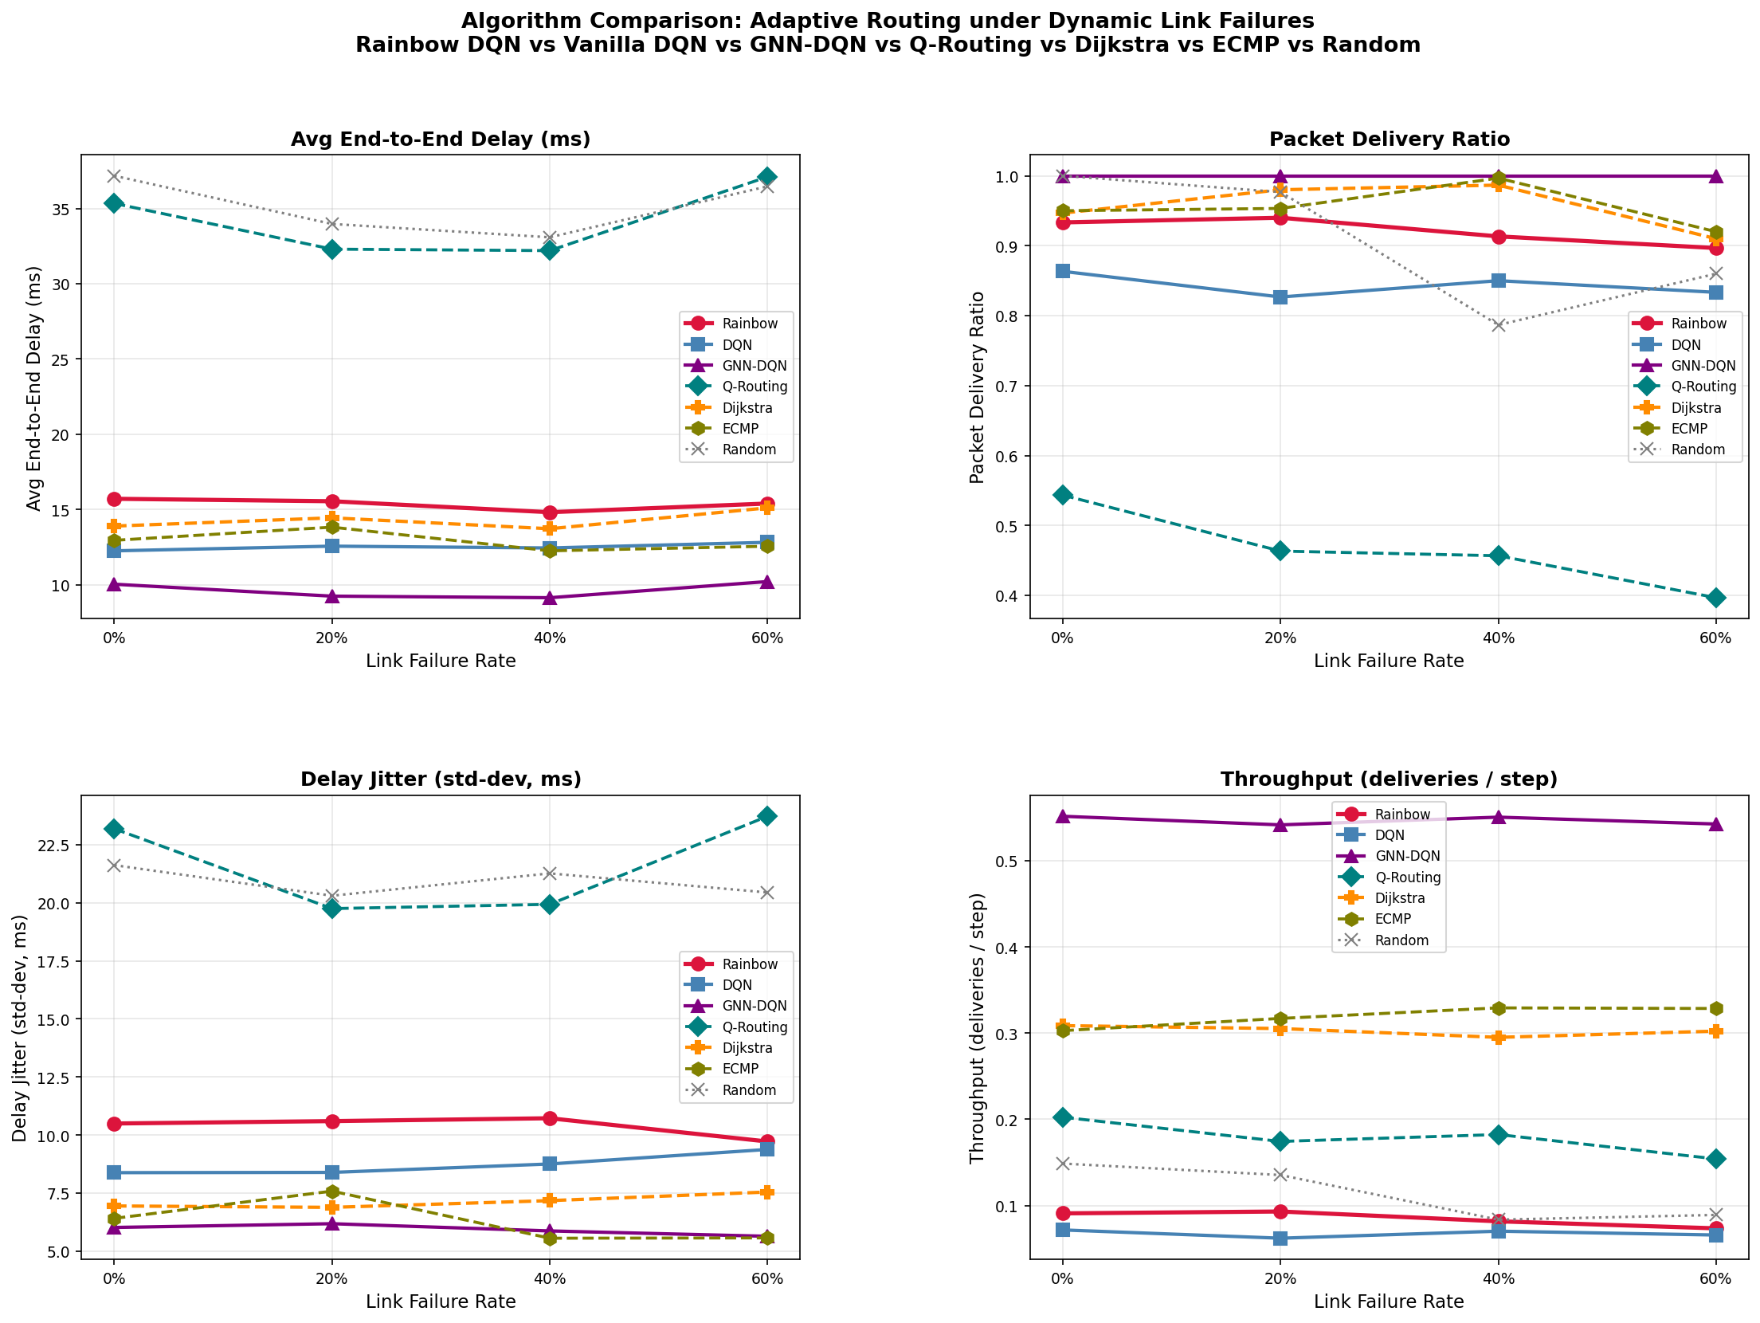
Headline: the GNN policy wins
PDR & delay vs link-failure rate
• GNN-DQN: PDR = 1.00 at every failure rate, lowest delay (~9–10 ms).
• Routes from graph structure → reroutes around failures with no degradation.
• Rainbow competitive (0.90–0.94); vanilla DQN trails baselines on PDR.
• Caveat: failed links are penalized but traversable, so PDR saturates —
– we add more discriminating metrics on the next slides.

Slide 6
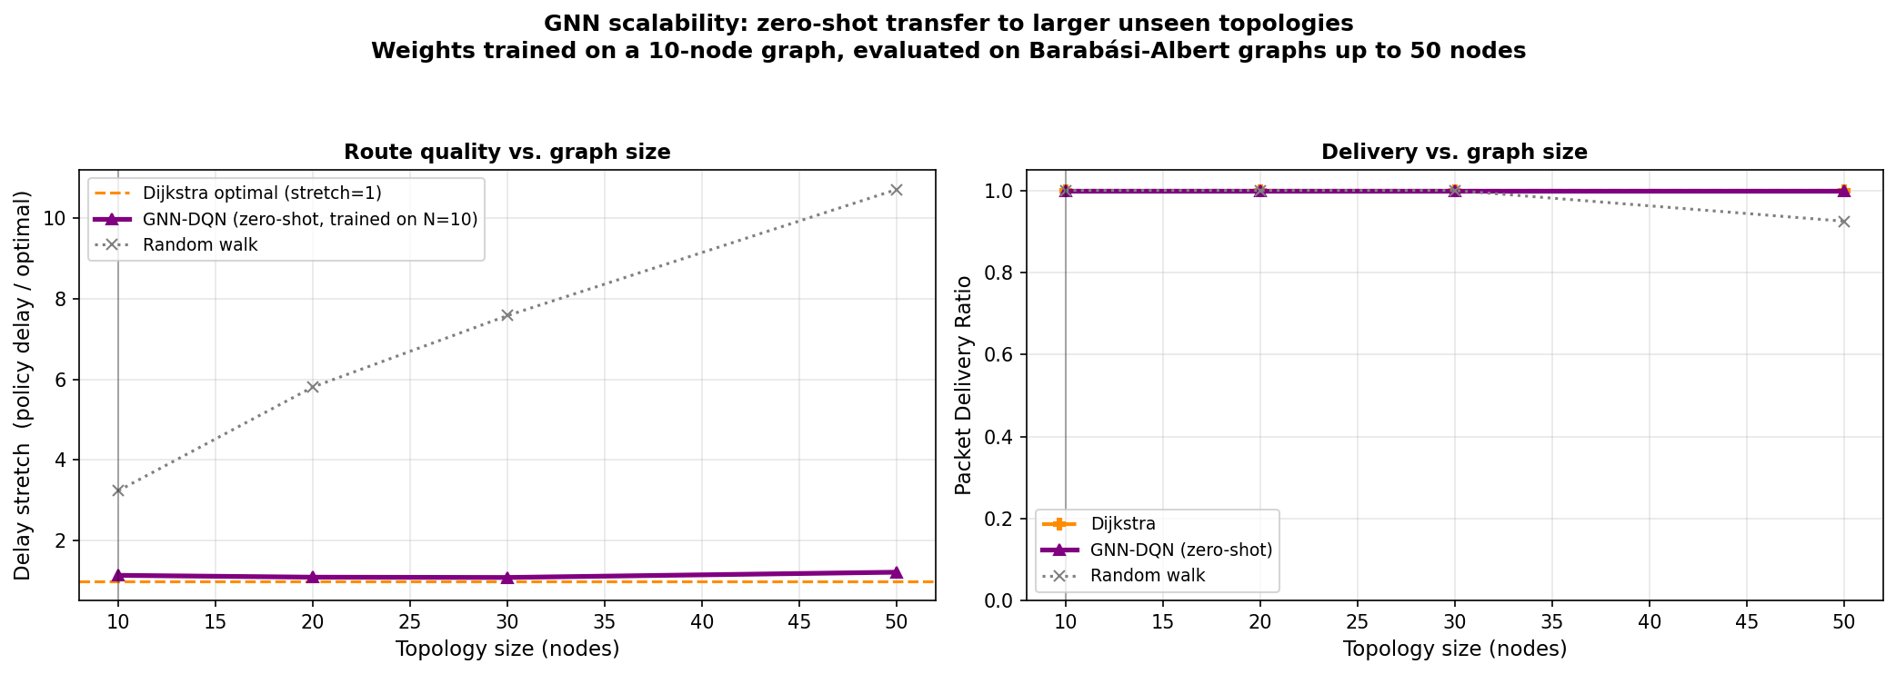
Zero-shot scalability
Trained on 10 nodes → applied to 50
• GNN weights are size-independent → apply to any graph.
• Metric: delay stretch = policy delay / Dijkstra-optimal.
• GNN stays ~1.1–1.2 up to 50 nodes (5× training size).
• Random walk degrades 3.2 → 10.7.
• Transfers route QUALITY, not just reachability.

Slide 7
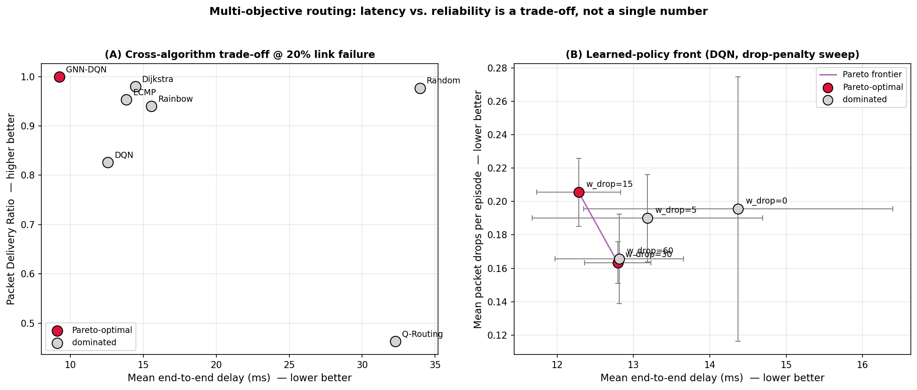
Multi-objective trade-offs
Latency vs reliability is not one number
• Across algorithms (delay, PDR): GNN-DQN is the SOLE Pareto-optimal point.
• Within one learner: sweep the reward's drop-penalty weight to trace its own front.
• Lets you pick an operating point instead of hard-coding one scalarization.

Slide 8
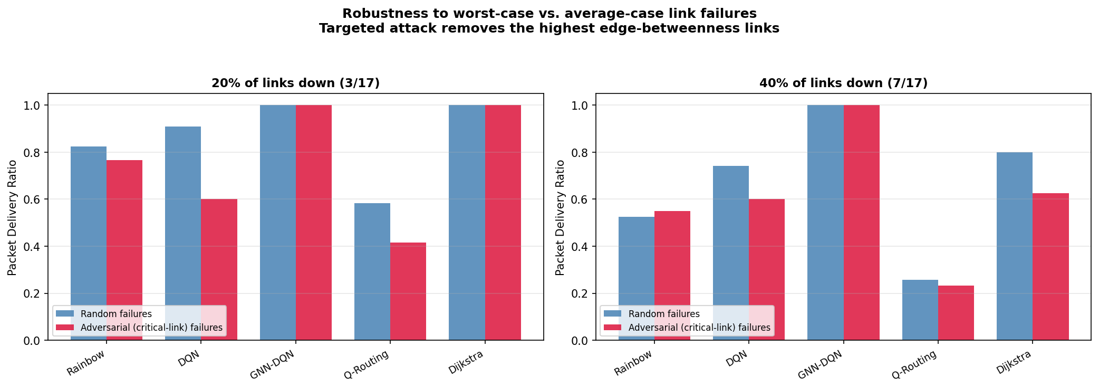
Adversarial robustness
Worst-case vs average-case failures
• Targeted attack disables the highest edge-betweenness (most critical) links.
• GNN keeps PDR = 1.00 under both random and targeted failures.
• Vanilla DQN collapses 0.91 → 0.60 under attack —
– an exposure invisible to random-failure testing.

Slide 9
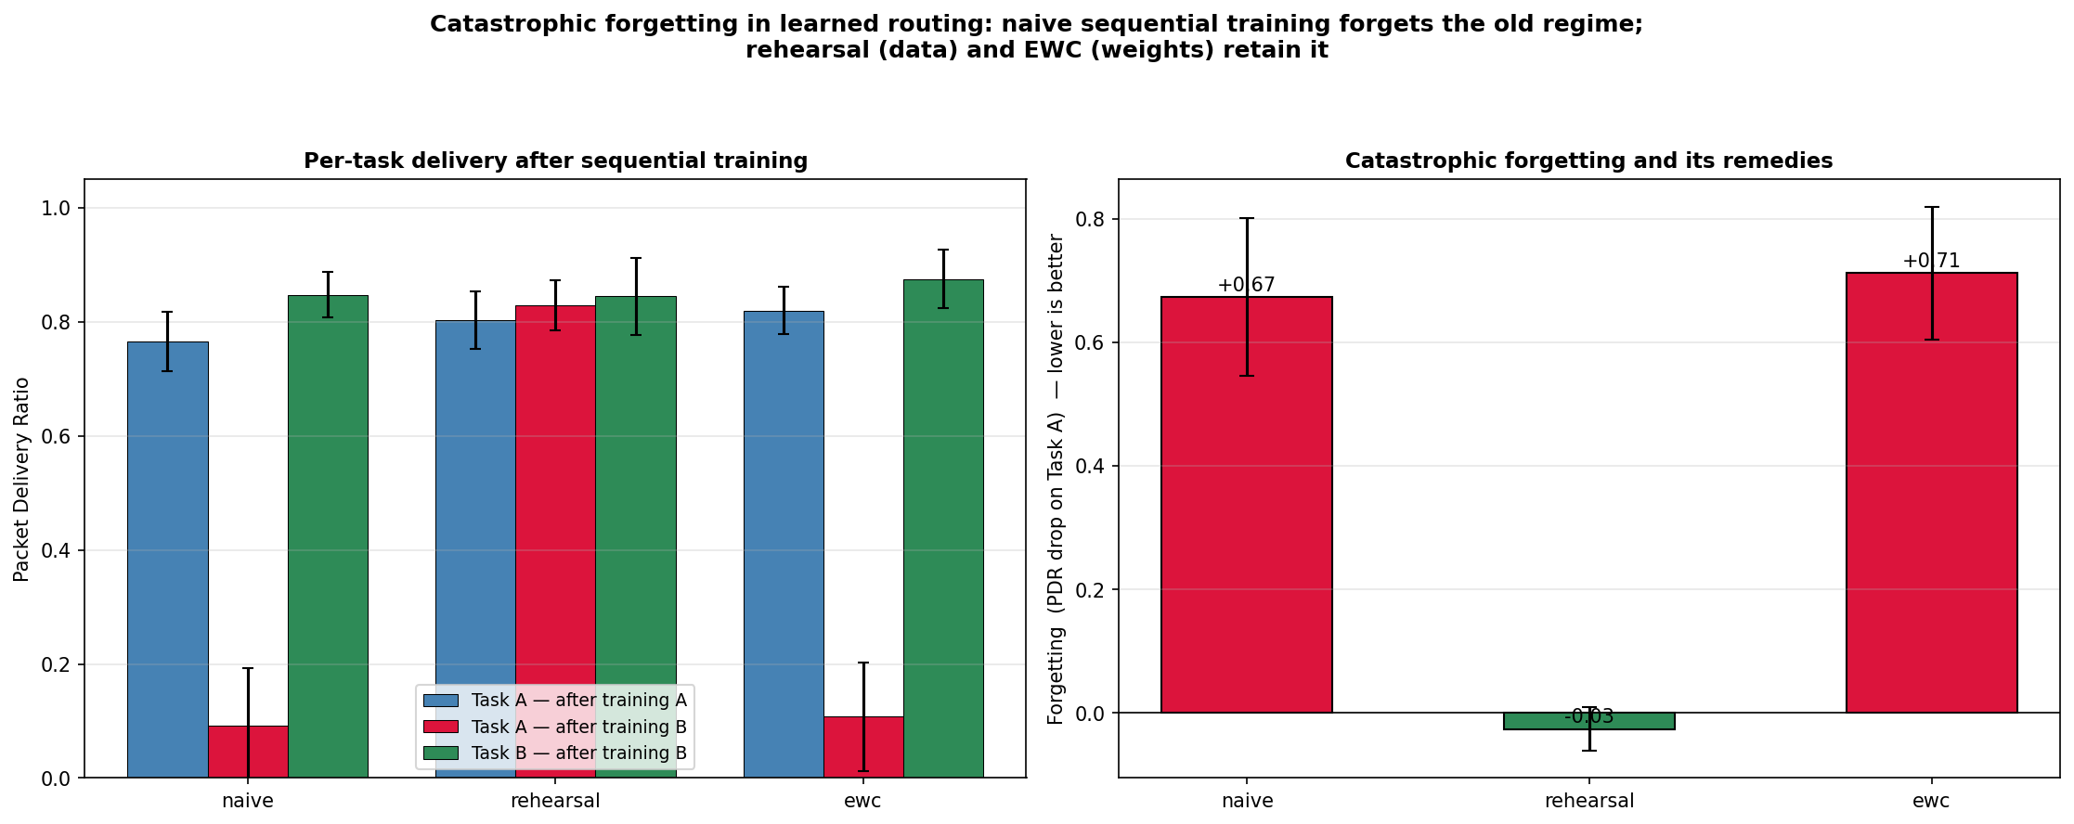
Catastrophic forgetting — the new result
Can an agent adapt without forgetting?
• Train one DQN sequentially on two conflicting destination tasks.
• Naive: Task-A delivery COLLAPSES 0.77 → 0.09 (catastrophic forgetting).
• Rehearsal (keep old replay data): fully prevents it (forgetting ≈ 0).
• EWC does NOT transfer here: destination-conditioned policy shares weights,
– diagonal-Fisher can't isolate task-specific computation.
• Takeaway: data-space rehearsal (≈ free in RL) is the robust fix.

Slide 10
Honest limitations
• Failed links are penalized but traversable → PDR saturates; discriminating metrics carry the analysis.
• Most experiments use one 10-node topology (scalability covers size, GNN-only, no failures).
• Simulation only; a localhost data-plane prototype forwards real packets and reroutes, but no hardware testbed yet.
• We investigated a non-Markovian / recurrent-memory thesis, found it unsupported in this env, and removed it rather than overclaim.

Slide 11
Takeaways & reproducibility
• A structure-aware GNN policy is Pareto-optimal, scales zero-shot, and resists targeted attacks.
• Catastrophic forgetting is real in learned routing; simple rehearsal is the robust remedy.
• Everything is reproducible: train.py, evaluate.py, experiments/*.py, 73 passing tests.
• Future work: larger & real testbeds, harder (hard-cut) failure regimes, decentralized multi-agent RL.
Code · tests · results · paper — all in the repository.

