Slide 1
A Problem Statement and Solution on
“Problem faced by Elderly people in bringing their daily needs”
Name: Vaibhav Sheth
Roll No: 177
Room Name: Poppy
Group Name: Luminars
Subject: Design Thinking & Innovations

Slide 2
Empathise: General survey of problem in near areas.*
What is happening? -- Old age people are feeling helpless in bringing there daily needs.
How people is reacting? -- Some neighbours help these people while some ignore them and move on.
Why was that reaction? -- People who ignore them feels that old people will just ask them
again and again if they help them once.
We asked neighbours this questions.
1) Do you consider this as a problem ?
2) Would you be happy to help elder people in there tough times?
*This survey was done for 20 houses with old age people and 76% of them are living alone. Also there were 40 neighbours around those houses.

Slide 3
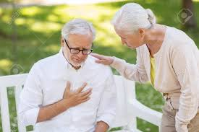

Problem Statement
In our neighborhood there are many old age people living all alone, who doesn’t have any children to look after them, and also they won’t prefer old-age homes, for them bringing groceries for daily needs is bit difficult as they need to walk by themselves a kilometer (which is of course equivalent to running a marathon for them) and bring necessary items or they would have to be dependent on others, also they don’t know nowadays smart technologies by which they can order anything online. So there must be a solution by which they don’t even need to step outside there home and also they can get groceries at there doorsteps.

Slide 4
Fish Bone Diagram: Challenges faced by elderly people.
02
01
03
All of this makes
them weak.
House
Location
problem.
Dependable on others.
Elder People with no children.
Psychological
problems.
No financial
stability.
Medical
problems
04
05
06

Slide 5
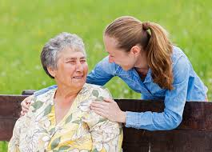
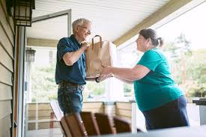

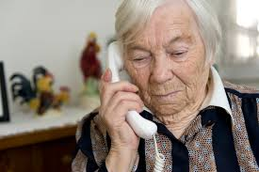
Brain Storming
Asking neighbours who are ready to help them in bringing necessary goods whenever they are going to purchase there own goods.
Increasing social engagement of elderly people with kids and neighbours so that they don’t hesitate in asking for help.
There are many people out there with no parents, connect those NGOs with this people so that they can get a family as well as there will be no dependencies on others.
They don’t use modern technologies but we can provide them a nearby local grocery’s phone number who will be willing to provide a free home delivery whenever needed.

Slide 6
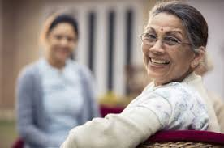
Implementation (Ready to use ideas/prototypes/future works)
Applied successfully
To contact a local grocery store and ask him to provide free delivery to all the houses(where elderly people live all alone), also giving them 20 such houses so that the shopkeeper wont be in loss by providing free delivery.
Arranging a small function in the society where there will be engaging games and fun activities where the participants will be children and elderly people only, such that they increase relative engagements in the society and don’t feel alone.
To ask the elderly people whether they are ready to adopt a kid from orphanage, so that now they will have a family. And the people who are ready to do so, we will contact them with orphan age home.
In process
“Life is getting easier
with Luminars “

