Slide 1
Unit 7 Non-Linear Optimization
EL-GY 6143/CS-GY 6923: Introduction to machine learning
Prof. Pei liu

Slide 2
Midterm Exam
Midterm will be on next week Nov 27, 6:00PM-8:30PM
Attendance at exams is mandatory
According to school policy, if you registered for in-person class, you must take in-person exams
If you registered for online class, you can take the exam online, or you can come to school and take the exam in person
Use the Zoom link for the lecture to join the exam
All materials in Lecture 1-7 will be in the exam
Including today’s lecture
You don’t need to submit this week’s homework as solution will be released early
Close-book exam
2 pieces of paper cheatsheet allowed, can write/print on both sides.

Slide 3
Requirement for In-person Exam
Assigned seating and you will get the seat assignment before the exam by email
Please wear a mask over your nose and mouth all the time
Write your answers in the question book
You should have enough space to answer the questions
Remember to write names on all pages
Don’t tear any page off the question book
Don’t write on the back of any page, as it will not be scanned
We will give you scratch paper. Don’t write your answers on them

Slide 4
Requirements for Online Exam
Please join the Zoom meeting on 15 minutes before the exam using the lecture Zoom link
Use your full name when you join.
If you have a printer, it is recommended that you print the exam papers and write on it. Otherwise, use your own paper.
Make sure you clearly write the page number on each page.
Each student is required to turn on a video camera, which captures hand/ face/computer keyboard. The whole exam will be recorded. To clearly capture the video of exam taking, it is recommended that:
Use am external webcam connected to the computer;
Or use another device other than the computer you use to read exam questions (smartphone/ipad/laptop with power plugged in);
In both cases, adjust the position/orientation of the camera so that it clearly captures the keyboard, hands, and face of the student.
During the exam, you should keep your video on all the time. If there is anything wrong with your Zoom connection, please email or call me ASAP.
Submit the exam over Gradescope.

Slide 5
Learning Objectives
Identify the objective function, parameters and constraints in an optimization problem
Compute the gradient of a loss function for scalar, vector and matrix parameters
Efficiently compute a gradient in python.
Write the gradient descent update
Describe the effect of the learning rate on convergence
Determine if a loss function is convex

Slide 6
Outline
Motivating example: Build an optimizer for logistic regression
Gradients of multi-variable functions
Gradient descent
Adaptive step size
Convexity

Slide 7
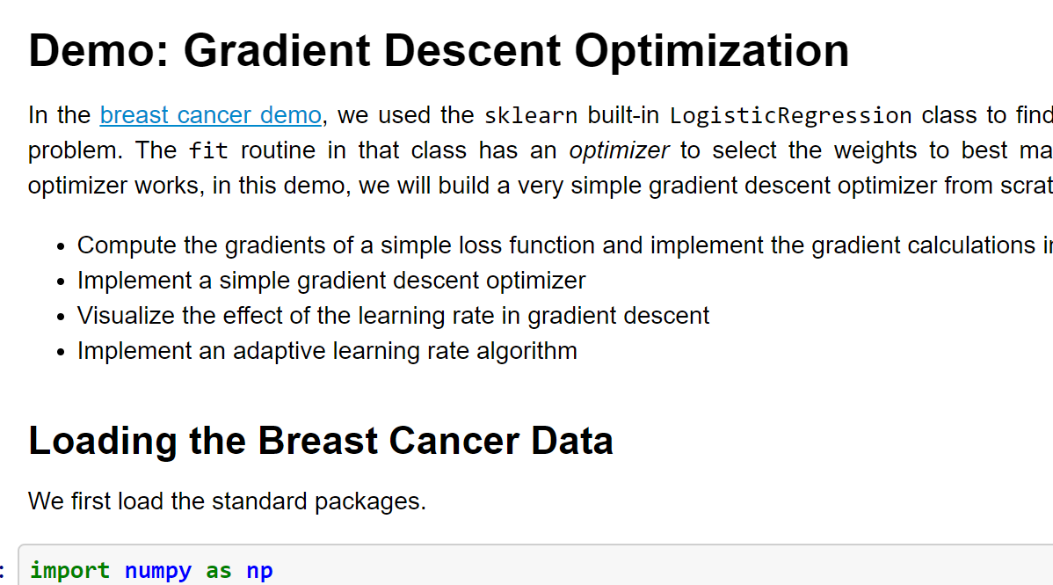
Demo on GitHub
https://github.com/pliugithub/MachineLearning/blob/master/optim/grad_descent.ipynb

Slide 8

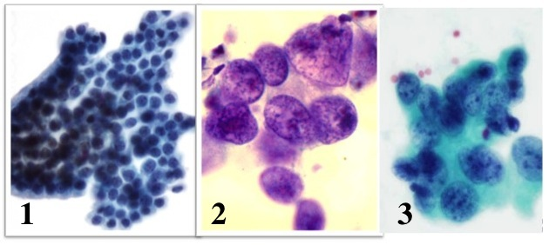
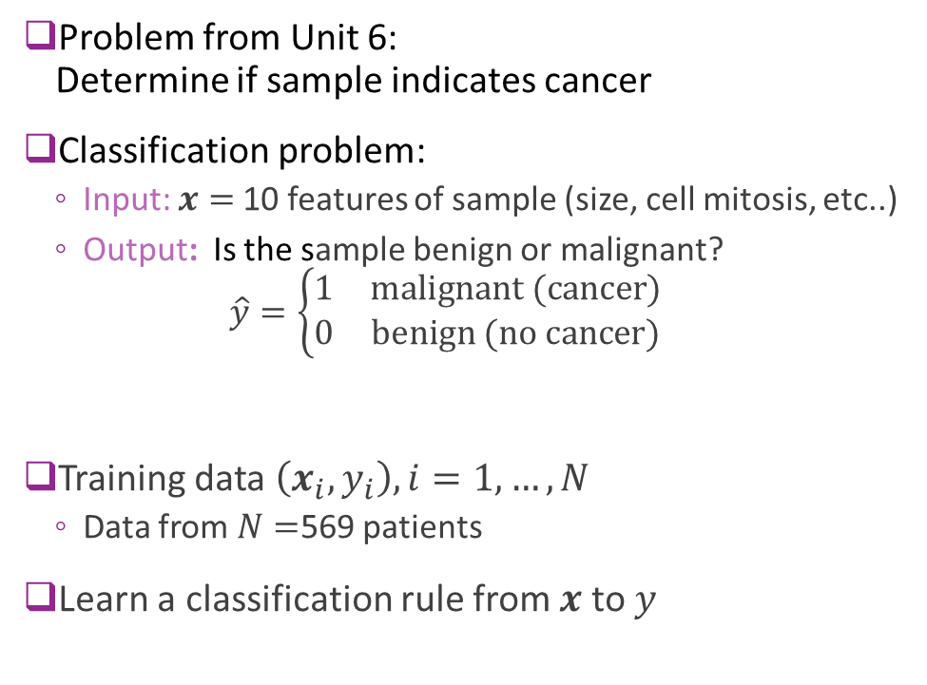
Recap: Breast Cancer Example
Problem from Unit 6: Determine if sample indicates cancer
Classification problem:
Input: $x=$10 features of sample (size, cell mitosis, etc..)
Output: Is the sample benign or malignant? $\hat{y}=\left\{\begin{matrix}1 & \text{malignant}\text{ (}\text{cancer}\text{)} \\ 0 & \text{benign}\text{ (}\text{no} \text{cancer}\text{)}\end{matrix}\right.$
Training data $\left(x_{i},y_{i}\right), i=1,…,N$
Data from $N=$569 patients
Learn a classification rule from $x$ to $y$
Grades of carcinoma cells
http://breast-cancer.ca/5a-types/

Slide 9
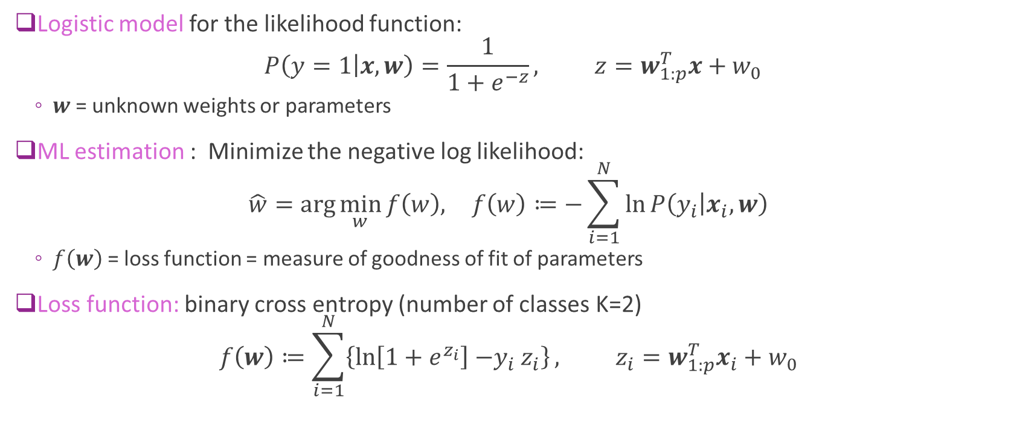
Logistic Regression Maximum Likelihood
Logistic model for the likelihood function: $P\left(y=1 | x,w\right)=\frac{1}{1+e^{−z}}, z=w_{1:p}^{T}x+w_{0}$
$w$= unknown weights or parameters
ML estimation : Minimize the negative log likelihood: $\hat{w}=\arg{\min_{w}{f\left(w\right), }} f\left(w\right)≔−\sum_{i=1}^{N}{\ln{P\left(y_{i} | x_{i},w\right)}}$
$f\left(w\right)$ = loss function = measure of goodness of fit of parameters
Loss function: binary cross entropy (number of classes K=2) $f\left(w\right)≔\sum_{i=1}^{N}{\left\{\ln\left[1+e^{z_{i}}\right]{−y}_{i}z_{i}\right\}}, z_{i}=w_{1:p}^{T}x_{i}+w_{0}$

Slide 10


Minimizing the Loss Function
No analytic solution to minimize loss
Used sklearn LogisticRegression.fit method
Used built-in optimizer to minimize loss function
Very fast and achieves good results
Questions for today:
How does this optimizer work?
How would we build one from scratch

Slide 11
Outline
Motivating example: Build an optimizer for logistic regression
Gradients of multi-variable functions
Gradient descent
Adaptive step size
Convexity

Slide 12
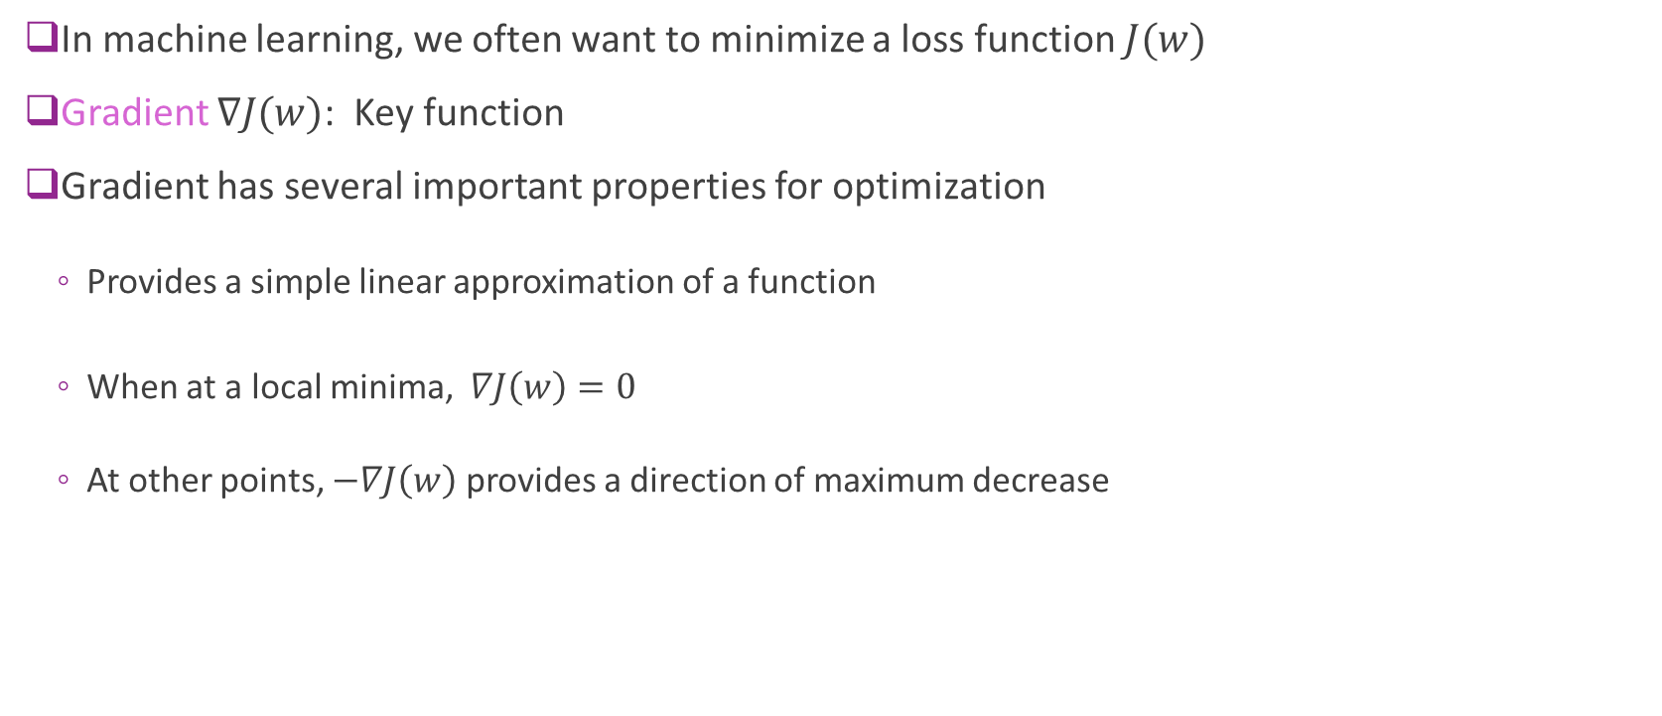
Gradients and Optimization
In machine learning, we often want to minimize a loss function $J(w)$
Gradient $∇J(w)$: Key function
Gradient has several important properties for optimization
Provides a simple linear approximation of a function
When at a local minima, $∇J\left(w\right)=0$
At other points, $−∇J\left(w\right)$ provides a direction of maximum decrease

Slide 13
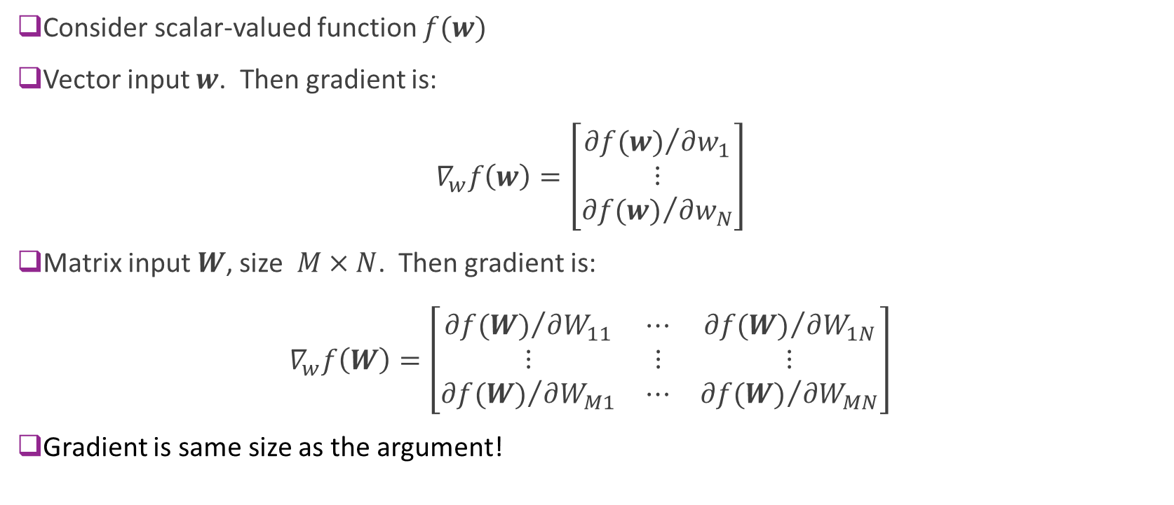
Gradient Defined
Consider scalar-valued function $f(w)$
Vector input $w$. Then gradient is: $∇_{w}f\left(w\right)=\left[\begin{matrix}{∂f(w)}/{∂w_{1}} \\ ⋮ \\ {∂f(w)}/{∂w_{N}}\end{matrix}\right]$
Matrix input $W$, size $M×N$. Then gradient is: $∇_{w}f\left(W\right)=\left[\begin{matrix}{∂f(W)}/{∂W_{11}} & ⋯ & {∂f(W)}/{∂W_{1N}} \\ ⋮ & ⋮ & ⋮ \\ {∂f(W)}/{∂W_{M1}} & ⋯ & {∂f(W)}/{∂W_{MN}}\end{matrix}\right]$
Gradient is same size as the argument!

Slide 14
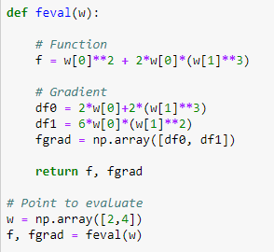


Example 1
$f\left(w_{1},w_{2}\right)=w_{1}^{2}+2w_{1}w_{2}^{3}$
Partial derivatives:
${∂f}/{∂w_{1}}=2w_{1}+2w_{2}^{3}$
${∂f}/{∂w_{2}}=6w_{1}w_{2}^{2}$
Gradient: $∇f=\left[\begin{matrix}2w_{1}+2w_{2}^{3} \\ 6w_{1}w_{2}^{2}\end{matrix}\right]$
Example to right:
Computes gradient at $w=\left(2,4\right)$
Gradient is a numpy vector

Slide 15
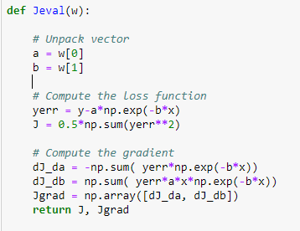
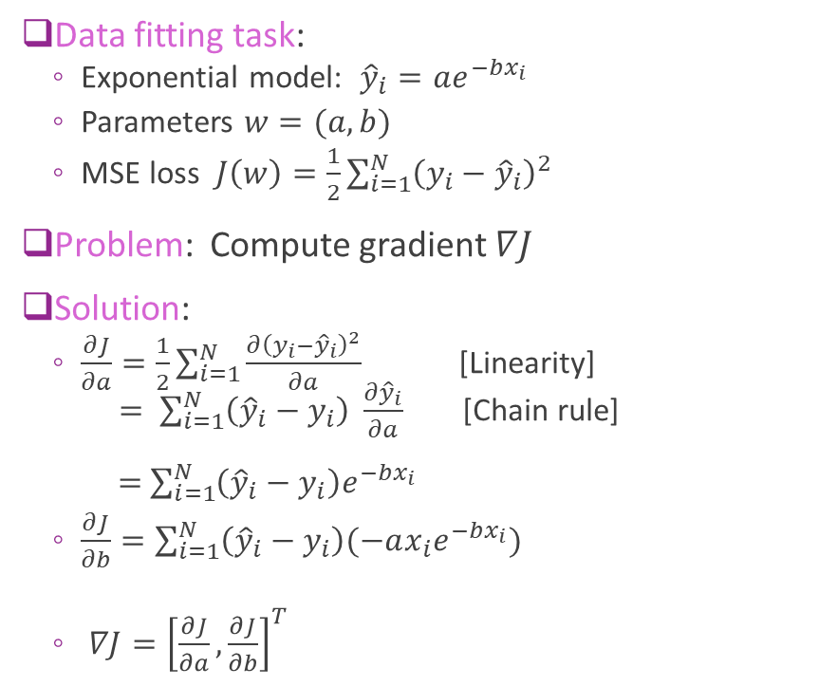
Example 2: An Exponential Model
Data fitting task:
Exponential model: ${\hat{y}}_{i}=ae^{−bx_{i}}$
Parameters $w=(a,b)$
MSE loss $J\left(w\right)=\frac{1}{2}\sum_{i=1}^{N}{{\left(y_{i}−{\hat{y}}_{i}\right)}^{2}}$
Problem: Compute gradient $∇J$
Solution:
$\frac{∂J}{∂a}=\frac{1}{2}\sum_{i=1}^{N}{\frac{∂{\left(y_{i}−{\hat{y}}_{i}\right)}^{2}}{∂a}}$ [Linearity] $= \sum_{i=1}^{N}{\left({\hat{y}}_{i}−y_{i}\right) }\frac{∂{\hat{y}}_{i}}{∂a}$ [Chain rule] $=$ $\sum_{i=1}^{N}{\left({\hat{y}}_{i}−y_{i}\right)e^{−bx_{i}}}$
$\frac{∂J}{∂b}=\sum_{i=1}^{N}{\left({\hat{y}}_{i}−y_{i}\right)(−ax_{i}e^{−bx_{i}})}$
$∇J={\left[\frac{∂J}{∂a},\frac{∂J}{∂b}\right]}^{T}$

Slide 16
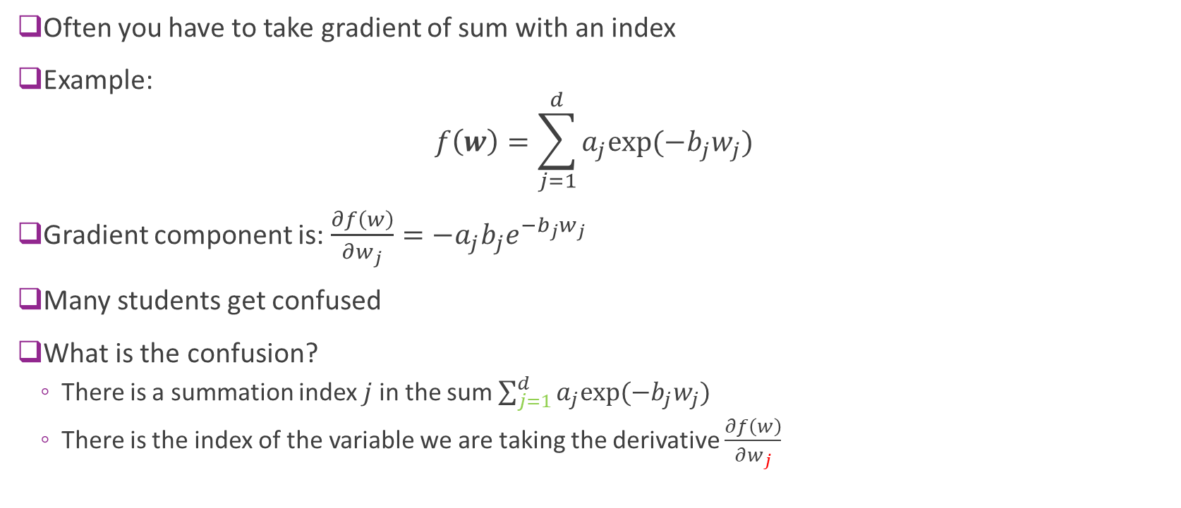
Gradients with Sums
Often you have to take gradient of sum with an index
Example: $f\left(w\right)=\sum_{j=1}^{d}{a_{j}exp⁡(−b_{j}w_{j})}$
Gradient component is: $\frac{∂f\left(w\right)}{∂w_{j}}={−a}_{j}b_{j}e^{−b_{j}w_{j}}$
Many students get confused
What is the confusion?
There is a summation index $j$ in the sum $\sum_{j=1}^{d}{a_{j}exp⁡(−b_{j}w_{j})}$
There is the index of the variable we are taking the derivative $\frac{∂f\left(w\right)}{∂w_{j}}$

Slide 17
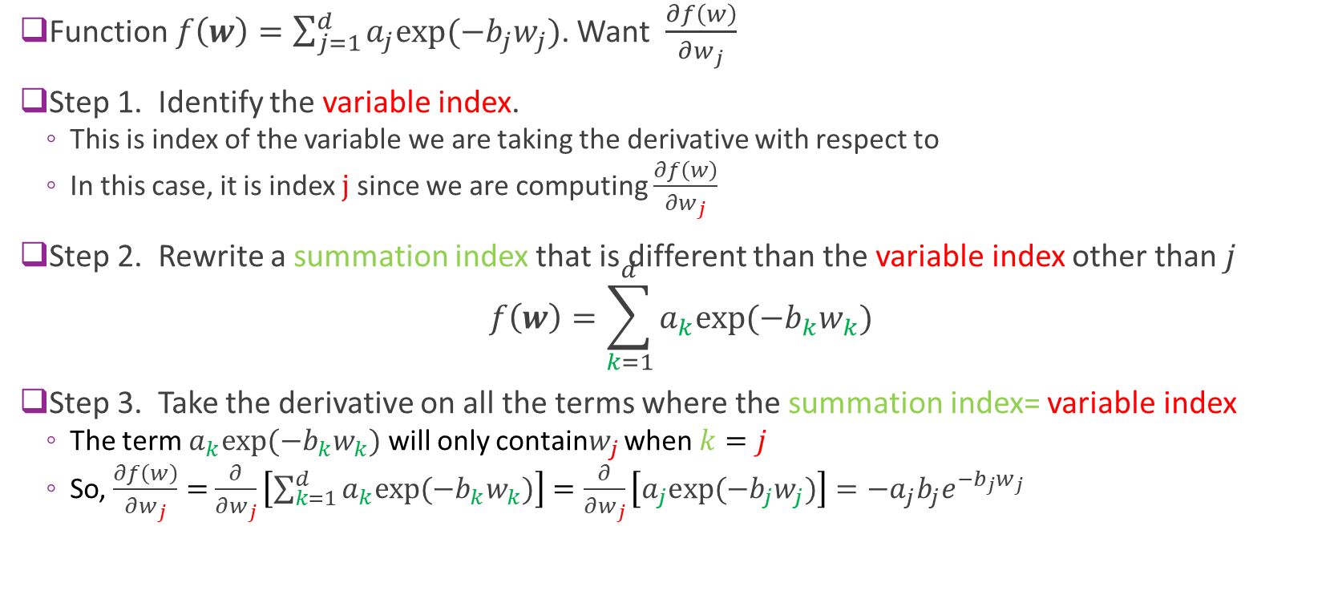
Gradients with Sums
Function $f\left(w\right)=\sum_{j=1}^{d}{a_{j}exp⁡(−b_{j}w_{j})}$. Want $\frac{∂f\left(w\right)}{∂w_{j}}$
Step 1. Identify the variable index.
This is index of the variable we are taking the derivative with respect to
In this case, it is index $j$ since we are computing $\frac{∂f\left(w\right)}{∂w_{j}}$
Step 2. Rewrite a summation index that is different than the variable index other than $j$ $f\left(w\right)=\sum_{k=1}^{d}{a_{k}exp⁡(−b_{k}w_{k})}$
Step 3. Take the derivative on all the terms where the summation index= variable index
The term $a_{k}exp⁡(−b_{k}w_{k})$ will only contain$w_{j}$ when $k=j$
So, $\frac{∂f\left(w\right)}{∂w_{j}}=$ $\frac{∂}{∂w_{j}}\left[\sum_{k=1}^{d}{a_{k}exp⁡(−b_{k}w_{k})}\right]=\frac{∂}{∂w_{j}}\left[a_{j}exp⁡(−b_{j}w_{j})\right]=−a_{j}b_{j}e^{−b_{j}w_{j}}$

Slide 18

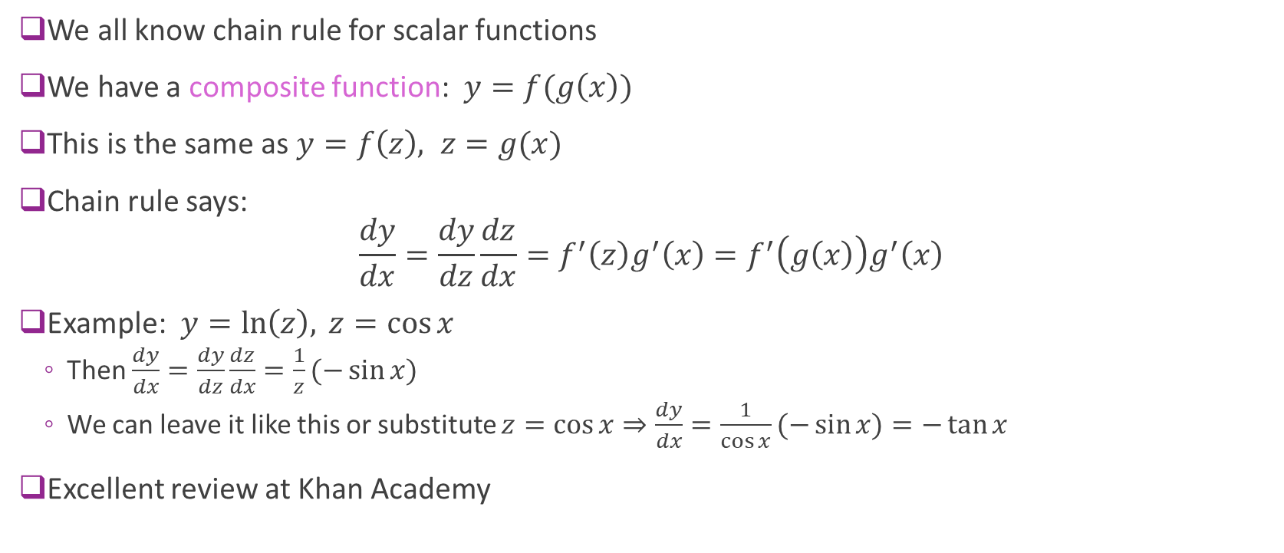


Chain Rule
We all know chain rule for scalar functions
We have a composite function: $y=f(g\left(x\right))$
This is the same as $y=f\left(z\right), z=g(x)$
Chain rule says: $\frac{dy}{dx}=\frac{dy}{dz}\frac{dz}{dx}=f^{′}\left(z\right)g^{′}\left(x\right)=f^{′}\left(g\left(x\right)\right)g^{′}\left(x\right)$
Example: $y=\ln\left(z\right), z=\cos{x}$
Then $\frac{dy}{dx}=\frac{dy}{dz}\frac{dz}{dx}=\frac{1}{z}(−\sin{x})$
We can leave it like this or substitute $z=\cos{x}⇒\frac{dy}{dx}=\frac{1}{\cos{x}}(−\sin{x)}=−\tan{x}$
Excellent review at Khan Academy
$$x$$
$$z$$
$$y$$

Slide 19



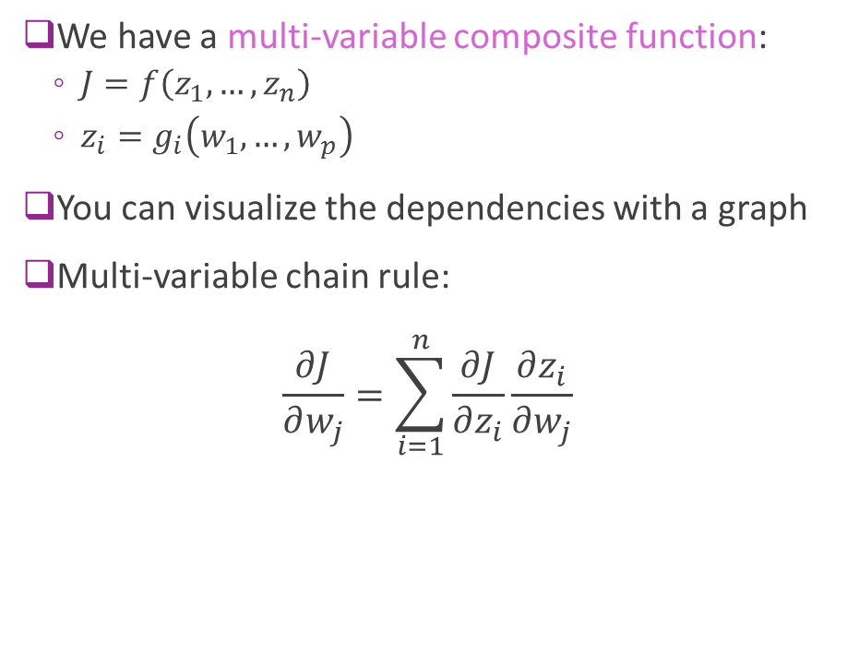




Multi-Variable Chain Rule
We have a multi-variable composite function:
$J=f\left(z_{1},…,z_{n}\right)$
$z_{i}=g_{i}\left(w_{1},…,w_{p}\right)$
You can visualize the dependencies with a graph
Multi-variable chain rule: $\frac{∂J}{∂w_{j}}=\sum_{i=1}^{n}{\frac{∂J}{∂z_{i}}\frac{∂z_{i}}{∂w_{j}}}$
$$z_{1}$$
$$w_{1}$$
$$J$$
$$⋮$$
$$⋮$$
$$w_{p}$$
$$z_{n}$$

Slide 20
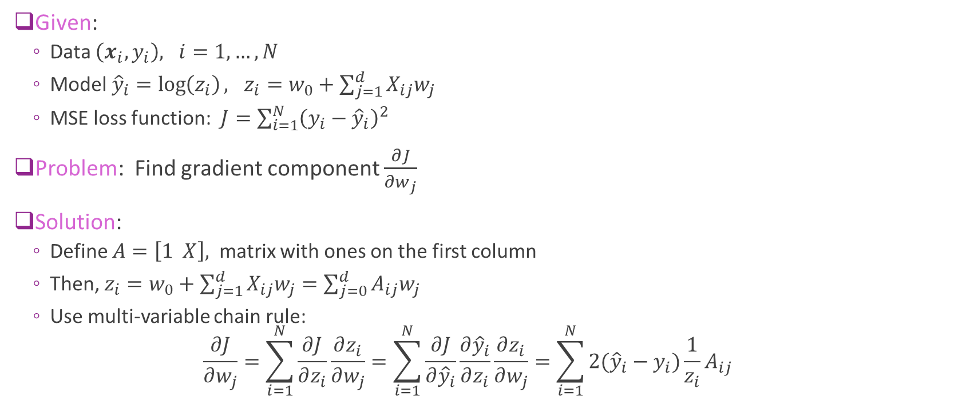
Example 3: Log-Linear Model
Given:
Data $\left(x_{i},y_{i}\right), i=1,…,N$
Model ${\hat{y}}_{i}=\log\left(z_{i}\right), z_{i}=w_{0}+\sum_{j=1}^{d}{X_{ij}w_{j}}$
MSE loss function: $J=\sum_{i=1}^{N}{{\left(y_{i}−{\hat{y}}_{i}\right)}^{2}}$
Problem: Find gradient component $\frac{∂J}{∂w_{j}}$
Solution:
Define $A=\left[1 X\right],$ matrix with ones on the first column
Then, $z_{i}=w_{0}+\sum_{j=1}^{d}{X_{ij}w_{j}}=\sum_{j=0}^{d}{A_{ij}w_{j}}$
Use multi-variable chain rule: $\frac{∂J}{∂w_{j}}=\sum_{i=1}^{N}{\frac{∂J}{∂z_{i}}}\frac{∂z_{i}}{∂w_{j}}=\sum_{i=1}^{N}{\frac{∂J}{∂{\hat{y}}_{i}}}\frac{∂{\hat{y}}_{i}}{∂z_{i}}\frac{∂z_{i}}{∂w_{j}}=\sum_{i=1}^{N}{2({\hat{y}}_{i}−y_{i})}\frac{1}{z_{i}}A_{ij}$

Slide 21
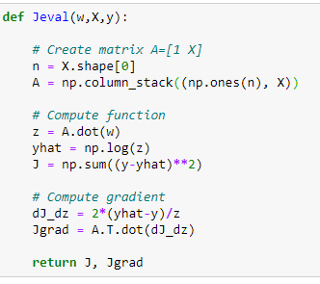

Example 3: Matrix Version
From previous slide:
$z_{i}=w_{0}+\sum_{j=1}^{d}{X_{ij}w_{j}}=\sum_{j=0}^{d}{A_{ij}w_{j}}$
$y_{i}=\log{(z_{i})}$
$\frac{∂J}{∂w_{j}}=2\sum_{i=1}^{N}{({\hat{y}}_{i}−y_{i})}\frac{1}{z_{i}}A_{ij}$
Can implement these with matrix operations:
Useful for efficient implementation in python
$z=Aw$
$\hat{y}=\log{(z)}$
$\frac{dJ}{dz}=2\left(\hat{y}−y\right)\frac{1}{z}$ [elementwise division]
$\frac{∂J}{∂w}=A^{T}\frac{dJ}{dz}$

Slide 22
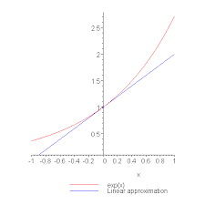
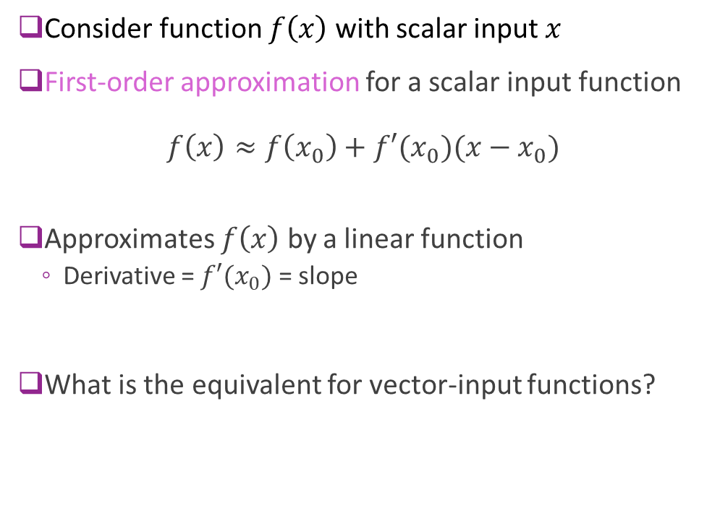
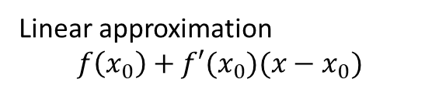
First-Order Approximations Scalar-Input Functions
Consider function $f\left(x\right)$ with scalar input $x$
First-order approximation for a scalar input function $f\left(x\right)≈f\left(x_{0}\right)+f′(x_{0})(x−x_{0})$
Approximates $f\left(x\right)$ by a linear function
Derivative = $f′(x_{0})$ = slope
What is the equivalent for vector-input functions?
Linear approximation
$$f\left(x_{0}\right)+f′(x_{0})(x−x_{0})$$

Slide 23
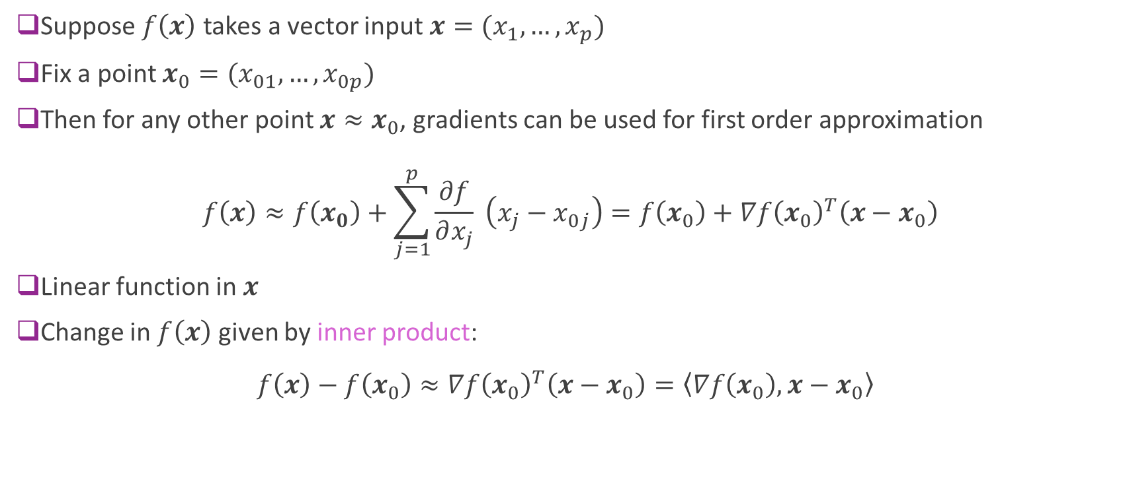
First-Order Approximations Vector Input Functions
Suppose $f\left(x\right)$ takes a vector input $x=(x_{1},…,x_{p})$
Fix a point $x_{0}=(x_{01},…,x_{0p})$
Then for any other point $x≈x_{0}$, gradients can be used for first order approximation
$$f\left(x\right)≈f\left(x_{0}\right)+\sum_{j=1}^{p}{\frac{∂f}{∂x_{j}}} \left(x_{j}−x_{0j}\right)=f\left(x_{0}\right)+∇f{\left(x_{0}\right)}^{T}\left(x−x_{0}\right)$$
Linear function in $x$
Change in $f\left(x\right)$ given by inner product: $f\left(x\right)−f\left(x_{0}\right)≈∇f{\left(x_{0}\right)}^{T}\left(x−x_{0}\right)=\left\langle ∇f\left(x_{0}\right),x−x_{0}\right\rangle$

Slide 24
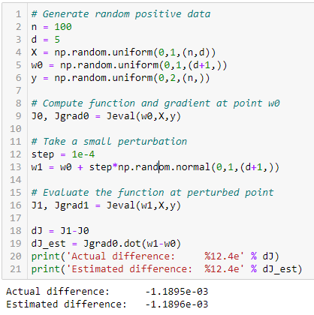
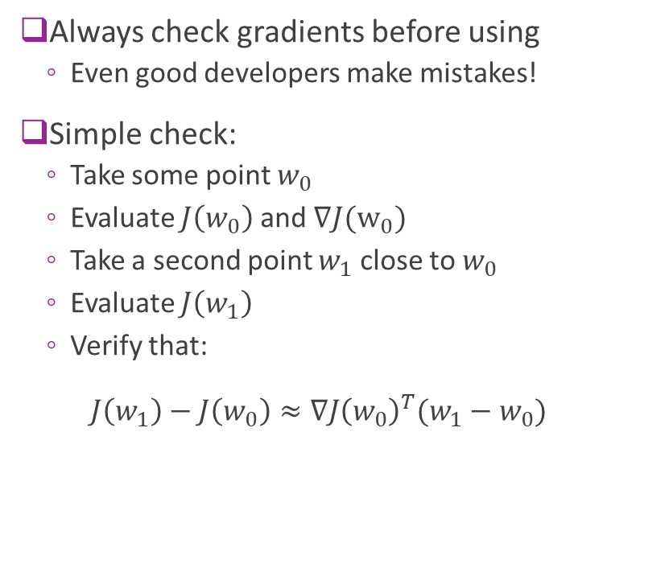
Checking Gradients
Always check gradients before using
Even good developers make mistakes!
Simple check:
Take some point $w_{0}$
Evaluate $J\left(w_{0}\right)$ and $∇J(w_{0})$
Take a second point $w_{1}$ close to $w_{0}$
Evaluate $J\left(w_{1}\right)$
Verify that: $J\left(w_{1}\right)−J\left(w_{0}\right)≈∇J{\left(w_{0}\right)}^{T}(w_{1}−w_{0})$

Slide 25
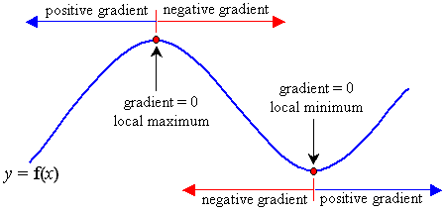
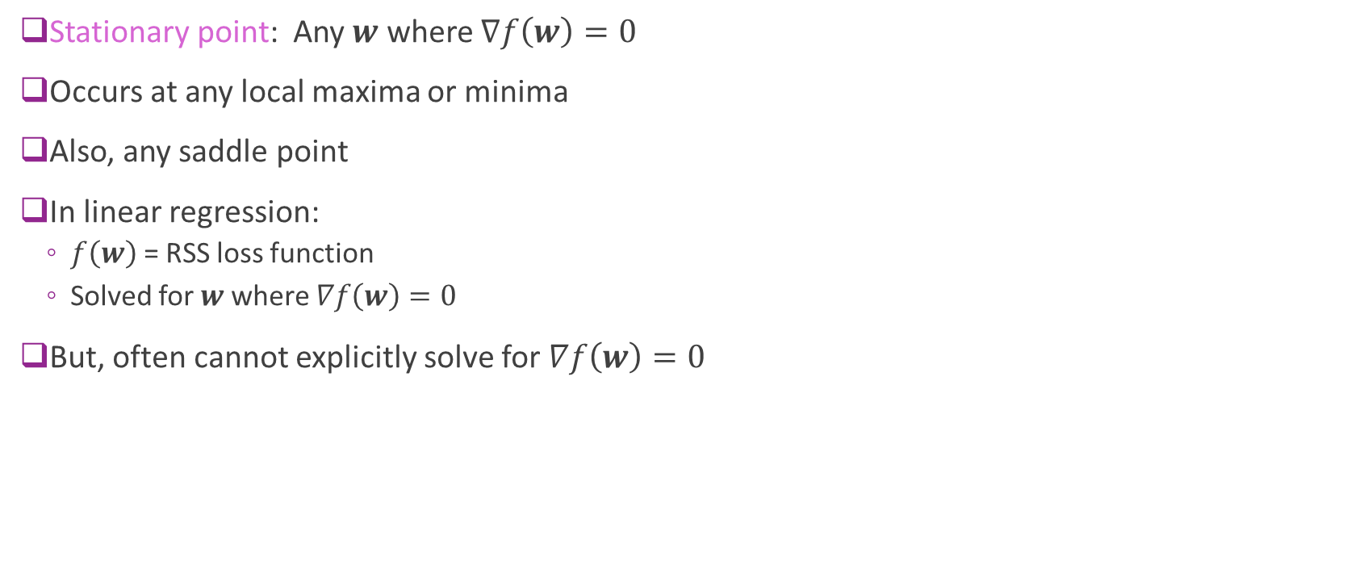
Gradients and Stationary Points
Stationary point: Any $w$ where $∇f\left(w\right)=0$
Occurs at any local maxima or minima
Also, any saddle point
In linear regression:
$f\left(w\right)$ = RSS loss function
Solved for $w$ where $∇f\left(w\right)=0$
But, often cannot explicitly solve for $∇f\left(w\right)=0$

Slide 26
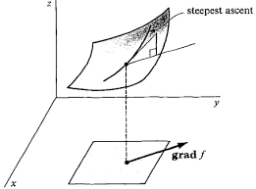
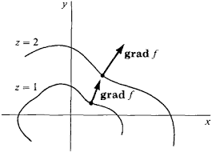
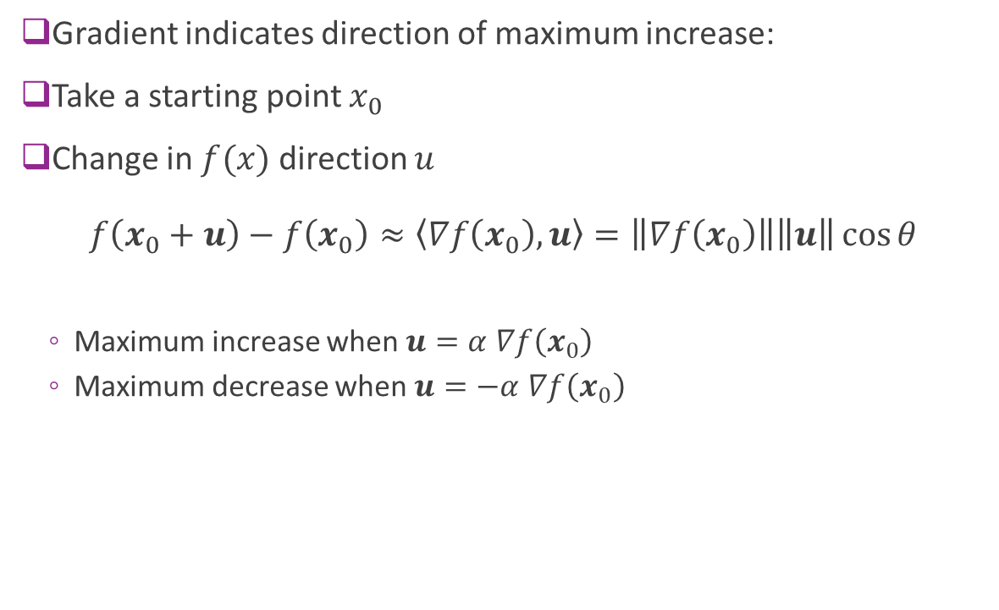
Direction of Maximum Increase
Gradient indicates direction of maximum increase:
Take a starting point $x_{0}$
Change in $f(x)$ direction $u$ $f\left(x_{0}+u\right)−f\left(x_{0}\right)≈\left\langle ∇f\left(x_{0}\right),u\right\rangle =\left\|∇f\left(x_{0}\right)\right\|\left\|u\right\|\cos{θ}$
Maximum increase when $u=α$ $∇f\left(x_{0}\right)$
Maximum decrease when $u=−α$ $∇f\left(x_{0}\right)$

Slide 27
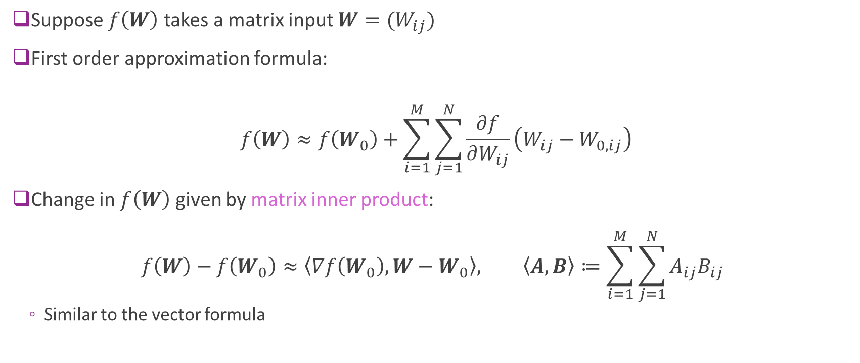
First-Order Approximations Matrix Input Functions (Advanced)
Suppose $f\left(W\right)$ takes a matrix input $W=(W_{ij})$
First order approximation formula:
$$f\left(W\right)≈f\left(W_{0}\right)+\sum_{i=1}^{M}{\sum_{j=1}^{N}{\frac{∂f}{∂W_{ij}}\left(W_{ij}−W_{0,ij}\right)}}$$
Change in $f\left(W\right)$ given by matrix inner product: $f\left(W\right)−f\left(W_{0}\right)≈\left\langle ∇f\left(W_{0}\right),W−W_{0}\right\rangle , \left\langle A,B\right\rangle ≔\sum_{i=1}^{M}{\sum_{j=1}^{N}{A_{ij}B_{ij}}}$
Similar to the vector formula

Slide 28
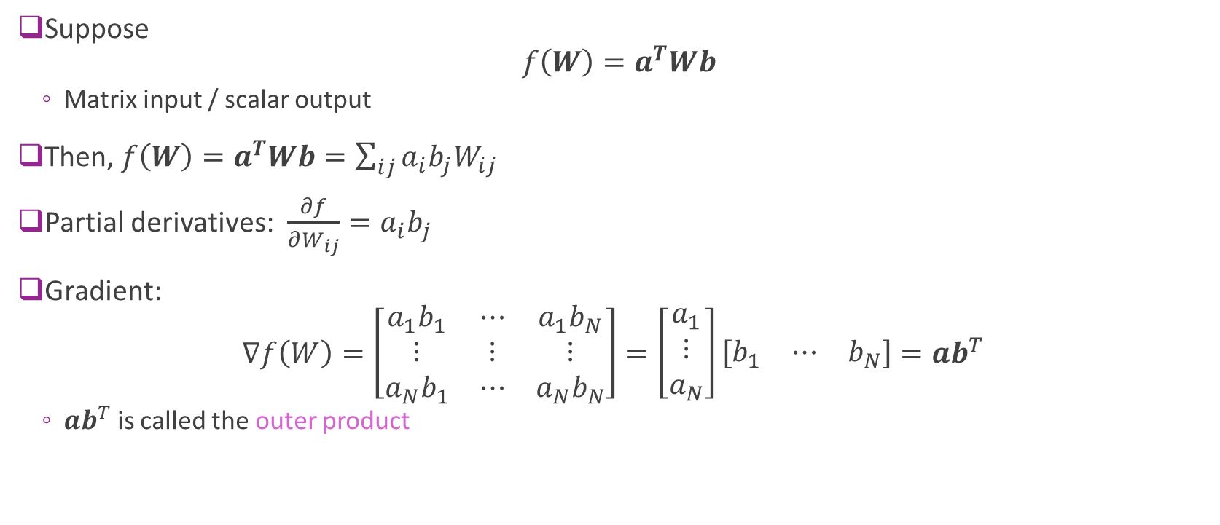
Example 4: Matrix-Input Function
Suppose $f\left(W\right)=a^{T}Wb$
Matrix input / scalar output
Then, $f\left(W\right)=a^{T}Wb=\sum_{ij}{a_{i}b_{j}W_{ij}}$
Partial derivatives: $\frac{∂f}{∂W_{ij}}=a_{i}b_{j}$
Gradient: $∇f\left(W\right)=\left[\begin{matrix}a_{1}b_{1} & ⋯ & a_{1}b_{N} \\ ⋮ & ⋮ & ⋮ \\ a_{N}b_{1} & ⋯ & a_{N}b_{N}\end{matrix}\right]=\left[\begin{matrix}a_{1} \\ ⋮ \\ a_{N}\end{matrix}\right]\left[\begin{matrix}b_{1} & ⋯ & b_{N}\end{matrix}\right]=ab^{T}$
$ab^{T}$ is called the outer product

Slide 29
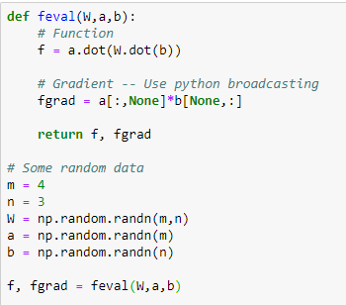

Example 4 in Python
Function: $f\left(W\right)=a^{T}Wb$
Use python `dot` for matrix-vector products
Gradient: $∇f\left(W\right)=ab^{T}$
Want fgrad[i,j] = a[i]b[j]
Avoid for-loops
Use python broadcasting
a[:,None] = m x 1
b[None,:] = 1 x n

Slide 30
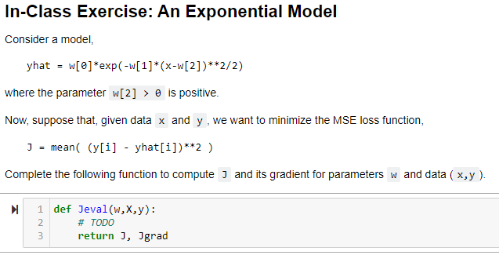
In-Class Exercise

Slide 31
Outline
Motivating example: Build an optimizer for logistic regression
Gradients of multi-variable functions
Gradient descent
Adaptive step size
Convexity

Slide 32
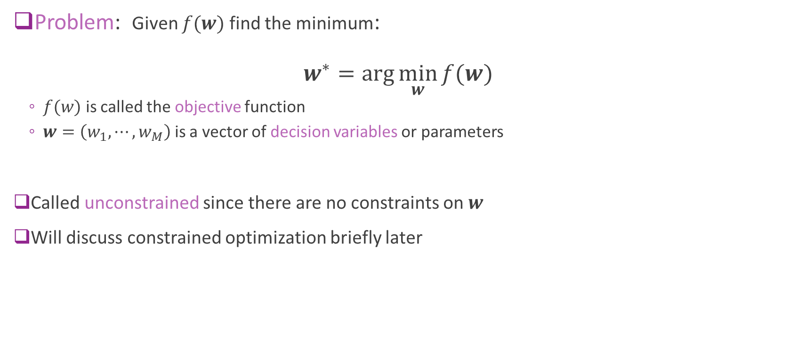
Unconstrained Optimization
Problem: Given $f(w)$ find the minimum: $w^{∗}=\arg{\min_{w}{f(w)}}$
$f(w)$ is called the objective function
$w=\left(w_{1},⋯,w_{M}\right)$ is a vector of decision variables or parameters
Called unconstrained since there are no constraints on $w$
Will discuss constrained optimization briefly later

Slide 33
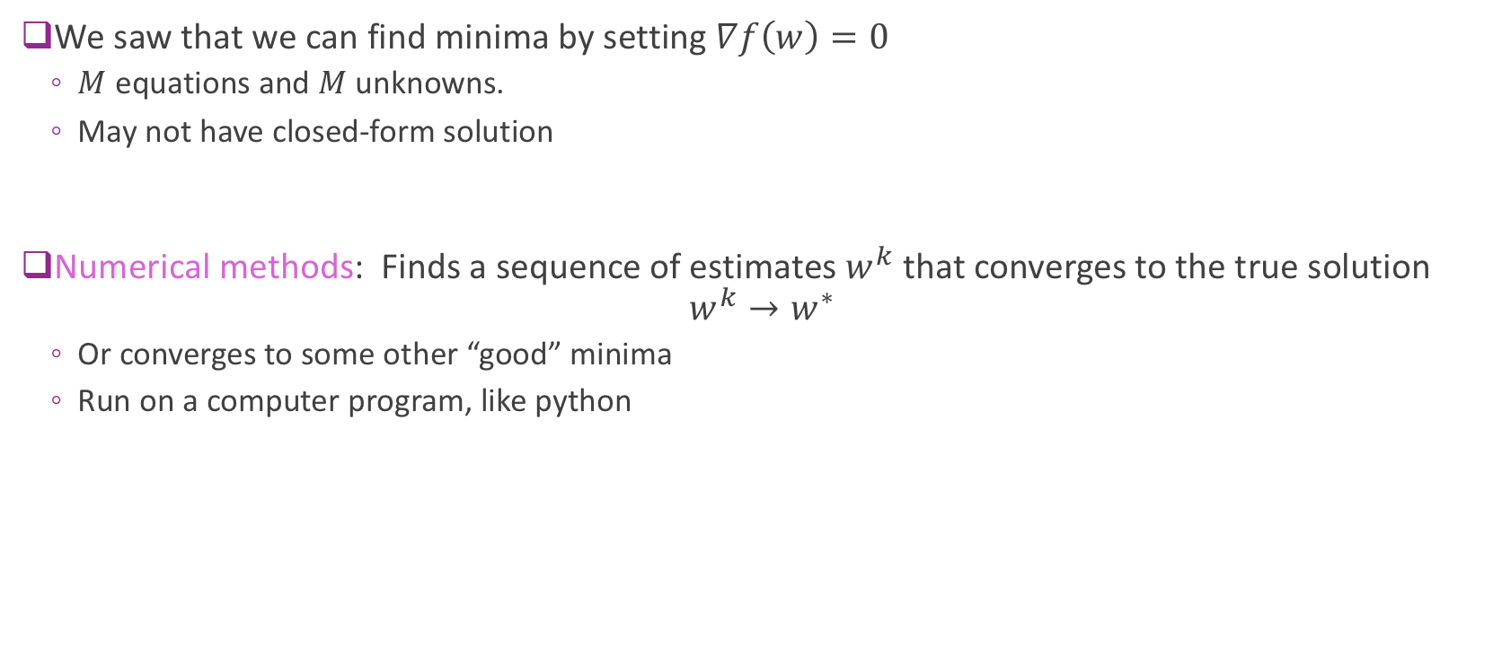
Numerical Optimization
We saw that we can find minima by setting $∇f\left(w\right)=0$
$M$ equations and $M$ unknowns.
May not have closed-form solution
Numerical methods: Finds a sequence of estimates $w^{k}$ that converges to the true solution $w^{k}→w^{∗}$
Or converges to some other “good” minima
Run on a computer program, like python

Slide 34
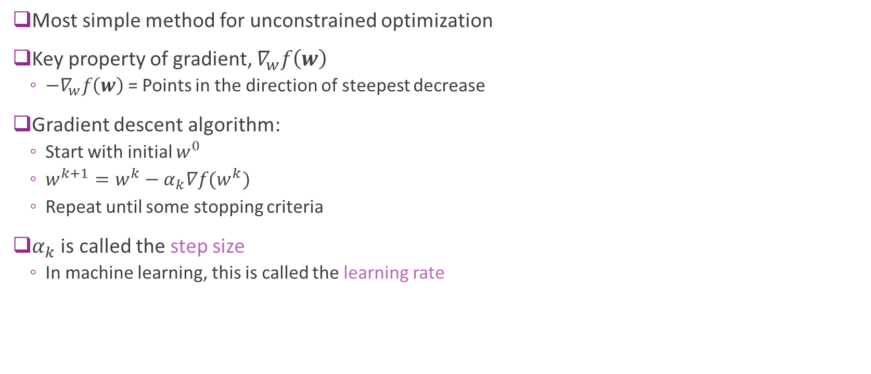
Gradient Descent
Most simple method for unconstrained optimization
Key property of gradient, $∇_{w}f\left(w\right)$
$−∇_{w}f\left(w\right)$= Points in the direction of steepest decrease
Gradient descent algorithm:
Start with initial $w^{0}$
$w^{k+1}=w^{k}−α_{k}∇f(w^{k})$
Repeat until some stopping criteria
$α_{k}$ is called the step size
In machine learning, this is called the learning rate

Slide 35
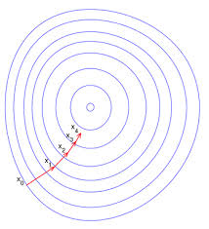
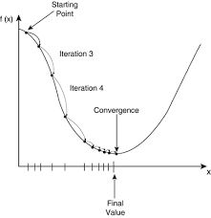
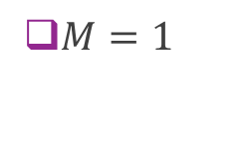

Gradient Descent Illustrated
$M=2$
$M=1$

Slide 36
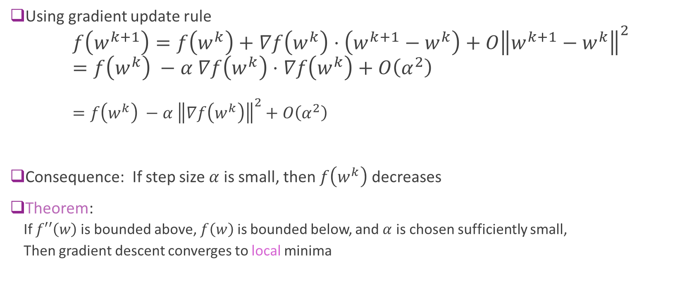
Gradient Descent Analysis
Using gradient update rule $f\left(w^{k+1}\right)=f\left(w^{k}\right)+∇f\left(w^{k}\right)⋅\left(w^{k+1}−w^{k}\right)+O{\left\|w^{k+1}−w^{k}\right\|}^{2}$ $=f\left(w^{k}\right) −α ∇f\left(w^{k}\right)⋅∇f\left(w^{k}\right)+O\left(α^{2}\right)$ $=f\left(w^{k}\right) −α {\left\|∇f\left(w^{k}\right)\right\|}^{2}+O\left(α^{2}\right)$
Consequence: If step size $α$ is small, then $f\left(w^{k}\right)$ decreases
Theorem:
If $f′′\left(w\right)$ is bounded above, $f\left(w\right)$ is bounded below, and $α$ is chosen sufficiently small,
Then gradient descent converges to local minima

Slide 37
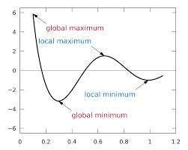
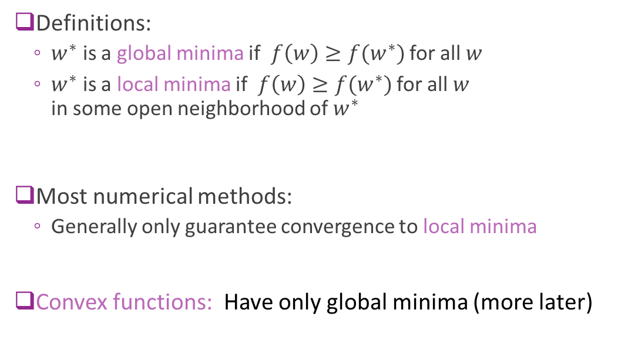
Local vs. Global Minima
Definitions:
$w^{∗}$ is a global minima if $f\left(w\right)≥f(w^{∗})$ for all $w$
$w^{∗}$ is a local minima if $f\left(w\right)≥f(w^{∗})$ for all $w$ in some open neighborhood of $w^{∗}$
Most numerical methods:
Generally only guarantee convergence to local minima
Convex functions: Have only global minima (more later)

Slide 38
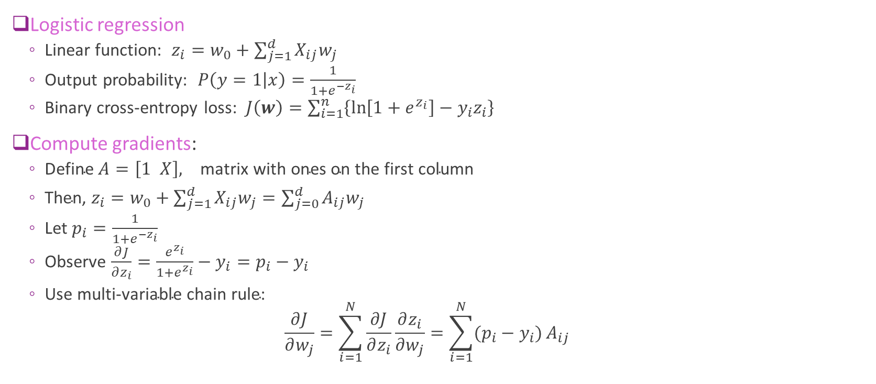
Gradients for Logistic Regression
Logistic regression
Linear function: $z_{i}=w_{0}+\sum_{j=1}^{d}{X_{ij}w_{j}}$
Output probability: $P\left(y=1 | x\right)=\frac{1}{1+e^{−z_{i}}}$
Binary cross-entropy loss: $J\left(w\right)=\sum_{i=1}^{n}{\left\{\ln\left[1+e^{z_{i}}\right]−y_{i}z_{i}\right\}}$
Compute gradients:
$\text{Define} A=\left[1 X\right], \text{matrix} \text{with} \text{ones} \text{on} \text{the} \text{first} \text{column}$
$\text{Then}\text{, }z_{i}=w_{0}+\sum_{j=1}^{d}{X_{ij}w_{j}}=\sum_{j=0}^{d}{A_{ij}w_{j}}$
Let $p_{i}=\frac{1}{1+e^{−z_{i}}}$
Observe $\frac{∂J}{∂z_{i}}=\frac{e^{z_{i}}}{1+e^{z_{i}}}−y_{i}=p_{i}−y_{i}$
$\text{Use} \text{multi}\text{−}\text{variable} \text{chain} \text{rule}\text{:}$ $\frac{∂J}{∂w_{j}}=\sum_{i=1}^{N}{\frac{∂J}{∂z_{i}}}\frac{∂z_{i}}{∂w_{j}}=\sum_{i=1}^{N}{(p_{i}−y_{i})}A_{ij}$

Slide 39
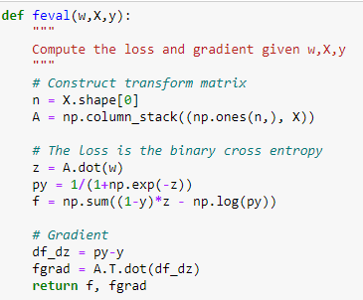
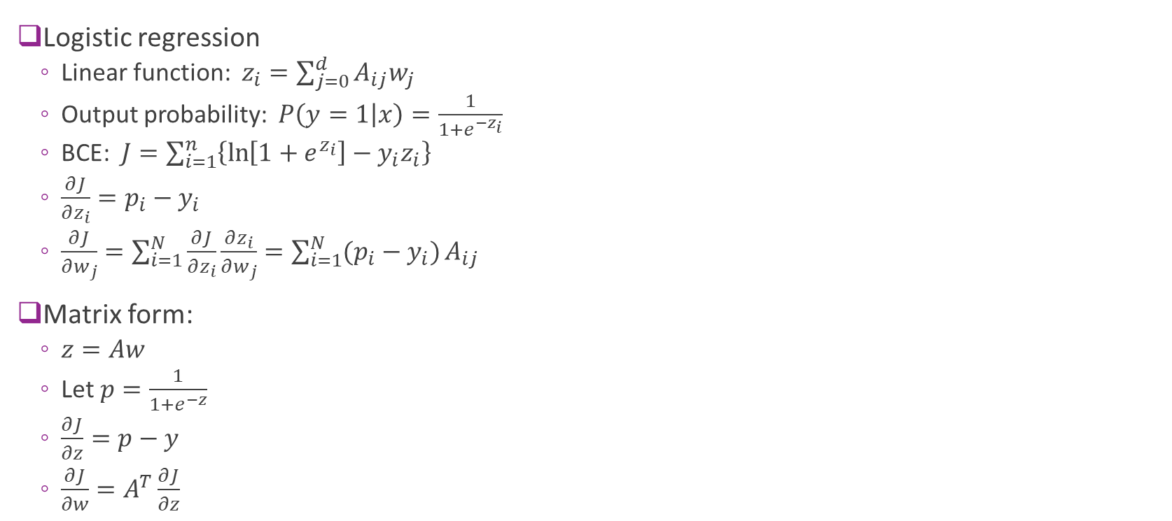
Matrix Form
Logistic regression
Linear function: $z_{i}=\sum_{j=0}^{d}{A_{ij}w_{j}}$
Output probability: $P\left(y=1 | x\right)=\frac{1}{1+e^{−z_{i}}}$
BCE: $J=\sum_{i=1}^{n}{\left\{\ln\left[1+e^{z_{i}}\right]−y_{i}z_{i}\right\}}$
$\frac{∂J}{∂z_{i}}=p_{i}−y_{i}$
$\frac{∂J}{∂w_{j}}=\sum_{i=1}^{N}{\frac{∂J}{∂z_{i}}}\frac{∂z_{i}}{∂w_{j}}=\sum_{i=1}^{N}{(p_{i}−y_{i})}A_{ij}$
Matrix form:
$z=Aw$
Let $p=\frac{1}{1+e^{−z}}$
$\frac{∂J}{∂z}=p−y$
$\frac{∂J}{∂w}=A^{T}\frac{∂J}{∂z}$

Slide 40
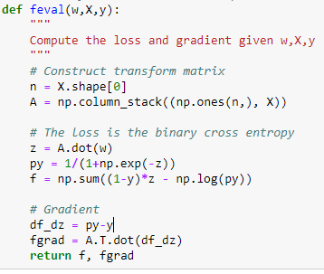
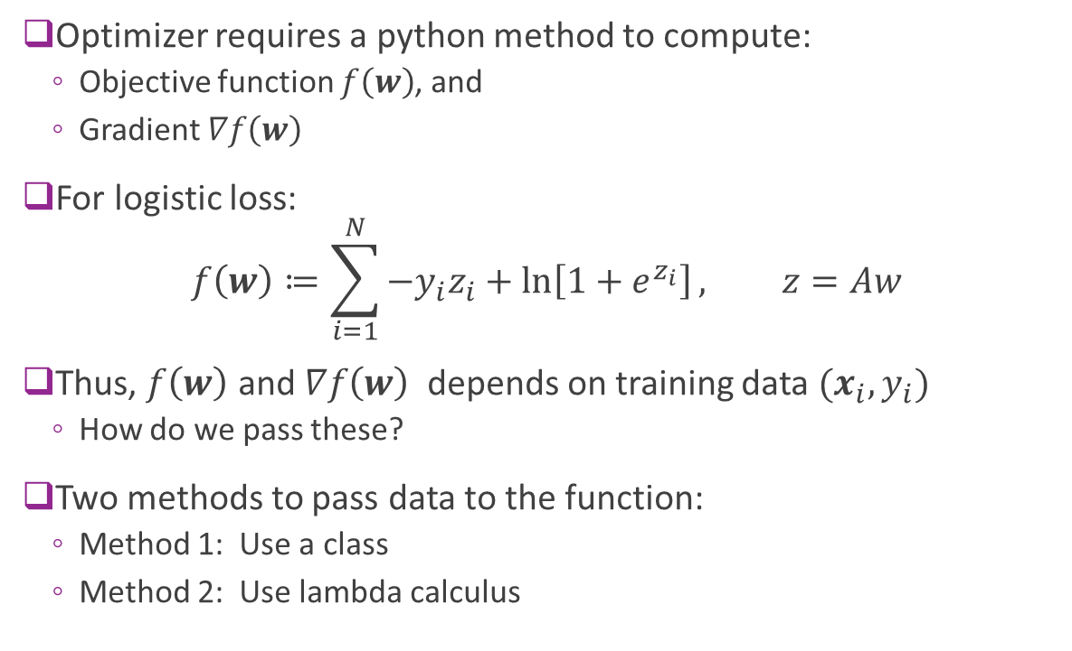
Implementation in Python
Optimizer requires a python method to compute:
Objective function $f\left(w\right)$, and
Gradient $∇f\left(w\right)$
For logistic loss:
$$f\left(w\right)≔\sum_{i=1}^{N}{{−y}_{i}z_{i}+\ln\left[1+e^{z_{i}}\right]}, z=Aw$$
Thus, $f\left(w\right)$ and $∇f\left(w\right)$ depends on training data $(x_{i},y_{i})$
How do we pass these?
Two methods to pass data to the function:
Method 1: Use a class
Method 2: Use lambda calculus
Training data

Slide 41
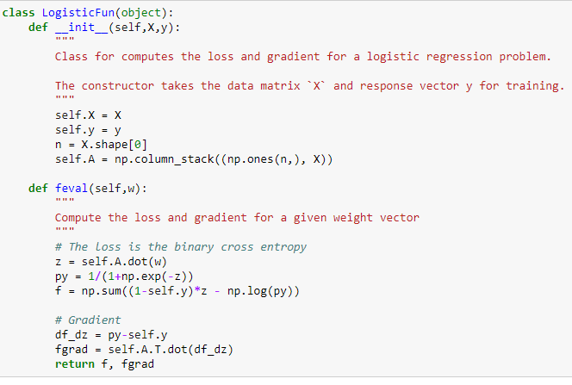

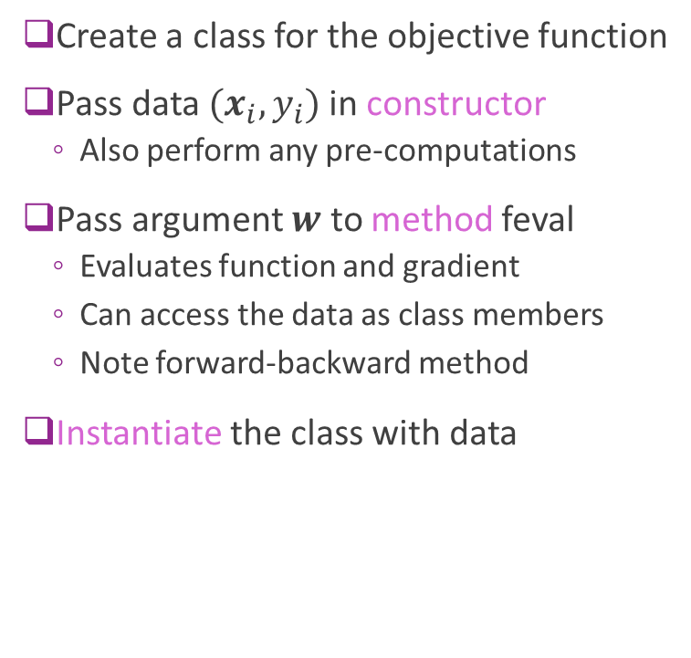
Method 1: Create a Class
Create a class for the objective function
Pass data $(x_{i},y_{i})$in constructor
Also perform any pre-computations
Pass argument $w$ to method feval
Evaluates function and gradient
Can access the data as class members
Note forward-backward method
Instantiate the class with data

Slide 42


Testing the Gradient
Always test your implementation!
Pick two points $w_{0}$, $w_{1}$ that are close
Make sure: $f\left(w_{1}\right)−f\left(w_{0}\right)≈∇f{\left(w_{0}\right)}^{T}\left(w_{1}−w_{0}\right)$

Slide 43


Method 2: Lambda Calculus
Create a function that take $w, X, y$
Use lambda function to fix $X, y$

Slide 44


Gradient Descent
Input parameters:
Function to return objective and gradient
Initial value $w^{0}$
Learning rate $α$
Number of iterations
Code returns:
Final estimate $w^{k}$
Final function value ${f(w}^{k})$
History (for debugging)

Slide 45



Gradient Descent on Logistic Regression
Random initial condition
1000 iterations
Convergence is slow.
Final accuracy poor
estimate has not converged

Slide 46


Different Step Sizes
Faster learning rate => Faster convergence
But, may be unstable

Slide 47
Outline
Motivating example: Build an optimizer for logistic regression
Gradients of multi-variable functions
Gradient descent
Adaptive step size
Convexity

Slide 48

Adaptive Step Size Selection
Most practical algorithms change step size adaptively $w^{k+1}=w^{k}−α_{k}∇f(w^{k})$
Tradeoff: Selecting large $α_{k}$:
Larger steps, faster convergence
But, may overshoot

Slide 49

Armijo Rule
Recall that we know if $w^{k+1}=w^{k}−α∇f(w^{k})$
$$f\left(w^{k+1}\right)=f\left(w^{k}\right) −α {\left\|∇f\left(w^{k}\right)\right\|}^{2}+O(α^{2})$$
Armijo Rule:
Select some $c∈(0,1)$. Usually $c=1/2$
Select $α$ such that $f\left(w^{k+1}\right)≤f\left(w^{k}\right) −cα {\left\|∇f\left(w^{k}\right)\right\|}^{2}$
Decreases by at least at fraction $c$ predicted by linear approx.
Simple update:
If Armijo rule passes: Accept point and increase step size: $α^{k+1}=βα^{k}, β>1$
If Armijo rule fails: Reject point and decrease step size: $α^{k+1}=β^{−1}α^{k}$
Can also use a line search

Slide 50



Armijo Rule Illustrated
Armijo rule: $f\left(w^{k+1}\right)≤f\left(w^{k}\right)−cα {\left\|∇f\left(w^{k}\right)\right\|}^{2}$
Guarantees decrements every iteration
No overshoot
Line representing $y(α)=f\left(w^{k}\right)−cα {\left\|∇f\left(w^{k}\right)\right\|}^{2}$ for a given c
Feasible region for $w^{k+1}$

Slide 51



Adaptive Gradient Descent in Python
Simple modification of fixed step size case
What is $β$ here?

Slide 52

In-Class Exercise
Complete Jupyter notebook

Slide 53
Outline
Motivating example: Build an optimizer for logistic regression
Gradients of multi-variable functions
Gradient descent
Adaptive step size
Convexity

Slide 54

Convex Sets
Definition: A set $X$ is convex if for any $x,y∈X$, $tx+\left(1−t\right)y∈X for all t∈[0,1]$
Any line between two points remains in the set.
Examples:
Square, circle, ellipse
$\left\{x \right|Ax≤b \}$ for any matrix $A$ and vector $b$

Slide 55


Convex Set Visualized
Convex
Not convex

Slide 56


Convex Functions
A real-valued function $f\left(x\right)$ is convex if:
Its domain is a convex set, and
For all $x,y$ and $t∈[0,1]$: $f\left(tx+\left(1−t\right)y\right)≤tf\left(x\right)+\left(1−t\right)f\left(y\right)$

Slide 57

Convex Function Examples
Linear function of a scalar $f\left(x\right)=ax+b$
Linear function of a vector $f\left(x\right)=a^{T}x+b$
Quadratic $f\left(x\right)=\frac{1}{2}ax^{2}+bx+c$ is convex iff $a≥0$
If $f^{′′}\left(x\right)$ exists everywhere, $f(x)$ is convex iff ${ f}^{′′}\left(x\right)≥0.$
When $x$ is a vector $f^{′′}\left(x\right)≥0$ means the Hessian must be positive semidefinite
$f\left(x\right)=e^{x}$
If $f\left(x\right)$ is convex, so is $f\left(Ax+b\right)$
Logistic loss is convex!

Slide 58

Global Minima and Convex Function
Theorem: If $f(w)$ is convex and $w$ is a local minima, then $w$ is a global minima
Implication for optimization:
Gradient descent only converges to local minima
In general, cannot guarantee optimality
Depends on initial condition
But, for convex functions can always obtain optimal

Slide 59
Other Topics We Did Not Cover
Our optimizer is OK, but not nearly as fast as sklearn method
Many techniques we did not cover
Newton’s method
Quasi-Newton’s method
Non-smooth optimization
Constrained optimization
Take an optimization class and learn more.

Slide 60
What you should know
Identify the objective function, parameters and constraints in an optimization problem
Compute the gradient of a loss function for scalar, vector parameters
Matrix parameters are advanced (graduate students only)
Efficiently compute a gradient in python.
Write the gradient descent update
Describe the effect of the learning rate on convergence
Determine if a loss function is convex

