Slide 1


PRATHYUSHA ENGINEERING COLLEGE
(An AUTONOMOUS INSTITUTION)
DEPARTMENT OF COMPUTER SCIENCE AND ENGINEERING
PROJECT REVIEW : VIVA VOICE
BATCH : CSE-34
TITLE :Enhance Machine Learning Algorithms for Monkeypox Detection
INTERNAL GUIDE NAME: MS. LAVANYA M
DESIGNATION:Assistant Professor
PRESENTED BY :
PARITALA VENKATA VAIBHAV -111421104078
PENIGALAPATI HASWANTH - 111421104082
R ANISH - 111421104098
CSE

Slide 2
PRATHYUSHA ENGINEERING COLLEGE
(An AUTONOMOUS INSTITUTION)
PROBLEM STATEMENT
Monkeypox is a rare and potentially life-threatening viral disease that has gained significant attention in recent years due to its increasing prevalence and potential for transmission. Early detection and diagnosis are crucial for effective treatment and prevention of transmission. However, diagnosing monkeypox can be challenging due to its similarity of other diseases. So, The goal of this problem statement is to develop accurate machine learning algorithms for monkeypox detection.
CSE
Department of Computer Science and Engineering

Slide 3
PRATHYUSHA ENGINEERING COLLEGE
(An AUTONOMOUS INSTITUTION)
SCOPE OF THE PROJECT
This project aims to develop an intelligent system for early detection of Monkeypox using enhanced machine learning algorithms. It begins with collecting and preprocessing clinical, demographic, and symptom-based data to ensure high-quality input for model training. Key algorithms like Linear Discriminant Analysis (LDA), AdaBoost, and Multi-Layer Perceptron(MLP Classifier) are implemented and optimized through techniques such as hyperparameter tuning and feature selection to boost prediction accuracy. Model performance is rigorously evaluated using metrics including accuracy, precision, recall, and ROC-AUC, along with cross-validation to ensure robustness. The final model is integrated into a web-based platform featuring user authentication and a chatbot assistant that offers real-time predictive insights and Monkeypox-related guidance. The system is designed to be scalable and user-friendly, making it suitable for deployment in both clinical and remote environments. Ultimately, the project supports faster diagnosis, informed decision-making, and improved public health outcomes in response to Monkeypox outbreaks.
CSE
Department of Computer Science and Engineering

Slide 4
PRATHYUSHA ENGINEERING COLLEGE
(An AUTONOMOUS INSTITUTION)
ABSTRACT
Monkeypox is an infectious disease caused by the monkeypox virus (MPXV) that primarily affects animals but can be transmitted to humans, resulting in serious health implications. Early detection and accurate diagnosis of the disease are crucial for effective containment and treatment. Controlling the rapid transmission of the disease necessitates timely and accurate diagnosis, but the availability of traditional confirmatory tests, such as Polymerase Chain Reaction (PCR), remains limited. In this challenging scenario, by leveraging advanced technology, this approach can present a valuable alternative to conventional testing methods.
CSE
Department of Computer Science and Engineering

Slide 5
PRATHYUSHA ENGINEERING COLLEGE
(An AUTONOMOUS INSTITUTION)
INTRODUCTION
Emerging Health Threat: Monkeypox, a re-emerging zoonotic virus, has seen a surge in global cases, necessitating rapid, accurate, and scalable detection methods to support public health responses and containment strategies.
Limitations of Traditional Methods: Conventional diagnostic approaches like PCR testing, while accurate, are time-consuming, resource-intensive, and often inaccessible in remote or under-resourced regions, highlighting the need for alternative detection methods.
Role of Machine Learning: Machine learning (ML) offers a promising solution by enabling automated analysis of clinical data, medical images, and symptoms to detect monkeypox with speed and accuracy, potentially even in early stages of infection.
Research Focus: This study focuses on enhancing ML algorithms—through model optimization, feature selection, and hybrid approaches—to improve diagnostic performance, reduce false positives/negatives, and create deployable solutions in real-world healthcare environments.
CSE
Department of Computer Science and Engineering

Slide 6
PRATHYUSHA ENGINEERING COLLEGE
(An AUTONOMOUS INSTITUTION)
LITERATURE SURVEY
Title | Authors | Published | Summary | Link
Monkeypox Detection Using Deep Neural Networks | Srikanth | DEC,2023 | This study implemented seven deep learning models leveraging pre-trained capabilities to diagnose Monkeypox based on skin lesion images. | Link
Application of Artificial Intelligence Techniques for Monkeypox | Saydul Akbar | DEC,2023 | This research utilized the Google Net deep neural network to extract features, achieving a maximum accuracy of 98.8% for Monkeypox detection in a multiclass dataset. | Link
A Deep Learning-Based Mobile Application for Monkeypox Detection | Haifa f Alhasson | NOV,2023 | This study employed the MobileNetV2 neural network to develop a mobile application aimed at improving Monkeypox diagnosis through deep learning methods. | Link
CSE
Department of Computer Science and Engineering

Slide 7
PRATHYUSHA ENGINEERING COLLEGE
(An AUTONOMOUS INSTITUTION)
LITERATURE SURVEY
Title | Authors | Published | Summary | Link
Utilizing Convolutional Neural Networks to Classify Monkeypox Skin Lesions | Tarek Abd El-Hafeez | 2023 | This study proposed an approach using CNNs to classify Monkeypox skin lesions, optimizing the model for improved accuracy. | Link
Human monkeypox: an emerging zoonotic disease. Future Microbiology | Scott Parker | 2007 | This study proposed an approach using CNNs to classify Monkeypox skin lesions, optimizing the model for improved accuracy. | Link
Image data collection and implementation of deep learning-based model in detecting monkeypox disease using modified vgg16 | Md Manjurul Ahsan. | 2022 | The study involves collecting image data of skin lesions and implementing a deep learning model using a modified VGG16 architecture to detect Monkeypox disease. The modified VGG16 is fine-tuned to improve classification accuracy for Monkeypox against other similar skin conditions. | Link
CSE
Department of Computer Science and Engineering

Slide 8
PRATHYUSHA ENGINEERING COLLEGE
(An AUTONOMOUS INSTITUTION)
LITERATURE SURVEY
Title | Authors | Published | Summary | Link
Improving the care and treatment of monkeypox patients in low-resource settings: applying evidence from contemporary biomedical and smallpox biodefense research | ^{Mary G} ^{Reynolds} | DEC,2017 | This study explores strategies to enhance Monkeypox care in low-resource settings by leveraging insights from modern biomedical research and historical smallpox biodefense. It emphasizes affordable diagnostics, effective treatment protocols, and community-based healthcare interventions. | Link
Deep learning methods for early detection of monkeypox skin lesion | Madhukar Dwivedi | 2022 | This research applies deep learning techniques to enable early detection of Monkeypox through analysis of skin lesion images. It highlights the use of CNN-based models for accurate and timely diagnosis to support outbreak control. | Link
CSE
Department of Computer Science and Engineering

Slide 9
PRATHYUSHA ENGINEERING COLLEGE
(An AUTONOMOUS INSTITUTION)
EXISTING & PROPOSED SYSTEM
Existing System:
The existing system for monkeypox disease detection relied primarily on traditional diagnostic methods, including clinical examination and laboratory tests. When patients exhibited symptoms characteristic of monkeypox, healthcare professionals conducted a thorough physical examination to identify the presence of skin lesions or other associated signs.
Static Models: Like fixed traffic signals, traditional ML models use pre-trained parameters that may not adapt to emerging viral strains or variations in symptoms.
Manual Monitoring: Diagnosis still heavily relies on manual interpretation of symptoms or images, limiting scalability and speed.
Limited Data Utilization: Existing models often underutilize real-time data from clinical reports, wearable health devices, or outbreak tracking platforms.
Reactive Diagnosis: Detection occurs after visible symptoms manifest, delaying isolation and increasing spread.
CSE
Department of Computer Science and Engineering

Slide 10
PRATHYUSHA ENGINEERING COLLEGE
(An AUTONOMOUS INSTITUTION)
EXISTING & PROPOSED SYSTEM
Proposed System
The proposed system leverages advanced machine learning and deep learning techniques to enhance the early and accurate detection of Monkeypox. It incorporates the following components:
Image-Based Detection Using Deep Learning.
Real-Time Data Integration.
Predictive Analytics.
Early Warning and Alert System
Improved Feature Extraction
CSE
Department of Computer Science and Engineering

Slide 11
PRATHYUSHA ENGINEERING COLLEGE
(An AUTONOMOUS INSTITUTION)
SYSTEM REQUIREMENTS
Category | Requirement | Details
Hardware | Computer with GPU | 16GB RAM, i7/Ryzen 7+, NVIDIA RTX 3060+
 | Cameras & IoT Sensors | HD (1080p/4K), traffic & speed sensors
 | Internet & Cloud | High-speed network, cloud storage
Software | OS & AI Tools | Windows/Linux, TensorFlow, PyTorch, OpenCV
 | Backend & Database | Python, MySQL, Firebase
 | Web Dashboard | React.js, Node.js
Security | Authentication | OAuth, JWT login
 | Encryption & Firewall | SSL/TLS, VPN, cloud security
Deployment | AI Model & Storage | ONNX, Docker, Kubernetes
 | Version Control | Git, GitHub
CSE
Department of Computer Science and Engineering

Slide 12
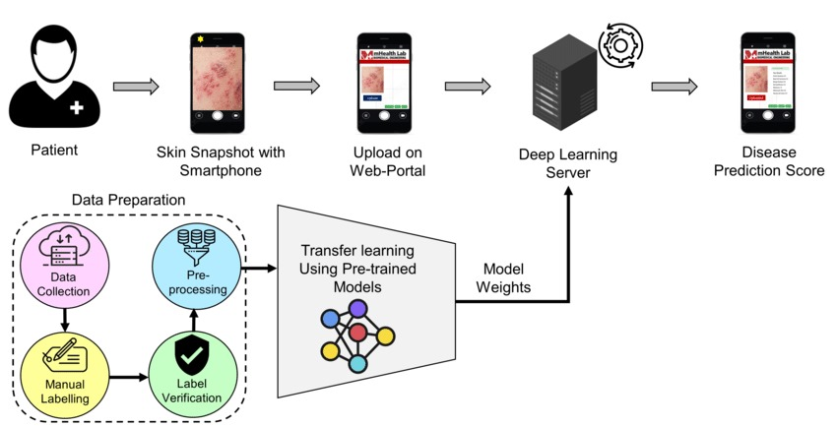
PRATHYUSHA ENGINEERING COLLEGE
(An AUTONOMOUS INSTITUTION)
SYSTEM ARCHITECTURE DIAGRAM
CSE
Department of Computer Science and Engineering

Slide 13
PRATHYUSHA ENGINEERING COLLEGE
(An AUTONOMOUS INSTITUTION)
LIST OF MODULES
1
Image Acquisition & Preprocessing
2
Lesion Detection & Classification
3
Deep Learning Approaches
4
Data Acquisition and Preprocessing
5
Violation Handling & Notifications
CSE
Department of Computer Science and Engineering

Slide 14
PRATHYUSHA ENGINEERING COLLEGE
(An AUTONOMOUS INSTITUTION)
Module 1: Image Acquisition & Preprocessing
Description:
This module is responsible for capturing real-time skin lesion images and preparing the data for further processing in Monkeypox detection.
Key Functions:
Capture Images: Acquire images from clinical datasets, medical imaging devices, or smartphone cameras.
Frame Extraction: Extract relevant image frames at intervals to ensure high-quality data for analysis.
Preprocessing Techniques:
Apply noise reduction, contrast enhancement, and background subtraction using OpenCV to refine image quality.
Normalize images and resize them to be compatible with deep learning models.
Apply color segmentation and edge detection techniques to highlight affected regions.
CSE
Department of Computer Science and Engineering

Slide 15
PRATHYUSHA ENGINEERING COLLEGE
(An AUTONOMOUS INSTITUTION)
Module 2: Leosin Detection & Classification
Description:
This module focuses on detecting Monkeypox skin lesions using a trained YOLO model. The model is trained on a custom dataset of Monkeypox and non-Monkeypox skin images, ensuring high accuracy in real-world medical scenarios.
Key Functions:
A custom dataset was created, containing annotated images of Monkeypox lesions.
The dataset was used to train a YOLO model, generating a best.pt file with optimized weights for high-accuracy detection.
The trained model was tested on real-world skin images, achieving optimal accuracy in distinguishing Monkeypox from other skin conditions.
Real-time lesion detection was implemented using the trained YOLO model to detect and classify Monkeypox symptoms.
The detected lesions are stored for further analysis, diagnosis, and medical recommendations.
CSE
Department of Computer Science and Engineering

Slide 16
PRATHYUSHA ENGINEERING COLLEGE
(An AUTONOMOUS INSTITUTION)
Module 3: Deep Learning Approaches
Description: This module focuses on extracting meaningful patterns from clinical or image-based data to detect Monkeypox cases with high accuracy. It utilizes advanced Machine Learning (ML) and Deep Learning (DL) models for classification and prediction. The system is designed to process symptoms, clinical features, or skin lesion images (if available) to support early diagnosis and improve healthcare responses.
Key Components:
Deep Learning-Based Classification
Neural Networks (e.g., MLPClassifier): Used for symptom-based data classification.
Convolutional Neural Networks (CNNs): Applied for skin lesion image recognition and diagnosis.
Transfer Learning :Utilizes pre-trained models like ResNet, VGG, or Inception to improve image detection accuracy and reduce training time on medical imaging datasets.
Data Integration & Storage :Combines clinical, image-based, and demographic data. Stores predictions and diagnostics securely for reporting and model improvement.
Database Matching & Feedback Loop :Compares results with verified medical records to refine predictions. Incorporates user and expert feedback to retrain and enhance model accuracy over time.
CSE
Department of Computer Science and Engineering

Slide 17
PRATHYUSHA ENGINEERING COLLEGE
(An AUTONOMOUS INSTITUTION)
Module 4: Data Acquisition and Preprocessing
Description:
This module is the foundation of your machine learning pipeline. It focuses on collecting relevant data related to Monkeypox infections and transforming it into a clean, consistent, and usable format for model training.
Key Components:
Clean and Transform Data Handles missing values, removes duplicates, and standardizes formats to ensure high-quality, consistent data for training.
Feature Engineering and Encoding Converts symptoms and categorical data into numerical form, scales features, and creates meaningful derived variables for better model accuracy.
Class Balancing and Dataset Splitting Addresses class imbalance using techniques like SMOTE and splits the dataset into training, validation, and test sets to prepare for effective machine learning.
CSE
Department of Computer Science and Engineering

Slide 18
PRATHYUSHA ENGINEERING COLLEGE
(An AUTONOMOUS INSTITUTION)
Module 5: Violation Handling & Notifications
Description: The Exploratory Data Analysis (EDA) module plays a crucial role in understanding the underlying structure and quality of the Monkeypox dataset. This step involves visually and statistically analyzing clinical, demographic, and symptom-based features to uncover important patterns, detect anomalies, and identify relationships between variables.
Key Functions:
Data Visualization :Use of histograms, box plots, and density plots to examine the distribution of each feature (e.g., age, fever, rash, lymphadenopathy).
Outlier Detection :Identify anomalies using box plots and scatter plots, which may indicate data entry errors or rare but important clinical cases.
Feature Distributions by Class :Compare feature distributions across Monkeypox-positive and Monkeypox-negative cases to uncover discriminative patterns.
CSE
Department of Computer Science and Engineering

Slide 19
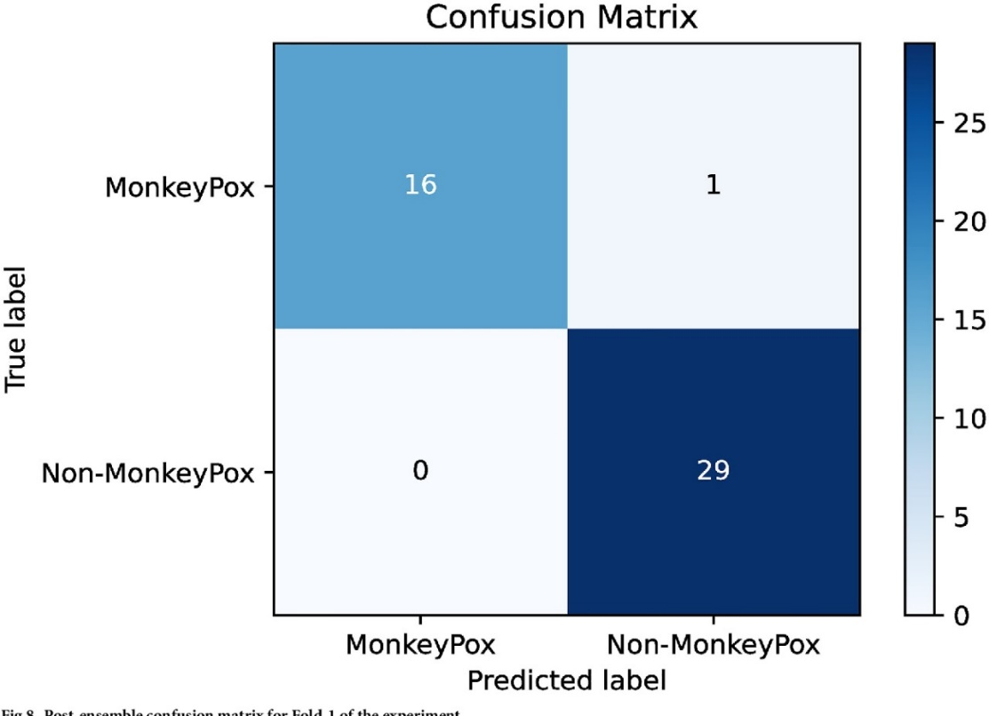
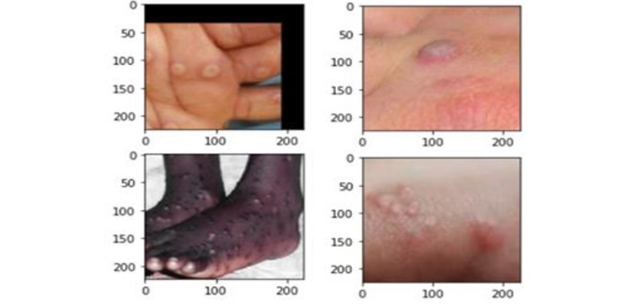
PRATHYUSHA ENGINEERING COLLEGE
(An AUTONOMOUS INSTITUTION)
RESULTS & DISCUSSIONS
CSE
Department of Computer Science and Engineering

Slide 20

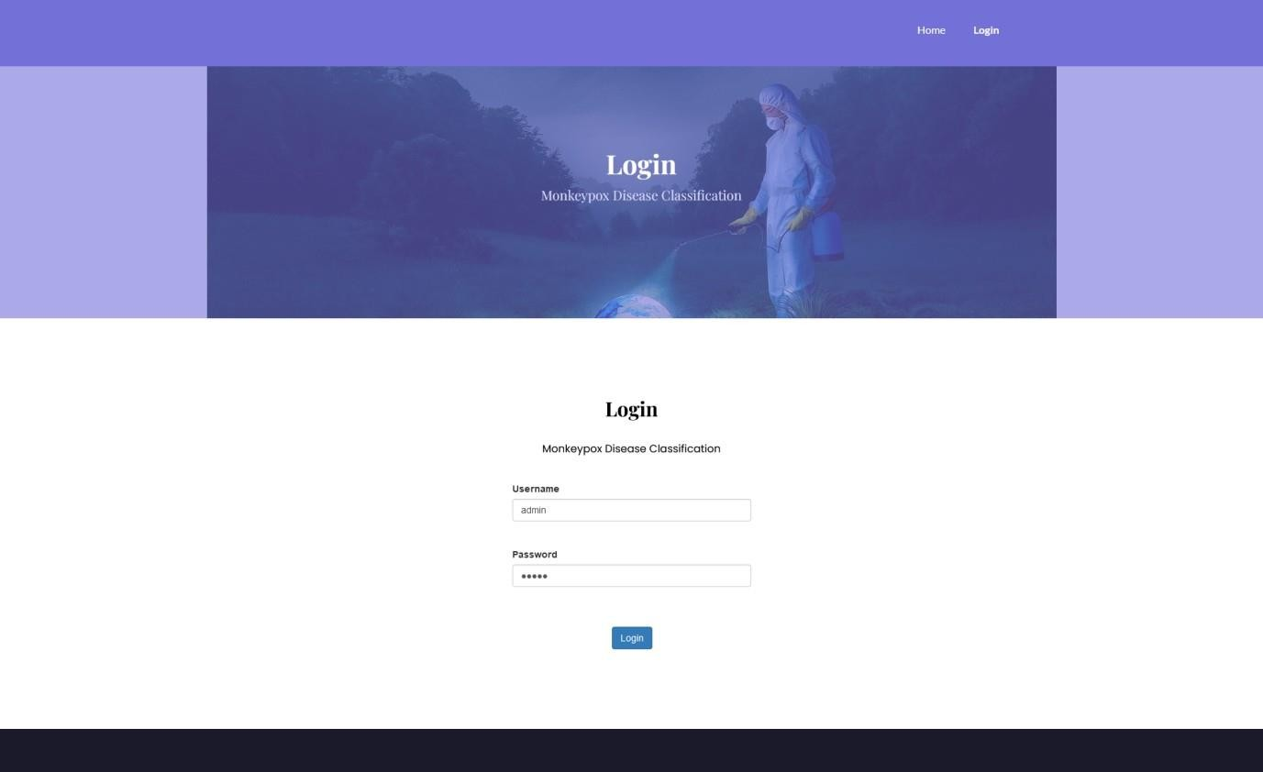
PRATHYUSHA ENGINEERING COLLEGE
(An AUTONOMOUS INSTITUTION)
RESULTS & DISCUSSIONS
CSE
Department of Computer Science and Engineering

Slide 21
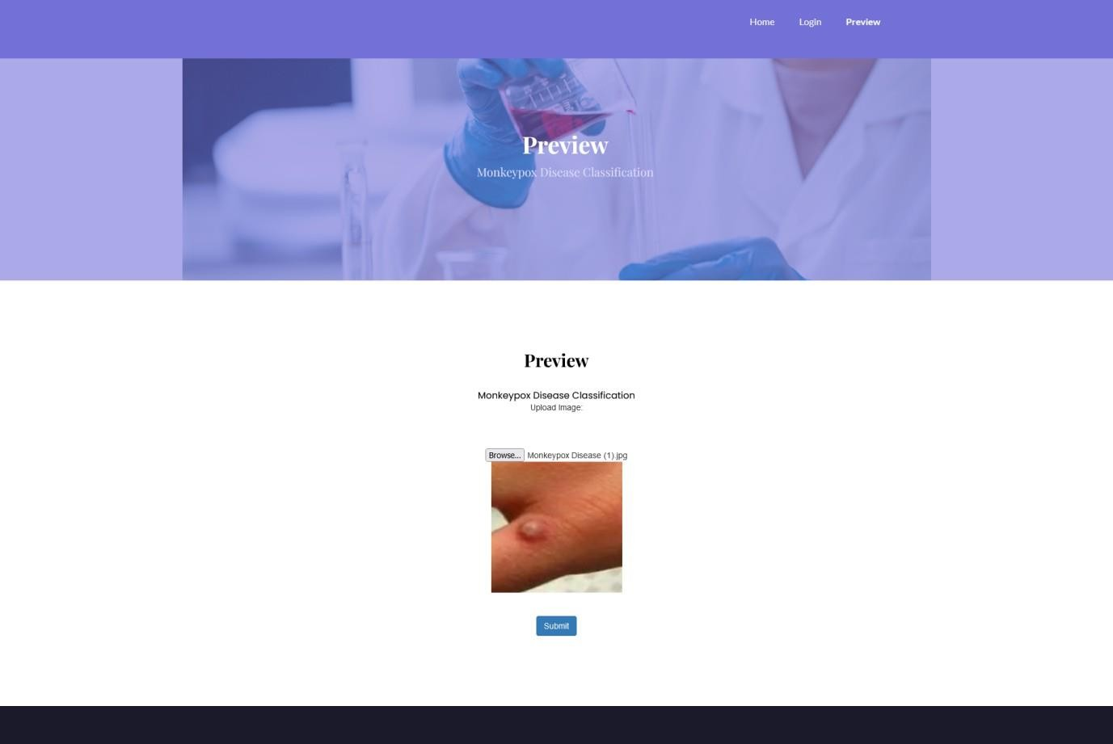
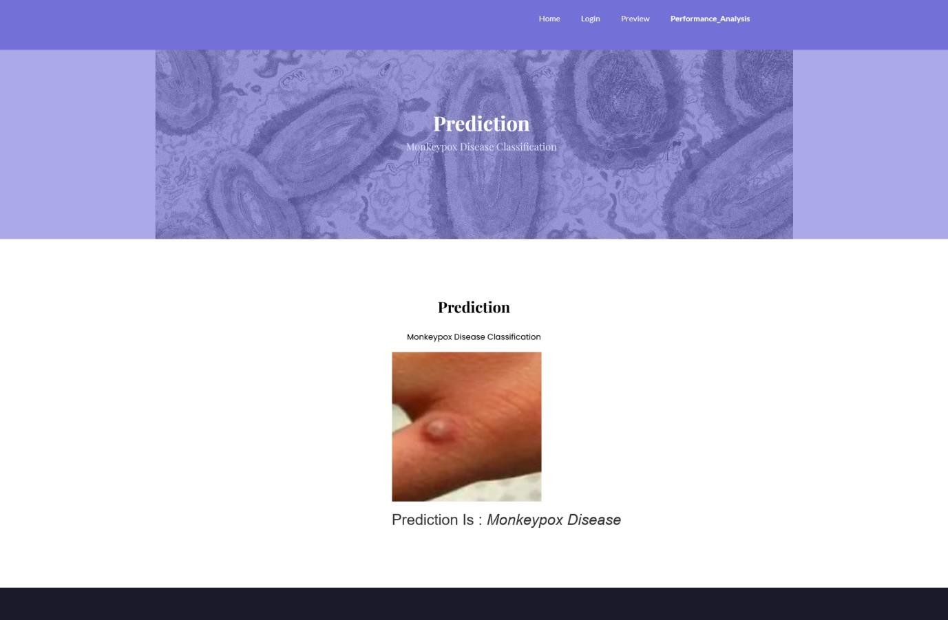
PRATHYUSHA ENGINEERING COLLEGE
(An AUTONOMOUS INSTITUTION)
RESULTS & DISCUSSIONS
CSE
Department of Computer Science and Engineering

Slide 22
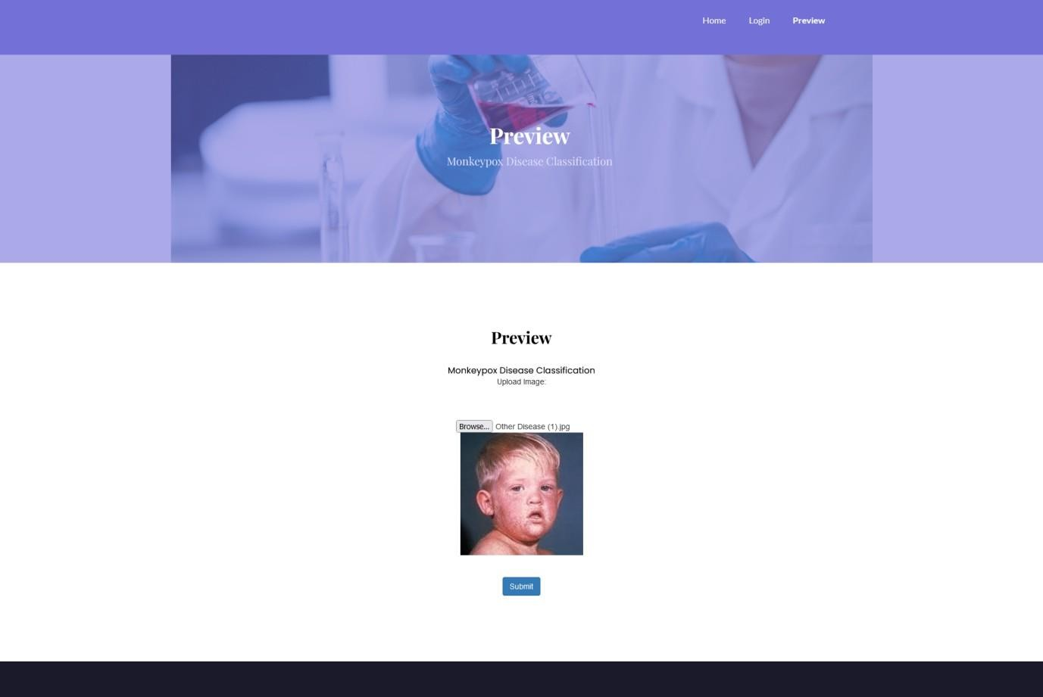
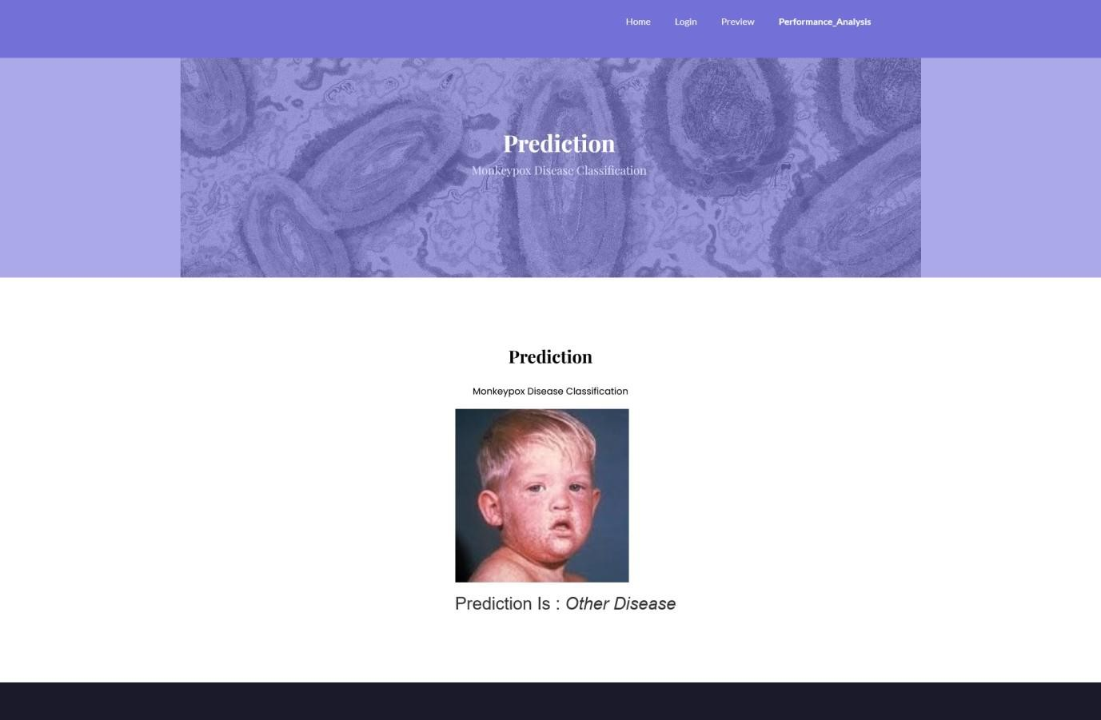
PRATHYUSHA ENGINEERING COLLEGE
(An AUTONOMOUS INSTITUTION)
RESULTS & DISCUSSIONS
CSE
Department of Computer Science and Engineering

Slide 23
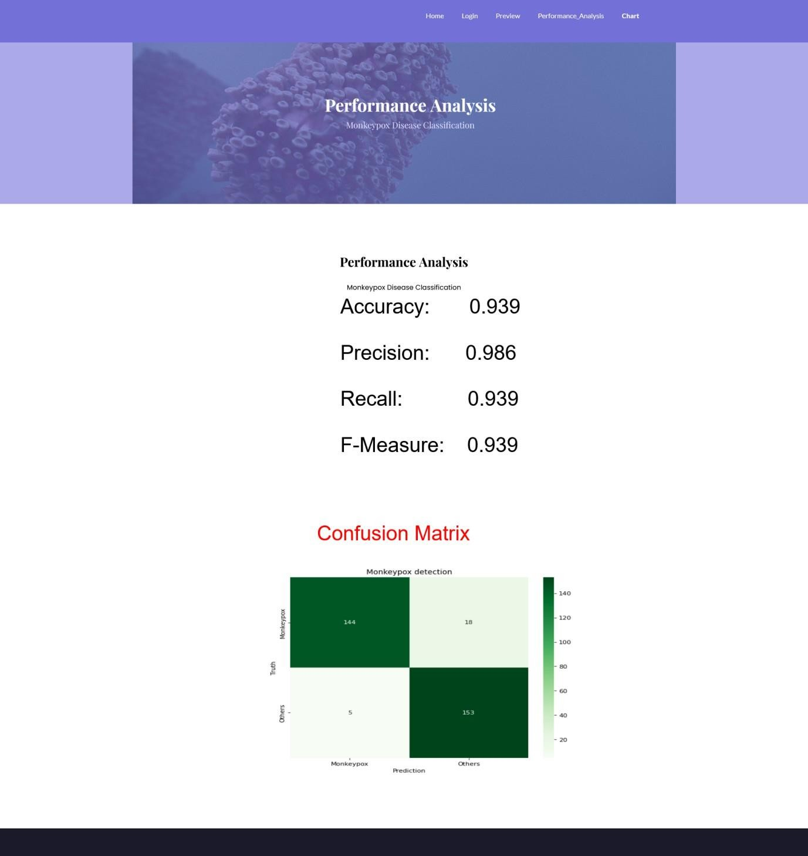
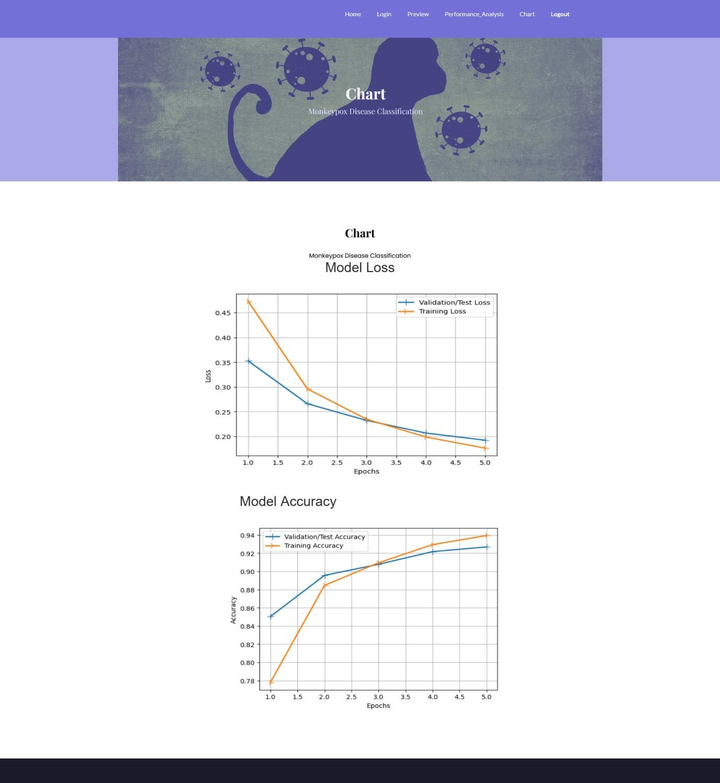
PRATHYUSHA ENGINEERING COLLEGE
(An AUTONOMOUS INSTITUTION)
RESULTS & DISCUSSIONS
CSE
Department of Computer Science and Engineering

Slide 24

PRATHYUSHA ENGINEERING COLLEGE
(An AUTONOMOUS INSTITUTION)
PROJECT OUTCOME OVERVIEW
Conference
CSE
Department of Computer Science and Engineering

Slide 25
PRATHYUSHA ENGINEERING COLLEGE
(An AUTONOMOUS INSTITUTION)
CONCLUSION
This project aims to develop and deploy machine learning algorithms for the accurate and early detection of Monkeypox, a critical aspect of timely diagnosis and treatment. Leveraging both medical images and clinical data, the project uses Convolutional Neural Networks (CNNs) and Random Forest models to analyze various inputs and provide accurate diagnostics. By focusing on early detection, the system helps healthcare professionals deliver faster and more effective treatments, ultimately reducing morbidity and mortality associated with Monkeypox.
Key machine learning models like Linear Discriminant Analysis (LDA), AdaBoost, and MLPClassifier were integrated to handle clinical and symptom-based data. The system's performance was rigorously evaluated using metrics such as accuracy, precision, recall, and ROC-AUC, confirming its high reliability and robustness. The integration of a user-friendly web interface and a chatbot assistant further enhances the platform's utility, allowing real-time decision-making and providing users with quick, accurate predictions.
This project establishes a strong foundation for AI-assisted infectious disease diagnosis, making it a valuable tool for healthcare professionals in managing Monkeypox outbreaks and improving overall patient outcomes.
CSE
Department of Computer Science and Engineering

Slide 26
PRATHYUSHA ENGINEERING COLLEGE
(An AUTONOMOUS INSTITUTION)
FUTURE ENHANCEMENTS
Integration of Medical Imaging Incorporate skin lesion images using CNNs and transfer learning to improve diagnostic accuracy for visual symptoms.
Larger & Diverse Datasets Expand dataset sources globally to improve model generalization across regions, demographics, and mutation variants.
Mobile Application Development Deploy the system in a mobile app for easier access in remote and resource-limited areas.
Real-Time Monitoring & Alerts Enable real-time case monitoring, trend analysis, and automated alert systems for healthcare authorities.
Explainable AI (XAI) Implement XAI techniques to make model decisions interpretable for clinicians, enhancing trust and adoption.
CSE
Department of Computer Science and Engineering

Slide 27

PRATHYUSHA ENGINEERING COLLEGE
(An AUTONOMOUS INSTITUTION)
INTERNSHIP ACCEPTANCE LETTER
PARITALA VENKATA VAIBHAV -111421104078
CSE
Department of Computer Science and Engineering

Slide 28
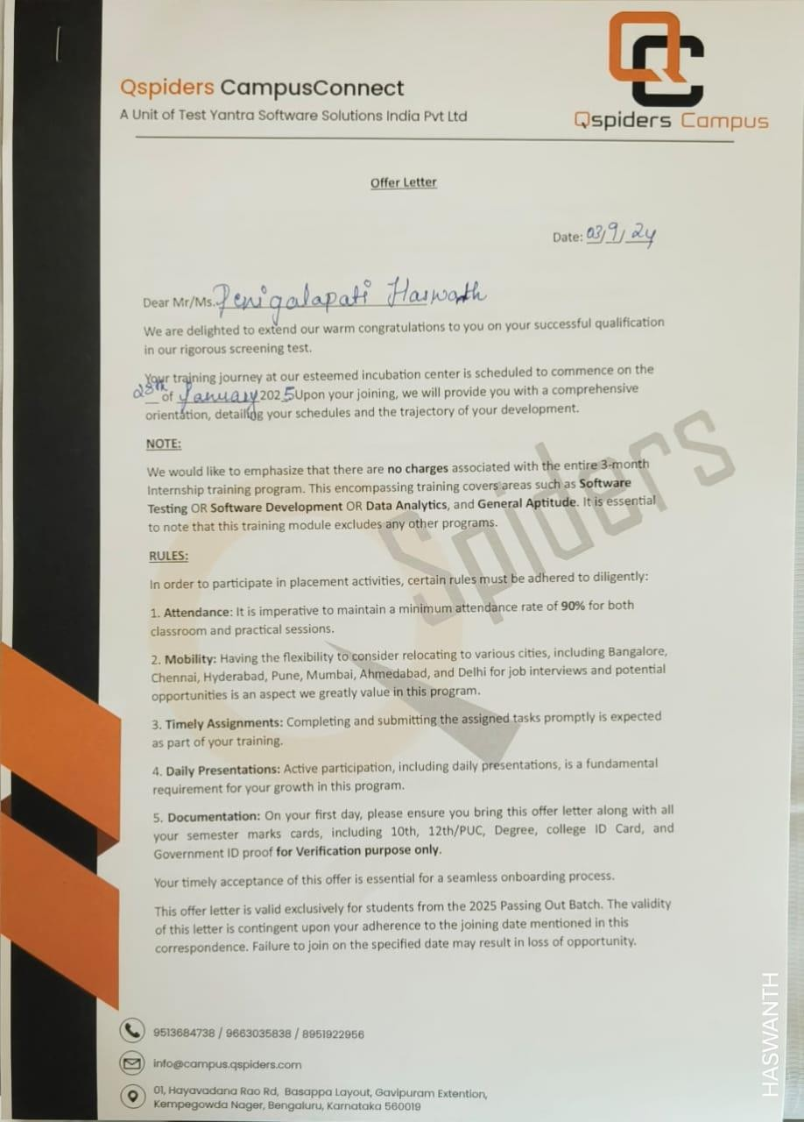
PRATHYUSHA ENGINEERING COLLEGE
(An AUTONOMOUS INSTITUTION)
INTERNSHIP ACCEPTANCE LETTER
PENIGALAPATI HASWANTH - 111421104082
CSE
Department of Computer Science and Engineering

Slide 29
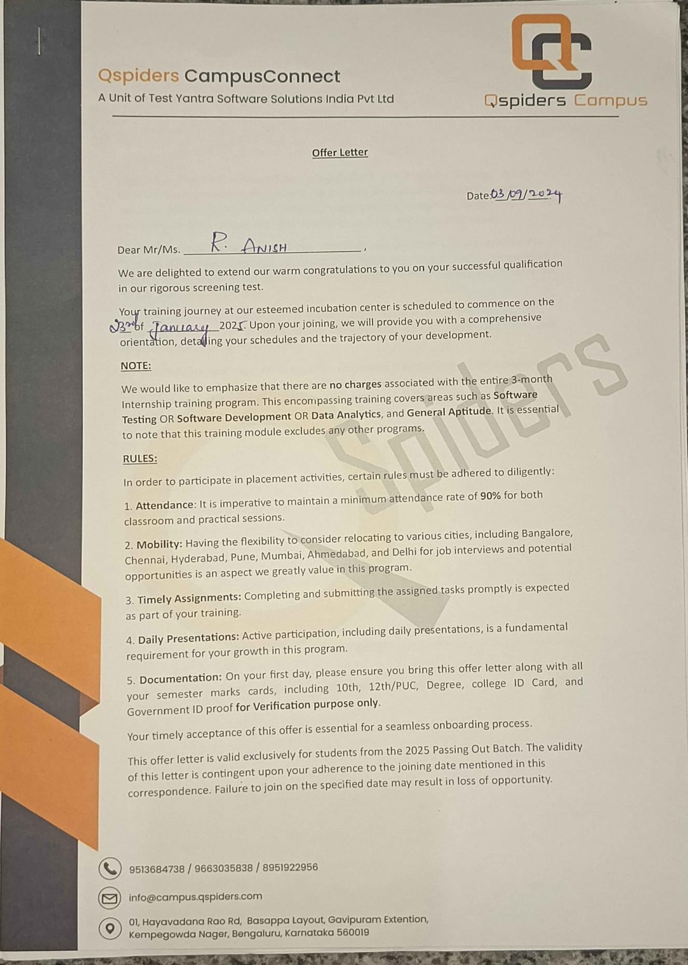
PRATHYUSHA ENGINEERING COLLEGE
(An AUTONOMOUS INSTITUTION)
INTERNSHIP ACCEPTANCE LETTER
R ANISH - 111421104098
CSE
Department of Computer Science and Engineering

Slide 30

PRATHYUSHA ENGINEERING COLLEGE
(An AUTONOMOUS INSTITUTION)
CSE
Department of Computer Science and Engineering

