Slide 1

Design & Development of Data Storage Solutions for Analysis
Submitted by:
Student Name: Aniket Bachewar (10621078)
Prathamesh Jadhav (10621081)
Vaibhav Tiwari (10621051)
Lecturer Name: Dr. Shazia A Afzal

Slide 2
Agenda
Introduction
Objective and Insights
The Key Stakeholders
ERD Diagram
Extraction, Transformation and Load (ETL)
ETL Data Flow
SSRS Reporting
Tableau Visualizations
Neo4j Graph Database
Graph vs Relational Database
CQL vs SQL
Conclusion

Slide 3
INTRODUCTION
IPL is one of the most prominent cricket leagues with a huge fan base coming from all over the world. Originally formed by Board of Control of Cricket in 2007, it is held annually and had 14 different teams over the years. Also, the tournament has been organized in multiple countries like India, UAE, South Africa and multiple states across these countries.
As part of this project assignment, we have used IPL dataset to obtain business intelligence from the data and develop a proof-of-concept data warehouse to benefit our key stakeholders. We have also visualized key findings using Tableau and SSRS reporting tools which can help in analyzing and exploring our data for making crucial business choices.This will further help the concern authorities to drill down the cause for the increase in the cases and take adequate action to minimize the same or irradicate it to core.

Slide 4
OBJECTIVE AND INSIGHTS
IPL dataset, helps us in gaining meaningful player and team insights which can help our key stakeholder with useful match facts and determining overall team performance. Fantasy cricket platforms can use this data to estimate each team capabilities by identifying statistical performance in actual game. Further filtering the targeted or most impacted city in the states from entire 50states of US and reporting to authorities.
Popular teams and players are often compensated generously with a high pay, and it sometimes makes it tough for clubs, investors, and sponsors to determine the accurate value of a team or a player based on one’s potential. With important parameters from the dataset such as player of the match and total number of team wins, we can provide visual insights of overall team performance within that particular season. This will help sponsors and clubs gain a clear picture of one potential and worth for the upcoming seasons.

Slide 5
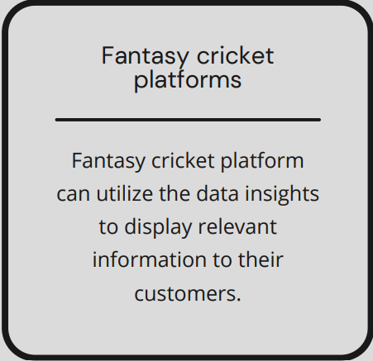
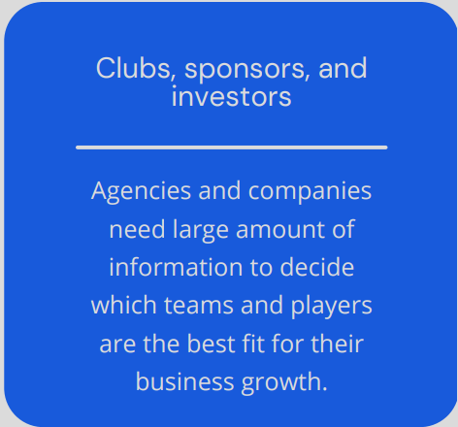
THE KEY STAKEHOLDERS

Slide 6
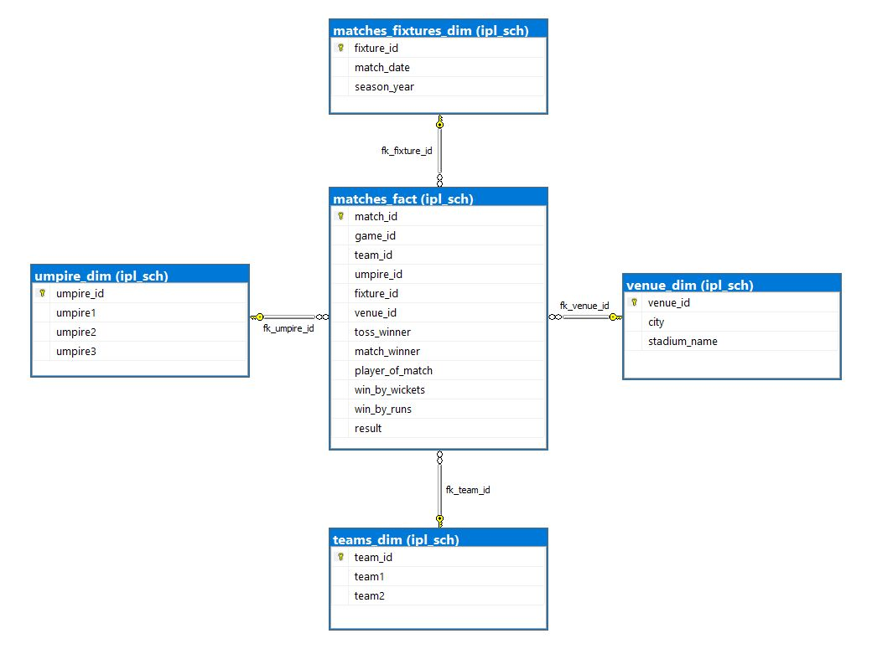
ERD DIAGRAM
Entity Relationship Diagram (ERD) depicts the graphical representation between multiple entities.

Slide 7
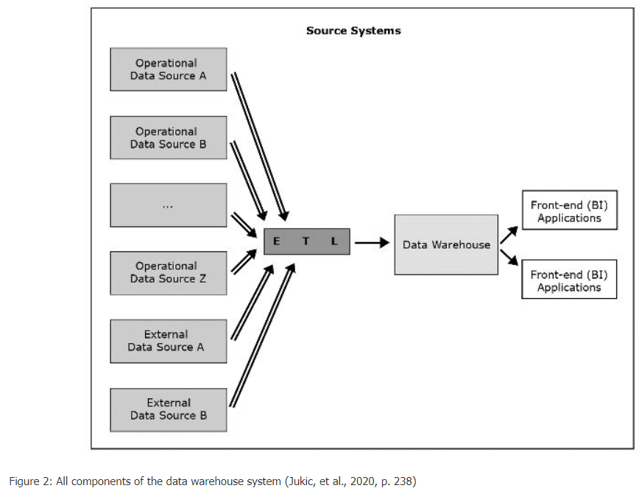
ETL

Slide 8
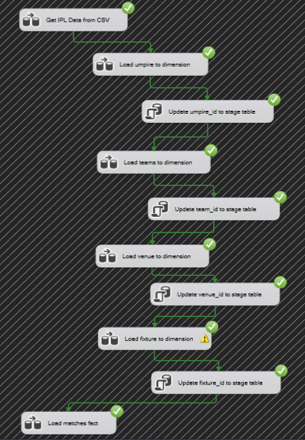
SSIS : ETL DATA FLOW
Tool : Visual Studio

Slide 9
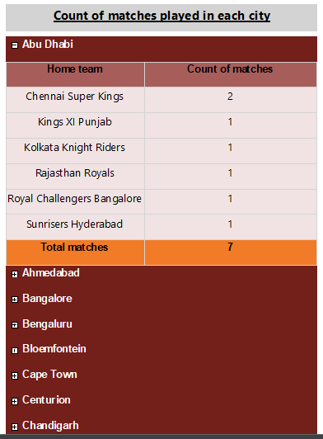
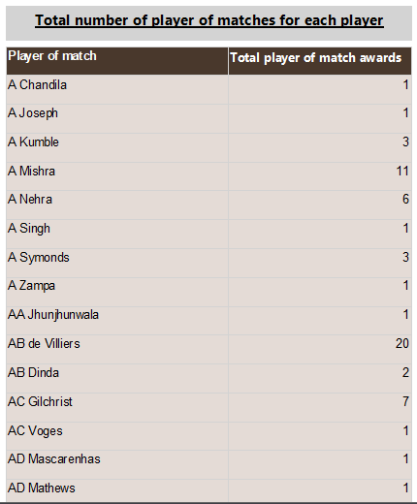
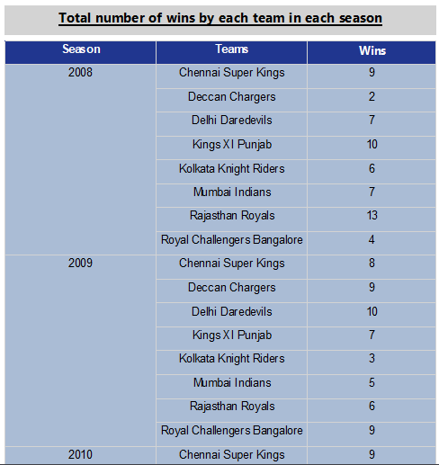
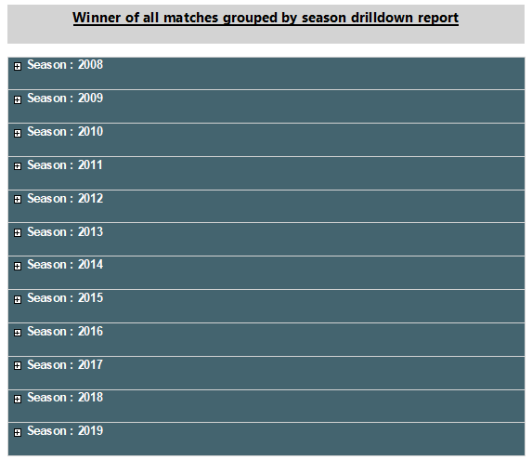
SSRS REPORTING
SSRS REPORTING
SQL Server Reporting Services (SSRS) is a report generating tool based on variety of data sources like SQL databases.
Tool : Visual Studio

Slide 10
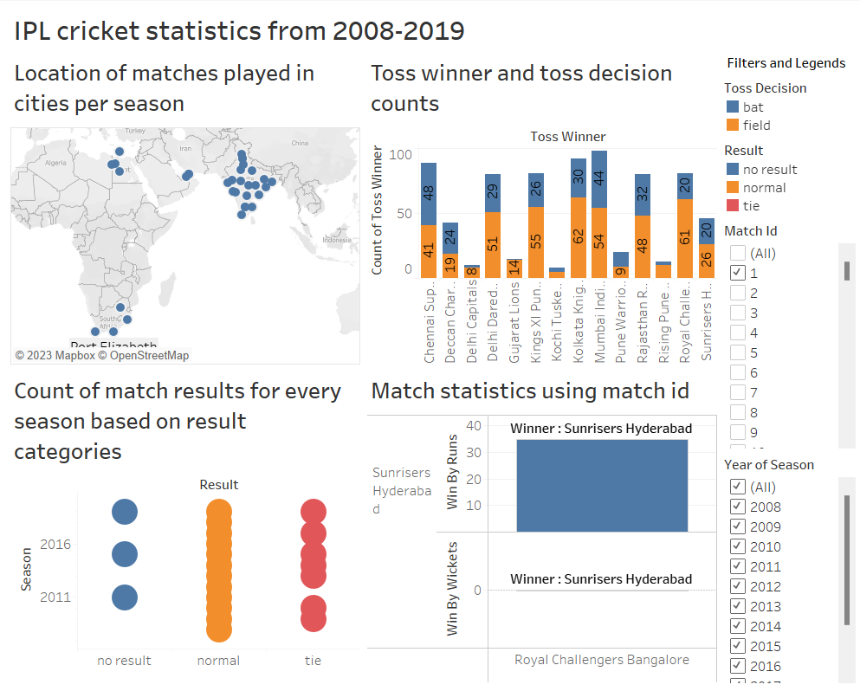
TABLEAU VISUALIZATION
Tableau is a Data Visualization software used for extracting business information and insights from the data source.

Slide 11
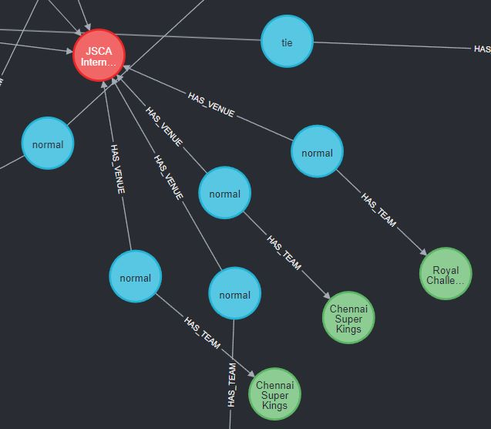
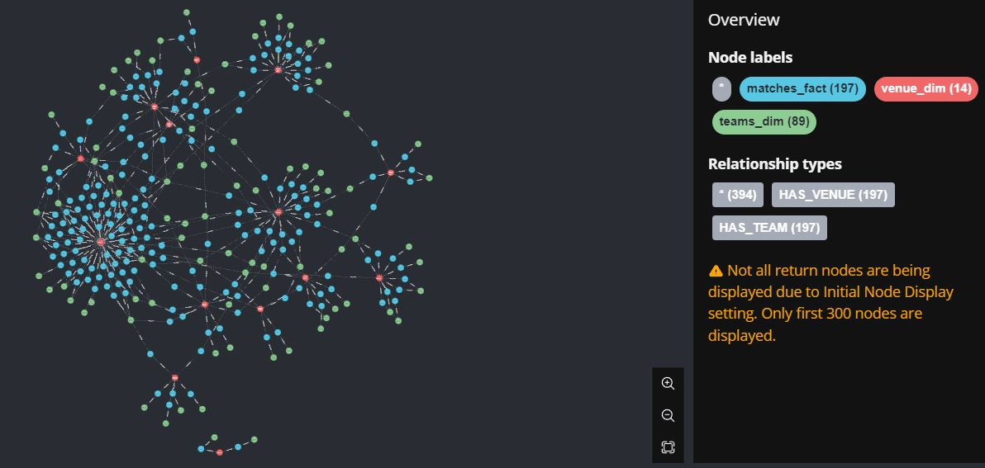
NEO4J
The graph database is a database that represents and stores data using graph structures for semantic searches, such as nodes, edges, and properties.
HAS
RELATIONSHIP

Slide 12
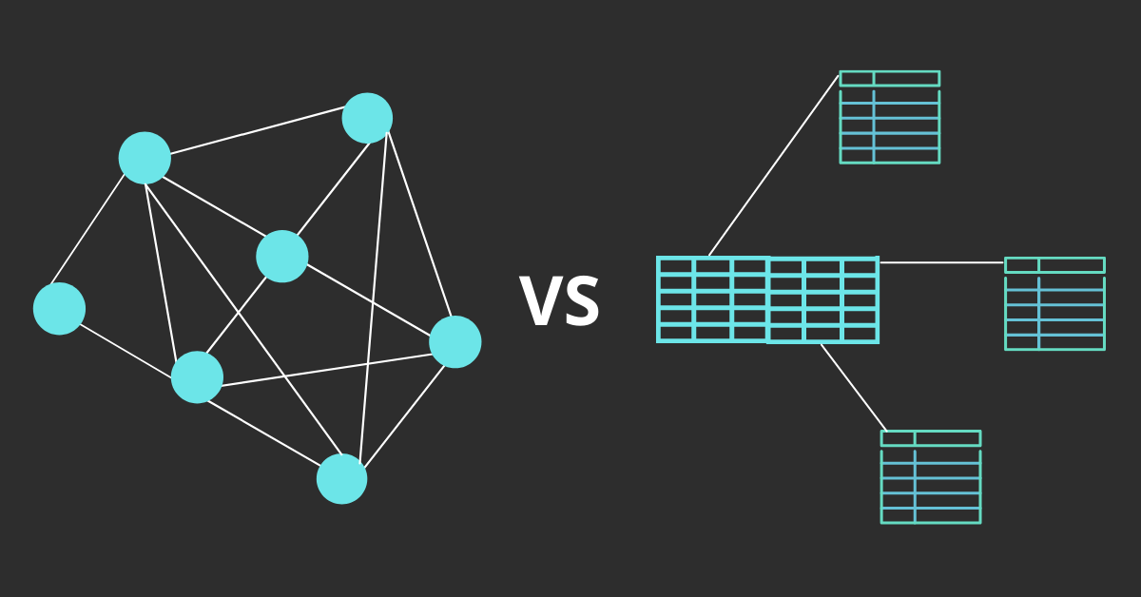
Graph vs Relational Database
Relational databases store data in tables with a fixed schema, and relationships between tables are defined through foreign keys. Whereas in graph databases, they store data as nodes, with the relationships between data unlike relational database which stores relation between data columns.

Slide 13
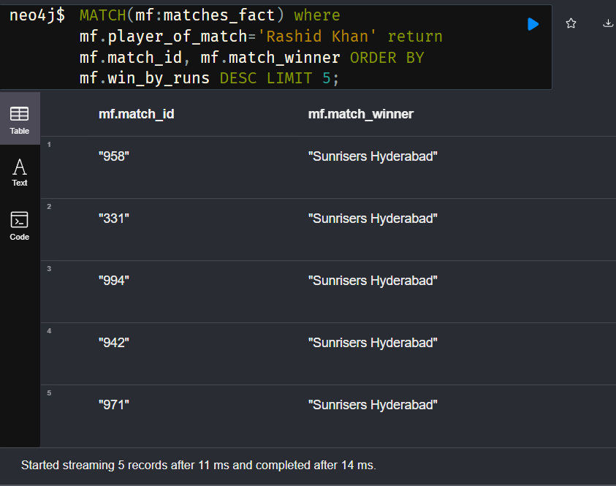
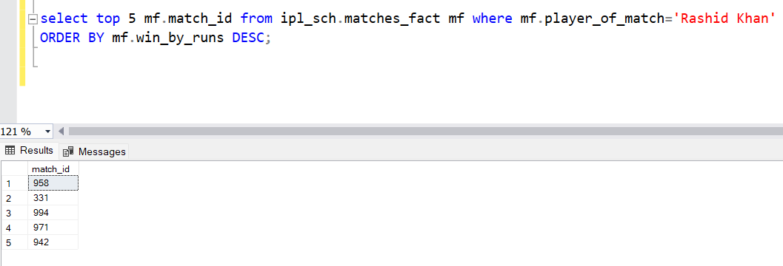
CQL vs SQL
NEO4J
CQL
SQL

Slide 14

CONCLUSION
We have modelled DataMart for IPL matches from 2008 to 2019. The Kaggle dataset contains all the information regarding all the matches played and the match outcomes for all the teams. Considering IPL cricket popularity, we have gained useful match insights and team impact report to assist key stakeholder such a Fantasy cricket platforms, sponsors, investors, or clubs in making their business decisions. Fantasy cricket platforms require player and teams’ historical data for creating appropriate biddings whereas clubs, investors or sponsors can determine teams performance based on the match stats and accordingly make an offer or sign a team. Crime Cases over the year for respective states are visualized by using SSRS.
After finalizing an ER schema – star schema, we started by creating with SSIS, which defines a ETL process to load data in various dimension and fact tables. We further created SSRS reports and Tableau visualization to give better understanding of the matches and teams which had significant impact in that IPL season. We also created a graph database using Neo4J which uses the same IPL dataset and compared the identical CQL queries with the traditional SQL database queries.

Slide 15
Thank You!

