Slide 1


Data Structure & Algorithm

Slide 2
About the Course
Free on YouTube
DSA Everything A-Z for Placement using JAVA
Theory
Practical
Notes
Practice Questions
Source Code on Github

Slide 3
Data Structure
A way of organizing and storing data so that it can be accessed and modified efficiently.
Data structures define the layout of data in memory and help improve the performance of operations like searching, sorting, and inserting.
Example
Array
Linked List
Trees
Graph

Slide 4
Algorithm
A finite sequence of well-defined instructions to solve a problem or perform a task. Algorithms are focused on optimizing time and space.
Example
Searching
Sorting
Why DSA
Optimization:
Coding Interviews
Real-world Applications

Slide 5
About Complexities
DSA the main goal is to solve problems effectively and efficiently.
To determine the efficiency of a program, we look at two types of complexities:
Time Complexity: This tells us how much time our code takes to run.
Space Complexity: This tells us how much memory our code uses.

Slide 6
Asymptotic Notation
We use asymptotic notation to compare the efficiencies of algorithms.
It’s a mathematical tool that estimates time based on input size without running the code.
Its focus is on how many basic operations the program performs, giving us an idea of how the algorithm behaves as input size increases.

Slide 7
Types of Asymptotic Notations
Big O (O): Describes the worst-case scenario or the upper bound of how the algorithm performs as the input size increases.
Omega (Ω): Describes the best-case scenario or the lower bound.
Theta (Θ): Describes the average-case or how the algorithm performs generally as input grows.

Slide 8
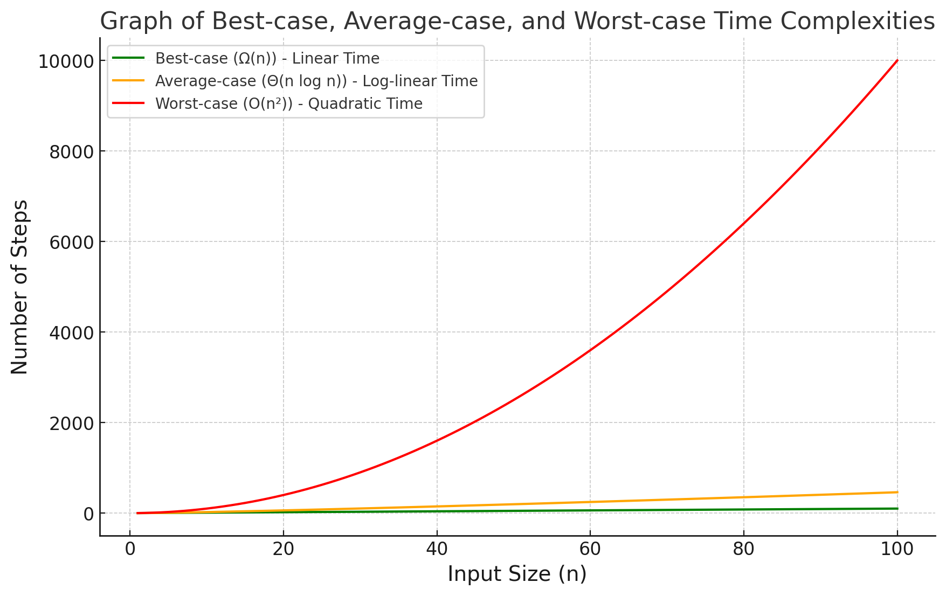

Slide 9
We are interested in the rate of growth over time with respect to the inputs taken during the program execution.

Slide 10
COMPLEXITIES

Slide 11
Big(1)- Constant Time
No matter the size of the array, accessing any element takes a constant time (1 step).
Example: Accessing a specific element in an array by index.

Slide 12
O(n) – Linear Time
The time grows directly proportional to the size of the input.
Example: Traversing an array of size

Slide 13
O(n²) – Quadratic Time
As the input grows, the time taken increases quadratically.
Example: Bubble sort or checking all pairs in an array.

Slide 14
O(log n) – Logarithmic Time
The algorithm cuts the problem size in half with each step, so the time grows logarithmically.
Example: Binary search in a sorted array.

Slide 15
O(n log n) – Linearithmic Time
The algorithm divides the input into subproblems (logarithmic) and processes each subproblem linearly
Example: Merge Sort or Quick Sort in average cases.

Slide 16
O(2^n) — Exponential Time Complexity
The time grows exponentially with the size of the input, meaning it doubles with each additional input.
Recursive algorithms that solve a problem by breaking it into multiple smaller subproblems, such as calculating Fibonacci numbers using recursion.

Slide 17
O(n!) - Factorial Time Complexity
Factorial time complexity occurs in algorithms that involve generating all possible permutations of a set, such as the brute-force solution for the Traveling Salesman Problem.
Example: Generating all permutations

Slide 18
Finding Complexity

