Slide 1

BCAC 0017 FUNDAMENTALS OF MACHINE LEARNING
Faculty Name
Mr. Sachin Sharma, Dr. Vinod Jain, Dr. Manu Banga,
Ms.Paromita Goswami, Ms.Chestha Bhardwaj, Mr. Atul Anand

Slide 2
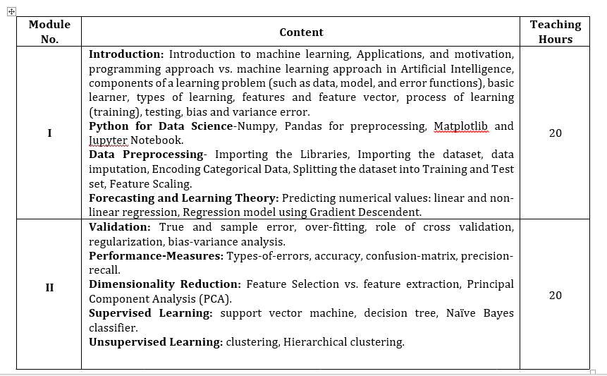
Course Structure

Slide 3
Course Objective
Objective:
The objective of this course to introduce basis process of machine learning, mathematical modeling of the supervised and unsupervised machine learning methods and to utilize combined voting of the different machine learning methods for solving real-world problems using machine learning. approach.

Slide 4
Course Outcome
CO1: Apply the basic concepts of machine learning
CO2: Make the use of different operations available using numpy and pandas libraries.
CO3: Apply the concept of data preprocessing and forecasting.
CO4: Conceptualize supervise and un supervise learning.
CO5: Apply performance measures and validation techniques.
CO6: Formulate the support vector machine, decision tree, Naïve Bayes classifier, clustering.

Slide 5
Books
Text Books:
Alpaydin, E. . Introduction to machine learning. MIT press, 2009.
Bishop, C. M. . Pattern recognition and machine learning (information science and statistics) springer-verlag new york. Inc. Secaucus, NJ, USA, 2006.
Reference Books:
Harrington, P. . Machine learning in action. Shelter Island, NY: Manning Publications Co , 2012.

Slide 6
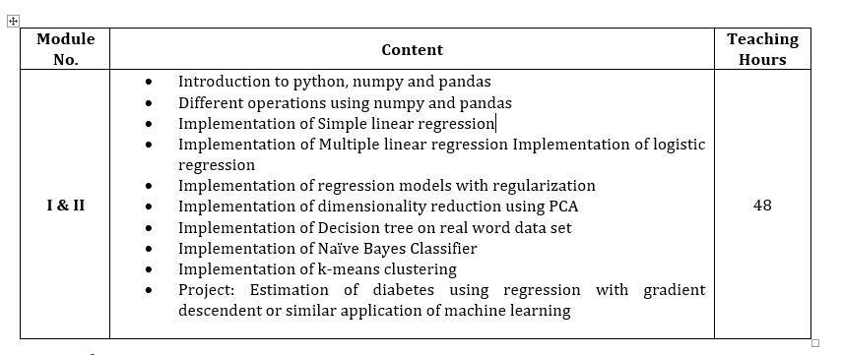
BCAC 0813 : MACHINE LEARNING USING PYTHON LAB

Slide 7
BCAC 0813 : MACHINE LEARNING USING PYTHON LAB
Introduction to python, numpy and pandas
Different operations using numpy and pandas
Implementation of Simple linear regression
Implementation of Multiple linear regression Implementation of logistic regression
Implementation of regression models with regularization
Implementation of dimensionality reduction using PCA
Implementation of Decision tree on real word data set
Implementation of Naïve Bayes Classifier
Implementation of k-means clustering
Project: Estimation of diabetes using regression with gradient descendent or similar application of machine learning

Slide 8
What is Machine Learning ?

Slide 9
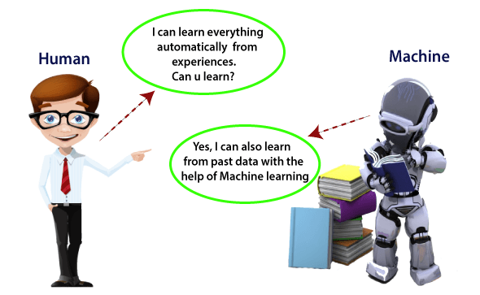
Machine Learning

Slide 10
What is Machine Learning ?
Machine Learning is said as a subset of artificial intelligence that is mainly concerned with the development of algorithms which allow a computer to learn from the data and past experiences on their own.

Slide 11
What is Machine Learning ?
We can define it in a summarized way as:
Machine learning enables a machine to automatically learn from data, improve performance from experiences, and predict things without being explicitly programmed.

Slide 12
What is Machine Learning ?
With the help of sample historical data, which is known as training data, machine learning algorithms build a mathematical model that helps in making predictions or decisions without being explicitly programmed.
Machine learning brings computer science and statistics together for creating predictive models.
Machine learning constructs or uses the algorithms that learn from historical data.
The more we will provide the information, the higher will be the performance.

Slide 13
How does Machine Learning work?

Slide 14
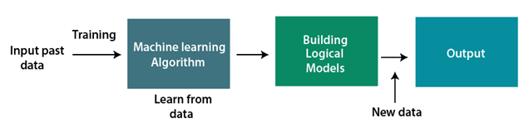
How does Machine Learning work?

Slide 15
Machine Learning
A Machine Learning system
-learns from historical data,
-builds the prediction models,
- and whenever it receives new data, predicts the output for it.

Slide 16
Machine Learning
Features of Machine Learning:
Machine learning uses data to detect various patterns in a given dataset.
It can learn from past data and improve automatically.
It is a data-driven technology.
Machine learning is much similar to data mining as it also deals with the huge amount of the data.

Slide 17
Machine Learning
Need for Machine Learning
As a human, we have some limitations as we cannot access the huge amount of data manually, so for this, we need some computer systems and here comes the machine learning to make things easy for us.

Slide 18
Machine Learning
Need for Machine Learning
We can train machine learning algorithms by providing them the huge amount of data and let them explore the data, construct the models, and predict the required output automatically.
The performance of the machine learning algorithm depends on the amount of data.
With the help of machine learning, we can save both time and money.

Slide 19
The importance of machine learning
The importance of machine learning can be easily understood by its use cases. Currently, machine learning is used in
self-driving cars
cyber fraud detection
face recognition
and friend suggestion by Facebook
Various top companies such as Netflix and Amazon have build machine learning models that are using a vast amount of data to analyze the user interest and recommend product accordingly.
Machine learning is making our day to day life easy from self-driving cars to Amazon virtual assistant "Alexa".

Slide 20
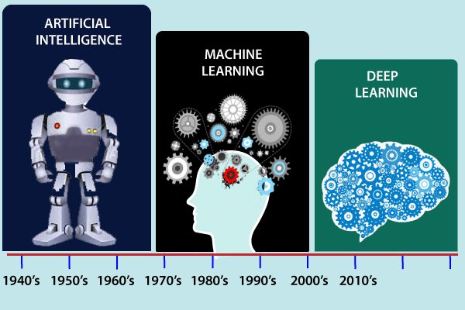
Machine Learning
History of Machine Learning

Slide 21
History of Machine Learning
1950: In 1950, Alan Turing published a seminal paper, "Computer Machinery and Intelligence," on the topic of artificial intelligence.
In his paper, he asked, "Can machines think?"

Slide 22
History of Machine Learning
Machine Learning from theory to reality
1959: In 1959, the first neural network was applied to a real-world problem to remove echoes over phone lines using an adaptive filter.
1985: In 1985, Terry Sejnowski and Charles Rosenberg invented a neural network NETtalk, which was able to teach itself how to correctly pronounce 20,000 words in one week.
1997: The IBM's Deep blue intelligent computer won the chess game against the chess expert Garry Kasparov, and it became the first computer which had beaten a human chess expert.

Slide 23
Machine Learning at 21st century
2006: In the year 2006, computer scientist Geoffrey Hinton has given a new name to neural net research as "deep learning," and nowadays, it has become one of the most trending technologies.
2012: In 2012, Google created a deep neural network which learned to recognize the image of humans and cats in YouTube videos.
2014: In 2014, the Chabot "Eugen Goostman" cleared the Turing Test. It was the first Chabot who convinced the 33% of human judges that it was not a machine.
2014: DeepFace was a deep neural network created by Facebook, and they claimed that it could recognize a person with the same precision as a human can do.
2016: AlphaGo beat the world's number second player Lee sedol at Go game. In 2017 it beat the number one player of this game Ke Jie.
2017: In 2017, the Alphabet's Jigsaw team built an intelligent system that was able to learn the online trolling. It used to read millions of comments of different websites to learn to stop online trolling.

Slide 24
Applications and motivation
We are using machine learning in our daily life even without knowing it such as Google Maps, Google assistant, Alexa, etc.
Below are some most trending real-world applications of Machine Learning:

Slide 25
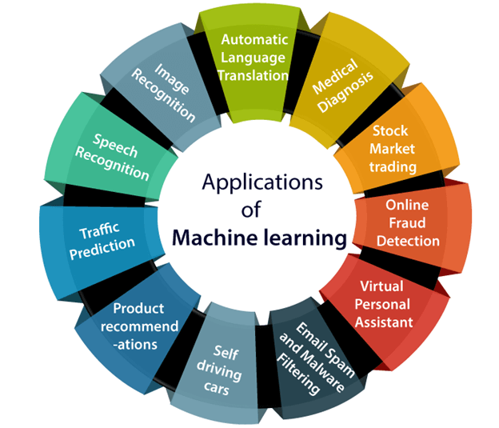
Applications and motivation

Slide 26
Applications and motivation
1. Image Recognition:
Image recognition is one of the most common applications of machine learning. It is used to identify objects, persons, places, digital images, etc. The popular use case of image recognition and face detection is, Automatic friend tagging suggestion:

Slide 27
Applications and motivation
2. Speech Recognition
While using Google, we get an option of "Search by voice," it comes under speech recognition, and it's a popular application of machine learning.
Google assistant, Siri, Cortana, and Alexa are using speech recognition technology to follow the voice instructions.

Slide 28
Applications and motivation
3. Traffic prediction:
If we want to visit a new place, we take help of Google Maps, which shows us the correct path with the shortest route and predicts the traffic conditions.
It predicts the traffic conditions such as whether traffic is cleared, slow-moving, or heavily congested with the help of two ways:
Real Time location of the vehicle form Google Map app and sensors
Average time has taken on past days at the same time.

Slide 29
Applications and motivation
4. Product recommendations:
Machine learning is widely used by various e-commerce and entertainment companies such as Amazon, Netflix, etc., for product recommendation to the user.
Whenever we search for some product on Amazon, then we started getting an advertisement for the same product while internet surfing on the same browser and this is because of machine learning.

Slide 30
Applications and motivation
5. Self-driving cars:
Tesla, the most popular car manufacturing company is working on self-driving car.
It is using unsupervised learning method to train the car models to detect people and objects while driving.

Slide 31
Applications and motivation
6. Email Spam and Malware Filtering:
Whenever we receive a new email, it is filtered automatically as important, normal, and spam.
We always receive an important mail in our inbox with the important symbol and spam emails in our spam box, and the technology behind this is Machine learning.

Slide 32
Applications and motivation
6. Email Spam and Malware Filtering:
Below are some spam filters used by Gmail:
Content Filter
Header filter
General blacklists filter
Rules-based filters
Permission filters
Some machine learning algorithms such as Multi-Layer Perceptron, Decision tree, and Naïve Bayes classifier are used for email spam filtering and malware detection.

Slide 33
Applications and motivation
7. Virtual Personal Assistant:
We have various virtual personal assistants such as Google assistant, Alexa, Cortana, Siri.
As the name suggests, they help us in finding the information using our voice instruction.
These assistant record our voice instructions, send it over the server on a cloud, and decode it using ML algorithms and act accordingly.

Slide 34
Applications and motivation
8. Online Fraud Detection:
Machine learning is making our online transaction safe and secure by detecting fraud transaction.
Whenever we perform some online transaction, there may be various ways that a fraudulent transaction can take place such as fake accounts, fake ids, and steal money in the middle of a transaction.
So to detect this, Feed Forward Neural network helps us by checking whether it is a genuine transaction or a fraud transaction.

Slide 35
Applications and motivation
9. Stock Market trading:
Machine learning is widely used in stock market trading.
In the stock market, there is always a risk of up and downs in shares, so for this machine learning's long short term memory neural network is used for the prediction of stock market trends.

Slide 36
Applications and motivation
10. Medical Diagnosis:
In medical science, machine learning is used for diseases diagnoses.
With this, medical technology is growing very fast and able to build 3D models that can predict the exact position of lesions in the brain.
It helps in finding brain tumors and other brain-related diseases easily.
It helps in
Diabetes Prediction
Kidney Disease prediction
Heart Failure Prediction

Slide 37
Applications and motivation
11. Automatic Language Translation:
Nowadays, if we visit a new place and we are not aware of the language then it is not a problem at all, as for this also machine learning helps us by converting the text into our known languages.
Google's GNMT (Google Neural Machine Translation) provide this feature, which is a Neural Machine Learning that translates the text into our familiar language, and it called as automatic translation.

Slide 38
Programming approach vs. machine learning approach
In the context of programming, the "Programming Approach" and the "Machine Learning Approach" refer to two different methodologies or paradigms for solving problems.

Slide 39
Programming approach vs. machine learning approach
Programming Approach:
The programming approach is the traditional way of solving problems using code and algorithms.
In this approach, the programmer writes explicit instructions and rules that the computer follows to perform specific tasks.
The focus is on designing algorithms, data structures, and logical steps to achieve the desired output.
The programmer needs to have a good understanding of the problem domain and needs to manually craft the solution.

Slide 40
Programming approach vs. machine learning approach
Advantages of the Programming Approach:
Control: The programmer has full control over the solution and the logic behind it.
Predictability: Since the programmer defines all the steps, the behavior of the program is highly predictable.
Smaller Data Requirements: Traditional programming often requires less data compared to machine learning approaches.

Slide 41
Programming approach vs. machine learning approach
Machine Learning Approach:
The machine learning approach, on the other hand, is a subset of artificial intelligence where algorithms are designed to learn patterns and relationships from data rather than being explicitly programmed.
In machine learning, models are trained on data, and they can improve their performance over time by learning from the patterns in the data.

Slide 42
Programming approach vs. machine learning approach
Advantages of the Machine Learning Approach:
Adaptability: Machine learning models can adapt to new data and changing conditions without the need for explicit reprogramming.
Complex Patterns: Machine learning can identify complex patterns and relationships in large datasets that may be challenging for traditional programming approaches.
Automation: Once the model is trained, it can make predictions on new data automatically.

Slide 43
Programming approach vs. machine learning approach
Use the Programming Approach when:
The problem is well-defined and can be solved using logical rules and algorithms.
There is a limited amount of data, and the problem doesn't require complex pattern recognition.
The rules and logic are straightforward and easy to implement.
Use the Machine Learning Approach when:
The problem involves complex patterns and relationships that are difficult to specify using explicit rules.
There is a large amount of data available for training the model.
The problem requires continuous learning and adaptation to changing conditions.

Slide 44
Programming approach vs. machine learning approach
In many real-world scenarios, a combination of both approaches may be used.
For example, you might pre-process and clean data using traditional programming methods before feeding it into a machine learning model for further analysis and prediction.

Slide 45
Components of a learning problem (such as data, model, and error functions)
Data:
Data is the foundation of any learning problem.
It consists of a collection of examples, each comprising input features and their corresponding target labels (in supervised learning) or just the input features (in unsupervised learning).
The data serves as the basis for the model to learn patterns, relationships, and generalizations.

Slide 46
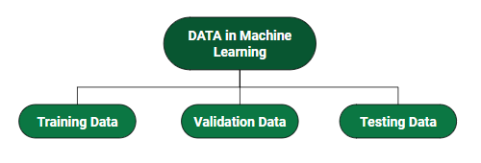

Components of a learning problem (such as data, model, and error functions)

Slide 47
Components of a learning problem (such as data, model, and error functions)
Model:
The model is the core component of the learning problem.
It is a mathematical representation or algorithm that learns from the data and makes predictions or inferences.
The model takes input features from the data and generates output predictions based on the patterns it has learned during the training process.

Slide 48
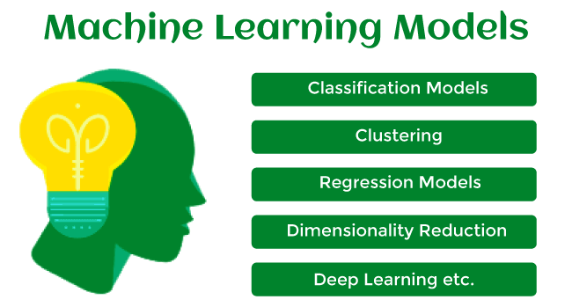
Components of a learning problem (such as data, model, and error functions)

Slide 49
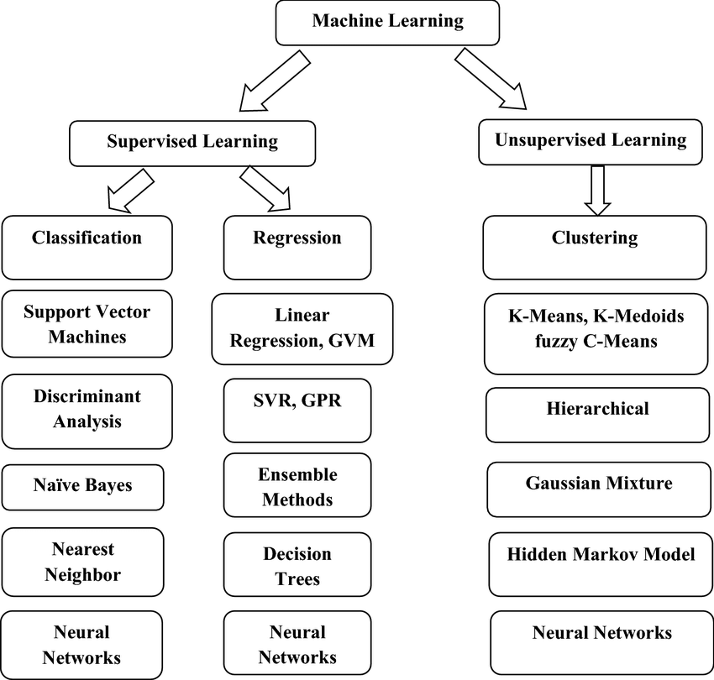

Slide 50
Components of a learning problem (such as data, model, and error functions)
Error (or Loss) Function:
The error function, also known as the loss function, quantifies the difference between the model's predictions and the actual target values (in supervised learning)
or a measure of how well the model represents the data (in unsupervised learning).
The goal of training a model is to minimize the error function, which leads to better predictions and generalization to new data.

Slide 51
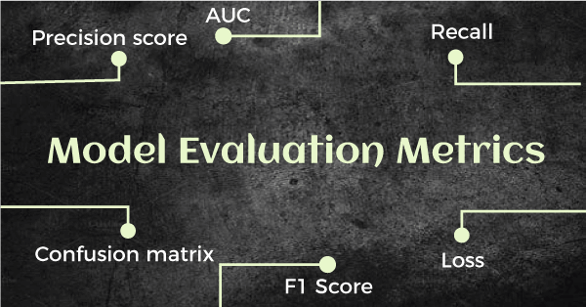
Components of a learning problem (such as data, model, and error functions)

Slide 52
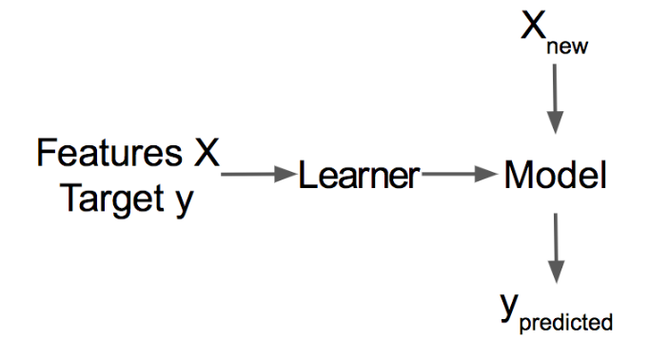
Basic learner in Machine Learning
A Learner or Machine Learning Algorithm is the program used to learn a machine learning model from data.
Another name is “inducer” (e.g. “tree inducer”).

Slide 53
Basic learner in Machine Learning
A basic learner is a model that has limited predictive power on its own.
But when combined with other weak learners in an ensemble learning method, it can contribute to creating a strong and powerful predictive model.
Ensemble learning techniques, such as boosting and bagging, leverage the diversity of multiple basic learners to improve overall predictive performance.

Slide 54
Basic learner in Machine Learning
Some examples of basic learners include:
Decision Stumps:
Perceptron:
Decision Trees with Limited Depth:
k-Nearest Neighbors (k-NN):
Etc.

Slide 55
Types of learning

Slide 56
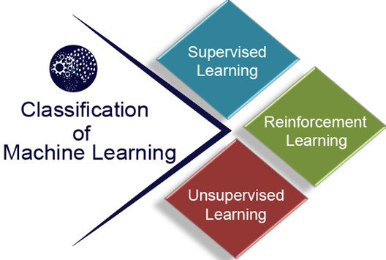

Slide 57
Types of learning
At a broad level, machine learning can be classified into three types:
Supervised learning
Unsupervised learning
Reinforcement learning

Slide 58
Supervised learning
Supervised learning is a type of machine learning method in which we provide sample labeled data to the machine learning system in order to train it, and on that basis, it predicts the output.
The system creates a model using labeled data to understand the datasets and learn about each data
once the training and processing are done then we test the model by providing a sample data to check whether it is predicting the exact output or not.

Slide 59
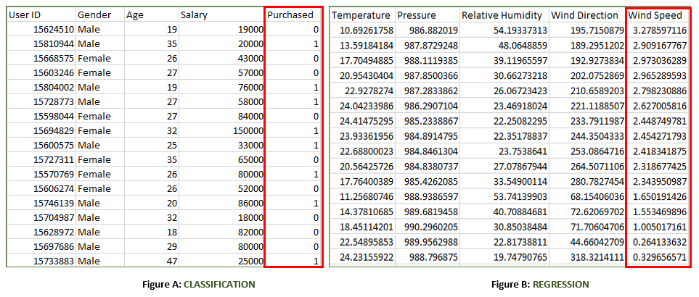
Labelled Data

Slide 60
Supervised learning
Supervised learning can be grouped further in two categories of algorithms:
Classification
Regression

Slide 61
Unsupervised learning
Unsupervised learning is a learning method in which a machine learns without any supervision.
The training is provided to the machine with the set of data that has not been labeled, classified, or categorized, and the algorithm needs to act on that data without any supervision.
The goal of unsupervised learning is to restructure the input data into new features or a group of objects with similar patterns.
In unsupervised learning, we don't have a predetermined result.
The machine tries to find useful insights from the huge amount of data.
It can be further classifieds into two categories of algorithms:
Clustering
Association

Slide 62
Reinforcement Learning
Reinforcement learning is a feedback-based learning method, in which a learning agent gets a reward for each right action and gets a penalty for each wrong action.
The agent learns automatically with these feedbacks and improves its performance.
In reinforcement learning, the agent interacts with the environment and explores it.
The goal of an agent is to get the most reward points, and hence, it improves its performance.
The robotic dog, which automatically learns the movement of his arms, is an example of Reinforcement learning.

Slide 63
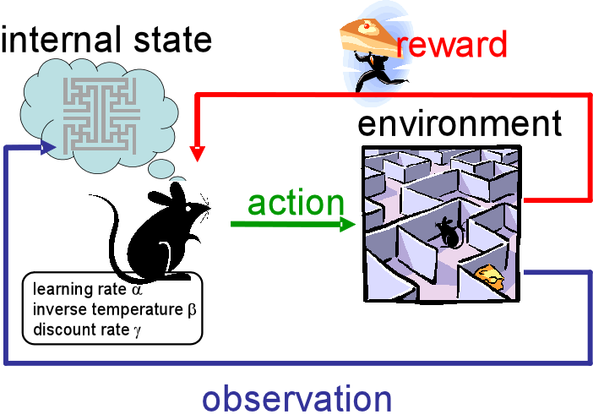
Reinforcement Learning

Slide 64
Features and feature vector
Features: Features are the individual measurable properties or characteristics of the data instances that are used to describe them.
These properties can be numeric or categorical, and they provide relevant information about the data that the machine learning algorithm can use to understand and make predictions.
In simpler terms, features are the attributes that define the input data.

Slide 65
Features and feature vector
For example
consider a dataset of houses where each data instance represents a house.
The features might include attributes such as the
number of bedrooms,
the square footage,
the location,
the number of bathrooms,
and so on.

Slide 66
Features and feature vector
Feature Vector:
A feature vector is a numerical representation of a data instance in a machine learning model.
It is an n-dimensional vector where 'n' is the number of features in the dataset.
Each element of the vector corresponds to the value of a specific feature for that particular data instance.

Slide 67
Features and feature vector
In the house example,
suppose we have five features: number of bedrooms, square footage, location, number of bathrooms, and age of the house.
A sample feature vector for a specific house might look like this:
[number of bedrooms, square footage, location, number of bathrooms, and age of the house]
[3, 1800, "City Center", 2, 15].

Slide 68
Process of learning
The process of training a model typically involves the following steps:
Data Collection:
Data Pre processing:
Model Selection:
Model Initialization:
Model Training:
Validation:
Hyper parameter Tuning:
Testing:
Deployment:

Slide 69
Process of learning
Data Collection: Gathering a labeled dataset that consists of input data (features) and corresponding output labels (target). The dataset is split into two parts: the training set and the test set.
Data Preprocessing: Preprocessing the data to handle missing values, normalize features, and perform other necessary transformations to make the data suitable for training.

Slide 70
Process of learning
Model Selection: Choosing an appropriate machine learning algorithm or model architecture for the specific task at hand. This can vary depending on the problem, such as classification, regression, clustering, etc.
Model Initialization: Initializing the model with random or predefined parameters before training.

Slide 71
Process of learning
Model Training:
Feeding the training data into the model and adjusting its internal parameters iteratively to minimize the difference between its predictions and the actual target values.
This process involves an optimization algorithm that adjusts the model's parameters based on the difference between predicted and actual values (known as the loss or cost function).

Slide 72
Process of learning
Validation:
During training, the model's performance is evaluated using a validation set, which is a portion of the training data held out for evaluation purposes.
This step helps monitor the model's performance and prevent overfitting (i.e., when the model memorizes the training data but fails to generalize to new data).

Slide 73
Process of learning
Hyperparameter Tuning: Adjusting the hyperparameters of the model to find the best configuration that leads to better performance. Hyperparameters are not learned during training but are set before the training process.
Testing: After the model has been trained and tuned, it is evaluated on a separate test dataset to assess its performance on unseen data. This step provides an estimate of how well the model will perform in the real world.
Deployment: Once the model has been trained and tested successfully, it can be deployed in a production environment to make predictions on new, unseen data.

Slide 74
Process of learning (training)
Model Training:
Feeding the training data into the model and adjusting its internal parameters iteratively to minimize the difference between its predictions and the actual target values.
This process involves an optimization algorithm that adjusts the model's parameters based on the difference between predicted and actual values (known as the loss or cost function).

Slide 75
Testing
Testing:
After the model has been trained and tuned, it is evaluated on a separate test dataset to assess its performance on unseen data.
This step provides an estimate of how well the model will perform in the real world.

Slide 76
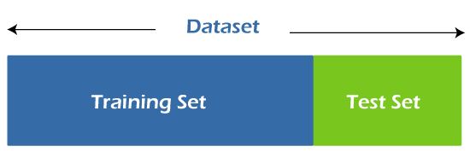
Train and Test datasets in Machine Learning
In machine learning projects, we generally divide the original dataset into training data and test data.
We train our model over a subset of the original dataset, i.e., the training dataset, and then evaluate whether it can generalize well to the new or unseen dataset or test set.

Slide 77
Training data vs. Testing Data
The main difference between training data and testing data is that training data is the subset of original data that is used to train the machine learning model, whereas testing data is used to check the accuracy of the model.
The training dataset is generally larger in size compared to the testing dataset. The general ratios of splitting train and test datasets are 80:20, 70:30, or 90:10.
Training data is well known to the model as it is used to train the model, whereas testing data is like unseen/new data to the model.

Slide 78
Bias and variance error

Slide 79
Errors in Machine Learning?
Errors in Machine Learning?
In machine learning, an error is a measure of how accurately an algorithm can make predictions for the previously unknown dataset.
On the basis of these errors, the machine learning model is selected that can perform best on the particular dataset.

Slide 80
Errors in Machine Learning?
There are mainly two types of errors in machine learning, which are:
Reducible errors:
These errors can be reduced to improve the model accuracy.
Such errors can further be classified into bias and Variance.
Irreducible errors:
These errors will always be present in the model regardless of which algorithm has been used.
The cause of these errors is unknown variables whose value can't be reduced.

Slide 81
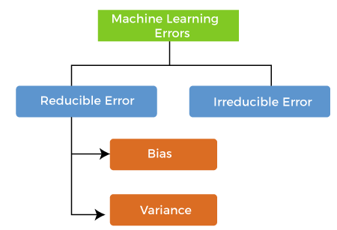
Errors in Machine Learning?

Slide 82
What is Bias?
While making predictions, a difference occurs between prediction values made by the model and actual values/expected values, and this difference is known as bias errors or Errors due to bias.

Slide 83
What is Bias?
It can be defined as an inability of machine learning algorithms such as Linear Regression to capture the true relationship between the data points.
Each algorithm begins with some amount of bias because bias occurs from assumptions in the model, which makes the target function simple to learn.

Slide 84
What is Bias?
A model has either:
Low Bias: A low bias model will make fewer assumptions about the form of the target function.
High Bias: A model with a high bias makes more assumptions, and the model becomes unable to capture the important features of our dataset. A high bias model also cannot perform well on new data.

Slide 85
What is Bias?
Generally, a linear algorithm has a high bias, as it makes them learn fast.
The simpler the algorithm, the higher the bias it has likely to be introduced. Whereas a nonlinear algorithm often has low bias.
Some examples of machine learning algorithms with low bias are Decision Trees, k-Nearest Neighbours and Support Vector Machines.
At the same time, an algorithm with high bias is Linear Regression, Linear Discriminant Analysis and Logistic Regression.

Slide 86
What is a Variance Error?
The variance would specify the amount of variation in the prediction if the different training data was used.
Ideally, a model should not vary too much from one training dataset to another, which means the algorithm should be good in understanding the hidden mapping between inputs and output variables.
Variance errors are either of low variance or high variance.

Slide 87
What is a Variance Error?
Low variance means there is a small variation in the prediction of the target function with changes in the training data set.
At the same time, High variance shows a large variation in the prediction of the target function with changes in the training dataset.
Some examples of machine learning algorithms with low variance are, Linear Regression, Logistic Regression, and Linear discriminant analysis. At the same time, algorithms with high variance are decision tree, Support Vector Machine, and K-nearest neighbours.

Slide 88
What is a Variance Error?
Since, with high variance, the model learns too much from the dataset, it leads to overfitting of the model. A model with high variance has the below problems:
A high variance model leads to overfitting.
Increase model complexities.

Slide 89
END

