Slide 1

BCAC 0017 FUNDAMENTALS OF MACHINE LEARNING
Section 2 : Python for Data Science
Faculty Name
Mr. Sachin Sharma, Dr. Vinod Jain, Dr. Manu Banga,
Ms.Paromita Goswami, Ms.Chestha Bhardwaj, Mr. Atul Anand

Slide 2
Section 2 : Python for Data Science
Python for Data Science
-Numpy, Pandas for preprocessing, Matplotlib and Jupyter Notebook.

Slide 3
Section 2 : Python for Data Science
Python List
Tuple
Dictionary
Numpy
Pandas
Mat Plot Lib

Slide 4
List in python
In Python, the sequence of various data types is stored in a list
.A list is a collection of different kinds of values or items.
Since Python lists are mutable, we can change their elements after forming.
The comma (,) and the square brackets [enclose the List's items] serve as separators.
Although six Python data types can hold sequences, the List is the most common and reliable form.
A list, a type of sequence data, is used to store the collection of data.
Tuples and Strings are two similar data formats for sequences.

Slide 5
List in python
List Declaration
# a simple list
list1 = [1, 2, "Python", "Program", 15.9]
list2 = ["Amy", "Ryan", "Henry", "Emma"]

Slide 6
List in python
# list example in detail
emp = [ "John", 102, "USA"]
Dep1 = [ "CS",10]
Dep2 = [ "IT",11]
HOD_CS = [ 10,"Mr. Holding"]
HOD_IT = [11, "Mr. Bewon"]

Slide 7
List in python
List Indexing and Splitting
list_varible(start:stop:step)
The beginning indicates the beginning record position of the rundown.
The stop signifies the last record position of the rundown.
Within a start, the step is used to skip the nth element: stop.

Slide 8
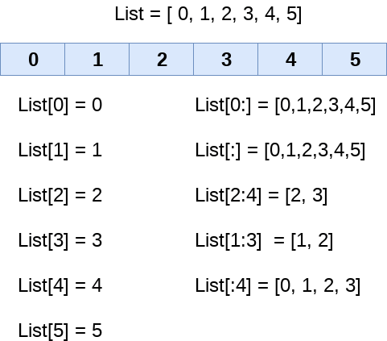
List in python
List Indexing and Splitting

Slide 9
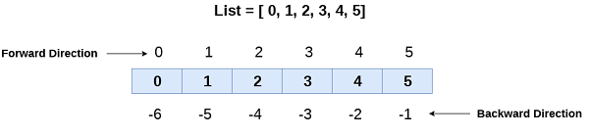
List in python
List

Slide 10
List in python
# negative indexing example
list = [1,2,3,4,5]
print(list[-1])
print(list[-3:])
print(list[:-1])
print(list[-3:-1])
Output:
5
[3, 4, 5]
[1, 2, 3, 4]
[3, 4]

Slide 11
List in python
Python List Operations
The different operations of list are
Repetition
Concatenation
Length
Iteration
Membership

Slide 12
Repetition
The redundancy administrator empowers the rundown components to be rehashed on different occasions.
Code
# repetition of list
list1 = [12, 14, 16, 18, 20]
# repetition operator *
l = list1 * 2
print(l)
Output:
[12, 14, 16, 18, 20, 12, 14, 16, 18, 20]

Slide 13
Concatenation
It concatenates the list mentioned on either side of the operator.
Code
# concatenation of two lists
# declaring the lists
list1 = [12, 14, 16, 18, 20]
list2 = [9, 10, 32, 54, 86]
# concatenation operator +
l = list1 + list2
print(l)
Output:
[12, 14, 16, 18, 20, 9, 10, 32, 54, 86]

Slide 14
Length
It is used to get the length of the list
Code
# size of the list
# declaring the list
list1 = [12, 14, 16, 18, 20, 23, 27, 39, 40]
# finding length of the list
len(list1)
Output:
9

Slide 15
Iteration
The for loop is used to iterate over the list elements.
Code
# iteration of the list
# declaring the list
list1 = [12, 14, 16, 39, 40]
# iterating
for i in list1:
print(i)
Output:
12
14
16
39
40

Slide 16
Membership
It returns true if a particular item exists in a particular list otherwise false.
Code
# membership of the list
list1 = [100, 200, 300, 400, 500]
print(600 in list1)
Output:
False

Slide 17
Python List Built-in Functions
Python provides the following built-in functions, which can be used with the lists.
len()
max()
min()

Slide 18
len( )
It is used to calculate the length of the list.
Code
# size of the list
# declaring the list
list1 = [12, 16, 18, 20, 39, 40]
# finding length of the list
len(list1)
Output:
6

Slide 19
Max( )
It returns the maximum element of the list
Code
# maximum of the list
list1 = [103, 675, 321, 782, 200]
# large element in the list
print(max(list1))
Output:
782

Slide 20
Min( )
It returns the minimum element of the list
Code
# minimum of the list
list1 = [103, 675, 321, 782, 200]
# smallest element in the list
print(min(list1))
Output:
103

Slide 21
List Reference
https://www.javatpoint.com/python-lists

Slide 22
Python Tuples
Python Tuples
A comma-separated group of items is called a Python tuple.
The ordering, settled items, and reiterations of a tuple are to some degree like those of a rundown, but in contrast to a rundown, a tuple is unchanging.
The main difference between the two is that we cannot alter the components of a tuple once they have been assigned.
On the other hand, we can edit the contents of a list.

Slide 23
Python Tuples
Example
("Suzuki", "Audi", "BMW"," Skoda ") is a tuple.

Slide 24
Python Tuples
Features of Python Tuple
Tuples are an immutable data type, meaning their elements cannot be changed after they are generated.
Each element in a tuple has a specific order that will never change because tuples are ordered sequences.

Slide 25
Python Tuples
# Creating tuple having integers
int_tuple = (4, 6, 8, 10, 12, 14)
print("Tuple with integers: ", int_tuple)
Output:
Tuple with integers: (4, 6, 8, 10, 12, 14)

Slide 26
Python Tuples
# Python program to show how to access tuple elements
# Creating a tuple
tuple_ = ("Python", "Tuple", "Ordered", "Collection")
print(tuple_[0])
print(tuple_[1])
Output:
Python
Tuple

Slide 27
Python Tuples : Reference
https://www.javatpoint.com/python-tutorial

Slide 28
Python Dictionary
Dictionaries are a useful data structure for storing data in Python because they are capable of imitating real-world data arrangements where a certain value exists for a given key.

Slide 29
Python Dictionary
The data is stored as key-value pairs using a Python dictionary.
This data structure is mutable
The components of dictionary were made using keys and values.
Keys must only have one component.
Values can be of any type, including integer, list, and tuple.

Slide 30
Python Dictionary
Dict = {"Name": "Gayle", "Age": 25}

Slide 31
Python Dictionary
Employee = {"Name": "Johnny", "Age": 32, "salary":26000,"Company":"^TCS"}
print(type(Employee))
print("printing Employee data .... ")
print(Employee)
Output
<class 'dict'>
printing Employee data ....
{'Name': 'Johnny', 'Age': 32, 'salary': 26000, 'Company': TCS}

Slide 32
Accessing the dictionary values
To access data contained in lists and tuples, indexing has been studied.
The keys of the dictionary can be used to obtain the values because they are unique from one another.
The following method can be used to access dictionary values.
Code
Employee = {"Name": "Dev", "Age": 20, "salary":45000,"Company":"WIPRO"}
print("Name : %s" %Employee["Name"])

Slide 33
Python Dictionary
Dict = {}
print("Empty Dict: ")
print(Dict)
Dict[0] = 'Ajay'
Dict[1] = 'Vijay'
print(Dict)
Output
Empty Dict:
{}
{0: 'Ajay', 1: 'Vijay'}

Slide 34
Python Dictionary
# Iterating Dictionary
Employee = {"Name": "John", "Age": 29, "salary":25000,"Company":"WIPRO"}
for x in Employee:
print(x)
Output :
Name
Age
salary
Company

Slide 35
Python Dictionary
https://www.javatpoint.com/python-dictionary

Slide 36
Numpy

Slide 37
Numpy
What is NumPy?
NumPy stands for Numerical Python.
NumPy is a Python library used for working with arrays.
It also has functions for working in domain of linear algebra, fourier transform, and matrices.
NumPy was created in 2005 by Travis Oliphant. It is an open source project and you can use it freely.

Slide 38
Why Use NumPy?
Why Use NumPy?
In Python we have lists that serve the purpose of arrays, but they are slow to process.
NumPy aims to provide an array object that is up to 50x faster than traditional Python lists.
The array object in NumPy is called ndarray, it provides a lot of supporting functions that make working with ndarray very easy.
Arrays are very frequently used in data science, where speed and resources are very important.

Slide 39
Why is NumPy Faster Than Lists?
NumPy arrays are stored at one continuous place in memory unlike lists, so processes can access and manipulate them very efficiently.
This behavior is called locality of reference in computer science.
NumPy is a Python library and is written partially in Python, but most of the parts that require fast computation are written in C or C++.

Slide 40
Where is the NumPy Codebase?
The source code for NumPy is located at this github repository https://github.com/numpy/numpy

Slide 41
Installation of NumPy
If you have Python and PIP already installed on a system, then installation of NumPy is very easy.
Install it using this command:
C:\Users\Your Name>pip install numpy
If this command fails, then use a python distribution that already has NumPy installed like, Anaconda, Spyder etc.

Slide 42
Import NumPy
Once NumPy is installed, import it in your applications by adding the import keyword:
import numpy
Now NumPy is imported and ready to use.

Slide 43
NumPy as np
NumPy is usually imported under the np alias.
alias: In Python alias are an alternate name for referring to the same thing.
Create an alias with the as keyword while importing:
import numpy as np
Now the NumPy package can be referred to as np instead of numpy.

Slide 44
Numpy
Example
import numpy as np arr = np.array([1, 2, 3, 4, 5]) print(arr)

Slide 45
# Using Numpy : Programs
# Using Numpy
# WAP to create an array using Numpy
# Checking NumPy Version
# Create a NumPy ndarray Object
# Use a tuple to create a NumPy array:
# Create a 0-D array with value 42
# Create a 1-D array containing the values 1,2,3,4,5:
# Create a 2-D array containing two arrays with the values 1,2,3 and 4,5,6:
# Create a 3-D array with two 2-D arrays, both containing two arrays with the values 1,2,3 and 4,5,6:
# Check how many dimensions the arrays have:
# Create an array with 5 dimensions and verify that it has 5 dimensions:

Slide 46
# Using Numpy
# WAP to create an array using Numpy from tuple
import numpy as np
tup1 = (1,2,3)
arr1 = np.array(tup1)
print(arr1)

Slide 47
# Using Numpy
# Checking NumPy Version
print(np.__version__)

Slide 48
# Using Numpy
# Create a NumPy ndarray Object
arr2 = np.array([1,2,3,4,5])
print("arr2 is ")
print(arr2)
print("Dimension is ", arr2.ndim)

Slide 49
# Using Numpy
# Create a 0-D array with value 42
arr3 = np.array(10)
print("Dimension is ", arr3.ndim)

Slide 50
# Using Numpy
# Create a 1-D array containing the values 1,2,3,4,5:
arr4=np.array([1,2,3,4,5])
print("arr4 is ")
print(arr4)
print("Dimension is ", arr4.ndim)

Slide 51
# Using Numpy
# Create a 2-D array containing two arrays with the values 1,2,3 and 4,5,6:
arr2d = np.array([[1,1],[2,2],[3,3]])
print("arr2d is ")
print(arr2d)
print("Dimension is ", arr2d.ndim)

Slide 52
# Using Numpy
# Create a 3-D array with two 2-D arrays, both containing two arrays with the values 1,2,3 and 4,5,6:
arr3d = np.array([ [[1,1],[2,2]],[[3,3],[4,4]] ])
print("arr2d is ")
print(arr3d)
print("Dimension is ", arr3d.ndim)

Slide 53
# Using Numpy
# Check how many dimensions the arrays have:
arr0d = np.array(100)
arr1d = np.array([1,2,3,4,5])
arr2d = np.array([[1,2,3],[4,5,6],[7,8,9]])
arr3d = np.array([ [[1,1],[2,2]], [[3,3],[4,4]]])
print("Dimension of arr0d is ", arr0d.ndim)
print("arr0d is ")
print(arr0d)
print("Dimension of arr1d is ", arr1d.ndim)
print("arr1d is ")
print(arr1d)
print("Dimension of arr2d is ", arr2d.ndim)
print("arr2d is ")
print(arr2d)
print("Dimension of arr3d is ", arr3d.ndim)
print("arr3d is ")
print(arr3d)

Slide 54
# Using Numpy
# Create an array with 5 dimensions and verify that it has 5 dimensions:
arr5d = np.array([1,2,3,4,5],ndmin=5)
print("Dimension of arr5d is ", arr5d.ndim)
print("arr5d is ")
print(arr5d)

Slide 55
References
https://www.w3schools.com/python/numpy/numpy_creating_arrays.asp

Slide 56
NumPy Array Indexing
Array indexing is the same as accessing an array element.
You can access an array element by referring to its index number.
The indexes in NumPy arrays start with 0, meaning that the first element has index 0, and the second has index 1 etc.

Slide 57
NumPy Array Indexing
# Printing element at index
arr = np.array([11, 21, 33, 46])
print("Element at index 2 = " , arr[2])

Slide 58
NumPy Array Indexing
# Indexing 2D Array Element
arr = np.array([[1,2,3,4,5], [6,7,8,9,10]])
print(arr)
print("Array Element at 2rd row 3rd column", arr[1,2])
print('5th element on 2nd row: ', arr[1, 4])

Slide 59
NumPy Array Indexing
# 3D array indexing
arr = np.array([[[1, 2, 3], [4, 5, 6]], [[7, 8, 9], [10, 11, 12]]])
print(arr[0, 1, 2])
# Output is 6

Slide 60
NumPy Array Indexing
# Negative Indexing
arr = np.array([[1,2,3,4,5], [6,7,8,9,10]])
print(arr)
print(" Last row Last Column arr [-1,-1] = ", arr[-1,-1])
print(" 2nd Last row 2nd Last Column arr [-2,-2] = ", arr[-1,-1])

Slide 61
NumPy Array Indexing
# 1D Array Slicing
Use negative indexing to access an array from the end.
# Work like list

Slide 62
NumPy Array Indexing
arr = np.array([0, 1, 2, 3, 4, 5, 6, 7, 8, 9])
print(" Complete array ",arr[:])
print("All from index 4 ", arr[4:])
print("Up to index 3",arr[:4])
print("Last three items ",arr[-3:])

Slide 63
# Slicing 2D # Very Important
# Slicing 2D # Very Important
#################################################
arr = np.array([[0,1, 2, 3, 4], [5, 6, 7, 8, 9],[10,11,12,13,14]])
print(arr)
# arr[which rows , Which columns ]
print("From the second row, slice elements from index 1 to index 3 (not included):")
print(arr[1, 1:4])
print("First row last two element ")
print(arr[0,-2:])
print("First row all element ")
print(arr[0,:])

Slide 64
NumPy Array Indexing
print("From both elements, return index 2:")
print(arr[:,2])
print("Last three columns of all the rows")
print(arr[:,-2:])
# First : means of all the rows, -2: means last two columns

Slide 65
# Data Types
By default Python have these data types:
strings - used to represent text data, the text is given under quote marks. e.g. "ABCD"
integer - used to represent integer numbers. e.g. -1, -2, -3
float - used to represent real numbers. e.g. 1.2, 42.42
boolean - used to represent True or False.
complex - used to represent complex numbers. e.g. 1.0 + 2.0j, 1.5 + 2.5j

Slide 66
# Data Types
Below is a list of all data types in NumPy and the characters used to represent them.
i - integer
b - boolean
u - unsigned integer
f - float
c - complex float
m - timedelta
M - datetime
O - object
S - string
U - unicode string
V - fixed chunk of memory for other type ( void )

Slide 67
# Data Types
# dtype returns the data type of the array
# Print data type of array
arr = np.array([1, 2, 3, 4])
print(arr.dtype)

Slide 68
# Data Types
#################################################
# Get the data type of an array containing strings:
arr = np.array(['apple', 'banana', 'cherry'])
print(type(arr))
print(arr.dtype)
#################################################
Output
[b'1' b'2' b'3' b'4']
|S1
#################################################

Slide 69
# Data Types
#################################################
# Create an array with data type 4 bytes integer:
arr = np.array([1,2,3],dtype='i4')
print(arr)
print(arr.dtype)
#################################################

Slide 70
# Data Types
Converting Data Type on Existing Arrays
The astype() function creates a copy of the array,
and allows you to specify the data type as a parameter.

Slide 71
# Data Types
#################################################
# Converting Data Type on Existing Arrays
arr = np.array([1.1, 2.1, 3.1])
newarr = arr.astype('i')
print(newarr)
print(newarr.dtype)
#OR
newarr = arr.astype(int)
print(newarr)
print(newarr.dtype)
#################################################

Slide 72
# Data Types
#################################################
#Change data type from integer to boolean:
import numpy as np
arr = np.array([1, 0, 3])
newarr = arr.astype(bool)
print(newarr)
print(newarr.dtype)
#################################################

Slide 73
# Data Types
#################################################
# Error in converting
import numpy as np
# arr = np.array(['a', '2', '3'], dtype='i')
arr = np.array(['1', '2', '3'], dtype='i')
print(arr)
# Error in converting 'a'
#################################################

Slide 74
Copy and View
# We can create copy or view of a numpy array
# The Difference Between Copy and View
# The main difference between a copy and a view of an array is that
# the copy is a new array,
# and the view is just a view of the original array.

Slide 75
Copy and View
#################################################
#Create a copy of the numpy array
arr = np.array([1, 2, 3, 4, 5])
copy1 = arr.copy()
arr[0] = 42
print("arr = ",arr)
print("copy1 =",copy1)
######################################
Output
arr = [42 2 3 4 5]
copy1 = [1 2 3 4 5]

Slide 76
Copy and View
#################################################
# Create a view from the numpy array
import numpy as np
arr =np.array([1,2,3,4,5])
view1 = arr.view()
arr[0] = 100
print("arr = ",arr)
print("view = ",view1)
######################################################
arr = [100 2 3 4 5]
view = [100 2 3 4 5]

Slide 77
# NumPy Array Shape
NumPy arrays have an attribute called shape
that returns a tuple with each index having the number of corresponding elements.

Slide 78
# NumPy Array Shape
#################################################
# print shape of a 2D array
arr = np.array([[1,2,3,4],[6,6,7,7]])
shap1 = arr.shape
print("Array is : ")
print(arr)
print("Its shape = ",shap1)
#################################################
Its shape = (2, 4)

Slide 79
# NumPy Array Reshaping
Reshaping means changing the shape of an array.
The shape of an array is the number of elements in each dimension.
By reshaping we can add or remove dimensions or change number of elements in each dimension.

Slide 80
# NumPy Array Reshaping
Can We Reshape Into any Shape?
Yes, as long as the elements required for reshaping are equal in both shapes.
We can reshape an 8 elements 1D array into 4 elements in 2 rows 2D array
but we cannot reshape it into a 3 elements 3 rows 2D array
as that would require 3x3 = 9 elements.

Slide 81
# NumPy Array Reshaping
#################################################
# Reshape From 1-D to 2-D
arr = np.array([1, 2, 3, 4, 5, 6, 7, 8, 9, 10, 11, 12])
print("Orriginal array = ")
print(arr)
print("Reshape 3*4 = ")
arr34 = arr.reshape(3,4)
print(arr34)
##############################
Orriginal array =
[ 1 2 3 4 5 6 7 8 9 10 11 12]
Reshape 3*4 =
[[ 1 2 3 4]
[ 5 6 7 8]
[ 9 10 11 12]]

Slide 82
# NumPy Array Reshaping
print("Reshape 6*2 = ")
arr62 = arr.reshape(6,2)
print(arr62)
print("Reshape 2*6 = ")
arr26 = arr.reshape(2,6)
print(arr26)
Reshape 6*2 =
[[ 1 2]
[ 3 4]
[ 5 6]
[ 7 8]
[ 9 10]
[11 12]]
Reshape 2*6 =
[[ 1 2 3 4 5 6]
[ 7 8 9 10 11 12]]

Slide 83
# NumPy Array Reshaping
#################################################
# Reshape From 1-D to 3-D
arr = np.array([1, 2, 3, 4, 5, 6, 7, 8, 9, 10, 11, 12])
print("Orriginal array = ")
print(arr)
print("Reshape 2,2,3 = ")
arr233 = arr.reshape(2,2,3)
print(arr233)
#################################################
Output
Orriginal array =
[ 1 2 3 4 5 6 7 8 9 10 11 12]
Reshape 2,2,3 =
[[[ 1 2 3]
[ 4 5 6]]
[[ 7 8 9]
[10 11 12]]]

Slide 84
Flattening the arrays
Flattening the arrays
Flattening array means converting a multidimensional array into a 1D array.
We can use reshape(-1) to do this.

Slide 85
Flattening the arrays
#################################################
flat1 = arr.reshape(-1)
#####################################
arr = np.array([[1,2,3,4],[6,6,7,7]])
print("Orriginal array = ")
print(arr)
flat1 = arr.reshape(-1)
print("Reshape -1 ")
print(flat1)
#################################################
Output
Orriginal array =
[[1 2 3 4]
[6 6 7 7]]
Reshape -1
[1 2 3 4 6 6 7 7]

Slide 86
# NumPy Array Iterating
Iterating means going through elements one by one.
As we deal with multi-dimensional arrays in numpy, we can do this using basic for loop of python.
If we iterate on a 1-D array it will go through each element one by one.

Slide 87
# NumPy Array Iterating
#################################################
# Iterate on the elements of the following 1-D array:
arr = np.array([1, 2, 3])
print("1D Array is : ")
for x in arr:
print(x, end = " ")
#################################################
Output
1D Array is :
1 2 3

Slide 88
# NumPy Array Iterating
#################################################
#Iterating 2-D Arrays
import numpy as np
arr = np.array([[1, 2, 3], [4, 5, 6]])
print("2D Array is : ")
for x in arr:
print(x)
#################################################
2D Array is :
[1 2 3]
[4 5 6]

Slide 89
# NumPy Array Iterating
#################################################
#Iterating 2-D Arrays
arr = np.array([[1, 2, 3], [4, 5, 6]])
print("2D Array is : ")
for x in arr:
print()
for y in x:
print(y, end = " ")
#################################################
2D Array is :
1 2 3
4 5 6

Slide 90
Nditer()
#################################################
# Iterating Arrays Using nditer()
# It help in iterating every element of 2d/3d array in one for loop
arr = np.array([[1, 2, 3], [4, 5, 6]])
for x in np.nditer(arr):
print(x, end =" ")
#################################################
Output
1 2 3 4 5 6

Slide 91
ndenumerate
##########################################
#ndenumerate , With index
arr = np.array([[1, 2, 3, 4], [5, 6, 7, 8]])
for idx, x in np.ndenumerate(arr):
print(idx, x)
######################################
Output
(0, 0) 1
(0, 1) 2
(0, 2) 3
(0, 3) 4
(1, 0) 5
(1, 1) 6
(1, 2) 7
(1, 3) 8

Slide 92
# NumPy Joining Array
# Cocatenate 1D array
arr1 = np.array([1, 2, 3])
arr2 = np.array([4, 5, 6])
print("arr1 = ")
print(arr1)
print("arr2 = ")
print(arr2)
print("arr1 + arr2")
arr = np.concatenate((arr1, arr2))
print(arr)
arr1 =
[1 2 3]
arr2 =
[4 5 6]
arr1 + arr2
[1 2 3 4 5 6]

Slide 93
# NumPy Joining Array
arr1
[[1 1]
[2 2]]
arr2
[[3 3]
[4 4]]
arr3 axis = 1 means row wise append
[[1 1 3 3]
[2 2 4 4]].
# Join two 2-D arrays along rows (axis=1):
arr1 = np.array( [[1,1],[2,2]])
arr2 = np.array( [[3,3],[4,4]])
# axis = 1 means expand Horizontly
arr3 = np.concatenate( (arr1,arr2),axis = 1)
print("arr1 ")
print(arr1)
print("arr2 ")
print(arr2)
print("arr3 axis = 1 means row wise append ")
print(arr3)

Slide 94
# NumPy Joining Array
#################################################
# axis = 0 means expand Vertical downward
print("arr1 = ")
print(arr1)
print("arr2 = ")
print(arr2)
arr4 = np.concatenate( (arr1,arr2),axis = 0)
print("arr4 axis = 0 Append downward ")
print(arr4)
#################################################
arr1
[[1 1]
[2 2]]
arr2
[[3 3]
[4 4]]
arr4 axis = 0 Append downward
[[1 1]
[2 2]
[3 3]
[4 4]]

Slide 95
# NumPy Splitting Array
#################################################
# NumPy Splitting Array
#################################################
# Splitting is reverse operation of Joining.
# Joining merges multiple arrays into one and
# Splitting breaks one array into multiple.
# We use array_split() for splitting arrays,
# we pass it the array we want to split and the number of splits.
.

Slide 96
# NumPy Splitting Array
#################################################
# Split the array in 3 parts:
# The return value is a list containing three arrays.
arr = np.array([1, 2, 3, 4, 5, 6])
list1 = np.array_split(arr, 3)
print(list1)
for x in list1:
print(x)
#################################################
[array([1, 2]), array([3, 4]), array([5, 6])]
[1 2]
[3 4]
[5 6]

Slide 97
# NumPy Splitting Array
#################################################
# If the array has less elements than required,
# it will adjust from the end accordingly.
# Split the array in 4 parts:
arr = np.array([1, 2, 3, 4, 5, 6])
newarr = np.array_split(arr, 4)
print(newarr)
#################################################
[array([1, 2]), array([3, 4]), array([5]), array([6])].

Slide 98
# NumPy Splitting Array
#################################################
# spliting and printing arrays
arr = np.array([1,2,3,4,5,6])
arrays = np.array_split(arr,3)
print(" Split Arrays are" )
print(arrays[0])
print(arrays[1])
print(arrays[2])
print(" Split Arrays are" )
for x in arrays:
print(x)
Split Arrays are
[1 2]
[3 4]
[5 6]
Split Arrays are
[1 2]
[3 4]
[5 6].

Slide 99
# NumPy Splitting Array
#################################################
# split 2d array
arr = np.array( [[1,2,3,4,5],[6,7,8,9,10] ])
split1 = np.array_split(arr,2)
for x in split1:
print("x = ", x)
#print(split1)
x = [[1 2 3 4 5]]
x = [[ 6 7 8 9 10]]

Slide 100
# NumPy Splitting Array
# split 2d array
arr = np.array([[1, 2], [3, 4], [5, 6], [7, 8], [9, 10], [11, 12]])
split1 = np.array_split(arr,3)
for x in split1:
print("x = ", x)
#print(split1)
x = [[1 2]
[3 4]]
x = [[5 6]
[7 8]]
x = [[ 9 10]
[11 12]]

Slide 101
# NumPy Splitting Array
x = [[ 1]
[ 4]
[ 7]
[10]
[13]
[16]]
x = [[ 2]
[ 5]
[ 8]
[11]
[14]
[17]]
x = [[ 3]
[ 6]
[ 9]
[12]
[15]
[18]]
# hsplit()
# the hsplit() method to split the 2-D array into three 2-D arrays along rows.
arr = np.array([[1, 2, 3], [4, 5, 6], [7, 8, 9], [10, 11, 12], [13, 14, 15], [16, 17, 18]])
newarr = np.hsplit(arr, 3)
# print(newarr)
for x in newarr:
print("x = ",x)

Slide 102
# Searching Arrays
#################################################
# Find index of odd numbers
arr = np.array([1, 2, 3, 4, 5, 4, 4])
xodd = np.where(arr%2 == 1)
print(xodd)
#################################################
(array([3, 5, 6], dtype=int64),)

Slide 103
# Search Sorted
# Search Sorted
# There is a method called searchsorted() which performs a binary search
# in the array, and returns the index where the specified value would be inserted
# to maintain the search order.
.

Slide 104
# Search Sorted
# Apply Search Sorted
arr = np.array([6, 7, 8, 9])
x = np.searchsorted(arr, 7)
print(x)
. 1

Slide 105
# Search Sorted
#################################################
# Multiple Values
# Find the indexes where the values 2, 4, and 6 should be inserted:
arr = np.array([1, 3, 5, 7])
x = np.searchsorted(arr, [2, 4, 6])
print(x)
[1 2 3].

Slide 106
# NumPy Sorting Arrays
#################################################
# NumPy Sorting Arrays
#################################################
# sort and print array
arr1 = np.array([1111,44,6,77])
arr2 = np.sort(arr1)
print(arr1)
print(arr2)
[1111 44 6 77]
[ 6 44 77 1111]

Slide 107
# NumPy Sorting Arrays
#################################################
# Sort the array alphabetically:
arr = np.array(['banana', 'cherry', 'apple'])
print(np.sort(arr))
['apple' 'banana' 'cherry'].

Slide 108
# Sorting a 2-D Array
#################################################
# Sorting a 2-D Array
arr = np.array([[3, 2, 4], [5, 0, 1]])
print("Unsorted array ",arr)
print("sorted array ",np.sort(arr))
Unsorted array [[3 2 4]
[5 0 1]]
sorted array [[2 3 4]
[0 1 5]]

Slide 109
Random Numbers in NumPy
Random number does NOT mean a different number every time.
Random means something that can not be predicted logically.
NumPy offers the random module to work with random numbers.
.

Slide 110
Random Numbers in NumPy
# Generate a random integer from 0 to 100:
import numpy as np
from numpy import random
x = random.randint(100)
print(x)
27.

Slide 111
Random Numbers in NumPy
#################################################
# Generate a random float from 0 to 1:
from numpy import random
x = random.rand()
print(x)
0.07335795510643917

Slide 112
Random Numbers in NumPy
# Generate a 1-D array containing 5 random integers from 0 to 100:
from numpy import random
x=random.randint(100, size=(5))
print(x)
[87 46 75 78 85].

Slide 113
Random Numbers in NumPy
# Generate a 2-D array with 3 rows, each row containing 5 random integers from 0 to 100:
from numpy import random
x = random.randint(100, size=(3, 5))
print(x)
.[[61 59 20 91 25]
[18 95 93 86 19]
[ 0 51 11 29 61]]

Slide 114
Random Numbers in NumPy
# Return one of the values in an array:
from numpy import random
x = random.choice([3, 5, 7, 9])
print(x)
9

Slide 115
Random Numbers in NumPy
#################################################
# Generate a 2-D array that consists of the values in the array parameter (3, 5, 7, and 9):
from numpy import random
x = random.choice([3, 5, 7, 9], size=(3, 5))
print(x)
#################################################
[[9 9 5 5 9]
[5 3 9 7 3]
[5 3 7 5 5]].

Slide 116
Pandas in Python

Slide 117
Pandas in Python
What is Pandas?
Pandas is a Python library used for working with data sets.
It has functions for analyzing, cleaning, exploring, and manipulating data.
The name "Pandas" has a reference to both "Panel Data", and "Python Data Analysis" and was created by Wes McKinney in 2008.

Slide 118
Pandas in Python
Data Science: is a branch of computer science where we study how to store, use and analyze data for deriving information from it.
What Can Pandas Do?
Pandas gives you answers about the data. Like:
Is there a correlation between two or more columns?
What is average value?
Max value?
Min value?
Pandas are also able to delete rows that are not relevant, or contains wrong values, like empty or NULL values. This is called cleaning the data.

Slide 119
Pandas in Python
Where is the Pandas Codebase?
The source code for Pandas is located at this github repository https://github.com/pandas-dev/pandas

Slide 120
Pandas in Python
Installation of Pandas
Install it using this command:
pip install pandas
If this command fails, then use a python distribution that already has Pandas installed like, Anaconda, Spyder etc.

Slide 121
Pandas in Python
Import Pandas
Once Pandas is installed, import it in your applications by adding the import keyword:
import pandas
OR
import pandas as pd

Slide 122
Pandas Series
What is a Series?
A Pandas Series is like a column in a table.
It is a one-dimensional array holding data of any type.

Slide 123
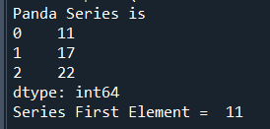
Pandas Series
##############################################
#Create a simple Pandas Series from a list:
import pandas as pd
a = [11, 17, 22]
print("Panda Series is ")
myvar = pd.Series(a)
print(myvar)
###################################################
# Return the first value of the Series:
print("Series First Element = ", myvar[0])
###################################################

Slide 124
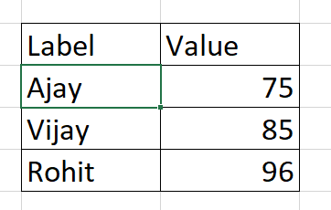
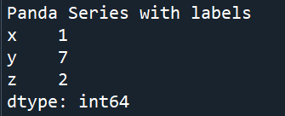
Pandas Series
Labels
If nothing else is specified, the values are labeled with their index number.
With the index argument, you can name your own labels.
###################################################
# Create your own labels:
import pandas as pd
a = [1, 7, 2]
print("POanda Series with labels")
myvar = pd.Series(a, index = ["x", "y", "z"])
print(myvar)

Slide 125
Pandas Series
import pandas as pd
a = [1, 7, 2]
print("Panda Series with labels")
myvar = pd.Series(a, index = ["x", "y", "z"])
print(myvar)
###################################################
# Return the value of "y":
print(myvar["y"])
###################################################

Slide 126
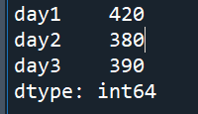
Pandas Series
###################################################
# Create a simple Pandas Series from a dictionary:
import pandas as pd
calories = {"day1": 420, "day2": 380, "day3": 390}
myvar = pd.Series(calories)
print(myvar)
###################################################

Slide 127
Pandas DataFrames
DataFrames
Data sets in Pandas are usually multi-dimensional tables, called DataFrames.
Series is like a column, a DataFrame is the whole table.

Slide 128
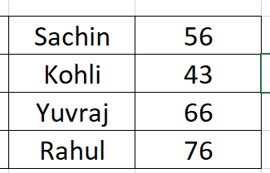
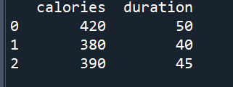
Pandas DataFrames
########################################
# Create a DataFrame from two Series:
import pandas as pd
data = {
"calories": [420, 380, 390],
"duration": [50, 40, 45]
}
#load data into a DataFrame object:
df = pd.DataFrame(data)
print(df)

Slide 129
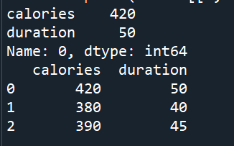
Pandas DataFrames
################################
# Pandas use the loc attribute
# to return one or more specified row(s)
# Return row 0:
#refer to the row index:
print(df.loc[0])
###############################
#use a list of indexes:
print(df.loc[[0, 1,2]])

Slide 130
Read CSV Files
Read CSV Files
A simple way to store big data sets is to use CSV files (comma separated files).
CSV files contains plain text and is a well know format that can be read by everyone including Pandas.
In our examples we will be using a CSV file called 'data.csv'.
#https://www.w3schools.com/python/pandas/pandas_csv.asp
# Click on link
# Download data.csv

Slide 131
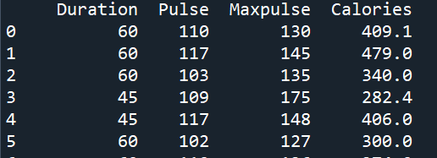
Read CSV Files
########################################
#https://www.w3schools.com/python/pandas/pandas_csv.asp
# Click on link
# Download data.csv
# Load the CSV into a DataFrame:
#######################################
import pandas as pd
df = pd.read_csv('data.csv')
print(df.to_string())
# only first and last 5 rows
df = pd.read_csv('data.csv')
print(df)

Slide 132

Pandas DataFrames
########################################
# Check the number of maximum returned rows:
# In my system the number is 60, which means that if the DataFrame contains more than 60 rows, the print(df) statement will return only the headers and the first and last 5 rows.
# You can change the maximum rows number with the same statement.
import pandas as pd
print(pd.options.display.max_rows)

Slide 133

Pandas DataFrames
########################################
# Increase the maximum number of rows to display the entire DataFrame:
import pandas as pd
pd.options.display.max_rows = 9999
df = pd.read_csv('data.csv')
print(pd.options.display.max_rows)

Slide 134
Pandas DataFrames
Read JSON
Big data sets are often stored, or extracted as JSON.
JSON is plain text, but has the format of an object, and is well known in the world of programming, including Pandas.
In our examples we will be using a JSON file called 'data.json'.
Open https://www.w3schools.com/python/pandas/data.js
Donwload and save it as jason file

Slide 135
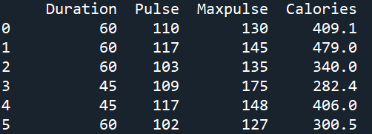
Pandas DataFrames
########################################
# Load the JSON file into a DataFrame:
import pandas as pd
df = pd.read_json('data.json')
print(df.to_string())

Slide 136
Pandas DataFrames
########################################
# JSON objects have the same format as Python dictionaries.
# If your JSON code is not in a file, but in a Python Dictionary, you can load it into a DataFrame directly:

Slide 137
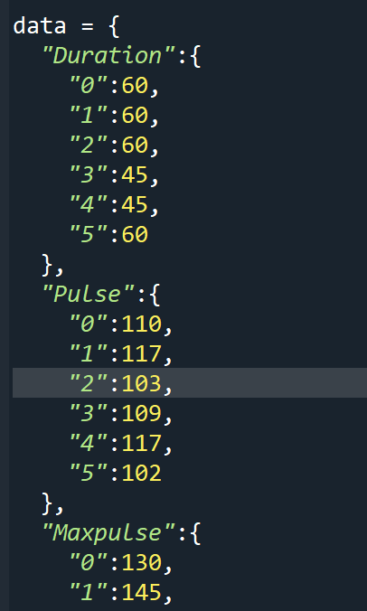

Slide 138
data = {
"Duration":{
"0":60,
"1":60,
"2":60,
"3":45,
"4":45,
"5":60
},
"Pulse":{
"0":110,
"1":117,
"2":103,
"3":109,
"4":117,
"5":102
},
"Maxpulse":{
"0":130,
"1":145,
"2":135,
"3":175,
"4":148,
"5":127
},
"Calories":{
"0":409,
"1":479,
"2":340,
"3":282,
"4":406,
"5":300
}
}
df = pd.DataFrame(data)
print(df)

Slide 139
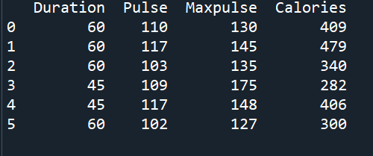
Pandas DataFrames from dictionary
df = pd.DataFrame(data)
print(df)

Slide 140
Pandas - Analyzing DataFrames
Viewing the Data : head() and tail() methods
One of the most used method for getting a quick overview of the DataFrame, is the head() method.
The head() method returns the headers and a specified number of rows, starting from the top.

Slide 141
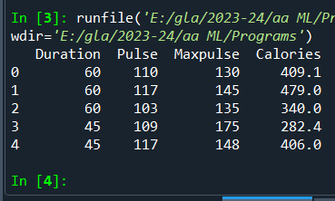
Analyzing DataFrames : df.head()
##############################################
# Print the first 5 rows of the DataFrame:
import pandas as pd
df = pd.read_csv('data.csv')
print(df.head())
##############################################
.

Slide 142
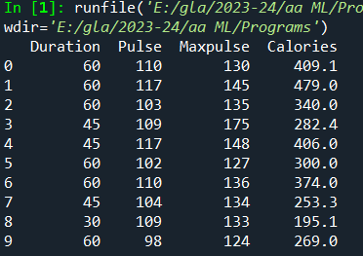
Analyzing DataFrames
##############################################
# printing the first 10 rows of the DataFrame:
import pandas as pd
df = pd.read_csv('data.csv')
print(df.head(10))
##############################################
.

Slide 143
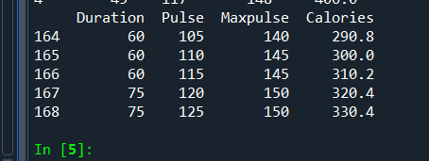
Analyzing DataFrames : df.tail()
There is also a tail() method for viewing the last rows of the DataFrame.
The tail() method returns the headers and a specified number of rows, starting from the bottom.
#Print the last 5 rows of the DataFrame:
print(df.tail())

Slide 144
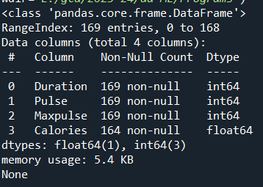
Info About the Data : info()
# The DataFrames object has a method called info(), that gives you more information about the data set.
# Print information about the data:
import pandas as pd
df = pd.read_csv('data.csv')
print(df.info())

Slide 145

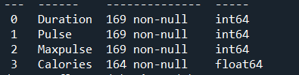
Analyzing DataFrames
Result Explained
The result tells us there are 169 rows and 4 columns:
And the name of each column,
with the data type:
.

Slide 146
Analyzing DataFrames : Null Values
Null Values
The info() method also tells us how many Non-Null values there are present in each column, and in our data set it seems like there are 164 of 169 Non-Null values in the "Calories" column.
Which means that there are 5 rows with no value at all, in the "Calories" column, for whatever reason.
Empty values, or Null values, can be bad when analyzing data, and you should consider removing rows with empty values. This is a step towards what is called cleaning data, and you will learn more about that in the next chapters.
.

Slide 147
END

