Slide 1

BCAC 0017 FUNDAMENTALS OF MACHINE LEARNING
Section 2 : Python for Data Science
Faculty Name
Mr. Sachin Sharma, Dr. Vinod Jain, Dr. Manu Banga,
Ms.Paromita Goswami, Ms.Chestha Bhardwaj, Mr. Atul Anand

Slide 2
Section 2 : Python for Data Science
Python for Data Science
-Numpy, Pandas for preprocessing, Matplotlib and Jupyter Notebook.

Slide 3
Section 2 : Python for Data Science
Python List
Tuple
Dictionary
Numpy
Pandas
Mat Plot Lib

Slide 4
Matplotlib in Python
What is Matplotlib?
Matplotlib is a low level graph plotting library in python that serves as a visualization utility.
Matplotlib was created by John D. Hunter.
Matplotlib is open source and we can use it freely.
Matplotlib is mostly written in python, a few segments are written in C, Objective-C and Javascript for Platform compatibility.

Slide 5
Matplotlib in Python
Where is the Matplotlib Codebase?
The source code for Matplotlib is located at this github repository https://github.com/matplotlib/matplotlib

Slide 6
Pyplot in Matplotlib
Pyplot
Most of the Matplotlib utilities lies under the pyplot submodule, and are usually imported under the plt alias:
import matplotlib.pyplot as plt
Now the Pyplot package can be referred to as plt.

Slide 7
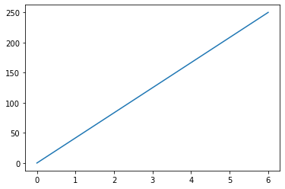
Matplotlib in Python - Line Graphs

Slide 8
Matplotlib in Python
#Draw a line in a diagram from position (0,0) to position (6,250):
import matplotlib.pyplot as plt
import numpy as np
xpoints = np.array([0, 6])
ypoints = np.array([0, 250])
plt.plot(xpoints, ypoints)
plt.show()

Slide 9
Matplotlib in Python
Matplotlib Plotting
Plotting x and y points
The plot() function is used to draw points (markers) in a diagram.
By default, the plot() function draws a line from point to point.
The function takes parameters for specifying points in the diagram.
Parameter 1 is an array containing the points on the x-axis.
Parameter 2 is an array containing the points on the y-axis.
If we need to plot a line from (1, 3) to (8, 10), we have to pass two arrays [1, 8] and [3, 10] to the plot function.

Slide 10
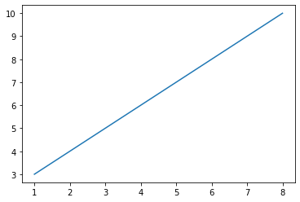
Matplotlib in Python
##############################################
# Draw a line in a diagram from position (1, 3) to position (8, 10):
import matplotlib.pyplot as plt
import numpy as np
xpoints = np.array([1, 8])
ypoints = np.array([3, 10])
plt.plot(xpoints, ypoints)
plt.show()

Slide 11
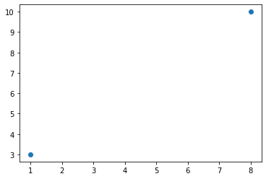
Matplotlib in Python
##############################################
# Draw two points in the diagram,
one at position (1, 3) and one in position (8, 10):
import matplotlib.pyplot as plt
import numpy as np
xpoints = np.array([1, 8])
ypoints = np.array([3, 10])
plt.plot(xpoints, ypoints, 'o')
plt.show()

Slide 12
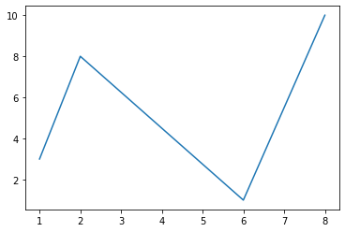
Matplotlib in Python
##############################################
# Draw a line in a diagram from position
# (1, 3) to (2, 8) then to (6, 1) and finally to position (8, 10):
import matplotlib.pyplot as plt
import numpy as np
xpoints = np.array([1, 2, 6, 8])
ypoints = np.array([3, 8, 1, 10])
plt.plot(xpoints, ypoints)
plt.show()

Slide 13
Matplotlib in Python
Default X-Points
If we do not specify the points on the x-axis, they will get the default values 0, 1, 2, 3 (etc., depending on the length of the y-points.
So, if we take the same example as above, and leave out the x-points, the diagram will look like this:

Slide 14
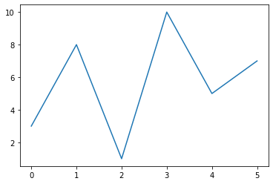
Matplotlib in Python
# Plotting without x-points:
import matplotlib.pyplot as plt
import numpy as np
ypoints = np.array([3, 8, 1, 10, 5, 7])
plt.plot(ypoints)
plt.show()

Slide 15
Matplotlib in Python
Markers
You can use the keyword argument marker to emphasize each point with a specified marker:

Slide 16
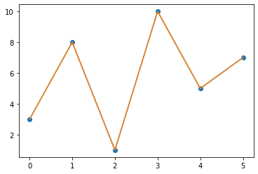
Matplotlib in Python
##############################################
# Plotting without x-points:
import matplotlib.pyplot as plt
import numpy as np
ypoints = np.array([3, 8, 1, 10, 5, 7])
plt.plot(ypoints, marker = 'o')
plt.plot(ypoints)
plt.show()

Slide 17
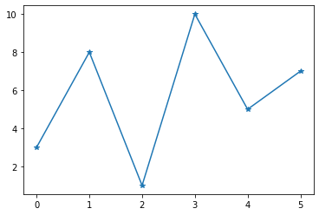
Matplotlib in Python
plt.plot(ypoints, marker = '*')

Slide 18
Matplotlib in Python
Marker Reference
You can choose any of these markers
Marker | Circle
'o' | Star
'*' | Point
'.' | Pixel
',' | X
'x' | X (filled)
'X' | Plus
'+' | Plus (filled)

Slide 19
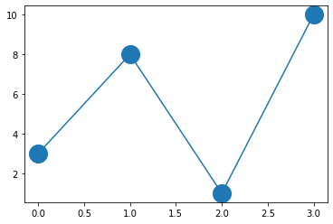
Marker Size
You can use the keyword argument markersize or the shorter version, ms to set the size of the markers:
Set the size of the markers to 20:
#############################
import matplotlib.pyplot as plt
import numpy as np
ypoints = np.array([3, 8, 1, 10])
plt.plot(ypoints, marker = 'o', ms = 20)
plt.show()
#############################

Slide 20
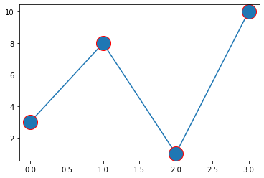
Matplotlib in Python : Marker Color
# Marker Color : Marker edge color mec
# Marker Color : markerfacecolor mfc
ypoints = np.array([3, 8, 1, 10])
plt.plot(ypoints, marker = 'o', ms = 20, mec = 'r')
plt.show()

Slide 21
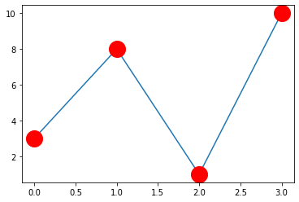
Matplotlib in Python : Marker Color
# Marker Color : Marker edge color mec
# Marker Color : markerfacecolor mfc
ypoints = np.array([3, 8, 1, 10])
plt.plot(ypoints, marker = 'o', ms = 20, mec = 'r', mfc = 'r')
plt.show()

Slide 22
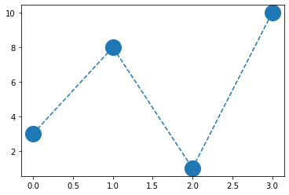
Matplotlib in Python :Linestyle
# Linestyle
# You can use the keyword argument linestyle,
or shorter ls,
to change the style of the plotted line:
# Use a dashed line:
ypoints = np.array([3, 8, 1, 10])
plt.plot(ypoints, marker = 'o', ms = 20,linestyle = 'dashed')
plt.show()

Slide 23
Matplotlib in Python : Linestyle
Shorter Syntax
The line style can be written in a shorter syntax:
linestyle can be written as ls.
dotted can be written as :.
dashed can be written as --.
ypoints = np.array([3, 8, 1, 10])
plt.plot(ypoints, marker = 'o',ms = 20,ls = ‘--')
plt.show()

Slide 24
Matplotlib in Python :Line Color
# Line Color
# You can use the keyword argument color or the shorter c to set the color of the line:
# Example
# Set the line color to red:
Eg.
plt.plot(ypoints, marker = 'o', ms = 20,linestyle = 'dashed', color = 'b')

Slide 25
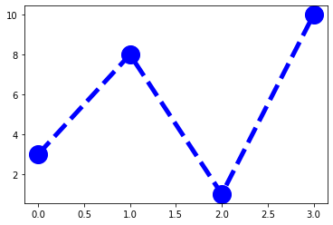
Matplotlib in Python :Line Width
Line Width
You can use the keyword argument linewidth
or the shorter lw to change the width of the line.
The value is a floating number, in points:
ypoints = np.array([3, 8, 1, 10])
plt.plot(ypoints,
marker = 'o', ms = 20,linestyle = 'dashed', color = 'b',linewidth = '5')
plt.show()

Slide 26
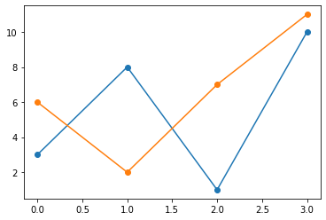
Matplotlib in Python :Multiple Lines
Multiple Lines
You can plot as many lines as you like by simply adding more plt.plot() functions:
Example : Draw two lines by specifying a plt.plot() function for each line:
y1 = np.array([3, 8, 1, 10])
y2 = np.array([6, 2, 7, 11])
plt.plot(y1,marker = 'o')
plt.plot(y2,marker = 'o')

Slide 27
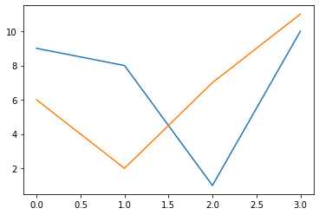
Matplotlib in Python :Multiple Lines
Draw two lines by specifiyng the x- and y-point values for both lines:
x1 = np.array([0, 1, 2, 3])
y1 = np.array([9, 8, 1, 10])
x2 = np.array([0, 1, 2, 3])
y2 = np.array([6, 2, 7, 11])
plt.plot(x1, y1, x2, y2)
plt.show()

Slide 28
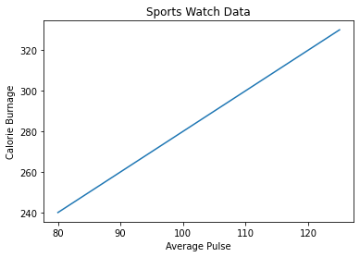
Matplotlib Labels and Title

Slide 29
Matplotlib Labels and Title
Labels and Title
With Pyplot, you can use the xlabel() and ylabel() functions to set a label for the x- and y-axis.
Create a Title for a Plot
With Pyplot, you can use the title() function to set a title for the plot.
Add a plot title and labels for the x- and y-axis:

Slide 30
Matplotlib Labels and Title
import numpy as np
import matplotlib.pyplot as plt
x = np.array([80, 85, 90, 95, 100, 105, 110, 115, 120, 125])
y = np.array([240, 250, 260, 270, 280, 290, 300, 310, 320, 330])
plt.plot(x, y)
plt.title("Sports Watch Data")
plt.xlabel("Average Pulse")
plt.ylabel("Calorie Burnage")
plt.show()

Slide 31

Matplotlib in Python - Grid Lines
Matplotlib Adding Grid Lines
you can use the grid() function to add grid lines to the plot.
ypoints = np.array([3, 8, 1, 10])
plt.plot(ypoints, marker = 'o', ms = 20, mec = 'r', mfc = 'r')
plt.grid()
plt.show()

Slide 32
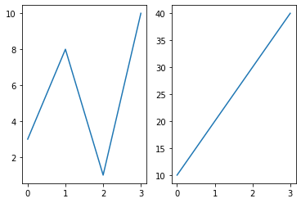
Matplotlib Subplot

Slide 33
Matplotlib Subplot
Matplotlib Subplot
Display Multiple Plots
With the subplot() function you can draw multiple plots in one figure:

Slide 34
Matplotlib Subplot
The subplot() Function
The subplot() function takes three arguments that describes the layout of the figure.
The layout is organized in rows and columns, which are represented by the first and second argument.
The third argument represents the index of the current plot.
plt.subplot(1, 2, 1)
#the figure has 1 row, 2 columns, and this plot is the first plot.
plt.subplot(1, 2, 2)
#the figure has 1 row, 2 columns, and this plot is the second plot.

Slide 35
Matplotlib Subplot
The subplot() Function
plt.subplot(1, 2, 2)
#the figure has 1 row, 2 columns, and this plot is the second plot.

Slide 36
Matplotlib Subplot
# Draw 2 plots:
import matplotlib.pyplot as plt
import numpy as np
#plot 1:
x = np.array([0, 1, 2, 3])
y = np.array([3, 8, 1, 10])
plt.subplot(1, 2, 1)
plt.plot(x,y)
#plot 2:
x = np.array([0, 1, 2, 3])
y = np.array([10, 20, 30, 40])
plt.subplot(1, 2, 2)
plt.plot(x,y)
plt.show()

Slide 37
Matplotlib Subplot

Slide 38
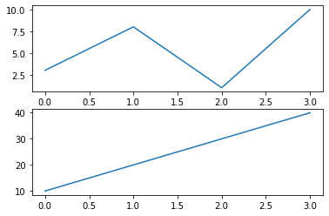
Matplotlib Subplot
# Draw 2 plots on top of each other:
import matplotlib.pyplot as plt
import numpy as np
#plot 1:
x = np.array([0, 1, 2, 3])
y = np.array([3, 8, 1, 10])
plt.subplot(2, 1, 1)
plt.plot(x,y)
#plot 2:
x = np.array([0, 1, 2, 3])
y = np.array([10, 20, 30, 40])
plt.subplot(2, 1, 2)
plt.plot(x,y)
plt.show()

Slide 39
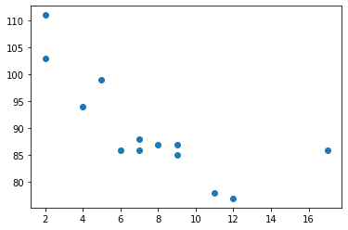
Matplotlib in Python - Scatter Plots

Slide 40
Matplotlib in Python - Scatter Plots
Creating Scatter Plots
With Pyplot, you can use the scatter() function to draw a scatter plot.
The scatter() function plots one dot for each observation.
It needs two arrays of the same length, one for the values of the x-axis, and one for values on the y-axis:

Slide 41
Matplotlib in Python - Scatter Plots
import matplotlib.pyplot as plt
import numpy as np
x = np.array([5,7,8,7,2,17,2,9,4,11,12,9,6])
y = np.array([99,86,87,88,111,86,103,87,94,78,77,85,86])
plt.scatter(x, y)
plt.show()

Slide 42
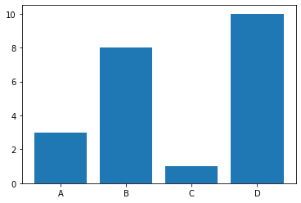
Matplotlib Bar Graphs

Slide 43
Matplotlib Bar Graphs
Matplotlib Bars
Creating Bars
With Pyplot, you can use the bar() function to draw bar graphs:
Draw 4 bars:

Slide 44
Matplotlib Bar Graphs
# Draw 4 bars:
import matplotlib.pyplot as plt
import numpy as np
x = np.array(["A", "B", "C", "D"])
y = np.array([3, 8, 1, 10])
plt.bar(x,y)
plt.show()

Slide 45
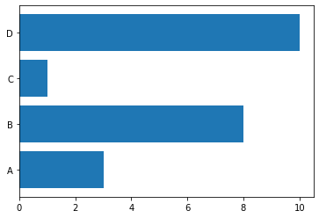
Matplotlib Bar Graphs - barh() function
# Horizontal Bars
# If you want the bars to be displayed horizontally instead of vertically,
# use the barh() function:
x = np.array(["A", "B", "C", "D"])
y = np.array([3, 8, 1, 10])
plt.barh(x, y)
plt.show()

Slide 46
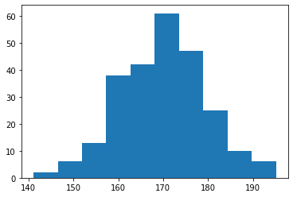
# Matplotlib Histograms

Slide 47
Matplotlib Histograms
Matplotlib Histograms
Histogram
A histogram is a graph showing frequency distributions.
It is a graph showing the number of observations within each given interval.

Slide 48
Matplotlib Histograms
Example: Say you ask for the height of 250 people,
you might end up with a histogram like this:
You can read from the histogram that there are approximately:
2 people from 140 to 145cm
5 people from 145 to 150cm
15 people from 151 to 156cm
31 people from 157 to 162cm
46 people from 163 to 168cm
53 people from 168 to 173cm
45 people from 173 to 178cm
28 people from 179 to 184cm
21 people from 185 to 190cm
4 people from 190 to 195cm

Slide 49
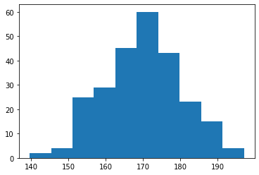
Matplotlib Histograms
##############################################
# A simple histogram:
import matplotlib.pyplot as plt
import numpy as np
# A Normal Data Distribution by NumPy:
x = np.random.normal(170, 10, 250)
plt.hist(x)
plt.show()
##############################################

Slide 50
References
https://www.w3schools.com/python/pandas/pandas_intro.asp
https://www.w3schools.com/python/matplotlib_pyplot.asp
https://www.w3schools.com/python/matplotlib_intro.asp

