Slide 1

BCAC 0017 FUNDAMENTALS OF MACHINE LEARNING
Section 3 : Data Preprocessing
Faculty Name
Mr. Sachin Sharma, Dr. Vinod Jain, Dr. Manu Banga,
Ms.Paromita Goswami, Ms.Chestha Bhardwaj

Slide 2
Section 3 : Data Preprocessing
Data Preprocessing-
Importing the Libraries, Importing the dataset, data imputation, Encoding Categorical Data, Splitting the dataset into Training and Test set, Feature Scaling.

Slide 3
Section 3 : Data Preprocessing
3.0 Data Preprocessing-
3.1 Importing the Libraries
3.2 Importing the dataset
3.3 data imputation
3.4 Encoding Categorical Data
3.5 Splitting the dataset into Training and Test set
3.6 Feature Scaling.

Slide 4
Section 3 : Data Preprocessing
Pre-processing simply refers to perform series of operations to transform or change data.
It is transformation applied to our data before feeding it to algorithm.
Data processing refers to perform operations on data to retrieve, transform, or change data, especially by computer.
It is technique that is used to convert raw data into clean data set.

Slide 5
Section 3 : Data Preprocessing
Need for Data Preprocessing :
It transforms raw data into meaningful information.
New technologies like ML (Machine Learning) is highly dependent upon data. So data has to be presented in way or format that makes it easier for the technologies to understand it.
It is simply used for achieving better results from applying model.
Some specified ML model needs specified format.
For example, Random forest algorithm doesn’t support NULL value. Therefore, to execute random forest algorithm, NULL values have to be managed from raw data set.

Slide 6
Section 3 : Data Preprocessing
Need for Data Preprocessing :
The dataset should be formatted in such way that more than one ML and deep algorithm are executed in one dataset and then best out of them is selected.
It increases accuracy and efficiency of an ML model as data pre-processing require tasks for cleaning data and to make it suitable for ML model.

Slide 7
Section 3 : Data Preprocessing
Steps in data pre processing
3.1 Importing the Libraries
3.2 Importing the dataset
3.3 data imputation
3.4 Encoding Categorical Data
3.5 Splitting the dataset into Training and Test set
3.6 Feature Scaling.

Slide 8
Section 3 : Data Preprocessing
It includes Data Cleaning
Data cleaning means fixing bad data in your data set.
Bad data could be:
Empty cells
Data in wrong format
Wrong data
Duplicates

Slide 9
References
https://www.javatpoint.com/data-preprocessing-machine-learning
https://www.upgrad.com/blog/data-preprocessing-in-machine-learning/
https://www.geeksforgeeks.org/data-preprocessing-and-its-types/

Slide 10
3.1 Importing the Libraries
Numpy
Pandas
Matplotlib

Slide 11
3.1 Importing the Libraries
In order to perform data preprocessing using Python, we need to import some predefined Python libraries.
These libraries are used to perform some specific jobs.
There are three specific libraries that we will use for data preprocessing, which are:
Numpy
Pandas
Matplotlib

Slide 12
3.1 Importing the Libraries
Numpy: Numpy Python library is used for including any type of mathematical operation in the code. It is the fundamental package for scientific calculation in Python. It also supports to add large, multidimensional arrays and matrices.
Matplotlib: The second library is matplotlib, which is a Python 2D plotting library, and with this library, we need to import a sub-library pyplot. This library is used to plot any type of charts in Python for the code.
Pandas: The last library is the Pandas library, which is one of the most famous Python libraries and used for importing and managing the datasets. It is an open-source data manipulation and analysis library.

Slide 13
References
https://www.javatpoint.com/data-preprocessing-machine-learning

Slide 14
3.2 Importing the dataset
We need to import the datasets which we have collected for our machine learning project.
But before importing a dataset, we need to set the current directory as a working directory.
To set a working directory in Spyder IDE, we need to follow the below steps:
Save your Python file in the directory which contains dataset.
Go to File explorer option in Spyder IDE, and select the required directory.
Click on F5 button or run option to execute the file.

Slide 15
3.2 Importing the dataset
Note: We can set any directory as a working directory, but it must contain the required dataset.
Here, in the below image, we can see the Python file along with required dataset. Now, the current folder is set as a working directory.

Slide 16
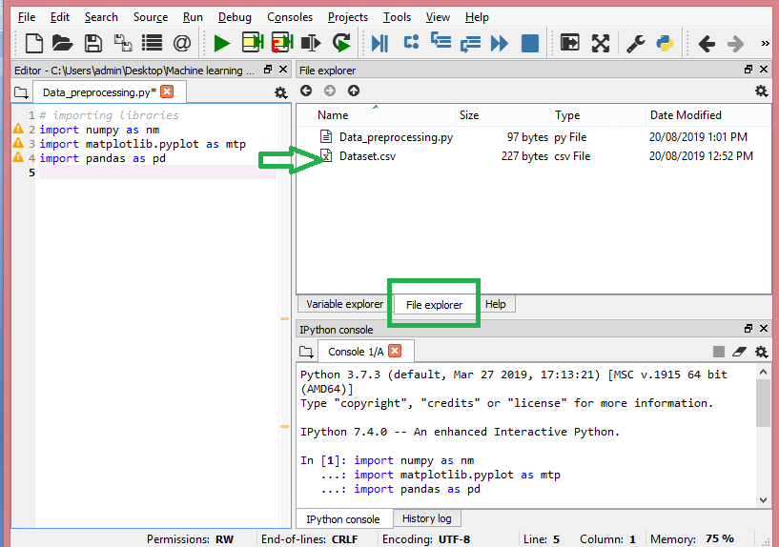

Slide 17
3.2 Importing the dataset - read_csv() function:
read_csv() function:
Now to import the dataset, we will use read_csv() function of pandas library, which is used to read a csv file.
data_set= pd.read_csv('Dataset.csv')
Here, data_set is a name of the variable to store our dataset, and inside the function, we have passed the name of our dataset.
We can also check the imported dataset by clicking on the section variable explorer, and then double click on data_set. Consider the below image:

Slide 18
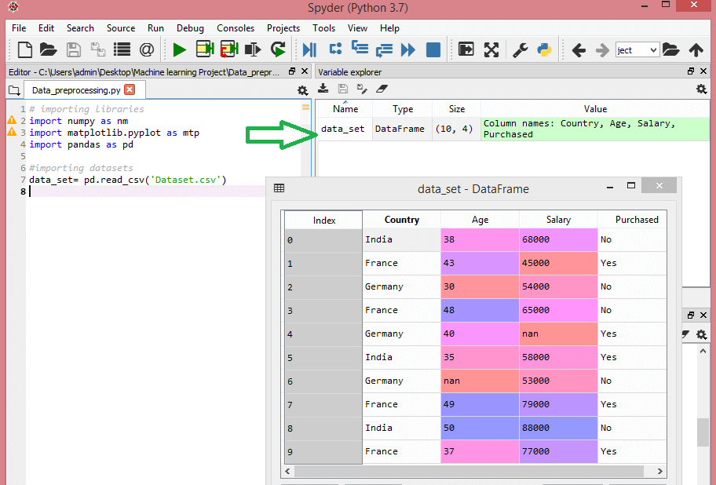

Slide 19
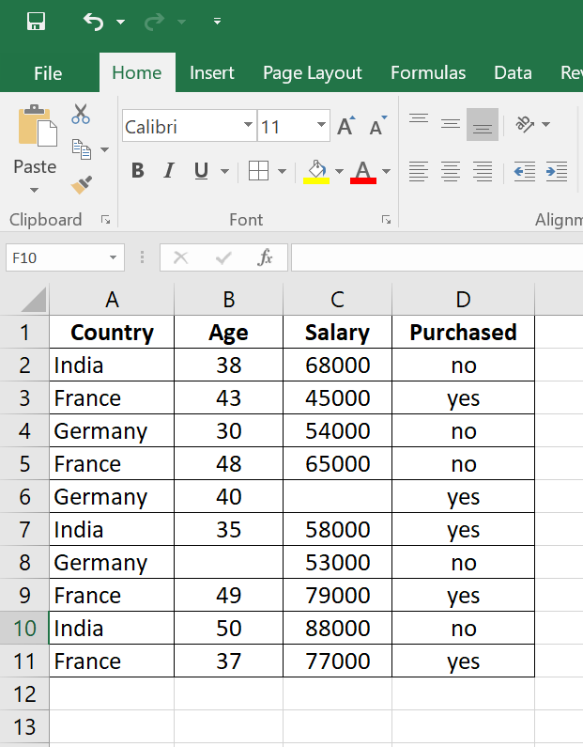
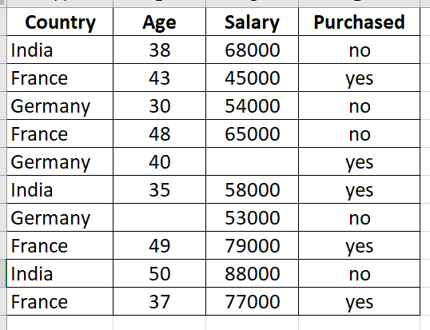

Slide 20
dependent and independent variables:
dependent and independent variables:
Independent variables:
Variable that is not dependent on other variables are known as Independent Variable.
It can be manipulated.
Dependent variables:
Variable that depends on another variable (mostly independent variable) are known as Dependent Variable.
It is observed or measured.

Slide 21
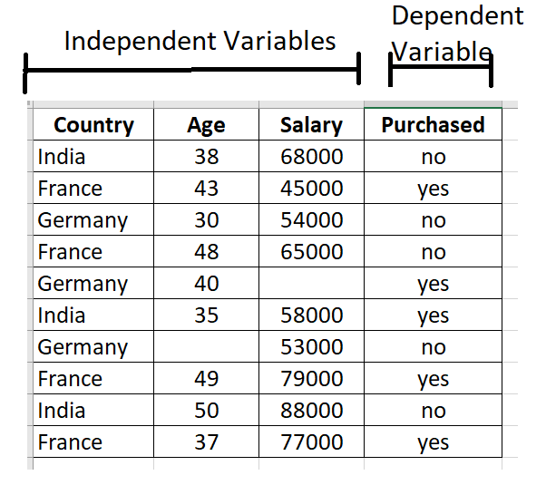

Slide 22
Extracting independent variable:
Extracting dependent and independent variables:
In machine learning, it is important to distinguish the matrix of features (independent variables) and dependent variables from dataset.
In our dataset, there are three independent variables that are Country, Age, and Salary, and one is a dependent variable which is Purchased.

Slide 23
Extracting independent variable:
Extracting independent variable:
To extract an independent variable, we will use iloc[ ] method of Pandas library.
Python iloc() function
The iloc() function is an indexed-based selecting method which means that we have to pass an integer index in the method to select a specific row/column.
This method does not include the last element of the range passed in it unlike loc().

Slide 24
Extracting independent variable:
Extracting independent variable:
To extract an independent variable, we will use iloc[ ] method of Pandas library. It is used to extract the required rows and columns from the dataset.
x= data_set.iloc[:,:-1].values
In the above code, the first colon(:) is used to take all the rows, and the second colon(:) is for all the columns.
Here we have used :-1, because we don't want to take the last column as it contains the dependent variable.

Slide 25
By executing the above code, we will get output as:
[['India' 38.0 68000.0]
['France' 43.0 45000.0]
['Germany' 30.0 54000.0]
['France' 48.0 65000.0]
['Germany' 40.0 nan]
['India' 35.0 58000.0]
['Germany' nan 53000.0]
['France' 49.0 79000.0]
['India' 50.0 88000.0]
['France' 37.0 77000.0]]

Slide 26
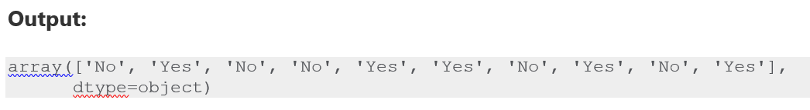
Extracting dependent variable:
To extract dependent variables, agan, we will use Pandas .iloc[] method.
y= data_set.iloc[:,3].values
Here we have taken all the rows with the last column only. It will give the array of dependent variables.

Slide 27
References
https://www.javatpoint.com/data-preprocessing-machine-learning
https://www.upgrad.com/blog/data-preprocessing-in-machine-learning/
https://www.geeksforgeeks.org/data-preprocessing-and-its-types/

Slide 28
3.3 data imputation
Imputation in statistics refers to the procedure of using alternative values in place of missing data.

Slide 29
Importance of Data Imputation
Distorts Dataset: Large amounts of missing data can lead to anomalies in the dataset.
Mistakes may occur because there is no automatic handling of these missing data.
Impacts on the Final Model: Missing data may lead to bias in the dataset, which could affect the final model's analysis.
Desire to restore the entire dataset: This typically occurs when we don't want to lose any (or any more) of the data in our dataset because all of it is crucial.
Additionally, while the dataset is not very large, eliminating a portion of it could have a substantial effect on the final model.

Slide 30
Data Imputation Techniques
Next or Previous Value
K Nearest Neighbors
Maximum or Minimum Value
Missing Value Prediction
Most Frequent Value
Average or Linear Interpolation
(Rounded) Mean or Moving Average or Median Value
Fixed Value

Slide 31
3.3 data imputation
Basically, there are two ways to handle missing data:
Deleting a particular row
Filling the missing data by values (mean/median/mode etc)

Slide 32
3.3 data imputation
Deleting a particular row –
In this method, you remove a specific row that has a null value for a feature or a particular column where more than 75% of the values are missing.
However, it is recommended that you use it only when the dataset has adequate samples (very large data set).

Slide 33
3.3 data imputation
Filling the missing data by values (mean/median/mode etc)
This method is useful for features having numeric data like age, salary, year, etc.
Here, you can calculate the mean, median, or mode of a particular feature or column or row that contains a missing value and replace the result for the missing value.
it yields better results compared to the first method (Deleting rows/cols).

Slide 34
Filling the missing data by values (mean/median/mode etc)
Measures of Central Tendency
Measure of central tendency is the representation of various values of the given data set.
There are various measures of central tendency and the most important three measures of central tendency are,
Mean (x̅ or μ)
Median(M)
Mode(Z)

Slide 35
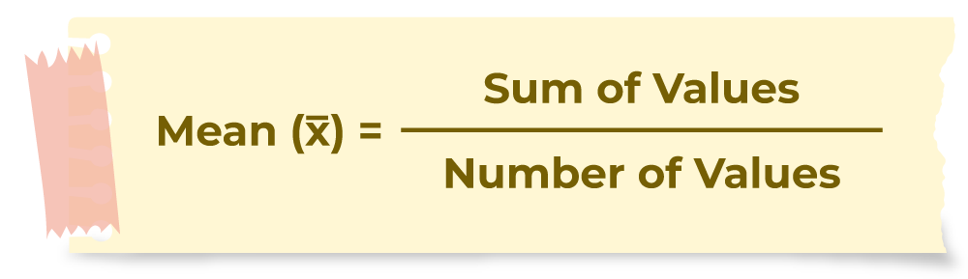
Filling the missing data by values (mean/median/mode etc)
What is Mean?
Mean is the sum of all the values in the data set divided by the number of values in the data set. It is also called the Arithmetic Average. Mean is denoted as x̅ and is read as x bar.
The formula to calculate the mean is,

Slide 36
Filling the missing data by values (mean/median/mode etc)
# Calculate the Mean
# of 'Age' column
mean = dataset['Age'].mean()
print(mean)

Slide 37
Filling the missing data by values (mean/median/mode etc)
What is Median?
A Median is a middle value for sorted data.
The sorting of the data can be done either in ascending order or descending order.
A median divides the data into two equal halves.

Slide 38
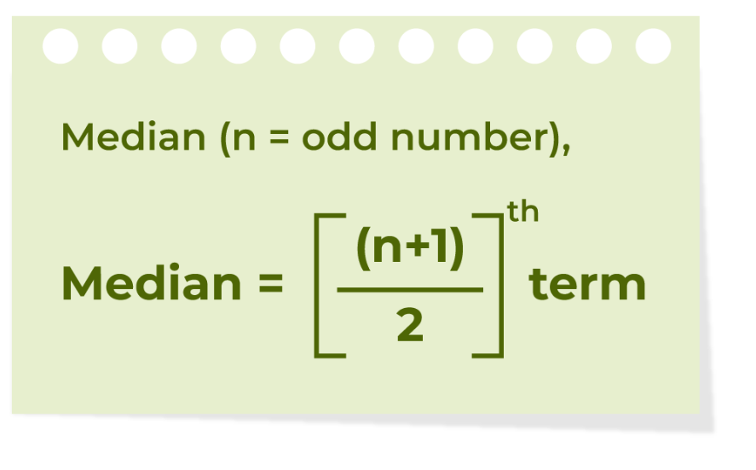
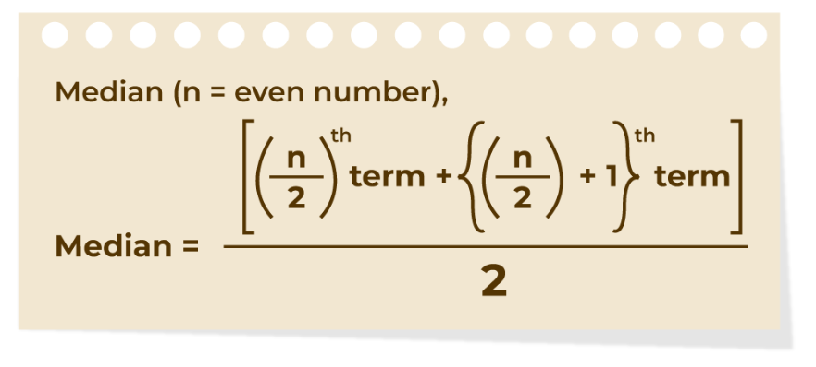
Filling the missing data by values (mean/median/mode etc)

Slide 39
Filling the missing data by values (mean/median/mode etc)
Median:
Calculates the median value by using DataFrame/Series.median() method.
# Calculate Median of 'Fare' column
median = dataset['Fare'].median()
# Print median
print(median)

Slide 40
Filling the missing data by values (mean/median/mode etc)
What is Mode?
A mode is the most frequent value or item of the data set. A data set can generally have one or more than one mode value.
If the data set has one mode then it is called “Uni-modal”. Similarly, If the data set contains 2 modes then it is called “Bimodal” and if the data set contains 3 modes then it is known as “Trimodal”.
If the data set consists of more than one mode then it is known as “multi-modal”(can be bimodal or trimodal).
There is no mode for a data set if every number appears only once.

Slide 41
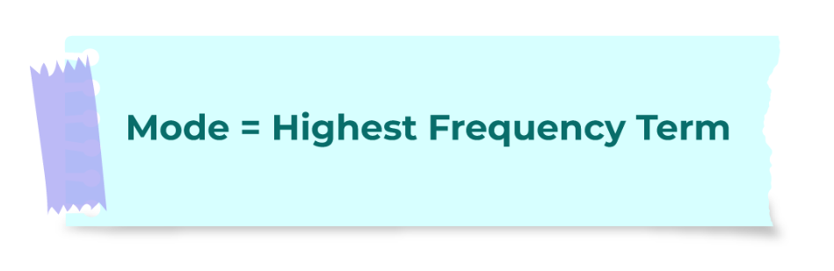
Filling the missing data by values (mean/median/mode etc)

Slide 42
Filling the missing data by values (mean/median/mode etc)
Example: Find the mode of the given data set 1, 2, 2, 2, 3, 3, 4, 5
Given set is {1, 2, 2, 2, 3, 3, 4, 5}
As the above data set is arranged in ascending order.
By observing the above data set we can say that,
Mode = 2
As, it has highest frequency (3)

Slide 43
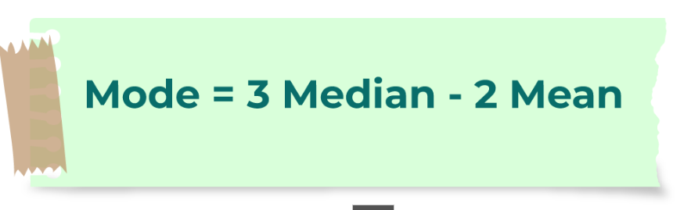
Filling the missing data by values (mean/median/mode etc)
Relation between Mean Median Mode
For any group of data, the relation between the three central tendencies mean, median, and mode is shown in the image below,

Slide 44
Filling the missing data by values (mean/median/mode etc)

Slide 45
Filling the missing data by values (mean/median/mode etc)
Country | Age | Salary | Purchased
India | 38 | 68000 | no
France | 43 | 45000 | yes
Germany | 30 | 54000 | no
France | 48 | 65000 | no
Germany | 40 |  | yes
India | 35 | 58000 | yes
Germany |  | 53000 | no
France | 49 | 79000 | yes
India | 50 | 88000 | no
France | 37 | 77000 | yes

Slide 46
###########################
# Calculating mean-median-mode
import numpy as nm
import matplotlib.pyplot as mtp
import pandas as pd
#importing datasets
data_set= pd.read_csv('Dataset-mean.csv')
print(data_set)
print()
print()
# Calculate mean of 'Age' column
mean_age = data_set['Age'].mean()
print("Mean of Age = " , mean_age)
# Calculate Median of 'Age' column
median_age = data_set['Age'].median()
print("Median of Age = " , median_age)
print()
# Calculate mode of 'Country' column
mode_Country = data_set['Country'].mode()
print("Mode of Country = " , mode_Country)
Mean of Age = 41.111111111111114
Median of Age = 40.0
Mode of Country = 0 France
Name: Country, dtype: object

Slide 47
Filling the missing data by values (mean/median/mode etc)
Country | Age | Salary | Purchased
India | 38 | 68000 | no
France | 43 | 45000 | yes
Germany | 30 | 54000 | no
France | 48 | 65000 | no
Germany | 40 |  | yes
India | 35 | 58000 | yes
Germany |  | 53000 | no
France | 49 | 79000 | yes
India | 50 | 88000 | no
France | 37 | 77000 | yes
Mean of Age = 41.111111111111114
Median of Age = 40.0
Mode of Country = 0 France
Name: Country, dtype: object

Slide 48
3.3 data imputation : Filling the missing data
Pandas treat None and NaN as essentially interchangeable for indicating missing or null values.
To facilitate this convention, there are several useful functions for detecting, removing, and replacing null values in Pandas DataFrame :
isnull()
notnull()
dropna() – Deleting
fillna() - Replacing
replace()
interpolate()

Slide 49
3.3 data imputation
fillna() method
The fillna() method replaces the NULL values with a specified value.
Syntax
dataframe.fillna(value, method, axis, inplace, limit, downcast)
The fillna() method returns a new DataFrame object
If inplace parameter is set to True, in that case the fillna() method does the replacing in the original DataFrame instead.

Slide 50
3.3 data imputation
Example :
import pandas as pd df = pd.read_csv('data.csv') newdf = df.fillna(222222)
data_set['Age'] = data_set['Age'].fillna(data_set['Age'].mean())

Slide 51
# importing libraries
import numpy as nm
import matplotlib.pyplot as mtp
import pandas as pd
#importing datasets
data_set= pd.read_csv('Dataset.csv')
print(data_set)
data_set['Age'] = data_set['Age'].fillna(data_set['Age'].mean())
# print(data_set)
data_set['Salary'] = data_set['Salary'].fillna(data_set['Salary'].mean())
print(data_set)

Slide 52
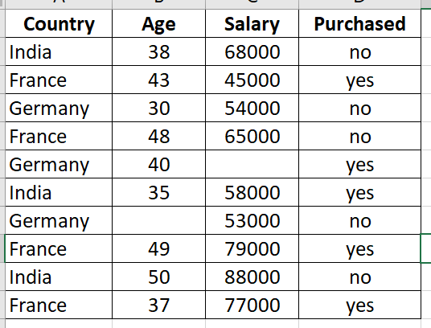
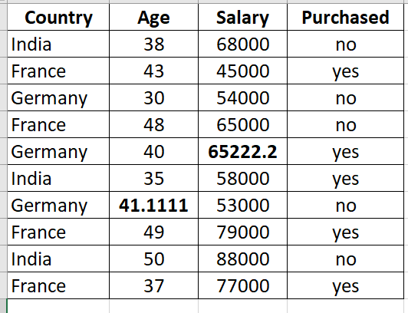
data_set['Age'] = data_set['Age'].fillna(data_set['Age'].mean())
data_set['Salary'] = data_set['Salary'].fillna(data_set['Salary'].mean())

Slide 53
References
https://www.geeksforgeeks.org/data-cleansing-introduction/
https://www.simplilearn.com/data-imputation-article

Slide 54
3.4 Encoding Categorical Data
Categorical data is data which has some categories such as, in our dataset; there are two categorical variable, Country, and Purchased.
Since machine learning model completely works on numbers
if our dataset would have a categorical variable, then it may create trouble while building the model.
So it is necessary to encode these categorical variables into numbers.

Slide 55
3.4 Encoding Categorical Data
So it is necessary to encode these categorical variables into numbers.
Some techniques are
1. Label Encoding
2. Dummy Encoding - One Hot Encoding

Slide 56
Label Encoding
For Country variable:
Firstly, we will convert the country variables into categorical data. So to do this, we will use LabelEncoder() class from preprocessing library.
Label Encoding
Label Encoding is a technique that is used to convert categorical columns into numerical ones

Slide 57
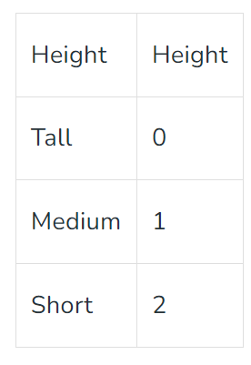
Label Encoding
After applying label encoding, the Height column is converted into a numerical column having elements 0,1, and 2 where 0 is the label for tall, 1 is the label for medium, and 2 is the label for short height.

Slide 58
Label Encoding
#for Country Variable
from sklearn.preprocessing import LabelEncoder, OneHotEncoder
label_encoder_x= LabelEncoder()
x[:, 0]= label_encoder_x.fit_transform(x[:, 0])
print(x)

Slide 59
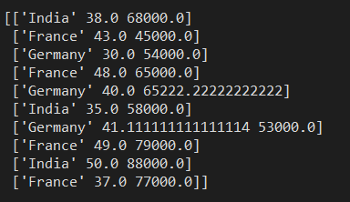
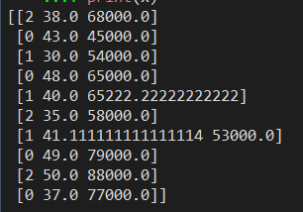
Label Encoding the Country Column
France - 0
Germany – 1
India - 2
x[:, 0]= label_encoder_x.fit_transform(x[:, 0])

Slide 60
Label Encoding
For Purchased Variable:
labelencoder_y= LabelEncoder()
y= labelencoder_y.fit_transform(y)
Orriginal y is
['no' 'yes' 'no' 'no' 'yes' 'yes' 'no' 'yes' 'no' 'yes']
After label encoding y is
[0 1 0 0 1 1 0 1 0 1]

Slide 61
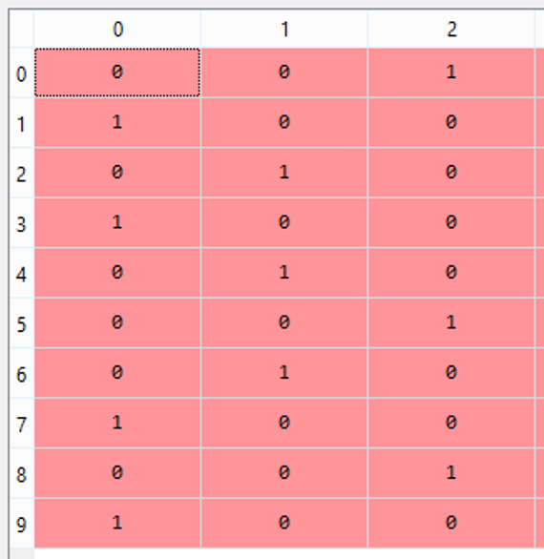
Dummy Encoding:
Dummy Variables:
Dummy variables are those variables which have values 0 or 1.
The 1 value gives the presence of that variable in a particular column, and rest variables become 0.
With dummy encoding, we will have a number of columns equal to the number of categories.

Slide 62
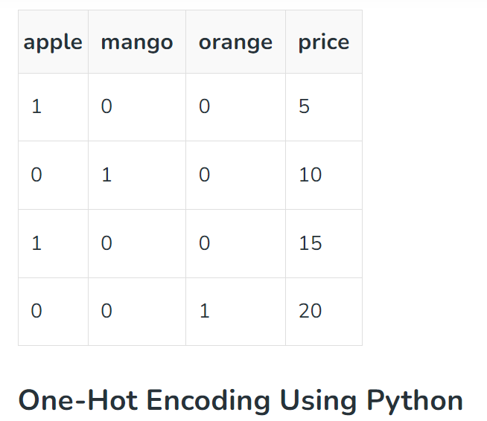
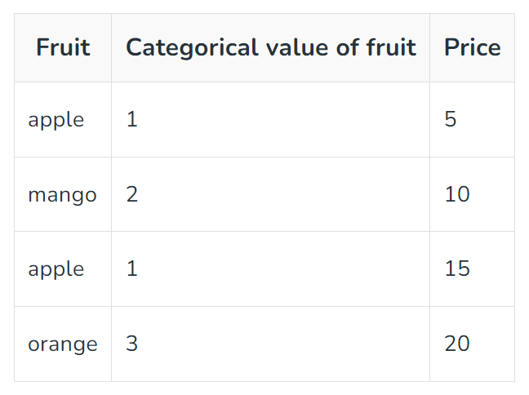
OneHotEncoder

Slide 63
Dummy Encoding:
In our dataset, we have 3 categories so it will produce three columns having 0 and 1 values.
For Dummy Encoding,
we will use OneHotEncoder class of preprocessing library.

Slide 64
Dummy Encoding:
OneHotEncoder
Study Link
https://www.geeksforgeeks.org/ml-one-hot-encoding-of-datasets-in-python/

Slide 65
OneHotEncoder
#Encoding for dummy variables
onehot_encoder= OneHotEncoder(categorical_features= [0])
x= onehot_encoder.fit_transform(x).toarray()

Slide 66
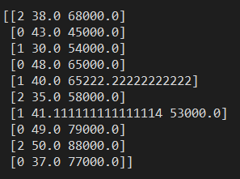

Slide 67
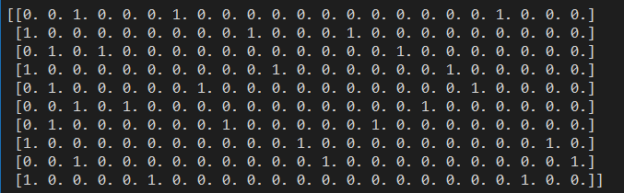
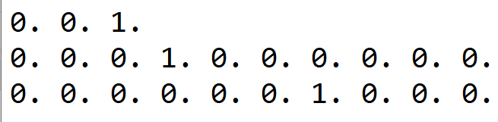
Three dummy columns for Country
Ten Dummy columns for Age
Ten Dummy columns for Salary
So three columns generates 33 dummy columns

Slide 68
Three dummy columns for Country
Ten Dummy columns for Age
Ten Dummy columns for Salary
So three columns generates 33 dummy columns

Slide 69
References
https://www.javatpoint.com/data-preprocessing-machine-learning
https://www.upgrad.com/blog/data-preprocessing-in-machine-learning/
https://www.geeksforgeeks.org/data-preprocessing-and-its-types/

Slide 70
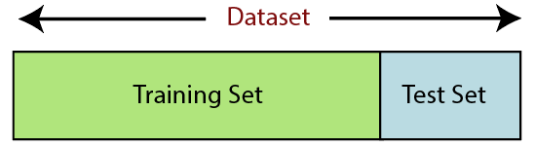
3.5 Splitting the dataset into Training and Test set
In machine learning data preprocessing, we divide our dataset into a training set and test set.
This is one of the crucial steps of data preprocessing as by doing this, we can enhance the performance of our machine learning model.

Slide 71
3.5 Splitting the dataset into Training and Test set
Training Set: A subset of dataset to train the machine learning model, and we already know the output.
Test set: A subset of dataset to test the machine learning model, and by using the test set, model predicts the output.

Slide 72
3.5 Splitting the dataset into Training and Test set
For splitting the dataset, we will use the below lines of code:
from sklearn.model_selection import train_test_split
x_train, x_test, y_train, y_test
= train_test_split(x, y, test_size= 0.2, random_state=0)

Slide 73
3.5 Splitting the dataset into Training and Test set
Explanation:
In the above code, the first line is used for splitting arrays of the dataset into random train and test subsets.
In the second line, we have used four variables for our output that are
x_train: features for the training data
x_test: features for testing data
y_train: Dependent variables for training data
y_test: Independent variable for testing data

Slide 74
3.5 Splitting the dataset into Training and Test set
In train_test_split() function, we have passed four parameters in which first two are for arrays of data, and test_size is for specifying the size of the test set. The test_size maybe .5, .3, or .2, which tells the dividing ratio of training and testing sets.
The last parameter random_state is used to set a seed for a random generator so that you always get the same result, and the most used value for this is 42.

Slide 75
# import modules
import pandas as pd
from sklearn.linear_model import LinearRegression
from sklearn.model_selection import train_test_split
# read the dataset
df = pd.read_csv('Real-estate.csv')
print(df)
print(df.head(10))

Slide 76
# get the locations
X = df.iloc[:, :-1]
y = df.iloc[:, -1]
# split the dataset
X_train, X_test, y_train, y_test = train_test_split(
X, y, test_size=0.05, random_state=0)
print()
print("X_train")
print(X_train)
print("y_train")
print(y_train)
print("X_test")
print(X_test)
print("y_test")
print(y_test)

Slide 77
# import modules
import pandas as pd
from sklearn.linear_model import LinearRegression
from sklearn.model_selection import train_test_split

Slide 78
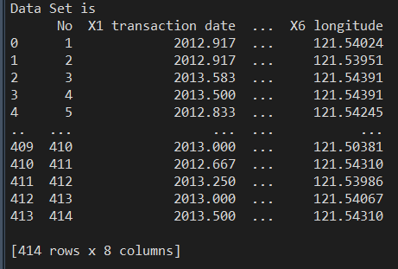
# read the dataset
df = pd.read_csv('Real-estate2.csv')
print("Data Set is ")
print(df)

Slide 79
# Extracting dependent and independent data
X = df.iloc[:, :-1]
y = df.iloc[:, -1]
# split the dataset
X_train, X_test, y_train, y_test = train_test_split(X, y, test_size=0.3, random_state=0)

Slide 80
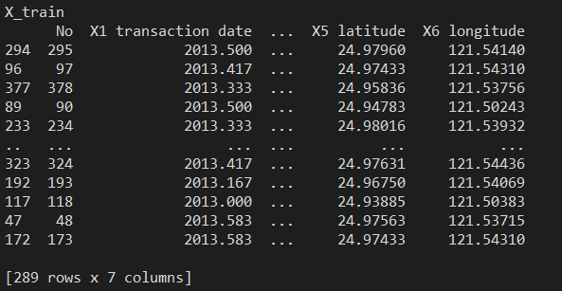
X_train, X_test, y_train, y_test = train_test_split(X, y, test_size=0.3, random_state=0)
print()
print("X_train")
print(X_train)

Slide 81
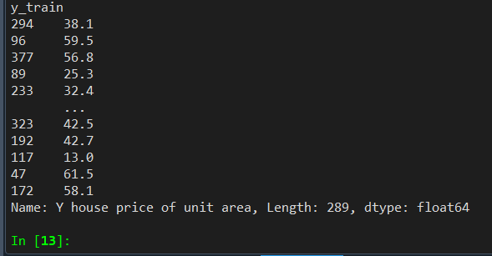
print("y_train")
print(y_train)

Slide 82
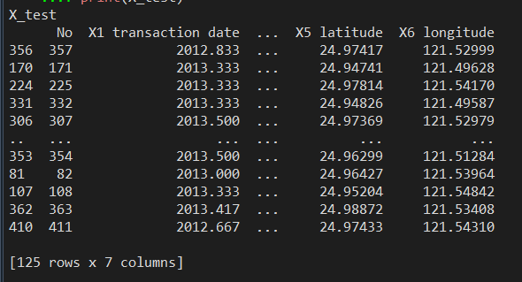
print("X_test")
print(X_test)

Slide 83
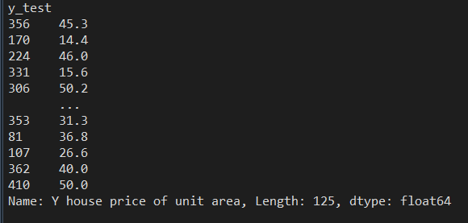
print("y_test")
print(y_test)

Slide 84
References
https://www.javatpoint.com/data-preprocessing-machine-learning
https://www.upgrad.com/blog/data-preprocessing-in-machine-learning/

Slide 85
3.6 Feature Scaling
Feature scaling is the final step of data preprocessing in machine learning.
It is a technique to standardize the independent variables of the dataset in a specific range.
In feature scaling, we put our variables in the same range and in the same scale so that no any variable dominate the other variable.

Slide 86
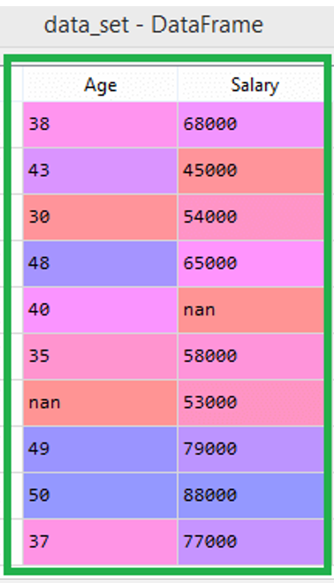
3.6 Feature Scaling.
The age and salary column values are not on the same scale.
If we compute any two values from age and salary, then salary values will dominate the age values, and it will produce an incorrect result.
So to remove this issue, we need to perform feature scaling for machine learning.
If we do not scale the variable, then it will cause some issue in our machine learning model.

Slide 87
3.6 Feature Scaling.
There are two ways to perform feature scaling in machine learning:
Standardization
Normalization

Slide 88
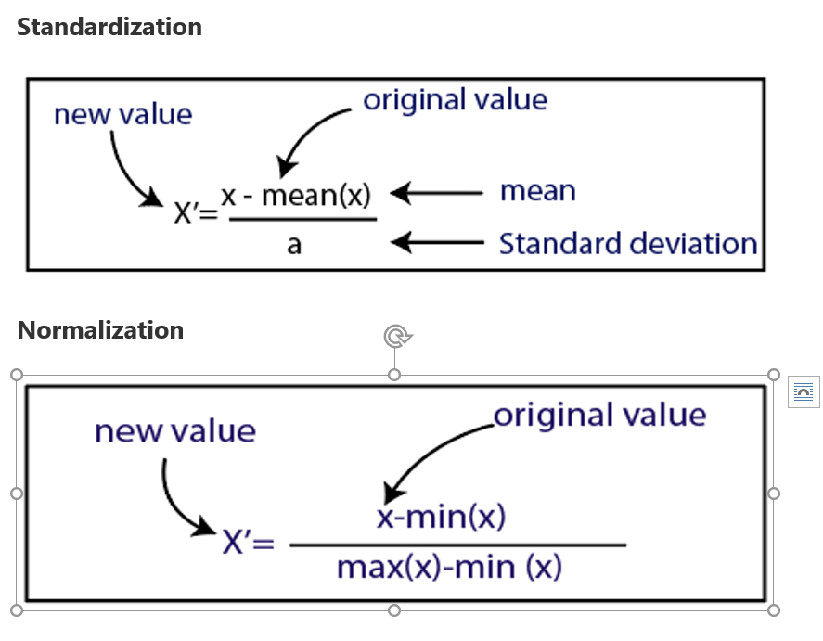

Slide 89
3.6 Feature Scaling.
Normalization or Min-Max Scaling is used to transform features to be on a similar scale.
The new point is calculated as:
X_new = (X - X_min)/(X_max - X_min)
This scales the range to [0, 1] or sometimes [-1, 1].

Slide 90
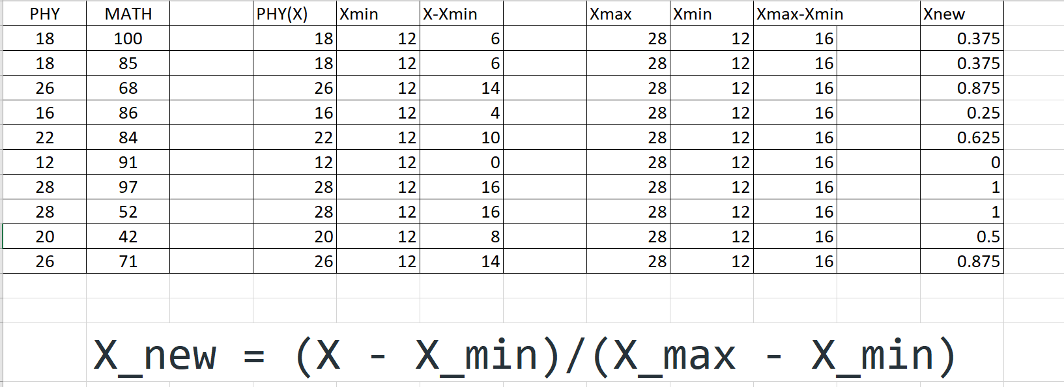

Slide 91
3.6 Feature Scaling.
Standardization or Z-Score Normalization is the transformation of features by subtracting from mean and dividing by standard deviation. This is often called as Z-score.
X_new = (X - mean)/Std
Standardization can be helpful in cases where the data follows a Gaussian distribution.

Slide 92
Difference between Normalization and Standardization

Slide 93
S.NO. | Normalization | Standardization
1. | Minimum and maximum value of features are used for scaling | Mean and standard deviation is used for scaling.
2. | It is used when features are of different scales. | It is used when we want to ensure zero mean and unit standard deviation.
3. | Scales values between [0, 1] or [-1, 1]. | It is not bounded to a certain range.
4. | It is really affected by outliers. | It is much less affected by outliers.
5. | Scikit-Learn provides a transformer called MinMaxScaler for Normalization. | Scikit-Learn provides a transformer called StandardScaler for standardization.
6. | It is useful when we don’t know about the distribution | It is useful when the feature distribution is Normal or Gaussian.
7. | It is a often called as Scaling Normalization | It is a often called as Z-Score Normalization.

Slide 94
Feature Scaling:MinMaxScaler
Data Set
PHY | MATH
18 | 98
18 | 85
26 | 68
16 | 86
22 | 84
12 | 100
28 | 97
28 | 52
20 | 42
26 | 71

Slide 95
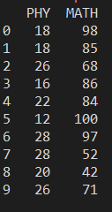
#################################
## Feature Scaling
import numpy as nm
import matplotlib.pyplot as mtp
import pandas as pd
from sklearn.preprocessing import MinMaxScaler
data = pd.read_csv('FeatureScaling1.csv')
print(data)

Slide 96
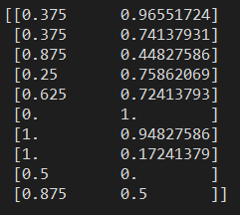
# define min max scaler
scaler = MinMaxScaler()
# transform data
scaled = scaler.fit_transform(data)
print(scaled)

Slide 97
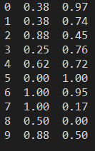
#round off every
#Convert scaled np 2d array into dataframe
scaleddf = pd.DataFrame(scaled)
#round off every item using lambda function
scaleddf[:]=scaleddf[:].apply(lambda x:round(x,2))
print(scaleddf)

Slide 98
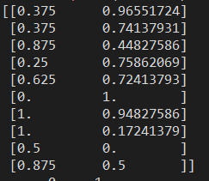
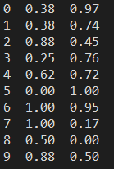
scaled = scaler.fit_transform(data)
print(scaled)
print(data)
#round off

Slide 99
Feature Scaling: Data Set 'FeatureScaling1.csv
PHY | MATH
18 | 98
18 | 85
26 | 68
16 | 86
22 | 84
12 | 100
28 | 97
28 | 52
20 | 42
26 | 71

Slide 100
Feature Scaling : Code
#################################
## Feature Scaling
import numpy as nm
import matplotlib.pyplot as mtp
import pandas as pd
from sklearn.preprocessing import MinMaxScaler
data = pd.read_csv('FeatureScaling1.csv')
print(data)
#MinMaxScaler
# define min max scaler
scaler = MinMaxScaler()
# transform data
scaled = scaler.fit_transform(data)
print(scaled)
#Convert scaled np 2d array into dataframe
scaleddf = pd.DataFrame(scaled)
#round off every
scaleddf[:]=scaleddf[:].apply(lambda x:round(x,2))
print(scaleddf)
# StandardScaler
from sklearn.preprocessing import StandardScaler
st_x= StandardScaler()
print(data)
# define standard scaler
scaler = StandardScaler()
# transform data
scaled = scaler.fit_transform(data)
print(scaled)
#Convert scaled np 2d array into dataframe
scaleddf = pd.DataFrame(scaled)
#round off every
scaleddf[:]=scaleddf[:].apply(lambda x:round(x,2))
print(scaleddf)

Slide 101
Feature Scaling: standard scaler
Data Set
PHY | MATH
18 | 98
18 | 85
26 | 68
16 | 86
22 | 84
12 | 100
28 | 97
28 | 52
20 | 42
26 | 71

Slide 102
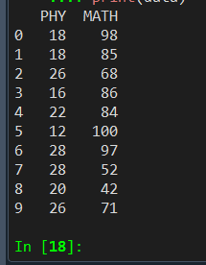
# StandardScaler
from sklearn.preprocessing import StandardScaler
st_x= StandardScaler()
print(data)

Slide 103
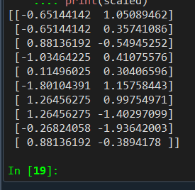
# define standard scaler
scaler = StandardScaler()
# transform data
scaled = scaler.fit_transform(data)
# Print Scaled Data
print(scaled)

Slide 104
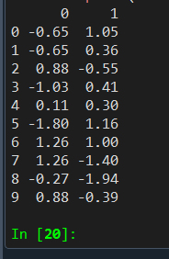
#round off every
#Convert scaled np 2d array into dataframe
scaleddf = pd.DataFrame(scaled)
#round off every
scaleddf[:]=scaleddf[:].apply(lambda x:round(x,2))
print(scaleddf)

Slide 105
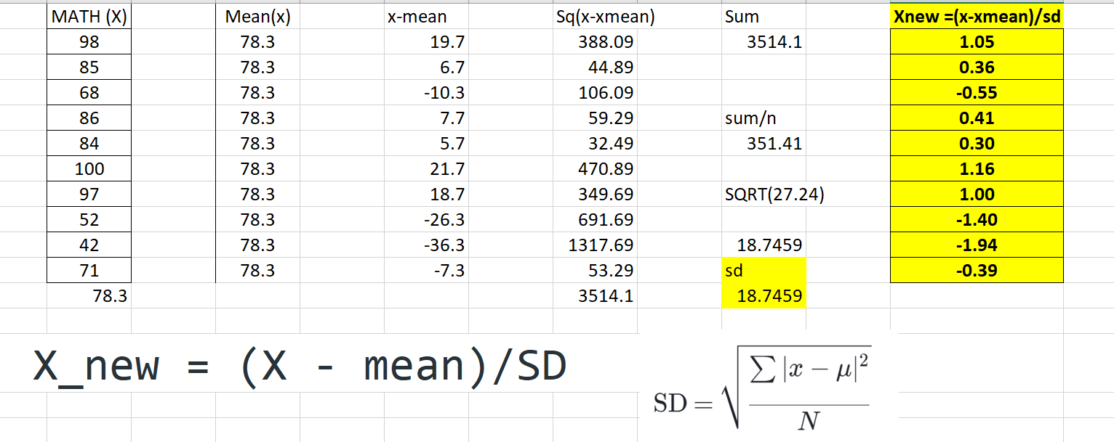

Slide 106
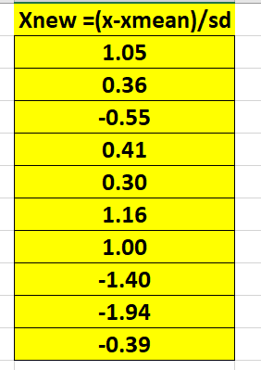

Slide 107
Feature Scaling: standard scaler
#################################
## Feature Scaling
import numpy as nm
import matplotlib.pyplot as mtp
import pandas as pd
from sklearn.preprocessing import MinMaxScaler
data = pd.read_csv('FeatureScaling1.csv')
print(data)
#MinMaxScaler
# define min max scaler
scaler = MinMaxScaler()
# transform data
scaled = scaler.fit_transform(data)
print(scaled)
#Convert scaled np 2d array into dataframe
scaleddf = pd.DataFrame(scaled)
#round off every
scaleddf[:]=scaleddf[:].apply(lambda x:round(x,2))
print(scaleddf)
# StandardScaler
from sklearn.preprocessing import StandardScaler
st_x= StandardScaler()
print(data)
# define standard scaler
scaler = StandardScaler()
# transform data
scaled = scaler.fit_transform(data)
print(scaled)
#round off every
#Convert scaled np 2d array into dataframe
scaleddf = pd.DataFrame(scaled)
#round off every
scaleddf[:]=scaleddf[:].apply(lambda x:round(x,2))
print(scaleddf)

Slide 108
References
https://machinelearningmastery.com/standardscaler-and-minmaxscaler-transforms-in-python/

Slide 109
END
A

