Slide 1

BCAC 0017 FUNDAMENTALS OF MACHINE LEARNING
Section 6: Performance-Measures:
Faculty Name
Mr. Sachin Sharma, Dr. Vinod Jain, Dr. Manu Banga,
Ms.Paromita Goswami, Ms.Chestha Bhardwaj

Slide 2
Section 6 : Performance-Measures:
Performance-Measures: Types-of-errors, accuracy, confusion-matrix, precision-recall.

Slide 3
Section 6 : Performance-Measures:
Performance-Measures:
Types-of-errors
accuracy
confusion-matrix
precision-recall

Slide 4
Performance-Measures
Evaluating the performance of a Machine learning model is one of the important steps while building an effective ML model.
To evaluate the performance or quality of the model, different metrics are used, and these metrics are known as performance metrics or evaluation metrics.
These performance metrics help us understand how well our model has performed for the given data.

Slide 5
Performance-Measures
In this way, we can improve the model's performance by tuning the hyper-parameters.
Each ML model aims to generalize well on unseen/new data, and performance metrics help determine how well the model generalizes on the new dataset.

Slide 6
Performance-Measures
In machine learning, each task or problem is divided into classification and Regression.
Not all metrics can be used for all types of problems; hence, it is important to know and understand which metrics should be used.

Slide 7
Performance-Measures
Different evaluation metrics are used for both Regression and Classification tasks.
In this topic, we will discuss metrics used for classification and regression tasks.
1. Performance Metrics for Regression
2. Performance Metrics for Classification

Slide 8
Types-of-errors
Different evaluation metrics (ERRORS) are used for both Regression and Classification tasks. So errors are categorized on the basis of type of machine learning used.
So mainly two types of errors (metrics ) are :
1. Performance Metrics for Regression
2. Performance Metrics for Classification

Slide 9
Types-of-errors
Performance Metrics for Regression
Following are the popular metrics that are used to evaluate the performance of Regression models.
Mean Absolute Error
Mean Squared Error
RMSE Mean Squared Error
R2 Score

Slide 10
Types-of-errors
2. Performance Metrics for Classification
In a classification, machine learning model learns from the given dataset and then classifies the new data into classes or groups based on the training.
It predicts class labels as the output, such as Yes or No, 0 or 1, Spam or Not Spam, etc.

Slide 11
Types-of-errors
2. Performance Metrics for Classification
To evaluate the performance of a classification model, different metrics are used, and some of them are as follows:
Accuracy
Confusion Matrix
Precision
Recall
F-Score
AUC(Area Under the Curve)-ROC

Slide 12
References
https://www.javatpoint.com/performance-metrics-in-machine-learning
https://www.geeksforgeeks.org/metrics-for-machine-learning-model/

Slide 13
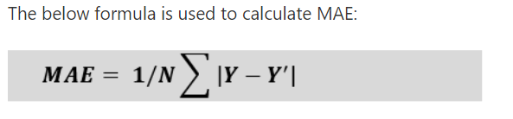
Mean Absolute Error
Mean Absolute Error (MAE)
Mean Absolute Error or MAE is one of the simplest metrics, which measures the absolute difference between actual and predicted values, where absolute means taking a number as Positive.
Y is the Actual outcome, Y' is the predicted outcome, and N is the total number of data points.

Slide 14
Mean Squared Error
It measures the average of the Squared difference between predicted values and the actual value given by the model.

Slide 15

Mean Squared Error
The formula for calculating MSE is given below:

Slide 16
Mean Squared Error
In MSE, errors are squared, therefore it only assumes non-negative values, and it is usually positive and non-zero.
Moreover, due to squared differences, it penalizes small errors also, and hence it leads to over-estimation of how bad the model is.

Slide 17

Root Mean Square Error(RMSE)
We can say that RMSE is a metric that can be obtained by just taking the square root of the MSE value.
This gives higher weightage to the large errors in predictions.

Slide 18
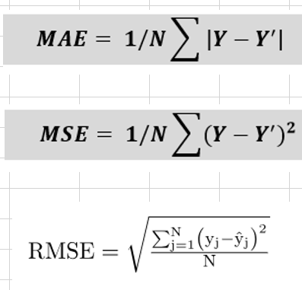
Marks in Mid Term of ML
 |  | Y | Y'
SN | CPI | Actual | predicted | Y-Y' | |Y-Y'| | (Y-Y')^2 | MAE
1 | 6.3 | 8 | 5 | 3 | 3 | 9 | [ (1/10)*22]
2 | 6.5 | 9 | 6 | 3 | 3 | 9 | 2.2
3 | 6.8 | 7 | 8 | -1 | 1 | 1
4 | 7.1 | 14 | 12 | 2 | 2 | 4
5 | 7.5 | 15 | 16 | -1 | 1 | 1 | MSE
6 | 7.7 | 10 | 17 | -7 | 7 | 49 | [ (1/10)*86]
7 | 7.9 | 22 | 22 | 0 | 0 | 0 | 8.6
8 | 8.1 | 27 | 24 | 3 | 3 | 9
9 | 8.5 | 26 | 26 | 0 | 0 | 0 | RMSE
10 | 8.8 | 29 | 27 | 2 | 2 | 4 | SQRT(8.6)
 |  |  | Sum | 4 | 22 | 86 | 2.93

Slide 19
Marks in Mid Term of COA
 |  | Y | Y'
SN | CPI | Actual | predicted | Y-Y' | |Y-Y'| | (Y-Y')^2 | MAE
1 | 6.3 | 5 | 5
2 | 6.5 | 6 | 6
3 | 6.8 | 7 | 8
4 | 7.1 | 12 | 12
5 | 7.5 | 11 | 16 |  |  |  | MSE
6 | 7.7 | 14 | 17
7 | 7.9 | 18 | 22
8 | 8.1 | 19 | 24
9 | 8.5 | 21 | 26 |  |  |  | RMSE
10 | 8.8 | 23 | 27
 |  |  | Sum

Slide 20
Marks in Mid Term of ML
 |  | Y | Y'
SN | CPI | Actual | predicted | Y-Y' | |Y-Y'| | (Y-Y')^2 | MAE
1 | 6.3 | 5 | 5 | 0 | 0 | 0 | [ (1/10)*27]
2 | 6.5 | 6 | 6 | 0 | 0 | 0 | 2.7
3 | 6.8 | 7 | 8 | -1 | 1 | 1
4 | 7.1 | 12 | 12 | 0 | 0 | 0
5 | 7.5 | 11 | 16 | -5 | 5 | 25 | MSE
6 | 7.7 | 14 | 17 | -3 | 3 | 9 | [ (1/10)*117]
7 | 7.9 | 18 | 22 | -4 | 4 | 16 | 11.7
8 | 8.1 | 19 | 24 | -5 | 5 | 25
9 | 8.5 | 21 | 26 | -5 | 5 | 25 | RMSE
10 | 8.8 | 23 | 27 | -4 | 4 | 16 | SQRT(11.7)
 |  |  | Sum | -27 | 27 | 117 | 3.42

Slide 21

R2 Score
R squared error is also known as Coefficient of Determination.
The R-squared metric enables us to compare our model with a constant baseline to determine the performance of the model.
The R squared score will always be less than or equal to 1 without concerning if the values are too large or small.

Slide 22
Types-of-errors
2. Performance Metrics for Classification
Accuracy
Confusion Matrix
Precision
Recall
F-Score

Slide 23

Accuracy
The accuracy can be determined as the number of correct predictions to the total number of predictions.
It can be formulated as:

Slide 24
Accuracy : How to calculate
Firstly, we need to import the accuracy_score function of the scikit-learn library as follows:
from sklearn.metrics import accuracy_score
print(“Accuracy Score = “,accuracy_score(y_test,y_hat)')
Here y_hat = y_test_predicted
Although it is simple to use and implement, it is suitable only for cases where an equal number of samples belong to each class.

Slide 25
Accuracy
When to Use Accuracy?
It is good to use the Accuracy metric when the target variable classes in data are approximately balanced.
For example, if 60% of classes in a fruit image dataset are of Apple, 40% are Mango.
In this case, if the model is asked to predict whether the image is of Apple or Mango, it will give a prediction with 97% of accuracy.

Slide 26
Accuracy
When not to use Accuracy?
It is recommended not to use the Accuracy measure when the target variable majorly belongs to one class.
For example, Suppose there is a model for a disease prediction in which, out of 100 people, only five people have a disease, and 95 people don't have one.
In this case, if our model predicts every person with no disease (which means a bad prediction), the Accuracy measure will be 95%, which is not correct.

Slide 27
Confusion-matrix
A confusion matrix is a tabular representation of prediction outcomes of any binary classifier, which is used to describe the performance of the classification model on a set of test data when true values are known.
The confusion matrix is simple to implement, but the terminologies used in this matrix might be confusing for beginners.

Slide 28
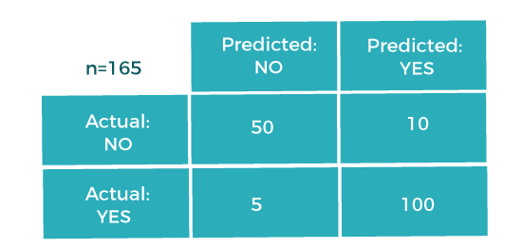
Confusion-matrix

Slide 29
Confusion-matrix
In the matrix, columns are for the prediction values, and rows specify the Actual values.
Here Actual and prediction give two possible classes, Yes or No.
So, if we are predicting the presence of a disease in a patient, the Prediction column with Yes means, Patient has the disease, and for NO, the Patient doesn't have the disease.

Slide 30
Confusion-matrix
In this example, the total number of predictions are 165, out of which 110 time predicted yes, whereas 55 times predicted No.
However, in reality, 60 cases in which patients don't have the disease, whereas 105 cases in which patients have the disease.

Slide 31
Confusion-matrix
In general, the table is divided into four terminologies, which are as follows:
True Positive(TP):
True Negative(TN):
False Positive(FP):
False Negative(FN):

Slide 32
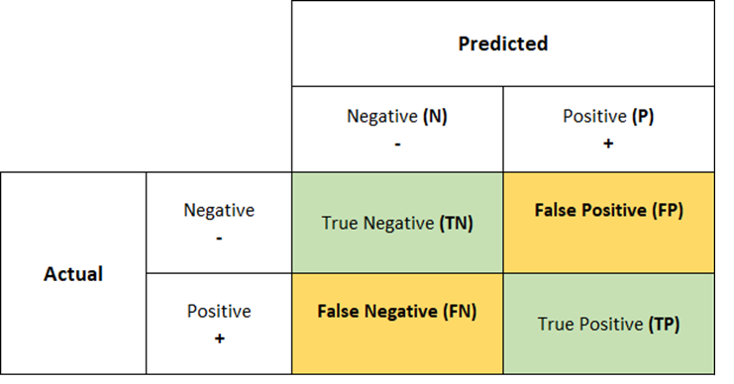
Confusion-matrix
In general, the table is divided into four terminologies, which are as follows:
True Positive(TP):
True Negative(TN):
False Positive(FP):
False Negative(FN):

Slide 33
Confusion-matrix

Slide 34
Confusion-matrix
TP and TN
True Positive(TP):
In this case, the prediction outcome is true, and it is true in reality, also.
True Negative(TN):
In this case, the prediction outcome is false, and it is false in reality, also.

Slide 35
Confusion-matrix
FP and FN
False Positive(FP):
In this case, prediction outcomes are true, but they are false in actuality.
False Negative(FN):
In this case, predictions are false, and they are true in actuality.

Slide 36
True Positive(TP): In this case, the prediction outcome is true, and it is true in reality, also.
True Negative(TN): in this case, the prediction outcome is false, and it is false in reality, also.
False Positive(FP): In this case, prediction outcomes are true, but they are false in actuality.
False Negative(FN): In this case, predictions are false, and they are true in actuality.

Slide 37
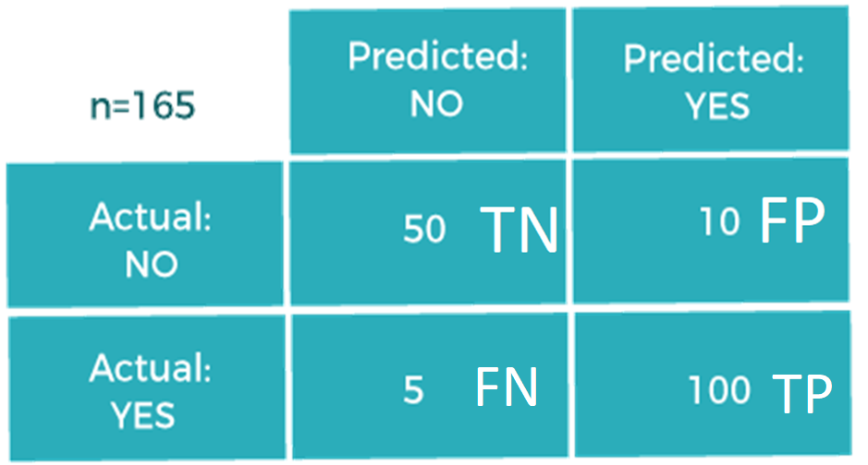
Confusion-matrix

Slide 38
Confusion-matrix
Model

Slide 39
Confusion-matrix
Cancer prediction for 200 patients |  |  |  | Verified
 | Positive | Negative
Actual | 100 | 100
Prediction | 95,5 | 93,7 | (Correct,Incorrect)
 |  |  | Confusion Matrix
TN |  |  | TN | FP
FP |  |  | FN | TP
FN
TP

Slide 40
Precision-recall
Cancer prediction for 200 patients |  |  |  | Verified
 | Positive | Negative
Actual | 100 | 100
Prediction | 95,5 | 93,7 | (Correct,Incorrect)
 |  |  | Confusion Matrix
TN | 93 |  | TN | FP
FP | 7 |  | FN | TP
FN | 5 |  | 93 | 7
TP | 95 |  | 5 | 95

Slide 41
Precision-recall
Cancer prediction for 300 patients |  |  |  | Verified
 | Positive | Negative
Actual | 250 | 50
Prediction | 225,25 | 40,10 | (Correct,Incorrect)
 |  |  | Confusion Matrix
TN |  |  | TN | FP
FP |  |  | FN | TP
FN
TP

Slide 42
Precision-recall
Cancer prediction for 300 patients |  |  |  | Verified
 | Positive | Negative
Actual | 250 | 50
Prediction | 225,25 | 40,10 | (Correct,Incorrect)
 |  |  | Confusion Matrix
TN | 40 |  | TN | FP
FP | 10 |  | FN | TP
FN | 25 |  | 40 | 10
TP | 225 |  | 25 | 225

Slide 43
Precision-recall
Diabetes prediction for 1000 patients |  |  |  | Verified
 | Positive | Negative
Actual | 600 | 400
Prediction | 550,50 | 370,30 | (Correct,Incorrect)
 |  |  | Confusion Matrix
TN | 370 |  | TN | FP
FP | 30 |  | FN | TP
FN | 50 |  | 370 | 30
TP | 550 |  | 50 | 550

Slide 44
Precision-recall
Diabetes prediction for 1000 patients |  |  |  | Verified
 | Positive | Negative
Actual | 600 | 400
Prediction | 550,50 | 370,30 | (Correct,Incorrect)
 |  |  | Confusion Matrix
TN |  |  | TN | FP
FP |  |  | FN | TP
FN
TP

Slide 45

Precision-recall
Precision
The precision metric is used to overcome the limitation of Accuracy.
The precision determines the proportion of positive prediction that was actually correct.
It can be calculated as the True Positive or predictions that are actually true to the total positive predictions (True Positive and False Positive).

Slide 46

Precision-recall
Recall or Sensitivity
It is also similar to the Precision metric;
It can be calculated as True Positive or predictions that are actually true to the total number of positives, either correctly predicted as positive or incorrectly predicted as negative (true Positive and false negative).

Slide 47
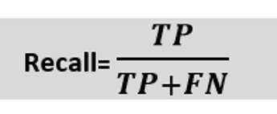
Precision-recall
When to use Precision and Recall?
Recall determines the performance of a classifier with respect to a false negative, whereas precision gives information about the performance of a classifier with respect to a false positive.

Slide 48
Precision-recall
When to use Precision and Recall?
So, if we want to minimize the false negative, then, Recall should be as near to 100%, and if we want to minimize the false positive, then precision should be close to 100% as possible.
In simple words, if we maximize precision, it will minimize the FP errors, and if we maximize recall, it will minimize the FN error.

Slide 49
Calculate Precision and recall
Cancer prediction for 300 patients |  |  |  | Verified
 | Positive | Negative
Actual | 250 | 50
Prediction | 225,25 | 40,10
TN |  | Precision | ?
FP |  | Recall | ?
FN
TP

Slide 50
Calculate Precision and recall
Cancer prediction for 300 patients |  |  |  | Verified
 | Positive | Negative
Actual | 250 | 50
Prediction | 225,25 | 40,10
TN | 40 | Precision | =225/(225+10)=0.9574
FP | 10 | Recall | =225/(225+25)=0.90
FN | 25
TP | 225

Slide 51
Calculate Precision and recall ? Question.
A judge take decision about total 100 cases in which he have take the decision for ‘Hang till death’.
He ordered in 40 cases for ‘hang till death’ but among which only 30 was culprit.
He do not punish 60 cases but from these 10 was culprit.
Create the confusion matrix.
Also find the value of precision and recall.

Slide 52


F-Score
F-score or F1 Score is a metric to evaluate a binary classification model on the basis of predictions that are made for the positive class.
It is calculated with the help of Precision and Recall.
It is a type of single score that represents both Precision and Recall.
So, the F1 Score can be calculated as the harmonic mean of both precision and Recall, assigning equal weight to each of them.

Slide 53
F-Score
When to use F-Score?
As F-score make use of both precision and recall, so it should be used if both of them are important for evaluation, but one (precision or recall) is slightly more important to consider than the other.
For example, when False negatives are comparatively more important than false positives, or vice versa.

Slide 54
References
https://www.javatpoint.com/performance-metrics-in-machine-learning
https://www.geeksforgeeks.org/metrics-for-machine-learning-model/

Slide 55
END

