Slide 1

BCAC 0017 FUNDAMENTALS OF MACHINE LEARNING
Section 7 Dimensionality Reduction :
Faculty Name
Mr. Sachin Sharma, Dr. Vinod Jain, Dr. Manu Banga,
Ms.Paromita Goswami, Ms.Chestha Bhardwaj

Slide 2
Section 7 Dimensionality Reduction :
Dimensionality Reduction :
Feature Selection vs. feature extraction
Principal Component Analysis (PCA).

Slide 3
Dimensionality Reduction
The number of input features, variables, or columns present in a given dataset is known as dimensionality
The process to reduce these features is called dimensionality reduction.

Slide 4
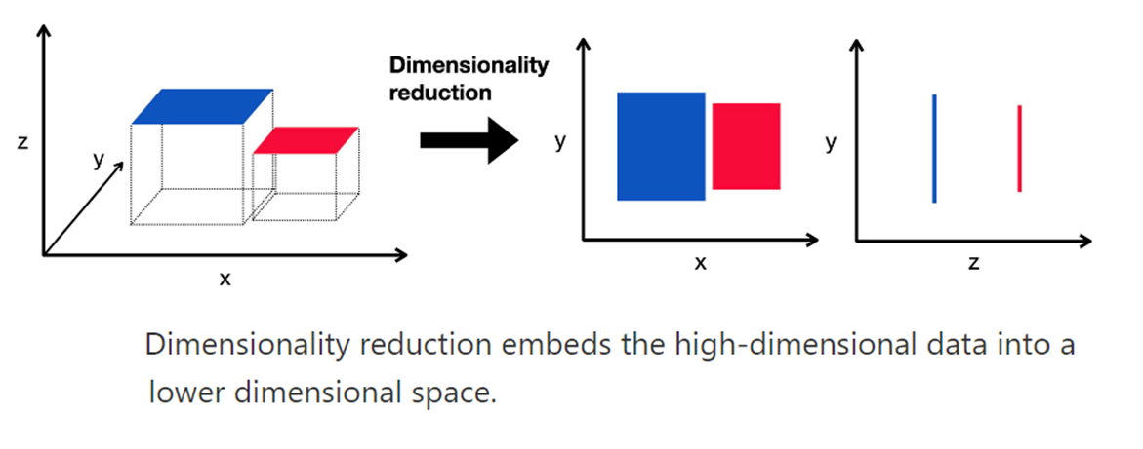

Slide 5
Dimensionality Reduction
Dimensionality reduction technique can be defined as,
"It is a way of converting the higher dimensions dataset into lesser dimensions dataset ensuring that it provides similar information."
These techniques are widely used in machine learning for obtaining a better fit predictive model while solving the classification and regression problems.

Slide 6
Dimensionality Reduction
It is commonly used in the fields that deal with high-dimensional data, such as
Speech Recognition,
Signal Processing,
Bioinformatics, Etc.
Data Visualization,
Noise Reduction,
Cluster Analysis, Etc.

Slide 7
Dimensionality Reduction
The Curse of Dimensionality
As the number of features increases, the number of samples also gets increased proportionally, and the chance of overfitting also increases.
If the machine learning model is trained on high-dimensional data, it becomes over fitted and results in poor performance.
Hence, it is often required to reduce the number of features, which can be done with dimensionality reduction.

Slide 8
Dimensionality Reduction
Benefits of applying Dimensionality Reduction
Some benefits of applying dimensionality reduction technique to the given dataset are given below:
By reducing the dimensions of the features, the space required to store the dataset also gets reduced.
Less Computation training time is required for reduced dimensions of features.
Reduced dimensions of features of the dataset help in visualizing the data quickly.
It removes the redundant features.

Slide 9
Disadvantages of dimensionality Reduction
There are also some disadvantages of applying the dimensionality reduction, which are given below:
Some data may be lost due to dimensionality reduction.
In the PCA dimensionality reduction technique, sometimes the principal components required to consider are unknown.

Slide 10
Approaches of Dimension Reduction
There are two ways to apply the dimension reduction technique, which are given below:
Feature Selection
Feature Extraction

Slide 11
Feature Selection
Feature selection is the process of selecting the subset of the relevant features and leaving out the irrelevant features present in a dataset to build a model of high accuracy.
In other words, it is a way of selecting the optimal features from the input dataset.

Slide 12
Feature Extraction:
Feature extraction is the process of transforming the space containing many dimensions into space with fewer dimensions.
This approach is useful when we want to keep the whole information but use fewer resources while processing the information.

Slide 13
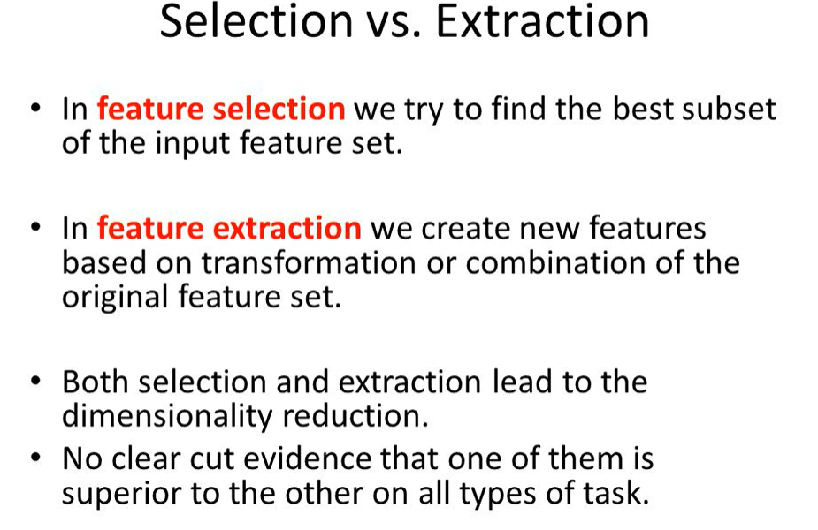

Slide 14
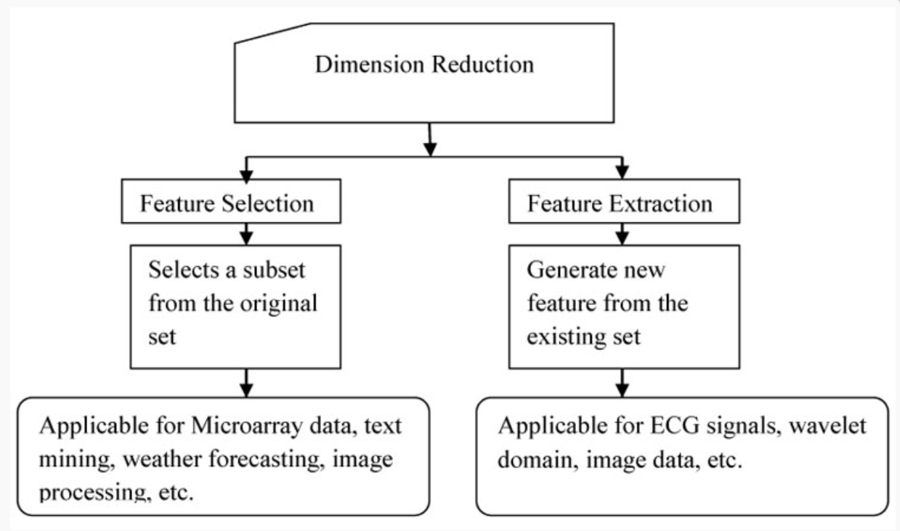

Slide 15
Feature Selection
Dimensionality Reduction

Slide 16
Feature Selection
Three methods are used for the feature selection:
Filter
Wrapper
Embedded

Slide 17
Feature Selection
1. Filters Methods
In this method, the dataset is filtered, and a subset that contains only the relevant features is taken. Some common techniques of filters method are:
Correlation
Chi-Square Test
ANOVA
Information Gain, etc.

Slide 18
Feature Selection
2. Wrappers Methods
In this method, some features are fed to the ML model, and evaluate the performance. The performance decides whether to add those features or remove to increase the accuracy of the model.
This method is more accurate than the filtering method but complex to work. Some common techniques of wrapper methods are:
Forward Selection
Backward Selection
Bi-directional Elimination

Slide 19
Feature Selection
3. Embedded Methods: Embedded methods check the different training iterations of the machine learning model and evaluate the importance of each feature. Some common techniques of Embedded methods are:
LASSO
Elastic Net
Ridge Regression, etc.

Slide 20
Feature Extraction

Slide 21
Feature Extraction
Feature Extraction:
Feature extraction is the process of transforming the space containing many dimensions into space with fewer dimensions.
This approach is useful when we want to keep the whole information but use fewer resources while processing the information.
Some common feature extraction techniques are:
Principal Component Analysis
Linear Discriminant Analysis
Kernel PCA
Quadratic Discriminant Analysis

Slide 22
Principal Component Analysis (PCA)

Slide 23
Principal Component Analysis (PCA)
Principal Component Analysis (PCA)
As stated earlier, Principal Component Analysis is a technique of feature extraction that maps a higher dimensional feature space to a lower-dimensional feature space.
While reducing the number of dimensions, PCA ensures that maximum information of the original dataset is retained in the dataset with the reduced no. of dimensions and the co-relation between the newly obtained Principal Components is minimum.

Slide 24
Principal Component Analysis (PCA)
The new features obtained after applying PCA are called Principal Components and are denoted as PCi (i=1,2,3…n).
Here, (Principal Component-1) PC1 captures the maximum information of the original dataset, followed by PC2, then PC3 and so on.

Slide 25
Principal Component Analysis (PCA)
Steps to Apply PCA in Python for Dimensionality Reduction
Step-1: Import necessary libraries
Step-2: Load the dataset
Step-3: Standardize the features
Step-3.1: Check the Co-relation between features without PCA (Optional)
Step-4: Applying Principal Component Analysis
Step-5: Checking Co-relation between features after PCA

Slide 26
Principal Component Analysis (PCA)
Step-3: Standardize the features
Before applying PCA or any other Machine Learning technique it is always considered good practice to standardize the data.
For this, Standard Scalar is the most commonly used scalar.

Slide 27
Principal Component Analysis (PCA)
Check the Co-relation between features without PCA
Now, we will check the co-relation between our scaled dataset using a heat map.
The correlation between various features is given by the corr() function and then the heat map is plotted by the heatmap() function.

Slide 28
Principal Component Analysis (PCA)
Check the Co-relation between features without PCA (Optional)
The colour scale on the side of the heatmap helps determine the magnitude of the co-relation.
In our example, we can clearly see that a darker shade represents less co-relation while a lighter shade represents more co-relation.

Slide 29
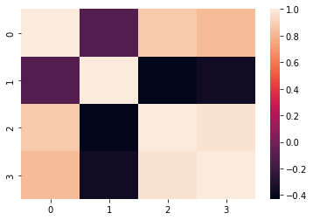
Principal Component Analysis (PCA)
Check the Co-relation between features without PCA (Optional)
The diagonal of the heatmap represents the co-relation of a feature with itself – which is always 1.0, thus, the diagonal of the heatmap is of the highest shade.

Slide 30
darker shade represents less co-relation while a lighter shade represents more co-relation.

Slide 31
Principal Component Analysis (PCA)
Step-1: Import necessary libraries
# Import necessary libraries
from sklearn import datasets # to retrieve the iris Dataset
import pandas as pd
from sklearn.preprocessing import StandardScaler # to standardize the features
from sklearn.decomposition import PCA # to apply PCA
import seaborn as sns # to plot the heat maps

Slide 32
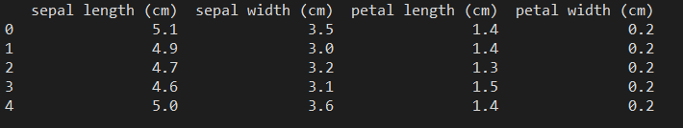
Principal Component Analysis (PCA)
Step-2: Load the dataset
#Load the Dataset
iris = datasets.load_iris()
#convert the dataset into a pandas data frame
df = pd.DataFrame(iris['data'], columns = iris['feature_names'])
#display the head (first 5 rows) of the dataset
print(df.head())

Slide 33
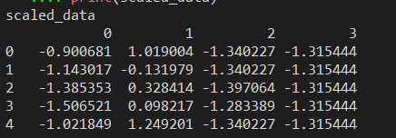
Principal Component Analysis (PCA)
Step-3: Standardize the features
#Standardize the features
#Create an object of StandardScaler which is present in sklearn.preprocessing
scalar = StandardScaler()
scaled_data = pd.DataFrame(scalar.fit_transform(df)) #scaling the data
print("scaled_data")
print(scaled_data)

Slide 34
Principal Component Analysis (PCA)
#Check the Co-relation between features without PCA
sns.heatmap(scaled_data.corr())

Slide 35
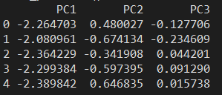
Principal Component Analysis (PCA)
Step-4: Applying Principal Component Analysis
#Applying PCA
#Taking no. of Principal Components as 3
pca = PCA(n_components = 3)
pca.fit(scaled_data)
data_pca = pca.transform(scaled_data)
data_pca = pd.DataFrame(data_pca,columns=['PC1','PC2','PC3'])
print("data_pca.head()")
print(data_pca.head())

Slide 36
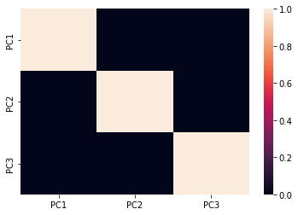
Principal Component Analysis (PCA)
Step-5: Checking Co-relation between features after PCA
#Checking Co-relation between features after PCA
sns.heatmap(data_pca.corr())

Slide 37
Principal Component Analysis (PCA) Code
################
# PCA
# https://www.geeksforgeeks.org/reduce-data-dimentionality-using-pca-python/
# Import necessary libraries
from sklearn import datasets # to retrieve the iris Dataset
import pandas as pd # to load the dataframe
from sklearn.preprocessing import StandardScaler # to standardize the features
from sklearn.decomposition import PCA # to apply PCA
import seaborn as sns # to plot the heat maps
#Load the Dataset
iris = datasets.load_iris()
#convert the dataset into a pandas data frame
df = pd.DataFrame(iris['data'], columns = iris['feature_names'])
#display the head (first 5 rows) of the dataset
print(df.head())
#Standardize the features
#Create an object of StandardScaler which is present in sklearn.preprocessing
scalar = StandardScaler()
scaled_data = pd.DataFrame(scalar.fit_transform(df)) #scaling the data
print("scaled_data")
print(scaled_data)
#Check the Co-relation between features without PCA
sns.heatmap(scaled_data.corr())
#Applying PCA
#Taking no. of Principal Components as 3
pca = PCA(n_components = 3)
pca.fit(scaled_data)
data_pca = pca.transform(scaled_data)
data_pca = pd.DataFrame(data_pca,columns=['PC1','PC2','PC3'])
print("data_pca.head()")
print(data_pca.head())
#Checking Co-relation between features after PCA
sns.heatmap(data_pca.corr())

Slide 38
References
https://www.javatpoint.com/dimensionality-reduction-technique
https://www.geeksforgeeks.org/dimensionality-reduction/

Slide 39
END

