Slide 1

BCAC 0017 FUNDAMENTALS OF MACHINE LEARNING
Section 5 : Validation
Faculty Name
Mr. Sachin Sharma, Dr. Vinod Jain, Dr. Manu Banga,
Ms.Paromita Goswami, Ms.Chestha Bhardwaj

Slide 2
Section 5 : Validation
Validation: True and sample error, over-fitting, role of cross validation, regularization, bias-variance analysis.

Slide 3
Section 5 : Validation
Validation:
True and sample error
over-fitting
role of cross validation
regularization
bias-variance analysis

Slide 4
Validation:
Model validation is the process that is carried out after Model Training where the trained model is evaluated with a testing data set.

Slide 5
Validation:
‘Machine Learning is about making predictions.’
These predictions come up after assorted processes like
Data Preparation,
Choosing a Model,
Training the Model,
Parameter Tuning,
Model Validation, etc.

Slide 6
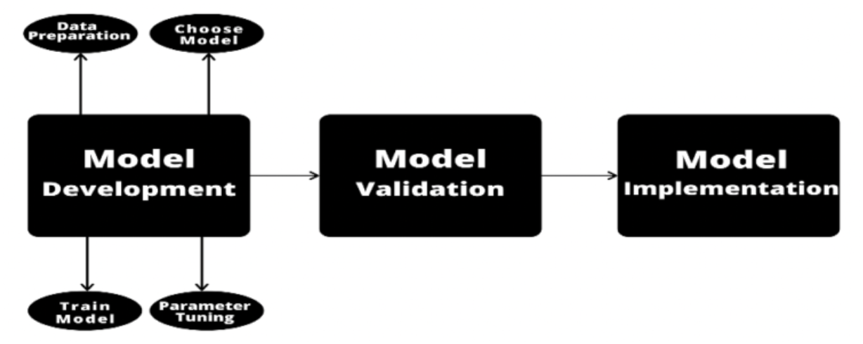
Machine Learning

Slide 7
Validation:
Model validation is the process that is carried out after Model Training where the trained model is evaluated with a testing data set.
The testing data may or may not be a chunk of the same data set from which the training set is procured.

Slide 8
Validation:
The two types of Model Validation techniques are namely,
In-sample validation – testing data from the same dataset that is used to build the model.
Out-of-sample validation – testing data from a new dataset that isn’t used to build the model

Slide 9
Validation:
Model validation is the process that is carried out after Model Training where the trained model is evaluated with a testing data set.
Model validation refers to the process of confirming that the model achieves its intended purpose i.e., how effective our model is.

Slide 10
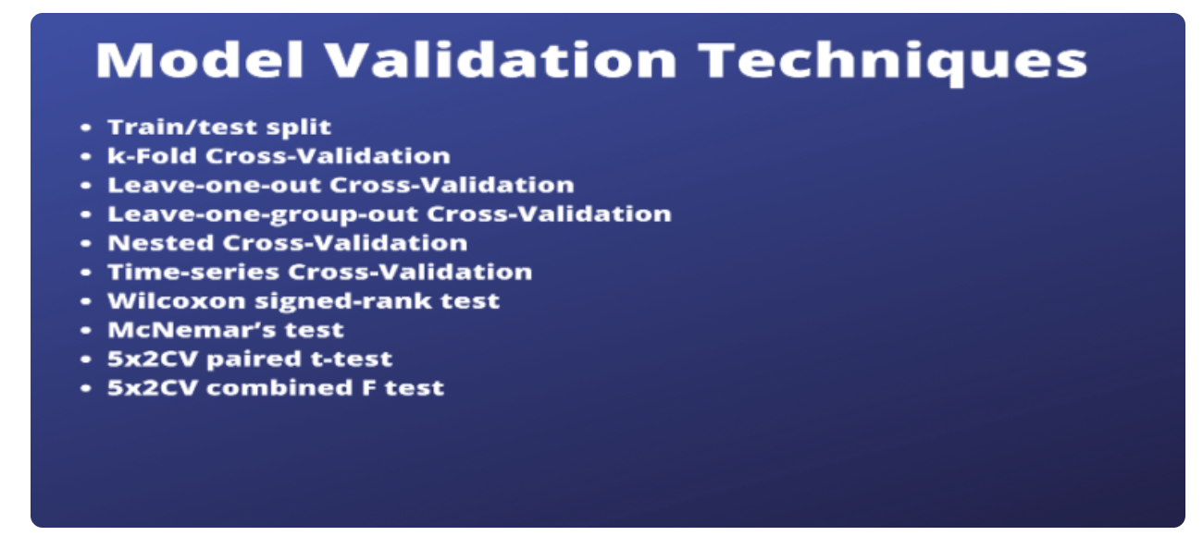

Slide 11
Validation:
There are various ways of validating a model among which the two most famous methods are Cross Validation and Bootstrapping.
But there is no single validation method that works in all scenarios.
Therefore, it is important to understand the type of data we are working with.

Slide 12
References
https://datatron.com/what-is-model-validation-and-why-is-it-important/

Slide 13
True and sample error
The true error represents the probability that a randomly drawn instance from the entire distribution is misclassified while the sample error is the fraction of sample which is misclassified.

Slide 14
True error
The true error represents the probability that a randomly drawn instance from the entire distribution is misclassified .
As true error represents entire population it becomes difficult to calculate hence we use sample to check our hypothesis.

Slide 15

True error
The true error can be said as the probability that the hypothesis will misclassify a single randomly drawn sample from the population.
Here the population represents all the data in the world.
Let’s consider a hypothesis h(x) and the true/target function is f(x) of population P.
The probability that h will misclassify an instance drawn at random i.e. true error is:

Slide 16
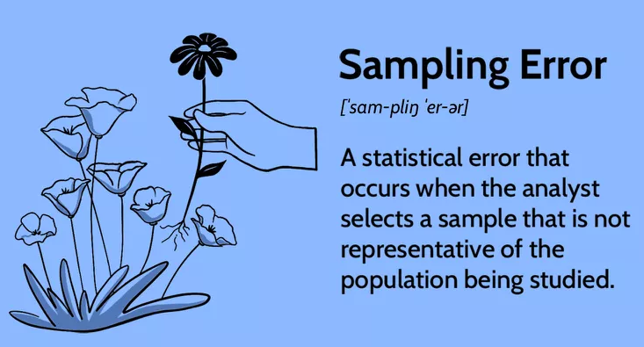

Slide 17
sample error
What are Sampling Errors?
Sampling errors are statistical errors that arise when a sample does not represent the whole population.
They are the difference between the real values of the population and the values derived by using samples from the population.
Since there is a fault in the data collection, the results obtained from sampling become invalid.

Slide 18
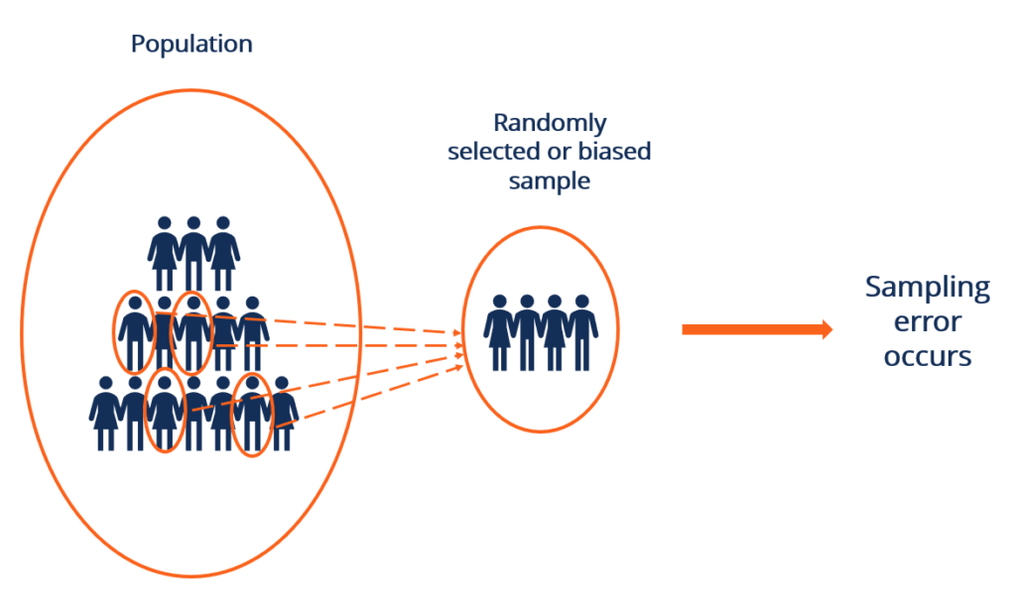

Slide 19


Sample error
The sample error of S with respect to target function f and data sample S is the proportion of examples S misclassifies.

Slide 20
True Error | Sample Error
True error is used to estimate the error of the population. | Sample Error is used to estimate the errors of the sample.
The true error represents the probability that a random sample from the population is misclassified. | Sample Error represents the fraction of the sample which is misclassified.
True error is difficult to calculate. It is estimated by the confidence interval range on the basis of Sample error. | Sample Error is easy to calculate. You just have to calculate the fraction of the sample that is misclassified.
The true error can be caused by poor data collection methods, selection bias, or non-response bias. | Sampling error can be of type population-specific error (wrong people to survey), selection error, sample-frame error (wrong frame window selected for sample), and non-response error (when respondent failed to respond).

Slide 21
References
https://www.geeksforgeeks.org/true-error-vs-sample-error/
https://corporatefinanceinstitute.com/resources/data-science/sampling-errors/

Slide 22
Under-fitting
It represents the inability of the model to learn the training data effectively result in poor performance both on the training and testing data.
In simple terms, an under-fit model’s are inaccurate.
It mainly happens when we uses very simple model with overly simplified assumptions.

Slide 23
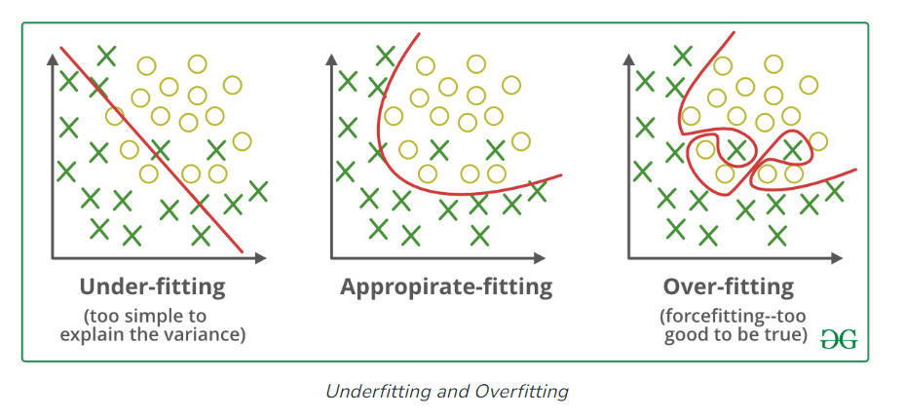

Slide 24
Under-fitting
A statistical model or a machine learning algorithm is said to have under-fitting when a model is too simple to capture data complexities.
To address underfitting problem of the model, we need to use more complex models, with enhanced feature representation.
Note: The underfitting model has High bias and low variance.

Slide 25
Under-fitting
Reasons for Under-fitting
The model is too simple, So it may be not capable to represent the complexities in the data.
The input features which is used to train the model is not the adequate representations of underlying factors influencing the target variable.
The size of the training dataset used is not enough.
Excessive regularization are used to prevent the overfitting, which constraint the model to capture the data well.
Features are not scaled.

Slide 26
Under-fitting
Techniques to Reduce Underfitting
Increase model complexity.
Increase the number of features, performing feature engineering.
Remove noise from the data.
Increase the number of epochs or increase the duration of training to get better results.

Slide 27
Over-fitting
A statistical model is said to be overfitted when the model does not make accurate predictions on testing data.
When a model gets trained with so much data, it starts learning from the noise and inaccurate data entries in our data set.

Slide 29
Over-fitting
Overfitting is a problem where the evaluation of machine learning algorithms on training data is different from unseen data.
The causes of overfitting are the non-parametric and non-linear methods because these types of machine learning algorithms have more freedom in building the model based on the dataset and therefore they can really build unrealistic models.

Slide 30
Over-fitting
Reasons for Overfitting:
High variance and low bias.
The model is too complex.
The size of the training data.

Slide 31
Over-fitting
Techniques to Reduce Overfitting
Increase training data.
Reduce model complexity.
Early stopping during the training phase (have an eye over the loss over the training period as soon as loss begins to increase stop training).
Ridge Regularization and Lasso Regularization.
Use dropout for neural networks to tackle overfitting.

Slide 32
References
https://www.geeksforgeeks.org/underfitting-and-overfitting-in-machine-learning/

Slide 33
Cross Validation
In practice, we use the following process to calculate the MSE of a given model:
1. Split a dataset into a training set and a testing set.
2. Build the model using only data from the training set.
3. Use the model to make predictions on the testing set

Slide 34
Cross Validation
However,
the drawback of using only one testing set is that the error can vary greatly depending on which observations were used in the training and testing sets.

Slide 35
Role Of Cross Validation
One way to avoid this problem is to fit a model several times using a different training and testing set each time.
This general method is known as cross-validation and a specific form of it is known as k-fold cross-validation.

Slide 36
Role Of Cross Validation
Cross-validation is a technique for validating the model efficiency by training it on the subset of input data and testing on previously unseen subset of the input data.
We can also say that it is a technique to check how a statistical model generalizes to an independent dataset.

Slide 37
Role Of Cross Validation
Hence the basic steps of cross-validations are:
Step 1: Randomly divide a dataset into k groups, or “folds”, of roughly equal size.
Step 2: Choose one of the folds to be the holdout set. Fit the model on the remaining k-1 folds. Calculate the test MSE on the observations in the fold that was held out.
Step 3: Repeat this process k times, using a different set each time as the holdout set.
Step 4: Calculate the overall test MSE to be the average of the k test MSE’s.

Slide 38
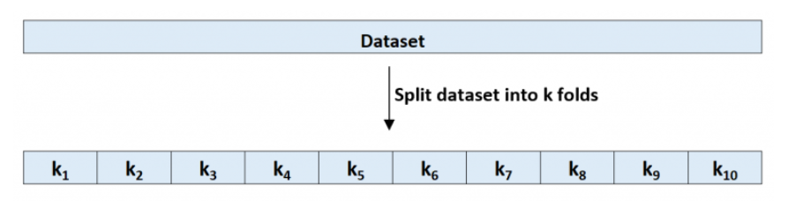
Role Of Cross Validation
Step 1: Randomly divide a dataset into k groups, or “folds”, of roughly equal size.

Slide 39
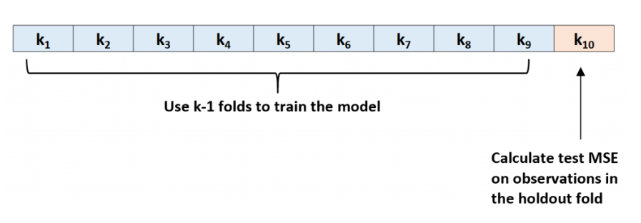
Role Of Cross Validation
Step 2: Choose one of the folds to be the holdout set. Fit the model on the remaining k-1 folds. Calculate the test MSE on the observations in the fold that was held out.

Slide 40
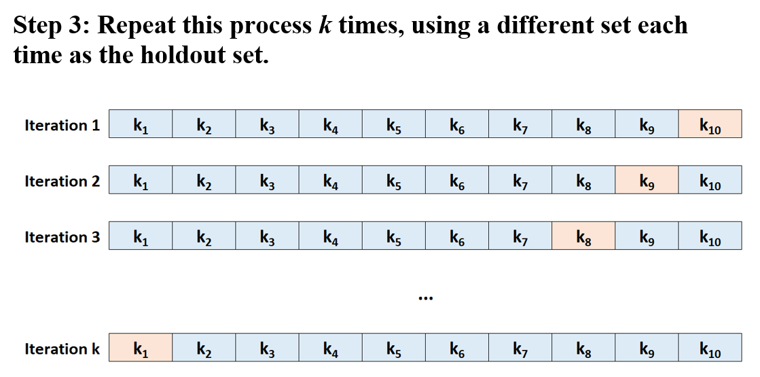
Role Of Cross Validation

Slide 41
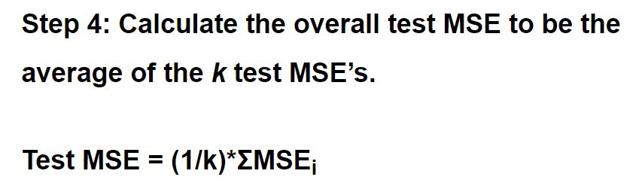
Role Of Cross Validation
where:
k: Number of folds
MSE_{i}: Test MSE on the i^{th} iteration

Slide 42
Role Of Cross Validation
How to Choose K
In general, the more folds we use in k-fold cross-validation the lower the bias of the test MSE but the higher the variance.
Conversely, the fewer folds we use the higher the bias but the lower the variance.
This is a classic example of the bias-variance tradeoff in machine learning.

Slide 43
Applications of Cross-Validation
This technique can be used to compare the performance of different predictive modeling methods.
It has great scope in the medical research field.
It can also be used for the meta-analysis, as it is already being used by the data scientists in the field of medical statistics.

Slide 44
Role Of Cross Validation
Extensions of K-Fold Cross-Validation
There are several extensions of k-fold cross-validation, including:
Repeated K-fold Cross-Validation:
Leave-One-Out Cross-Validation:
Stratified K-Fold Cross-Validation:
Nested Cross-Validation:

Slide 45
Code
# Applying K fold cross validation
# https://www.statology.org/k-fold-cross-validation-in-python/
from sklearn.model_selection import train_test_split
from sklearn.model_selection import KFold
from sklearn.model_selection import cross_val_score
from sklearn.linear_model import LinearRegression
from numpy import mean
from numpy import absolute
from numpy import sqrt
import pandas as pd

Slide 46
df = pd.DataFrame({'y': [6, 8, 12, 14, 14, 15, 17, 22, 24, 23],
'x1': [2, 5, 4, 3, 4, 6, 7, 5, 8, 9],
'x2': [14, 12, 12, 13, 7, 8, 7, 4, 6, 5]})
#define predictor and response variables
X = df[['x1', 'x2']]
y = df['y']

Slide 47
#define cross-validation method to use
# cv = KFold(n_splits=10, random_state=1, shuffle=True)
cv = KFold(n_splits=10)
#build multiple linear regression model
model = LinearRegression()
#use k-fold CV to evaluate model
scores = cross_val_score(model, X, y, scoring='neg_mean_absolute_error',cv=cv, n_jobs=-1)
#view mean absolute error
mae= mean(absolute(scores))
print("MSE = ", mae)
Output
MSE = 3.1461548083469744

Slide 48
Code
# Applying K fold cross validation
# https://www.statology.org/k-fold-cross-validation-in-python/
from sklearn.model_selection import train_test_split
from sklearn.model_selection import KFold
from sklearn.model_selection import cross_val_score
from sklearn.linear_model import LinearRegression
from numpy import mean
from numpy import absolute
from numpy import sqrt
import pandas as pd
df = pd.DataFrame({'y': [6, 8, 12, 14, 14, 15, 17, 22, 24, 23],
'x1': [2, 5, 4, 3, 4, 6, 7, 5, 8, 9],
'x2': [14, 12, 12, 13, 7, 8, 7, 4, 6, 5]})
print(df)
#define predictor and response variables
X = df[['x1', 'x2']]
y = df['y']
#define cross-validation method to use
# cv = KFold(n_splits=10, random_state=1, shuffle=True)
cv = KFold(n_splits=10)
#build multiple linear regression model
model = LinearRegression()
#use k-fold CV to evaluate model
scores = cross_val_score(model, X, y, scoring='neg_mean_absolute_error',cv=cv, n_jobs=-1)
#view mean absolute error
mae= mean(absolute(scores))
print("MSE = ", mae)
print("Scores = ", scores)

Slide 49
Kfold() Function
K-Folds cross-validator
Provides train/test indices to split data in train/test sets.
Split dataset into k consecutive folds (without shuffling by default).
Each fold is then used once as a validation while the k - 1
remaining folds form the training set.
Example
cv = KFold(n_splits=10, random_state=1, shuffle=True)

Slide 50
Kfold() Function : Parameters
cv = KFold(n_splits=10, random_state=1, shuffle=True)
Number of folds. Must be at least 2. random_state : int, RandomState instance or None,
default=None
When shuffle is True, random_state affects the ordering of the indices, which controls the randomness of each fold.
Shuffle : bool, default=False
shuffle the data before splitting into batches.

Slide 51
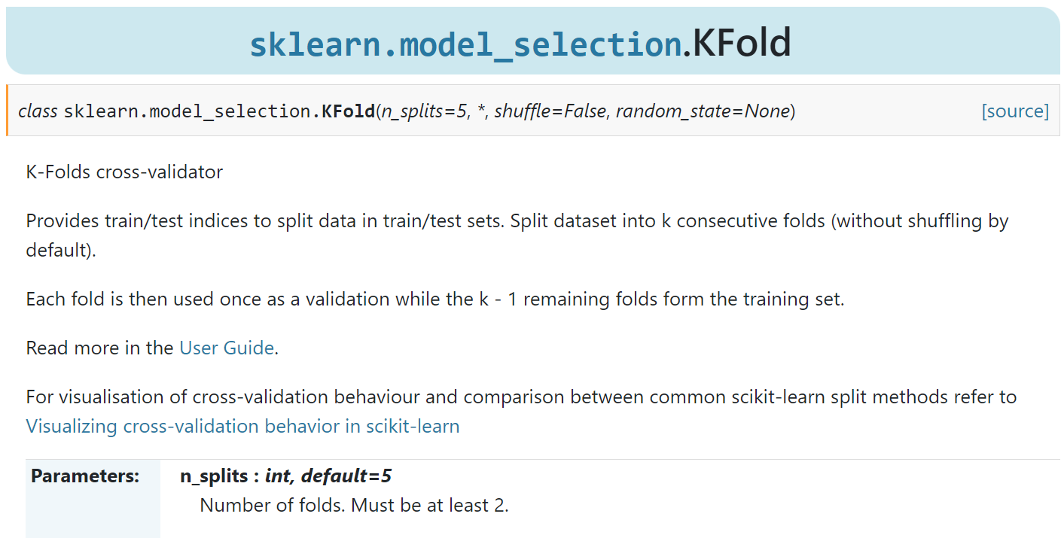
from sklearn.model_selection import Kfold
https://scikit-learn.org/stable/modules/generated/sklearn.model_selection.KFold.html

Slide 52
from sklearn.model_selection import Kfold
Official Documentation
https://scikit-learn.org/stable/modules/generated/sklearn.model_selection.KFold.html

Slide 53
cross_val_score ()
Evaluate a score by cross-validation.
General Form
sklearn.model_selection.cross_val_score(estimator, X, y=None, *, groups=None, scoring=None, cv=None, n_jobs=None, verbose=0, fit_params=None, pre_dispatch='2*n_jobs', error_score=nan)
scores = cross_val_score(model, X, y,
scoring='neg_mean_absolute_error',cv=cv, n_jobs=-1)

Slide 54
cross_val_score ()
Evaluate a score by cross-validation.
General Form
sklearn.model_selection.cross_val_score(estimator, X, y=None, *, groups=None, scoring=None, cv=None, n_jobs=None, verbose=0, fit_params=None, pre_dispatch='2*n_jobs', error_score=nan)
scores = cross_val_score(model, X, y,
scoring='neg_mean_absolute_error',cv=cv, n_jobs=-1)

Slide 55
cross_val_score ()
estimator : estimator object
The object to use to fit the data.
Xarray- The data to fit.
yarray- The target variable to try to predict in the case of supervised learning.
scoring : str , A str or a scorer callable object
cv : int, cross-validation generator or an iterable
Determines the cross-validation splitting strategy.

Slide 56
cross_val_score ()
n_jobs :
int, default=None
Number of jobs to run in parallel.
-1 means using all processors.

Slide 57
from sklearn.model_selection import cross_val_score
Official Documentation
https://scikit-learn.org/stable/modules/generated/sklearn.model_selection.cross_val_score.html

Slide 58
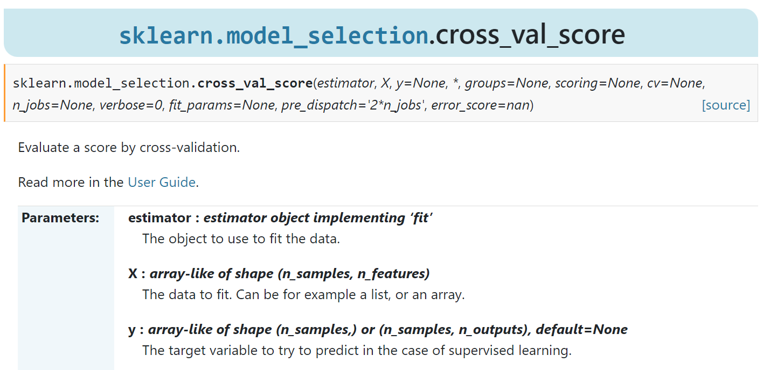
from sklearn.model_selection import cross_val_score
https://scikit-learn.org/stable/modules/generated/sklearn.model_selection.cross_val_score.html

Slide 59
References
https://www.statology.org/k-fold-cross-validation/
https://www.javatpoint.com/cross-validation-in-machine-learning
https://scikit-learn.org/stable/modules/generated/sklearn.model_selection.KFold.html
https://scikit-learn.org/stable/modules/generated/sklearn.model_selection.cross_val_score.html

Slide 60
Regularization
Text

Slide 61
Regularization
Overfitting is a phenomenon that occurs when a Machine Learning model is constrained to the training set and not able to perform well on unseen data.
That is when our model learns the noise in the training data as well.
This is the case when our model memorizes the training data instead of learning the patterns in it.

Slide 62
Regularization
Regularization is a technique used to reduce errors by fitting the function appropriately on the given training set and avoiding overfitting.

Slide 63
Regularization
The commonly used regularization techniques are :
Lasso Regularization – L1 Regularization
Ridge Regularization – L2 Regularization
Elastic Net Regularization – L1 and L2 Regularization

Slide 64
Lasso Regression
LASSO (Least Absolute Shrinkage and Selection Operator)
A regression model which uses the L1 Regularization technique is called LASSO regression.
Lasso Regression adds the “absolute value of magnitude” of the coefficient as a penalty term to the loss function(L).
Lasso regression also helps us achieve feature selection by penalizing the weights to approximately equal to zero if that feature does not serve any purpose in the model.

Slide 65
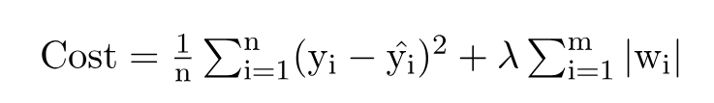
Lasso Regression
where,
m – Number of Features
n – Number of Examples
y_i – Actual Target Value
y_i(hat) – Predicted Target Value

Slide 66
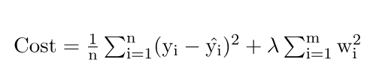
Ridge Regression
A regression model that uses the L2 regularization technique is called Ridge regression.
Ridge regression adds the “squared magnitude” of the coefficient as a penalty term to the loss function(L).

Slide 67

Elastic Net Regression
This model is a combination of L1 as well as L2 regularization.
That implies that we add the absolute norm of the weights as well as the squared measure of the weights.
With the help of an extra hyperparameter (Alpha) that controls the ratio of the L1 and L2 regularization.

Slide 68
Lasso Regression
Key Difference between Ridge Regression and Lasso Regression
Ridge regression is mostly used to reduce the overfitting in the model, and it includes all the features present in the model.
Lasso regression helps to reduce the overfitting in the model as well as feature selection.

Slide 69
Regularization : Program
In this guide, you will learn how to implement the following linear regression models using scikit-learn:
Linear Regression
Ridge Regression
Lasso Regression
Elastic Net Regression
https://www.pluralsight.com/guides/linear-lasso-ridge-regression-scikit-learn

Slide 70
Regularization : Program
The data used in this project was produced from US economic time series data.
available from
[https://www.kaggle.com/datasets/yeonseokcho/economicsdataset]
The data contains 574 rows and 5 variables, as described below:
psavert - personal savings rate.
pce - personal consumption expenditures, in billions of dollars.
uempmed - median duration of unemployment, in weeks.
pop - total population, in thousands.
unemploy- number of unemployed in thousands (dependent variable).

Slide 71
Regularization : Program
Evaluation Metrics
We will evaluate the performance of the model using two metrics - R-squared value and Root Mean Squared Error (RMSE)

Slide 72
Regularization : Program
Steps
In this guide, we will follow the following steps:
Step 1 - Loading the required libraries and modules.
Step 2 - Loading the data and performing basic data checks.
Step 3 - Creating arrays for the features and the response variable.
Step 4 - Creating the training and test datasets.
Step 5 - Build, Predict and Evaluate the regression model.
We will be repeating Step 5 for the various regression models.
The following sections will cover these steps.

Slide 73
Regularization : Program
# Note download the data set from kaggle.
# rename it as regressionexample2.csv
# delete the first (date) column from data set
# run the following code

Slide 74
Regularization : Program : Font Size 1
# https://www.pluralsight.com/guides/linear-lasso-ridge-regression-scikit-learn
# https://www.kaggle.com/datasets/yeonseokcho/economicsdataset
# Note download the data set from kaggle.
# rename it as regressionexample2.csv
# delete the first (date) column from data set
# run the following code
import pandas as pd
import numpy as np
from sklearn import model_selection
from sklearn.linear_model import LinearRegression
from sklearn.linear_model import Ridge
from sklearn.linear_model import Lasso
from sklearn.linear_model import ElasticNet
from sklearn.metrics import r2_score
from sklearn.model_selection import train_test_split
df = pd.read_csv('regressionexample2.csv')
print("Orriginala data set ")
print(df.head())
# Normalization of data
print("Normalized train (divide by max value) data set ")
target_column = ['unemploy']
predictors = list(set(list(df.columns))-set(target_column))
df[predictors] = df[predictors]/df[predictors].max()
df.describe()
print(df.head())
X = df[predictors].values
y = df[target_column].values
X_train, X_test, y_train, y_test = train_test_split(X, y, test_size=0.30, random_state=40)
print(X_train.shape);
print(X_test.shape)
lr = LinearRegression()
lr.fit(X_train, y_train)
pred_train_lr= lr.predict(X_train)
pred_test_lr= lr.predict(X_test)
print("Result for Standard LinearRegression")
print("On Testing Data Score = ", r2_score(y_test, pred_test_lr))
# Ridge Regression
rr = Ridge(alpha=0.01)
rr.fit(X_train, y_train)
pred_test_rr= rr.predict(X_test)
print("Result for Ridge Regression")
print("On Testing Data Score = ", r2_score(y_test, pred_test_rr))
# Lasso Regression
model_lasso = Lasso(alpha=0.01)
model_lasso.fit(X_train, y_train)
pred_test_lasso= model_lasso.predict(X_test)
print("result for Lasso Regression")
print("On Testing Data Score = ", r2_score(y_test, pred_test_lasso))
# ElasticNet Regression
model_enet = ElasticNet(alpha = 0.01)
model_enet.fit(X_train, y_train)
pred_test_enet= model_enet.predict(X_test)
print("Result for ElasticNet Regression")
print("On Testing Data Score = ", r2_score(y_test, pred_test_enet))
# # -*- coding: utf-8 -*-
# """
# Created on Sat Oct 28 21:28:54 2023
# @author: A
# """
# # https://www.pluralsight.com/guides/linear-lasso-ridge-regression-scikit-learn
# # https://www.kaggle.com/datasets/yeonseokcho/economicsdataset
# import pandas as pd
# import numpy as np
# from sklearn import model_selection
# from sklearn.linear_model import LinearRegression
# from sklearn.linear_model import Ridge
# from sklearn.linear_model import Lasso
# from sklearn.linear_model import ElasticNet
# from sklearn.neighbors import KNeighborsRegressor
# from sklearn.tree import DecisionTreeRegressor
# from sklearn.svm import SVR
# from sklearn.ensemble import RandomForestRegressor
# from sklearn.metrics import r2_score
# from sklearn.model_selection import train_test_split
# from sklearn.metrics import mean_squared_error
# from math import sqrt
# df = pd.read_csv('regressionexample2.csv')
# print(df.shape)
# df.describe()
# target_column = ['unemploy']
# predictors = list(set(list(df.columns))-set(target_column))
# df[predictors] = df[predictors]/df[predictors].max()
# df.describe()
# X = df[predictors].values
# y = df[target_column].values
# X_train, X_test, y_train, y_test = train_test_split(X, y, test_size=0.30, random_state=40)
# print(X_train.shape); print(X_test.shape)
# lr = LinearRegression()
# lr.fit(X_train, y_train)
# print("######################################")
# pred_train_lr= lr.predict(X_train)
# pred_test_lr= lr.predict(X_test)
# print(r2_score(y_test, pred_test_lr))
# print(" Result for Standard LinearRegression")
# print("On Testing Data Score = ", r2_score(y_test, pred_test_lr))
# print("######################################")
# print("######################################")
# # Ridge Regression
# rr = Ridge(alpha=0.01)
# rr.fit(X_train, y_train)
# pred_test_rr= rr.predict(X_test)
# print(" Result for Ridge Regression")
# print("On Testing Data Score = ", r2_score(y_test, pred_test_rr))
# print("######################################")
# # Lasso Regression
# model_lasso = Lasso(alpha=0.01)
# model_lasso.fit(X_train, y_train)
# pred_test_lasso= model_lasso.predict(X_test)
# print("result for Lasso Regression")
# print("On Testing Data Score = ", r2_score(y_test, pred_test_lasso))
# print("######################################")
# # ElasticNet Regression
# model_enet = ElasticNet(alpha = 0.01)
# model_enet.fit(X_train, y_train)
# pred_test_enet= model_enet.predict(X_test)
# print("Result for ElasticNet Regression")
# print("On Testing Data Score = ", r2_score(y_test, pred_test_enet))
# print("######################################")
# print("######################################")

Slide 75
import pandas as pd
import numpy as np
from sklearn import model_selection
from sklearn.linear_model import LinearRegression
from sklearn.linear_model import Ridge
from sklearn.linear_model import Lasso
from sklearn.linear_model import ElasticNet
from sklearn.metrics import r2_score
from sklearn.model_selection import train_test_split
df = pd.read_csv('regressionexample2.csv')
print("Orriginala data set ")
print(df.head())

Slide 76
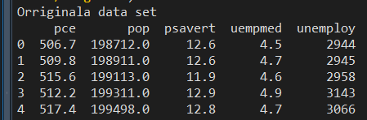

Slide 77
# Normalization of data
print("Normalized train (divide by max value) data set ")
target_column = ['unemploy']
predictors = list(set(list(df.columns))-set(target_column))
df[predictors] = df[predictors]/df[predictors].max()
df.describe()
print(df.head())
X = df[predictors].values
y = df[target_column].values
X_train, X_test, y_train, y_test = train_test_split(X, y, test_size=0.30, random_state=40)
print(X_train.shape);
print(X_test.shape)

Slide 78
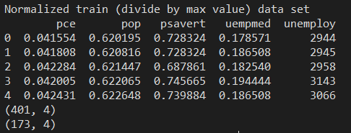

Slide 79
# Standard LinearRegression
lr = LinearRegression()
lr.fit(X_train, y_train)
pred_train_lr= lr.predict(X_train)
pred_test_lr= lr.predict(X_test)
print("Result for Standard LinearRegression")
print("On Testing Data Score = ", r2_score(y_test, pred_test_lr))
Output
Result for Standard LinearRegression
On Testing Data Score = 0.8316156967087425

Slide 80
# Ridge Regression
rr = Ridge(alpha=0.01)
rr.fit(X_train, y_train)
pred_test_rr= rr.predict(X_test)
print("Result for Ridge Regression")
print("On Testing Data Score = ", r2_score(y_test, pred_test_rr))
Output
Result for Ridge Regression
On Testing Data Score = 0.8330386695177572

Slide 81
# Lasso Regression
model_lasso = Lasso(alpha=0.01)
model_lasso.fit(X_train, y_train)
pred_test_lasso= model_lasso.predict(X_test)
print("result for Lasso Regression")
print("On Testing Data Score = ", r2_score(y_test, pred_test_lasso))
Output
result for Lasso Regression
On Testing Data Score = 0.8316452818380049

Slide 82
# ElasticNet Regression
model_enet = ElasticNet(alpha = 0.01)
model_enet.fit(X_train, y_train)
pred_test_enet= model_enet.predict(X_test)
print("Result for ElasticNet Regression")
print("On Testing Data Score = ", r2_score(y_test, pred_test_enet))
Output
Result for ElasticNet Regression
On Testing Data Score = 0.7059436829753674

Slide 83
Result for Standard LinearRegression
On Testing Data Score = 0.8316156967087425
Result for Ridge Regression
On Testing Data Score = 0.8330386695177572
result for Lasso Regression
On Testing Data Score = 0.8316452818380049
Result for ElasticNet Regression
On Testing Data Score = 0.7059436829753674
Conclusion
Linear Regression Model: R-square of 83.1615 percent.
Ridge Regression Model: R-square of 83.30 percent. Best
Lasso Regression Model: R-square of 83.1645 percent.
ElasticNet Regression Model: R-square of 70.59 percent.

Slide 84
References
# https://www.pluralsight.com/guides/linear-lasso-ridge-regression-scikit-learn
# https://www.kaggle.com/datasets/yeonseokcho/economicsdataset

Slide 85
Bias-variance Analysis
What is Bias?
The bias is known as the difference between the prediction of the values by the Machine Learning model and the correct value.
Being high in biasing gives a large error in training as well as testing data.
It recommended that an algorithm should always be low-biased to avoid the problem of underfitting.

Slide 86
Bias-variance Analysis
What is Bias?
By high bias, the data predicted is in a straight line format, thus not fitting accurately in the data in the data set.
Such fitting is known as the Under fitting of Data.
This happens when the hypothesis is too simple or linear in nature.

Slide 87
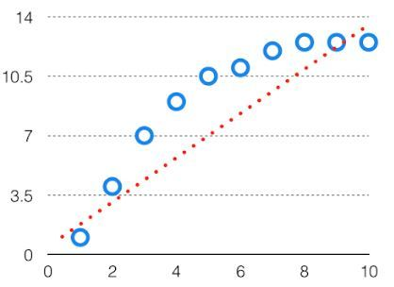
Bias-variance Analysis
Refer to the graph given below for an example of such a situation.

Slide 88
Bias-variance Analysis
What is Variance?
The model with high variance has a very complex fit to the training data and thus is not able to fit accurately on the data which it hasn’t seen before.
As a result, such models perform very well on training data but have high error rates on test data.
When a model is high on variance, it is then said to as Overfitting of Data.

Slide 89
Bias-variance Analysis
What is Variance?
Overfitting is fitting the training set accurately via complex curve and high order hypothesis but is not the solution as the error with unseen data is high.

Slide 90
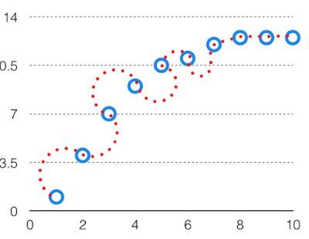
Bias-variance Analysis
The high variance data looks as follows.

Slide 91
Bias Variance Tradeoff
Bias Variance Tradeoff
If the algorithm is too simple (hypothesis with linear equation) then it may be on high bias and low variance condition and thus is error-prone.
If algorithms fit too complex (hypothesis with high degree equation) then it may be on high variance and low bias.
In the latter condition, the new entries will not perform well.

Slide 92
Bias Variance Tradeoff
Well, there is something between both of these conditions, known as a Trade-off or Bias Variance Trade-off.
This tradeoff in complexity is why there is a tradeoff between bias and variance.
An algorithm can’t be more complex and less complex at the same time.

Slide 93
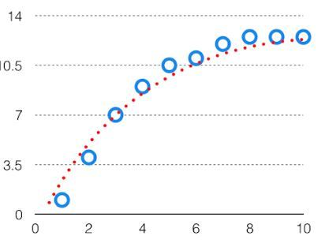
Bias Variance Tradeoff
For the graph, the perfect tradeoff will be like this.

Slide 94
Bias Variance Tradeoff
We try to optimize the value of the total error for the model by using the Bias-Variance Tradeoff.
The best fit will be given by the hypothesis on the tradeoff point.
The error to complexity graph to show trade-off is given as –

Slide 95
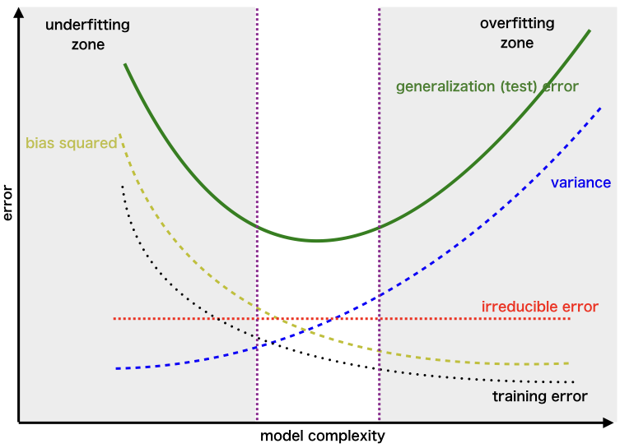
The error to complexity graph to show trade-off is given as –

Slide 96
Bias Variance Tradeoff
This is referred to as the best point chosen for the training of the algorithm which gives low error in training as well as testing data.

Slide 97
References
https://www.geeksforgeeks.org/ml-bias-variance-trade-off/

Slide 98
END

