Slide 1
TCP connection

Slide 2
TCP is connection-oriented.
It establishes a virtual path between the source and destination.
All of the segments belonging to a message are sent over this virtual path.
TCP, which uses the services of IP, a connectionless protocol, can be connection- oriented.
The point is that a TCP connection is virtual, not physical.
TCP operates at a higher level.
TCP uses the services of IP to deliver individual segments to the receiver, but it controls the connection itself.
If a segment is lost or corrupted, it is retransmitted.
This protocol works based on full duplex mode.

Slide 3
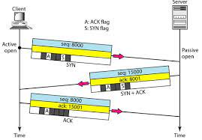
Connection establishment using three-way handshake

Slide 4
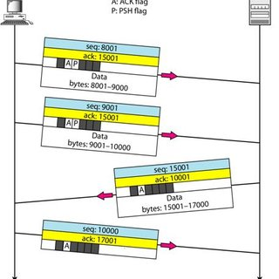
Data transfer

Slide 5
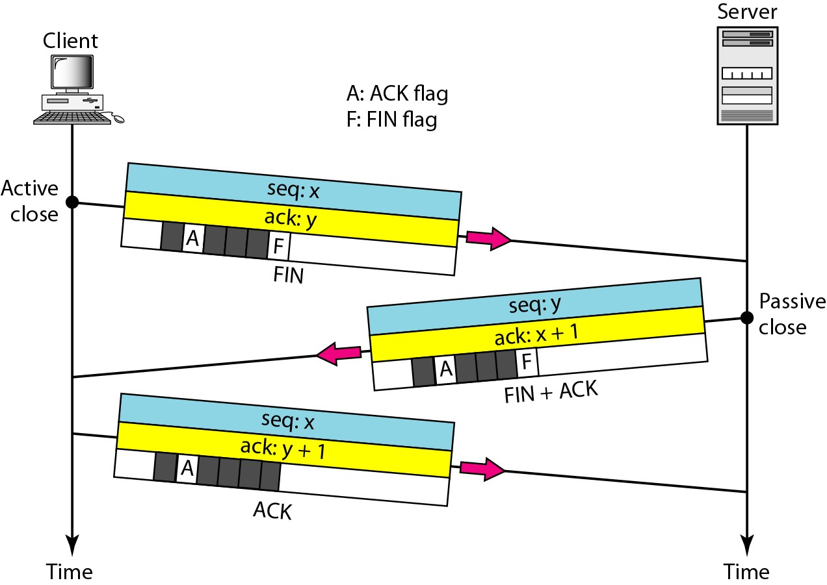
Connection termination using three-way handshaking

Slide 6
TCP Window Management (Control Flow)
TCP uses two windows (send window and receive window) for each direction of data transfer, which means four windows for a bidirectional communication
To make the discussion simple, we make an assumption that communication is
only unidirectional
The bidirectional communication can be inferred using two unidirectional communications with piggybacking

Slide 7
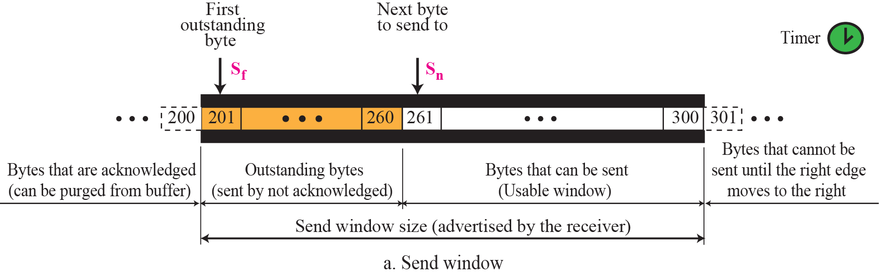
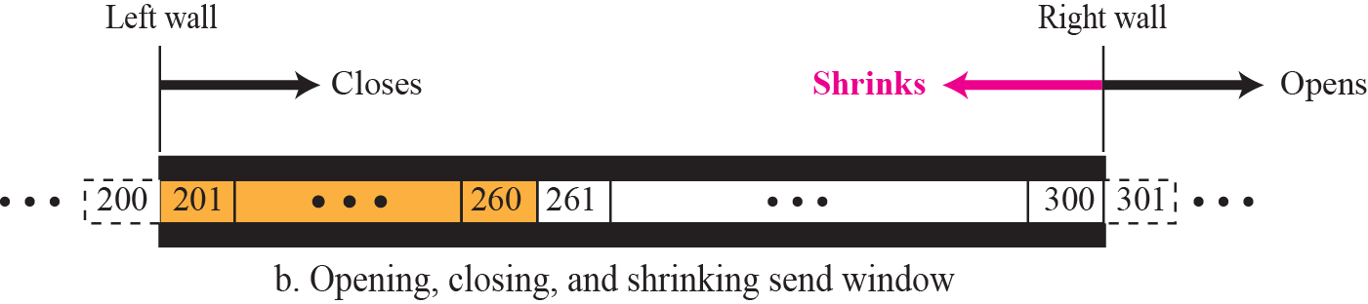
Send window in TCP

Slide 8
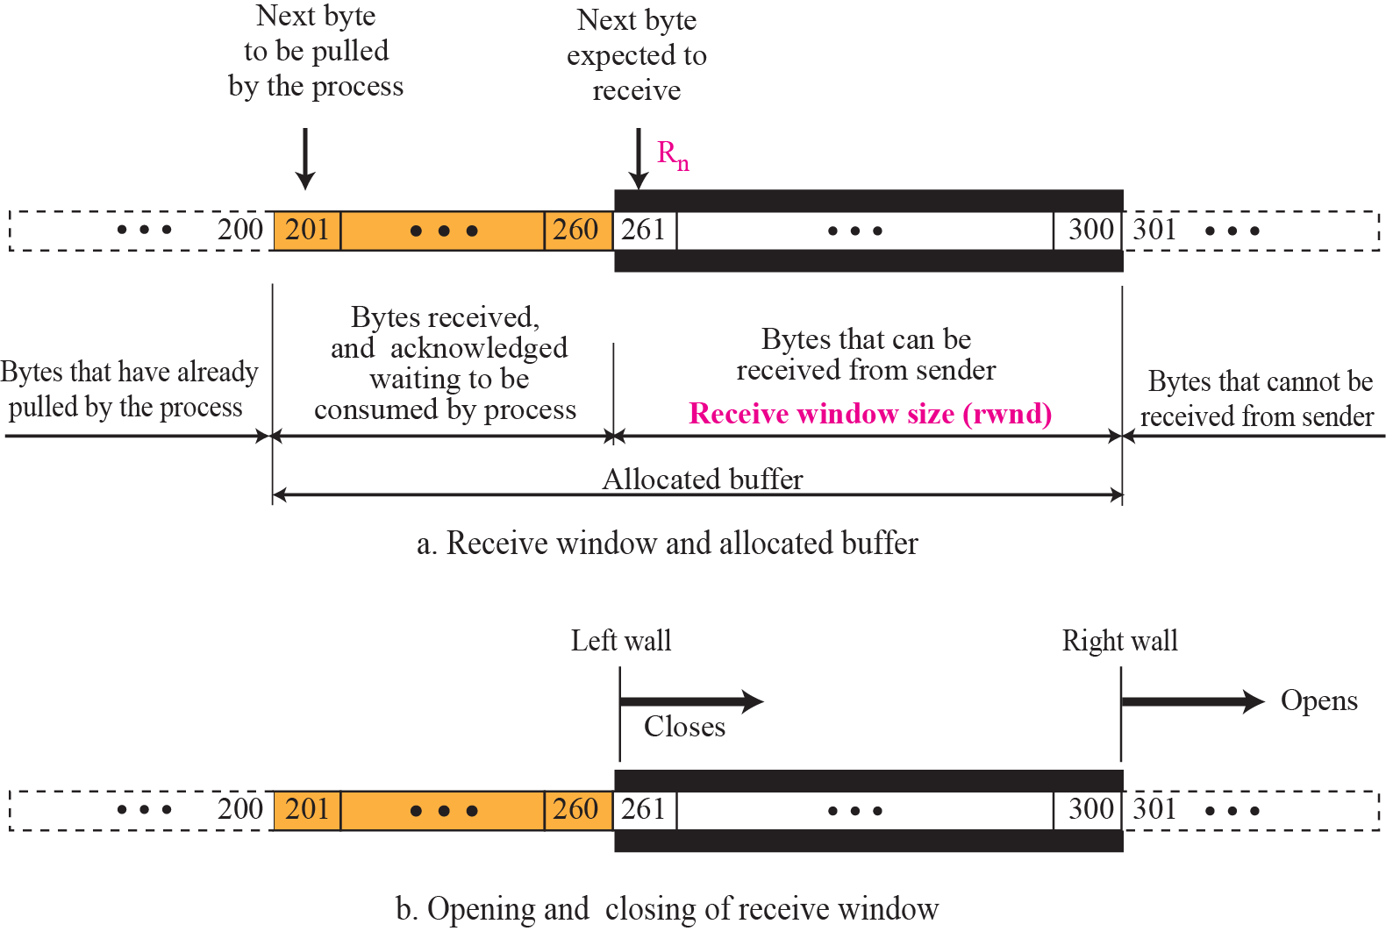
Receive window in TCP

Slide 9
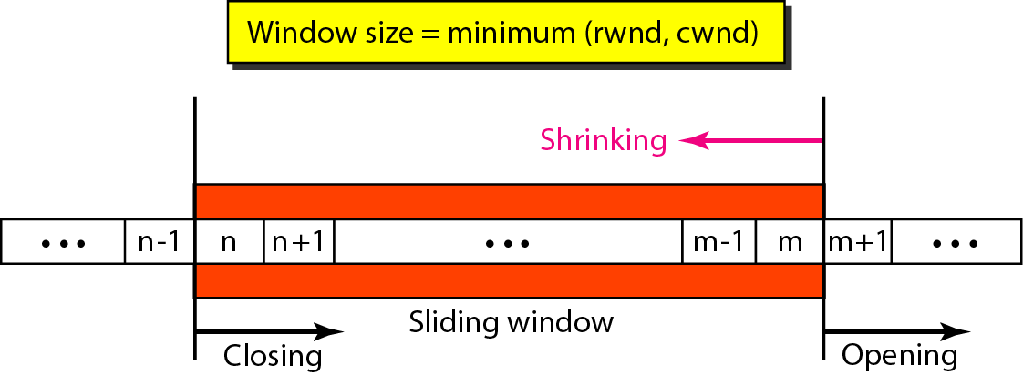
Sliding window
A sliding window is used to make transmission more efficient as well as to control the flow of data so that the destination does not become overwhelmed with data.
TCP sliding windows are byte-oriented

Slide 10
What is the size of the window for host A if the value of rwnd is 3000 bytes and the value of cwnd is 3500 bytes?
Solution
The size of the window is the smaller of rwnd and cwnd, which is 3000 bytes

Slide 11
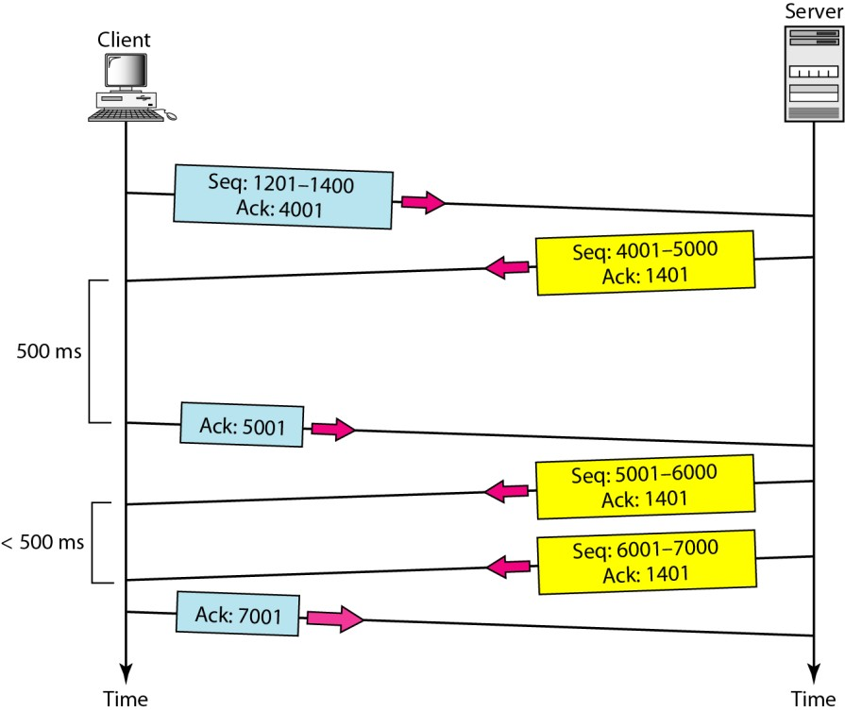
Normal operation

Slide 12
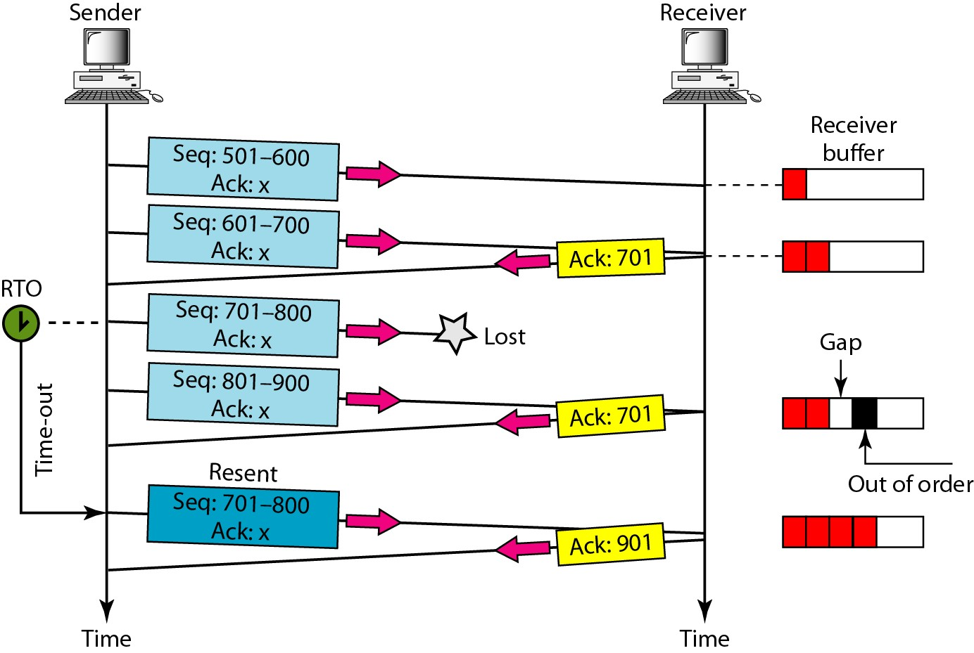
Lost segment

Slide 13
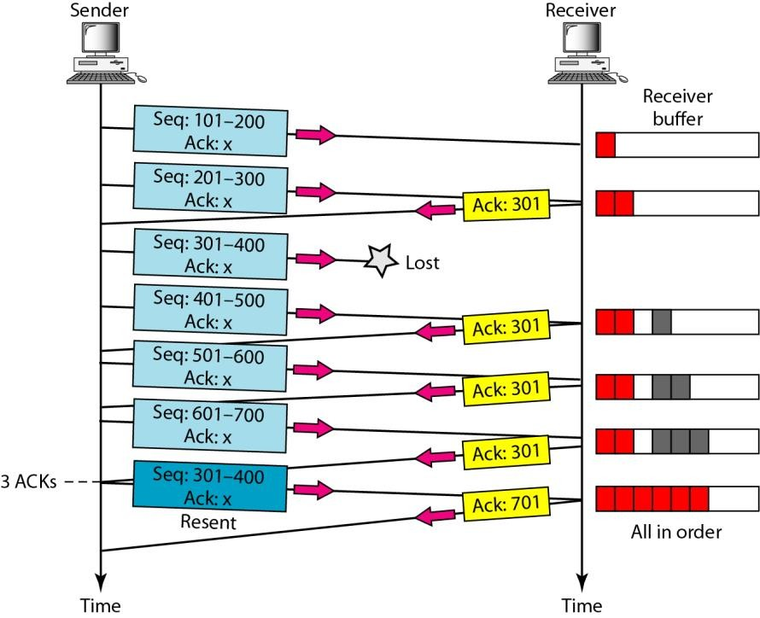
Fast retransmission
The receiver TCP delivers only ordered data to the process

Slide 14
UDP
The User Datagram Protocol (UDP) is called a connectionless, unreliable transport protocol
It does not add anything to the services of IP except to provide process-to process communication instead of host-to-host communication

Slide 15
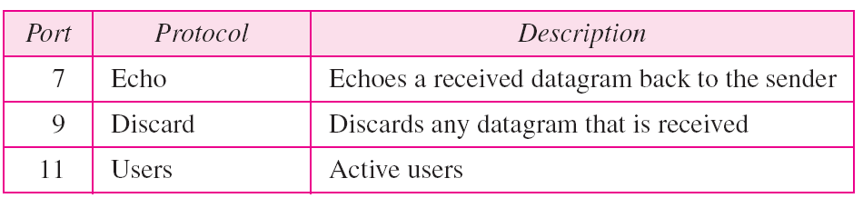
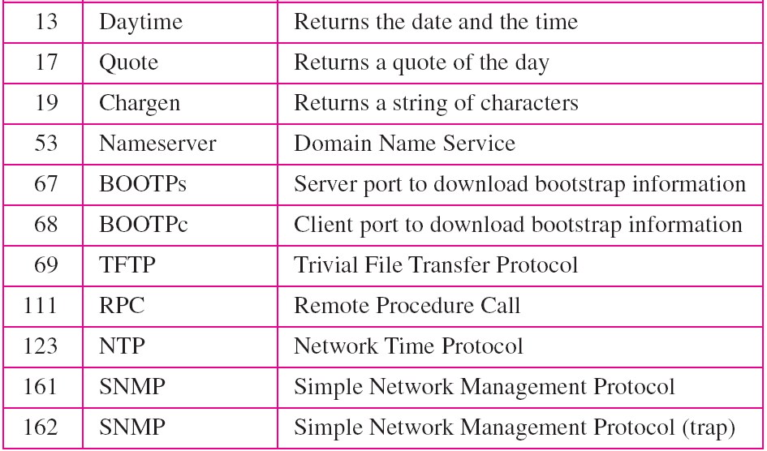
Well-known ports used with UDP

Slide 16
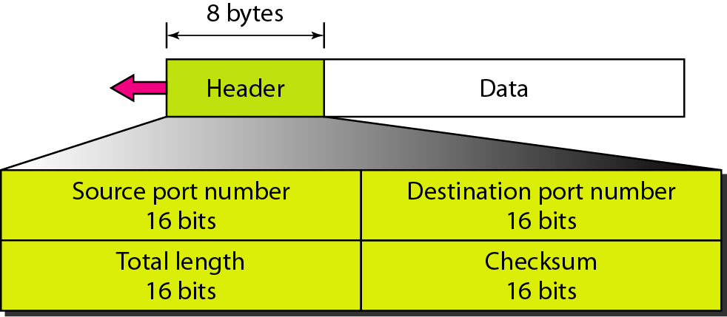
UDP format

Slide 17
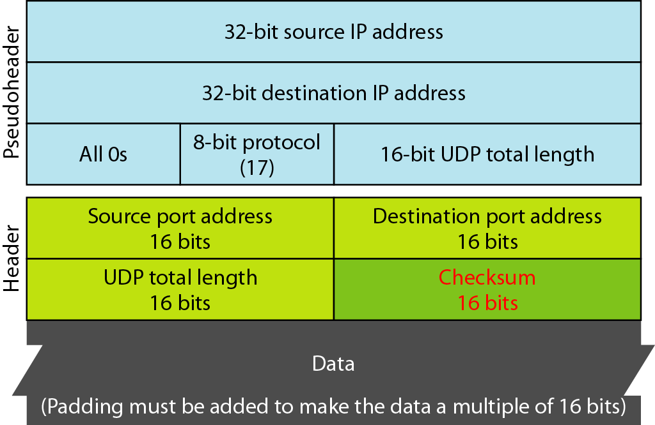
Pseudo-header for checksum calculation

Slide 18
UDP provides
best effort delivery
Connectionless
Unreliable
Out of order delivery
TCP
Reliable
In-order delivery
Congestion control
Flow control
Connection setup

