Slide 1
IPv6
The network layer protocol in the TCP/IP protocol suite is currently IPv4.
Although IPv4 is well designed, data communication has evolved since the inception of IPv4 in the 1970s.
IPv4 has some deficiencies that make it unsuitable for the fast-growing Internet.
It is based on the 128 bits protocol

Slide 2
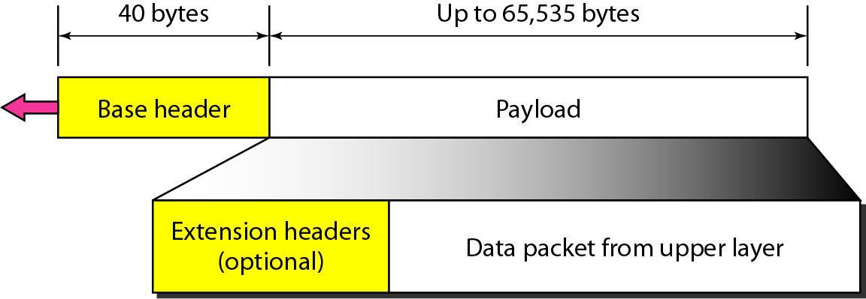
IPv6 datagram header and payload

Slide 3
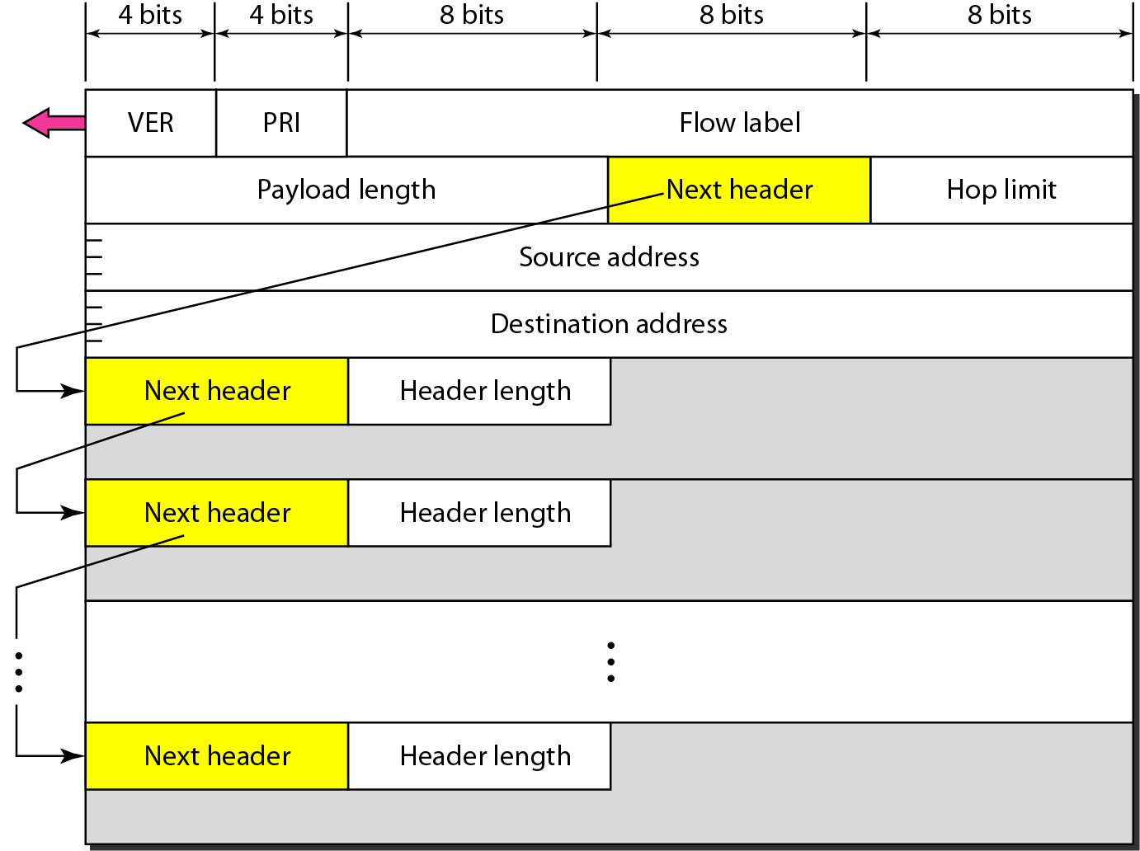
Format of an IPv6 datagram

Slide 4
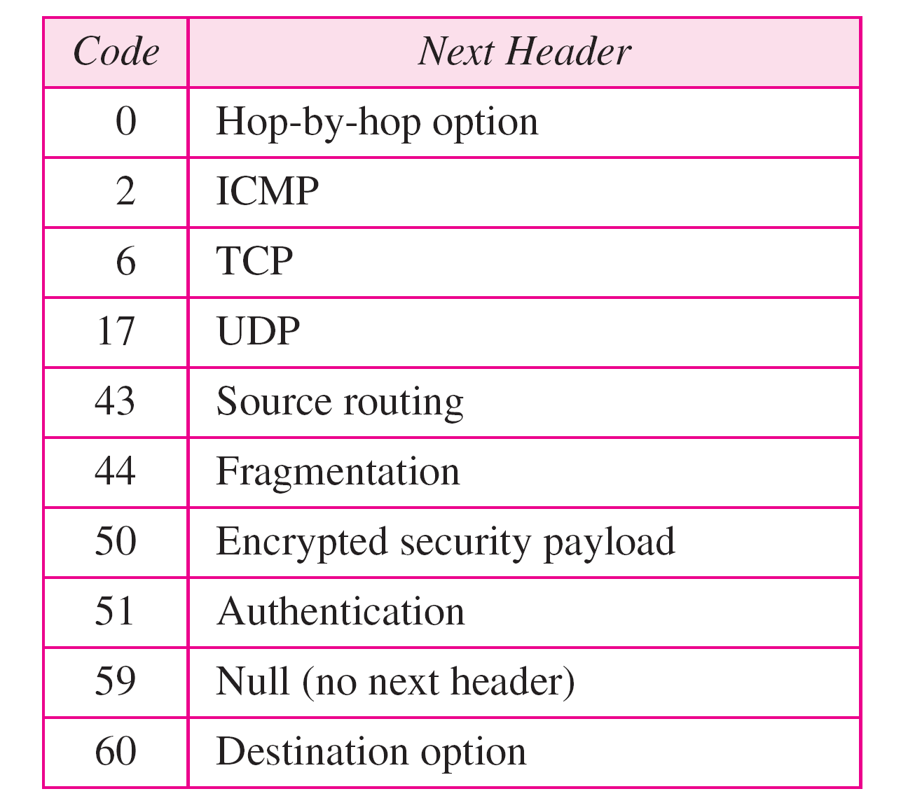
Next header codes for IPv6

Slide 5
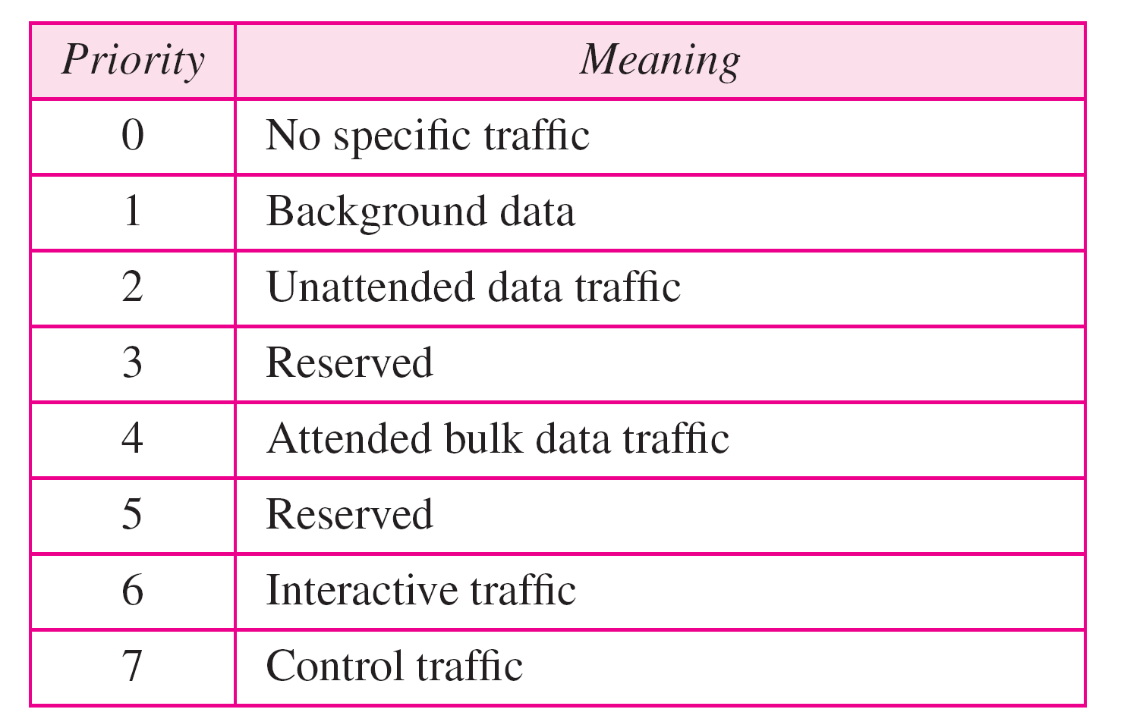
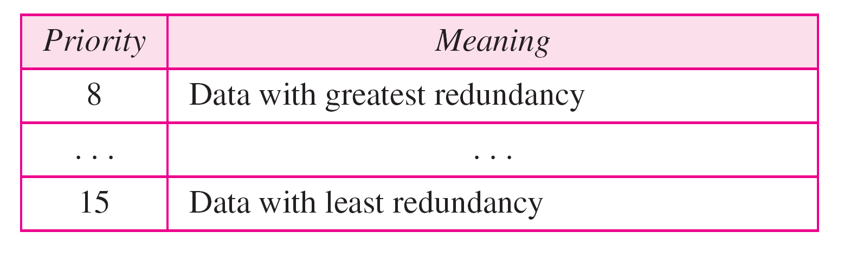
Priorities for noncongestion-controlled traffic
Priorities for congestion-controlled traffic

Slide 6
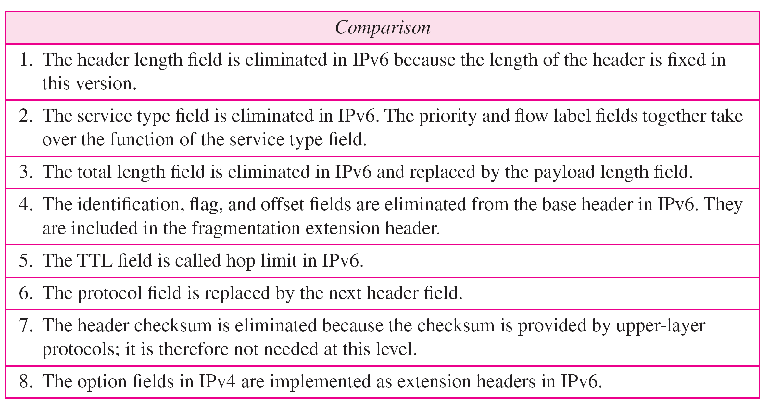
Comparison between IPv4 and IPv6 packet headers

Slide 7
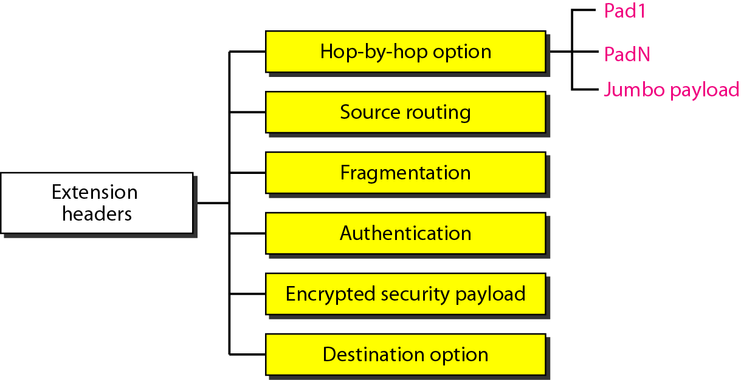
Extension header types

Slide 8
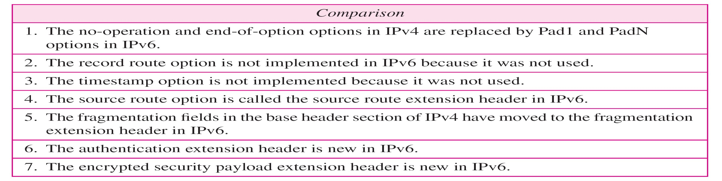
Comparison between IPv4 options and IPv6 extension headers

Slide 9
Transition from IPv4 to IPv6
Because of the huge number of systems on the Internet, the transition from IPv4 to IPv6 cannot happen suddenly
It takes a considerable amount of time before every system in the Internet can
move from IPv4 to IPv6
The transition must be smooth to prevent any problems between IPv4 and IPv6 systems

Slide 10
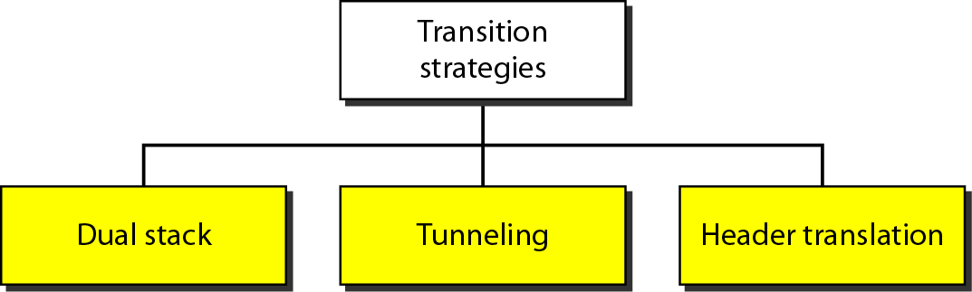
Three transition strategies

Slide 11
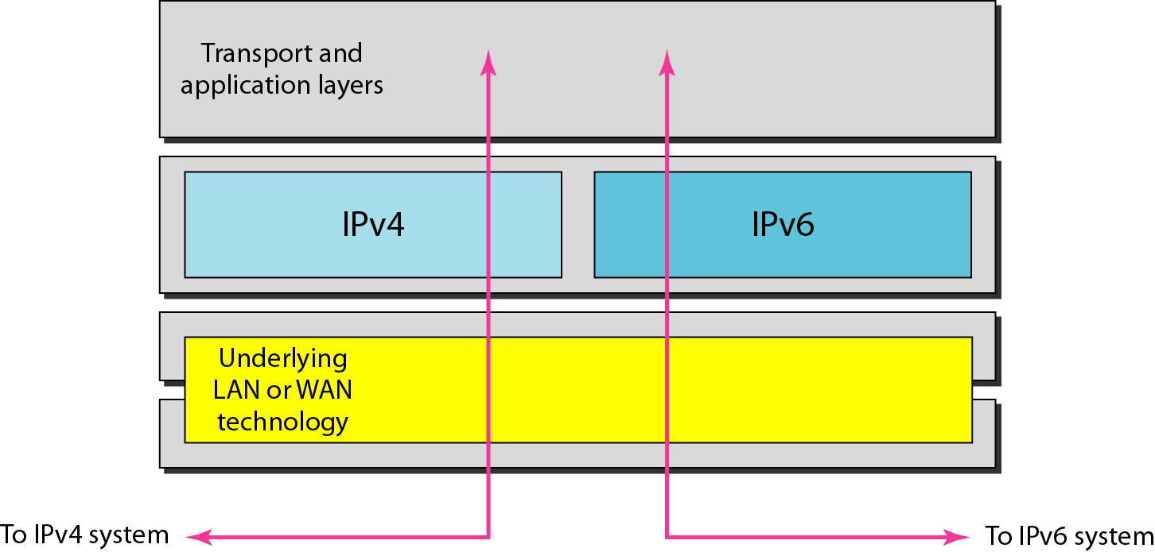
Dual stack
If both the end stations support IPv6, they can communicate using IPv6; otherwise they will communicate using IPv4.
This will allow both IPv4 and IPv6 to coexist and slow transition from IPv4 to IPv6 can happen.

Slide 12
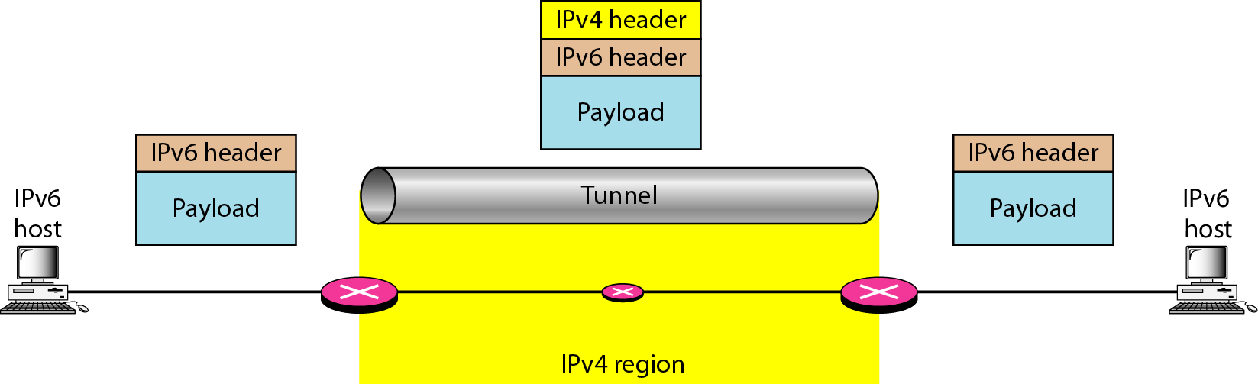
Tunneling strategy
This allows encapsulating IPv6 packets in IPv4 packets for transport over IPv4 only network.
This will allow IPv6 only end stations to communicate over IPv4 only networks.

Slide 13
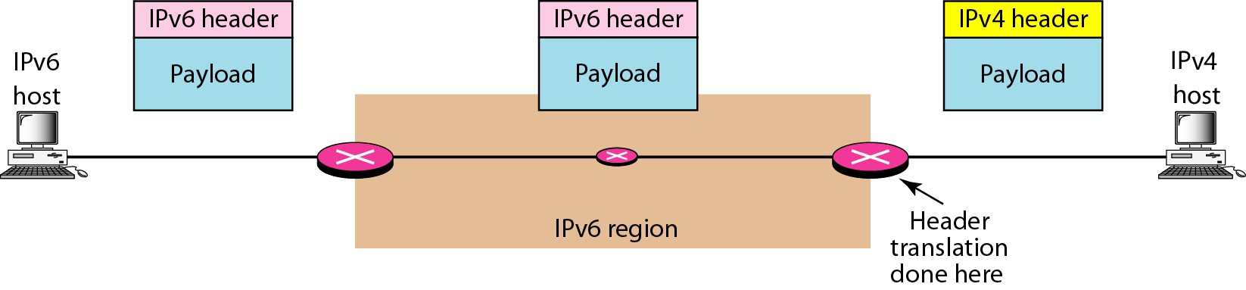
Header translation strategy
This allows communication between IPv4 only and IPv6 only end stations.
The job of the translator is to translate IPv6 packets into IPv4 packets by doing address and port translation and vice versa.

Slide 14
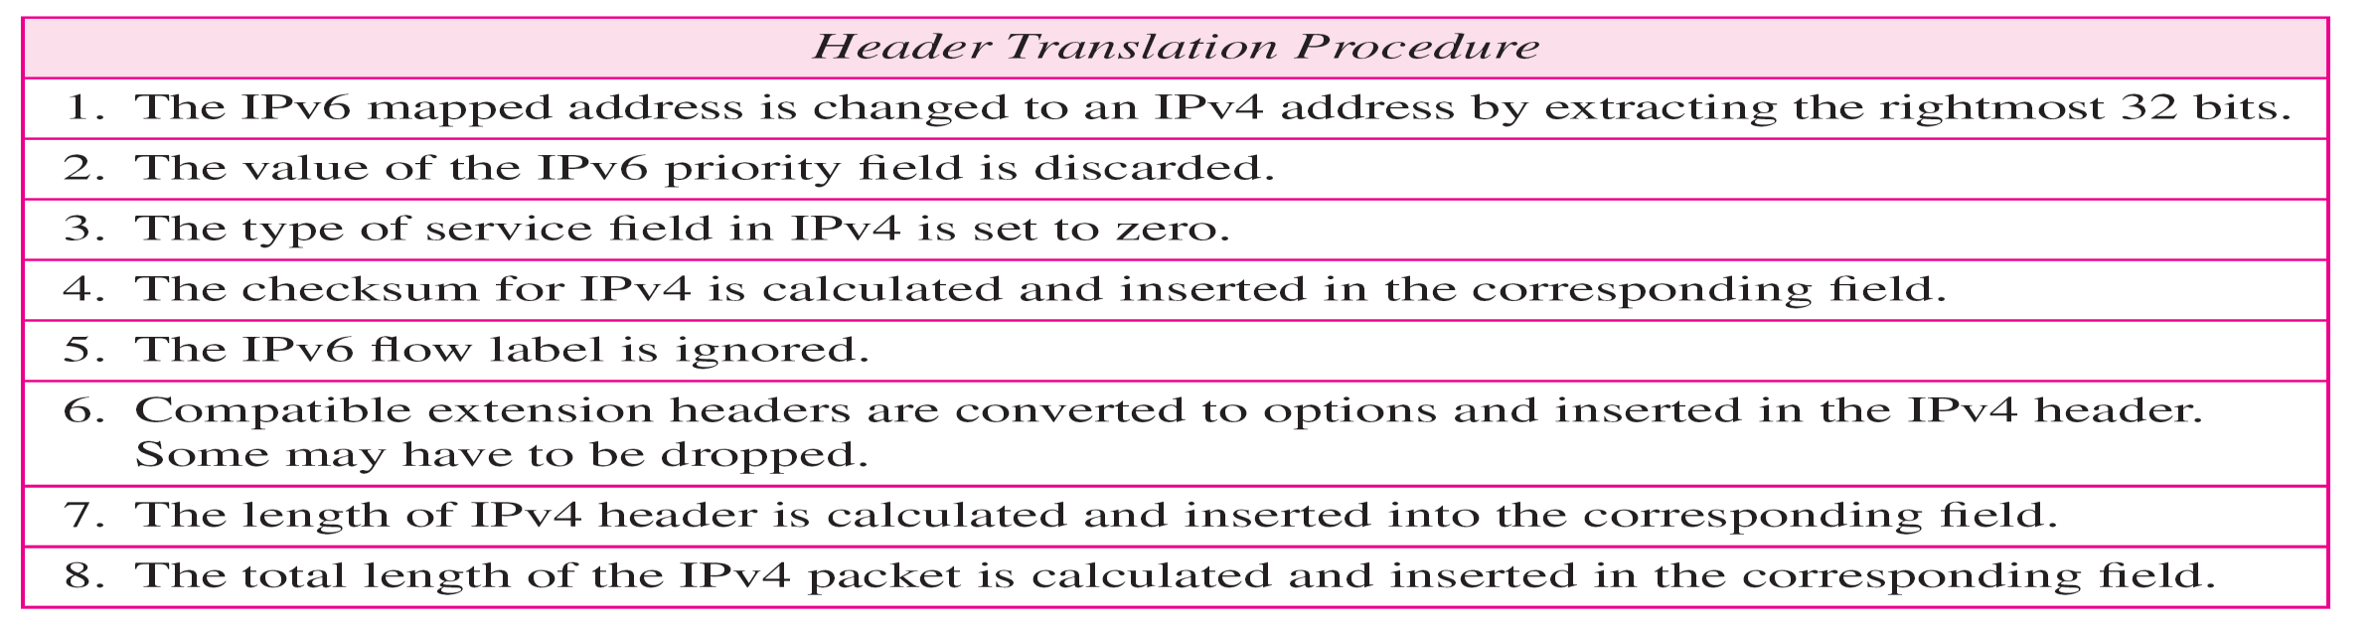
Header translation

