Slide 1


Slide 2

OJT (on Job Training) - 1
College Name : Government polytechnic Udupi (GPT)
Project Name : Password Cracker
Team Members : Vaibhav
Naman
Tanish
Sujan Naik

Slide 3
PROJECT SUMMARY
Password Cracker
Defination : A password cracker is a program that attempts to break passwords to gain access to a system or account.
Use Cases :
* Ethical hacking & cybersecurity testing – to find weak passwords
* Security auditing – to improve system protection. It can also be used illegally to hack accounts

Slide 4
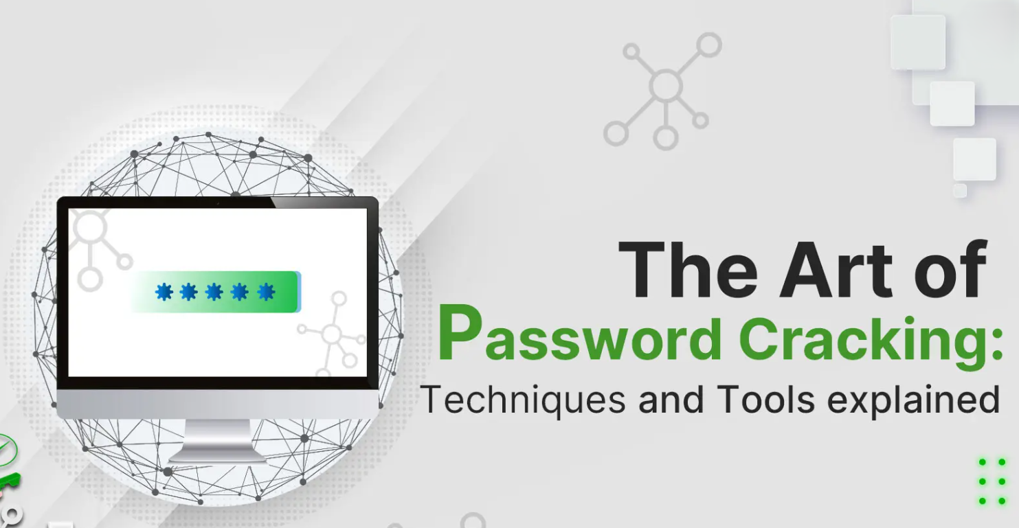

Slide 5
Techniques
Password Spraying
Phishing
Malware
Brute Force Attack
Mask Attack
Spidering
MITM
Attack
Rainbow Tables
Credential Stuffing
Dictionary Attack

Slide 6
Brute Force Attack
Malware
Password Spraying
Phishing
Techniques
Credential Stuffing
Rainbow Tables
Dictionary Attack
MITM
Attack
Mask Attack
Spidering

Slide 7
EXPLAINATION:
Brute Force Attack : In a brute-force password attack, a hacker tries to access a secure user account through trial and error.
Password Spraying : A password spray attack is a type of brute force attack in which, rather than trying many random passwords against a single account.
Credential Stuffing : In a credential stuffing attack, hackers use compromised credentials, to log in to other user accounts.
Dictionary Attack : a hacker systematically enters common words and word variations from a specific, preselected list.
Mask Attack : A mask attack is similar to a dictionary attack, but it's a far more targeted brute-force technique.
Spidering : Spidering is also intended to support a dictionary attack and similarly requires some dedicated effort on the part of the hacker.
MITM(Man In The Middle)Attack : involve eavesdropping on or otherwise intercepting sensitive communications between the app or website a user is connected.
Rainbow Tables : are comprehensive directories that use a password hash algorithm to list out every possible plaintext version of an encrypted password.
Phishing : A phishing attack is less about cracking passwords and more about getting users.
Malware : refers to programs that are designed specifically for stealing passwords.

Slide 9
4. Medusa
5. Rainbow Crack
3. THC Hydra
6. Aircrack-ng
2. Wfuzz
1. Hashcat
7. Brutus
Fig : TOOLS

Slide 10
EXPLAINATION:
Hashcat : Hashcat is one of the most popular and widely used password cracking software tools in existence
Wfuzz :Wfuzz is a web application password-cracking tool that tries to crack passwords via a brute-force guessing attack.
THC Hydra : THC Hydra is an online password-cracking tool that attempts to determine user credentials via a brute-force password-guessing attack.
Medusa : Medusa is an online password-cracking tool similar to THC Hydra. It claims to be a speedy parallel, modular and login brute-forcing tool.
Rainbow Crack : If an attacker has precomputed a table of password/hash pairs and stored them as a “rainbow table,” then the password-cracking process is simplified to a table lookup.
Aircrack-ng : Aircrack-ng is a Wi-Fi password-cracking tool that can crack WEP or WPA/WPA2 PSK passwords.
Brutus : Brutus was one of the most popular remote online password-cracking tools. It claims to be the fastest and most flexible password-cracking tool.

Slide 11


