Slide 1

  Project: University suggestion and complaint
  and psychological consultation appointment form
  Submitted by : Vaibhav Thakur(181368)
  Apoorav Chaudhary (181371)
  Submitted to : Dr. Aman Sharma

Slide 2
TECHNOLOGIES USED:
HTML(HYPER TEXT MARKUP LANGUAGE)
We have used HTML and added parallax in the webpage aligned texts and added various font styles and background images in the webpage. We have also added various hyperlinks to our webpage using html
CSS(CASCADING STYLE SHEETS)
We have used external CSS to align our text and to add
Various background colours as well as background styles in our webpage we have also created various container within the front-end of webpage to add additional information.

Slide 3
PHP(HYPERTEXT PREPROCESSOR)
We have used php in our project to write server side scripts we have used it for taking input and storing it in the database .
Wamp Server (WINDOWS, APACHE,MYSQL AND PHP)
We have used wamp to use our computer as a local server
and host websites on it.
PHPMYADMIN
We have used phpmyadmin to create database for storing various types of data .

Slide 4
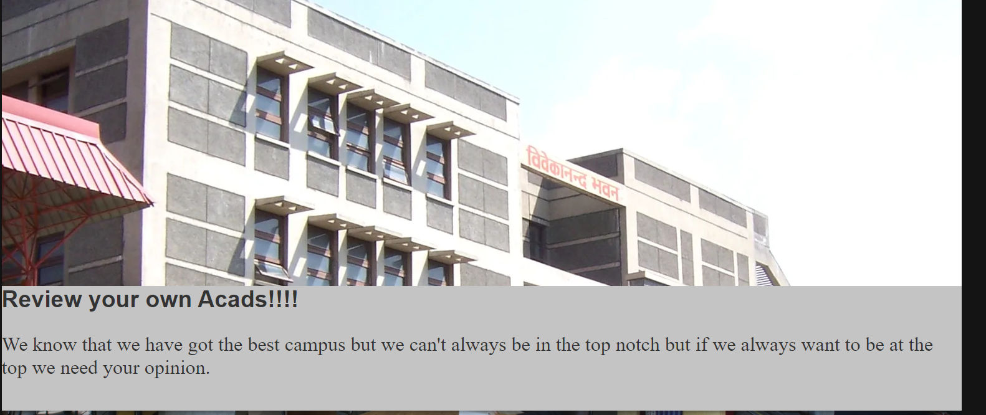
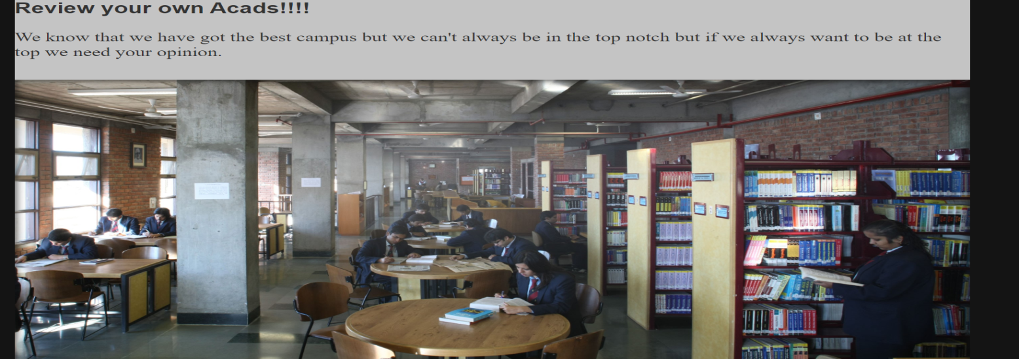
The Main Page
We have created the main page using HTML and CSS and added various division as well as containers for logo
We have added a parallax effect to our webpage and all the information regarding our college within that mainpage. We have also added various hyperlinks to our survey and suggestion forms and a hyperlink to college website as well.
In our code we have implemented external CSS for font style ,background images and aligning texts.

Slide 5
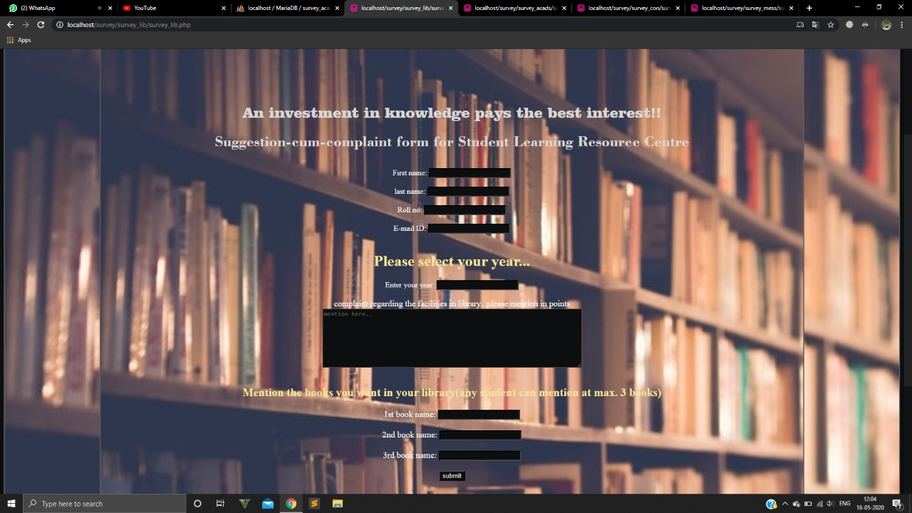
Library suggestion cum complaint form
We have created a form for complaints and feedbacks related to library and we have taken various inputs and stored it in our database and in the suggestion column we have added an additional field where students can tell about the books which they require to be in the library.

Slide 6
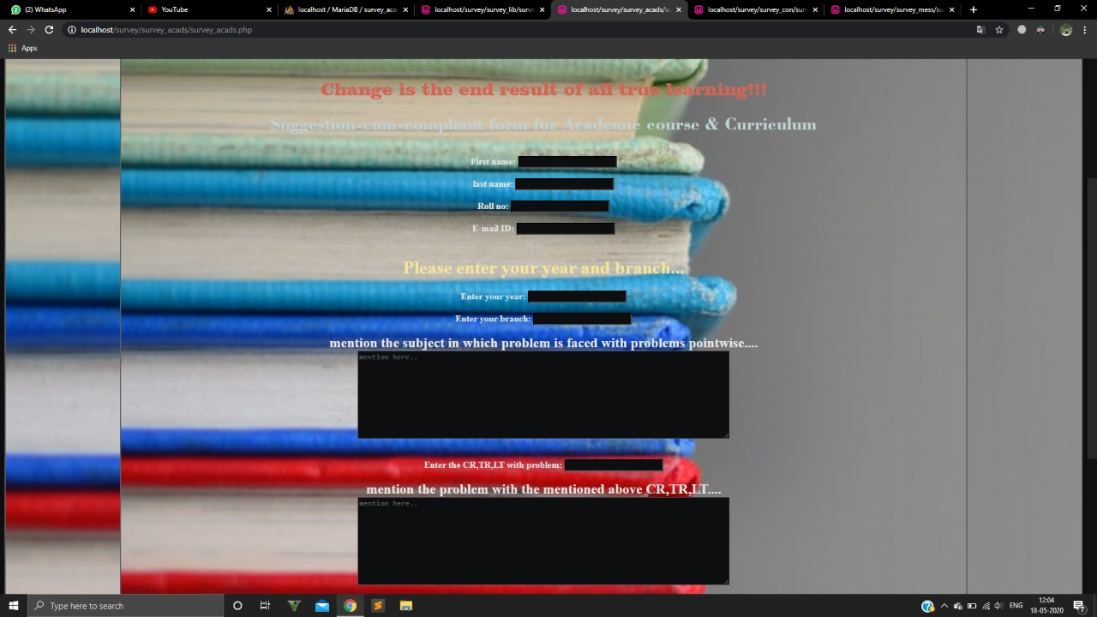
Academics and curriculum suggestion cum complaint form
We have created a form for academics and curriculum related complaints and feedbacks and we have taken various inputs and stored it in our database

Slide 7
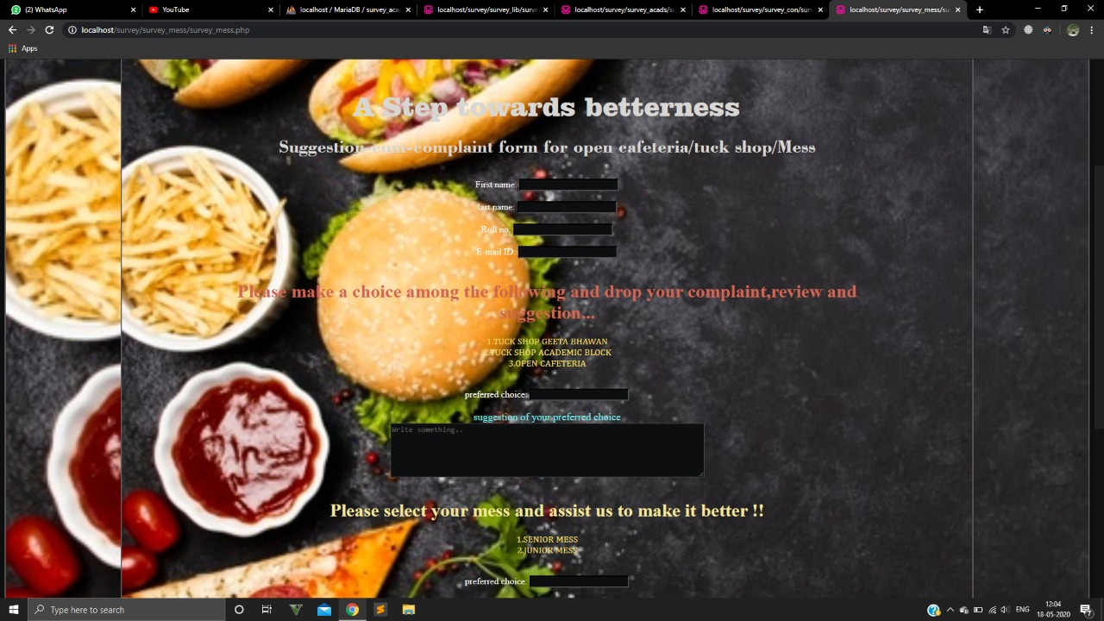
Mess and cafeteria suggestion cum complaint form
We have created a form for Mess and cafeteria related complaints and feedbacks and we have taken various inputs and stored it in our database .

Slide 8
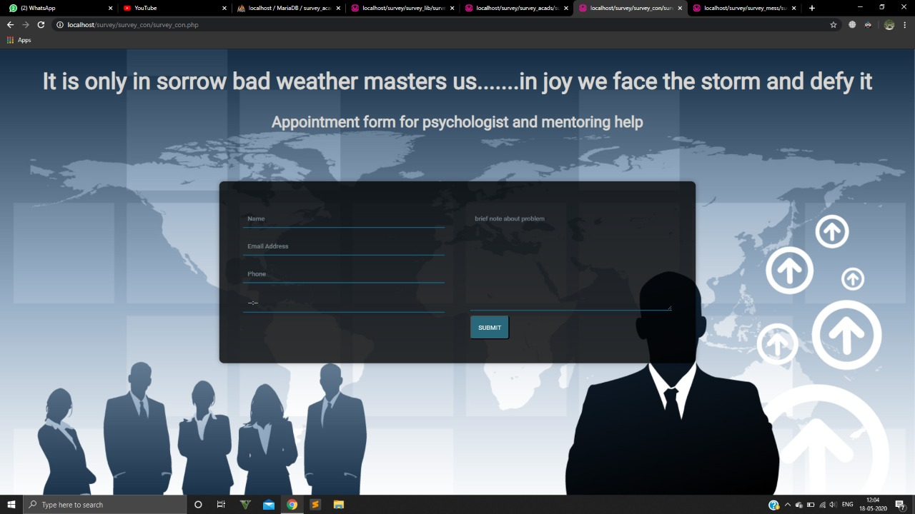
Psychological Consultation appointment form
We have created a form for Psychological Consultation appointment so that any student can take apointments of the college psychologist if he/ she is facing any mental problems.

Slide 9
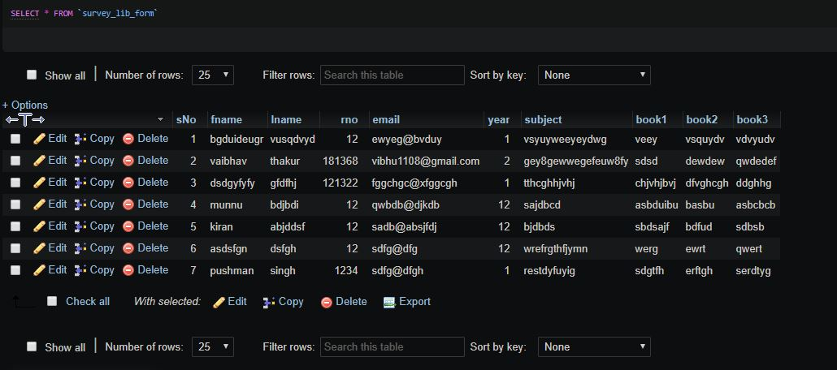
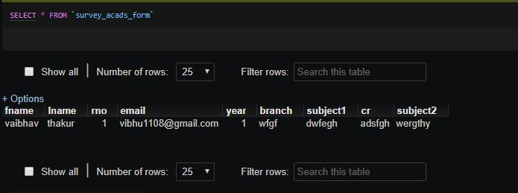
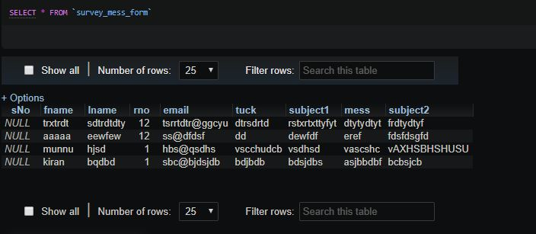
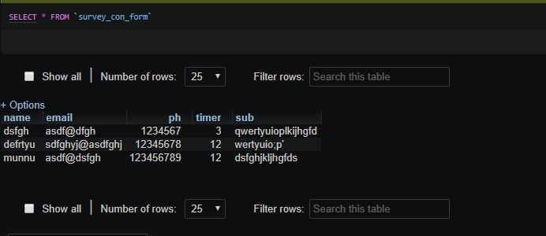
Database
Using phpmyadmin we have created various databases and used them to store data of all our survey forms through SQL in phpmyadmin we have created various tables within our database which store variety of data, we have created tables for storing names , roll no. ,gender and suggestions or feedbacks within our database.

Slide 10
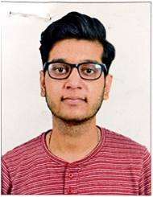
We have referred to various sources for the successful completion of our project
  W3School
  StackOverflow
  MDN
  TutorialPoint
At last we would like to give a special thanks to our mentor Dr. Aman Sharma for guiding our way in making this project a success .

