Slide 1
Heart Disease prediction using machine learning techniques
-Vaibhav Jumde
Under guidance of :
Dr. Ruby Jain mam & Prof. Kumar Sanjay Bhorekar sir

Slide 2
Introduction
As indicated by the World Health Organization, consistently 12 million passing happen worldwide because of Heart Disease. The heap of cardiovascular illness is quickly expanding everywhere on the world from the previous few years. Numerous explores have been directed in endeavor to pinpoint the most powerful factors of coronary illness just as precisely anticipate the general danger.
Coronary illness is even featured as a quiet executioner which prompts the passing of the individual without clear side effects. The early conclusion of coronary illness assumes a crucial part in settling on choices on way of life changes in high-hazard patients and thusly decrease the complexities.

Slide 3
Heart Disease Prediction
Heart disease is one of the biggest causes of morbidity and mortality among the population of the world. Prediction of cardiovascular disease is regarded as one of the most important subjects in the section of clinical data analysis.
The amount of data in the healthcare industry is huge. Data mining turns the large collection of raw healthcare data into information that can help to make informed decisions and predictions.

Slide 4
Objectives:
The main purpose of this project is how many people suffering from heart disease, by implementing various machine learning Algorithm.
To determine accuracy by applied algorithms on that particular medical dataset which may lead to heart disease.
To determined accuracy through analyzing the data.

Slide 5
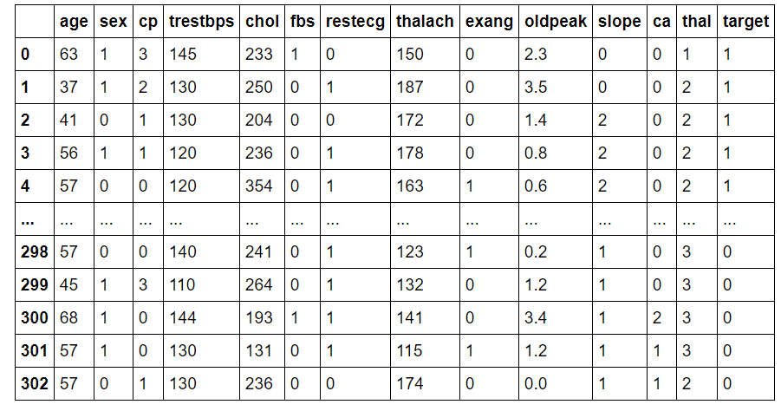
Data set of Heart Disease Prediction

Slide 6
Data Preprocessing
Data preprocessing is a data mining technique which is used to transform the raw data in a useful and efficient format.
It is a process of preparing the raw data and making it suitable for a machine learning model. It is the first and crucial step while creating a machine learning model.
When creating a machine learning project, it is not always a case that we come across the clean and formatted data. And while doing any operation with data, it is mandatory to clean it and put in a formatted way. So for this, we use data pre-processing task.

Slide 7
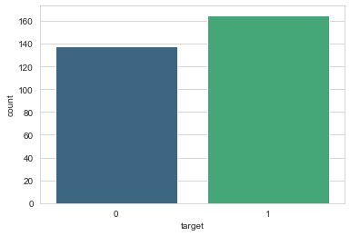
Count Plot:
Fig. Count plot from the data set

Slide 8
Algorithms:
1. K-Nearest Neighbour Algorithm
2. Support Vector Machine Algorithm 2. Random Forest Learning Algorithm

Slide 9
1. K-NN Algorithm
K-Nearest Neighbour is one of the simplest machine learning algorithms based on Supervised learning technique.
knn algorithm assumes the similarity between the new case/data and available cases and put the new case into the category that is most similar to the available categories.

Slide 10
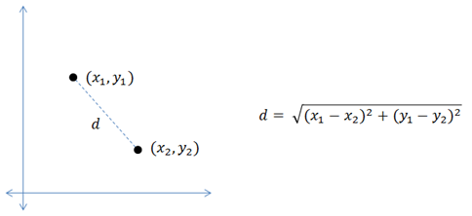
How K-NN Algorithm Works?
K-NN works on a principle assuming every data point falling in near to each other is falling in the same class. In other words it classifies a new data point based on similarity
Euclidean Distance:

Slide 11
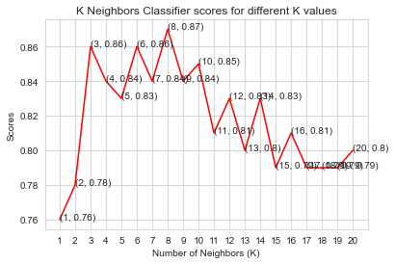
KNN Classifier Score

Slide 12
By the performance of K-NN algorithm the accuracy is, 0.8448387096774195

Slide 13
2. Support Vector Machine Algorithm
Support Vector Machine (SVM) is a supervised machine learning algorithm which can be used for both classification or regression challenges.
The goal of the SVM algorithm is to create the best line or decision boundary that can segregate n-dimensional space into classes so that we can easily put the new data point in the correct category in the future. This best decision boundary is called a hyperplane.

Slide 14
How SVM Algorithm Works?
we have a classification problem where we have to separate the red data points from the blue ones.
Since it is a two-dimensional problem, our decision boundary will be a line, for the 3-dimensional problem we have to use a plane, and similarly, the complexity of the solution will increase with the rising number of features.

Slide 15
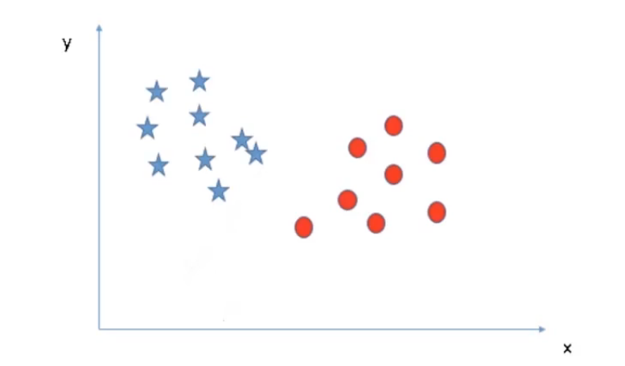
SVM Algorithm working plot

Slide 16
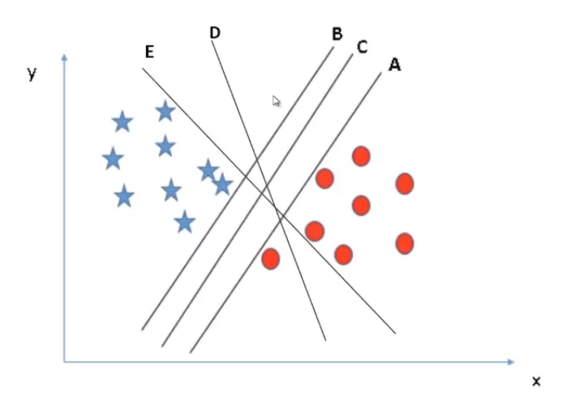
There are few rules that can help us to identify the best line.
Maximum classification and Best Separation.
Maximum classification:
The selected line must be able to successfully segregate all the data points into the respective classes. But we can clearly see lines E and D are miss classifying a red data point. See the below figure
Hence, for this problem lines A, B, C is better than E and D. So we will drop them.

Slide 17
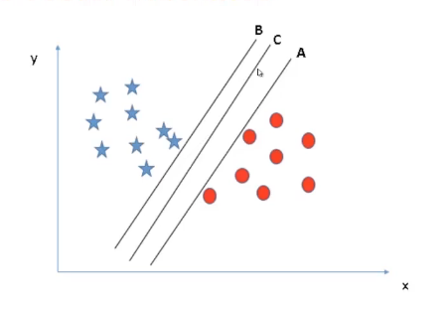
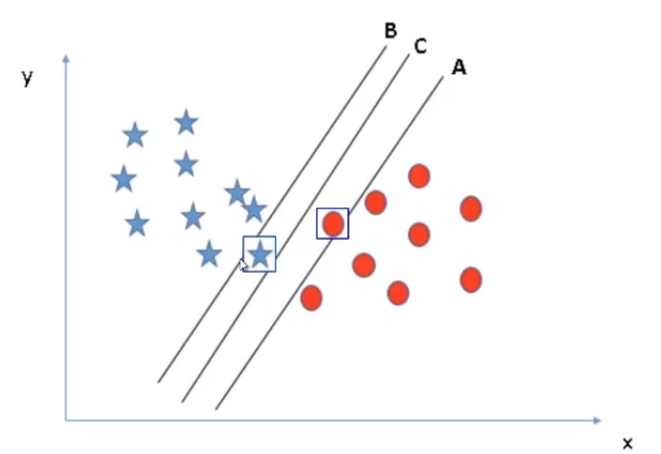
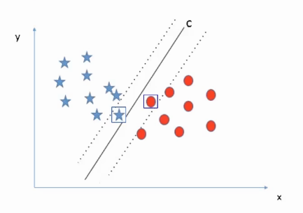
Best Separation:
In best separation we must choose a line such that it is perfectly able to separate the data points.
Stage 1
Stage 2
Stage 3

Slide 18
Confusion Matrix
TP
FP
33 | 8
7 | 43
FN
TN
By the performance of SVM algorithm the accuracy is,
0.8351648351648352

Slide 19
3. Random Forest Learning Algorithm
Random forest is a supervised learning algorithm.
The forest it builds, is an ensemble of decision trees, usually trained with the bagging method.
Random forest is an ensemble algorithm so the ensemble algorithm is the combination of more than one algorithm.

Slide 20
How does the random forest method work?
The random forest is a classification algorithm consisting of many decisions trees. It uses bagging and feature randomness.
The general idea of the bagging method is that a combination of learning models increases the overall result.

Slide 21
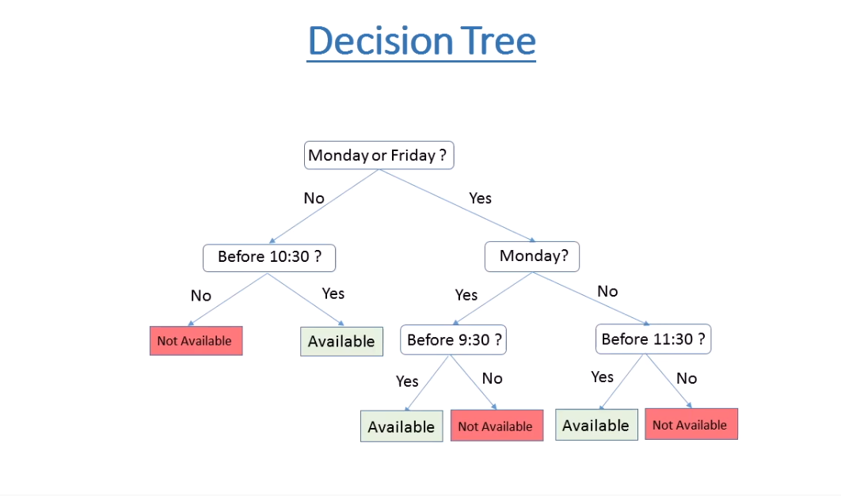

Slide 22
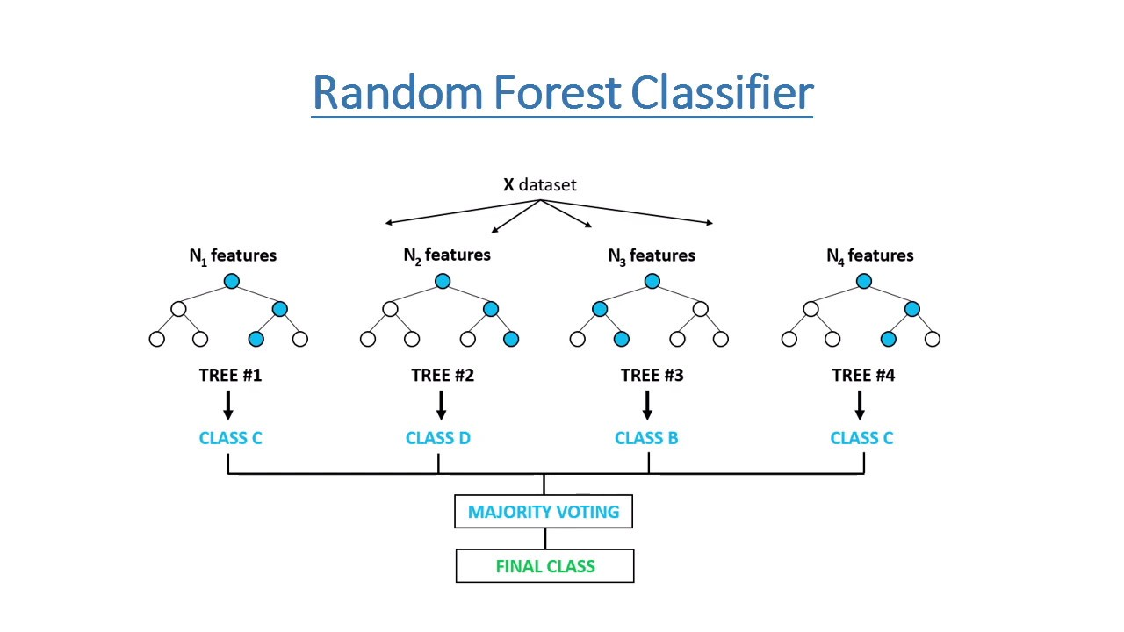

Slide 23
By the performance Random forest algorithm the accuracy is, 0.8219354838709677

Slide 24
Conclusion:
In this project we have used Machine Learning Algorithms for prediction of patient who has suffering from a heart disease. After applying machine learning algorithms, K Neighbors Classifier, Support Vector Classifier and Random Forest Classifier. I varied parameters across each model to improve their scores. In the end, K Neighbors Classifier achieved the highest score of approx. 84% with 8 nearest neighbors.

Slide 25
THANK YOU !

