Slide 1
Employee Data Management Ext JS - Grid Features

Slide 2
Introduction of Ext JS Grid Features
The Ext JS Grid is one of the most powerful and feature-rich components in the Ext JS framework. It is designed to display and manage tabular data efficiently, making it ideal for building data-driven web applications.
This is a simple component to display data, which is a collection of record stored in Ext.data.Store in a tabular format.
The Ext JS Grid is a versatile and powerful component that provides a rich set of features for displaying and managing tabular data. Its flexibility, performance, and ease of use make it an excellent choice for building data-driven web applications.

Slide 3
Ext JS Grid Features
Column Resizing & Reordering
Data Display: Structured tabular format
Sorting: Ascending/descending order
Filtering: Refine data visibility
Row Selection: Single/multi-row operations
Editing: Inline editing support
Customizable UI: Modify styles and themes

Slide 4
Project Overview
A web Application of managing the information of employee
Using Grid Ext JS for storing the data in tabular format
Using CRUD operation Create, Update , Delete the Employee from the Grid.
Using Checkboxes it will enable the user to edit the employee data

Slide 5
/Employee data mangement
├── /app
│ ├── /model
│ ├── /store
│ ├── /view
│ ├── /controller
│ └── app.js
├── /ext
│ ├── /build
│ ├── /examples
│ ├── /locale
│ ├── /packages
│ ├── /plugins
│ ├── /resources
│ ├── ext-all.js
│ ├── ext-all-debug.js
│ └── ...
├── /resources
│ └── /css
│ └── app.css
├── /data
│ └── data.json
├── index.html
└── app.json
Layout Structure of the Project

Slide 6
Features of the Project
Employee List (Grid Panel) : Show employee details (ID, Name, Department, Email, Phone) in a tabular format.
Add Employee : A modal window with fields for entering employee details (Name, Department, Email, Phone).
Edit Employee: A modal window pre-filled with the selected employee's details.
Delete Employee : A text field to search for employees by name. Remove the employee with a confirmation dialogue.

Slide 7
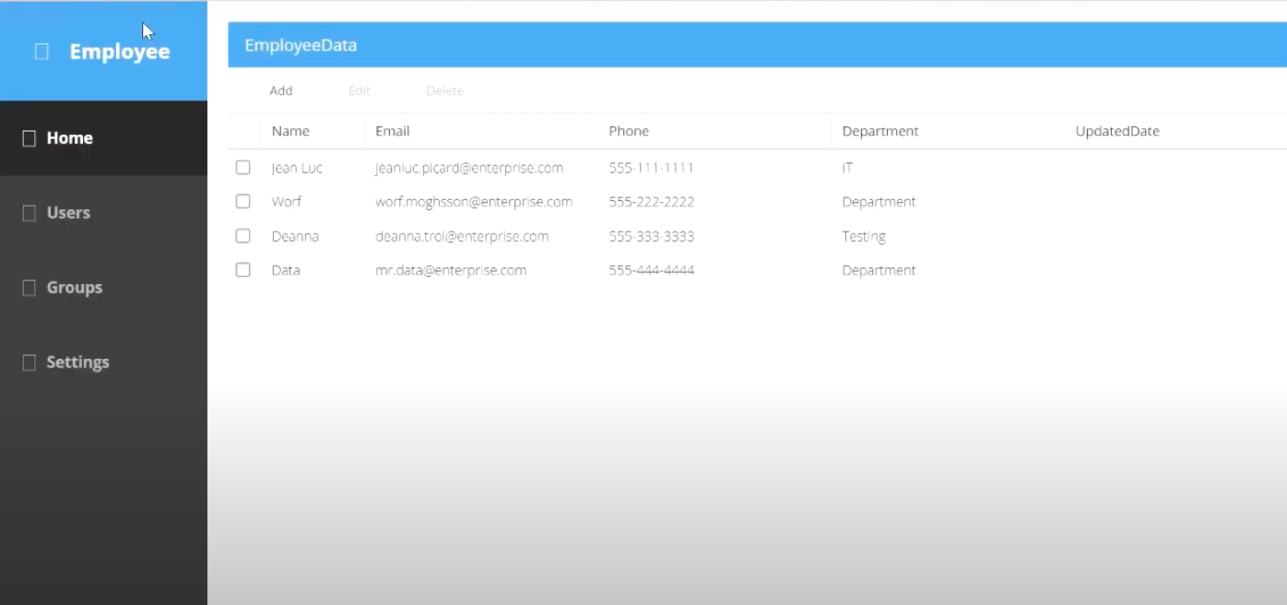
Output of the Application:

Slide 8
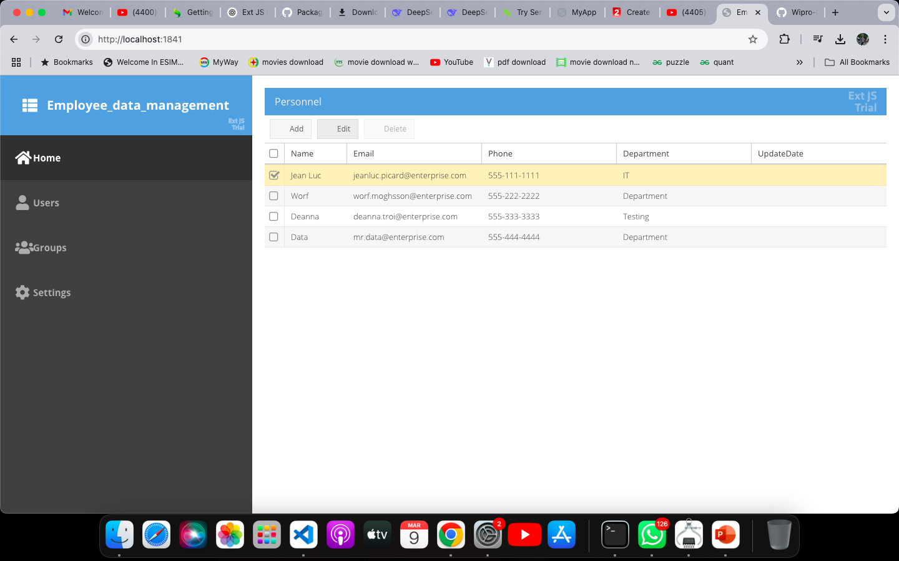

Slide 9
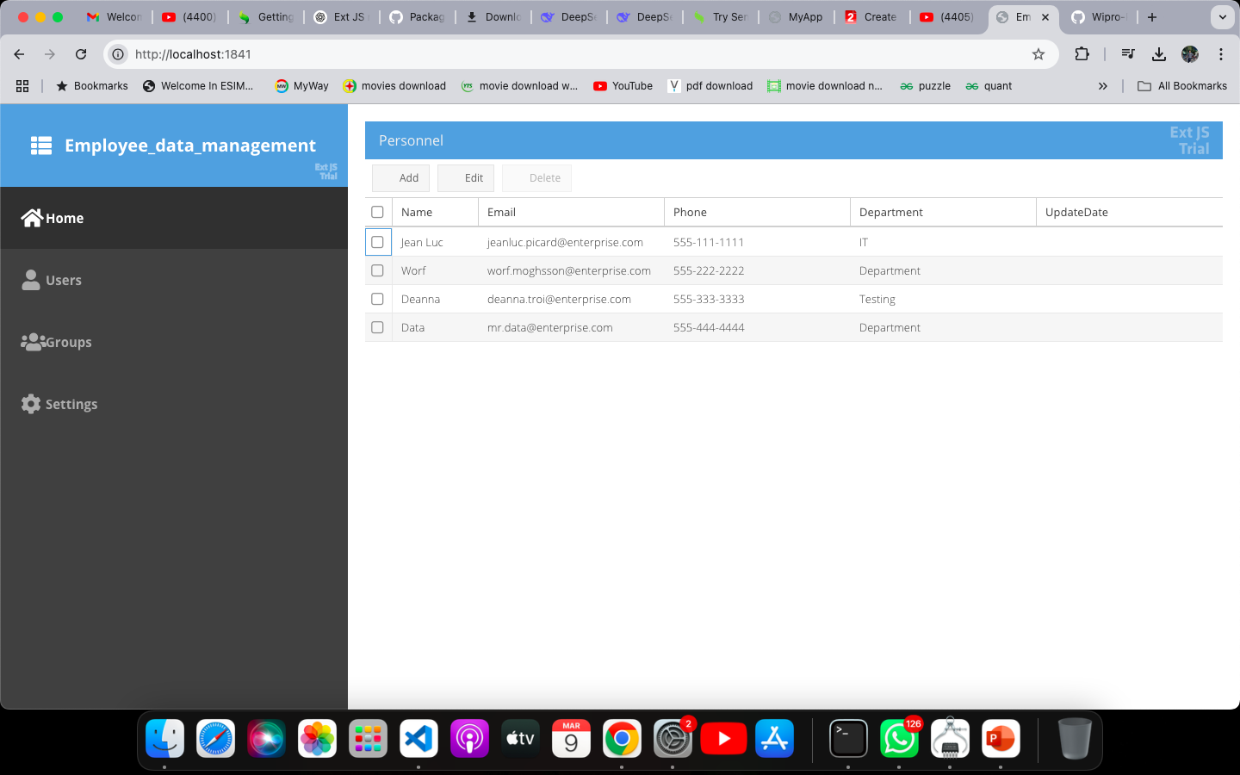

Slide 10
Project Overview:
Employee Data Management is a web-based application for handling employee records efficiently.
Purpose:
- Streamline employee record management
- Provide an intuitive UI
- Enable quick access with sorting & filtering
Technologies Used:
- Front-end: Ext JS
- Back-end: JavaScript

Slide 11
ThankYou

