Slide 1
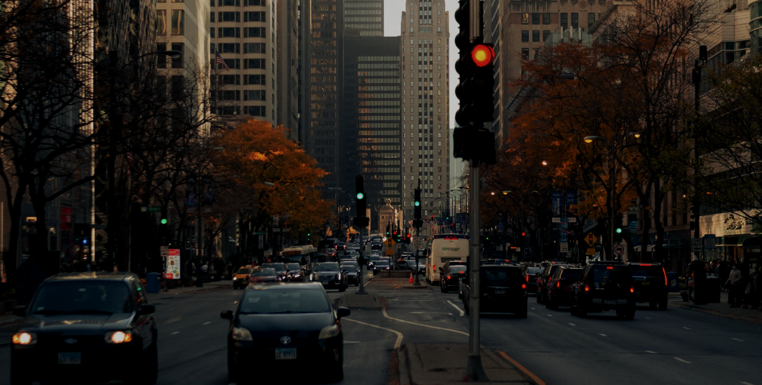
Vehicle Trends and Infrastructure Planning
TRANSPORTATION
Research Question: How can vehicle population trends inform sustainable growth opportunities in private and commercial markets while addressing pollution impacts, and guide policies and strategies to reduce emissions and meet future demands?
By: Vaibhav Magoo

Slide 2
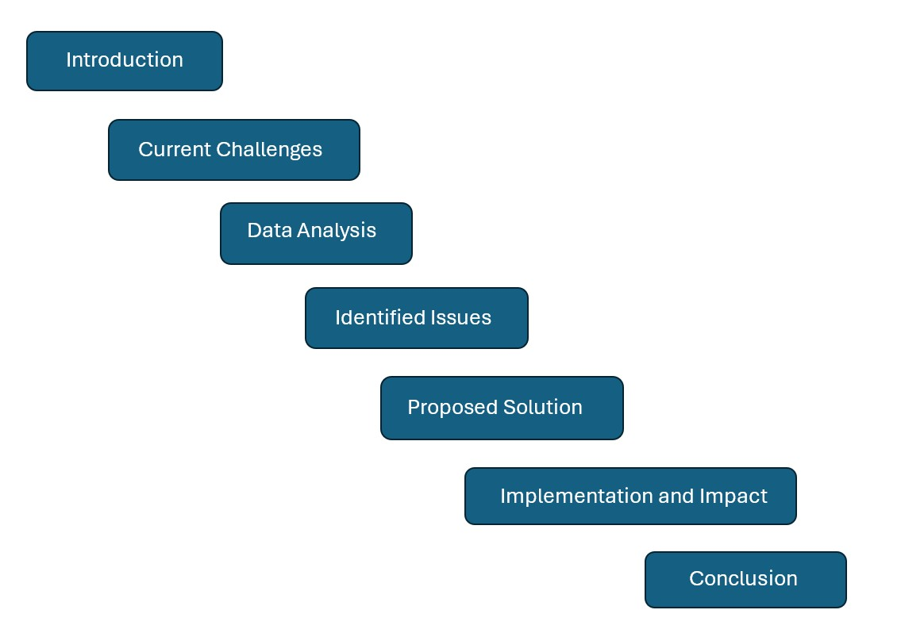
Agenda

Slide 3
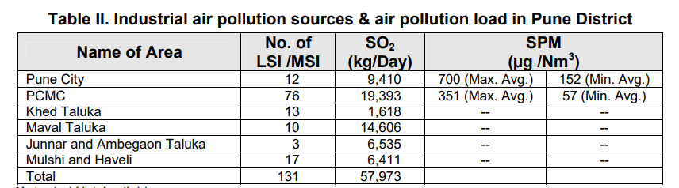
Overview
Maharashtra, India.
Table II below shows the different cities in Maharashtra with their LSI/MSI and SO₂.
LSI/MSI are the number of large/medium-scale industries within that specific city.
Oil refineries, power plants, food processing factories
SO₂ (Sulfur Dioxide)is the gas produced by the burning of fossil fuels containing sulfur compounds.
Vehicle emissions, smelting, and burning of fossil fuels (coal, oil, gas)
Damages plants, leads to respiratory illnesses (like coughing, shortness of breath).
Notes:
Dataset originates from Maharashtra, a state in India whose capital is Mumbai.

Slide 4
Why These Classifications Matter in Air Pollution
Emission Regulations: It helps authorities create specific rules and guidelines to control pollution. Customized Regulations.
Environmental Impact Assessments: Aids in evaluating their environmental impact and planning mitigation strategies.
Targeted Monitoring: LSIs may require stricter monitoring due to their higher emissions, while MSIs may focus on improving efficiency and adopting cleaner technologies.

Slide 5
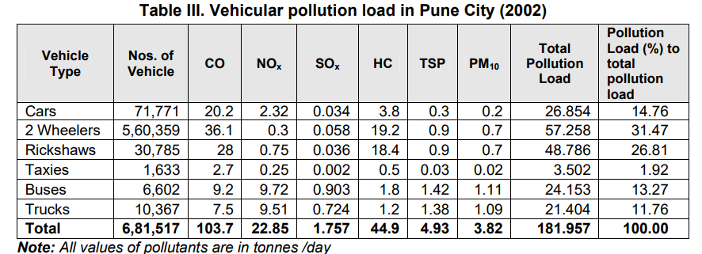
Pune City
Table III displays the vehicles and their total pollution load in tonnes/day in Pune City.
Private vehicles are Cars and 2 Wheelers. Total 46% Pollution Load.
Commercial vehicles are Rickshaws, Trucks, Taxis, and Buses. Total 54% Pollution Load.

Slide 6
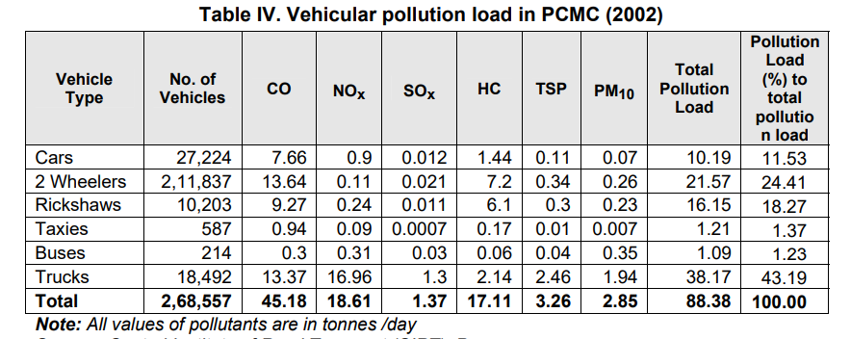
Pimpri Chinchwad Municipal Corporation (PCMC)
Table IV displays the vehicles and their total pollution load in tonnes/day in PCMC.
Private vehicles are Cars and 2 Wheelers. Total 36%% Pollution Load.
Commercial vehicles are Rickshaws, Trucks, Taxis, and Buses. Total 64% Pollution Load.

Slide 7
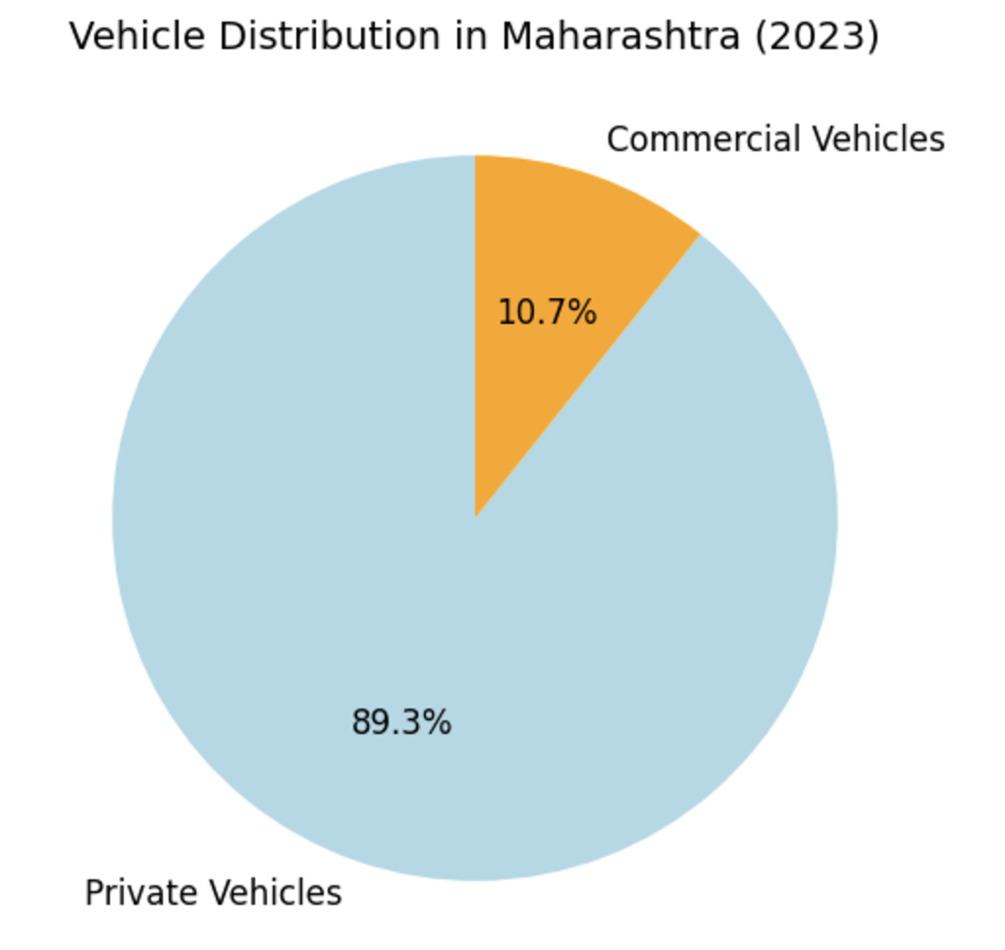
Vehicle Registration Data (2023): Maharashtra
In 2023, Maharashtra registered a total of 2.3 million vehicles, with a staggering 9:1 ratio of private to commercial vehicles.
Around 2.05 million were private vehicles, while only 0.245 million (245,000) were commercial vehicles, including taxis, buses, and heavy trucks.
This dominance of private vehicles is contributing to serious transportation issues such as rising traffic congestion, worsening air pollution, and increased pressure on urban infrastructure like parking and roadways.
These challenges highlight the need for sustainable transport strategies, including improving public transit and promoting shared or commercial transport options.

Slide 8
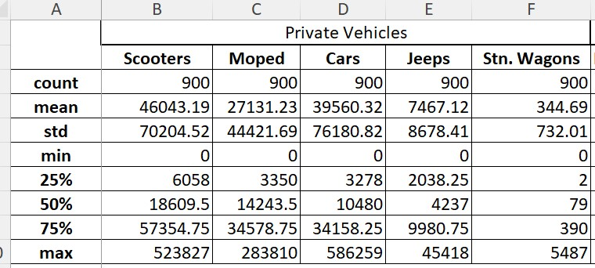
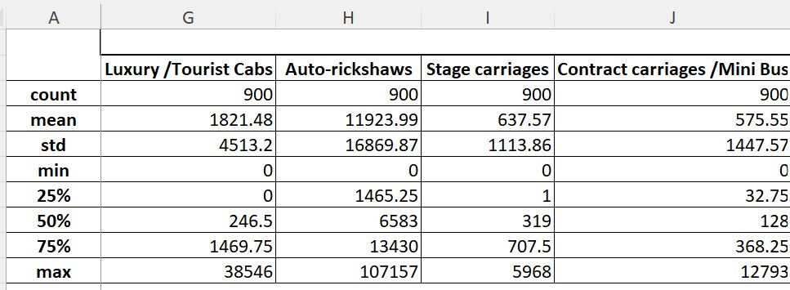
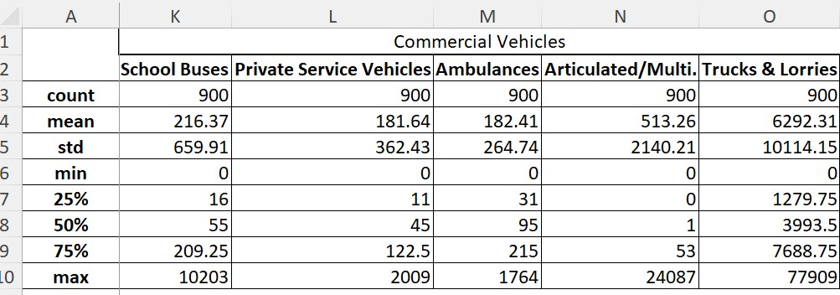
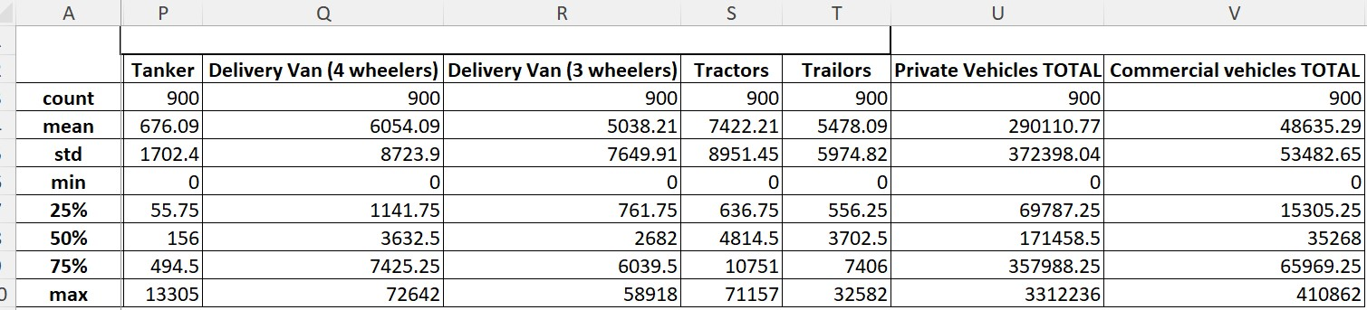

Slide 9
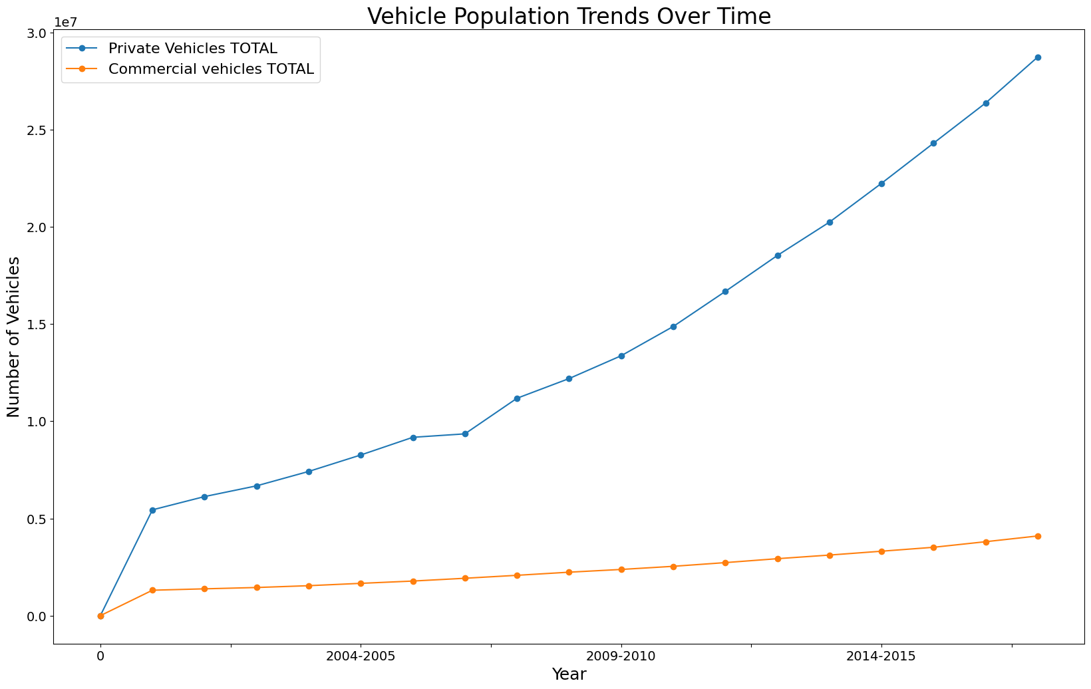
Line Chart of Vehicle Population Trends from 2004 to 2015
- This line chart shows a steady increase in both private and commercial vehicle populations over time, with private vehicles experiencing significantly faster growth.
- This reflects rising consumer preference for personal vehicles and highlights infrastructure challenges.

Slide 10
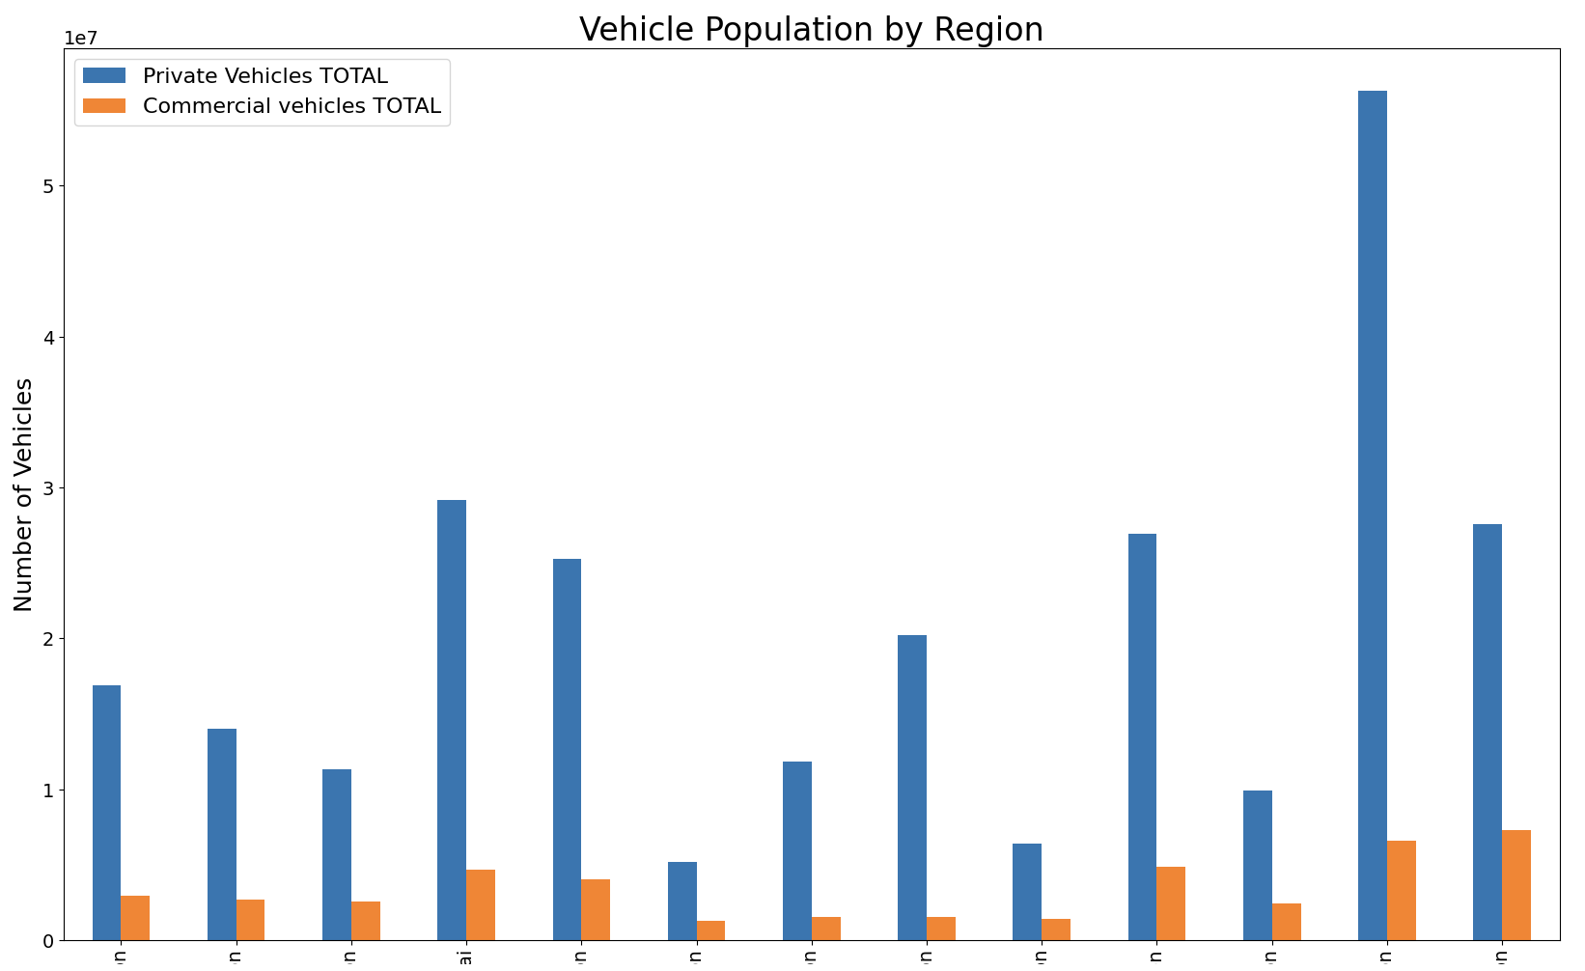
Graph: Vehicle Population by Region
- This graph contrasts private and commercial vehicle populations by region.
- Private vehicles dominate across all regions, with Pune having the highest numbers, while commercial vehicles remain relatively low, suggesting imbalanced usage trends.

Slide 11
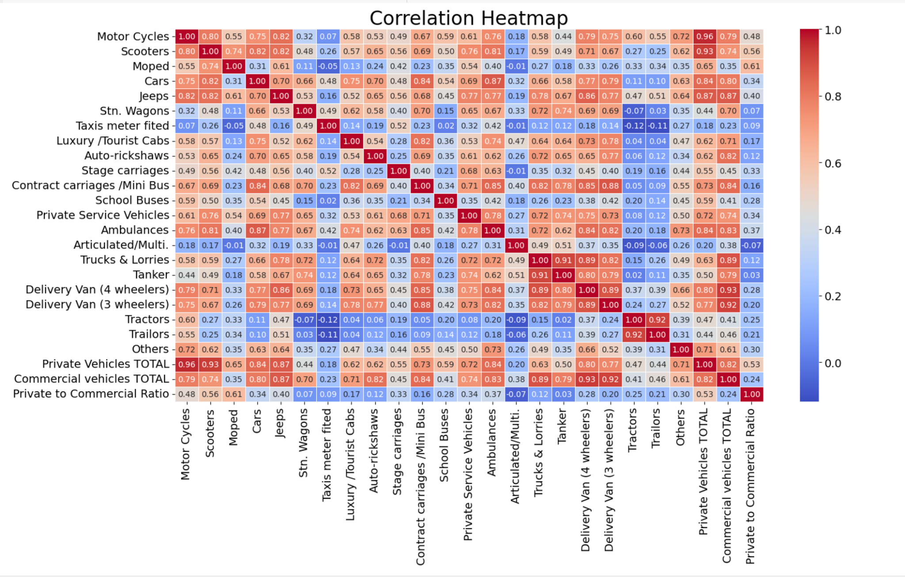
- The Heatmap highlights the correlations between different vehicle categories in Maharashtra, showing strong positive relationships between similar types like motorcycles and scooters, while private and commercial vehicles exhibit weaker correlations.
- It emphasizes disparities in vehicle ownership, particularly through the "Private to Commercial Ratio.”

Slide 12
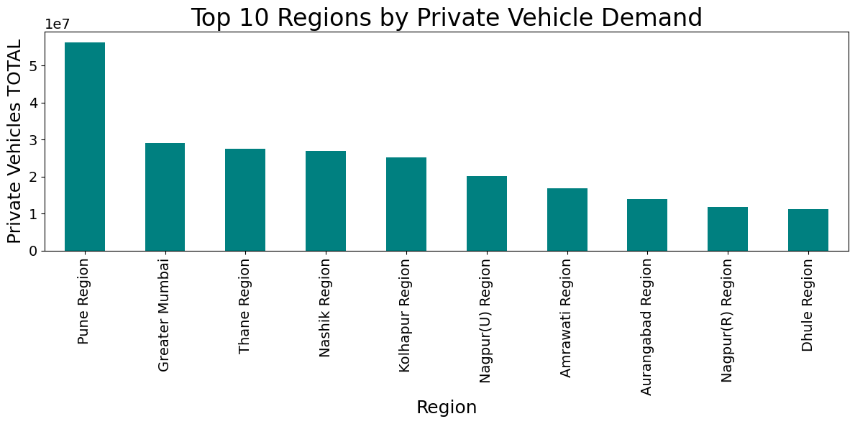
Graph: Top 10 Regions by Private Vehicle Demand
- Pune, Greater Mumbai, and Thane dominate private vehicle demand, reflecting their urban density and economic activity.
- The high vehicle numbers underscore the need for better traffic and infrastructure planning.

Slide 13
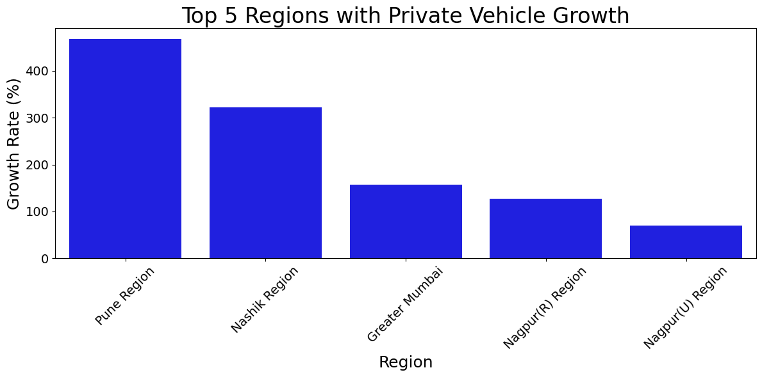
Graph: Top 5 Regions with Private Vehicle Growth
The chart highlights varying private vehicle growth rates. Pune leads with over 400%, followed by Nashik at 300%, while regions like Nagpur (R) and Nagpur (U) show comparatively lower growth.
Pune’s remarkable rise reflects economic vibrancy, while Nagpur’s modest figures suggest limited demand. The chart’s clarity effectively illustrates these regional trends.

Slide 14
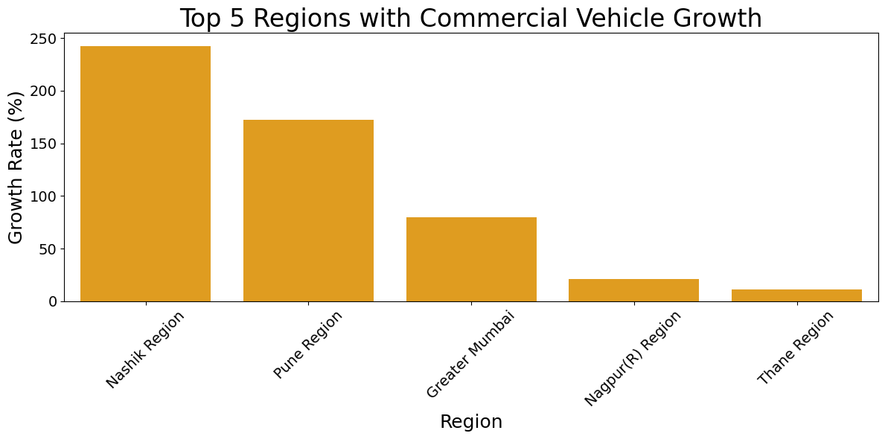
Graph: Top 5 Regions with Commercial Vehicle Growth
The chart unveils notable disparities in commercial vehicle growth among five regions. Nashik soars with an impressive 250% increase, trailed by Pune at just under 200%, while Greater Mumbai, Nagpur (R), and Thane exhibit comparatively modest figures.
Nashik's exceptional rise may be attributed to industrial advancements or progressive policies, whereas subdued growth in Nagpur and Thane reflects uneven regional progress. The chart’s elegant presentation succinctly captures these variations.

Slide 15
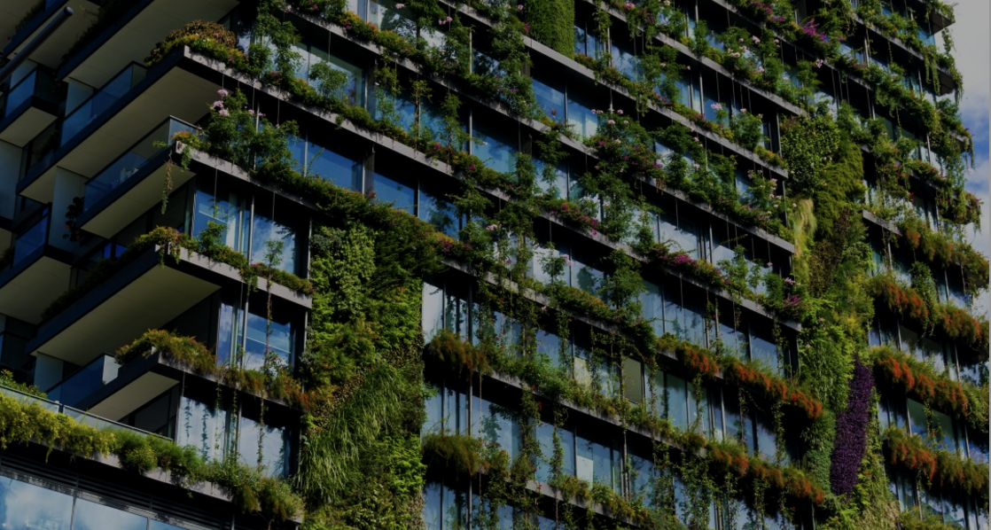
What’s The Solution?
Created a Python program and utilized Google Colab to generate graphs and identify correlations, enabling the analysis of vehicle data and classification of vehicles into private and commercial categories.
Remove missing data, using Python code, in order to analyze trends accurately.
More public transportation
EVs
Green infrastructure

Slide 16
Solution 1 : Upgrading Public Transportation
Expand Bus Networks: Increase bus fleet size to meet the recommended benchmark of 40-60 buses per 100,000 residents. Focus on cities like Pune and Nagpur to enhance first and last-mile metro connectivity.
Safety and Accessibility: Prioritize safe, reliable public transport options, especially for women, through measures like better lighting, CCTV cameras, and secure stops.
Sustained Government Funding: Implement a viability gap funding scheme to support bus services across Maharashtra.
Integrated Transit Systems: Develop seamless connections between metro, buses, and other transit options to encourage greater public transport usage.
Example: Let’s say a bus can carry 40 passengers at once. These 40 passengers can reduce the emissions of 40 private vehicles by using one public vehicle instead.

Slide 17
Solution 2 : Electric Vehicles
Policy Support: Leverage the Maharashtra EV Policy 2021 to accelerate EV adoption through subsidies, tax exemptions, and buyback agreements.
Infrastructure Development: Expand public charging stations across urban areas and highways, supported by the allocated $124 million investment.
Commercial EV Transition: Focus on electrifying auto-rickshaws, taxis, and freight vehicles to reduce emissions and fuel dependency.
Job Creation: Promote EV manufacturing in Maharashtra to establish the state as a leader in the EV sector while generating employment opportunities.
Awareness and Collaboration: Work with manufacturers, service providers, and the public to raise awareness and address barriers like charging access and cost.
Environmental Protection Agency states that EVs have the potential to reduce air pollution by eliminating approximately 246,000 tons of fine particles and over 1 million tons of nitrogen oxides cumulatively by 2055.

Slide 18
Solution 3 : Green Infrastructure
Eco-Friendly Urban Design: Encourage the development of roads with dedicated pedestrian walkways and cycling lanes to promote sustainable mobility.
Green Data Centres: Leverage the state's Green Integrated Data Centre Parks initiative to integrate renewable energy sources and eco-friendly technologies in urban planning.
Low-Emission Zones: Establish low-emission zones in urban areas to reduce vehicular pollution and promote clean transportation options.
Urban Green Spaces: Develop green belts and parks within cities to improve air quality and provide spaces for non-motorized transport pathways.
Smart City Integration: Align green infrastructure initiatives with Maharashtra's broader digital and smart city development goals.

Slide 19
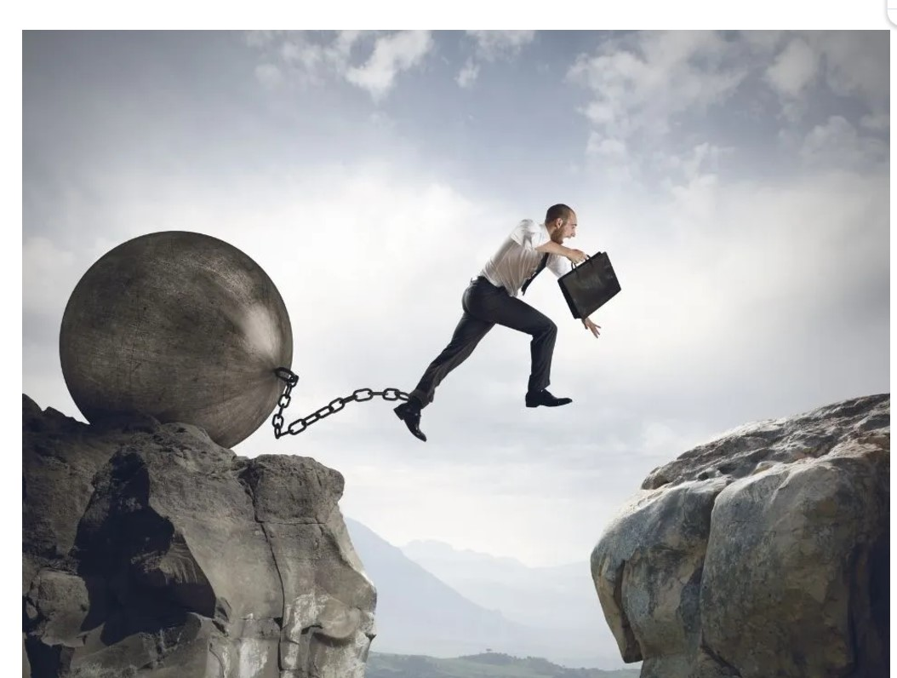
What are the most challenging parts?
Balancing Growth and Sustainability : Achieving economic growth while protecting the environment requires aligning diverse priorities and addressing regional disparities in industrial and pollution impacts.
Policy and Infrastructure Development : Crafting targeted policies and upgrading public transport systems are hindered by fiscal limitations, urban transport dependency, and uneven regional needs.
Data Accuracy and Integration : Ensuring reliable analysis is challenging due to data inconsistencies, complex correlations, and the need to synthesize multifaceted datasets.
Promoting EV Adoption : Accelerating the transition to electric vehicles faces high costs, logistical challenges, and resistance from traditional stakeholders.
Sustainable Urban Planning : Constructing green infrastructure and fostering societal change is constrained by spatial limitations, integration challenges, and entrenched resistance to transformation

Slide 20

What are the most novel/interesting parts?
Regional Insights : Segmentation of vehicle trends and pollution metrics by region highlights Maharashtra-specific challenges like private vehicle dominance and industrial emissions, offering targeted insights into urban and environmental issues.
Sustainable Growth Strategies : Proposals integrating public transport expansion, EV adoption, and green infrastructure form a cohesive plan to balance urban growth with environmental preservation.
Infrastructure and Transit Connectivity : Addressing traffic congestion and inadequate public transit requires smarter urban planning and intermodal systems that seamlessly connect buses, metros, and other transport modes to improve accessibility.
Localized and Inclusive Policies : Tailored emission regulations based on industrial density and a focus on safety for women foster both effective environmental management and inclusive transport solutions.
Modern Analytical Tools : Heatmaps, charts, and Python-driven analysis simplify complex data trends, enabling strategic decision-making and actionable insights.

Slide 21
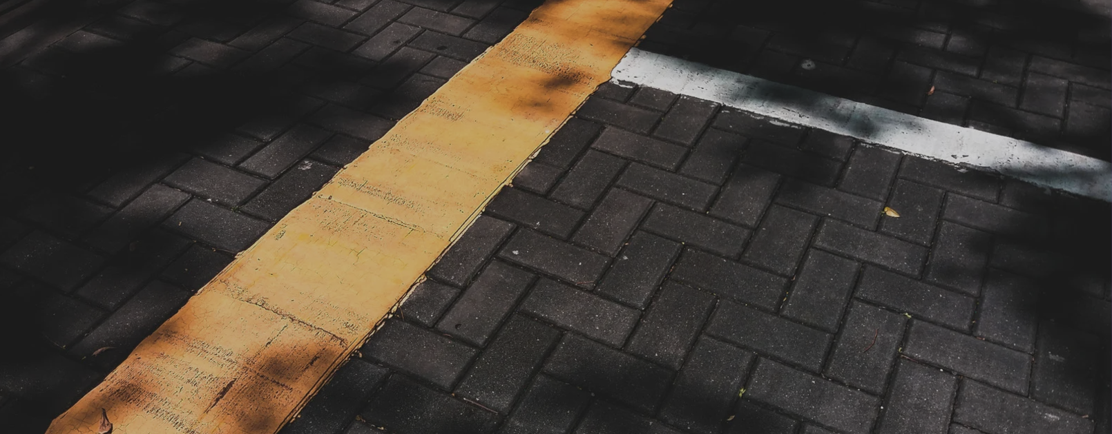
References
https://www.hindustantimes.com/cities/mumbai-news/more-than-25-lakh-vehicles-registered-in-maharashtra-in-2023-7-91-pc-rise-in-one-year-101704113134907.html
https://www.statista.com/statistics/831009/total-number-of-commercial-vehicles-in-maharashtra-india/#:~:text=Services-,About%20Statista,within%20the%20segment%20that%20year.
https://citizenmatters.in/maharashtra-elections-cities-mumbai-pune-mobility-public-transport/#:~:text=The%20public%20transport%20deficit,coverage%2C%20or%20lower%20population%20density.
https://www.mpcb.gov.in/sites/default/files/miscellaneous-topics/environmental-planning/CHAPTER5.pdf
https://www.pranaair.com/in/blog/10-ways-to-reduce-air-pollution/
https://www.edf.org/setting-record-straight-electric-vehicles#:~:text=EVs%20greatly%20reduce%20this%20health,million%20tons%20cumulatively%20by%202055.

