Slide 1
BHASHAFIX · LOCALISATION RELEASE FIREWALL
AI translated the product.
Who proved it still works?
BhashaFix opens real browsers, measures locale failures, prepares bounded source repairs, and reruns the identical predicates before release.
LIVE · CLI · CI · MCP · OPEN SOURCE
Notes:
[Sources]
First-party product narrative; no external claim.
Live product: https://bhashafix.vercel.app

Slide 2
THE PRODUCTION GAP
A translation can be correct.
The interface can still fail.
DEUTSCH CTA text clips by 77 px
العربية page remains left-to-right
日本語 raw key cta.primary reaches users
FRANÇAIS {amount} placeholder disappears
These failures appear when language meets layout, accessibility and runtime behaviour—not when a model returns a string.
Notes:
[Sources]
Defect classes are backed by artifacts/nextjs-repair-proof.json and submission/repair-proof.json.

Slide 3
THE CLOSED LOOP
Evidence before repair.
The same evidence after.
DISCOVER → RENDER → MEASURE → DIAGNOSE
↓
PROVE ← IDENTICAL RERUN ← ALLOWLISTED DIFF
The model may propose. Only the measured predicate can pass.
Notes:
[Sources]
Workflow contract is implemented across packages/core, packages/browser, packages/repair-engine and packages/verifier.

Slide 4
REAL PUBLIC SITES · REAL BROWSER ARTIFACTS
A URL becomes browser evidence.
HOSTED QUICK SCAN
Real Chromium in the Vercel function
One route · one viewport · up to 3 locales
DOM measurements · axe · screenshots
Nothing persisted · 60-second ceiling
LOCAL / CI
Full route × locale × viewport matrix
Shown: actual Wikipedia browser artifact from the CLI path.
Notes:
[Sources]
public/evidence/index.json
public/evidence/scans/browser-707f6817-0e68-4236-a5e8-7e97b530a4f0/screenshots/626916722c9b.png
Hosted scan limitations are stated in README.md and the live UI.

Slide 5
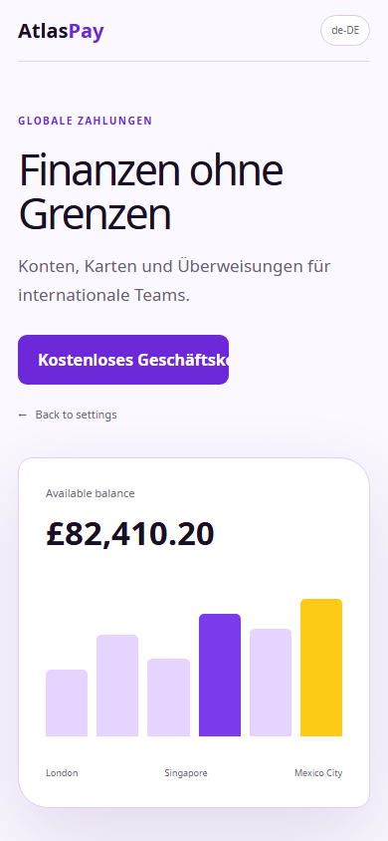
ONE DETERMINISTIC FINDING · NEXT.JS FIXTURE
Every issue is falsifiable.
BF-VIS-TEXT-OVERFLOW-X · de-DE
TEXT Kostenlos mit Meridian starten
MEASURE 245 px scroll / 168 px client
DELTA +77 px · overflow hidden
LOCATED [data-testid="cta-primary"]
PREDICATE scrollWidth ≤ clientWidth + 2
Notes:
[Sources]
artifacts/nextjs-repair-proof.json
public/evidence/BF-VIS-DE-002.png

Slide 6
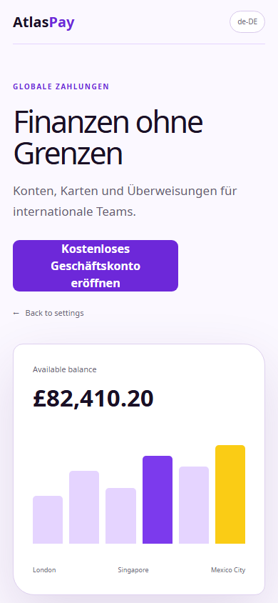
BOUNDED SOURCE REPAIR · NEXT.JS FIXTURE
6 blockers. 3 files.
Identical rerun: 0.
layout.tsx lang + dir
globals.css wrapping + width
ja-JP.json missing key
✓ git apply --check exited 0
✓ source locale 0 → 0
✓ new blockers 0
✓ rollback snapshot restored
Notes:
[Sources]
artifacts/nextjs-repair-proof.json
artifacts/nextjs-repair.diff
public/evidence/BF-VIS-DE-002-after.png

Slide 7
SAFE BY CONSTRUCTION
The scanner may read URLs.
The repair may write code.
Both are fenced.
URL BOUNDARY
protocol → DNS → redirects → every subrequest
private networks blocked · 500-request cap
REPAIR BOUNDARY
explicit scan ID + issue IDs · path allowlist
symlinks rejected · dry run · diff first · rollback
Only the identical predicate can return VERIFIED.
Notes:
[Sources]
packages/browser/src/serverless.ts
packages/crawler/src/url-policy.ts
packages/repair-engine source path and allowlist enforcement.

Slide 8
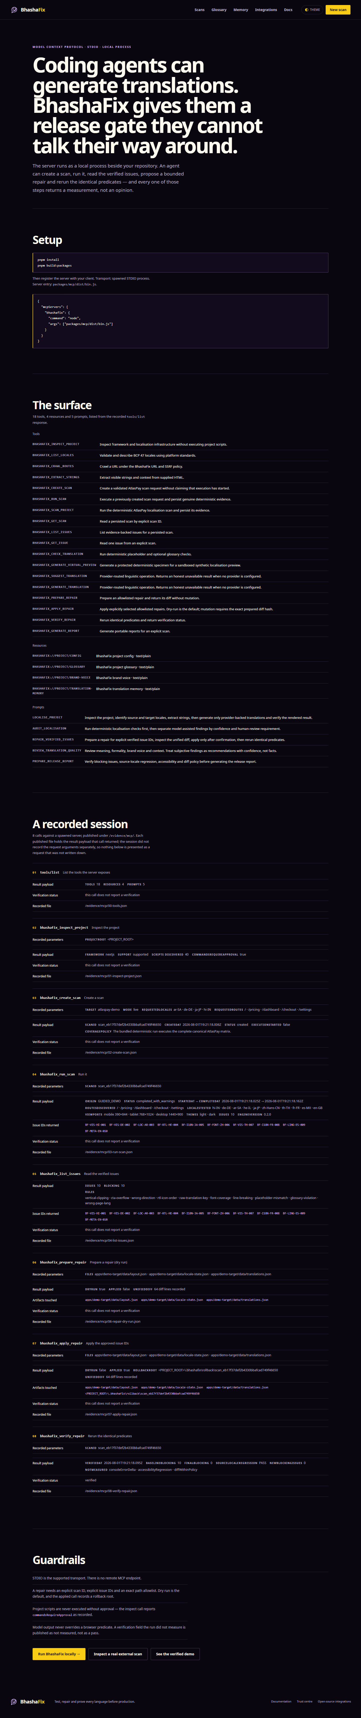
EFFECTIVE USE OF CODEX · MCP
Codex calls the gate.
The gate answers with proof.
spawned STDIO process · 18 strict tools
Inspector + MCPC independently invoked
inspect → create scan → run → list issues
→ prepare dry run → apply approved IDs
→ rerun identical predicates
Fixture-scoped receipt: 10 blocking → 0
source locale PASS · status VERIFIED
Notes:
[Sources]
artifacts/mcp-stdio-receipt.json
public/evidence/index.json#mcp
public/evidence/scans/browser-3f4cdf97-6c5c-4f84-b083-ea310ceee8a9/screenshots/9644643c4737.png

Slide 9
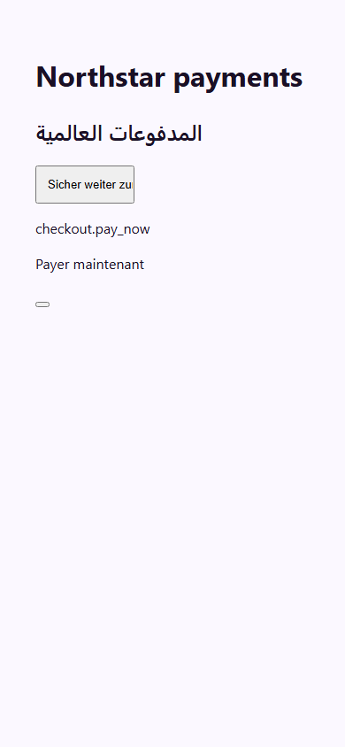
SEEDED FIXTURE BENCHMARK · NOT A MARKET CLAIM
70 labelled defects.
204 expected detections.
12 rule families · 12 locales · 3 viewports
288 Chromium renders
FIXTURE RECALL 100%
FIXTURE PRECISION 100%
CLEAN VARIANT FINDINGS 0
Real public-site scans exposed two rule defects;
both were fixed in the engine.
Notes:
[Sources]
artifacts/benchmark.json
artifacts/real-site-scans.json
artifacts/fixtures/broken.png
The metrics are explicitly limited to the generated labelled fixture.

Slide 10
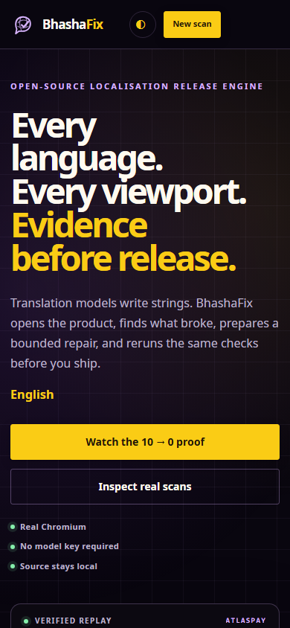
OPEN SOURCE · NO MODEL KEY REQUIRED
Scan now.
Prove before release.
bhashafix.vercel.app
github.com/vaibhav4046/bhashafix
git clone https://github.com/vaibhav4046/bhashafix
pnpm install
pnpm bhashafix scan --url https://example.com
Hosted: bounded one-route Chromium.
Local: full matrix, artifacts and repair.
Notes:
[Sources]
Live product: https://bhashafix.vercel.app
Public repository: https://github.com/vaibhav4046/bhashafix
submission/screenshots/03-landing-mobile.png

