Slide 1
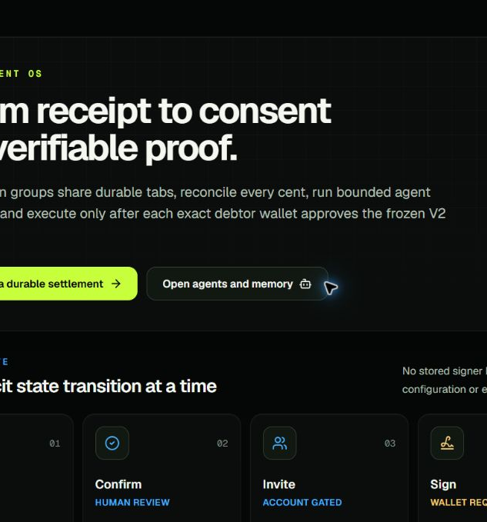
FINALTab
Proof—not optimism—closes the tab.
Exact receipt math
External wallet consent
KeeperHub execution
Independent onchain proof
KeeperHub Agents Onchain finalist pitch
FINALTab • KeeperHub Agents Onchain
01
Notes:
Open: A receipt is easy to read. The dangerous part is turning it into money. FINALTab refuses to call a settlement complete until execution and independent proof agree.
[Sources]
- First-party release captures: video/finaltab-winner/assets/capture-v3
- Live product: https://finaltab.vercel.app/
- Repository: https://github.com/vaibhav4046/finaltab
- Retained transaction: https://sepolia.basescan.org/tx/0x7a6fb760f691954a41c71d5d508629c58aa09207bba0de4eaf164f097c59a789

Slide 2
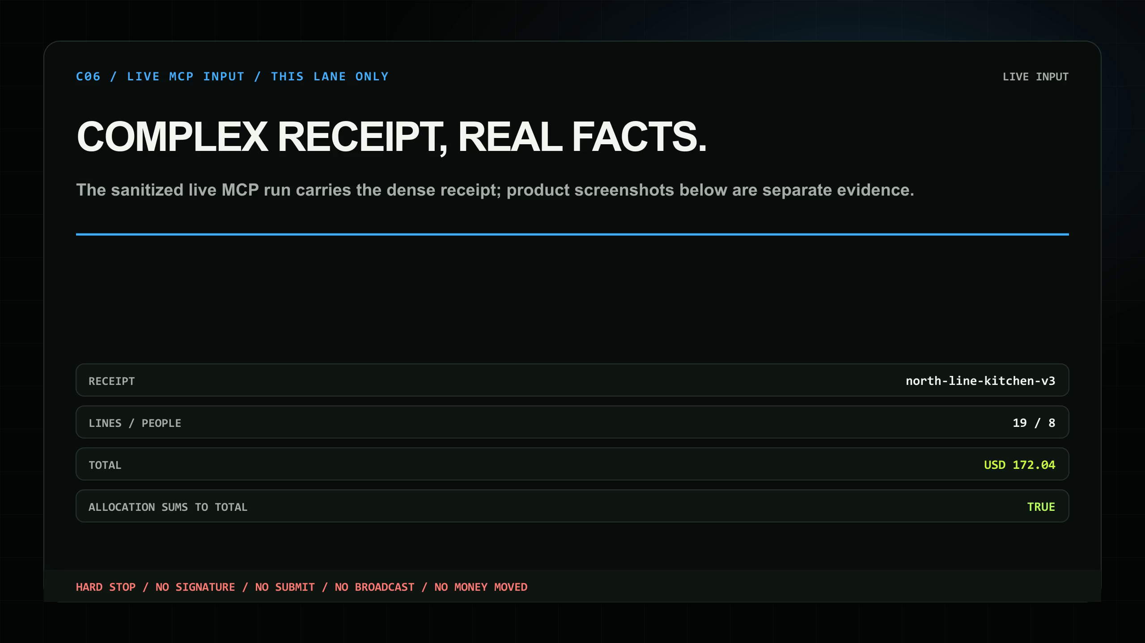
THE HARD PROBLEM
Messy intent must become one exact plan
$172.04
19 receipt lines
8 participants
Weights, exclusions, shared charges and a payer correction—all reconciled in integer minor units.
AI structures the intent. Deterministic code owns every cent.
FINALTab • KeeperHub Agents Onchain
02
Notes:
Describe the complex film input. The model proposes structure; largest-remainder allocation makes the total exact. No floating-point arithmetic touches balances.
[Sources]
- First-party release captures: video/finaltab-winner/assets/capture-v3
- Live product: https://finaltab.vercel.app/
- Repository: https://github.com/vaibhav4046/finaltab
- Retained transaction: https://sepolia.basescan.org/tx/0x7a6fb760f691954a41c71d5d508629c58aa09207bba0de4eaf164f097c59a789

Slide 3
SAFETY ARCHITECTURE
AI proposes. Code decides. Wallets consent.
01
02
03
04
05
06
Interpret
→
Reconcile
→
Review
→
Freeze
→
Consent
→
Execute + prove
model proposal
integer cents
4 bounded stages
ledger + plan hashes
external dual signatures
KeeperHub + RPC
Bounded audit memory retains input, stage events and evidence hashes—never policy, code or keys.
Any upstream edit invalidates review. Any stale, replayed, mutated or imbalanced plan reverts.
FINALTab • KeeperHub Agents Onchain
03
Notes:
Walk left to right. Freeze binds the complete plan. Each debtor signs USDC authorization and FINALTab SettlementConsent in an external wallet. The server does not custody arbitrary participant keys.
[Sources]
- First-party release captures: video/finaltab-winner/assets/capture-v3
- Live product: https://finaltab.vercel.app/
- Repository: https://github.com/vaibhav4046/finaltab
- Retained transaction: https://sepolia.basescan.org/tx/0x7a6fb760f691954a41c71d5d508629c58aa09207bba0de4eaf164f097c59a789

Slide 4
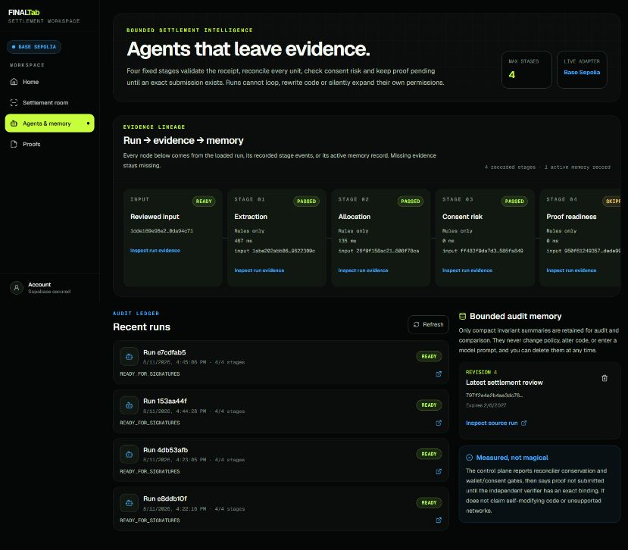
BOUNDED AGENT MEMORY
The agents leave evidence—not mystery
INPUT
→ 4 fixed reviews
→ compact audit memory
Real nodes only
Sequence-sorted stage events, evidence hashes, revisions and expiry.
Cannot alter policy, source code, wallet authority or settlement truth.
FINALTab • KeeperHub Agents Onchain
04
Notes:
Show the actual product capture. Every graph node derives from a loaded run input, recorded stage event, real evidence or active bounded memory record. Missing evidence stays missing.
[Sources]
- First-party release captures: video/finaltab-winner/assets/capture-v3
- Live product: https://finaltab.vercel.app/
- Repository: https://github.com/vaibhav4046/finaltab
- Retained transaction: https://sepolia.basescan.org/tx/0x7a6fb760f691954a41c71d5d508629c58aa09207bba0de4eaf164f097c59a789

Slide 5
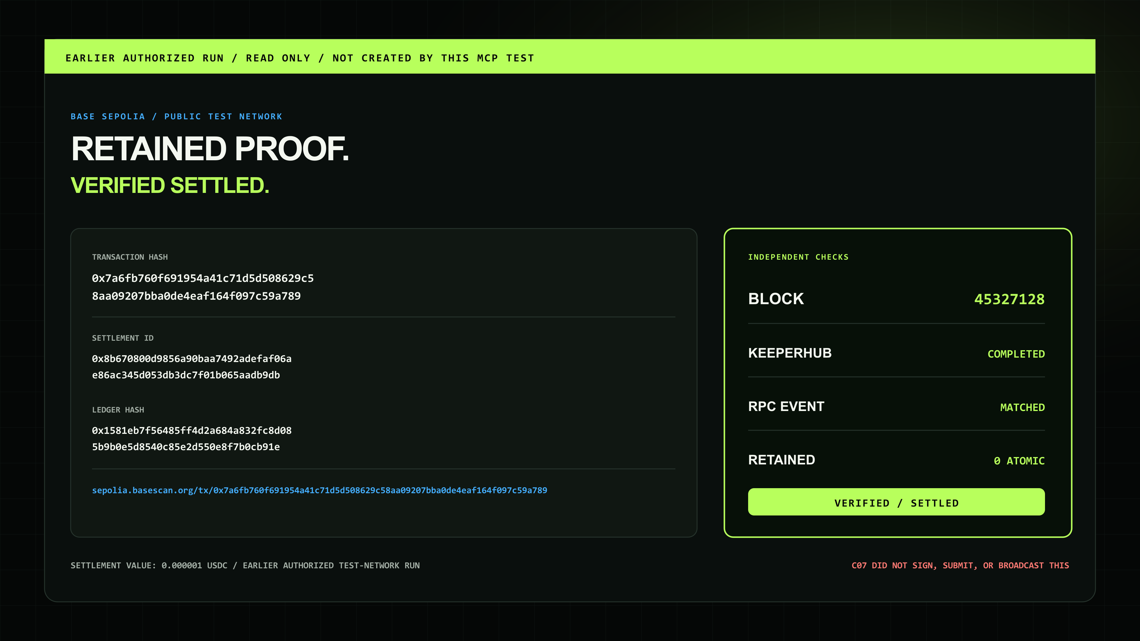
REAL EXECUTION EVIDENCE
A transaction hash is not proof
KeeperHub execution
3hmlqi36zweiwg6fc5o2u
Base Sepolia block
45327128
1 atomic USDC
debtor −1 • creditor +1
contract 0 • delta 0
Earlier authorized run.
Separate from the filmed MCP test.
FINALTab • KeeperHub Agents Onchain
05
Notes:
Visual climax. KeeperHub reported a verified successful receipt, then FINALTab independently fetched Base Sepolia and matched the exact indexed SettlementExecuted event, settlement ID and ledger hash. The retained run is separate from the film's MCP trace.
[Sources]
- First-party release captures: video/finaltab-winner/assets/capture-v3
- Live product: https://finaltab.vercel.app/
- Repository: https://github.com/vaibhav4046/finaltab
- Retained transaction: https://sepolia.basescan.org/tx/0x7a6fb760f691954a41c71d5d508629c58aa09207bba0de4eaf164f097c59a789

Slide 6
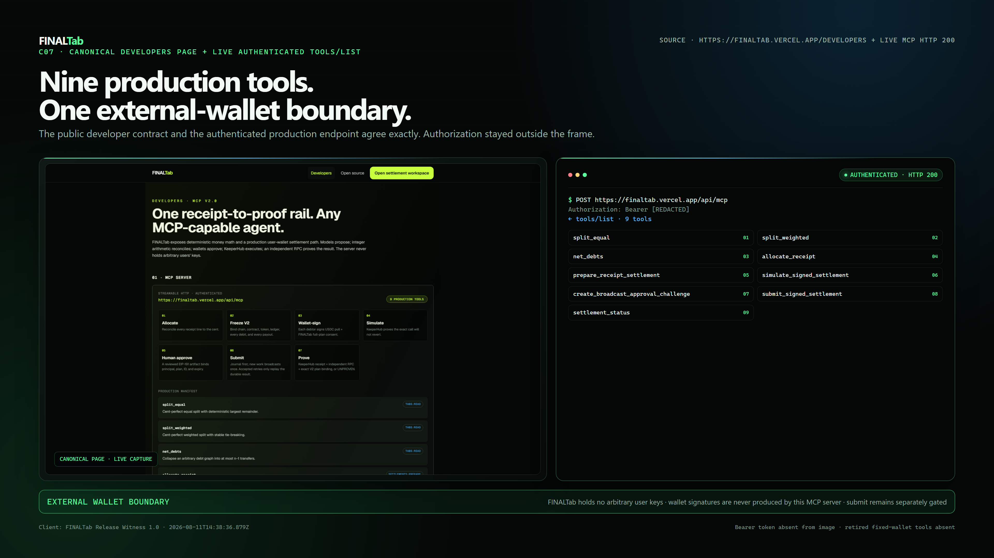
AGENT-NATIVE SURFACE
One product. Nine authenticated tools. One hard stop.
CALCULATE
split_equal • split_weighted
net_debts
PREPARE
allocate_receipt
prepare_receipt_settlement
EXECUTION SAFETY + PROOF
simulate • challenge • submit
settlement_status
FILMED TEST: challenge created → HARD STOP
No signature. No submit. No broadcast. No value.
FINALTab • KeeperHub Agents Onchain
06
Notes:
The real authenticated MCP test initialized the server, listed all nine tools, allocated the complex receipt, prepared typed data and created an approval challenge. It deliberately stopped there.
[Sources]
- First-party release captures: video/finaltab-winner/assets/capture-v3
- Live product: https://finaltab.vercel.app/
- Repository: https://github.com/vaibhav4046/finaltab
- Retained transaction: https://sepolia.basescan.org/tx/0x7a6fb760f691954a41c71d5d508629c58aa09207bba0de4eaf164f097c59a789

Slide 7

WHY THIS CAN WIN
Execution depth meets onboarding clarity
Real onchain execution
KeeperHub V2 settlement + independently matched Base Sepolia event
Failure-mode thinking
Dual consent, stale-review invalidation, atomic revert, fail-closed proof
Developer experience
Nine scoped MCP tools, workflow export, reusable MIT monorepo
Onboarding contribution
Open KeeperHub CLI PR #95 adds --require-verified
FINALTab • KeeperHub Agents Onchain
07
Notes:
Map directly to judging: working execution, depth of KeeperHub use, reliability, real-world utility, integration quality and builder onboarding. Do not claim PR #95 is merged.
[Sources]
- First-party release captures: video/finaltab-winner/assets/capture-v3
- Live product: https://finaltab.vercel.app/
- Repository: https://github.com/vaibhav4046/finaltab
- Retained transaction: https://sepolia.basescan.org/tx/0x7a6fb760f691954a41c71d5d508629c58aa09207bba0de4eaf164f097c59a789

Slide 8
CLOSE THE TAB
The safe path should be the easy path
AI interprets
Code reconciles
Wallets consent
KeeperHub executes
Proof closes the tab.
finaltab.vercel.app
github.com/vaibhav4046/finaltab
Testnet today. Honest boundaries. A reusable rail for expense, treasury and agent workflows.
FINALTab • KeeperHub Agents Onchain
08
Notes:
Close: FINALTab makes the safe path the easy path—AI interprets, code reconciles, wallets consent, KeeperHub executes, and proof—not optimism—closes the tab. Current scope is Base Sepolia testnet; voice is configured but not live-proven.
[Sources]
- First-party release captures: video/finaltab-winner/assets/capture-v3
- Live product: https://finaltab.vercel.app/
- Repository: https://github.com/vaibhav4046/finaltab
- Retained transaction: https://sepolia.basescan.org/tx/0x7a6fb760f691954a41c71d5d508629c58aa09207bba0de4eaf164f097c59a789

