Slide 1

NORTH EASTERN REGIONAL INSTITUTE OF SCIENCE AND TECHNOLOGY NIRJULI- 791109, ARUNACHAL PRADESH
Presentation On Deforestation Classification Using Deep Learning
Under the guidance of Dr. Ajit Kumar Yadav
Submitted by
Sanjana Kumari (D/19/CS/123)
Vaibhav Kumar (D/18/CS/118)

Slide 2
Index
Abstract
Introduction
Literature review
Existing Method
Drawbacks
Proposed method
Advantages
Implementation
Algorithms
Hardware and Software Requirements
Architecture
UML diagrams
Results
Conclusion
References

Slide 3
Abstract:
Human-induced deforestation has a major impact on forest ecosystems and therefore its detection and analysis methods should be improved. Where, this type of detection or classification helps us to degrade the deforestations in future. In this project we are mainly focusing on the problem of deforestation, performing the classification of deforestation and the healthy forests with the help of deep learning model. CNN is the algorithm that which are been using here for the classification process. We are preparing a dataset which is trained using the algorithm and classification will be performed in testing.
Keywords: Deforestation, Deep learning, CNN

Slide 4
Introduction:
Deforestation, clearance, clear cutting, or clearing is the removal of a forest
the conversion of forest to other land uses
The removal of trees
Motivation
Detection and analysis
Degrade the Deforestation

Slide 5
Literature Review:
S. No | Journal Type with year | Authors | Title | Outcomes
1 | Biotropica 2001, 33, 378–384 | Sanchez-Azofeifa, G.A.; Harriss, R.C.; Skole | Deforestation in Costa Rica: A quantitative analysis using remote sensing imagery. | Quantitative analysis using remote sensing imagery
2 | Remote Sens. 1996, 17, 3233–3255 | Frohn, R.; McGwire, K.; Dale, V.; Estes, J | Using Satellite Remote Sensing Analysis to Evaluate a Socio-Economic and Ecological Model of Deforestation in Rondonia, Brazil | Satellite Remote Sensing Analysis to Evaluate a Socio-Economic and Ecological Model of Deforestation
3 | Remote Sens. Environ. 1995, 54, 198–208. | Achard, F.; Estreguil | Forest Classification of Southeast Asia using NOAA AVHRR Data | Forest Classification
4 | Remote Sens. Environ. 2006, 102, 1–11 | Desclée, B.; Bogaert, P.; Defourny | Forest Change Detection by Statistical Object-Based Method | Forest Change Detection

Slide 6
Existing Method:
This model emphasizes an existing method that which is designed using the ANN algorithm of deep learning. As the deforestation has a major impact on forest ecosystems and therefore its detection and analysis methods should be improved. Where, the classification of healthy forest and the areas of deforestation is important to recognize for which ANN is used that which can classify the deforestation area and healthy forest area.

Slide 7
Disadvantages in Existing Method:
• Less feature compatibility
• Fixed size input and output
• Low accuracy

Slide 8
Proposed Method:
In our proposed method we are performing the deforestation classification using convolution neural network (CNN) of deep learning. Where, this type of detection or classification helps us to degrade the deforestations in future. In this project we are mainly focusing on the problem of deforestation, performing the classification of deforestation and the healthy forests with the help of deep learning model. CNN is the algorithm that which has been using here for the classification process. We are preparing a dataset which is trained using the algorithm and classification will be performed in testing. The block diagram of the proposed system is shown in below figure.

Slide 9
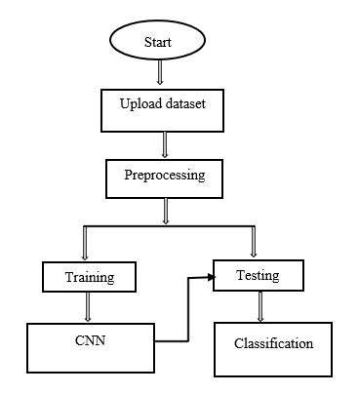
Proposed Method:
Block diagram of proposed method

Slide 10
Advantages of Proposed Method:
• Accurate classification
• Less complexity
• High performance

Slide 11
Implementation
System:
Takes the data
Preprocessing the dataset
Training
User:
Registration
Login into website
Deforestation Classification
Logout

Slide 12
Algorithm:
CNN:
In deep learning, a convolutional neural network (CNN, or ConvNet) is a class of deep neural networks, most commonly applied to analyzing visual imagery.
A convolutional neural network consists of an input layer, hidden layers and an output layer. In any feed-forward neural network, any middle layers are called hidden because their inputs and outputs are masked by the activation function and final convolution. In a convolutional neural network, the hidden layers include layers that perform convolutions. Typically this includes a layer that does multiplication or other dot product, and its activation function is commonly ReLU. This is followed by other convolution layers such as pooling layers, fully connected layers and normalization layers.

Slide 13
Hardware & Software Requirements:
H/W Configuration:
• Processor - I3/Intel Processor
• Hard Disk -160GB
• RAM - 8Gb
S/W Configuration:
• Operating System : Windows 7/8/10 .
• Server side Script : HTML, CSS & JS.
• IDE : Pycharm.
• Libraries Used : Numpy, IO, OS, Flask, keras.
• Technology : Python 3.6+.

Slide 14
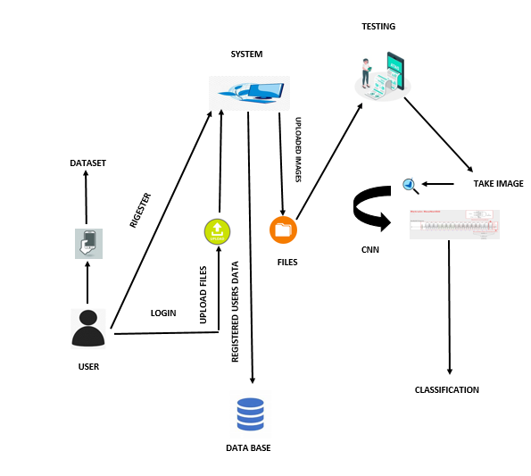
Architecture:

Slide 15
Use Case Diagram

Slide 16
Class Diagram
In software engineering, a class diagram in the Unified Modeling Language (UML) is a type of static structure diagram that describes the structure of a system by showing the system's classes, their attributes, operations (or methods), and the relationships among the classes. It explains which class contains information.

Slide 17
Activity Diagram

Slide 18
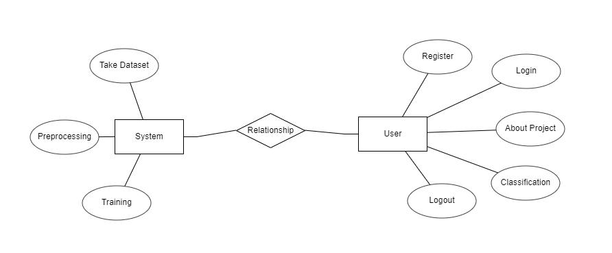
ER Diagram:

Slide 19
Results
In this application, we have considered the dataset of healthy forest and deforestation images and trained using CNN algorithm.
In the testing part the image is uploaded and the image is classified.

Slide 20
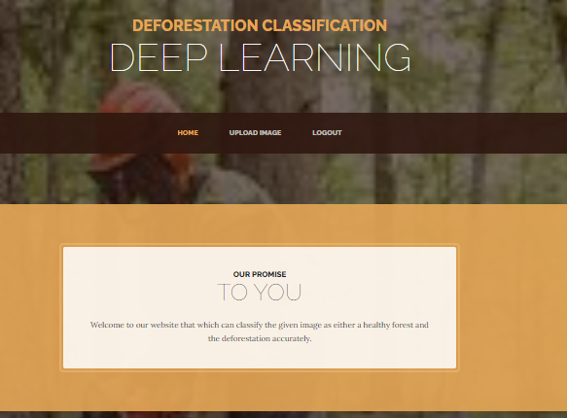
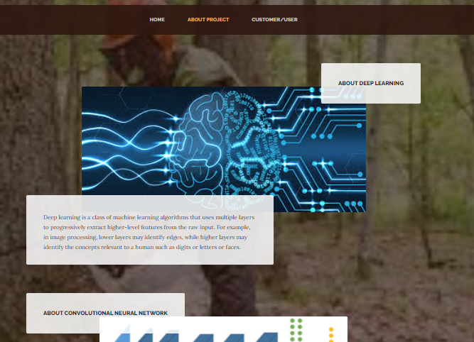
Results:
Home Page
About Project

Slide 21
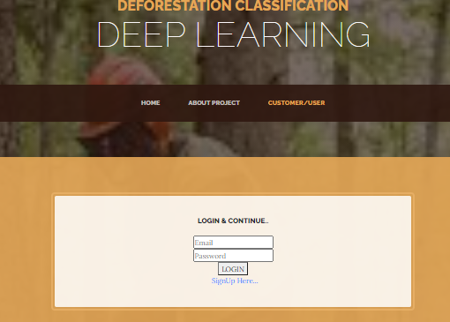
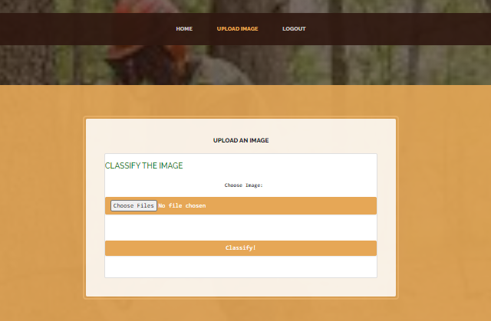
Results and Discussions:
Login page
Image Uploading

Slide 22
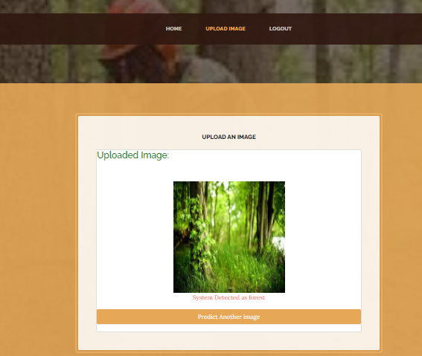
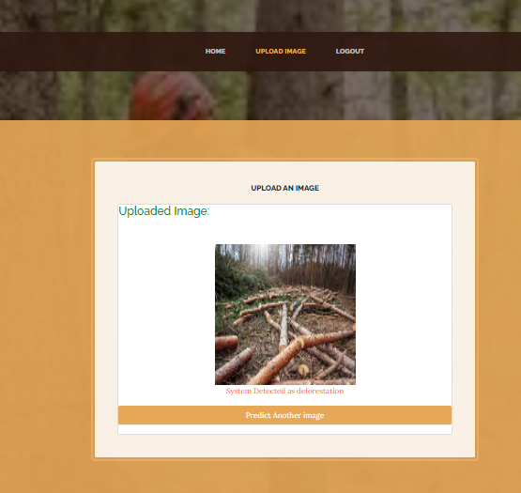
Results and Discussions:
Image Classified as Forest
Image Classified as Deforestation

Slide 23
Conclusion:
In this project we have successfully classified the images of healthy forest and the one with deforestation using the convolution neural network of the deep learning. Here, we have considered the dataset of images with 2 classes which among one are not deforested and another are deforested and trained using CNN. After the training we have tested by uploading the image and classified it.

Slide 24
References:
[1] Sanchez-Azofeifa, G.A.; Harriss, R.C.; Skole, D.L. Deforestation in Costa Rica: A quantitative analysis using remote sensing imagery 1. Biotropica 2001, 33, 378–384.
[2] Frohn, R.; McGwire, K.; Dale, V.; Estes, J. Using Satellite Remote Sensing Analysis to Evaluate a Socio-Economic and Ecological Model of Deforestation in Rondonia, Brazil. Remote Sens. 1996, 17, 3233–3255.
[3] Achard, F.; Estreguil, C. Forest Classification of Southeast Asia using NOAA AVHRR Data. Remote Sens. Environ. 1995, 54, 198–208..
[4] Desclée, B.; Bogaert, P.; Defourny, P. Forest Change Detection by Statistical Object-Based Method. Remote Sens. Environ. 2006, 102, 1–11.
[5] YLary, D.J.; Alavi, A.H.; Gandomi, A.H.; Walker, A.L. Machine Learning in Geosciences and Remote Sensing. Geosci. Front. 2016, 7, 3–10.

