Slide 1
Real-Data Machine Learning for Telemedicine Triage and Outbreak Surveillance
Author One, Author Two · Placeholder Department, Placeholder Institute, City, India
Nexathon II · Paper Presentation · AIKTC · 9 October 2026
Public real-world data only · no synthetic records · released for exact reproduction
✓
IEEE 6-page paper, 13 references
#
Seed-42 byte-identical reruns
!
Fail-closed data pipeline
Notes:
Opening: two everyday decisions on a rural telemedicine platform, answered only with public data. Byline is a placeholder in the current draft.

Slide 2
Two decisions, asymmetric errors
1
Patient-level triage
2
Population-level outbreak signal
Which callers can be managed remotely, and which need urgent escalation? Errors are asymmetric: a missed high-acuity patient is a safety event, while an unnecessary referral costs access and trust.
Is this district-week part of a developing wave? In routine public surveillance there is no outbreak label to train on — only a fixed weekly review budget, so every alert displaces another.
Constraint: 15.2% of encounters are high-acuity; uncertain cases must be deferred, not guessed.
Constraint: a top-5% alert budget, and evaluation that must stay descriptive.
✓
Both layers run on ordinary public data — no proprietary EHR, no private sensor feed, no synthetic records.
02
Notes:
Frame the two decisions and their asymmetric error costs. Surveillance has no labels, which dictates an alert-budget, descriptive evaluation.

Slide 3
Three real public datasets — nothing synthetic
13,595
126,712
69
ED analysis encounters
district-weeks of SARI signals
months of pharmacy sales
CDC NHAMCS 2019 public microdata (19,481 raw, protocol exclusions applied) [1]
covid19india public archive, 840 districts, 2020–2023 [2]
Kaggle monthly series, CC BY-NC 4.0 — supplementary forecast task [3]
!
Missing raw file ⇒ hard FileNotFoundError
#
Seed 42 — byte-identical reruns
✓
0 synthetic rows anywhere in the pipeline
Every dataset is public and licensed; URLs, retrieval dates and licences are cited in the paper — see Data Availability.
03
Notes:
All three sources are free and public. NHAMCS and covid19india carry DOI/URL citations; Kaggle is CC BY-NC. Fail-closed means a stale download cannot silently degrade results.

Slide 4
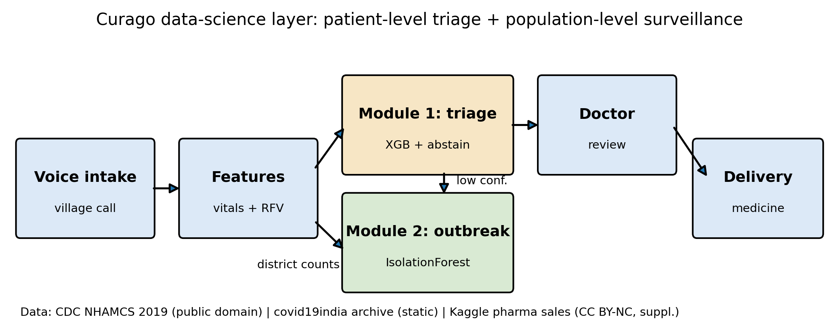
Two modules, one reproducible pipeline
1
Module 1 — patient triage
Calibrated XGBoost (isotonic) risk score → cross-fitted tuned threshold → abstention for uncertain cases → PAC split-conformal recall control at α = 0.15.
2
Module 2 — district outbreak signal
IsolationForest anomaly score per district-week → fixed 5% weekly alert budget → top-scoring district-weeks surfaced for review, then described retrospectively.
✓
Both modules recompute from raw CSVs; every table and figure in the paper is a generated artifact — never hand-edited.
04
Notes:
Pipeline figure straight from the paper. Emphasise: thresholds are tuned on validation folds only; the conformal layer wraps the tuned model.

Slide 5
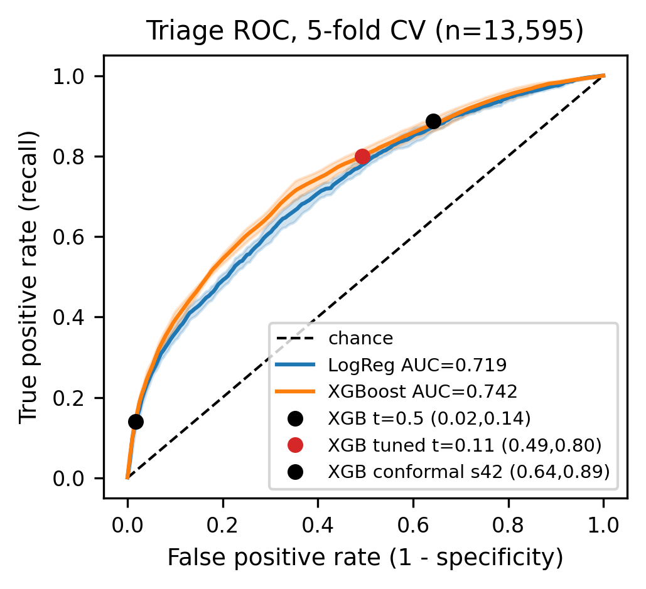
Module 1 — discrimination and operating point
0.742
17.2%
primary model CV AUC
under-triage, cross-fitted
vs 0.719 logistic; 95% CI [0.728, 0.751]
down from 85.9% at default t = 0.50; FPR 0.545
0.829
0.113
recall at the chosen point
OOF Brier, isotonic
precision 0.214; thresholds 0.09–0.10 per outer fold
beats 0.129 for a constant — calibration holds
Cross-validated ROC, seed 42 — regenerated from ds/paper_figures.py.
05
Notes:
Under-triage is the metric the platform cares about: the default t=0.5 threshold with a calibrated model is far too conservative (85.9% under-triage), so cross-fitted threshold selection is the lever. The nested estimate tunes each outer fold on the other four only — no test-fold peeking. Brier below the constant baseline means the probabilities are calibrated enough to threshold.

Slide 6
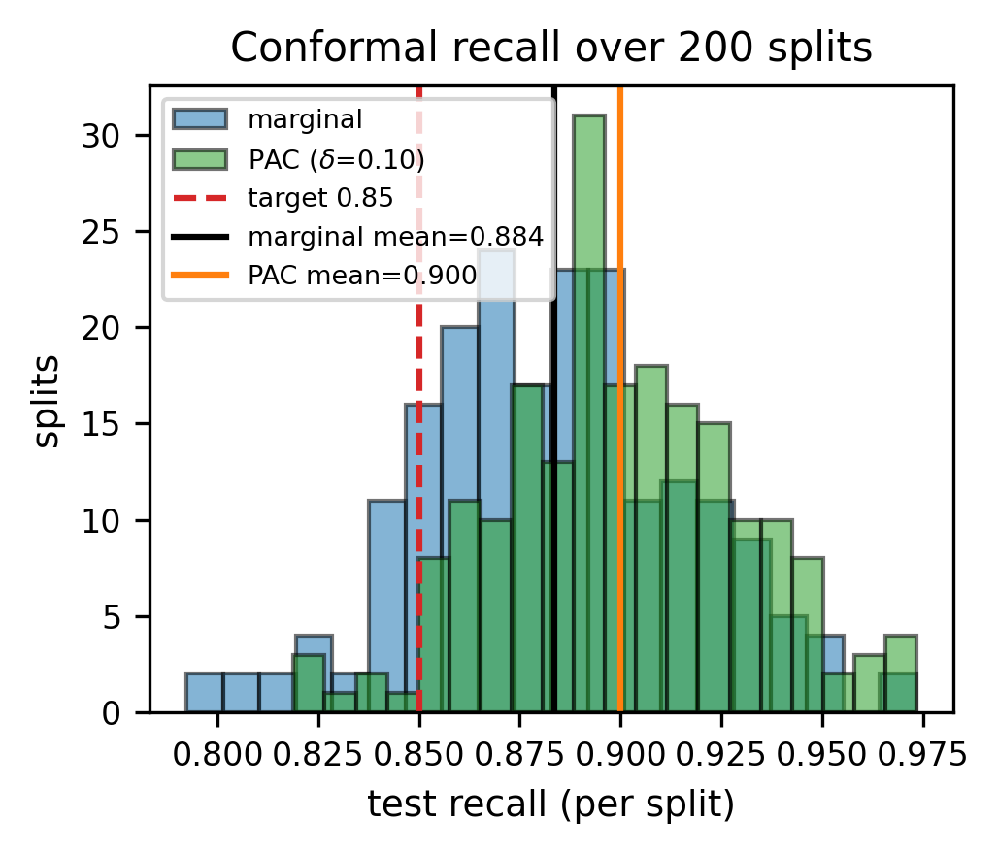
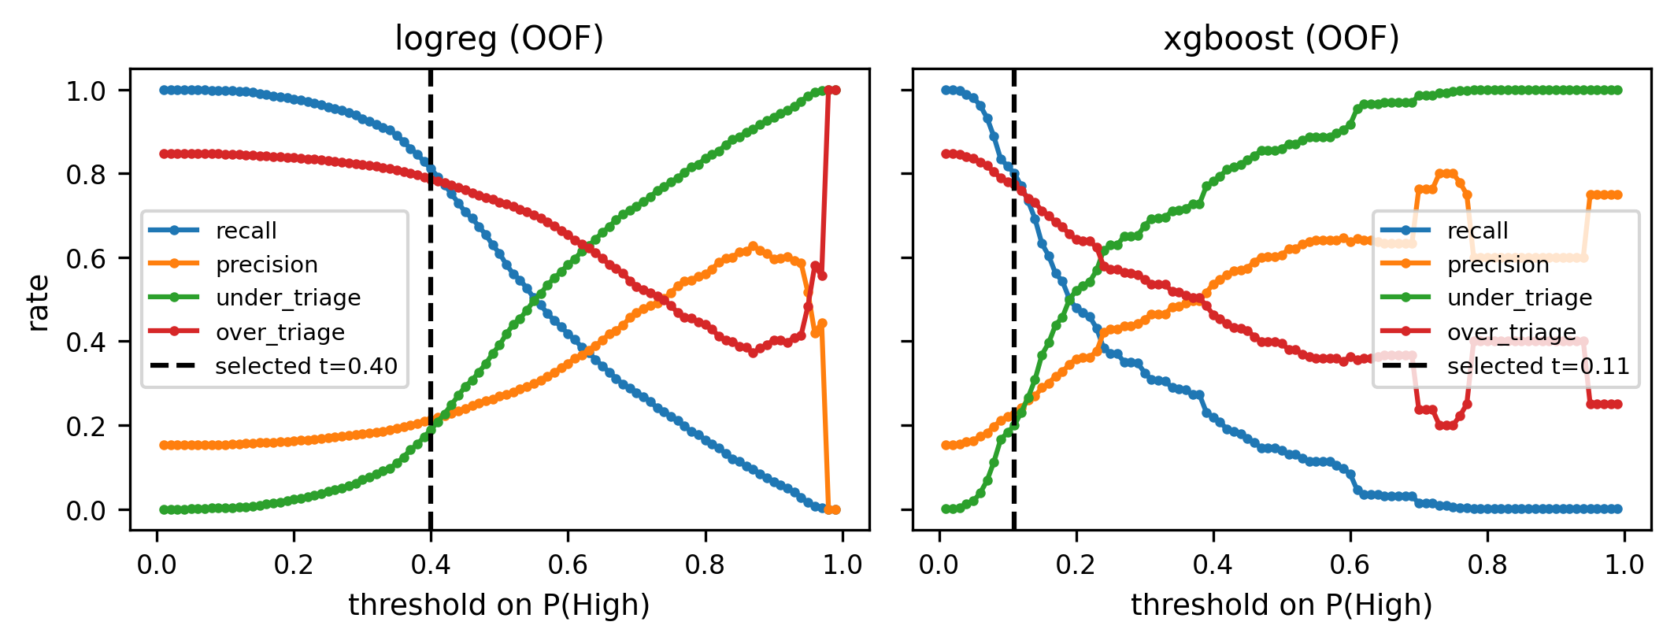
Split-conformal recall control — marginal vs PAC
Recall distribution over 200 random splits, both rules, α = 0.15.
Threshold–coverage trade-off, split means ± SD.
Marginal rule: mean recall 0.884 (SD 0.033), yet 12.5% of splits fall below the 0.85 target — average-case only.
PAC rule (δ = 10%): mean recall 0.900, below-target splits cut to 3.5% at precision 0.191.
!
✓
06
Notes:
The honest core: the textbook conformal rule is marginal — 12.5% of the 200 splits miss the nominal 0.85 target. The PAC (Beta order-statistic) rule buys a per-split-style bound: below-target share drops to 3.5% (within delta=10%) with slightly higher mean recall; the price is a lower threshold and precision 0.191 vs 0.196. Both rules are stated in the abstract, results and conclusion.

Slide 7
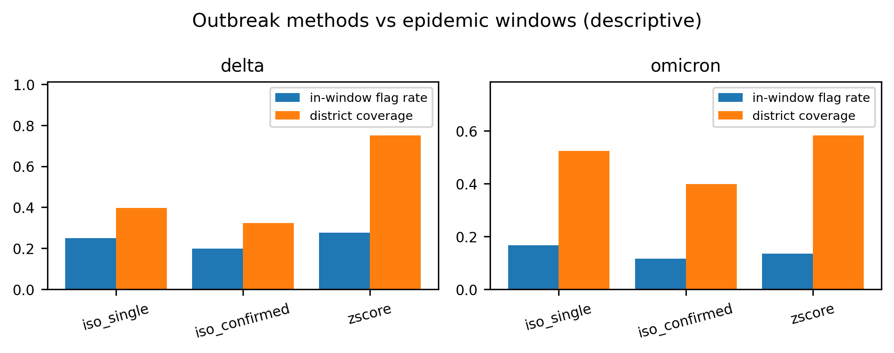
Module 2 — outbreak surveillance, described not claimed
7.0×
Delta-wave enrichment
flag rate inside the wave vs background
2 weeks
median lead over the wave
at the fixed 5% alert budget
Weekly IsolationForest flags across 126,712 district-weeks — regenerated from ds/paper_figures.py.
25%
Descriptive only: no labelled outbreak ground truth exists in routine district data [2]. Enrichment is retrospective description at a fixed budget — not a validated detector.
of Delta weeks flagged
vs 3.6% of weeks outside it
!
07
Notes:
Biggest enrichment is on the Delta wave with a two-week median lead. Caveat is printed on the slide: no outbreak labels, so this is description at a fixed budget.

Slide 8
What we do not claim
!
Guarantees rest on exchangeability — The marginal rule is average-case (12.5% of splits below target); PAC bounds that share at δ = 10%, but neither survives distribution shift.
2
Transfer is unproven — Trained on US NHAMCS emergency-department data; rural Indian telemedicine casemix and workflow differ. External validation is future work, not a result.
3
Calibrated, not oracular — Isotonic Brier 0.113 beats the constant 0.129 — but probabilities are not validated absolute risks; they drive thresholds, not quotations.
4
Outbreak detection is descriptive — IsolationForest enrichment is retrospective description at a 5% budget; naive baselines and NEWS2 stay competitive (cutoff 1: precision 0.168, recall 0.669).
✓
All ten mandated disclosures are machine-checked in paper/audit.py and pass — full text in Section V of the paper.
08
Notes:
Read these aloud if time is short. Judges reward calibrated claims: each limitation here is also stated in the abstract or results of the paper.

Slide 9
Reproducible by construction
✓
Fail-closed data pipeline
42
Seed 42, byte-identical
A missing or stale raw file raises FileNotFoundError. No silent imputation, no synthetic backfill, no cached numbers on disk.
Repeated runs produce identical CSVs and PNGs; published metrics are read back from generated artifacts at build time.
#
One JSON behind every number
★
Automated audits on every build
LaTeX, Markdown, DOCX and this deck all resolve metrics from paper_numbers.json — zero hand-typed figures.
Numbers, citations, originality, honesty disclosures and IEEE format are machine-checked — all pass.
↗
github.com/vaibhav7087/curago_paper_version · MIT licence · data licences, URLs and retrieval dates in Data Availability
09
Notes:
Reproducibility is treated as a feature of the pipeline, not a README promise: fail-closed inputs, deterministic seeds, and one numeric source of truth across four output formats.

Slide 10
Takeaways
1
Ordinary public data, tuned without test-fold peeking, beats naive baselines on both tasks — AUC 0.742 for triage (cross-fitted under-triage 17.2%) and 7.0× outbreak enrichment — with protocol limits stated up front.
2
Guarantees must be priced: the marginal conformal rule leaves 12.5% of splits below target, and the PAC rule cuts that to 3.5% at δ = 10% — publish the failures alongside the mean.
3
Reproducibility is a feature, not a footnote: fail-closed inputs, byte-identical seed-42 reruns, and one JSON behind every number in four output formats.
Next: prospective validation on rural-Indian telemedicine casemix, drift monitoring, threshold re-tuning — SHAP, calibration and forecast artifacts ship with the repository.
10
Notes:
Close on the three claims the evidence actually supports, then the honest future-work list. Invite questions on the conformal layer or the transfer caveat.

Slide 11
References
[1] National Center for Health Statistics, "National hospital ambulatory medical care survey: 2019 emergency department summary," Centers for Disease Control and Prevention (CDC), 2019, data documentation: https://ftp.cdc.gov/pub/Health_Statistics/NCHS/Dataset_Documentation/NHAMCS/doc19-ed-508.pdf. [Online]. Available: https://www.cdc.gov/nchs/nhamcs/documentation/about-the-data-2019.html
[2] covid19india.com Data Operations Group and incovid19 Team, "Covid-19 india national and district-level time-series archive," Static data archive hosted at https://data.incovid19.org/, 2023, retrieved 2026-10-07. Retrospective observed series from 2020-04-26 to 2023-08-22 across 840 state-qualified districts.
[3] M. Zdravković, "Pharma sales data: Point-of-sale transactional dataset resampled to monthly aggregates," Kaggle, 2019, license: Creative Commons Attribution-NonCommercial 4.0 International (CC BY-NC 4.0). [Online]. Available: https://www.kaggle.com/datasets/milanzdravkovic/pharma-sales-data
[4] Royal College of Physicians, *National Early Warning Score (NEWS) 2: Standardising the Assessment of Acute-Illness Severity in the NHS*. London, UK: Royal College of Physicians, 2017, report of a working party.
[5] G. B. Smith, D. R. Prytherch, P. Meredith, P. E. Schmidt, and P. I. Featherstone, "The ability of the National Early Warning Score (NEWS) to discriminate patients at risk of early death in acute medical admissions," *Resuscitation*, vol. 84, no. 4, pp. 465–470, 2013.
[6] T. Chen and C. Guestrin, "XGBoost: A scalable tree boosting system," in *Proceedings of the 22nd ACM SIGKDD International Conference on Knowledge Discovery and Data Mining (KDD '16)*, 2016, pp. 785–794.
[7] G. Ke, Q. Meng, T. Finley, T. Wang, W. Chen, W. Ma, Q. Ye, and T.-Y. Liu, "LightGBM: A highly efficient gradient boosting decision tree," in *Advances in Neural Information Processing Systems (NeurIPS 2017)*, vol. 30, 2017, pp. 3146–3154.
[8] F. Pedregosa, G. Varoquaux, A. Gramfort, V. Michel, B. Thirion, O. Grisel, M. Blondel, P. Prettenhofer, R. Weiss, V. Dubourg, J. Vanderplas, A. Passos, D. Cournapeau, M. Brucher, M. Perrot, and É. Duchesnay, "Scikit-learn: Machine learning in Python," *Journal of Machine Learning Research (JMLR)*, vol. 12, pp. 2825–2830, 2011.
[9] V. Vovk, A. Gammerman, and G. Shafer, *Algorithmic Learning in a Random World*. New York, NY, USA: Springer Science & Business Media, 2005.
[10] A. N. Angelopoulos and S. Bates, "A gentle introduction to conformal prediction and distribution-free uncertainty quantification," *arXiv preprint arXiv:2107.07511*, 2021.
[11] S. M. Lundberg and S.-I. Lee, "A unified approach to interpreting model predictions," in *Advances in Neural Information Processing Systems (NeurIPS 2017)*, vol. 30, 2017, pp. 4765–4774.
[12] J. Clarke, M. U. G. Kraemer, and et al., "OpenDengue: Data platform for global dengue surveillance," *Scientific Data*, vol. 11, no. 1, p. 324, 2024.
[13] S. Seabold and J. Perktold, "Statsmodels: Econometric and statistical modeling with Python," in *Proceedings of the 9th Python in Science Conference (SciPy 2010)*, 2010, pp. 92–96.
11
Notes:
Same 13-item bibliography as the PDF, exported from the compiled .bbl — citation numbering is identical.

