Slide 1

Nexathon II · Paper Presentation · AIKTC
Real-Data Machine Learning for Telemedicine Triage and Outbreak Surveillance
Vaibhav Kadam · Tanvi Gandhi · Omkar Shinolikar
Bylance Technologies, India
9 October 2026 · IEEE conference format
Real public data only · no synthetic records · seed-42 byte-identical reruns · fail-closed pipeline
Notes:
Title slide. Three authors, Bylance Technologies. The paper and deck are generated from committed artifacts — nothing is hand-typed.

Slide 2
Presentation Outline
Introduction
Problem Statement
Methodology
Results
Conclusion
Future Work
References
Notes:
Standard conference outline, same as the template.

Slide 3
Abstract
Telemedicine platforms face two simultaneous decisions: which visit needs urgent escalation, and is a district-level outbreak beginning.
Real public data only — CDC NHAMCS 2019 ED (n = 13,595), COVID-19 India district-weeks (126,712), Kaggle pharma sales; fail-closed if raw data is missing.
Primary model fixed by a pre-declared rule (min OOF Brier): unweighted XGBoost + isotonic — AUC 0.742 [0.728, 0.751], Brier 0.113 vs 0.129 constant.
Nested cross-fitted threshold: recall 0.829, under-triage 0.172, FPR 0.545.
PAC split-conformal rule (δ = 0.10): mean recall 0.900 with 3.5% of splits below target (marginal: 0.884 / 12.5%).
Outbreak module: 7.0× descriptive enrichment at a 5% alert budget — reported as enrichment, never as detection rates.
Notes:
Condensed abstract with the locked headline numbers. Every figure here is also in the 6-page paper.

Slide 4
Introduction
Two everyday decisions on a telemedicine platform, answered only with public data.
Decision 1 — patient level: route an encounter to urgent care or routine advice. Errors are asymmetric: under-triage can be fatal.
Decision 2 — population level: detect district-week outbreak signals under a fixed alert budget.
Supplementary: pharmaceutical demand forecasting as a robustness check (naive baselines win 4/8 drugs — reported).
Safety-first framing: sensitivity is prioritized, and every claim is audit-locked to a committed artifact.
Notes:
Frame the two decisions and the honest-data philosophy before any method detail.

Slide 5
Problem Statement
Default threshold t = 0.50 is clinically unsafe: recall 0.141 → under-triage 85.9% (FPR 0.016).
Thresholds tuned and evaluated on the same data overstate performance — nested cross-fitting is required for an honest estimate.
The textbook conformal guarantee is only marginal: 12.5% of splits miss the 0.85 target.
Outbreak data has no gold-standard labels — precision, recall and ROC cannot be honestly computed.
Objective: conservative operating points + calibrated claims, all from real public data.
Notes:
Three honest problems: unsafe default, evaluation leakage, missing labels. Everything else in the deck is a response to these.

Slide 6
Literature Survey 1
Clinical severity scores (NEWS2):
Vitals-only bedside score — cutoff ≥5: recall 0.138, precision 0.207; best cutoff 1: 0.669 / 0.168.
No cutoff ≥1 reaches 0.85 recall on calibration — matched comparison infeasible (documented).
Learned triage models:
Models over reason-for-visit + vitals outperform vitals-only scoring at comparable precision.
NHAMCS is the standard public ED benchmark for triage research [1].
Limitation: US data — non-transferability to deployment settings is stated explicitly.
Notes:
Anchor against the clinical baseline (NEWS2) â€” the paper reports we cannot match 0.85 recall with any NEWS2 cutoff.

Slide 7
Literature Survey 2
Conformal prediction:
Split-conformal prediction gives distribution-free marginal coverage [11], [12].
Marginal ≠ per-split: the guarantee holds in expectation over calibration draws.
Risk control:
PAC (probably-approximately-correct) guarantees bound the share of bad splits via β order statistics [11].
Our contribution:
Apply PAC rank selection to triage recall control on a calibrated primary model — marginal and PAC rules both reported over 200 seeds.
Notes:
Position the PAC rule as the honest upgrade of textbook conformal recall control.

Slide 8
Literature Survey 3
Outbreak surveillance without labels:
Open volunteer district archives (e.g. OpenDengue [13]) are rich in time series, poor in ground-truth labels.
Standard practice: alert-budget concentration in verified wave windows (EARS-style) instead of ROC curves.
Forecasting baselines:
Seasonal naive and Holt-Winters are strong competitors on low-variance series — the free-lunch finding is reported, not hidden [7].
Limitation: descriptive enrichment only; retrospective on a static archive.
Notes:
Justify why the outbreak module reports enrichment instead of precision/recall.

Slide 9
Proposed Methodology
Six triage pipelines: LogReg, class-weighted XGB, unweighted XGB, + isotonic, + Platt, constant baseline.
Primary chosen by pre-declared rule: minimum 5-fold OOF Brier among calibrated candidates (ties → isotonic).
Threshold rule: argmax precision subject to OOF recall ≥ 0.80 (0.01 grid; ties → higher threshold).
Nested cross-fitting: each outer fold re-selects its threshold on the other four folds only.
Abstention band: calibrated p ∈ (0.4, 0.6) → human review (4.2% of cases).
Workflow: real data → calibrated model → cross-fitted threshold → PAC recall control → triage advice
Notes:
The methodology in one slide: model selection, thresholding, abstention, conformal layer.

Slide 10
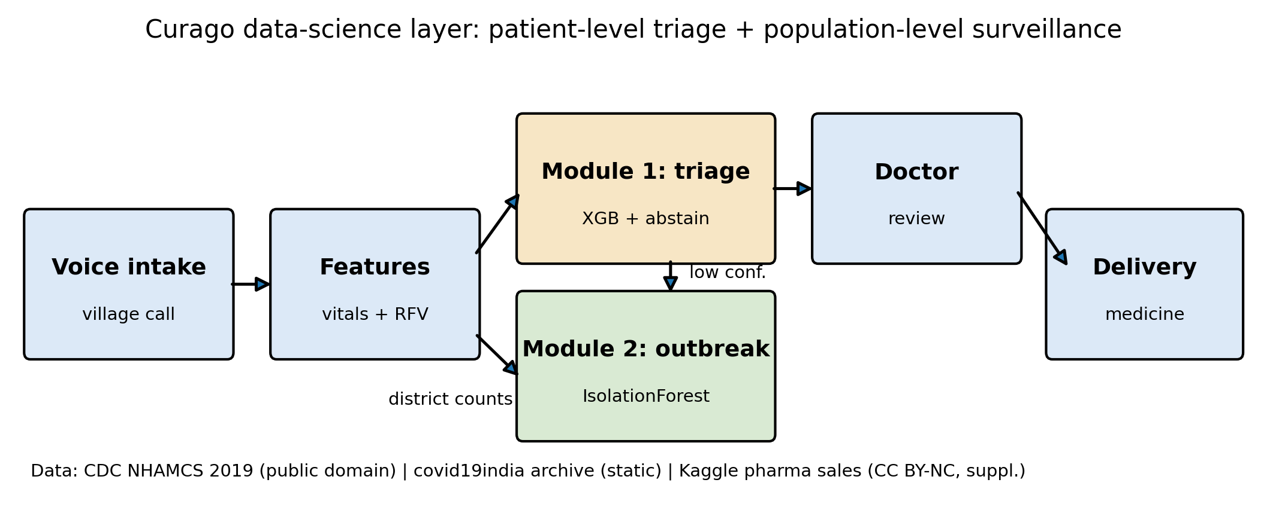
Flowchart of Proposed Method
Curago data-science layer: patient-level triage + population-level surveillance (Fig. 1 of the paper). Data: NHAMCS 2019 ED, inCOVID19 district archive, Kaggle pharma sales.
Notes:
Walk left to right: intake, Module 1 triage with abstention, Module 2 surveillance, forecasting.

Slide 11
Primary Model & Calibration
Primary: unweighted XGBoost + isotonic calibration — AUC 0.742 [0.728, 0.751].
Logistic regression: AUC 0.719 [0.708, 0.731]; paired difference CI [0.012, 0.031] excludes zero.
Class weighting distorts probabilities: Brier 0.165 vs 0.113 (isotonic).
Calibrated model beats the constant baseline: 0.113 < 0.129.
Probabilities drive a threshold rule — they are not quoted as absolute risks.
Notes:
The calibration story: why isotonic was pre-selected and what the probabilities are (and are not) used for.

Slide 12
Threshold Selection & Cross-Fitting
Rule: argmax precision subject to OOF recall ≥ 0.80 (0.01 grid; ties → higher threshold).
Pooled: t = 0.11 → recall 0.800, FPR 0.493, under-triage 0.200.
Nested (headline): outer 5-fold — threshold re-tuned on the other four folds only, then evaluated on its own test fold.
Nested result: t = 0.09–0.10 → recall 0.829, FPR 0.545, under-triage 0.172, abstention 0.042.
No test-fold peeking — the conservative operating point we report.
Notes:
Emphasise the nested protocol: this is what makes the 0.829 recall number honest.

Slide 13
PAC Split-Conformal Guarantee
Protocol: 200 seeds, 60/20/20 stratified splits, α = 0.15 (target recall 0.85).
Marginal rule (rank k = ⌊α(n+1)⌋): mean 0.884 (SD 0.033), 12.5% of splits below target.
PAC rule: largest k with BetaCDF(1−α; n+1−k, k) ≤ δ, δ = 0.10.
PAC result: mean 0.900 (SD 0.030), 3.5% below target (≤ δ), precision 0.191.
PAC bounds the share of below-target splits — still not a per-split guarantee, and we say so.
Notes:
Core methodological contribution: PAC rank selection. Lower rank â†’ lower threshold â†’ higher recall, at a small precision cost.

Slide 14
Datasets Used
CDC NHAMCS 2019 ED — 13,595 encounters after screening (US public domain).
COVID-19 India district time-series — 126,712 district-weeks, 840 districts (open archive).
Kaggle pharma sales — 69 monthly points, 8 ATC groups (CC BY-NC 4.0).
Evaluation: 5-fold OOF CV, nested cross-fitting, 200-seed conformal study, 12-step forecast holdout.
Every CSV carries a Data Source column; licenses and citations in docs/citations.md.
Notes:
All three datasets are public; raw data lives outside git and the pipeline fails closed without it.

Slide 15
Results & Discussion
Triage: under-triage 85.9% → 17.2% via cross-fitted thresholds (recall 0.829, FPR 0.545).
Calibration: Brier 0.113 beats constant 0.129; probabilities are threshold inputs, not quoted risks.
Guarantees: marginal 0.884 / 12.5% below target; PAC 0.900 / 3.5% (δ = 10%).
Seed-42 split: recall 0.886 [0.856, 0.914], precision 0.199, FPR 0.643.
Outbreak: 7.0× enrichment (0.250 vs 0.036), 39.8% district coverage — descriptive.
Notes:
Results with their honest qualifiers attached. Numbers follow directly from the tables on the next slides.

Slide 16
Table 1. Triage model comparison (5-fold OOF, t = 0.50)
Model | AUC | Recall | Precision | Brier
Logistic regression | 0.719 | 0.609 | 0.269 | 0.209
XGBoost (class-weighted) | 0.732 | 0.513 | 0.334 | 0.165
XGBoost + isotonic (primary) | 0.742 | 0.141 | 0.606 | 0.113
Constant (train prevalence) | 0.500 | 0.000 | 0.000 | 0.129
Primary chosen by min OOF Brier among calibrated candidates. Data: CDC NHAMCS 2019 ED (n = 13,595).
Notes:
Calibration is the differentiator: the primary model has the best Brier while staying at the top of the AUC table.

Slide 17
Table 2. Operating points
Setting | t | Recall | Precision | FPR | Under-triage
Default, primary | 0.50 | 0.141 | 0.605 | 0.016 | 0.859
Tuned, pooled OOF | 0.11 | 0.800 | 0.226 | 0.493 | 0.200
Nested cross-fitted (headline) | 0.09–0.10 | 0.829 | 0.214 | 0.545 | 0.172
Logistic regression, tuned | 0.400 | 0.811 | 0.214 | 0.536 | 0.189
Conformal, seed-42 split | 0.099 | 0.886 | 0.199 | 0.643 | 0.114
The nested row is the conservative headline: thresholds selected without test-fold access. Data: CDC NHAMCS 2019 ED.
Notes:
Read the default row first (unsafe), then the nested row (the number we stand behind).

Slide 18
Table 3. Conformal α sweep — marginal vs PAC (200 splits)
α | Rule | Mean recall | SD | Below target | Mean precision
0.05 | marginal | 0.966 | 0.015 | 14.5% | 0.169
0.05 | PAC (δ = 0.10) | 0.976 | 0.013 | 3.0% | 0.164
0.10 | marginal | 0.924 | 0.023 | 15.5% | 0.183
0.10 | PAC (δ = 0.10) | 0.938 | 0.021 | 3.0% | 0.179
0.15 | marginal | 0.884 | 0.033 | 12.5% | 0.196
0.15 | PAC (δ = 0.10) | 0.900 | 0.030 | 3.5% | 0.191
0.20 | marginal | 0.832 | 0.038 | 22.0% | 0.212
0.20 | PAC (δ = 0.10) | 0.858 | 0.038 | 6.0% | 0.204
0.30 | marginal | 0.737 | 0.043 | 17.5% | 0.243
0.30 | PAC (δ = 0.10) | 0.768 | 0.043 | 2.5% | 0.233
α = 0.15 rows (bold) are the paper’s headline: marginal 12.5% below target vs PAC 3.5% ≤ δ. Data: CDC NHAMCS 2019 ED.
Notes:
The PAC rule trades a little precision for a bounded below-target share at every alpha.

Slide 19
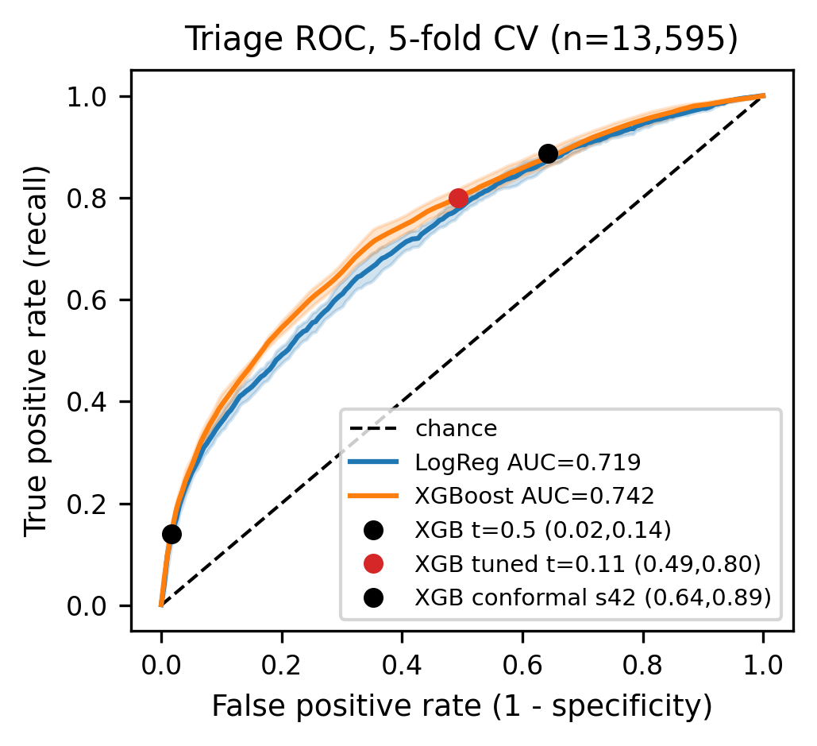
ROC Curve
5-fold OOF ROC: primary AUC 0.742 [0.728, 0.751] vs LogReg 0.719 (Fig. 2 of the paper).
Notes:
The paired difference CI [0.012, 0.031] excludes zero â€” the AUC gain is real but modest; calibration is the bigger win.

Slide 20
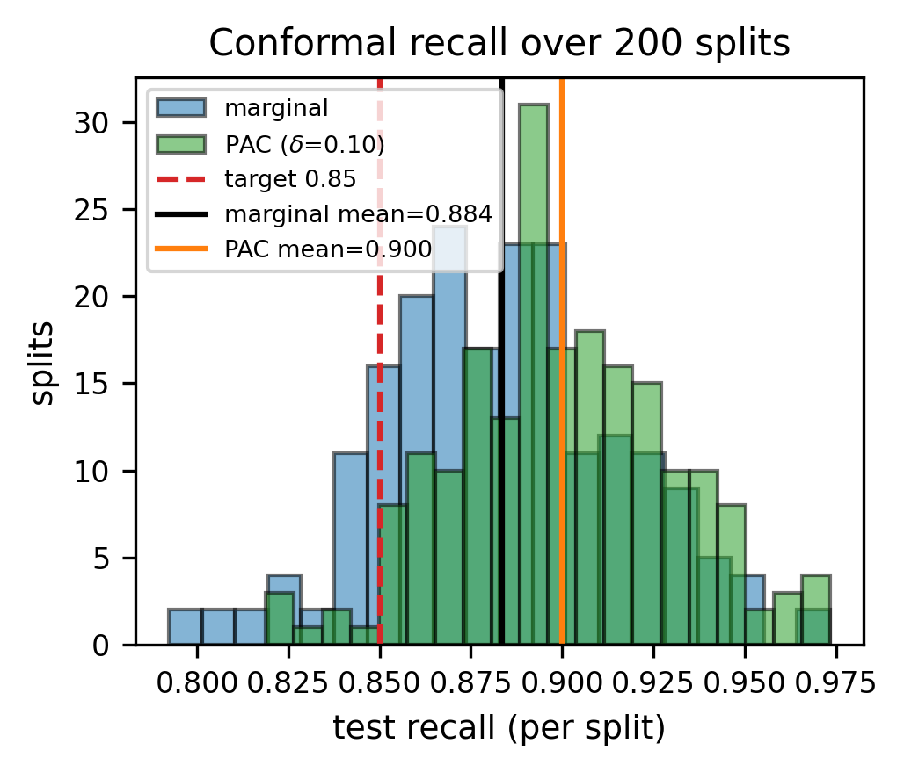
Conformal Recall Distribution
Test recall over 200 splits at α = 0.15: marginal vs PAC rule (Fig. 5 of the paper).
Notes:
Visual of the honest core: the marginal rule scatters below 0.85; the PAC rule shifts mass above the target.

Slide 21
Conclusion
Real public data, no synthetic records — full pipeline fail-closed and seed-42 reproducible.
Calibrated primary + nested cross-fitting: recall 0.829 at under-triage 0.172 (FPR 0.545).
PAC conformal control: below-target share 3.5% ≤ δ = 10% (marginal 12.5%).
Outbreak module: descriptive 7.0× enrichment only — stated as such.
Future Work:
External validation under covariate shift; outcome-linked labels (T4); surveillance baselines (T5); prospective live evaluation.
Notes:
Close on honesty: what we proved, what we deliberately did not claim, and what comes next.

Slide 22
References
[1] National Center for Health Statistics, "National hospital ambulatory medical care survey: 2019 emergency department summary," Centers for Disease Control and Prevention (CDC), 2019, data documentation: https://ftp.cdc.gov/pub/Health_Statistics/NCHS/Dataset_Documentation/NHAMCS/doc19-ed-508.pdf. [Online]. Available: https://www.cdc.gov/nchs/nhamcs/documentation/about-the-data-2019.html
[2] covid19india.com Data Operations Group and incovid19 Team, "Covid-19 india national and district-level time-series archive," Static data archive hosted at https://data.incovid19.org/, 2023, retrieved 2026-10-07. Retrospective observed series from 2020-04-26 to 2023-08-22 across 840 state-qualified districts.
[3] M. Zdravković, "Pharma sales data: Point-of-sale transactional dataset resampled to monthly aggregates," Kaggle, 2019, license: Creative Commons Attribution-NonCommercial 4.0 International (CC BY-NC 4.0). [Online]. Available: https://www.kaggle.com/datasets/milanzdravkovic/pharma-sales-data
[4] Royal College of Physicians, *National Early Warning Score (NEWS) 2: Standardising the Assessment of Acute-Illness Severity in the NHS*. London, UK: Royal College of Physicians, 2017, report of a working party.
[5] G. B. Smith, D. R. Prytherch, P. Meredith, P. E. Schmidt, and P. I. Featherstone, "The ability of the National Early Warning Score (NEWS) to discriminate patients at risk of early death in acute medical admissions," *Resuscitation*, vol. 84, no. 4, pp. 465–470, 2013.
[6] T. Chen and C. Guestrin, "XGBoost: A scalable tree boosting system," in *Proceedings of the 22nd ACM SIGKDD International Conference on Knowledge Discovery and Data Mining (KDD '16)*, 2016, pp. 785–794.
[7] G. Ke, Q. Meng, T. Finley, T. Wang, W. Chen, W. Ma, Q. Ye, and T.-Y. Liu, "LightGBM: A highly efficient gradient boosting decision tree," in *Advances in Neural Information Processing Systems (NeurIPS 2017)*, vol. 30, 2017, pp. 3146–3154.
[8] F. Pedregosa, G. Varoquaux, A. Gramfort, V. Michel, B. Thirion, O. Grisel, M. Blondel, P. Prettenhofer, R. Weiss, V. Dubourg, J. Vanderplas, A. Passos, D. Cournapeau, M. Brucher, M. Perrot, and É. Duchesnay, "Scikit-learn: Machine learning in Python," *Journal of Machine Learning Research (JMLR)*, vol. 12, pp. 2825–2830, 2011.
[9] V. Vovk, A. Gammerman, and G. Shafer, *Algorithmic Learning in a Random World*. New York, NY, USA: Springer Science & Business Media, 2005.
[10] A. N. Angelopoulos and S. Bates, "A gentle introduction to conformal prediction and distribution-free uncertainty quantification," *arXiv preprint arXiv:2107.07511*, 2021.
[11] S. M. Lundberg and S.-I. Lee, "A unified approach to interpreting model predictions," in *Advances in Neural Information Processing Systems (NeurIPS 2017)*, vol. 30, 2017, pp. 4765–4774.
[12] J. Clarke, M. U. G. Kraemer, and et al., "OpenDengue: Data platform for global dengue surveillance," *Scientific Data*, vol. 11, no. 1, p. 324, 2024.
[13] S. Seabold and J. Perktold, "Statsmodels: Econometric and statistical modeling with Python," in *Proceedings of the 9th Python in Science Conference (SciPy 2010)*, 2010, pp. 92–96.
Notes:
Same 13-item bibliography as the compiled paper — citation numbering is identical.

Slide 23
Thank You
Questions?
Paper: Real-Data Machine Learning for Telemedicine Triage and Outbreak Surveillance · github.com/vaibhav7087/curago_paper_version
Notes:
Open for questions. Repo link points to the committed artifacts behind every number.

