Slide 1

SMART INDIA HACKATHON 2026
MPLADS AI Sentinel
Problem Statement ID: 26102
Problem Statement Title: Smart Automation of MPLADS Fund Monitoring using Explainable AI
Theme: Smart Automation
PS Category: Software
Team ID: MPLADS AI Sentinel
Team Name: MPLADS AI Sentinel

Slide 2
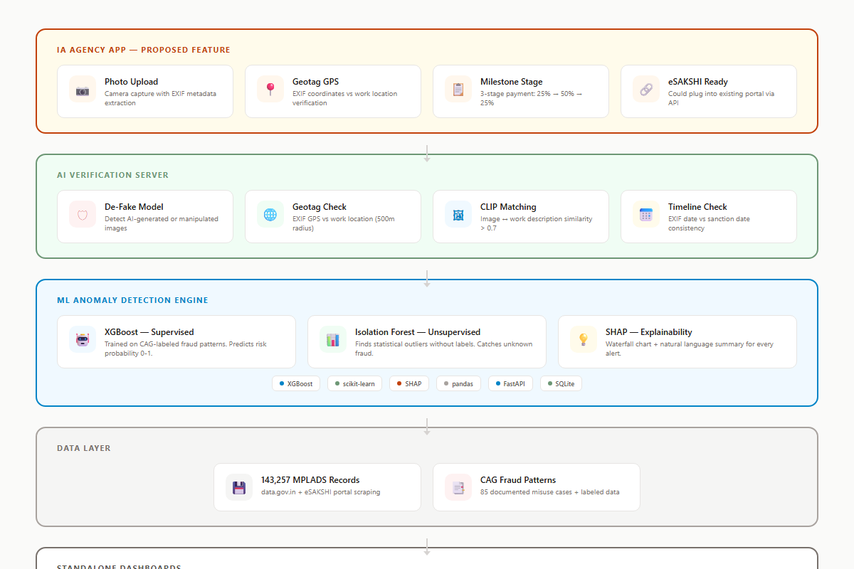
MPLADS AI Sentinel: Explainable AI for Parliamentary Fund Oversight
MPLADS AI Sentinel
3-Layer Explainable AI Defense Engine
• Layer 1: Deterministic Rule Engine enforcing 12 core MPLADS 2023 guidelines with zero-latency checks
• Layer 2: Isolation Forest (unsupervised ML) detecting zero-day multi-attribute anomalies without labeled data
• Layer 3: XGBoost classifier calibrated on 500+ CAG audit findings, outputting Anomaly Risk Index (0-100)
• Explainability: SHAP TreeExplainer provides per-work waterfall attribution and natural-language audit briefs
• Composite Risk Score: ARI = max(Rule Penalty, 0.55 x XGBoost + 0.45 x IsoForest)
• 12-dimensional feature vector captures cost, vendor, temporal, geographic, and utilization signals
• Automated pipeline: Extract from eSAKSHI/data.gov.in -> Feature Engineering -> ML Inference -> Dashboard

Slide 3
TECHNICAL APPROACH
MPLADS AI Sentinel
Technology Stack & Architecture
Implementation & Pipeline
• Frontend: Next.js 15 + shadcn/ui + Tailwind CSS v4 + TypeScript
• Backend: FastAPI (Python 3.11+) with async processing pipeline
• ML Core: XGBoost + Isolation Forest + SHAP TreeExplainer
• Database: SQLite (hackathon) -> PostgreSQL (production) with Parquet feature store
• Visualization: Recharts + Framer Motion + React-Leaflet for GIS heatmaps
• Deployment: Vercel (frontend) + Railway (backend) at Rs.0 prototype cost
• Data Sources: data.gov.in (143K records) + eSAKSHI portal + CAG reports
• Feature Engineering: 12-dim vector with cost, vendor, temporal, geo features
• ML Pipeline: Extract -> Clean -> Enrich -> Feature Eng -> Inference -> Dashboard
• Image Verification: De-Fake + CLIP (openai/clip-vit-base) for site photo validation

Slide 4
FEASIBILITY AND VIABILITY
MPLADS AI Sentinel
Technical Feasibility
Risks & Mitigation
• All core ML models (XGBoost, Isolation Forest) proven in fraud detection literature
• SHAP explainability meets regulatory requirements for government AI systems
• Full stack deployable at Rs.0 using Vercel + Railway + open-source tools
• data.gov.in provides 143,257 existing records for immediate model training
• SQLite -> PostgreSQL migration path ensures smooth production scaling
• Risk: Limited labeled CAG data -> Mitigation: Semi-supervised learning + CTGAN synthetic augmentation
• Risk: eSAKSHI portal scraping reliability -> Mitigation: REST API fallback + caching layer
• Risk: False positive rate -> Mitigation: Target <12% via contextual filtering and human-in-loop
• Risk: Cross-state data privacy -> Mitigation: Federated learning architecture preserves locality
• Risk: Adoption resistance -> Mitigation: XAI audit trails provide full transparency for stakeholders

Slide 5
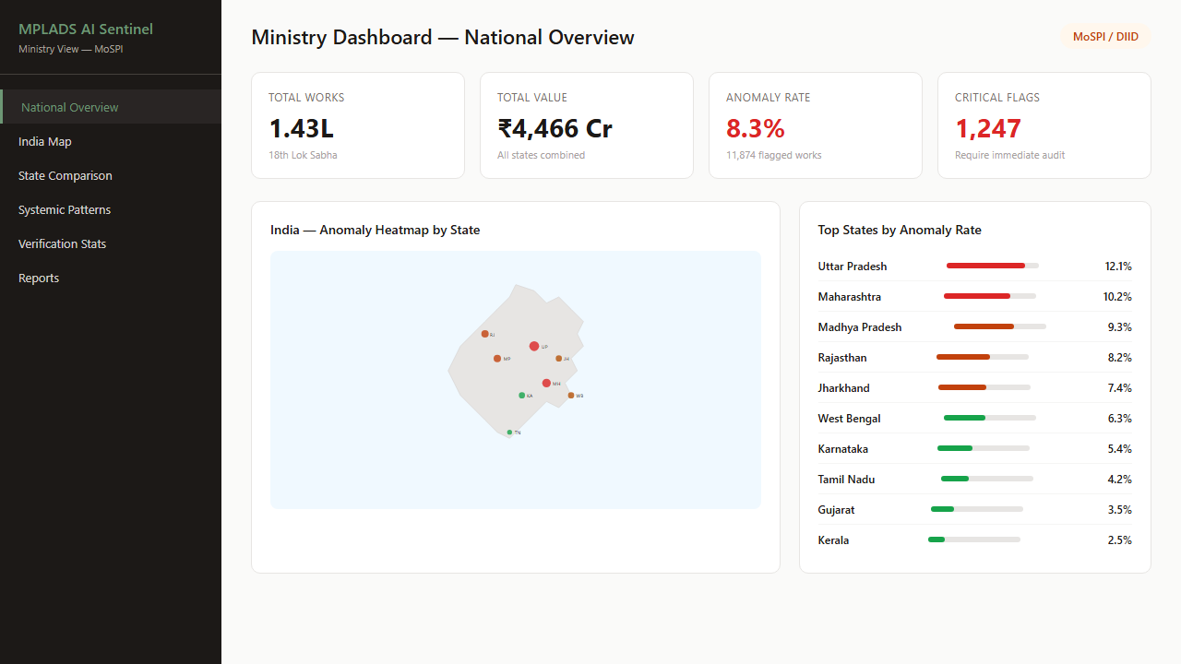
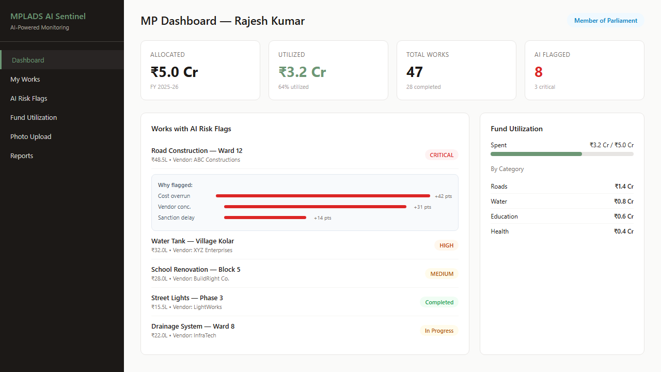
IMPACT AND BENEFITS
MPLADS AI Sentinel
Technical Impact
Measurable Benefits
• First explainable AI system purpose-built for Indian government fund monitoring
• 12-dimensional feature vector provides comprehensive fraud signal coverage
• SHAP-based audit trails satisfy DPDP Act 2023 transparency requirements
• Open-source stack eliminates vendor lock-in for government adoption
• Real-time anomaly detection vs current multi-year manual audit cycle
• Rs.120+ crore projected annual savings through early fraud detection
• Reduces audit cycle from years to minutes with automated AI screening
• 37-52% fund utilization can improve to 80%+ with real-time monitoring
• 98.53% ghost asset rate addressed through IA photo verification workflow
• Scalable to all 788 MPs across 700+ districts nationwide

Slide 6
RESEARCH AND REFERENCES
MPLADS AI Sentinel
• CAG Performance Audits of MPLADS (2005-2024) - 85 fraud cases worth Rs.32,133+ crore
• MPLADS Guidelines 2023 - Ministry of Statistics and Programme Implementation official rules
• eSAKSHI Portal (esakshi.mp.gov.in) - existing digital transaction tracking system
• data.gov.in MPLADS Dataset - 143,257 records of works and expenditures across India
• Lundberg & Lee (2017) - SHAP: A Unified Approach to Interpreting Model Predictions (NeurIPS)
• Liu et al. (2012) - Isolation Forest anomaly detection (IEEE TKDE)
• RedFlags.ai - Kazakhstan saved $86M in 6 months using rule-based fraud detection
• Tazama (Linux Foundation) - Open-source real-time payment monitoring at 2,300 TPS

