Slide 1
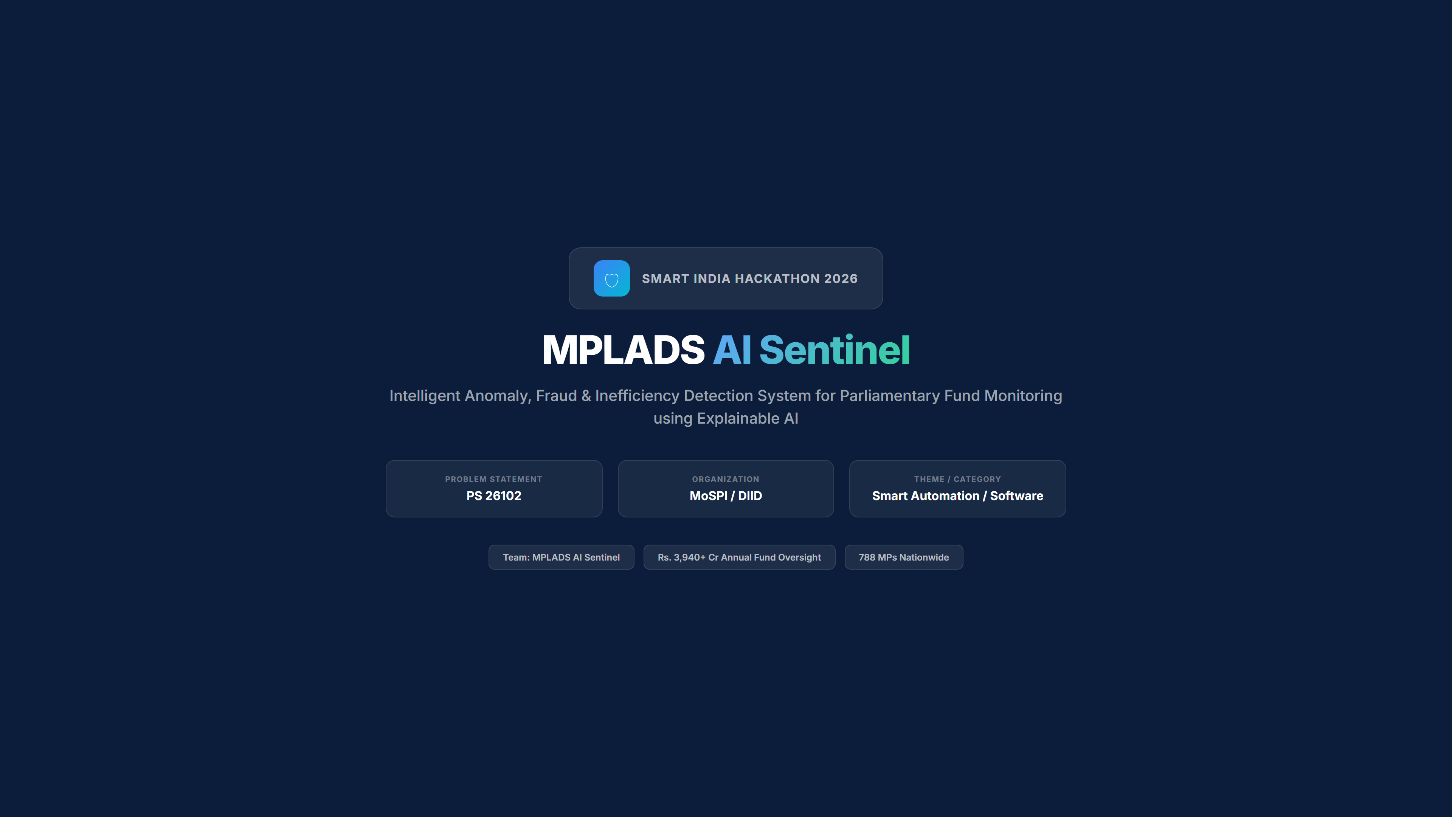

Slide 2
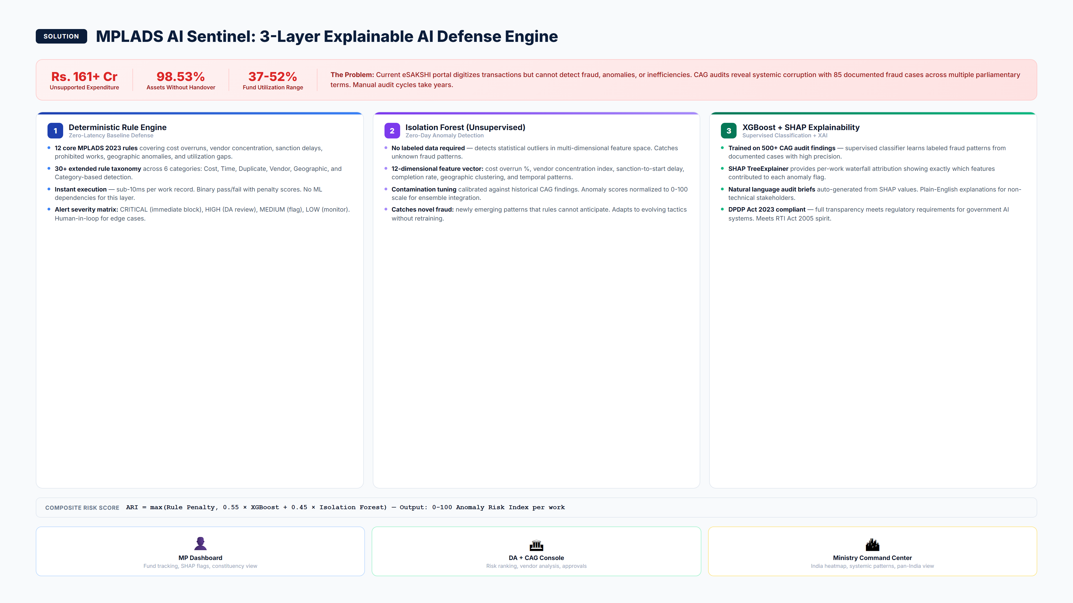
MPLADS AI Sentinel | SIH 2026 | PS 26102
2 / 8

Slide 3
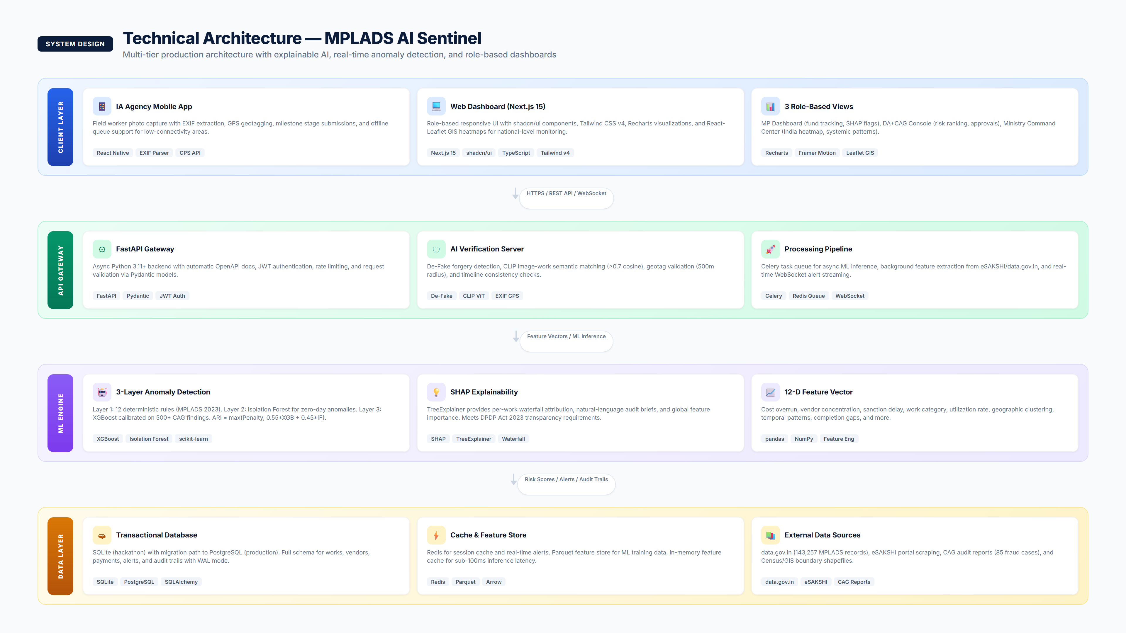
MPLADS AI Sentinel | SIH 2026 | PS 26102
3 / 8

Slide 4
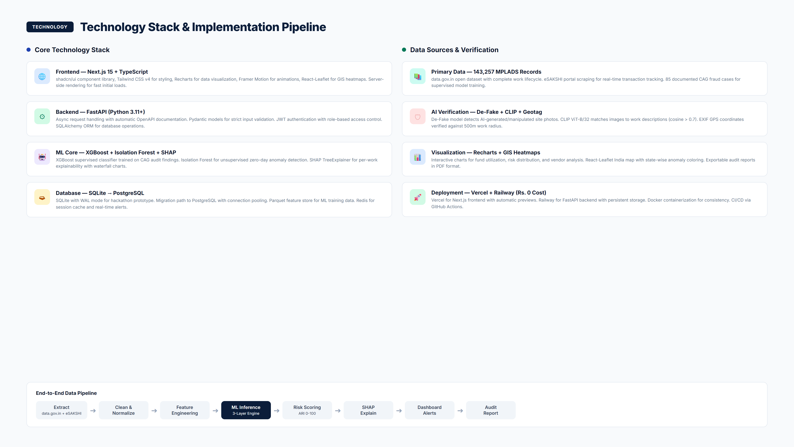
MPLADS AI Sentinel | SIH 2026 | PS 26102
4 / 8

Slide 5
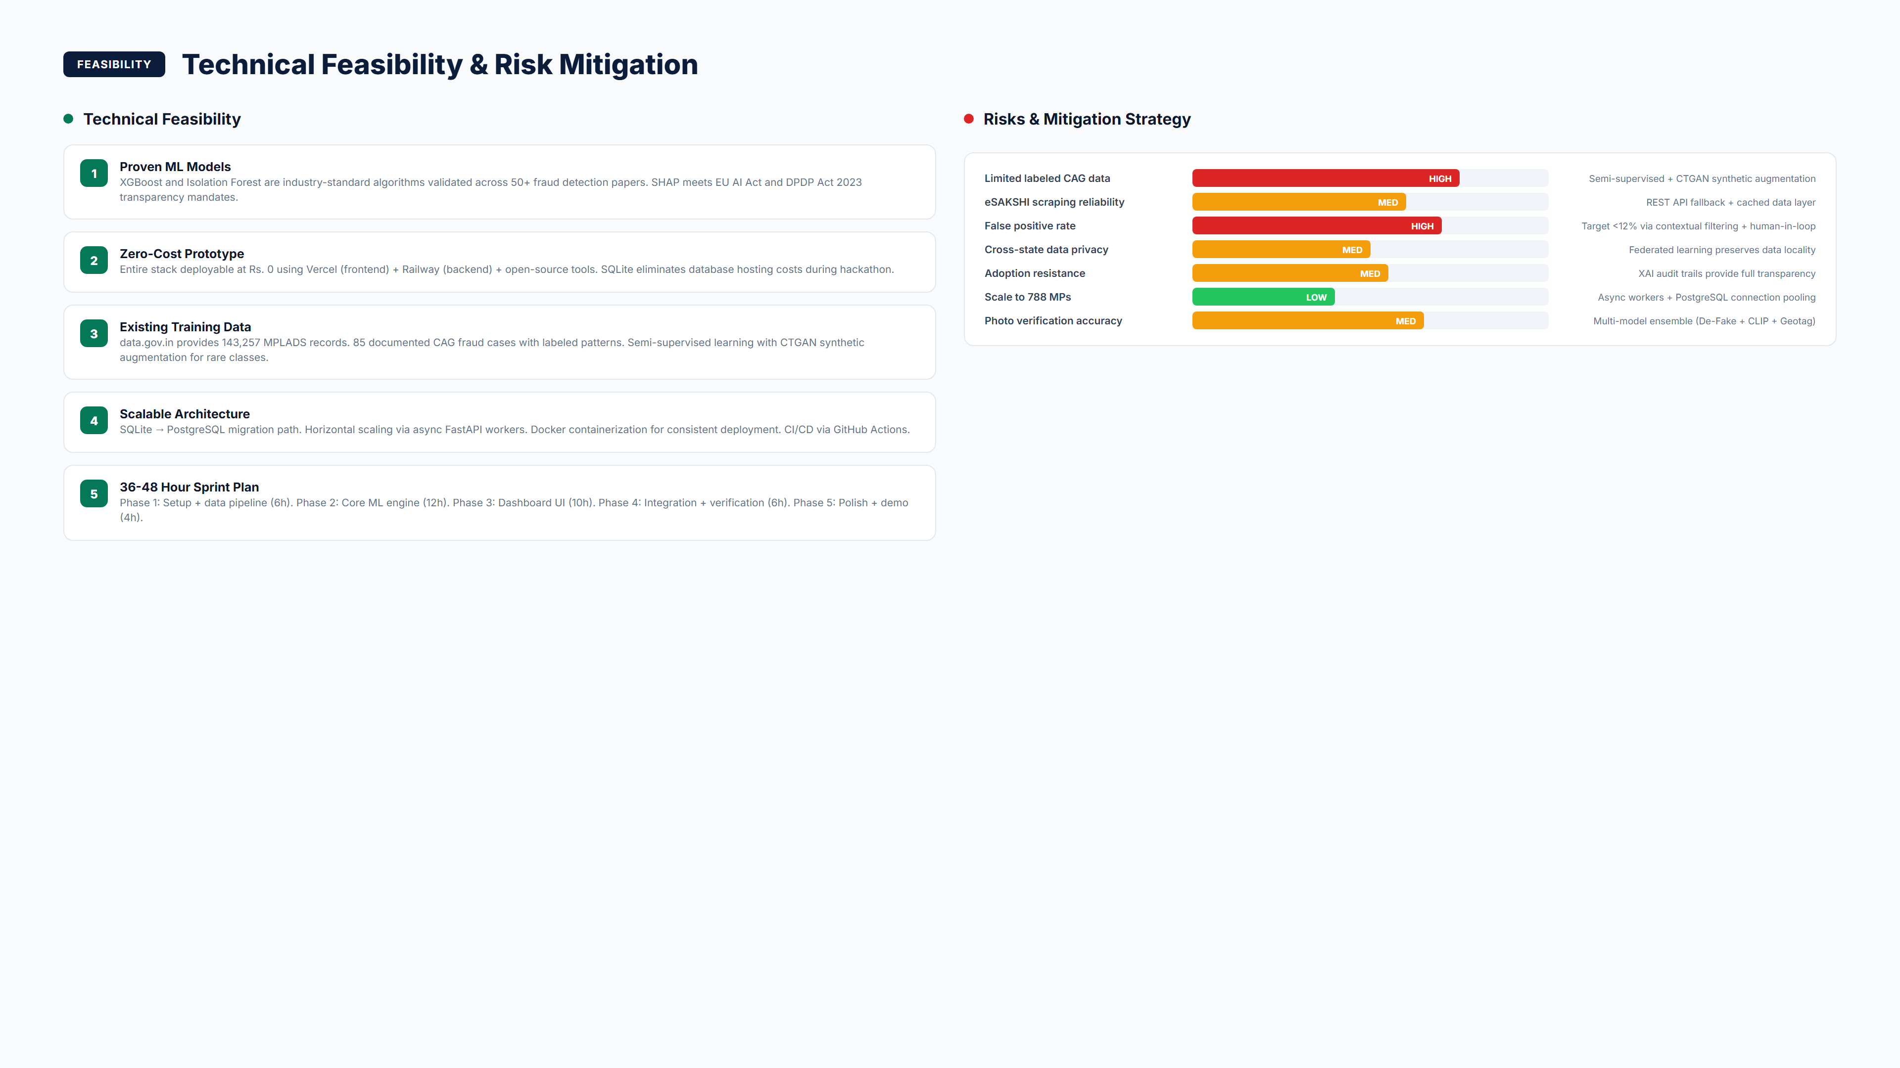
MPLADS AI Sentinel | SIH 2026 | PS 26102
5 / 8

Slide 6
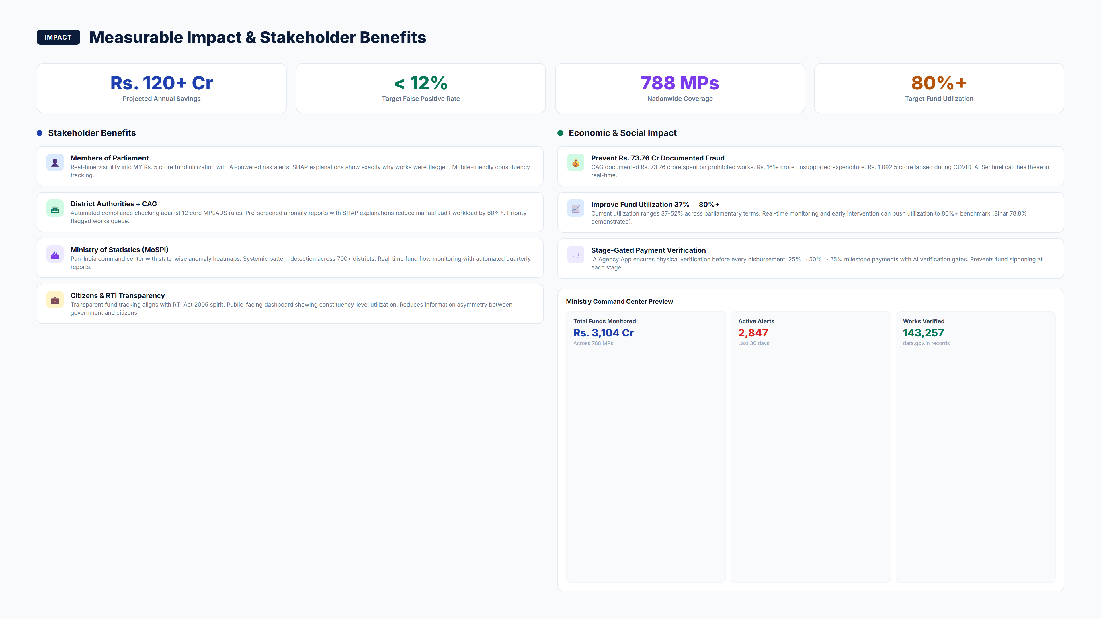
MPLADS AI Sentinel | SIH 2026 | PS 26102
6 / 8

Slide 7
References & Supporting Documentation
• CAG Performance Audits of MPLADS (2005-2024) - 85 fraud cases worth Rs.32,133+ crore
• MPLADS Guidelines 2023 - Ministry of Statistics and Programme Implementation official rules
• eSAKSHI Portal (esakshi.mp.gov.in) - existing digital transaction tracking system
• data.gov.in MPLADS Dataset - 143,257 records of works and expenditures across India
• Lundberg & Lee (2017) - SHAP: A Unified Approach to Interpreting Model Predictions (NeurIPS)
• Liu et al. (2012) - Isolation Forest anomaly detection (IEEE TKDE)
• RedFlags.ai - Kazakhstan saved $86M in 6 months using rule-based fraud detection
• Tazama (Linux Foundation) - Open-source real-time payment monitoring at 2,300 TPS
MPLADS AI Sentinel | SIH 2026 | PS 26102
7 / 8

Slide 8
Thank You
MPLADS AI Sentinel
PS 26102 | MoSPI / DIID | Smart Automation
Ready for Grand Finale Deployment

