Slide 1

SMART INDIA HACKATHON 2026
MPLADS AI Sentinel
Problem Statement ID: 26102
Problem Statement Title: Smart Automation of MPLADS Fund Monitoring using Explainable AI
Theme: Smart Automation
PS Category: Software
Team ID: MPLADS AI Sentinel
Team Name: MPLADS AI Sentinel

Slide 2
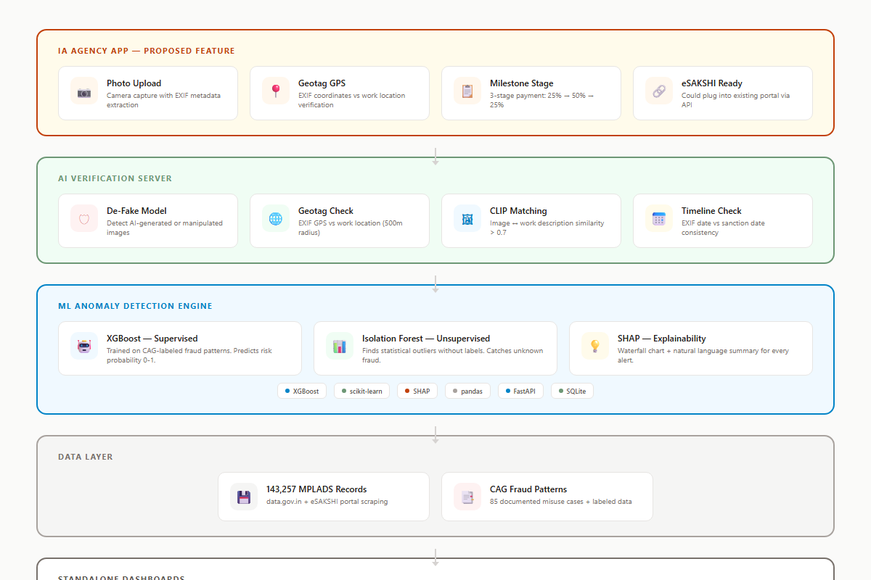
MPLADS AI Sentinel: Explainable AI for Parliamentary Fund Oversight
MPLADS AI Sentinel
Transparent AI Protecting Rs.3,940+ Crore Annual Public Funds
• Problem: Rs.161+ crore unsupported expenditure found by CAG; 98.53% assets lack handover records
• Current eSAKSHI portal digitizes transactions but cannot detect fraud or anomalies automatically
• AI Sentinel runs 12 deterministic rules + 2 ML models on every MP work record in real-time
• Multi-tier dashboards: MP view (MY Rs.5 crore), District Authority view, Ministry pan-India command center
• Stage-gated payments via IA Agency App: photo upload + geotag + AI verification before each disbursement
• De-Fake image verification prevents fake site photos using CLIP + YOLO-based forgery detection
• Projecting Rs.120+ crore annual savings through early fraud detection and automated compliance

Slide 3
TECHNICAL APPROACH
MPLADS AI Sentinel
Multi-Tier Architecture
Verification & Payments
• Tier 1 - Data Ingestion: Playwright scraper for eSAKSHI + REST API for data.gov.in
• Tier 2 - Rule Engine: 12 core deterministic rules from 30+ MPLADS guideline taxonomy
• Tier 3 - ML Inference: Isolation Forest (unsupervised) + XGBoost (supervised ensemble)
• Tier 4 - Explainability: SHAP waterfall charts + natural language audit briefs
• Tier 5 - Dashboard: Role-based views (MP / DA+CAG / Ministry) with real-time alerts
• IA Agency Mobile App: Photo upload + geotagging + milestone submission workflow
• AI Verification Server: De-Fake forgery detection + CLIP image-work matching
• Stage-Gated Payments: 25% -> 50% -> 25% disbursement with AI verification gates
• Vendor Network Graph: Node2Vec + Louvain community detection for collusion rings
• Time-Series: LSTM Autoencoder + Prophet for seasonal spending pattern anomalies

Slide 4
FEASIBILITY AND VIABILITY
MPLADS AI Sentinel
Implementation Viability
Scalability Strategy
• 36-48 hour hackathon sprint plan with 5 phases: Setup -> Core ML -> Frontend -> Integration -> Polish
• Existing data pipeline extracts and processes 143K+ records from data.gov.in automatically
• 12 core fraud rules mapped directly to documented CAG audit findings for immediate impact
• Role-based dashboard architecture tested with MP, District Authority, and Ministry personas
• Stage-gated payment system aligns with existing MPLADS 2023 disbursement guidelines
• Phase 1 (Pilot): 12 rules + baseline dashboards for single state deployment
• Phase 2 (Full Suite): ML classifier + SHAP + GIS heatmaps for multi-state rollout
• Phase 3 (Integration): eSAKSHI API + IA photo verification + automated audit summaries
• Horizontal scaling via PostgreSQL connection pooling and async FastAPI workers
• Projected Rs.120+ crore annual savings across 788 MPs and 700+ districts

Slide 5
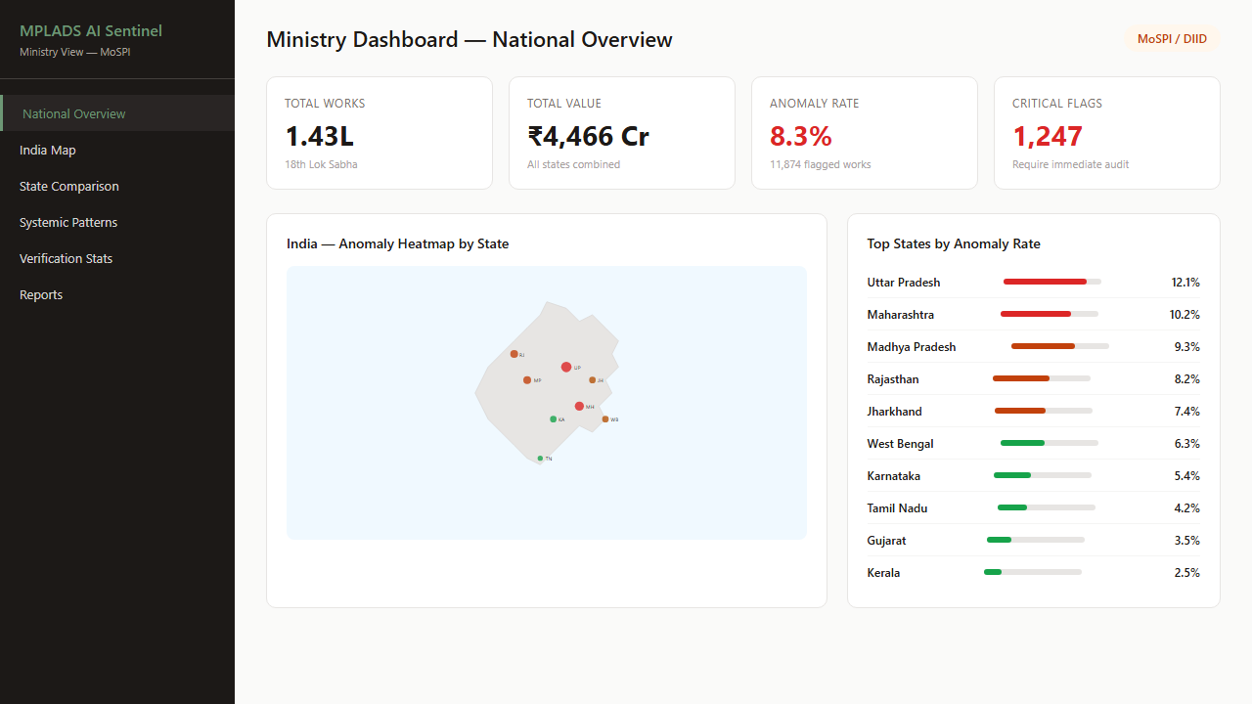
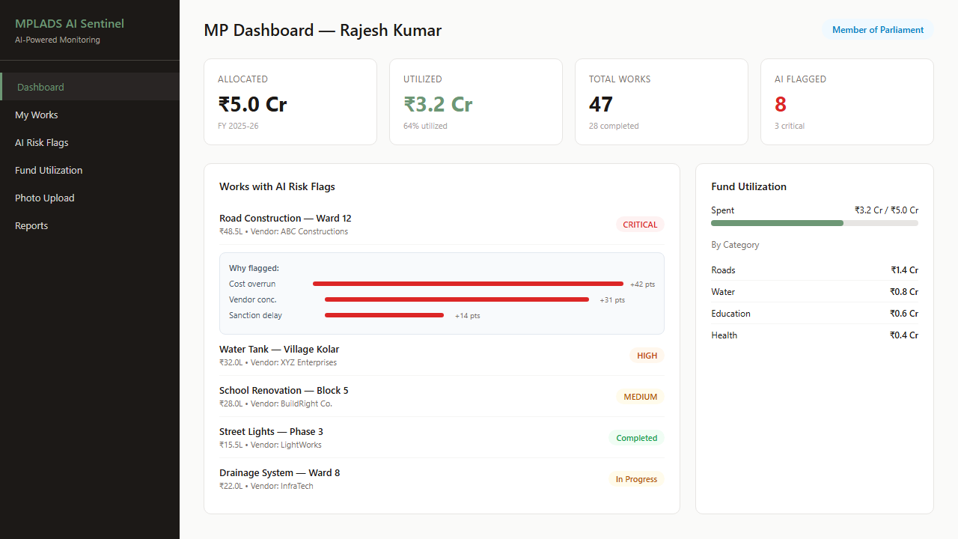
IMPACT AND BENEFITS
MPLADS AI Sentinel
Stakeholder Benefits
Economic & Social Impact
• MPs: Real-time visibility into MY Rs.5 crore utilization with risk alerts
• District Authorities: Automated compliance checking against 12 core rules
• MoSPI: Pan-India command center with state-wise anomaly heatmaps
• CAG: Pre-screened anomaly reports with SHAP explanations reduce manual workload
• Citizens: Transparent fund tracking aligns with RTI Act 2005 spirit
• Prevents Rs.73.76 crore spent on prohibited works (per CAG documented cases)
• Addresses Rs.1,092.5 crore lapsed funds during COVID with better tracking
• Improves completion rates from 14.7% (Assam) toward 78.8% (Bihar) benchmark
• Stage-gated payments prevent fund siphoning at each construction milestone
• IA Agency App ensures physical verification before every disbursement

Slide 6
RESEARCH AND REFERENCES
MPLADS AI Sentinel
• ARC (2011) Report on MPLADS - Recommended abolishing scheme due to systemic corruption
• NAC Recommendations - National Advisory Council reform proposals for MPLADS governance
• 2005 Sting Operations - 18 MPs caught demanding commissions (documented in CAG reports)
• DPDP Act 2023 - Digital Personal Data Protection Act compliance framework for AI systems
• RTI Act 2005 - Right to Information Act transparency requirements for public fund monitoring
• UK HMRC AI Platform - GBP 175M Quantexa contract for entity resolution in tax fraud
• RBI MuleHunter.AI - 85-90% accuracy rate with 26+ bank partnerships for fraud detection
• MPLADS Annual Reports (2019-2024) - Fund utilization data: 37-52% across parliamentary terms

