Slide 1
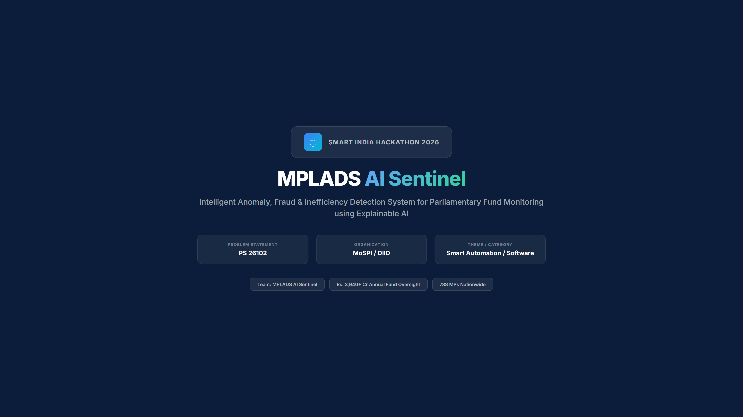

Slide 2
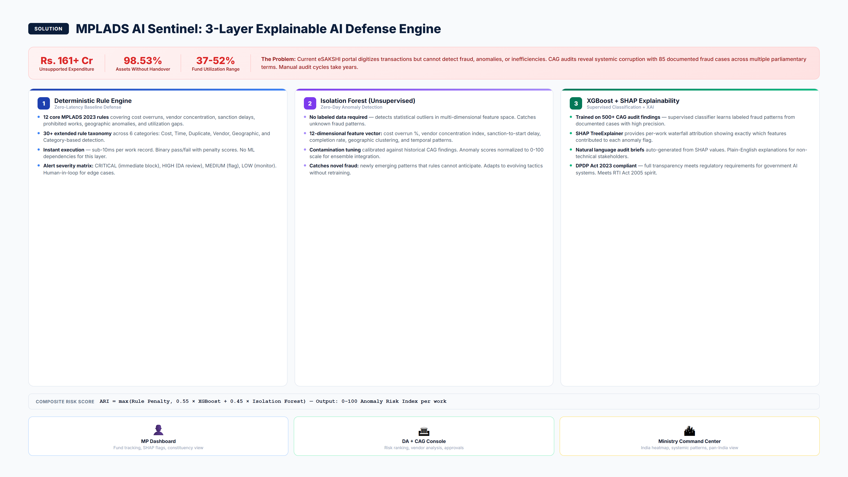
MPLADS AI Sentinel | SIH 2026 | PS 26102
2 / 8

Slide 3
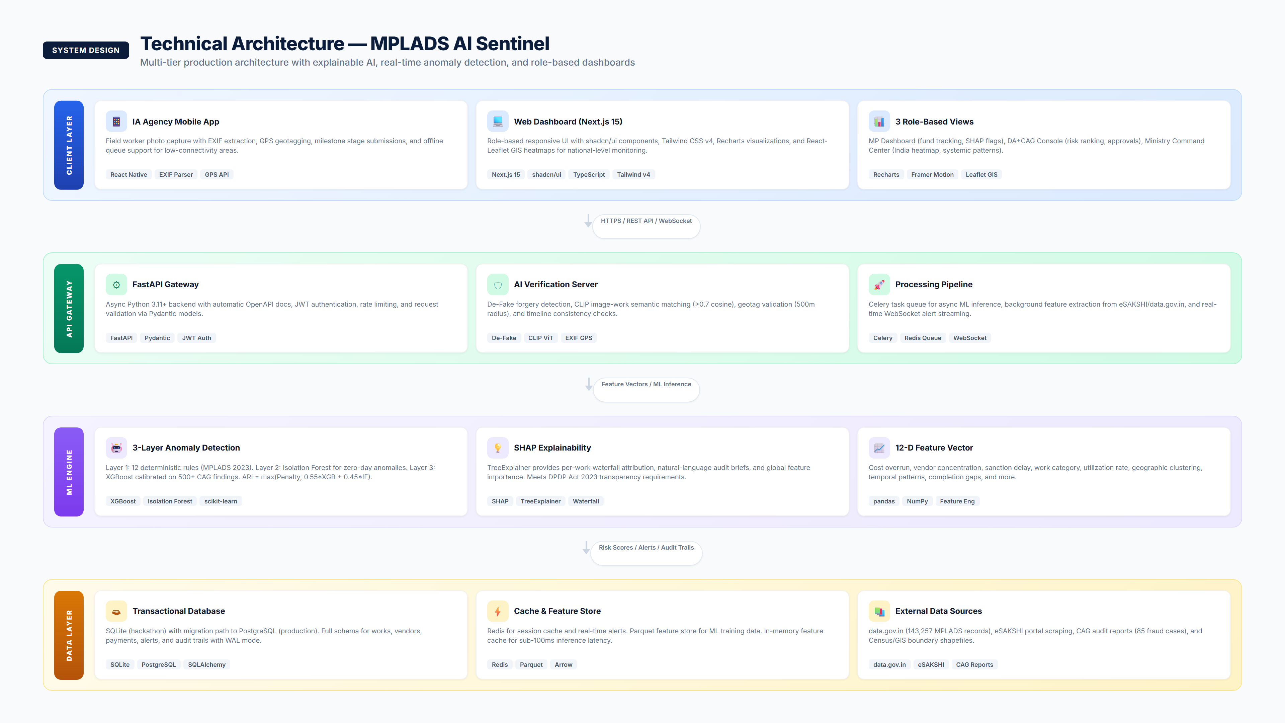
MPLADS AI Sentinel | SIH 2026 | PS 26102
3 / 8

Slide 4
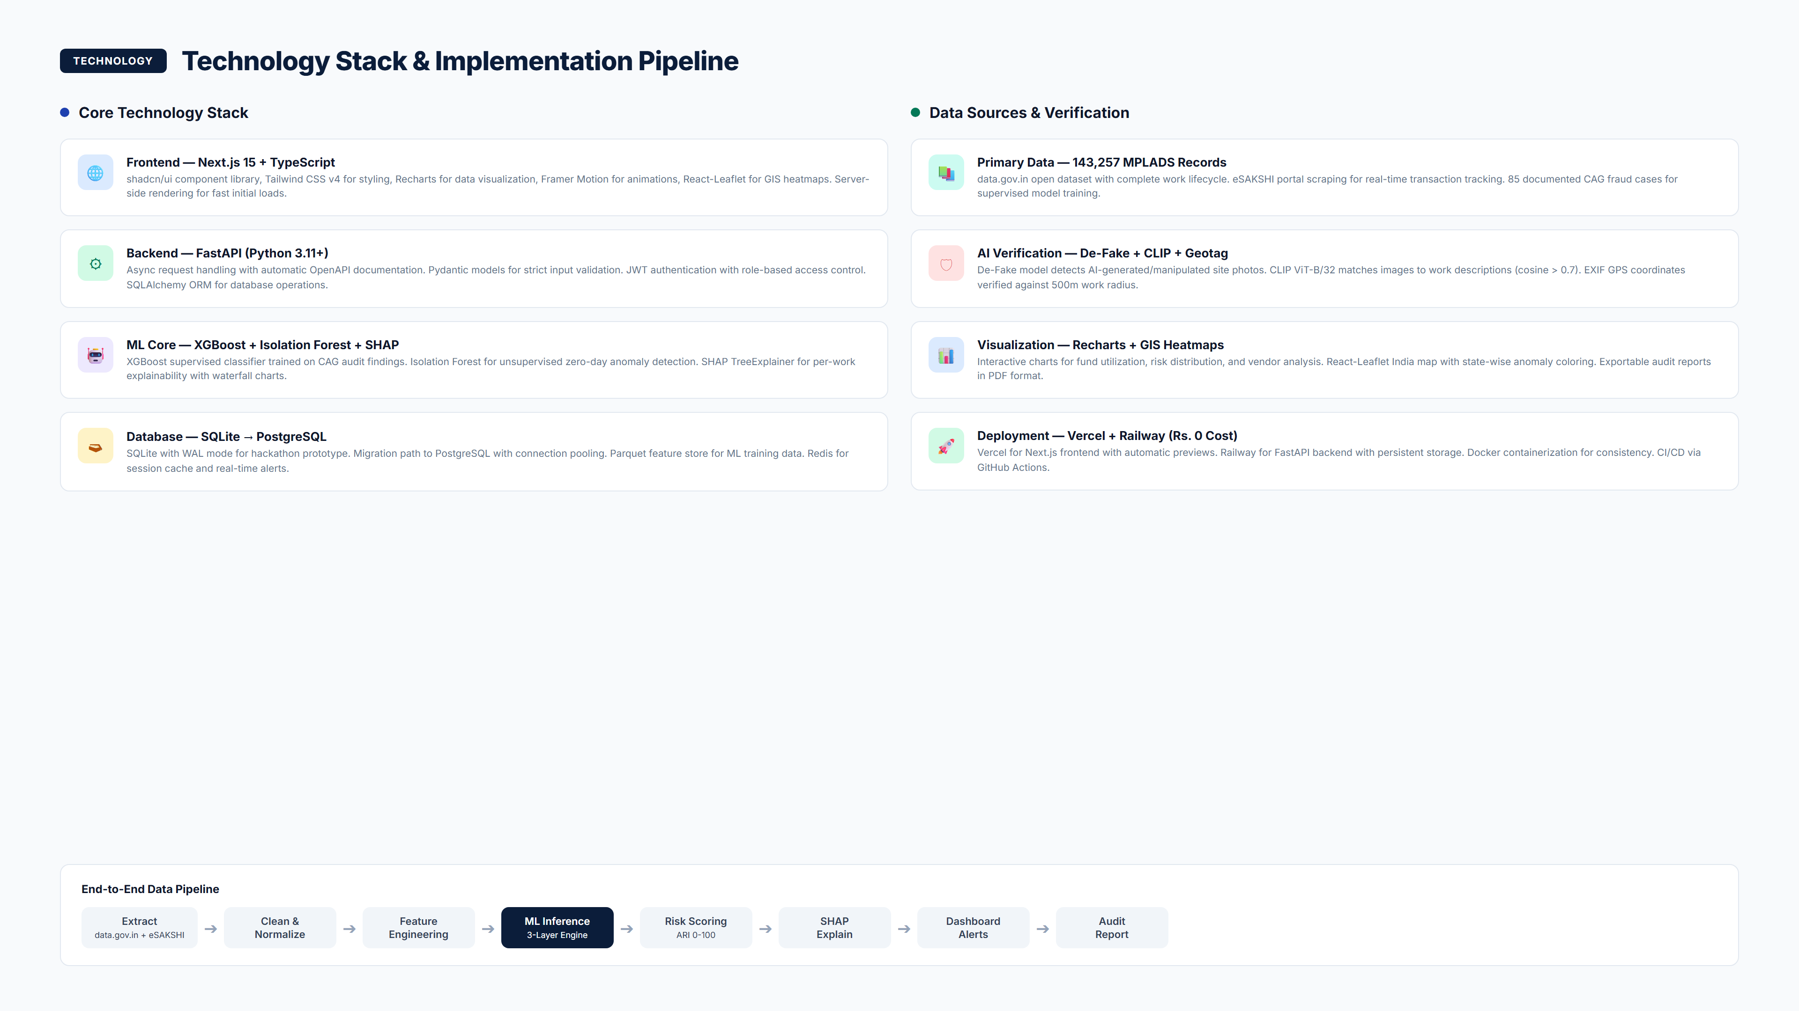
MPLADS AI Sentinel | SIH 2026 | PS 26102
4 / 8

Slide 5
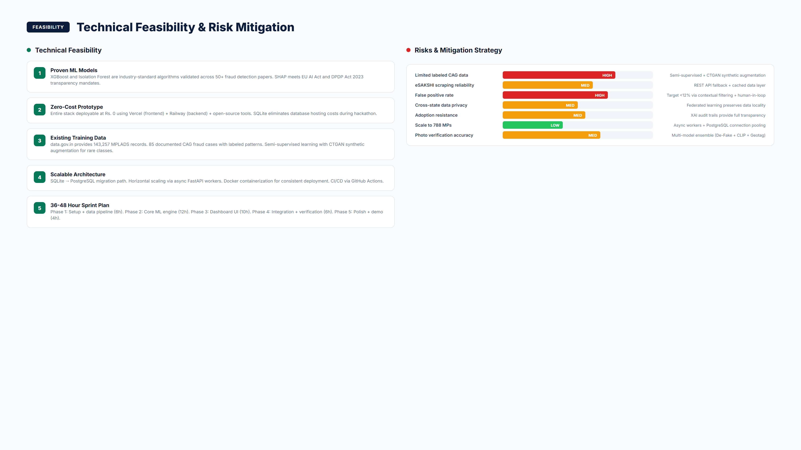
MPLADS AI Sentinel | SIH 2026 | PS 26102
5 / 8

Slide 6
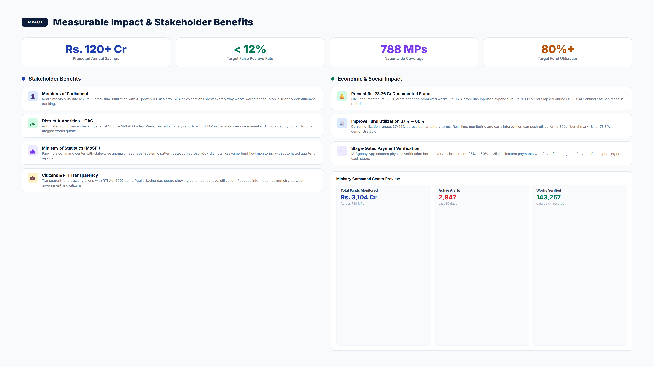
MPLADS AI Sentinel | SIH 2026 | PS 26102
6 / 8

Slide 7
References & Supporting Documentation
• ARC (2011) Report on MPLADS - Recommended abolishing scheme due to systemic corruption
• NAC Recommendations - National Advisory Council reform proposals for MPLADS governance
• 2005 Sting Operations - 18 MPs caught demanding commissions (documented in CAG reports)
• DPDP Act 2023 - Digital Personal Data Protection Act compliance framework for AI systems
• RTI Act 2005 - Right to Information Act transparency requirements for public fund monitoring
• UK HMRC AI Platform - GBP 175M Quantexa contract for entity resolution in tax fraud
• RBI MuleHunter.AI - 85-90% accuracy rate with 26+ bank partnerships
• MPLADS Annual Reports (2019-2024) - Fund utilization: 37-52% across parliamentary terms
MPLADS AI Sentinel | SIH 2026 | PS 26102
7 / 8

Slide 8
Thank You
MPLADS AI Sentinel
PS 26102 | MoSPI / DIID | Smart Automation
Ready for Grand Finale Deployment

