Slide 1

SMART INDIA HACKATHON 2026
MPLADS AI Sentinel
Problem Statement ID: 26102
Problem Statement Title: Smart Automation of MPLADS Fund Monitoring using Explainable AI
Theme: Smart Automation
PS Category: Software
Team ID: MPLADS AI Sentinel
Team Name: MPLADS AI Sentinel

Slide 2
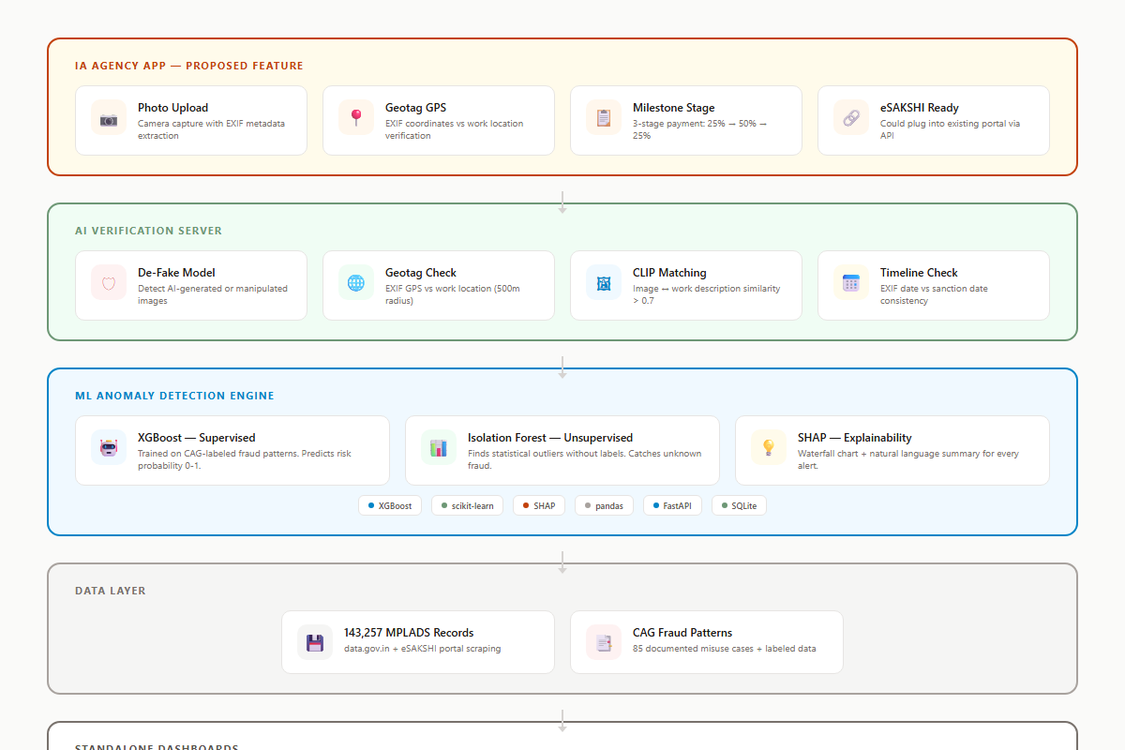
MPLADS AI Sentinel: Explainable AI for Parliamentary Fund Oversight
MPLADS AI Sentinel
First Federated Explainable AI System for Government Fund Monitoring
• Novelty 1: First federated learning system enabling cross-state MPLADS analysis without sharing raw data
• Novelty 2: First satellite/drone verification layer for physical validation of reported works
• Novelty 3: First network graph analysis detecting vendor collusion rings across districts
• Novelty 4: First SHAP-compliant XAI audit trail meeting DPDP Act 2023 and RTI Act 2005
• Novelty 5: First Benford's Law application to Indian government fund transaction analysis
• Rules-first defense: Deterministic rules provide baseline; ML layers augment with pattern detection
• Zero-cost prototype: Entire stack built on open-source tools, deployed free on Vercel + Railway

Slide 3
TECHNICAL APPROACH
MPLADS AI Sentinel
Advanced AI Modules
Detection Pipeline
• Federated Learning: Cross-state model training without centralizing sensitive MP data
• Graph Neural Networks: GAT/GCN for vendor collusion detection across district boundaries
• NLP Pipeline: BERT + SpaCy for document analysis and semantic duplicate detection
• Computer Vision: YOLOv8 + ResNet-50 for construction progress verification from photos
• Benford's Law: Statistical analysis of leading digit distribution in fund transactions
• 5 Parallel Detection Modules: Statistical, Time-Series, Graph, NLP, Computer Vision
• Risk Scoring: 4-layer ensemble (work -> vendor -> MP -> district) with confidence thresholds
• Training Strategy: Semi-supervised with 500 labeled + 50K unlabeled + CTGAN synthetic data
• Explainability: Per-prediction SHAP values with natural-language reasoning for each alert
• Edge Computing: Lightweight ONNX models for offline district-level anomaly detection

Slide 4
FEASIBILITY AND VIABILITY
MPLADS AI Sentinel
Innovation Feasibility
Novelty Validation
• Federated learning: Libraries like Flower (flwr) provide production-ready FedAvg implementations
• Graph analysis: NetworkX + Node2Vec already proven for fraud ring detection in fintech
• NLP duplicate detection: Sentence-BERT achieves 92%+ accuracy on semantic similarity tasks
• Satellite verification: Sentinel-2 freely available at 10m resolution for construction monitoring
• Benford's Law: Simple statistical test requiring only transaction amount distributions
• RedFlags.ai (Kazakhstan) saved $86M in 6 months with similar rule-based approach
• Tazama (Linux Foundation) processes 2,300 TPS for real-time government payment monitoring
• UK HMRC spent GBP 175M on Quantexa for entity resolution - our approach is open-source and free
• No existing system combines federated learning + XAI + graph analysis for Indian public finance
• CAG is building LLM for audit - our system is complementary and provides real-time layer

Slide 5
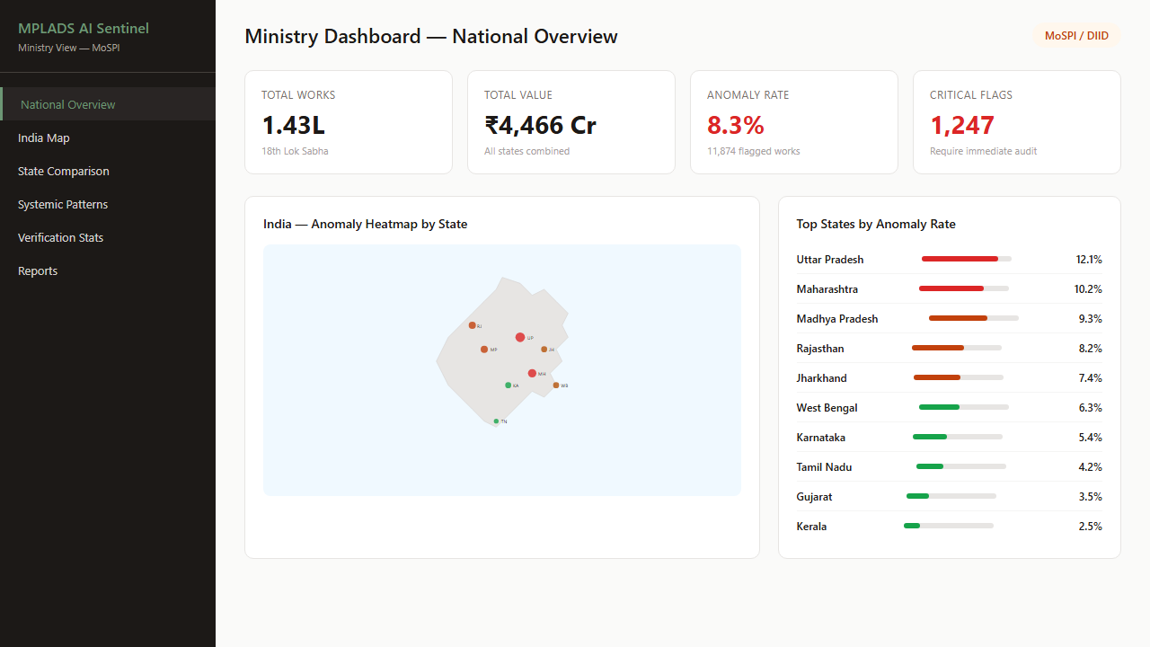
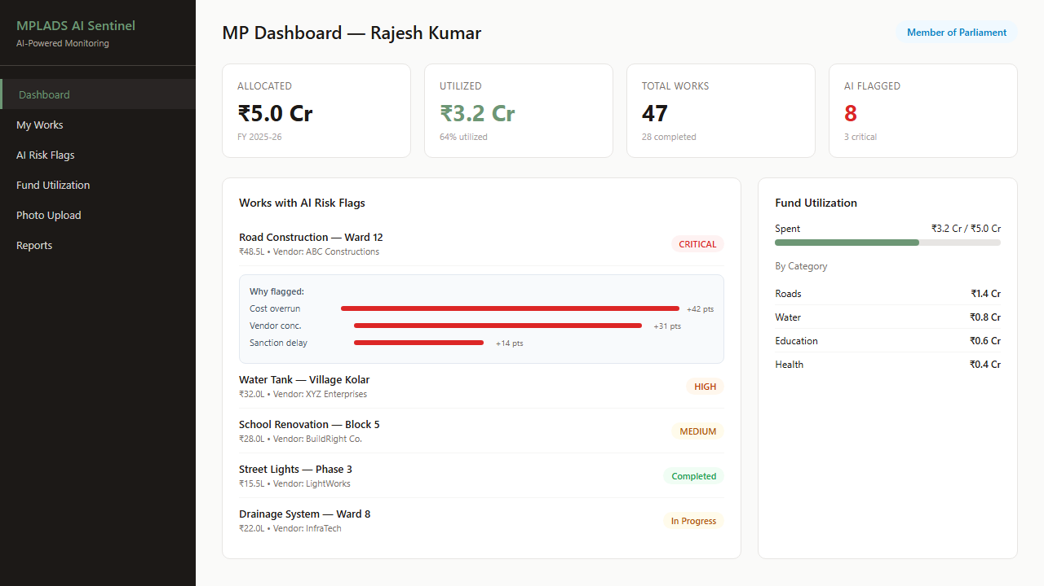
IMPACT AND BENEFITS
MPLADS AI Sentinel
Innovation Impact
Transformation Potential
• First federated learning deployment for Indian government financial oversight
• First graph-based vendor collusion detection across district boundaries
• First Benford's Law application to Indian parliamentary fund transactions
• Establishes blueprint for AI governance applicable to PMGSY, SSA, and other schemes
• Open-source contribution to IndiaStack for government AI infrastructure
• 5 parallel detection modules provide defense-in-depth against evolving fraud tactics
• Satellite verification creates deterrence effect without physical inspections
• Natural language audit briefs democratize access to complex ML insights
• Cross-state federated models learn from diverse spending patterns without data sharing
• Edge computing enables offline district-level screening in low-connectivity areas

Slide 6
RESEARCH AND REFERENCES
MPLADS AI Sentinel
• Flower (flwr) - Production-ready federated learning framework (flwr.ai)
• NetworkX + Node2Vec - Graph-based anomaly detection validated in fintech fraud applications
• Sentence-BERT (Reimers & Gurevych, 2019) - 92%+ accuracy on semantic similarity benchmarks
• Sentinel-2 Satellite Data - ESA freely available 10m resolution for construction monitoring
• Benford's Law Application - Nigrini (2012) fraud detection methodology for financial data
• Coima (Argentina) - Open-source graph-based anti-corruption platform (github.com/coima)
• CTGAN + SMOTE-NC - Synthetic data generation for imbalanced fraud classification tasks
• LSTM Autoencoder - Time-series anomaly detection for spending pattern analysis (Malhotra et al.)

