Slide 1
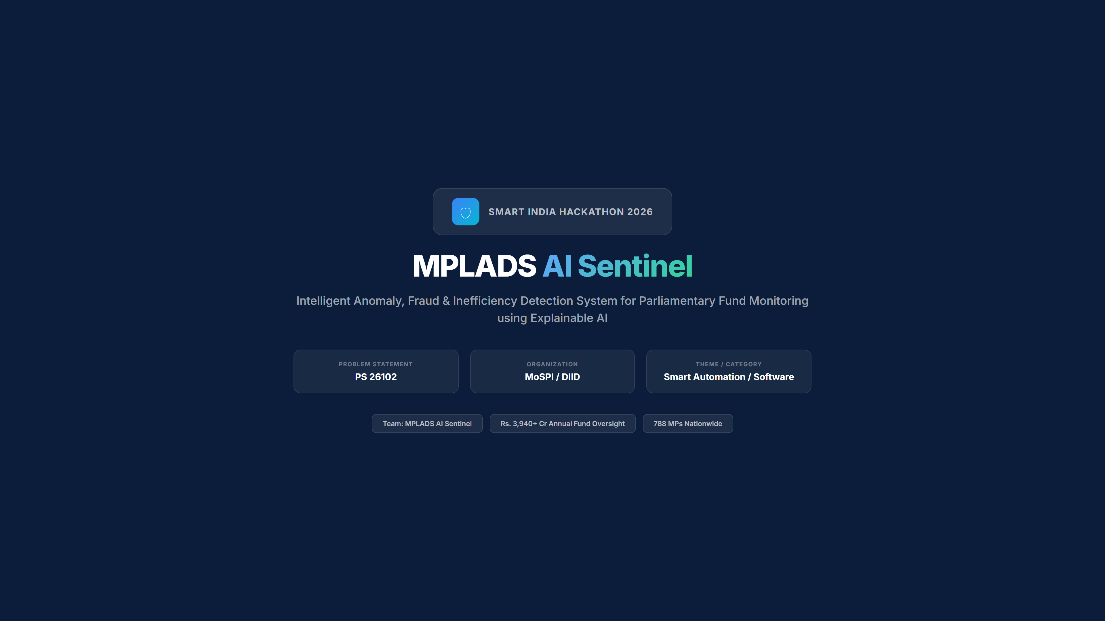

Slide 2
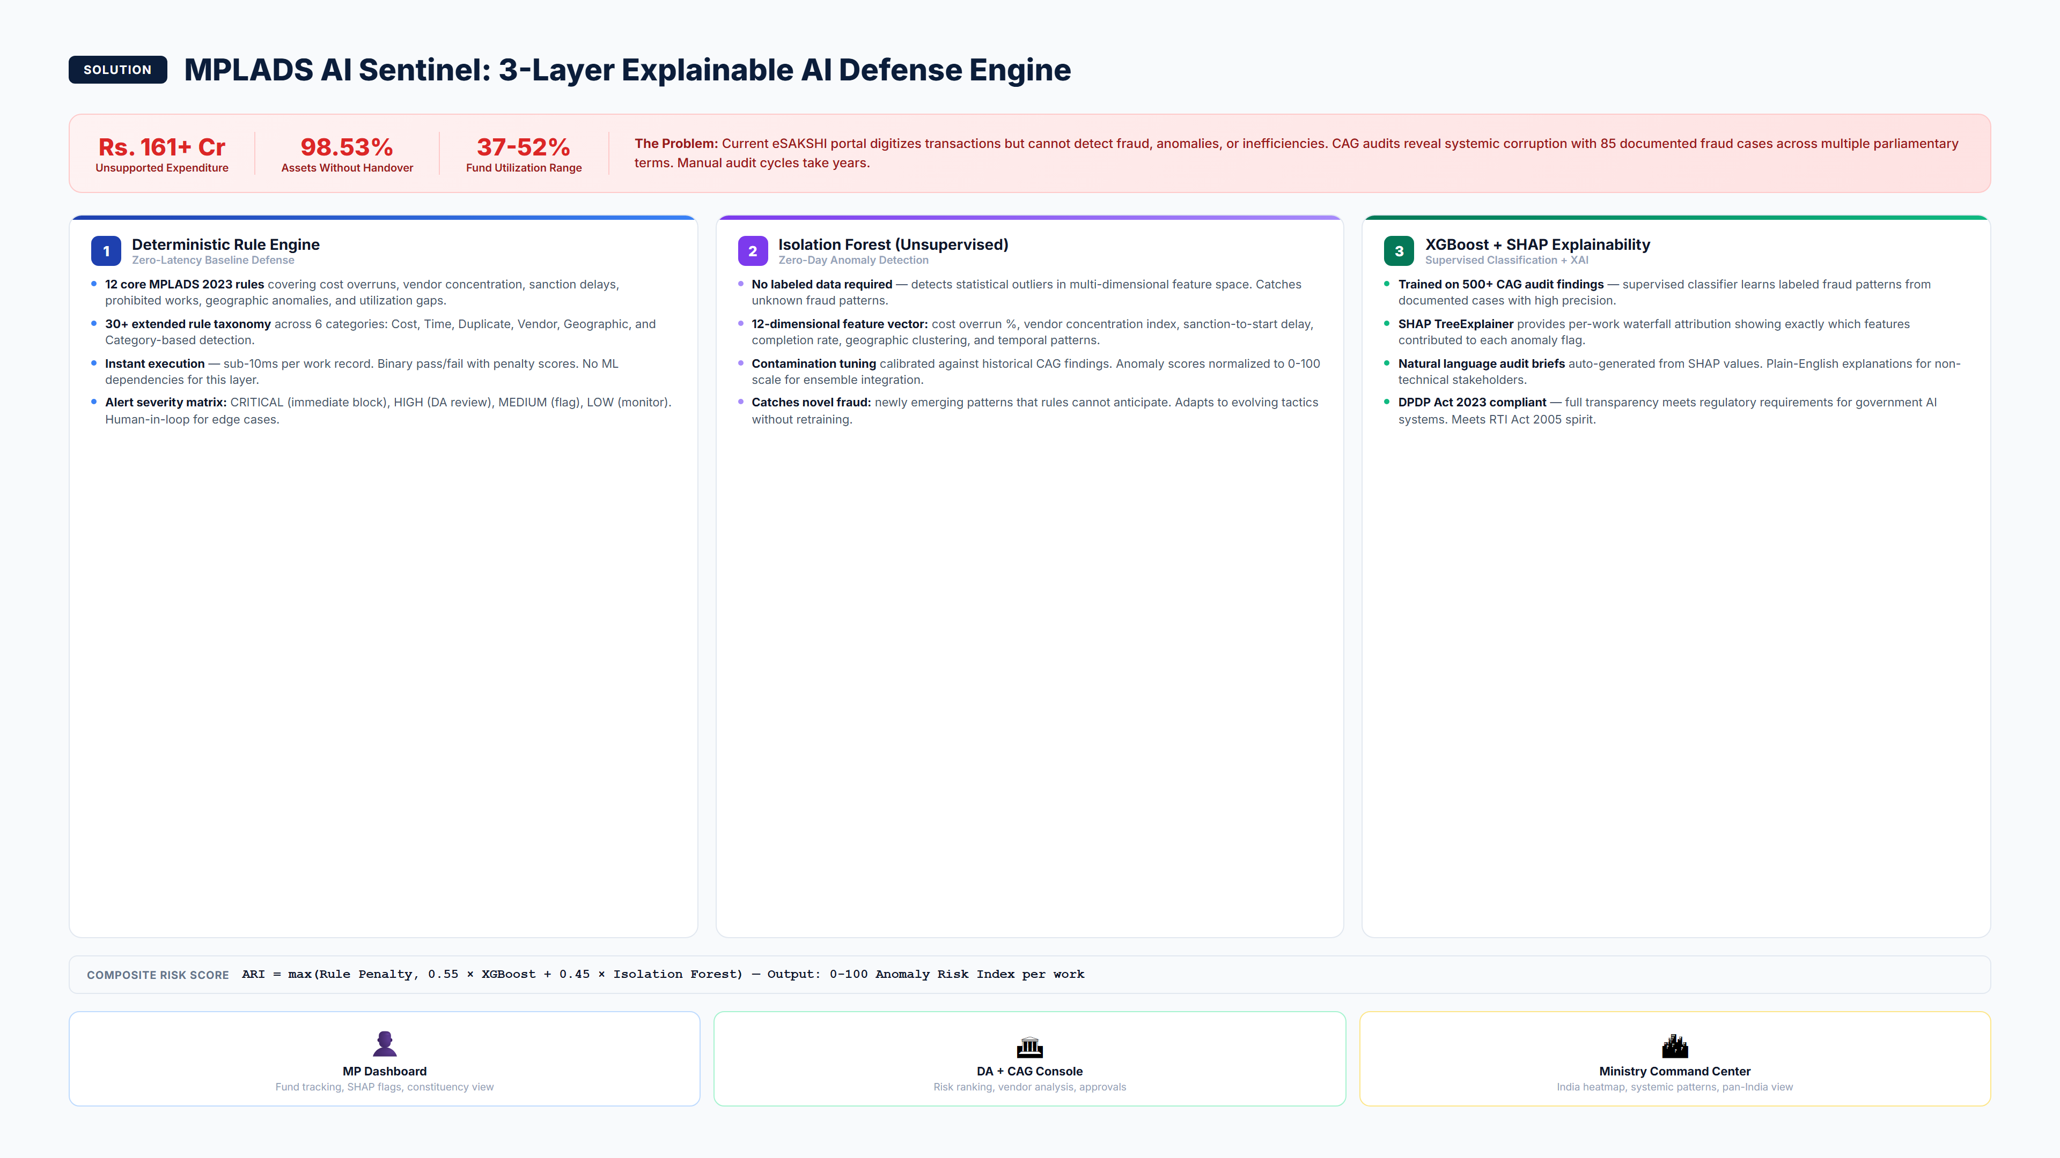
MPLADS AI Sentinel | SIH 2026 | PS 26102
2 / 8

Slide 3
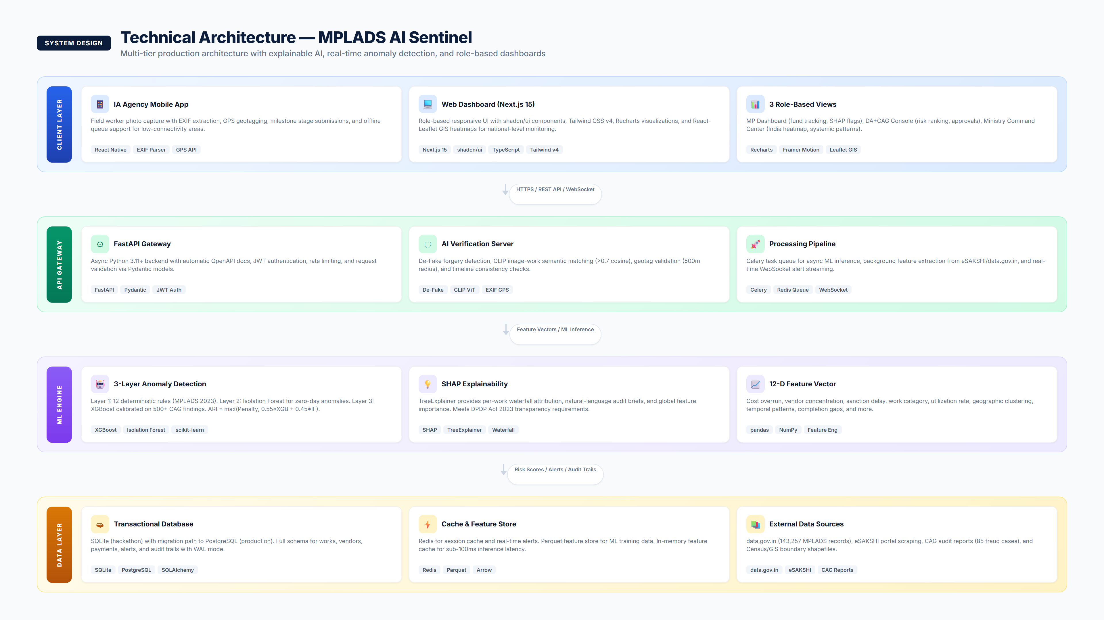
MPLADS AI Sentinel | SIH 2026 | PS 26102
3 / 8

Slide 4
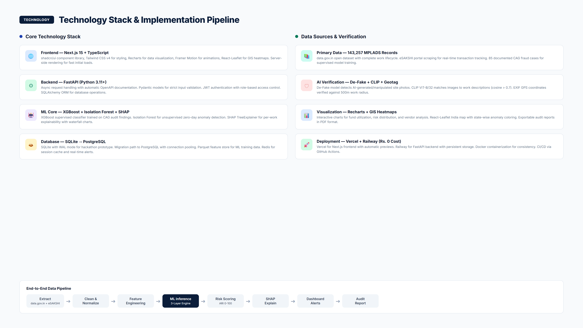
MPLADS AI Sentinel | SIH 2026 | PS 26102
4 / 8

Slide 5
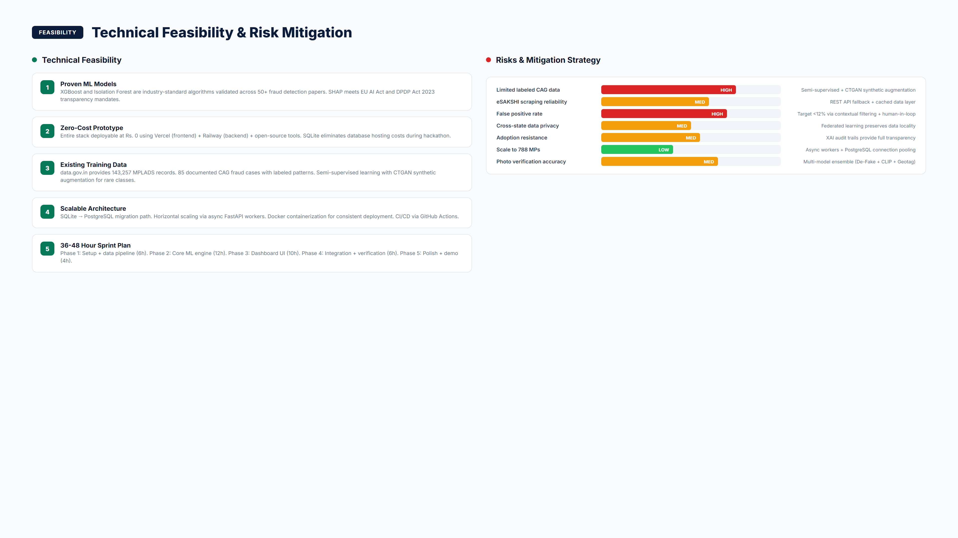
MPLADS AI Sentinel | SIH 2026 | PS 26102
5 / 8

Slide 6
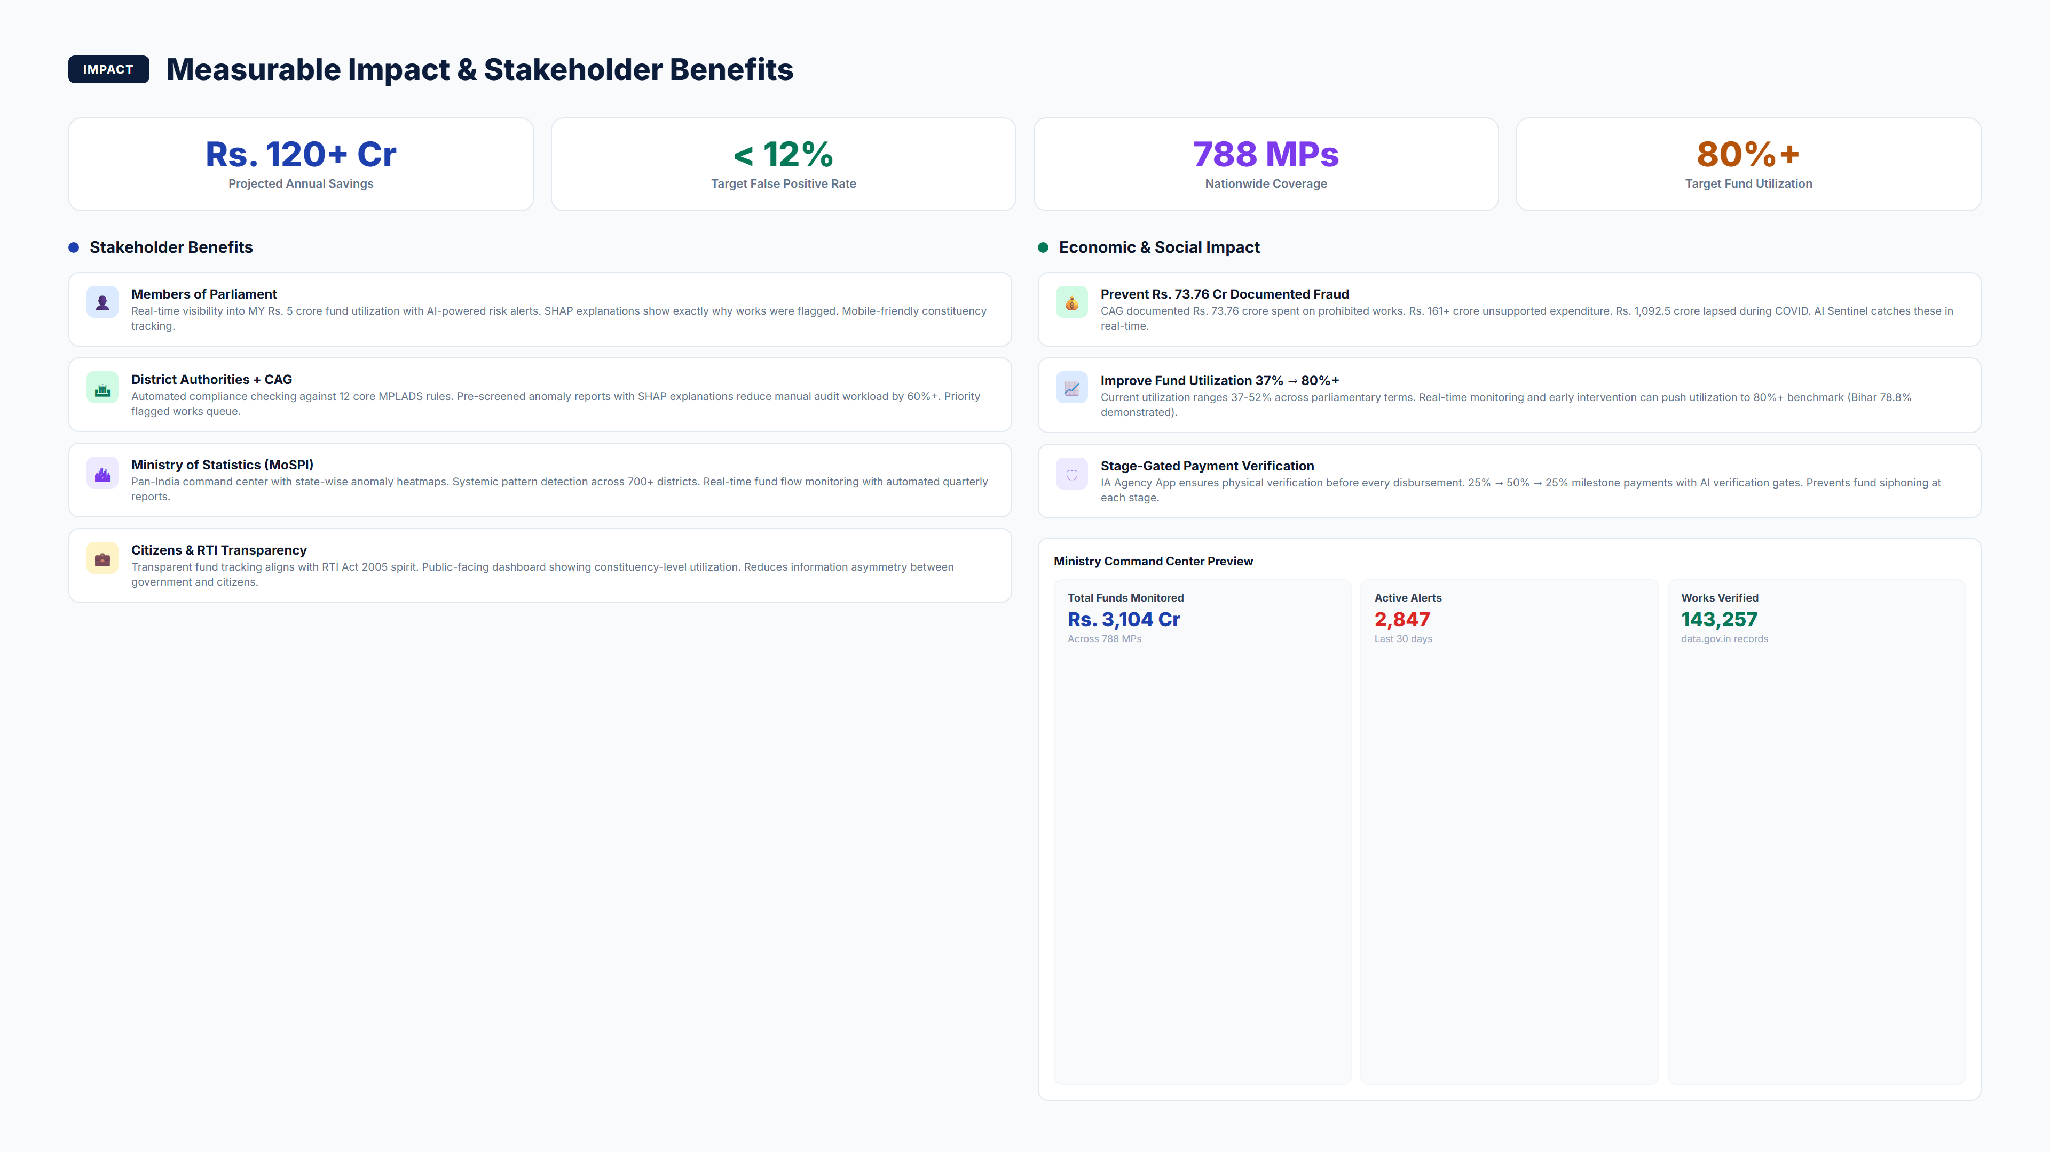
MPLADS AI Sentinel | SIH 2026 | PS 26102
6 / 8

Slide 7
References & Supporting Documentation
• Flower (flwr) - Production-ready federated learning framework (flwr.ai)
• NetworkX + Node2Vec - Graph-based anomaly detection validated in fintech fraud
• Sentence-BERT (Reimers & Gurevych, 2019) - 92%+ accuracy on semantic similarity
• Sentinel-2 Satellite Data - ESA freely available 10m resolution for construction monitoring
• Benford's Law Application - Nigrini (2012) fraud detection methodology for financial data
• Coima (Argentina) - Open-source graph-based anti-corruption platform
• CTGAN + SMOTE-NC - Synthetic data generation for imbalanced fraud classification
• LSTM Autoencoder - Time-series anomaly detection (Malhotra et al.)
MPLADS AI Sentinel | SIH 2026 | PS 26102
7 / 8

Slide 8
Thank You
MPLADS AI Sentinel
PS 26102 | MoSPI / DIID | Smart Automation
Ready for Grand Finale Deployment

