Slide 1
MPLADS AI Sentinel
AI-Powered Anomaly, Fraud & Inefficiency Detection
for MPLAD Scheme Implementation
Problem Statement 26102 | MoSPI / DIID | Smart Automation
Smart India Hackathon 2026

Slide 2
The Problem
MPLADS tracks WHAT happened but cannot detect WHAT IS WRONG
₹161 Cr
98.53%
8.3%
0
Unsupported expenditure
found by CAG
Works with no handover
record (ghost assets)
Anomaly rate across
1.43 lakh works
AI detection systems
currently exist
Key Gaps in Current System
No Anomaly Detection — Suspicious patterns go unnoticed until manual audits
No Predictive Analytics — Cannot predict fraud before fund disbursement
No Image Verification — Ghost assets — 98.53% works had no handover record
No Explainable AI — No audit-ready explanation for flagged works

Slide 3
Our Solution
MPLADS AI Sentinel — An AI-powered monitoring platform with role-based dashboards
📊
🤖
📷
3 Role-Based Dashboards
AI Anomaly Detection
IA Agency App (Proposed)
• MP Dashboard — "MY ₹5 crore"
• XGBoost (supervised)
• Photo upload + geotagging
• DA+CAG Dashboard — "MY district"
• Isolation Forest (unsupervised)
• AI verification (De-Fake + CLIP)
• Ministry Dashboard — "ALL states"
• SHAP explainability per alert
• Stage payment verification
Build: 3 dashboards + AI detection + SHAP | Propose: IA App + AI verification | Future: eSAKSHI + satellite + citizen app

Slide 4
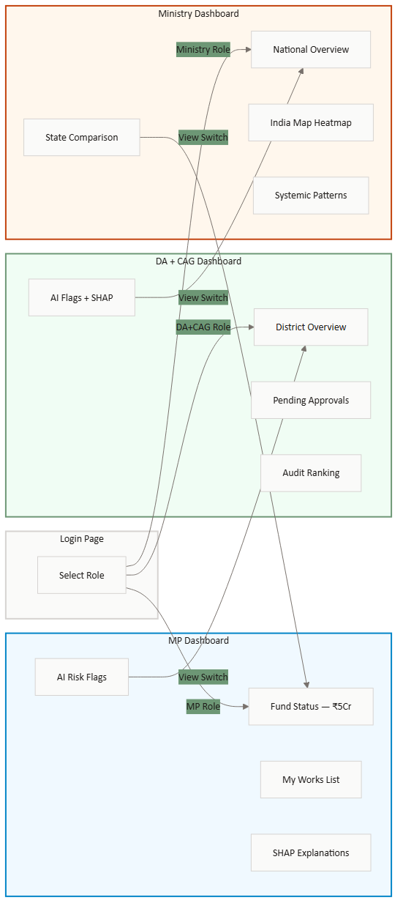
User Flow
Three roles, three dashboards, one AI engine
MP "What's happening with MY ₹5 crore?"
DA + CAG "What's suspicious in MY district?"
Ministry "What's happening across ALL states?"

Slide 5
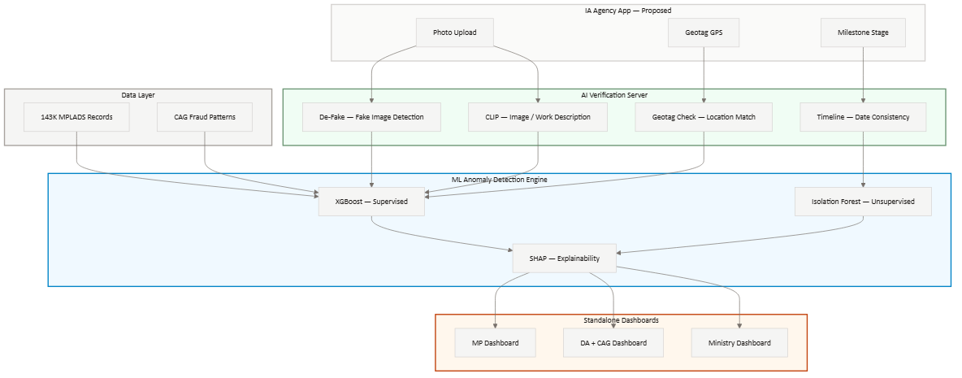
Technical Architecture
End-to-end AI pipeline: Data → ML → Explainability → Dashboards

Slide 6
AI / ML Engine
Dual-model ensemble with explainable risk scoring
XGBoost
Isolation Forest
SHAP
Supervised
Unsupervised
Explainability
Trained on CAG-labeled fraud patterns. Predicts probability of anomaly per work.
Finds statistical outliers without labels. Catches unknown fraud patterns.
Explains WHY each work was flagged. Waterfall chart + natural language summary.
Ensemble Scoring: risk_score = 0.6 × XGBoost_prob + 0.4 × IsoForest_score → 0-100 per work
12-Dimensional Feature Vector
cost_overrun_ratio — #1 fraud predictor
work_category_risk — Guideline violation
vendor_concentration — Collusion signal
tenure_phase — Spending rush pattern
sanction_delay_days — Process violation
mp_utilization_rate — Underutilization

Slide 7
Use Cases
Real fraud patterns from CAG reports — detected by our AI engine
340%
62%
2
98.53%
Cost Overrun
Vendor Collusion
Duplicate Works
Ghost Assets
Road construction sanctioned ₹12L, actual cost ₹52.8L. XGBoost flags cost_overrun_ratio > 1.0 as CRITICAL.
One vendor gets 62% of all works in a district. Isolation Forest detects abnormal concentration.
Same road project, different IDs, different vendors. Cosine similarity > 0.85 on work descriptions.
Works marked complete but no handover record. IA App would verify with photos + geotag.
COST-002
VEND-002
DUP-001
GEO-001

Slide 8
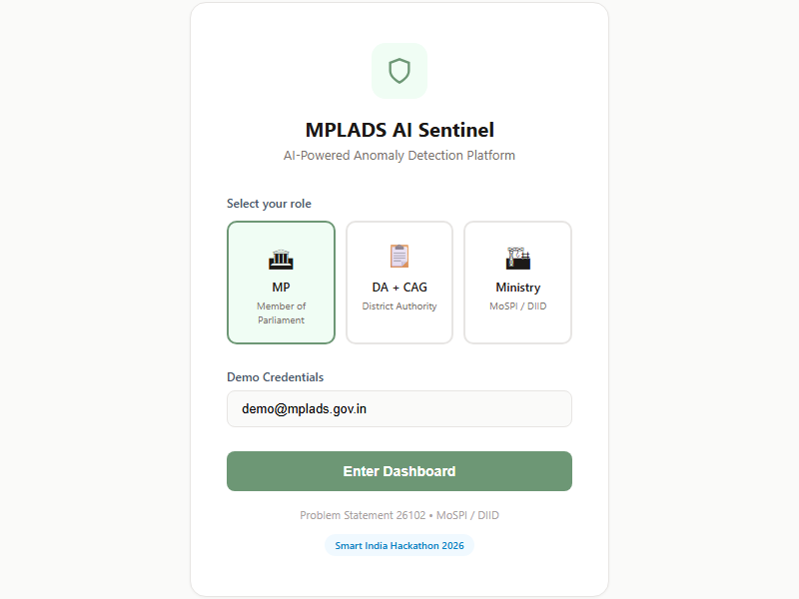
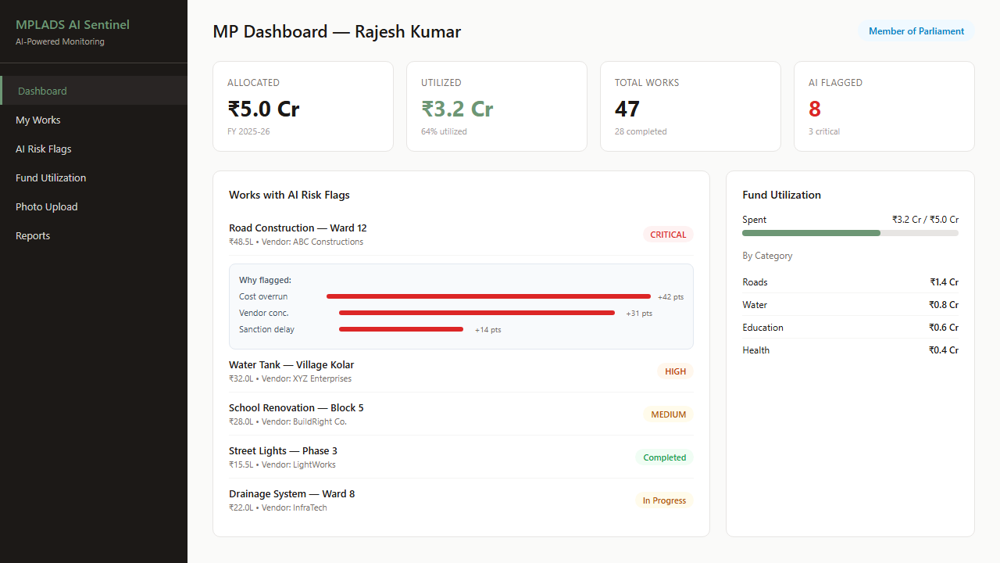
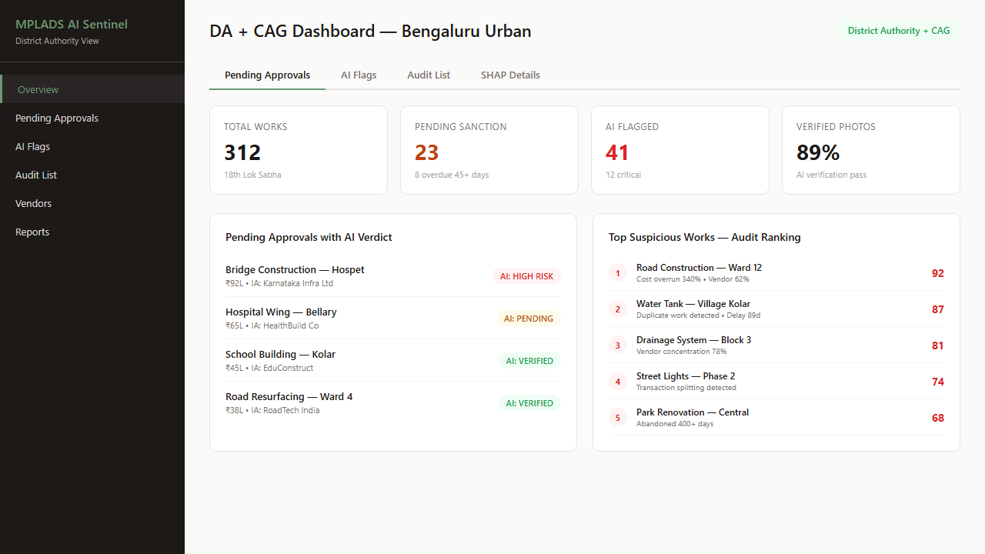
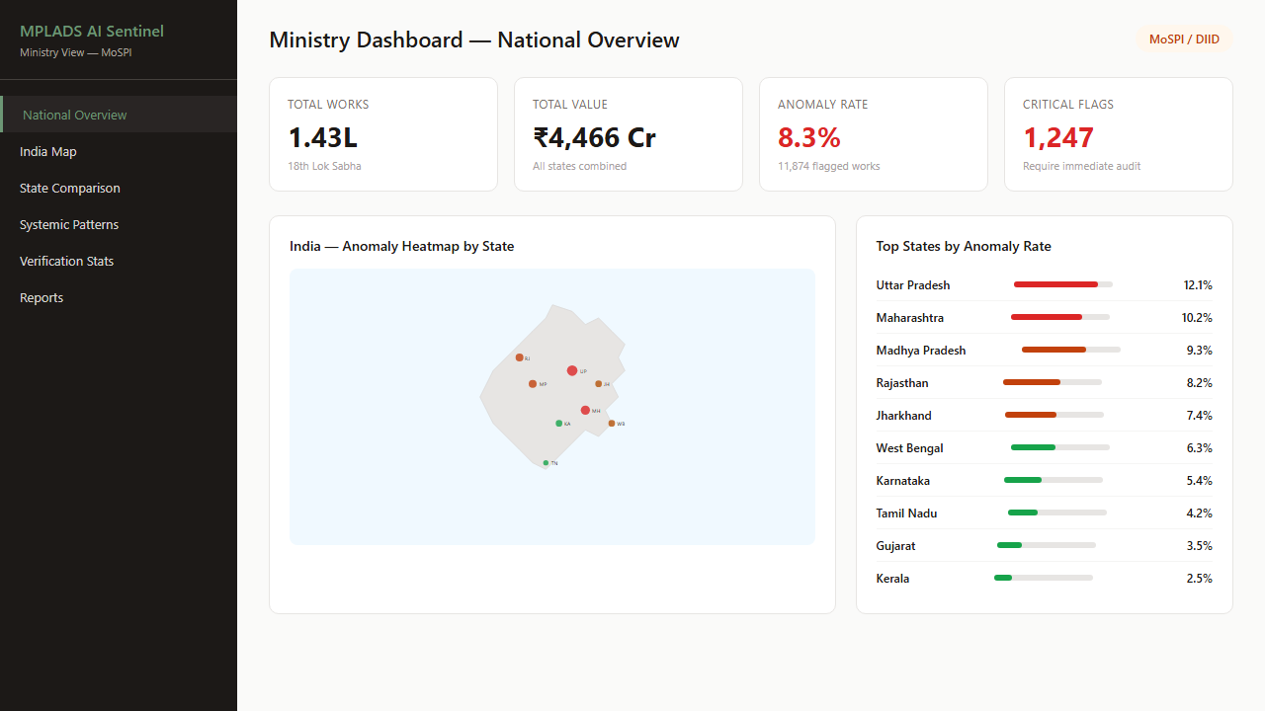
Prototype
Role-based dashboards with AI-powered risk scoring and SHAP explanations
Login — Role Selector
MP Dashboard
DA + CAG Dashboard
Ministry Dashboard

Slide 9
IA Agency App — Proposed Feature
AI verification at every payment stage — could plug into eSAKSHI portal
Stage 1
25%
Stage 2
50%
Stage 3
25%
First Payment
→
Second Payment
→
Completion
Initial progress
AI: Photo + Geotag
Substantial progress
AI: CLIP + Timeline
Final verification
AI: 3+ photos, before/after
AI Verification Checks
De-Fake Model — Is this photo AI-generated?
CLIP Matching — Does photo match work description?
Geotag Check — EXIF GPS vs work location (500m radius)
Timeline Check — EXIF date vs sanction date

Slide 10
Future Scope & Team
🔗
🛰
📱
🔒
eSAKSHI Integration
Satellite Verification
Citizen App
Federated Learning
AI verification layer plugs into existing portal via API
Sentinel-2 imagery for construction progress verification
Mobile app for ground-truthing works with photo upload
Privacy-preserving cross-state fraud pattern analysis
Team
ML Lead — XGBoost, Isolation Forest, SHAP, feature engineering
Backend Lead — FastAPI, database, data pipeline, API integration
Frontend Lead — Next.js dashboards, maps, charts, animations
Design Lead — UI/UX, login page, India map, presentation
QA Lead — Testing, demo data, fallbacks, deployment
36-Hour Hackathon Timeline
Foundation
ML Engine
Dashboards
Integration
Polish

