Slide 1
PRIVACY - AWARE MOBILITY PREDICTION PLATFORM
Reading Exam
June 1 2016
Vaibhav Kulkarni – DopLab
Advisor: Prof. Benoît Garbinato

Slide 2
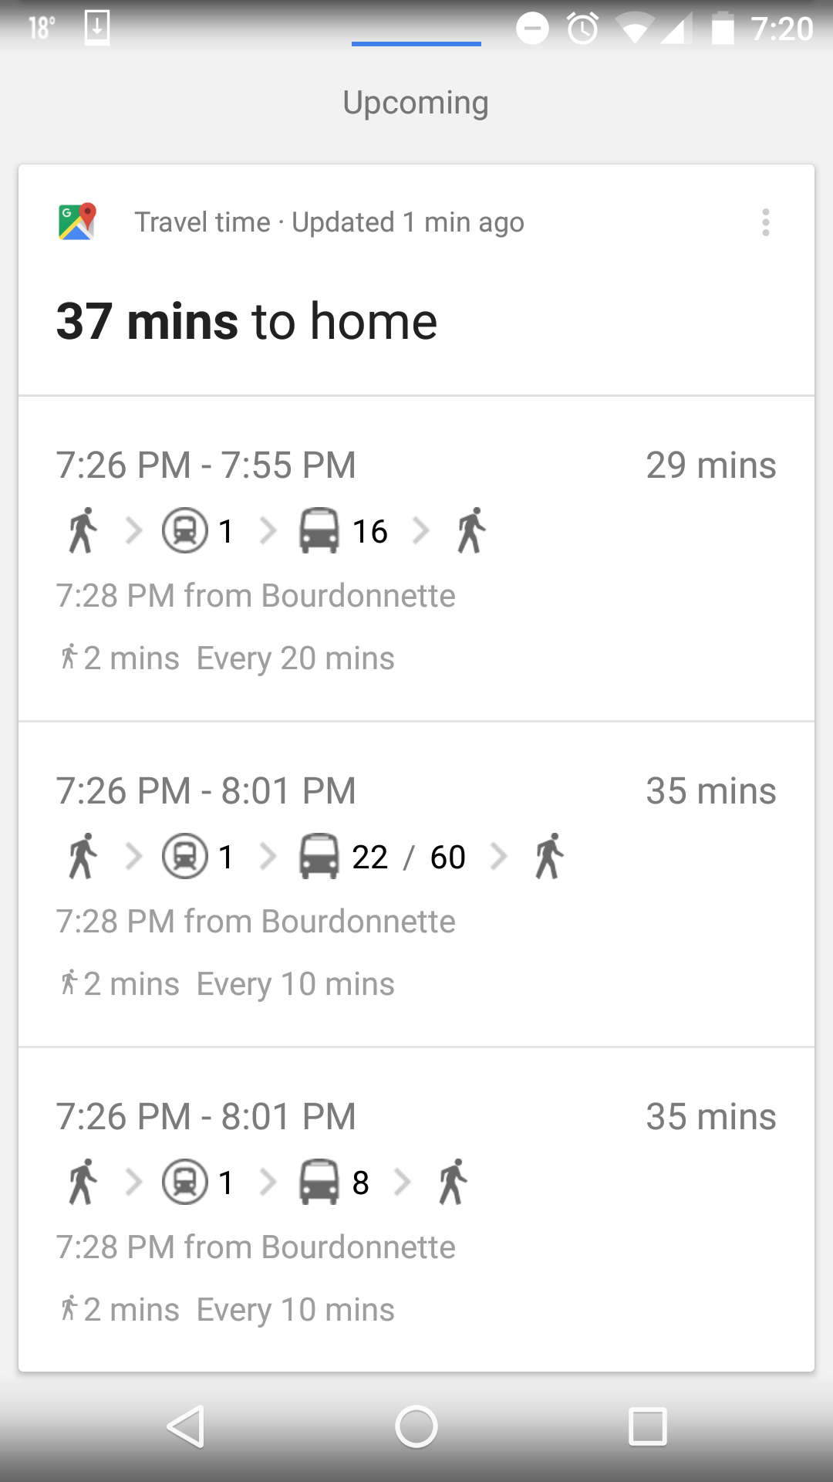
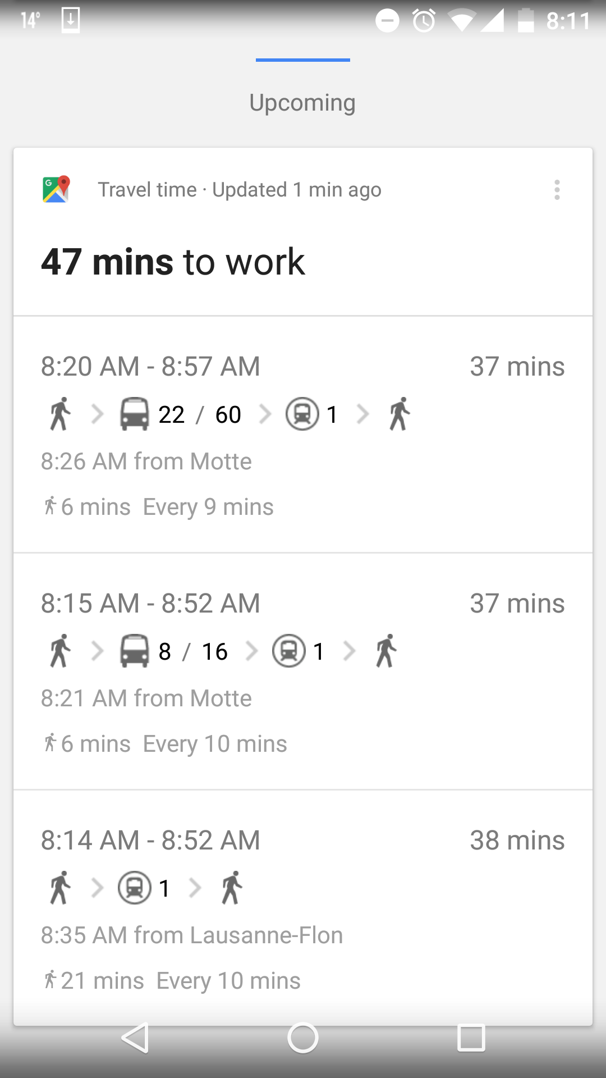


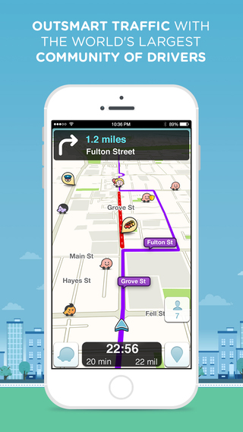

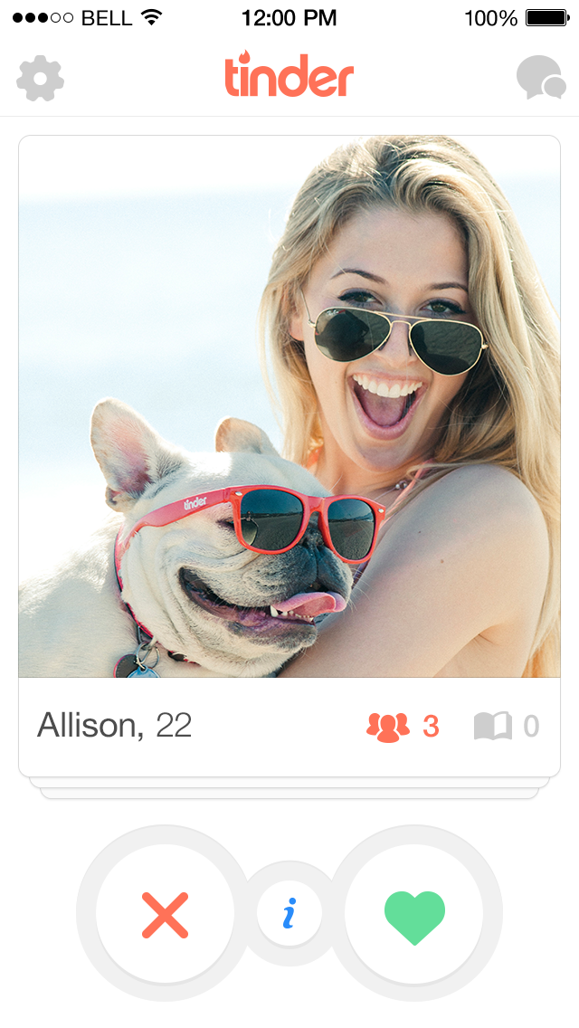

Lets Talk about Bob

Slide 3
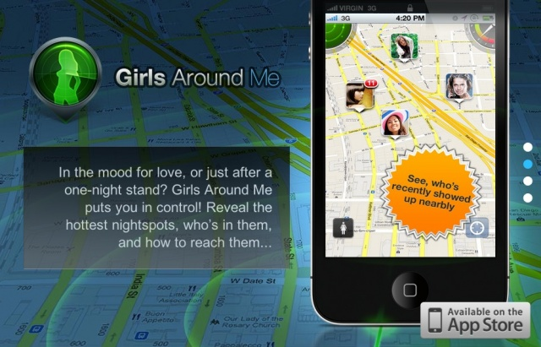

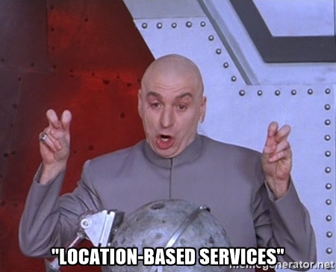

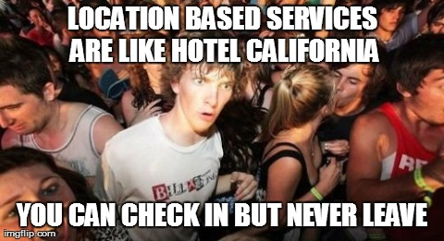

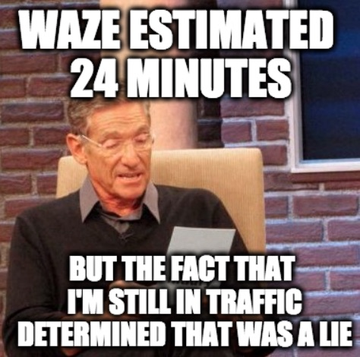
The Other Side

Slide 4
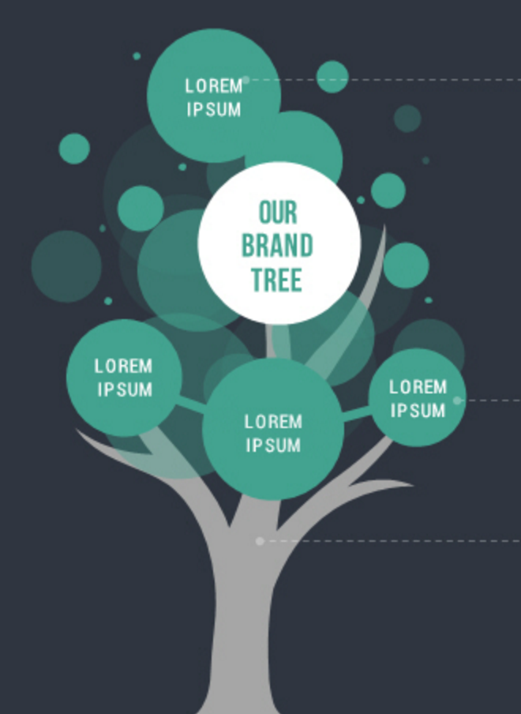

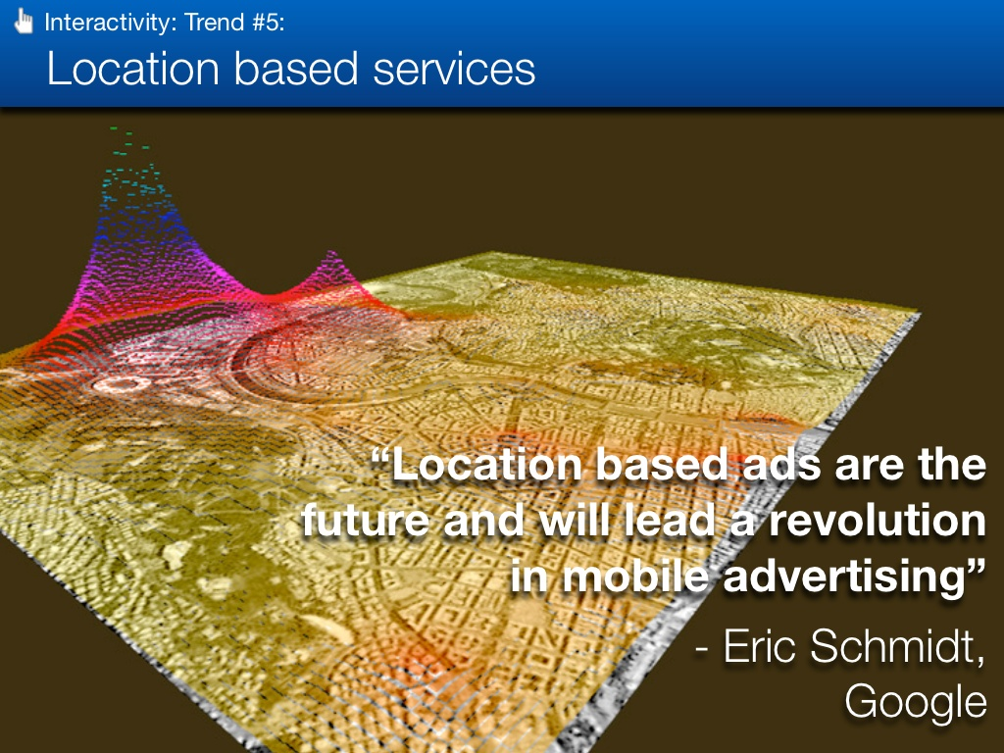
Some Background
Utility
Space
Success of
Location Based Services
User
Privacy
Resource
Management
Location
Based
Ads
Mobility
Prediction
Mobility Prediction Platform

Slide 5
Selected Articles
Predictability of
Human Mobility
Understanding Mobility from GPS Data
Mining Mobility Profiles of Users
Location Privacy through Camouflage
Privacy
Preserving
Deep
Learning

Slide 6



Slide 7
Privacy-Preserving
Deep Learning

Slide 8
Privacy-Preserving Deep Learning – Shokri et al.
Context
More
Data
More
Customers
Better
Learning
Problem
Better
Insights
Approach

Slide 9

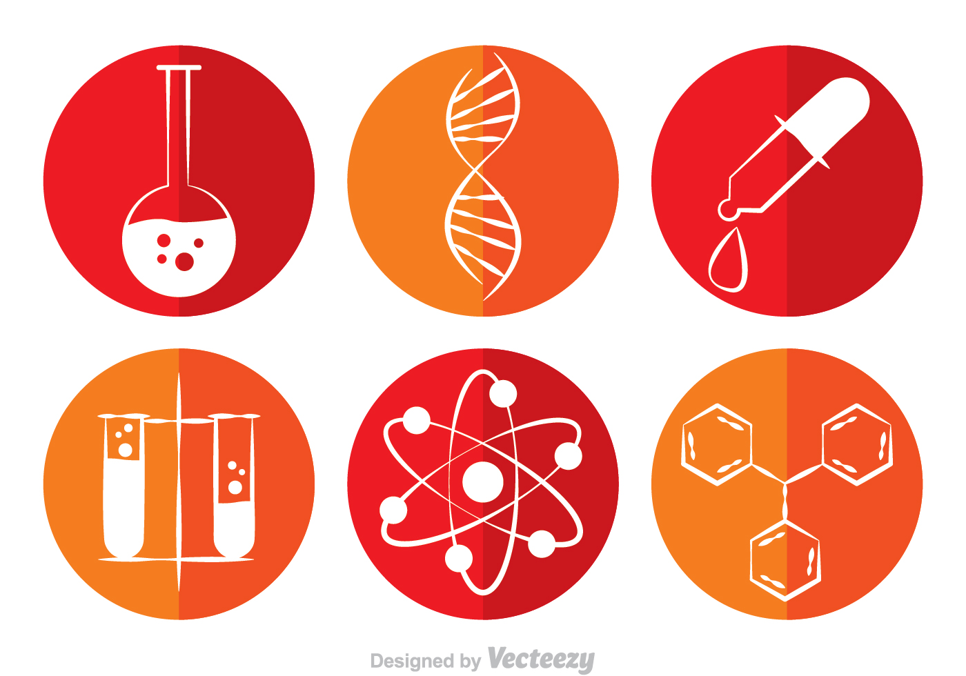
Deep Learning Today

Slide 10
21 October 2015

Slide 11
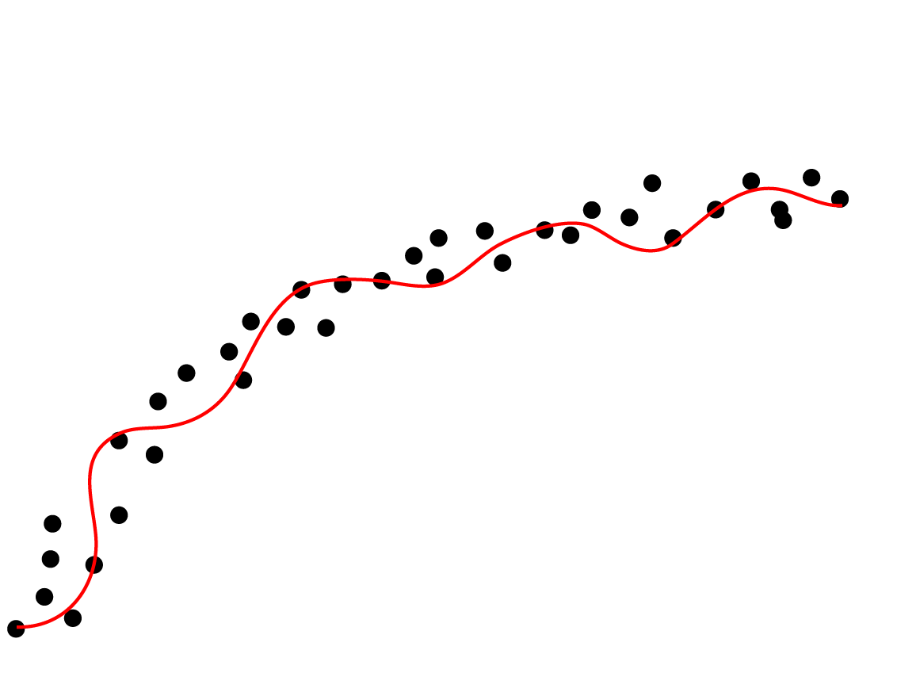
Deep Neural Networks
activation signals
Next layer
N1
w1
N2
w2
w3
f(wa)
N3
wk
Activation
function
Nk
parameters

Slide 12

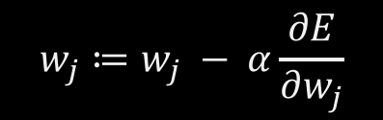
Parameter Training
$$w_{j}≔w_{j} − α\frac{∂E}{∂w_{j}}$$
$$\frac{∂E}{∂w_{j}}$$
Error
Starting point
Convergence
Iterations

Slide 13
Distributed Selective SGD Architecture
global parameters
Download latest, most-updated parameters
Selected
parameters
Selected
gradients
Upload gradient of selected parameters
Local training, Global convergence
High training stochasticity
Less overfitting
Local parameters & gradients
SGD
Local training dataset

Slide 14
1
Centralized training (no privacy)
Accuracy
So Close!
gain
0.93
Collaborative
training
Stand-alone training
(maximum privacy)
0
0.01
0.1
1
Parameter selection rate for upload

Slide 15
Indirect Information Leakage
D
Including
Bob
D’
excluding
Bob

Slide 16
Indirect Information Leakage – Differentially private comparison
>threshold
>threshold

Slide 17
Massive data collection for deep learning results in severe privacy risks
The paper presents a design of privacy-preserving deep learning system
Differentially-private information exchange protocol
Pretty good accuracy
Conclusions

Slide 18

MAPS
our office

Slide 19
89,526,124$
185,244 users
100%
That’s a lot of money
And a lot of users
Total success!

Slide 20
LET’S REVIEW SOME CONCEPTS
Yellow
Is the color of gold, butter and ripe lemons. In the spectrum of visible light, yellow is found between green and orange.
Blue
Is the colour of the clear sky and the deep sea. It is located between violet and green on the optical spectrum.
Red
Is the color of blood, and because of this it has historically been associated with sacrifice, danger and courage.
Yellow
Is the color of gold, butter and ripe lemons. In the spectrum of visible light, yellow is found between green and orange.
Blue
Is the colour of the clear sky and the deep sea. It is located between violet and green on the optical spectrum.
Red
Is the color of blood, and because of this it has historically been associated with sacrifice, danger and courage.

Slide 21
Thanks!
ANY QUESTIONS?
You can find me at
@username
user@mail.me

Slide 22
CREDITS
Special thanks to all the people who made and released these awesome resources for free:
Presentation template by SlidesCarnival
Photographs by Unsplash

