Slide 1
PRIVACY - AWARE MOBILITY PREDICTION PLATFORM
Reading Exam
June 1 2016
Vaibhav Kulkarni
Advisor: Prof. Benoît Garbinato

Slide 2
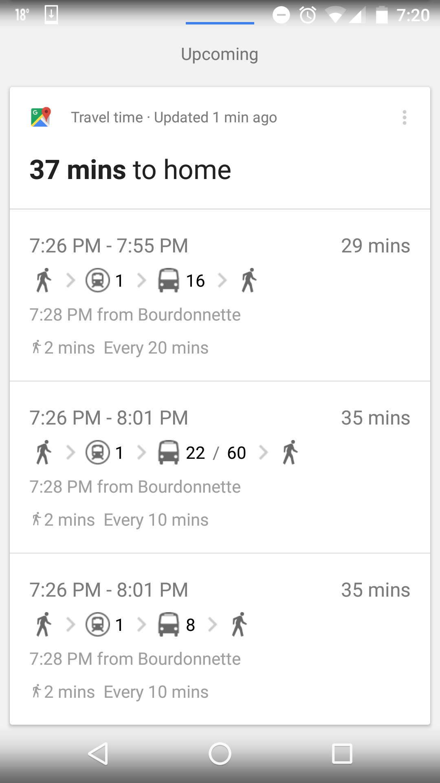
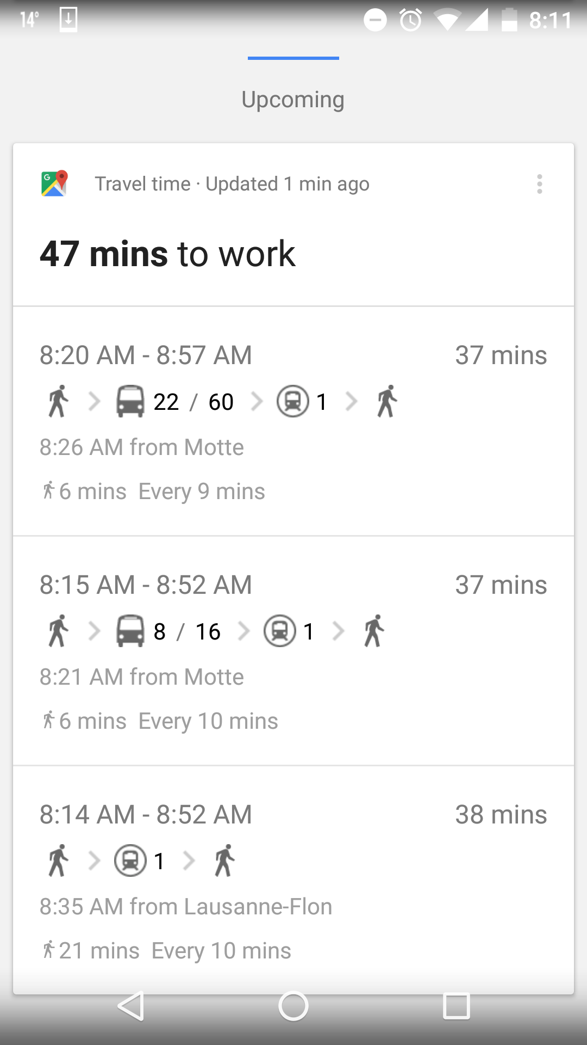


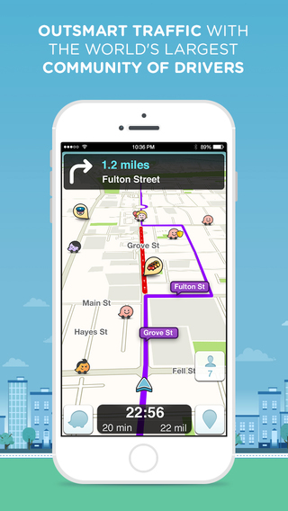

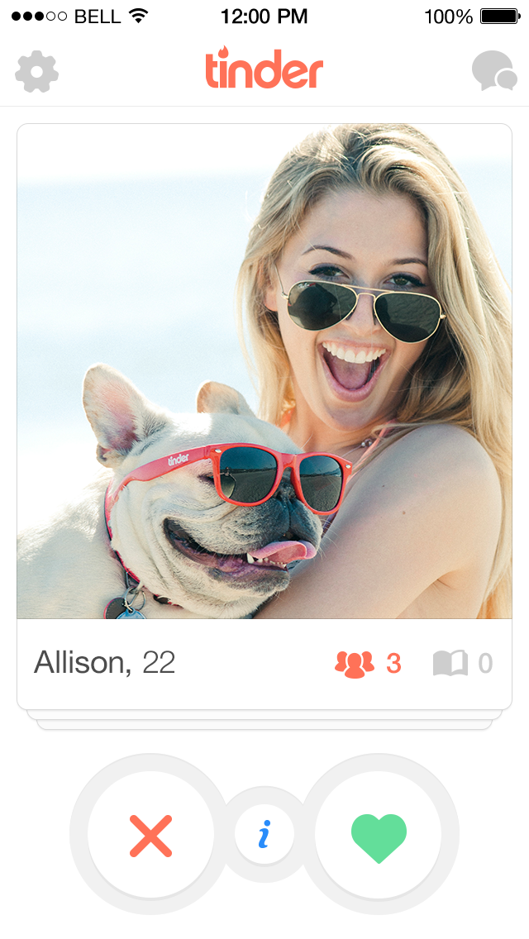

Lets Talk about Bob
Notes:
- The ubiquity of mobile devices with global positioning functionality and Internet connectivity has resulted in widespread development of location-based services (LBS).
- local business search, e-marketing, social networking,and automotive traffic monitoring.

Slide 3


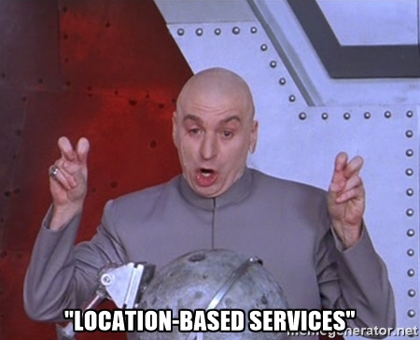



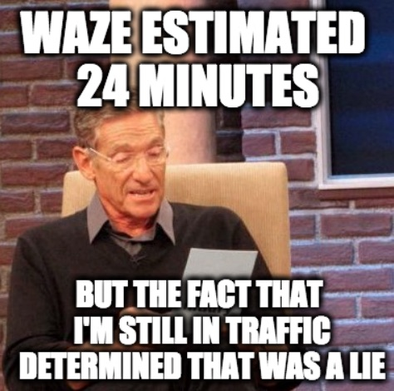
The Other Side
Notes:
In fact, there are many real-life scenarios where perpetrators abuse location-detectiontechnologies to gain access to private location information about victims

Slide 4
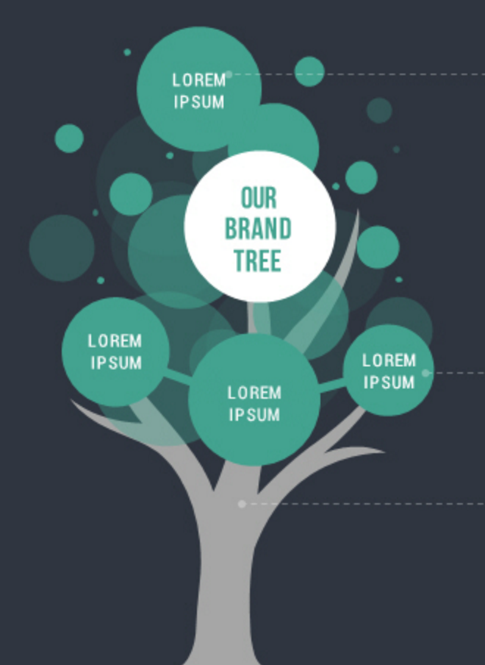

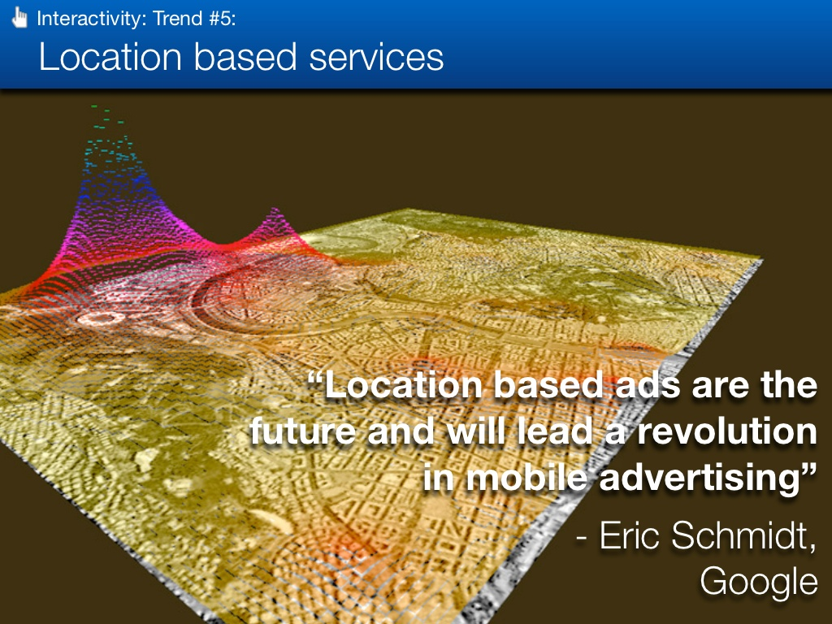
Some Background
Utility
Space
Success of
Location Based Services
User
Privacy
Resource
Management
Location
Based
Ads
Mobility
Prediction
Mobility Prediction Platform

Slide 5
Selected Articles
Predictability of
Human Mobility
Understanding Mobility from GPS Data
Mining Mobility Profiles of Users
Location Privacy through Camouflage
Privacy
Preserving
Deep
Learning
Notes:
- Human behaviour is characterised by spontaneity, randomness and change.
-

Slide 6



Slide 7
Privacy-Preserving
Deep Learning
Notes:
Deep learning based on ANN is a very popular approach to modelling, classifying and recognizing complex data including images, speech and text.
The un paralleled accuracy of deep learning techniques is leading the foundation of new AI based services on the Internet.
Reasons for selecting this paper:
Google is working on a similar system called “Model Averaging” – training deep-learning algorithms from data in closed networks, rather than having the information transfer into Google’s cloud.
Microsoft has also looked for a way to train deep-learning algorithms from private information – CryptoNets allow organizations to apply neural networks to their encrypted data.
Through a process called ‘homomorphic encryption’, the neural nets supposedly deliver encrypted answers that keep data confidential.

Slide 8
Privacy-Preserving Deep Learning – Shokri et al.
Context
More
Data
More
Customers
Better
Learning
Problem
Better
Insights
Approach
Notes:
Commercial companies that collect user data on a large scale have been the main beneficiaries of this trend.
The success of deep learning is directly proportional to the amount of data available for training.

Slide 9


Deep Learning Today
Notes:
Massive data collection required for deep learning presents obvious privacy issues.
Users’ personal, highly sensitive data such as photos and voice recordings is kept indefinitely by the companies that collect it.
Users can neither delete it, nor restrict the purposes for which it is used
Furthermore, centrally kept data is subject to legal subpoenas and extra-judicial surveillance
Many data owners—for example, medical institutions that may want to apply deep learning methods to clinical records—
are prevented by privacy and confidentiality concerns from sharing the data and thus benefitting from large-scale deep learning.

Slide 10
21 October 2015
Notes:
Solution:
we design, implement, and evaluate a practical system that enables multiple parties to jointly learn an accurate neuralnetwork model for a given objective without sharing their input datasets
We exploit the fact that the optimization algorithms used in modern deep learning, namely, those based on stochastic gradient descent, can be parallelized and executed asynchronously
Our system lets participants train independently on their own datasets and selectively share small subsets of their models’ key parameters during training.
This offers an attractive point in the utility/privacy tradeoff space: participants preserve the privacy of their respective data while still benefitting from other participants’ models and thus boosting their learning accuracy beyond what is achievable solely on their own inputs.

Slide 11
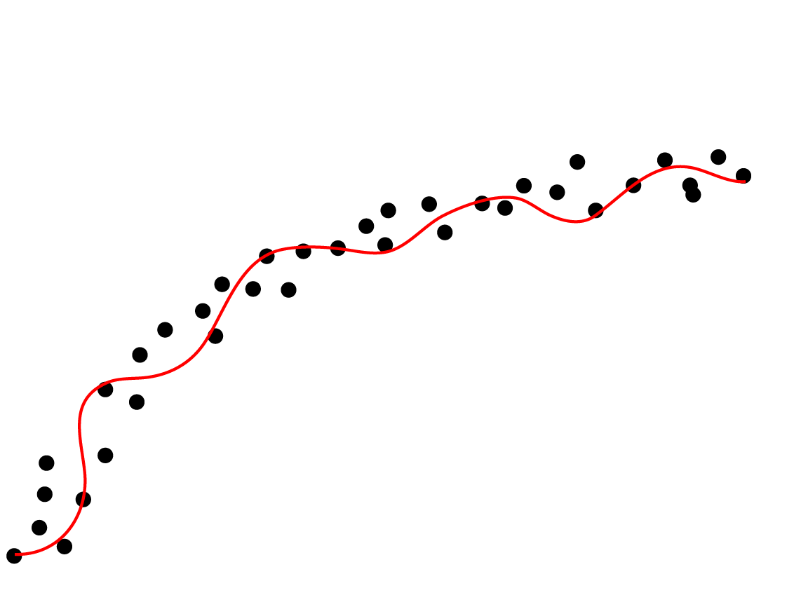









Deep Neural Networks
activation signals
Next layer
$$N_{1}$$
$$w_{1}$$
$$N_{2}$$
$$w_{2}$$
$$w_{3}$$
$$f(w)$$
$$N_{3}$$
$$w_{k}$$
$$N_{k}$$
Activation
function
parameters
Hidden Layer
Notes:
Deep learning architectures are usually constructed as multi-layer networks so that more abstract features are computed as nonlinear functions of lower-level features.
We mainly focus on supervised learning, where the training inputs are labeled with correct classes
Multi-layer neural networks are the most common form of deep learning architectures. Figure 1 shows a typical neural network with one hidden layers
In a typical multi-layer network, each neuron receives the output of the neurons in the previous layer plus a bias signal
The output of the neuron is computed by applying a nonlinear activation function to the total input value.
where f is an activation function and w is the weight matrix that determines the contribution of each input signal.
In general, the values computed in higher layers represent more abstract features of the data. The first layer is composed of the raw features extracted from the data,

Slide 12

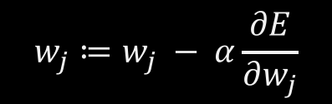
Parameter Training
$$w_{j}≔w_{j} − α\frac{∂E}{∂w_{j}}$$
$$\frac{∂E}{∂w_{j}}$$
Error
Starting point
Convergence
Iterations
Notes:
Learning the parameters of a neural network is a nonlinear optimization problem. In supervised learning, the objective function is the output of the neural network. The algorithms that are used to solve this problem are typically variants of gradient descent
Simply put, gradient descent starts at a random point (set of parameters for the neural network), then, at each step, computes the gradient of the nonlinear function being optimized and updates the parameters so as to decrease the gradient. This process continues until the algorithm converges to a local optimum.
In a neural network, the gradient of each weight parameter is computed through feed-forward and back-propagation procedures.
Feed-forward sequentially computes the output of the network given the input data and then calculates the error
Back-propagation propagates this error back through the network and computes the contribution of each neuron to the total error
individual parameters are computed from the neurons’ activation values and their contribution to the error.
Stochastic gradient descent (SGD) is a drastic simplification which computes the gradient over an extremely small subset (mini-batch) of the whole dataset

Slide 13
Distributed Selective SGD Architecture
global parameters
Download latest, most-updated parameters
Selected
parameters
Selected
gradients
Upload gradient of selected parameters
Local training, Global convergence
High training stochasticity
Less over-fitting
Local parameters & gradients
SGD
Local training dataset
Notes:
The core of our approach is a distributed, collaborative deep learning protocol
updates to different parameters during gradient descent are inherently independent
different training datasets contribute to different parameters
different features do not contribute equally to the objective function
Selective Stochastic Gradient Descent
The main intuition behind selective parameter update is that during SGD, some parameters contribute much more to the neural network’s objective function and thus undergo much bigger updates during a given iteration of training.
two or more participants training independently and concurrently.
Each participant then trains the neural network using the standard SGD algorithm, iterating over his local training data over many epochs.
There are several ways to choose which gradients to share at the end of each local epoch.
The first method is to select exactly θu fraction of values, picking big values that significantly contribute to the gradient descent algorithm.
The other method is to select a random subset of values that are larger than threshold
The parameter server initializes the parameter vector w(global) and then handles the participants’ upload and download requests.
Each participant can initialize his local parameters randomly or by downloading their latest values from the parameter server.
The parameter server initializes the parameter vector w(global) and then handles the participants’ upload and download requests
Updating local parameters with a subset of global parameters during training increases the stochasticity of local SGD.
This plays an essential role in preventing local SGD from overfitting to its small local dataset.
When training alone, each participant is susceptible to falling into local optima.
Overwriting locally learned parameters with values learned by other participants, who train on different datasets,
helps each participant escape local optima and enables them to explore other values, resulting in more accurate models
Stochasticity due to asynchronous parameter update is known to be effective for training accurate deep neural networks.
This is also consistent with regularizing techniques that randomly corrupt neurons or input data during training in order to avoid overfitting.

Slide 14
Results !
1
Centralized training (no privacy)
Accuracy
So Close!
gain
0.93
Collaborative
training
Stand-alone training
(maximum privacy)
0
0.01
0.1
1
Parameter selection rate for upload / # Participants / Differential Privacy
Notes:
We evaluate our system on two major datasets used as benchmarks in the deep-learning literature. MNIST dataset and SVHN dataset
MLP and CNN (CNNs are a special kind of multi-layer neural networks with sparse connectivity)
different parameter exchange protocols—round robin, random order, and asynchronous
The first is Centralized SGD on the entire dataset. This is a privacy-violating scenario where all the training data is pooled into one dataset
The other scenario is Standalone SGD. This is the scenario where participants train solely on their own training data, without any collaboration.
We evaluate the effect of different values of (the differential privacy parameter), N (the number of participants),
and θu (the fraction of uploaded gradients) on the accuracy of neural networks trained using distributed selective SGD with differential privacy
In a nutshell, a computation is differentially private if the probability of producing a given output does not depend very much on
whether a particular data point is included in the input dataset.

Slide 15
Indirect Information Leakage
D
Including
Bob
D’
excluding
Bob
Notes:
Differentially private parameter selection and gradient sharing

Slide 16
Differentially private comparison
>threshold
> threshold
Notes:
Select a small fraction of perturbed gradients that are above the perturbed threshold

Slide 17

Massive data collection for deep learning results in severe privacy risks
The paper presents a design of privacy-preserving deep learning system
Differentially-private information exchange protocol
Pretty good accuracy
Conclusions

Slide 18
References
Template : https://templates.office.com/en-us/templates-for-PowerPoint
Meme1: http://memerepo.com/
Meme2: http://dankmemerepository.tumblr.com/
Meme3: https://www.beris.nl/blog/meme-repository/
Meme4: http://www.b3takit.co.uk/site/
App Images: https://play.google.com/intl/en_us/badges/
Tree image: http://www.dreamstime.com/photos-images/tree.html

Slide 19
Thanks!
“We “learn” some parameters from everyone who passes through our lives. Some parameters train our life models in a better way, some the contrary.
However, they all ensure that one achieves a fulfilled life (global convergence).
- Vaibhav Kulkarni
ANY QUESTIONS?

