Slide 1
PRIVACY - AWARE MOBILITY PREDICTION PLATFORM
Reading Exam
June 1 2016
Vaibhav Kulkarni – DopLab
Advisor: Prof. Benoît Garbinato

Slide 2
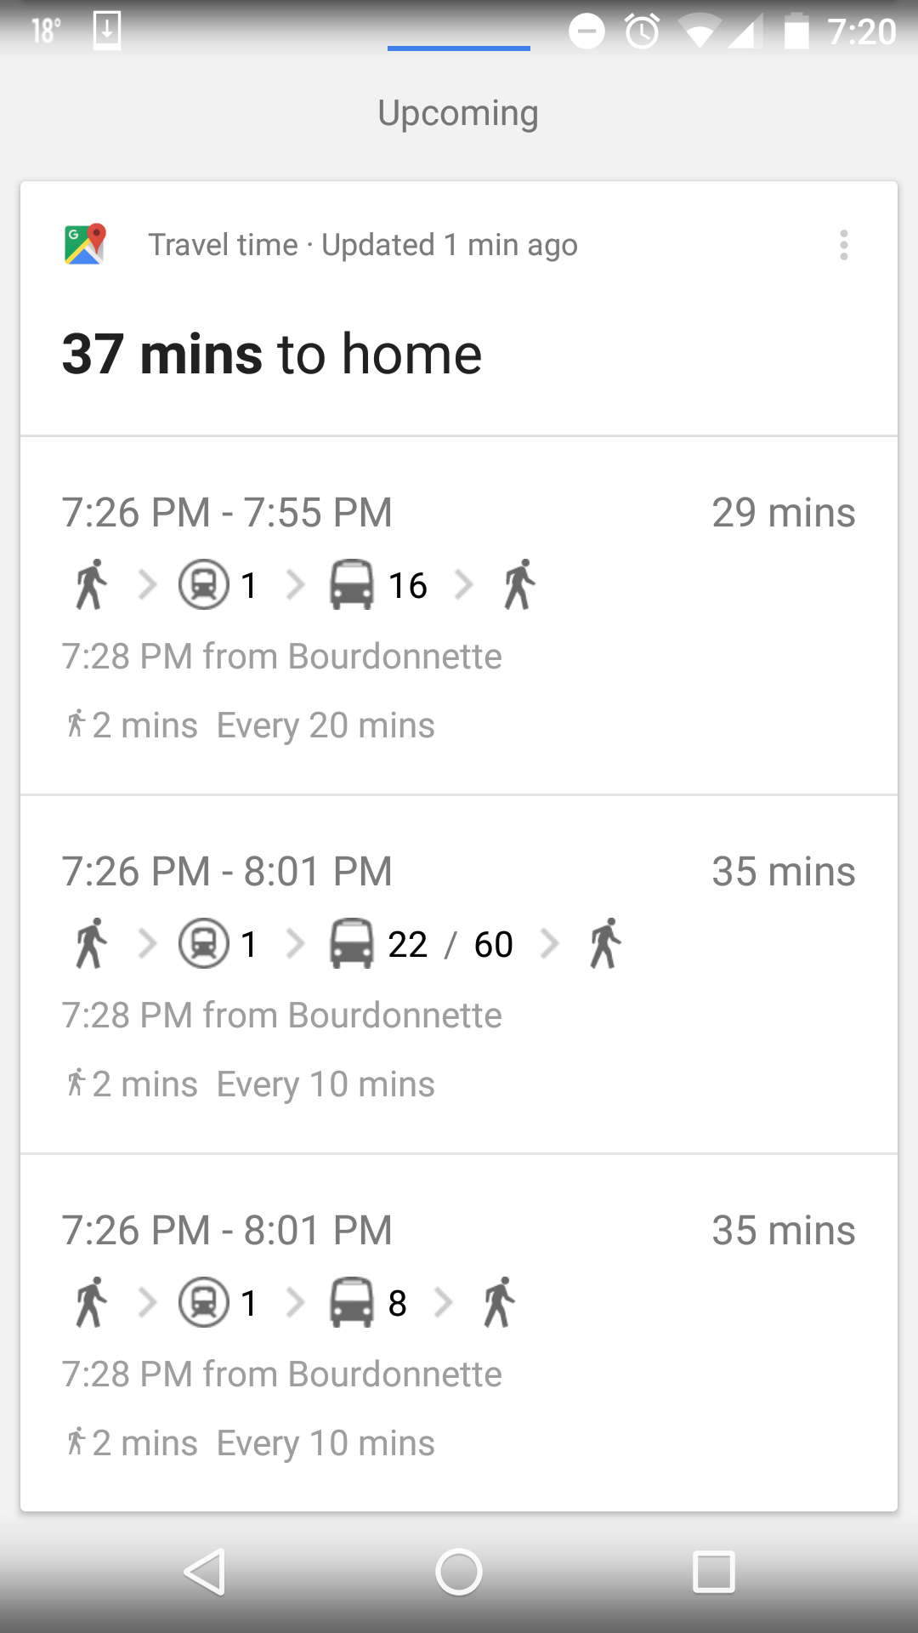
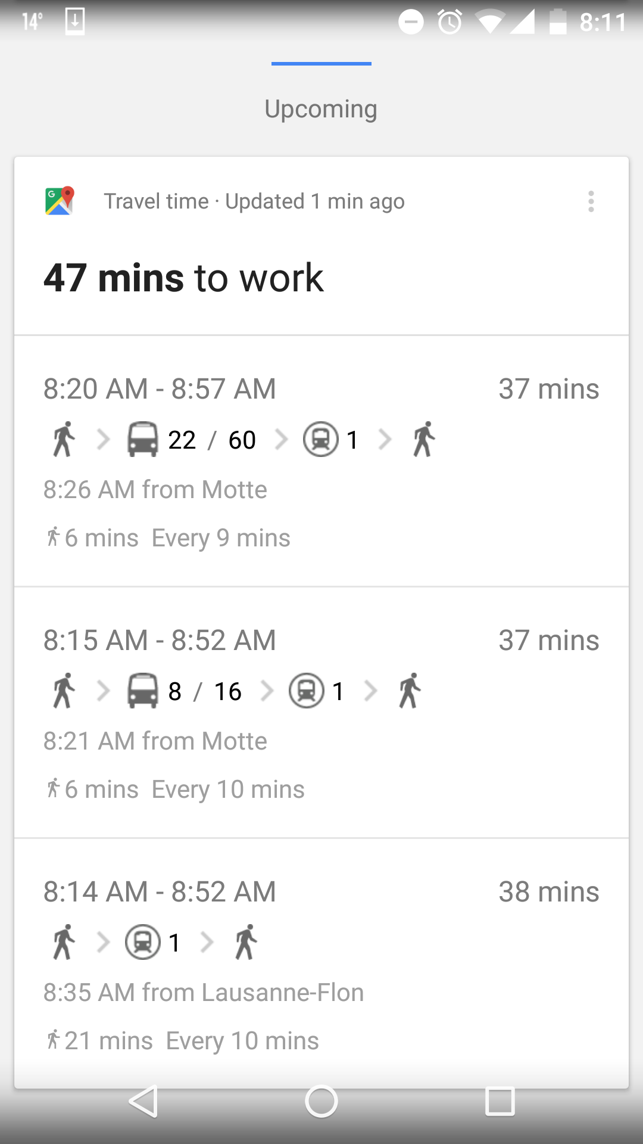
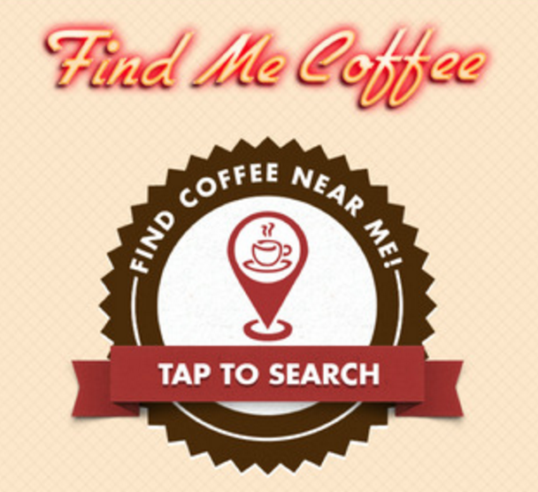

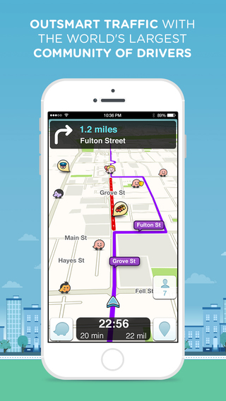

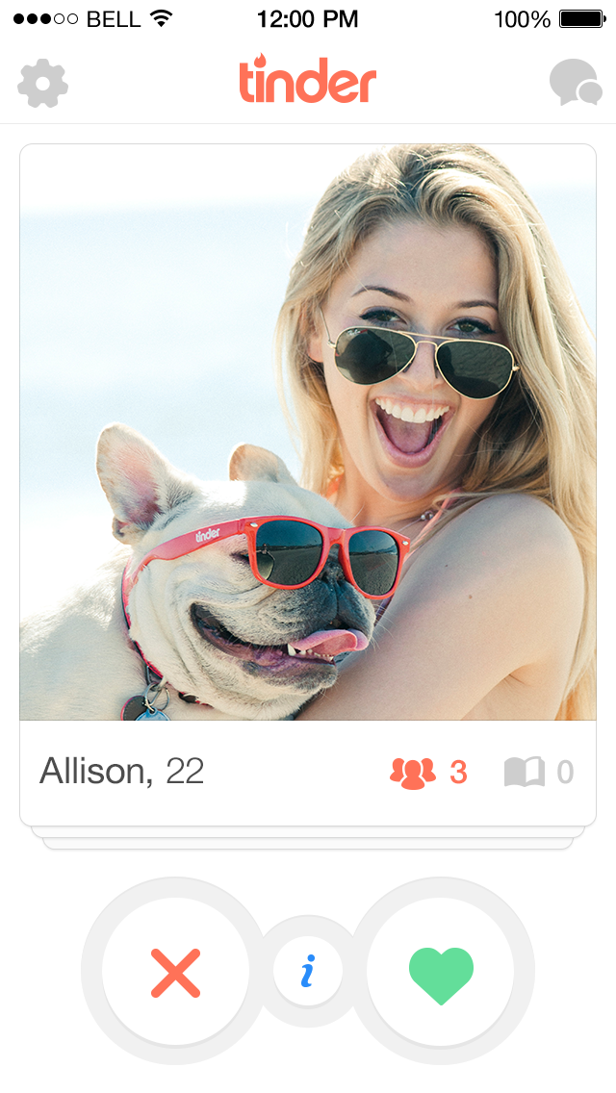

Lets Talk about Bob

Slide 3
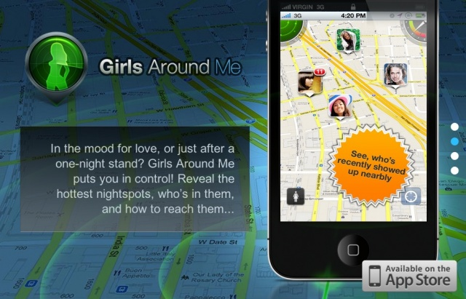

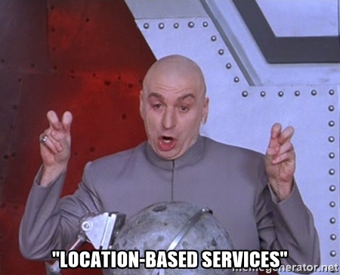

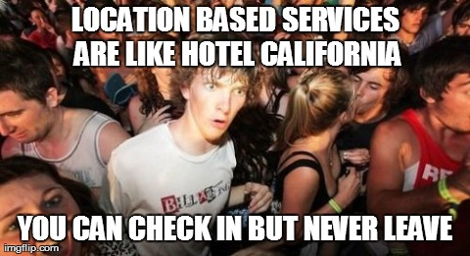
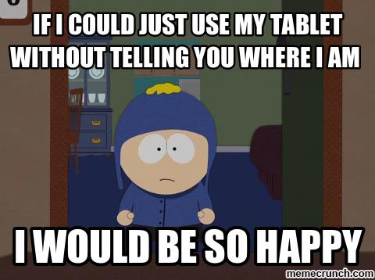
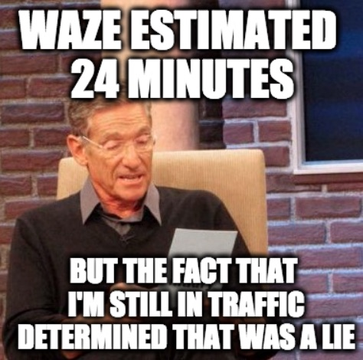
The Other Side

Slide 4
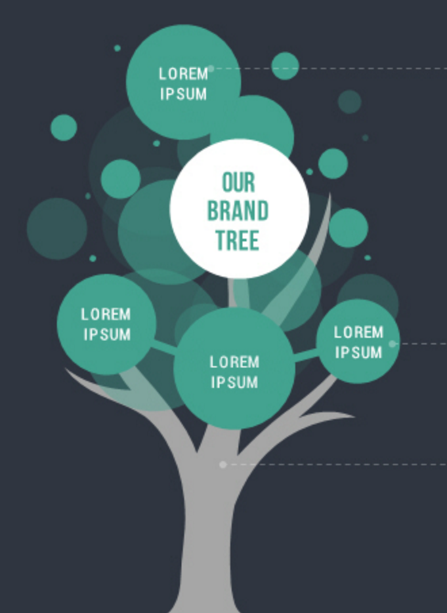

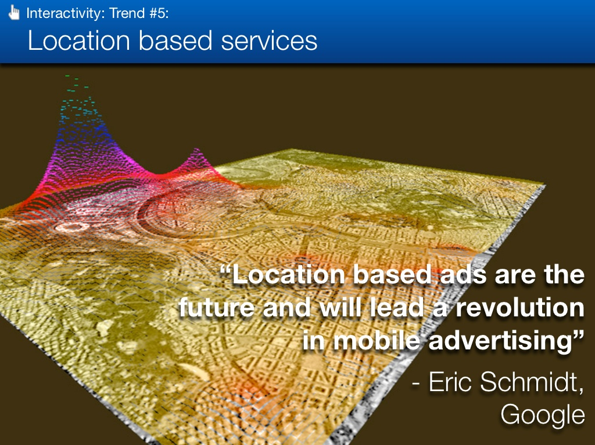
Some Background
Utility
Space
Success of
Location Based Services
User
Privacy
Resource
Management
Location
Based
Ads
Mobility
Prediction
Mobility Prediction Platform

Slide 5
Selected Articles
Predictability of
Human Mobility
Understanding Mobility from GPS Data
Mining Mobility Profiles of Users
Location Privacy through Camouflage
Privacy
Preserving
Deep
Learning

Slide 6
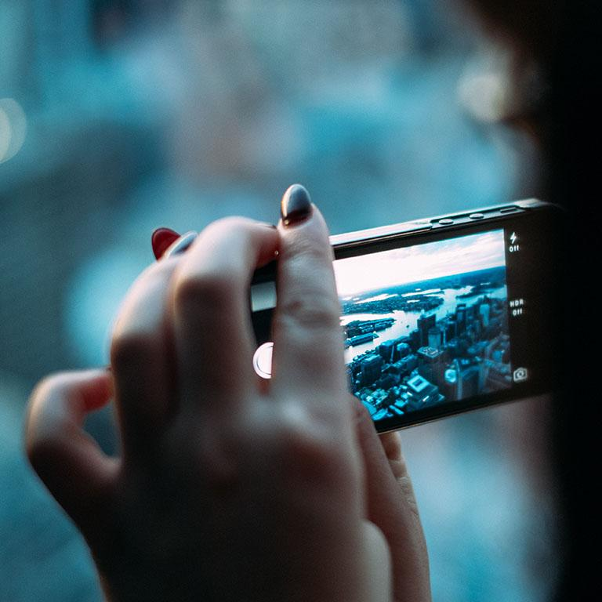


Slide 7
Privacy-Preserving
Deep Learning

Slide 8
Privacy-Preserving Deep Learning – Shokri et al.
Context
More
Data
More
Customers
Better
Learning
Problem
Better
Insights
Approach

Slide 9

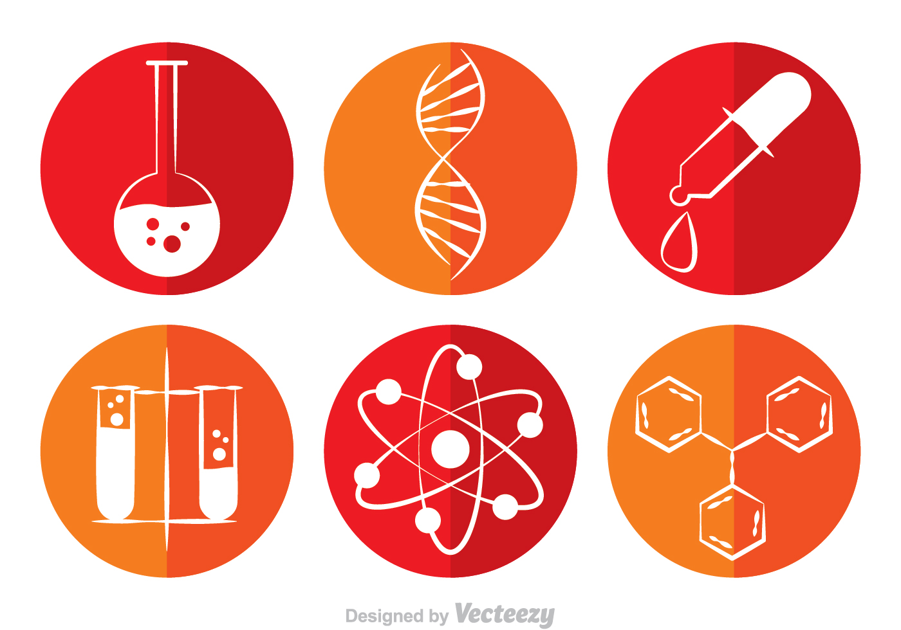
Deep Learning Today

Slide 10
21 October 2015

Slide 11
IN TWO OR THREE COLUMNS

Slide 14
TRANSITION HEADLINE
1
Let’s start with the first set of slides

Slide 15
THIS IS A SLIDE TITLE
Here you have:
A list of items
And some text
But remember not to overload your slides with content
You audience will listen to you or read the content, but won’t do both.

Slide 16
YOU CAN ALSO SPLIT YOUR CONTENT
White
Is the color of milk and fresh snow, the color produced by the combination of all the colors of the visible spectrum.
Black
Is the color of coal, ebony, and of outer space. It is the darkest color, the result of the absence of or complete absorption of light.

Slide 17
IN TWO OR THREE COLUMNS
Yellow
Is the color of gold, butter and ripe lemons. In the spectrum of visible light, yellow is found between green and orange.
Blue
Is the colour of the clear sky and the deep sea. It is located between violet and green on the optical spectrum.
Red
Is the color of blood, and because of this it has historically been associated with sacrifice, danger and courage.

Slide 18
A PICTURE IS WORTH A THOUSAND WORDS
A complex idea can be conveyed with just a single still image, namely making it possible to absorb large amounts of data quickly.

Slide 19
WANT BIG IMPACT?
Use big image.

Slide 20
USE CHARTS TO EXPLAIN YOUR IDEAS
White
Gray
Black

Slide 21
AND TABLES TO COMPARE DATA
 | A | B | C
Yellow | 10 | 20 | 7
Blue | 30 | 15 | 10
Orange | 5 | 24 | 16

Slide 22

MAPS
our office

Slide 23
89,526,124
Whoa! That’s a big number, aren’t you proud?

Slide 24
89,526,124$
185,244 users
100%
That’s a lot of money
And a lot of users
Total success!

Slide 25
LET’S REVIEW SOME CONCEPTS
Yellow
Is the color of gold, butter and ripe lemons. In the spectrum of visible light, yellow is found between green and orange.
Blue
Is the colour of the clear sky and the deep sea. It is located between violet and green on the optical spectrum.
Red
Is the color of blood, and because of this it has historically been associated with sacrifice, danger and courage.
Yellow
Is the color of gold, butter and ripe lemons. In the spectrum of visible light, yellow is found between green and orange.
Blue
Is the colour of the clear sky and the deep sea. It is located between violet and green on the optical spectrum.
Red
Is the color of blood, and because of this it has historically been associated with sacrifice, danger and courage.

Slide 26
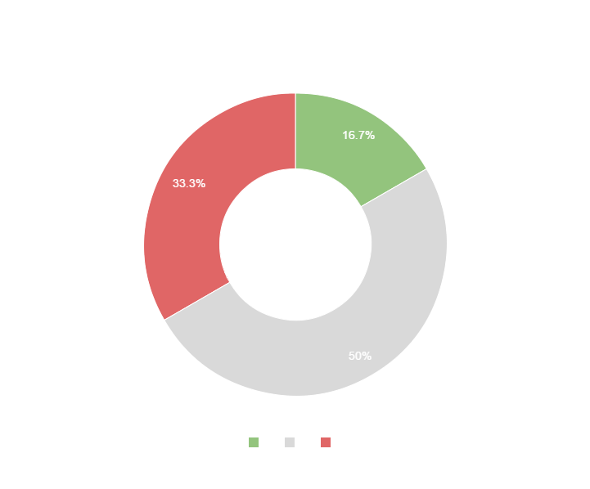
You can copy&paste graphs from Google Sheets

Slide 27
Place your screenshot here
ANDROID PROJECT
Show and explain your web, app or software projects using these gadget templates.

Slide 28
Place your screenshot here
iPHONE PROJECT
Show and explain your web, app or software projects using these gadget templates.

Slide 29
Place your screenshot here
TABLET PROJECT
Show and explain your web, app or software projects using these gadget templates.

Slide 30
Place your screenshot here
DESKTOP PROJECT
Show and explain your web, app or software projects using these gadget templates.

Slide 31
Thanks!
ANY QUESTIONS?
You can find me at
@username
user@mail.me

Slide 32
CREDITS
Special thanks to all the people who made and released these awesome resources for free:
Presentation template by SlidesCarnival
Photographs by Unsplash

Slide 33

PRESENTATION DESIGN
This presentations uses the following typographies and colors:
Titles & body copy: Quicksand
You can download the fonts on this page:
http://www.google.com/fonts#UsePlace:use/Collection:Quicksand:300,400,700
Click on the “arrow button” that appears on the top right
Dark gray #2e3037
Aqua #39c0ba
Salmon #f35b69
Blue #6d9eeb
You don’t need to keep this slide in your presentation. It’s only here to serve you as a design guide if you need to create new slides or download the fonts to edit the presentation in PowerPoint®

Slide 34
SlidesCarnival icons are editable shapes.
This means that you can:
Resize them without losing quality.
Change line color, width and style.
Isn’t that nice? :)
Examples:

