Slide 1
Human mobility predictability
Characteristics and prediction algorithms
Alicia Rodriguez-Carrion
University Carlos III of Madrid, Spain
E-mail: arcarrio@it.uc3m.es

Slide 2
Why do we want to know how people move?
Study statistical properties of human mobility or some particular group of people
  Building mobility models [1] [2]
  Building models capturing population movement under extreme events (e.g. earthquakes) [3]
  Spread of biological and mobile viruses [4][5]
November 2013
Alicia Rodriguez-Carrion

Slide 3
Why do we want to know how a particular person moves?
If we know how a user usually behaves, we can guess her intents in advance and react consequently
  Pervasive computing [6] (e.g. Home automation patent by Apple)
  Location Based Services
  Detect unusual behaviors (e.g. elderly people)
November 2013
Alicia Rodriguez-Carrion

Slide 4
Why do we want to know how people move in a particular area?
Interest in identifying areas where people concentrate on weekdays or weekends, the major routes, etc.
  Urban planning [7]
  Traffic forecasting [8]
  Intelligent Transport Systems
November 2013
Alicia Rodriguez-Carrion

Slide 5
Objectives
Two steps
  Understand how people move (spatial and temporal distributions, most visited locations…)
  Apply mobility knowledge to improve the prediction of their future routes or destinations
November 2013
Alicia Rodriguez-Carrion

Slide 6
Table of content
Collecting mobility data
Mobility parameters extracted from collected data
How to improve prediction algorithms based on mobility parameters
November 2013
Alicia Rodriguez-Carrion

Slide 7
Why so much interest in this topic right now?
Most of people carry a mobile phone all day long
How much data have your phone operator about you?
  Malte Spitz – Your phone company is watching
  Mobile devices enable massive data collection
November 2013
Alicia Rodriguez-Carrion

Slide 8
How to collect mobility data using a mobile phone
GPS: best accuracy, high battery drain, limited coverage
WLAN: lower accuracy, lower battery drain, limited coverage
GSM: lowest accuracy, lowest battery drain, worldwide coverage
November 2013
Alicia Rodriguez-Carrion

Slide 9
Symbolic locations
Divide the area into regions
Assign a symbol to each region
a
d
c
b
e
A = {a, b, c, d, e…}
November 2013
Alicia Rodriguez-Carrion

Slide 10

GSM-based mobility data
Location history
a
b
c
e
L=
b
c
a
e
d
November 2013
Alicia Rodriguez-Carrion

Slide 11
How to collect GSM-based mobility data
From the device
  Plenty of methods to obtain different information in Android API (TelephonyManager class)
  Not so easy in iOS
From the network
  Operators know the cell tower you are connected to when you make/receive a call, sms or data
  Good luck obtaining those records
November 2013
Alicia Rodriguez-Carrion

Slide 12
Challenges of data collection
How to engage people to collect these data
How to deal with missing/fake data
How to deal different spatial and temporal granularities
November 2013
Alicia Rodriguez-Carrion

Slide 13
Table of content
Collecting mobility data
Mobility parameters extracted from collected data
How to improve prediction algorithms based on mobility parameters
November 2013
Alicia Rodriguez-Carrion

Slide 14
From physical to GSM domain
Movement features
  Length of routes
  Area covered
  Speed…
There are no coordinates in symbolic domain
Translation needed from continuous to symbolic domain
November 2013
Alicia Rodriguez-Carrion

Slide 15
Example dataset
Reality Mining dataset
  95 users
  9 months
  Many features measured: location, calls, sms, WLAN and Bluetooth connections, application usage…
Many other datasets
  CRAWDAD at Dartmouth
November 2013
Alicia Rodriguez-Carrion

Slide 16
Amount of movement
In physical domain → length of movement (meters)
In GSM domain → number of cell changes (total, per day, per hour…)
  This estimation could be improved if we know the cell tower coordinates
  Problem: need to take into account network effects not related to movement (ping-pong effect [9])
November 2013
Alicia Rodriguez-Carrion

Slide 17
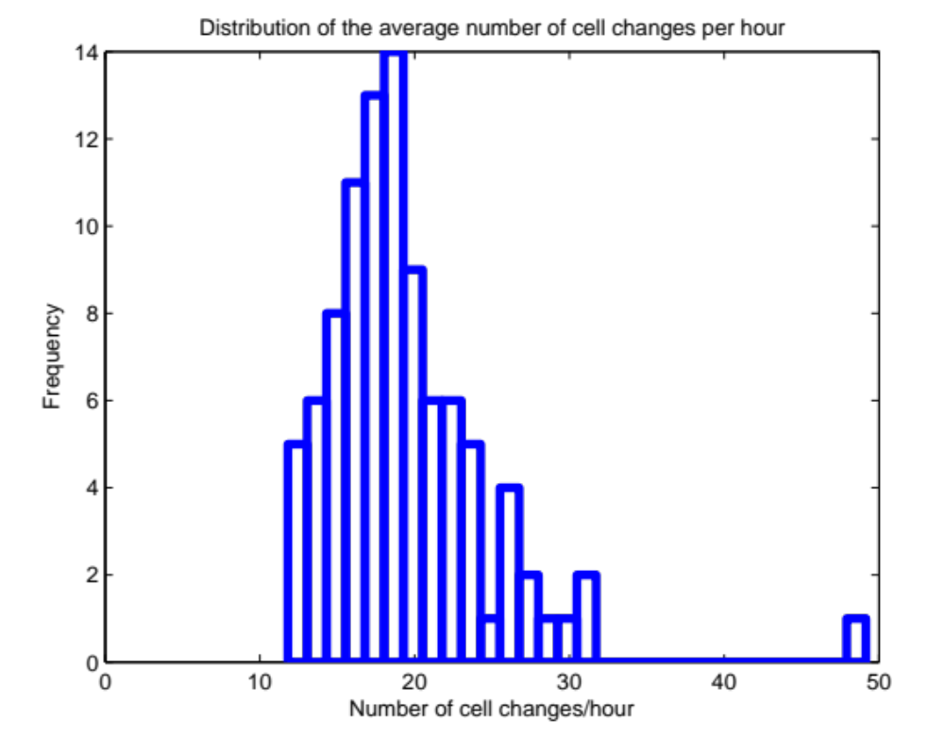
Amount of movement
November 2013
Alicia Rodriguez-Carrion

Slide 18
Diversity of visited locations
In physical domail → radius or shape of area covered
In GSM domain → number of different cells visited (total, per day, per hour)
  Problem: once again, possible bias because of the ping pong effect
November 2013
Alicia Rodriguez-Carrion

Slide 19
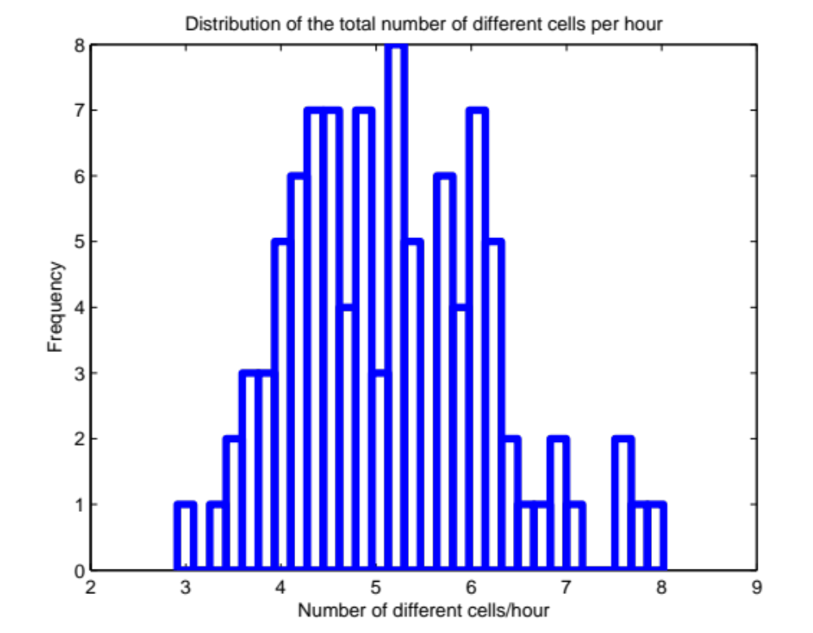
Diversity of visited locations
November 2013
Alicia Rodriguez-Carrion

Slide 20
Visitation frequency
Physical domain → How many times does the user visit a location/region?
GSM domain → How many times does the user visit each cell tower?
November 2013
Alicia Rodriguez-Carrion

Slide 21
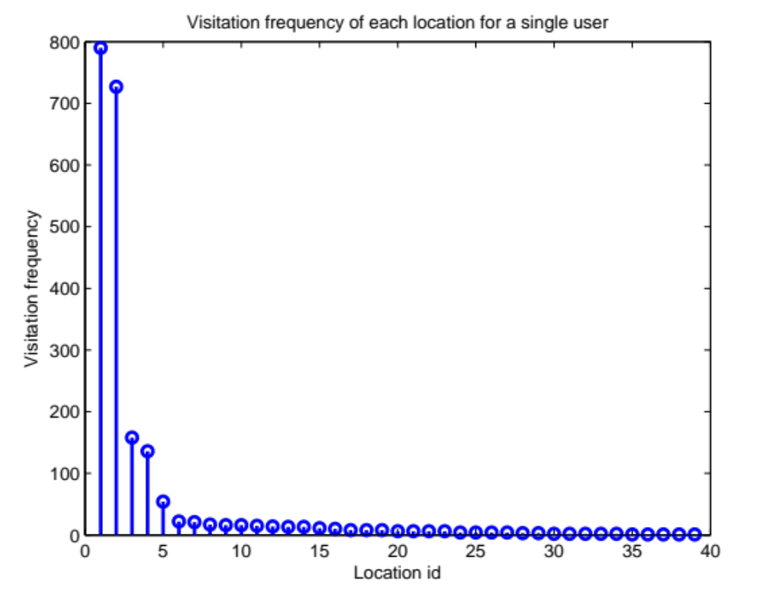
Visitation frequency
Home
Work
November 2013
Alicia Rodriguez-Carrion

Slide 22
Periodicity
Physical domain → Do the user make the same routes daily/weekly/monthly
GSM domain → How much time does it go by between consecutive visits to the same cell?
  Problem: ping-pong effect have special importance in this measurement
November 2013
Alicia Rodriguez-Carrion

Slide 23
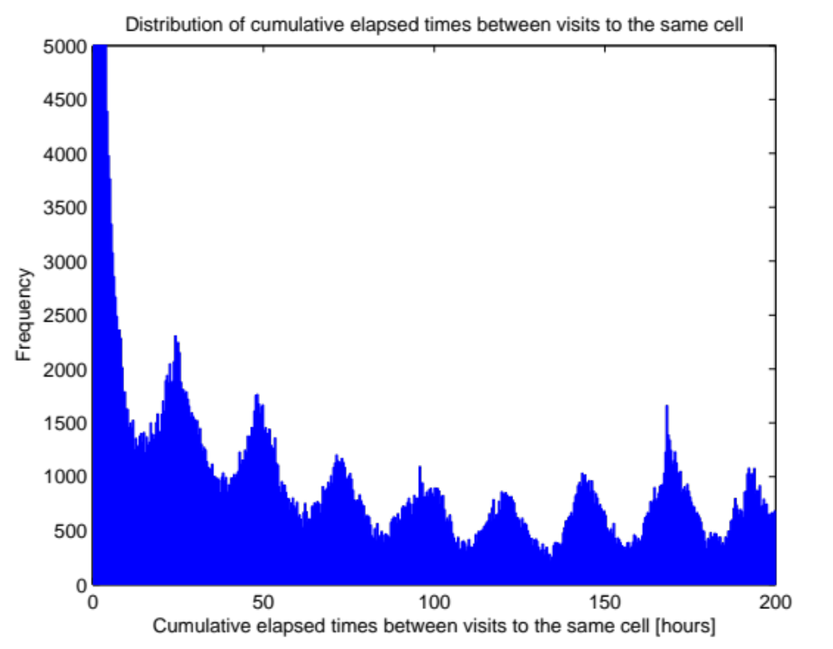
Periodicity
Ping-pong effect!
24 hours
1 week
48 hours
November 2013
Alicia Rodriguez-Carrion

Slide 24
Randomness
How to measure randomness?
  Entropy → uncertainty about the next event
    Taking into account spatial dependencies (Shannon estimator)
    Taking into account spatial and temporal dependencies (LZ estimator)
November 2013
Alicia Rodriguez-Carrion

Slide 25
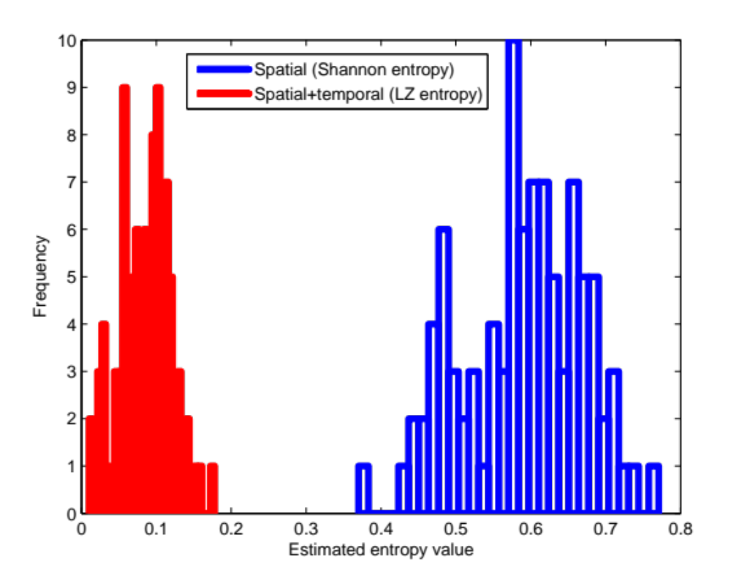
Randomness
November 2013
Alicia Rodriguez-Carrion

Slide 26
Predictability
Impacts directly one of the main targets of understanding human mobility
Predictability (%) [10] = maximum accuracy that can be achieved with a prediction algorithm (i.e. it is impossible to obtain a higher percentage of correct predictions than the predictability value) → upper bound
November 2013
Alicia Rodriguez-Carrion

Slide 27
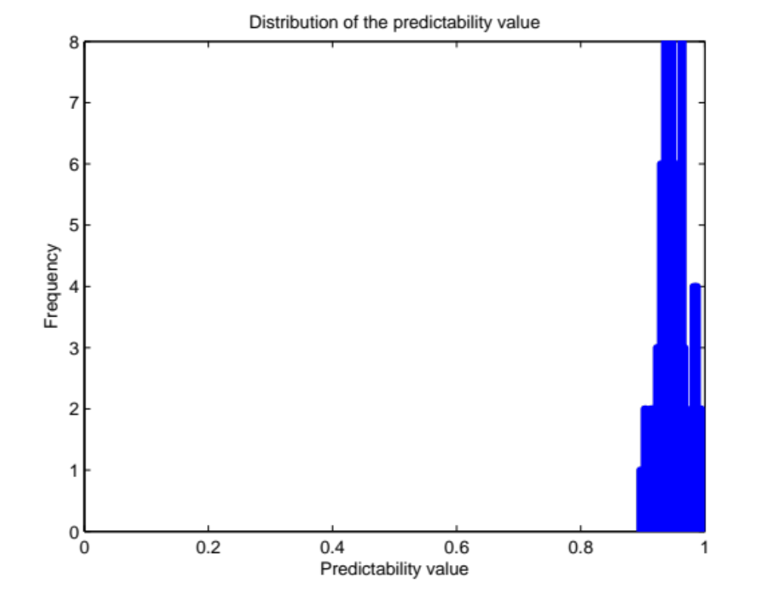
Predictability
93% !
November 2013
Alicia Rodriguez-Carrion

Slide 28
Extensive set of features
Different levels
  Individual (i)
  Group (g)
  Region (r)
Besides the previous ones
  Temporal evolution of number of new locations (i,g) [11]
  Displacement distribution (g) [12]
  Pause time distribution (g) [12]
  Radius of gyration (i,g) [12]
  Footprint (r) [7]
  ...
November 2013
Alicia Rodriguez-Carrion

Slide 29
Feature extraction challenges
Could you think on more interesting mobility features? How to translate them into the symbolic domain?
Are these features biased by the collection data process? How to deal with this bias?
November 2013
Alicia Rodriguez-Carrion

Slide 30
Table of content
Collecting mobility data
Mobility parameters extracted from collected data
How to improve prediction algorithms based on mobility parameters
November 2013
Alicia Rodriguez-Carrion

Slide 31
Mobility prediction algorithms
There are plenty of them
  Bayesian networks
  Neural networks
  …
Focus on LZ and Markov [13] [14] [15] [16]
  Lightweight (important if they are executed in mobile devices)
  Adapt to users’ changes
November 2013
Alicia Rodriguez-Carrion

Slide 32
LZ algorithms at a glance
L=ababacabca → a, b, ab, ac, abc, a
γ
L=aba
L=abab
L=ababacabc
L=ababacabca
L=ab
L=a
a:2
a:4
a:5
a:1
b:1
b:1
b:2
c:1
c:1
November 2013
Alicia Rodriguez-Carrion

Slide 33

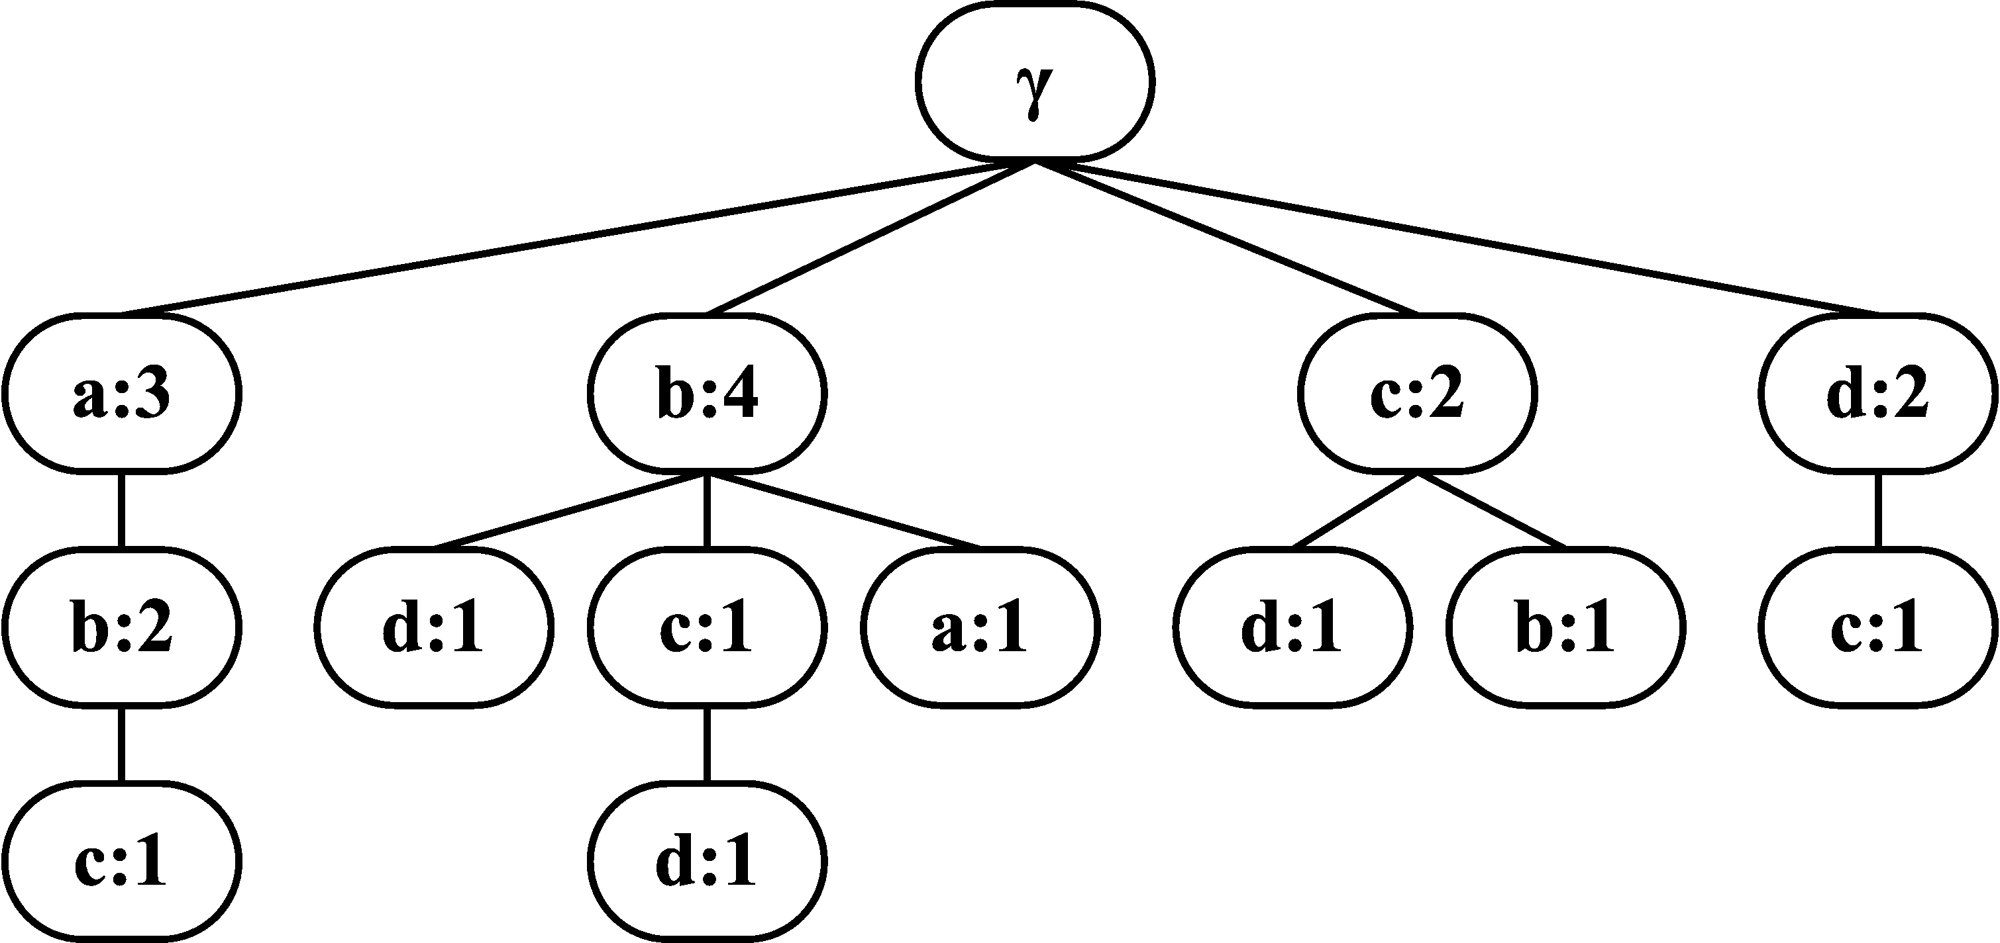
LZ algorithms at a glance
LZ PREDICTION ALGORITHM
c
Learning phase
Prediction phase
…cab
d
d
0.8
b
0.1
a
0.05
November 2013
Alicia Rodriguez-Carrion

Slide 34
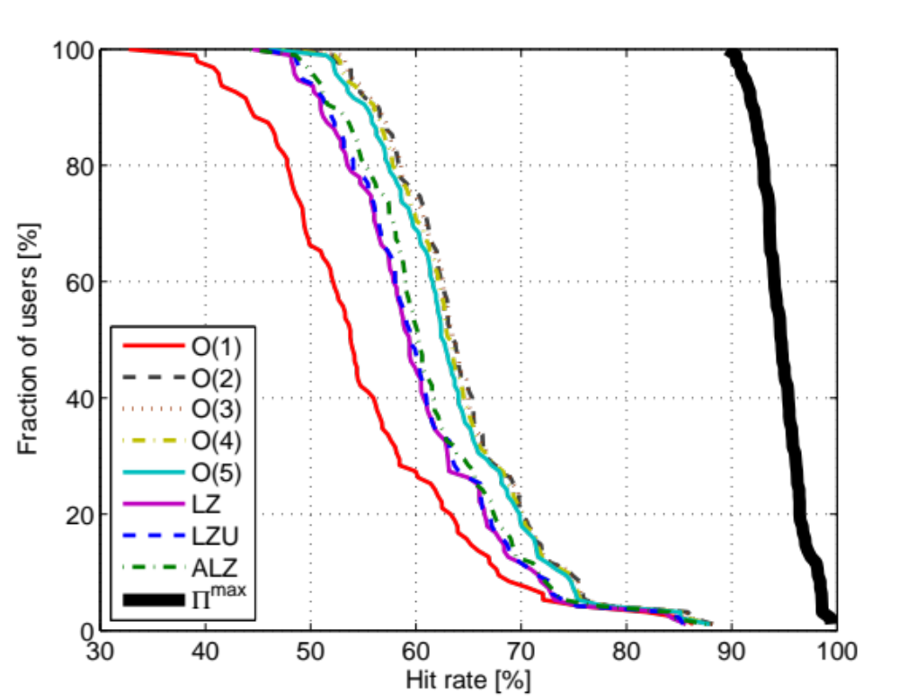
Current results
70% of population have 60% of correct predictions
November 2013
Alicia Rodriguez-Carrion

Slide 35
How to improve the algorithms
General compression algorithms…
How to tailor them to leverage mobility specific features?
Several approaches
  Neglect unimportant locations (preprocessing step)
  Leverage spatial constraints (adjacent cells)
  Improve entropy estimation (learn better)
November 2013
Alicia Rodriguez-Carrion

Slide 36
Conclusions
Many data collection technologies and procedures. Best one depends on application
Extensive set of mobility aspects can be extracted from mobile records, at collective, individual and region levels
Mobility prediction algorithms can be improved with the features extracted, with an analytical upper bound for accuracy
November 2013
Alicia Rodriguez-Carrion

Slide 37
Thank you!
Human mobility predictability
Alicia Rodriguez-Carrion
E-mail: arcarrio@it.uc3m.es
Web page: http://www.gast.it.uc3m.es/~acarrion
November 2013
Alicia Rodriguez-Carrion

Slide 38
References
[1] K. Lee, S. Hong, S. J. Kim, I. Rhee and S. Chong. SLAW: A mobility model for human walks. In Proceedings of the 28th Annual Joint Conference of the IEEE Computer and Communications Societies (INFOCOM), 2009
[2] I. Rhee, M. Shin, S. Hong, K. Lee and S. Chong. On the Levy-Walk nature of human mobility. In Proceedings of the IEEE Conference on Computer Communications, pp. 924–932, 2008
[3] L. Bengtsson, X. Lu, A. Thorson, R. Garfield and J. Schreeb. Improved response to disasters and outbreaks by tracking population movements with mobile phone network data: A Post-Earthquake geospatial study in Haiti. PLoS Med, 8(8), 2011
[4] P. Wang, M. C. Gonzalez, C. A. Hidalgo, and A.-L. Barabasi. Understanding the spreading patterns of mobile phone viruses. Science, 324, 2009
[5] H. Eubank, S. Guclu, V. S. A. Kumar, M. Marathe, A. Srinivasan, Z. Toroczkai, and N. Wang. Controlling Epidemics in Realistic Urban Social Networks. Nature, 429, 2004
[6] M. Satyanarayanan. Pervasive computing: vision and challenges. IEEE Personal Communications, 8(4), pp.10–17, 2001.
November 2013
Alicia Rodriguez-Carrion

Slide 39
References
[7] A. Sridharan and J. Bolot. Location patterns of mobile users: A large-scale study. In Proceedings of INFOCOM 2013, pp. 1007-1015, 2013
[8] R. Kitamura, C. Chen, R. M. Pendyala and R. Narayanan. Micro-simulation of daily activity-travel patterns for travel demand forecasting. Transportation, 27(1), pp. 25-51, 2000
[9] J.-K. Lee and J. C. Hou. 2006. Modeling steady-state and transient behaviors of user mobility: formulation, analysis, and application. In Proceedings of the 7th ACM international symposium on Mobile ad hoc networking and computing (MobiHoc '06), pp. 85-96, 2006
[10] C. Song, Z. Qu, N. Blumm, and A.-L. Barabási. Limits of Predictability in Human Mobility. Science, 327(5968), pp. 1018-1021, 2010
[11] C. Song, T. Koren, P. Wang and A.-L. Barabási. Modelling the scaling properties of human mobility, Nature Physics, 6, pp. 818–823, 2010
[12] M. C. González, C. A. Hidalgo and A.-L. Barabási. Understanding individual human mobility patterns. Nature, 453, pp. 779-782, 2008
[13] L. Song, D. Kotz, R. Jain and X. He. Evaluating Next-Cell Predictors with Extensive Wi-Fi Mobility Data. IEEE Transactions on Mobile Computing, 5(12), pp. 1633-1649, 2006
November 2013
Alicia Rodriguez-Carrion

Slide 40
References
[14] A. Bhattacharya and S. K. Das. 2002. LeZi-update: an information-theoretic framework for personal mobility tracking in PCS networks. Wireless Networks 8(2/3), pp. 121-135, 2002
[15] K. Gopalratnam and D.J. Cook. Online Sequential Prediction via Incremental Parsing: The Active LeZi Algorithm. IEEE Intelligent Systems, 22(1), pp. 52-58, 2007
[16] A. Rodriguez-Carrion, C. Garcia-Rubio, C. Campo, A. Cortés-Martín, E. Garcia-Lozano and P. Noriega-Vivas. Study of LZ-Based Location Prediction and Its Application to Transportation Recommender Systems. Sensors, (12), pp. 7496-7517, 2012
November 2013
Alicia Rodriguez-Carrion

