Slide 1

Clinical Data Storage
Making Informed Technology Choices
Vaibhav Kulkarni, Data Engineering Lead – Debiopharm PhD, Computer Science Vaibhav.Kulkarni@debiopharm.com vaibhav90.github.io
BioTechX, Basel, Oct 5, 2023
background image source: https://www.heise.de/

Slide 2
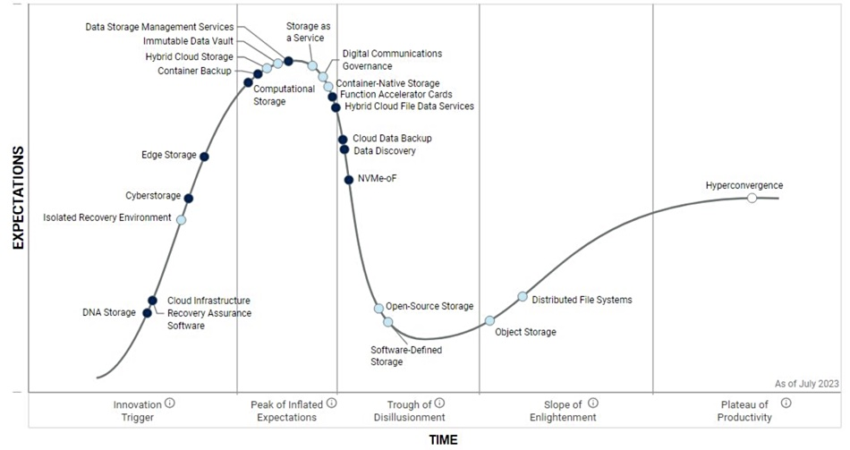
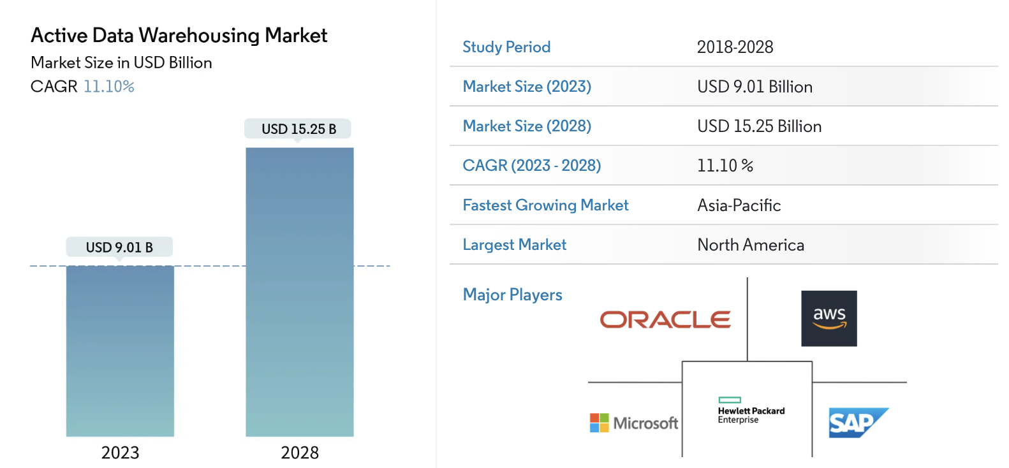


Building Future-Ready Clinical Data Storage Solutions
Data Centralization: Transform raw data into actionable insights
Innovation Catalyst: Expedite AI-driven drug discovery process
exponential data growth pushes data-store technologies on top of the hype cycle
market shift: Increased data, advanced intelligence
sources
https://www.gartner.com/en/documents/4009950
https://www.mordorintelligence.com/industry-reports/

Slide 3
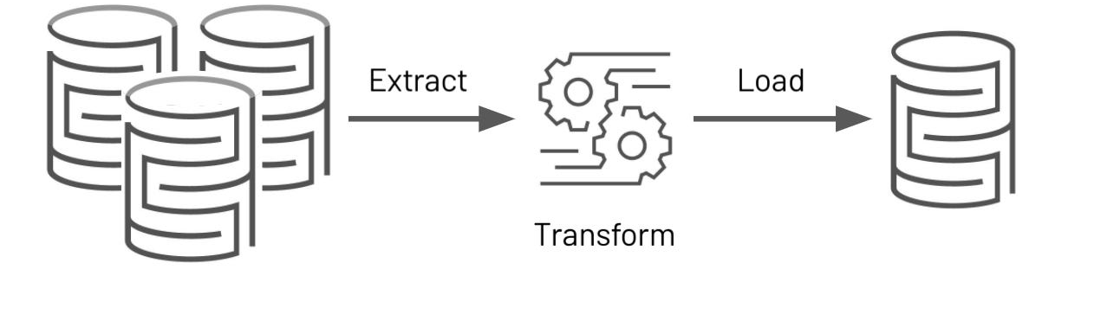
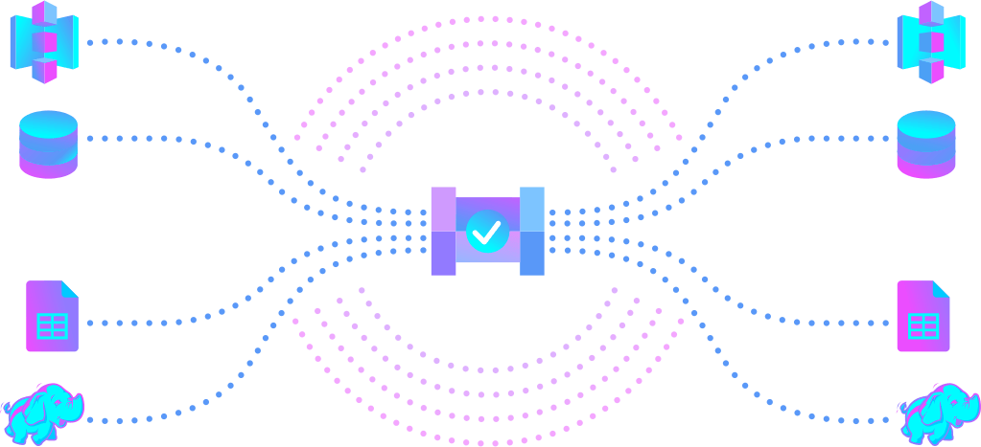

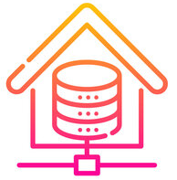
Building Clinical Data Storage: Key Components
source data providers
data quality
data destination
data pipeline
data quality
data storage

Slide 4


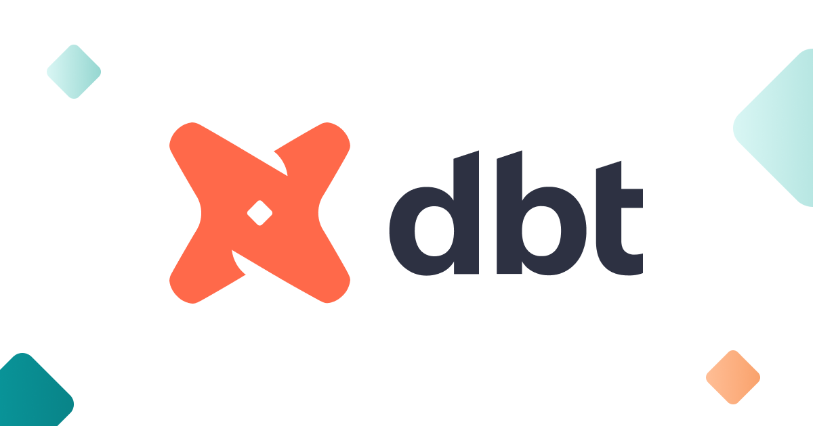


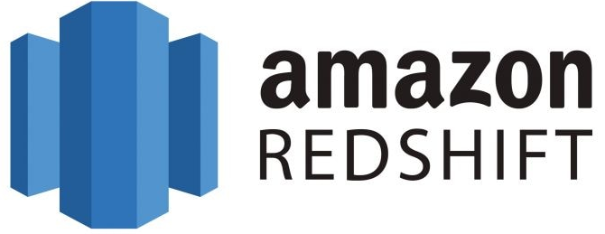






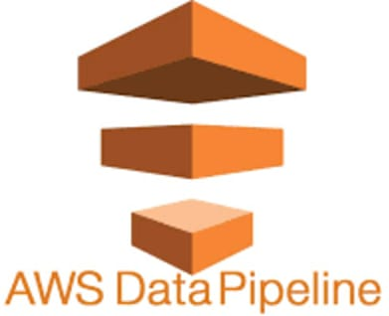


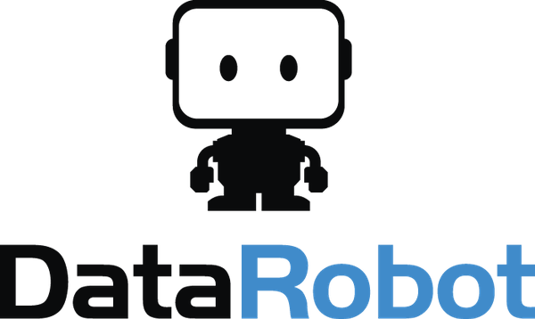







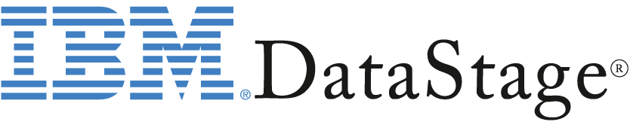










Clinical Data Warehouse Architecture – Today’s Landscape
Data Pipeline
Data Quality
Data Storage
Data sources: https://stackoverflow.com https://news.ycombinator.com
https://dev.to/
https://www.reddit.com/r/dataengineering/
data available here: https://github.com/vaibhav90/biotechX-CDW-Tech-Choices

Slide 5

Architecting Data Warehouse - Decision Areas
data quality
Data collected from stackoverflow Question, Answers, Reputation
Tags #data-warehouse #clinical-data-storage
#healthcare-data-store
#etl-pipelines
#elt-pipelines
#data-lake storage
6000
performance & scalability
data injestion type
data source diversity
4000
data-Processing Frequency
infrastructure & deployment model
data governance & security
2000
flexibility & future proofing
analytics platforms connection
budget & team composition
2015
2018
2023

Slide 6
Technology Selection - Metrics
Cost Efficiency 💰 Setup & licensing
Operational costs
Implementation Ease 🚀 Setup & integration time
User interface & experience
Flexibility & Scalability 🛠️ Adaptability & customization
Workload response
Security & Compliance 🔒 Compliance Security & user access
Maintenance & Support 🧰
Update frequency Customer support
Community engagement

Slide 7

How to decide on a tech-stack? Can a data-driven methodology answer this question?
Data pipeline
Data quality checks
Data storage
Aimed to provide a data-backed recommendation, eliminating biases & focusing on real-world performance & fit

Slide 8
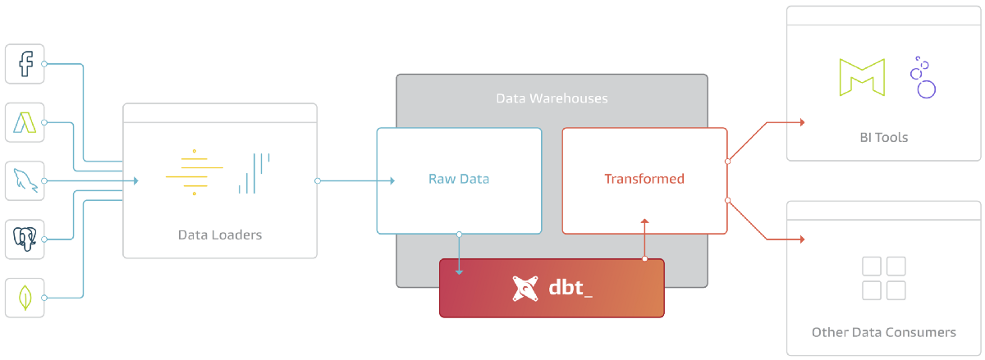
Low effort Data Warehousing Tech-Stack
💰💰 | 🚀 🚀 🚀 | 🛠️ | 🔒 🔒 | 🧰 🧰 🧰 |
Enable data integration from common data sources to facilitate seamless querying for data analysts
stitch - cloud-native ETL platform offering seamless integrations and rapid deployment
dbt - streamlines data modelling with built-in quality tests and an intuitive design

Slide 9
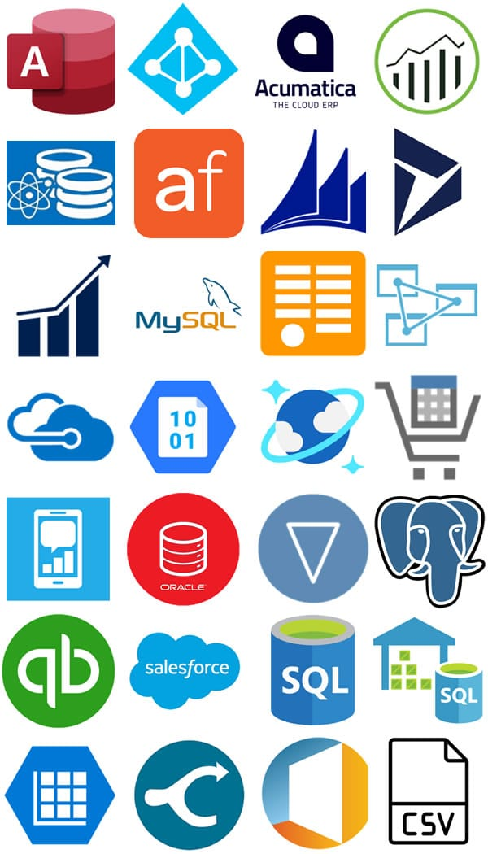

Complex data source configuration
💰 | 🚀 🚀 | 🛠️ 🛠️ 🛠️ | 🔒 🔒 | 🧰 🧰 |
airflow is suited for complex, programmable workflow management where customization is key
stitch is a good choice for simpler, out-of-the-box data replication with less setup & maintenance

Slide 10
Strict regulatory compliance & entreprice grade security
| 💰 💰 | 🚀 🚀 | 🛠️ | 🔒 🔒 🔒 | 🧰 🧰 🧰 |
Integrated with your cloud ecosystem
Serverless environment and support
Built-in monitoring and management
Global reach, security, time-to market

Slide 11
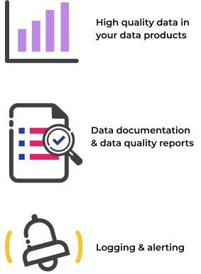
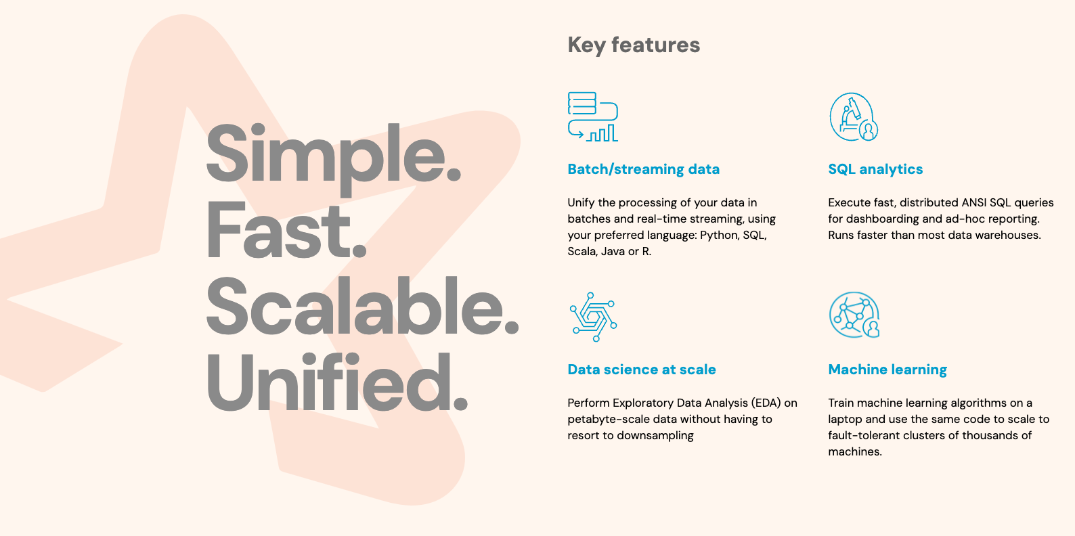
Complex data quality checks & scalable transformations
| 💰 | 🚀 🚀 | 🛠️ 🛠️ 🛠️ | 🔒 🔒 | 🧰 🧰 |

Slide 12
Data storage
Structured Data
Semi-structured Data
Un-structured Data

Slide 13
What have I learnt over the years?
No universally correct solution; solutions must fit the business problem, domain, & team
Obsession with architecture is misplaced; tools/services are secondary
Quality of code (SQL, Python, Spark, etc.) is crucial; poor code leads to issues
Organizations overemphasize high-level decisions because they feel important and are easier
Real challenge: understanding and defining business problems
Tool choice (DBT, Airflow, Snowflake, etc.) is secondary; most can solve your problem
Focus on the problem the team is addressing; engage with business partners; avoid assumptions
Experience is beneficial, but absolute certainty is rare in the field.

