Slide 1
CAR PRICE PREDICTION PROJECT
Data Scientist Name: Vaibhav Tayade
Date: 11-10-2021
(Submited as a part of internship projects)

Slide 2
Aknowledgement
Special thanks to Sapna Verma madam for guiding me for this project.
And also thanks to Deepika Sharma madam, for teaching us this skills to perform data analysis.
This project is submitted to fliprobo company as a part of internship projects.

Slide 3
INTRODUCTION
We have seen lot of changes in the car market. Second hand cars market is on rise globally because of inflation and also because of new technological changes happening around the market. With the eve of Electric Cars and their related regulations many people think twice before investing in new car that’s also one of the reason in second hand cars market rise. With the change in market due to Covid 19 impact, our client is facing problems with their previous car price valuation machine learning models. So, they are looking for new machine learning models from new data. We have to make car price valuation model. This project contains two phase.
Data Collection Phase: In this phase we have gathered used cars data from the cars selling website using web scrapping techniques.
Model Building Phase: In this phase we have worked on machine learning model building process.

Slide 4
Steps Perfomed in Data Analysis
Phase 1) - Data Collection
Phase 2) - Model Building
1) Data Cleaning
2) Exploratory Data Analysis
3) Data Visualization
4) Outliers and Skewness
5) Studying Correlation matrix
6) Label Encoding the categorical data
7) Scaling the Dataset
8) Train-Test Split
9) Machine Learning model building
11) Checking Accuracy of all the model
12) Saving the model.

Slide 5
Data Collection
Data Collection is done using selenium and beautiful soup web scrapping libraries.
We have used www.olx.com website for data collection.
We have collected almost 4120 cars data from the website.
We have collected Cars Model name which included Car’s manufacturer name, model name, manufacturing data, kilometers ran, city and suburb together, Car’s Estimated price with respect to their owner.
We will clean this dataset in the phase 2 of the project and create differect useful columns from it.
We save this extracted dataset in csv format file for further phase 2 use.

Slide 6
Phase 2) - Model building
Data Cleaning:
Data cleaning is a very important step because many times data contains Null values or ‘0’ values, we need to deal this values so that it doesn’t hamper our model building in the end.
We replaced Null values with mode values of the ‘Fuel’ columns where we found many null values with respect to its dataset types.
We ensured there are no Null values left by plotting heatmap again.
We extracted different datasets from the old data, we created Car Manufacturer column and Car Model name from the old car name column, We extracted ‘YearsOld’ i.e. age of the car from the Manufacturing Date of the car, we extracted ‘Fuel’ type from the dataset, we extracted Main City and Suburb separate columns from the old city column.
We converted Categorical columns to numerical colums.

Slide 7
Exploratory Data Analysis
We checked for outliers and skewness using box plot and dist plot, we found out that all the nuemerical columns has Outliers and skewness in it.
We worked on Outliers removing techniques like Z-score method.
We worked on removing the outliers which came out to be approx. 3% of the dataset which is fine and very much in limit.

Slide 8
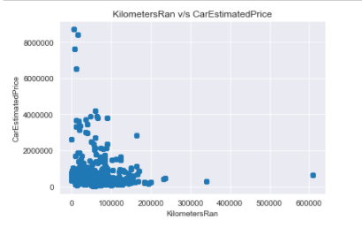
Exploratory Data Analysis
We worked on data analysis using various different types of plots like violin plot, line plot, lm plot, median line plot, count plot, swarm plot, strip plot, scatter plot and pair plot.
We can see from the scatter plot shown above that kilometersRan column is inversely proportional to the CarEstimatedPrice column. Less the KilometerRan value medium to high the price is while High the value of KilometersRan column is Less the price.

Slide 9
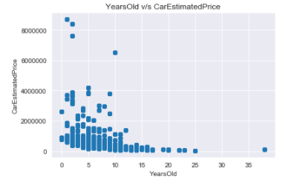
Exploratory Data Analysis
We can see from the scatter plot shown above that YearsOld column is inversely proportional to the CarEstimatedPrice column. Less the YearsOld value High the value of CarEstimatedPrice column.

Slide 10
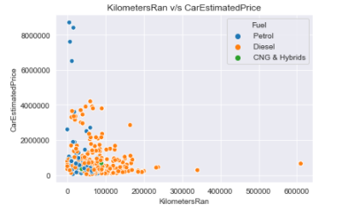
Exploratory Data Analysis
We can see from the scatter plot shown above that KilometersRan column is inversely proportional to the CarEstimatedPrice column. Petrol cars are highly priced than the Diesel Cars and CNG-Hybrid cars are least priced.

Slide 11
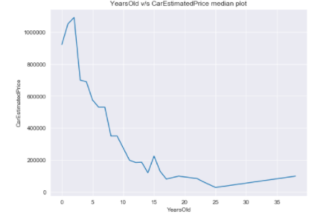
Exploratory Data Analysis
We can see that from the above median plot, YearsOld column is inversely proportional to CarEstimatedPrice column. We can see the declining of the prices as years increases.

Slide 12
Model Building Pipeline
Label Encoding the dataset: We Label Encode the categorical data columns like ‘CarManufacturer’, ‘Model’, ‘Fuel’, ‘MainCity’, ‘Suburb’, so that we can work on model building process smoothly.
Scaling the dataset: Scaling is much important to get all the dataset values in same scale. It improves the model predicting performances.
Train Test Dataset making: We kept 80% dataset for training the model and 20% dataset for testing the model.
Model Making Process: We in this project tried to build 6 different types of model to understand the model dataset and model predicting accuracy of the mode.

Slide 13
Model Making
Linear Regression: LinearRegression Model has shown accuracy score of 22.95%
Lasso regression (regularization): Lasso regression model has shown accuracy of 22.95%
Ridge regression (regularization): Ridge Regression model has shown accuracy of 22.95%
ElasticNet Regression: ElasticNet Regression model has shown accuracy of 22.95%
Random Forest Regression: Random Forest Regression model has shown accuracy of 99.96%
Support Vector Regression: Support Vector Regression model has shown negative accuracy results.
Ada Boost Regression: Ada Boost Regression model has shown accuracy of 52.83 %
Observation:
After checking all model’s accuracy score and cross validation score and also their errors, we found out that Random Forest Regression model seems to be the best model, as it has good accuracy score and least error comparatively. The difference between the accuracy score and cross validation score is also minimal which indicates less over fitting in the model. So we selected Random Forest regression model as our final model.

Slide 14
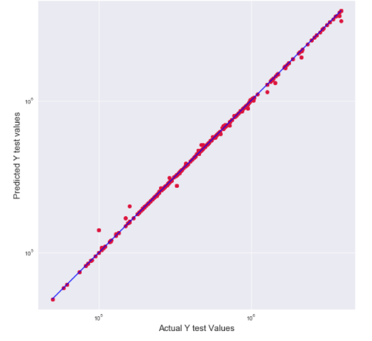
Observations
We checked the scatter plot of y_test dataset and model’s predicted y_test dataset, we found out that all the points falls in same line which indicates the good model building.

Slide 15
Conclusions
How many Kilometers has car ran is inversely proportional to Car’s Estimated price.
How many years old the car is inversely inversely proportional to Car’s Estimated price.
Petrol Cars are usually high priced than Diesel cars and then CNG-Hybrid cars.
Most of the cars are priced between 0 to 4 lakhs and in that too between 0 to 2 lakhs.
Cars more than 15 years old, are very much less priced.
Random Forest Regression model seems to be the best fit model as its showing less overfitting, verified by cross validation score.
Random Forest Regression model is showing accuracy of 99.96%

Slide 16
THANK YOU

