Slide 1
FLIGHT PRICE PREDICTION PROJECT
Data Scientist Name: Vaibhav Tayade
Date: 28-10-2021
(Submited as a part of internship projects)

Slide 2
Aknowledgement
Special thanks to Sapna Verma madam for guiding me for this project.
And also thanks to Deepika Sharma madam, for teaching us this skills to perform data analysis.
This project is submitted to fliprobo company as a part of internship projects.

Slide 3
INTRODUCTION
Flights Price prediction is seems to be very tricky because most of the website are dynamic in nature i.e. they have dynamic pricing depanding on users available on that particular timing of bookings. Here in this project we’ll use various machine learning techniques to make flight prediction price model.
Data Collection Phase: In this phase we have gathered flights routes and fares data from the tourist websites like yatra.com, easemytrip.com using web scrapping techniques.
Model Building Phase: In this phase we have worked on machine learning model building process.

Slide 4
Steps Perfomed in Data Analysis
Phase 1) - Data Collection using web scraping techniques.
Phase 2) - Model Building
1) Data Cleaning
2) Exploratory Data Analysis
3) Data Visualization
4) Outliers and Skewness
5) Studying Correlation matrix
6) Label Encoding the categorical data
7) Scaling the Dataset
8) Train-Test Split
9) Machine Learning model building
11) Checking Accuracy of all the model
12) Saving the model.

Slide 5
Data Collection
Data Collection is done using selenium and beautiful soup web scrapping libraries.
We have used www.easemytrip.com website for data collection.
We have collected almost 1571 rows of data from the website.
We have collected informations like Date of the flight, Airway carrier, flight departure timings, flight arrival timings, fromcity, tocity, flight price.
We will clean this dataset in the phase 2 of the project and create different useful columns from it.
We save this extracted dataset in csv format file for further phase 2 use.

Slide 6
Phase 2) - Model building
Data Cleaning:
Data cleaning is a very important step because many times data contains Null values or ‘0’ values, we need to deal this values so that it doesn’t hamper our model building in the end.
We found out that there are no Null values in our dataset using heatmap.
We extracted different datasets from the old data, we created Date and Month column and Flight_departs_timings in hours column, Flight_departs_timings in mins column, Flight_destination_arrival_timings in hours column and Flight_destination_arrival_timings in minutes columns.
We created flight price which was earlier in categorical form to numerical data type form.
We converted Categorical columns to numerical colums.

Slide 7
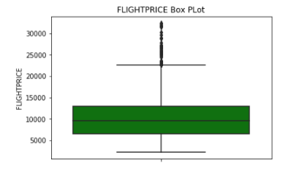
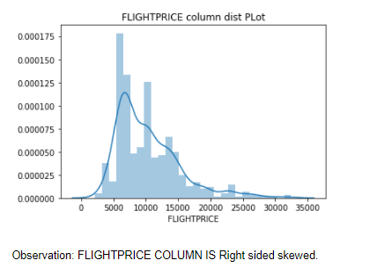
Exploratory Data Analysis
We checked for outliers and skewness using box plot and dist plot, we found out that flight price column has Outliers and skewness in it.
We worked on Outliers removing techniques like Z-score method.
We worked on removing the outliers which came out to be approx. 2.03% of the dataset which is fine and very much in limit.

Slide 8
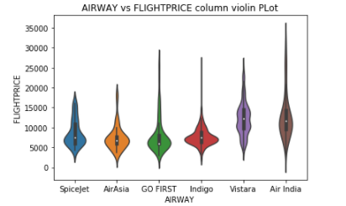
Exploratory Data Analysis
We worked on data analysis using various different types of plots like violin plot, scatter plot etc.
We can see from the violin plot shown above that Air India is having maximum flight price range while Spicejet, Air Asia and Indigo airlines having least flight price range.

Slide 9
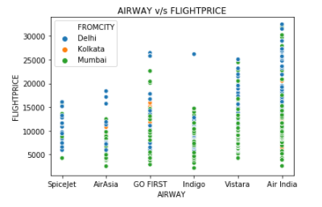
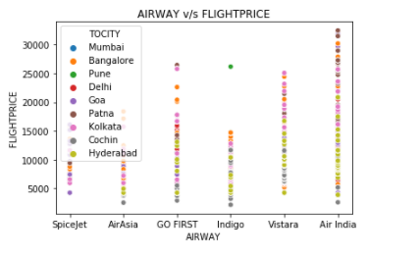
Exploratory Data Analysis
We can see from the scatter plot shown above that AirIndia having maximum flight price range and Delhi city is having expensive flights among other cities. Mumbai is second expensive after delhi

Slide 10
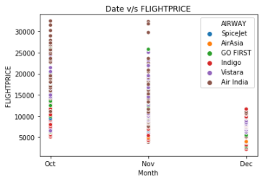
Exploratory Data Analysis
We can see from the scatter plot shown above that October being current month is having Most expensive flights, while November being near future month having second highest expensive flight prices and December being far future month having least expensive flight prices.

Slide 11
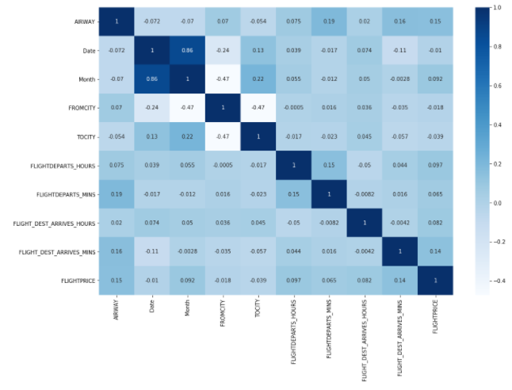
Exploratory Data Analysis
Observation: From the above heatmap of correlation matrix, we can make out that, Airway is having highly correlation with the Flight price with 0.15 units while FLIGHT_DEST_ARRIVES_MINS having 0.14 units of correlation. so we can say that Airway and Flight_Dest_Arrives_mins column is having highly correlation with the flight price.

Slide 12
Model Building Pipeline
Label Encoding the dataset: We Label Encode the categorical data columns like ‘Airway’, ‘Month’, ‘FromCity’, ‘ToCity’ so that we can work on model building process smoothly.
Scaling the dataset: Scaling is much important to get all the dataset values in same scale. It improves the model predicting performances.
Train Test Dataset making: We kept 80% dataset for training the model and 20% dataset for testing the model.
Model Making Process: We in this project tried to build 7 different types of model to understand the model dataset and model predicting accuracy of the mode.

Slide 13
Model Making
Linear Regression: LinearRegression Model has shown accuracy score of 9%
Lasso regression (regularization): Lasso regression model has shown accuracy of 9%
Ridge regression (regularization): Ridge Regression model has shown accuracy of 9%
ElasticNet Regression: ElasticNet Regression model has shown accuracy of 9%
Random Forest Regression: Random Forest Regression model has shown accuracy of 94%
Support Vector Regression: Support Vector Regression model has shown negative and less positive accuracy results.
Ada Boost Regression: Ada Boost Regression model has shown accuracy of 38.71%
Decision Tree Regression: Decision Tree regression model has shown accuracy of 99%.
Observation:
After checking all model’s accuracy score and cross validation score and also their errors, we found out that Ada Boost Regression model seems to be the best model, as it has good accuracy score and least error comparatively. The difference between the accuracy score and cross validation score is also minimal which indicates less over fitting in the model. So we selected Ada Boost regression model as our final model.

Slide 14
Conclusions
Air India is the most expensive flight.
Spice Jet , Air Asia, Indigo seems to be cheapest flights.
More nearner the journey date maximum the flight price.
Farer the journey date least the flight price.
Most of the expensive flights are from Delhi and then secondmost expensive are from Mumbai.
Least the Journey time, expensive the flight price.
Ada Boost Regression model seems to be the best fit model as its showing less overfitting, verified by cross validation score.
Ada Boost Regression model is showing accuracy of 38.71%.

Slide 15
THANK YOU

