Slide 1
r
DBConnection
r
Timer
r
SMS Sender
r
Start
SMS Receiver
r
Send Test SMS
r
Receive SMS
r
Agent

Slide 2


Connect
Project Briefing to NetApp-ATG
~ Vaibhav Jain
Project
Lotus

Slide 3
Agenda
1. Aboute Me
2. Demo
3. Deconstructing the Demo
4. Introducing Connect-Toolkit

Slide 4
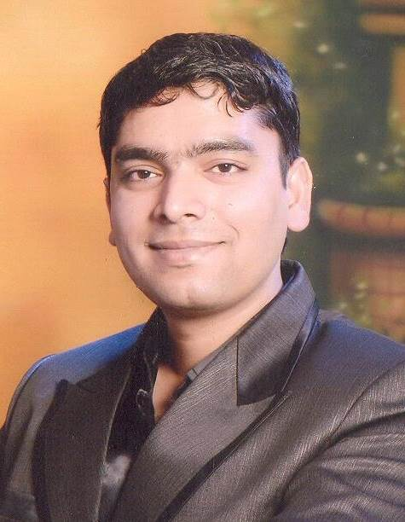
Professional Profile
About 7 Years of professional experience in developing complex applications
Have experience in diverse technological spectrums including Mobile/Web/Enterprises.
Presently working at EMC Corporation on their flagship Networker/Avamar products.
In the past have worked for Nokia for their N8 of mobile device. Worked on its S60 Web Browser based on the Apple Webkit.
Worked as an intern/engineer at Impetus iLabs based in Indore.

Slide 5
Personal Profile
Graduated with Masters in Computer Applications from S.G.S.I.T.S, Indore - 2007
A self confessed geek who wrote his first code at the age of 12
Love tinkering with both hardware/software
Have founded and worked in a small startup called “Intellective-Solutions” that used to publish shareware software.
In the past have taught computers & mathematics to school kids and adults.

Slide 6
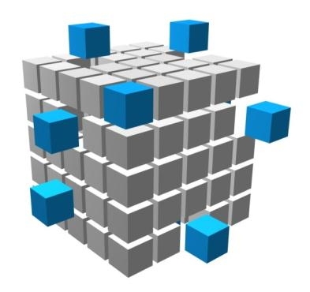

Current Assignment
“ A new Block Based Backup feature for file systems that really screams, eliminating the walk of high density file systems and the creation of an index… yet, enables granular level recovery using the new Recovery UI. Best yet, this feature simply ‘comes with’ NetWorker! “- http://goo.gl/jPHcAV
Block Based Backup
Use change block tracking to keep track of changed blocks on the disk.
Incremental backups are very fast as only the changed blocks on the disk are backed up.
Volume backups performed on a PIT snapshot.
Restores are directly mountable on Hyper-V for quick Disaster Recovery.
Own the backup workflow and the block tracking kernel-driver on Linux.

Slide 7
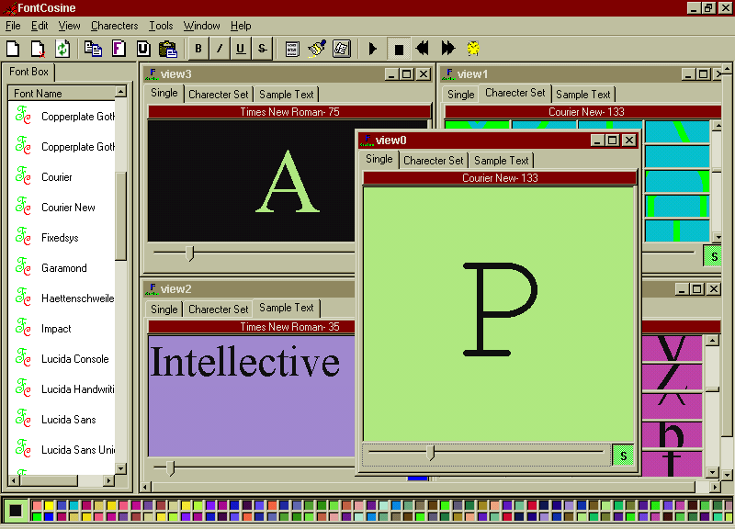
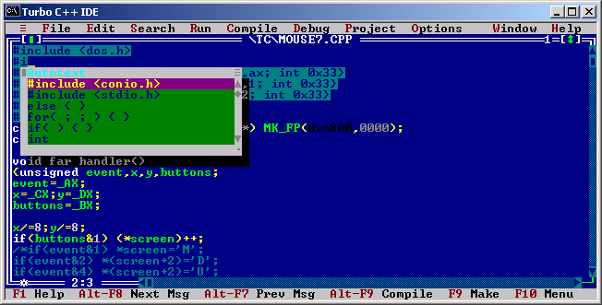

Some Personal Projects
Font Management and Previewing Tool
Shareware – 2000
Auto-Text
Autocomplete for Turbo-C
2004

Slide 8

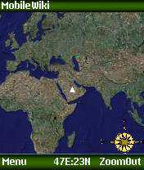
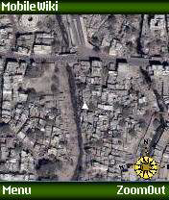
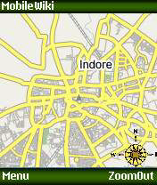
Some Personal Projects
W-Mail
SMS Based Email System for the masses
2006
Mobile Wiki
Geo tagging mobile-app using Google Maps
2007

Slide 9
Demo

Slide 10
Live Message Board
Message
Message
Message
Message
Message
Send your messages to +91-8861229883

Slide 11
Audience Voting
Do you think Apple iOS is better than Android?
Send your opinion to +91-8861229883

Slide 12
Deconstructing the Demo

Slide 13
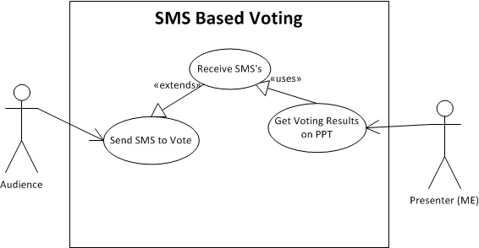
Main Use Cases
This translates to two major implementation challenges:
The system should be able to receive (and send) voting SMSs
  That’s the main functionality
The system should be able display voting results on the PowerPoint slide shown by the presenter.
  Don’t want the presenter to switch to a separate application to perform this use case.

Slide 14
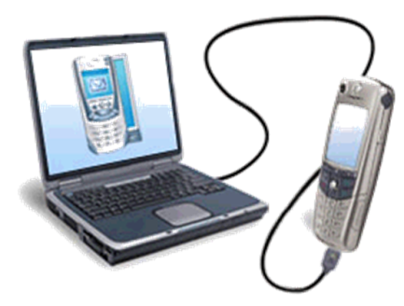
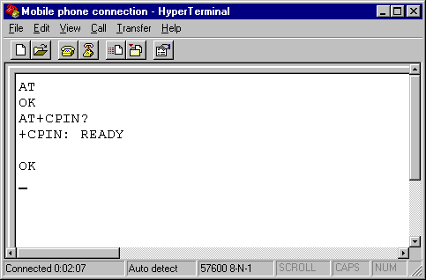
Realizing Use-Case#1
“The system should be able to receive (and send) voting SMS”
DTE
DCE
Sending and Receiving SMSs can be achieved by using a GSM Device.
The desktop essentially sees the GSM device as a Modem which is connected via a Serial port.
Interaction happens when DTE sends AT commands over the link to the GSM Device (DCE).
Send/Receive of SMS messages is achieved using AT command specific to GSM modems. E.g. AT+CMGS to send an SMS.

Slide 15
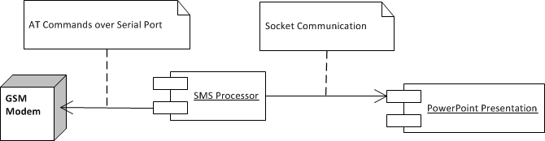
Realizing Use-Case#2
The system should be able display voting results on the PowerPoint slide shown by the presenter.
PowerPoint programmability using Visual Basic for Application.
Elements on a slide can be manipulated via PowerPoint object model.
DCE isn't directly accessed from VBA so as to get a reusable sms processing module.
Communication between SMS Processor and VBA be achieved using TCP-Sockets.

Slide 16
Introducing Connect-Toolkit

Slide 17

Introduction
Connect is a reusable toolkit to send and receive Text message from a GSM phone.
Developed as a part of “Project Lotus” in Jun-2006 which developed a product called WMail.
‘Connect’ was originally just a module for sending and receiving SMSs’.
Demonstrated W-Mail professionally to my first employer Impetus Technologies, who saw some potential. So this toolkit was quickly branched out for use in many other projects.
Finally a standalone component called “Connect-Toolkit” was created to making it easy to reuse.
Connect

Slide 18
Technical Highlights
Very simple to use and build applications around it.
Capable of both sending and receiving sms messages using cheap hardware.
Written completely in Java-SE so can be easily integrated to existing enterprise applications.
Uses javax.comm api’s to communicate over serial port.
Installation & running costs are very small.
Best suited for low volume/temporary systems.
Was implemented using Rational Rose’s Roundtrip Engineering capabilities.

Slide 19
Sample SMS-Echo Server
import smssystem.*;
public class SmsDemo implements SMSReceiver {
private static GSMDevice gm;
public static void main(String args[]) {
gm=new GSMDevice(“COM1”);
gm.addSMSReceiver(new SMSDemo());
}
public void processSMS( SMSMessage msg) {
System.out.println(“New Message From:”+ msg.getMessage());
System.out.println(”Message:“+msg.getPhoneNumber());
gm.sendMessage(msg);
}
}

Slide 20
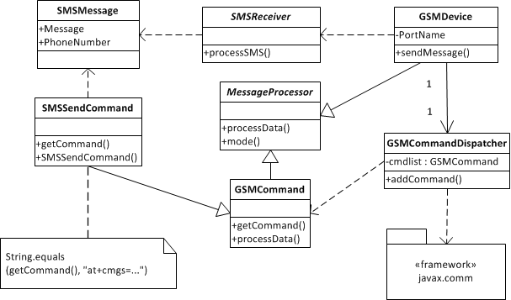
Connect Toolkit Architecture
Uses the Interpreter Pattern to process GSM Commands.
GSM Dispatcher maintains a stack of Message Processors to parse output of various GSM Commands.
In case the command stack is empty then it indicates a DCE notification which is then handled by the GSM Device.

Slide 21
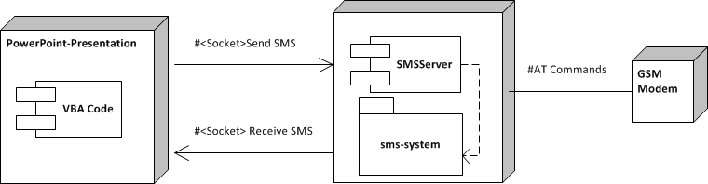
Communication with PowerPoint
Functionality of sms-system package is exposed from a process called SMS-Server.
It exposes two tcp listening sockets which are for sending and receiving smss’ respectively.
Communication protocol is plain text and greatly simplified to have minimum processing overhead in VBA code.
When the slide show starts, the VBA code initiates a socket connection to these two ports.

Slide 22
Processing in PowerPoint
Processing within PowerPoint happens in VBA Code.
The code makes heavy use of VBA features like Classes, Properties, Events and Polymorphism.
Manipulation of Slide show elements is done via PowerPoint Object Model.
Uses Winsock ActiveX controls on a hidden form to communicate with the SMS-Server.
Code is based on clear separation of concerns making it very modular and extensible.
Each dynamic slide is handled by a separate class derived from “SlideHandler”
Every slide handler class has access to sms send/receive functionality.

Slide 23
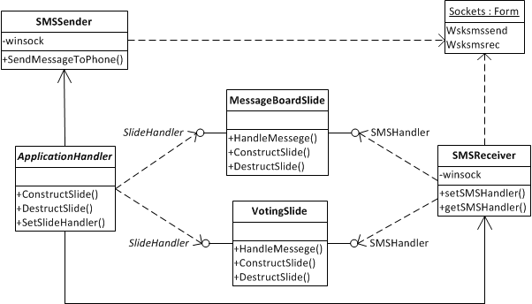
VBA Code Architecture
The ApplicationHandler orchestrates the application and keeps watch on the slide navigation and when a dynamic slide is shown notifies the corresponding SlideHandler instances.
Individual SlideHandler instances can implement the SMSHandler interface to receive SMS Messages.
Receiving/Sending of SMS messages is handled in SMS-Receiver and SMSSender classes respectively.

Slide 24
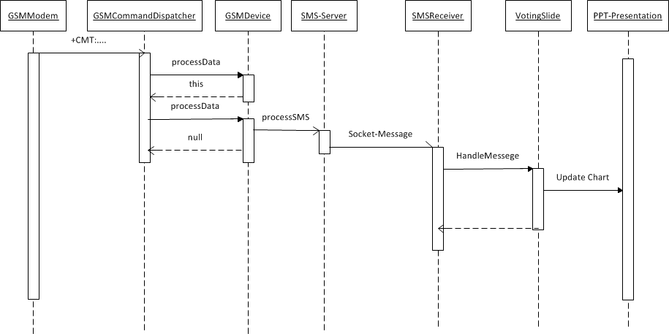
Tying it all together

Slide 25
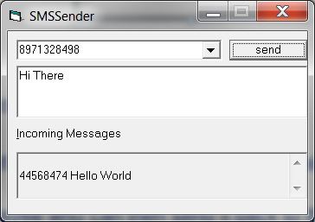
Testing Tool
Testing/Development with live SMS-Server is costly and slow.
  ≈ 30p/SMS in year 2006.
  During peak hours SMS delivery used to be delayed by 10 Minutes.
Solution was to create a SMS-Server emulator
  Just like SMS-Server it used to listen on 2 ports for sending/receiving SMS’s.
  The simple UI would let simulate an incoming sms and display outgoing SMS’s
Was written in Visual Basic 6.0
  It used the same ActiveX controls that were used in VBA code.
  VB 6.0 had an integrated Packaging & Installer Tool which used to deploy the missing ActiveX controls on target system.

Slide 26
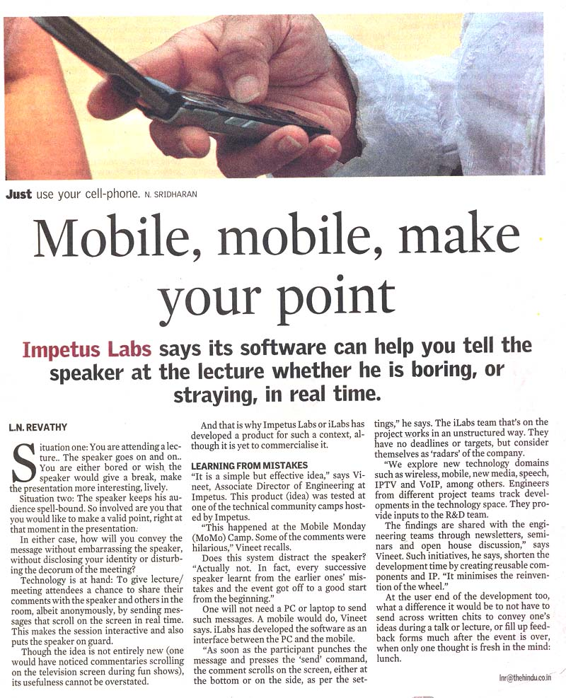

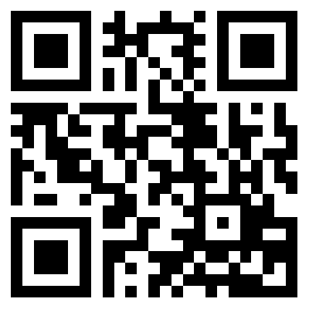
Monday, Sep 10, 2007

Slide 27
Some Other Applications
SMS based mobile currency/payment solution.
  Central server issues currency notes.
  Each currency descriptor is a 20 byte MD5-HMAC followed by plain text value of currency note.
  The currency note is sent to intended payee who can then send it back to the central server for verification/credit.
Blood Donor helpline
  Provides a quick way for people to find donors of a specific blood group.
  A person just need to send a text message like “need blood O+” to the helpline number
  The service will pick 3 random donors of the specific blood group and send it back.
  Donors can also register by sending their blood group in a text message to the helpline number.

Slide 28


mr.vaibhavjain@gmail.com
Thank You
http://blog.vaibhavjain.info

