Slide 1


Project Presentation (KCS 851) Virtual Interactive Board Project ID- PCS24-70
KIET Group of Institutions, Ghaziabad
(An ISO – 9001: 2008 Certified & ‘A+’ Grade accredited Institution by NAAC)
Guide Name: Mrs Arushi Gupta
Project Members Name with Roll Number & Section
1. Vaibhav Mittal (2000290120182) 8C
2. Vaibhav Singh (2000290120183) 8C
3. Sarthak Srivastava (2000290120136) 8 C

Slide 2
Problem Statement
Developing an interface between human hand and the system using open cv techniques and python language to pick the color and draw using hand on the developed drawing area.

Slide 3
Objectives
To create a virtual canvas to sketch.
To detect the human finger as a color marker.
To create an interface between user and the system
Iterative Development and Improvement

Slide 4
Technology Used
• Python
• PyCharm
• MediaPipe
• NumPy
• OpenCV
• GitHub

Slide 5
Literature Survey
Paper title- AN EFFICIENT TOOL FOR ONLINE TEACHING USING OPENCV
Author name- Gangadhara Rao Kommu
Journal Name- International Journal of Creative Research Thoughts (IJCRT)
Year of publishing- 2021
Followed by Summary of papers.- In this study, designing of the hand gesture recognition is one of the complicated job that involves two major problem. Firstly is the detection of hand. Another problem is to create the sign that is suitable to be used for one hand in a time. This project concentrates on how a system could detect, recognize and interpret the hand gesture recognition through computer vision with the challenging factors which variability in pose, orientation, location and scale. To perform well for developing this project, different types of gestures such as numbers and sign languages need to be created in this system. The image taken from the realtime video is analysed via Haar-cascaded Classifier to detect the gesture of hand before the image processing is done or in the other word to detect the appearance of hand in a frame. In this project, the detection of hand will be done using the theories of Region of Interest (ROI) via Python programming. The explanation of the results will be focused on the simulation part since the different for the hardware implementation is the source code to read the real-time input video. The developing of hand gesture recognition using Python and OpenCV can be implemented by applying the theories of hand segmentation and the hand detection system which use the Haar-cascade classifier. The hand gesture recognition using Python and OpenCV can be implemented by applying the theories of hand segmentation and the hand detection system which use the Haar-cascade classifier.

Slide 6
Paper title- Virtual Sketch using Open CV
Author name- Pranavi Srungavarapu, Eswar Pavan Maganti, Srilekkha Sakhamuri, Sai Pavan Kalyan Veerada, Anuradha Chinta
Journal Name- International Journal of Innovative Technology and Exploring Engineering (IJITEE)
Year of publishing- 2021
Followed by Summary of papers-
Virtual Sketch is in where we can draw by just capturing the motion of a colored marker with a camera. One colored object at the tip of the finger is mainly used as the marker. We are here now, using the techniques of computer vision in open cv to build this project. The required language for this project is python due to its more exhaustive libraries and easy to make use of the syntax and but understanding the basics as well as it can be implemented in any open cv supported languages The color tracking and detection processes are used to achieve the goal of this project. The color marker here used is detected and mask is produced. The next steps of morphological operations on the mask produced those are Erosion and Dilation. Erosion makes the impurities present in the mask to get reduced and Dilation further regains the eroded main mask.

Slide 7
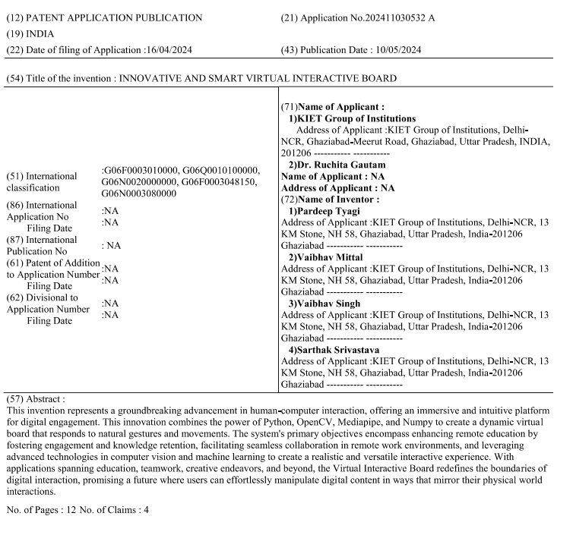
Patent Status
Patent Published.

Slide 8
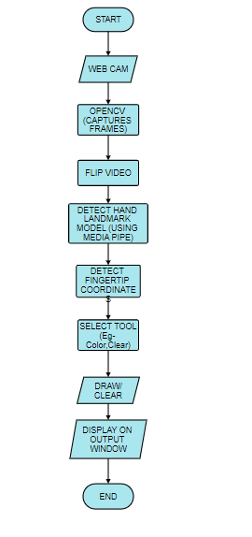
Workflow Diagram

Slide 9
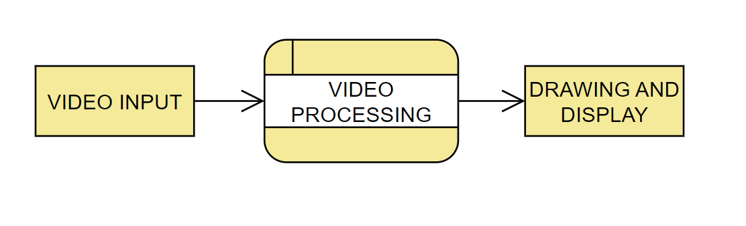
Zero Level DFD

Slide 10
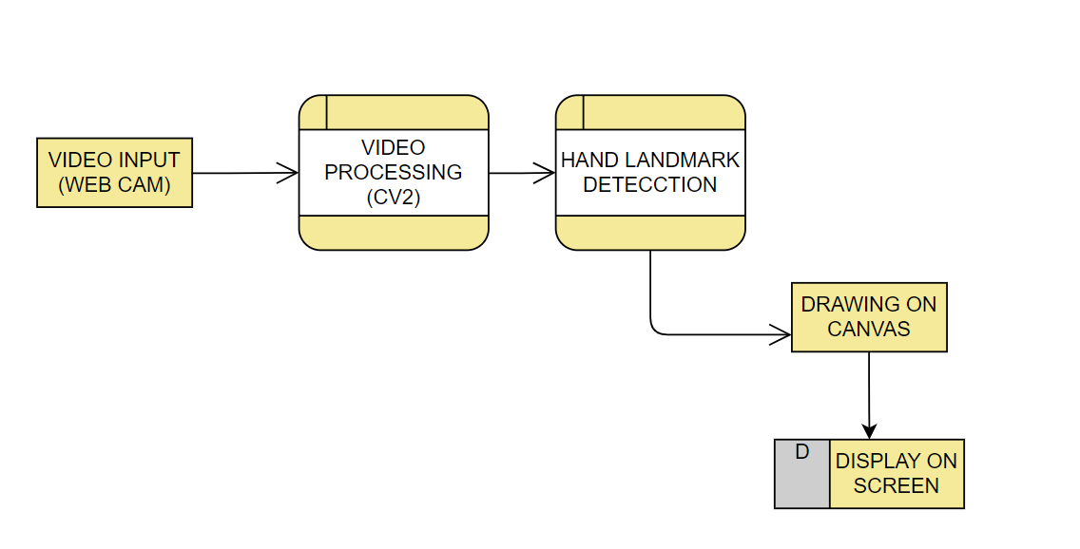
One Level DFD

Slide 11
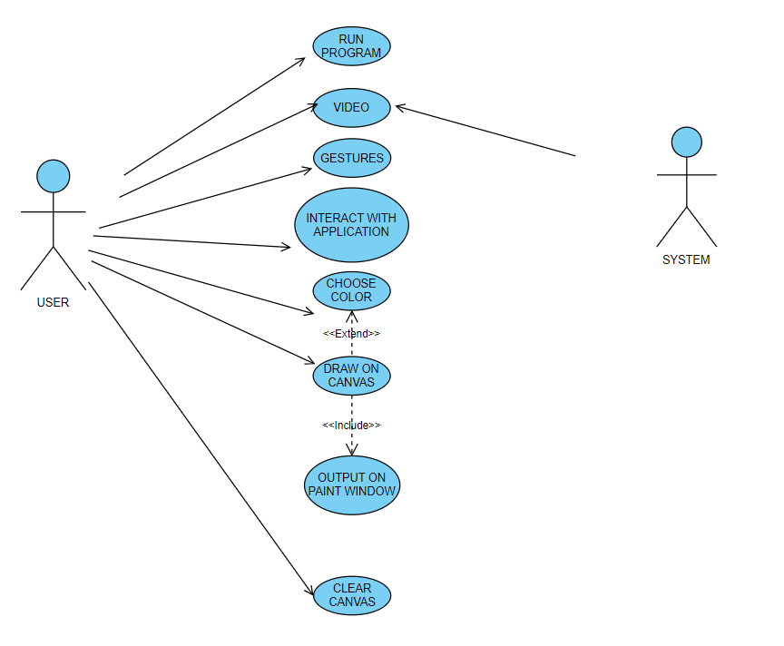
Use Case Diagram

Slide 12
Research Paper Status
Soft copy reviewed by the guide.
Draft completion status- Completed
Submitted in Multiple Conferences, waiting for Acceptance
PAPER

Slide 13
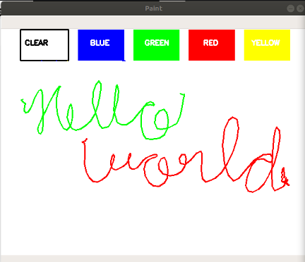
Project Status
Project is 100% implemented.
Working Screenshots

Slide 14
Testing Report
Test Report

Slide 15
References
[1] Vladimir I. Pavlovic, Student Member, IEEE, Rajeev Sharma, Member, IEEE and Thomas S. Huang, Fellow, IEEE “Visual Interpretation of Hand Gestures for HumanComputer Interaction: A Review” VOL. 19, NO. 7, JULY 1997
[2] Gangadhara Rao Kommu, Assistant Professor Department Of Information technology, Chaitanya Bharati Institute of Technology, Hy
[3] Pranavi Srungavarapu, Eswar Pavan Maganti, Srilekkha Sakhamuri, Sai Pavan Kalyan Veerada, Anuradha Chinta “Virtual Sketch using Open CV” International Journal of Innovative Technology and Exploring Engineering (IJITEE) ISSN: 2278-3075 (Online), Volume-10 Issue-8, June 2021
[4] Abdelghafar R. Elshenaway, Shawkat K. Guirguis Department of Information Technology, Institute of Graduate Studies and Research, Alexandria University, Alexandria ,21526, Egypt Corresponding author: Abdelghafar R. Elshenaway “On-Air Hand Drawn Doodles for IoT Devices Authentication During COVID-19.”

