Slide 1

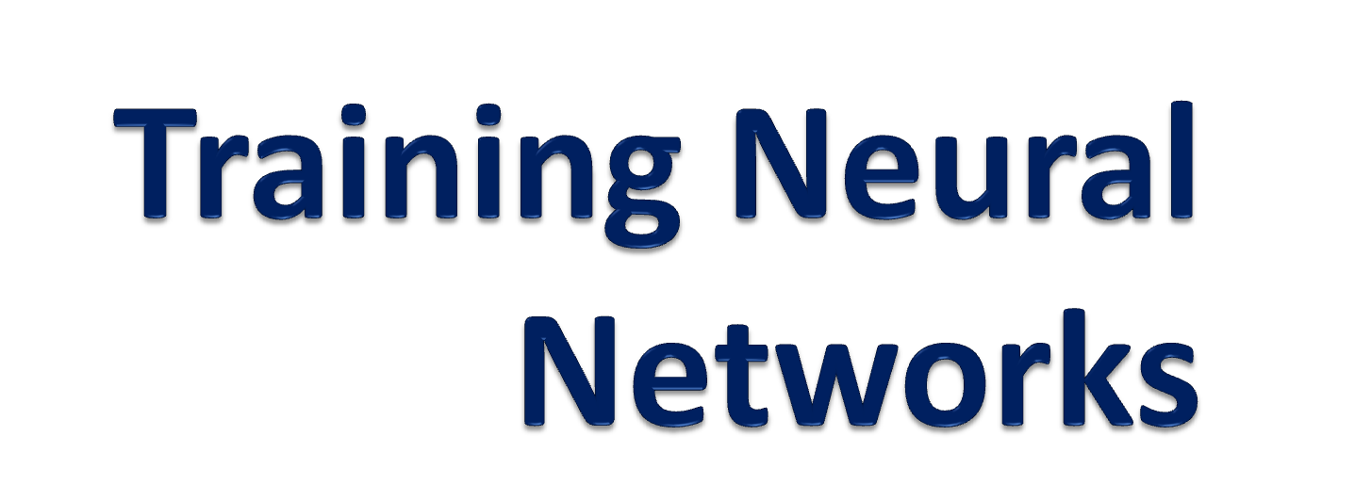

Slide 2
Objective
Introduce fundamental concepts in Artificial Neural Networks
Discuss methods of training ANNs
Explore some uses of ANNs
Assess the accuracy of artificial neurons as models for biological neurons
Discuss current views, ideas and research

Slide 3
Organization
Why Neural Networks?
Single TLUs
Training Neural Nets: Back propagation
Working with Neural Networks
Modeling the neuron
The multi-agent architecture
Directions and destinations

Slide 4
History of Neural Networks
1943: McCullough and Pitts - Modeling the Neuron for Parallel Distributed Processing
1958: Rosenblatt - Perceptron
1969: Minsky and Papert publish limits on the ability of a perceptron to generalize
1970’s and 1980’s: ANN renaissance
1986: Rumelhart, Hinton + Williams present backpropagation
1989: Tsividis: Neural Network on a chip

Slide 5
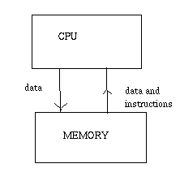
The “Von Neumann” architecture
Memory for programs and data
CPU for math and logic
Control unit to steer program flow

Slide 6
Von Neumann vs. ANNs
Von Neumann
Neural Net
Follows Rules
Solution can/must be formally specified
Cannot generalize
Not error tolerant
Learns from data
Rules on data are not visible
Able to generalize
Copes well with noise

Slide 7
Circuits that LEARN
Three ways of learning:
  Supervised Learning
  Unsupervised Learning
  Reinforcement Learning
Hebbian networks: reward ‘good’ paths, punish ‘bad’ paths
Train neural net by adjusting weights
PAC (Probably Approximately Correct) theory: Kerns & Vazirani 1994, Haussler 1990

Slide 8
LEARNING
Supervised learning or Associative learning in which the network is trained by providing it with input and matching output patterns. These input-output pairs can be provided by an external teacher, or by the system which contains the neural network (self-supervised).

Slide 9
LEARNING
Unsupervised learning or Self-organisation in which an (output) unit is trained to respond to clusters of pattern within the input. In this paradigm the system is supposed to discover statistically salient features of the input population. Unlike the supervised learning paradigm, there is no a priori set of categories into which the patterns are to be classified; rather the system must develop its own representation of the input stimuli.

Slide 10
LEARNING
Reinforcement Learning This type of learning may be considered as an intermediate form of the earlier two types of learning. Here the learning machine does some action on the environment and gets a feedback response from the environment. The learning system grades its action good (rewarding) or bad (punishable) based on the environmental response and accordingly adjusts its parameters. Generally, parameter adjustment is continued until an equilibrium state occurs, following which there will be no more changes in its parameters. The self-organizing neural learning may be categorized under this type of learning.

Slide 11
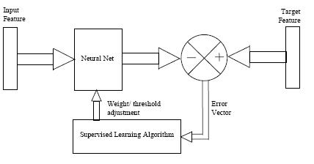

Slide 12
Supervised Learning Concepts
Training set Θ: Input/output pairs
  Supervised learning because we know the correct action for every input in Θ
  We want our Neural Net to act correctly in as many training vectors as possible
  Choose training set to be a typical set of inputs
  The Neural net will (hopefully) generalize to all inputs based on training set
Validation Set: Check to see how well our training can generalize

Slide 13
Examples
Supervised learning :
a) AI learning: Meta-DENDRAL (Buchanan & Mitchell
ID3 (Quinlan)
b) Neural Network learning : Back propagation
Unsupervised learning :
a) AI learning: AM , BACON, Conceptual clustering
b) Neural Network learning : ART

Slide 14
Types of Learning
Rote learning (Memorization)
Direct instruction (by being told)
Analogy
Induction
Deduction

Slide 15
The TLU at a glance
TLU: Threshold Logic Unit
Loosely based on the firing of biological neurons
Many inputs, one binary output
Threshold: Biasing function
Squashing function compresses infinite input into range of 0 - 1

Slide 16
The neuron to the TLU
Cell Body (Soma) = accumulator plus its threshold function
Dendrites = inputs to the TLU
Axon = output of the TLU
Information Encoding:
  Neurons use frequency
  TLUs use value

Slide 17
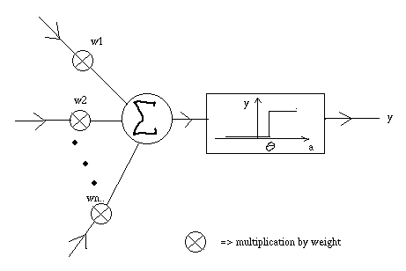
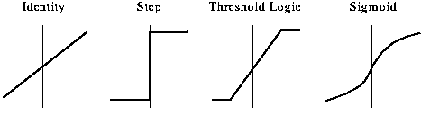
The TLU in Action

Slide 18
Training TLUs: Notation
θ = Threshold of TLU
X = Input Vector
W = Weight Vector
s = X · W
ie: if s ≥ θ, o/p = 1
if s < θ, o/p = 0
d = desired output of TLU
f = output of TLU with current X and W

Slide 19
Augmented Vectors
Motivation: Train threshold θ at the same time as input weights
X ⋅ W ≥ θ is the same as X ⋅ W - θ ≥ 0
Set threshold of TLU = 0
Augment W: W = [w₁, w₂, … w_{n}, -θ]
Augment X: X = [x₁, x₂, .. x_{n}, 1]
New TLU equation: X · W ≥ 0
(for augmented X and W)

Slide 20
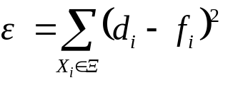
Gradient Descent Methods
Error Function: How far off are we?
  Example Error function:
ε depends on weight values
Gradient Descent: Minimize error by moving weights along the decreasing slope of error
The Idea: iterate through the training set and adjust the weights to minimize the gradient of the error

Slide 21
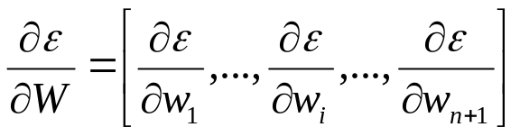
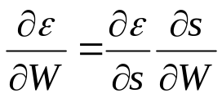
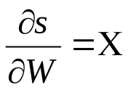
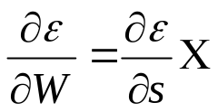
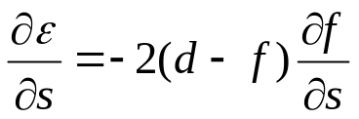
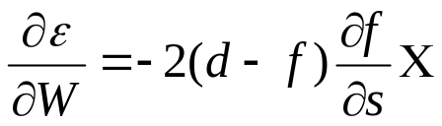
Gradient Descent: The Math
We have ε = (d - f)²
Gradient of ε:
Using the chain rule:
Since , we have
Also:
Which finally gives:

Slide 22
Gradient Descent: Back to reality
So we have
The problem: ∂f / ∂s is not differentiable
Three solutions:
  Ignore It: The Error-Correction Procedure
  Approximate it: The Generalized Delta Procedure

Slide 23
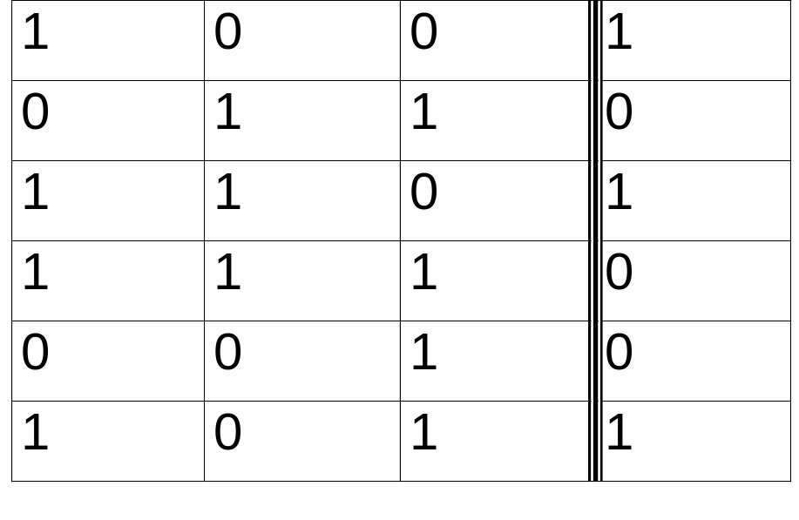
Training a TLU: Example
Train a neural network to match the following linearly separable training set:

Slide 24
Neural Network Fundamentals
Chain multiple TLUs together
Three layers:
  Input Layer
  Hidden Layers
  Output Layer
Two classifications:
  Feed-Forward
  Recurrent

Slide 25

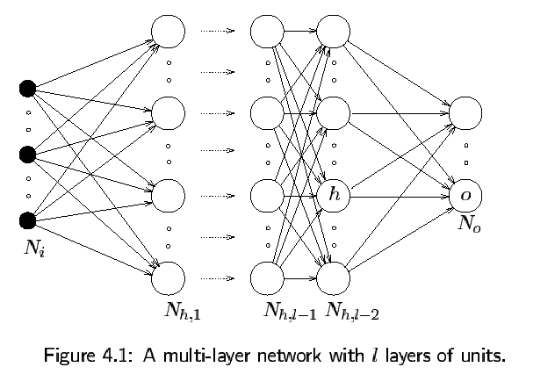

Slide 26
Training ANNs: Backpropagation
Main Idea: distribute the error function across the hidden layers, corresponding to their effect on the output
Works on feed-forward networks
Use sigmoid units to train, and then we can replace with threshold functions.

Slide 27
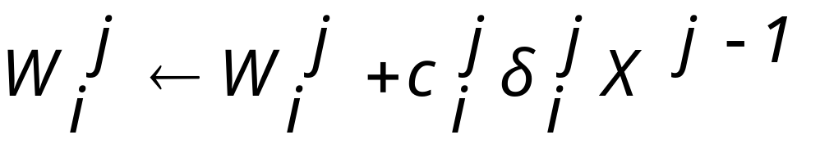
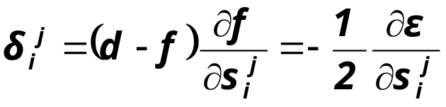
Back-Prop: Sharing the Blame
We want to assign
  W_{i}^{j} = weights of i-th sigmoid in j-th layer
  X^{j-1} = inputs to our TLU (outputs from previous layer)
  c_{i}^{j} = learning rate constant of i-th sigmoid in j-th layer
  δ_{i}^{j} = sensitivity of the network output to changes in the input of our TLU
  Important equation:

Slide 28
Back-Prop: Problems
Learning rate is non-optimal
  One solution: “Learn” the learning rate
Network Paralysis: Weights grow so large that f_{i}^{j}(1-f_{i}^{j}) --> 0, and the net never learns
Local Extrema: Gradient Descent is a greedy method
These problems are acceptable in many cases, even if workarounds can’t be found

Slide 29
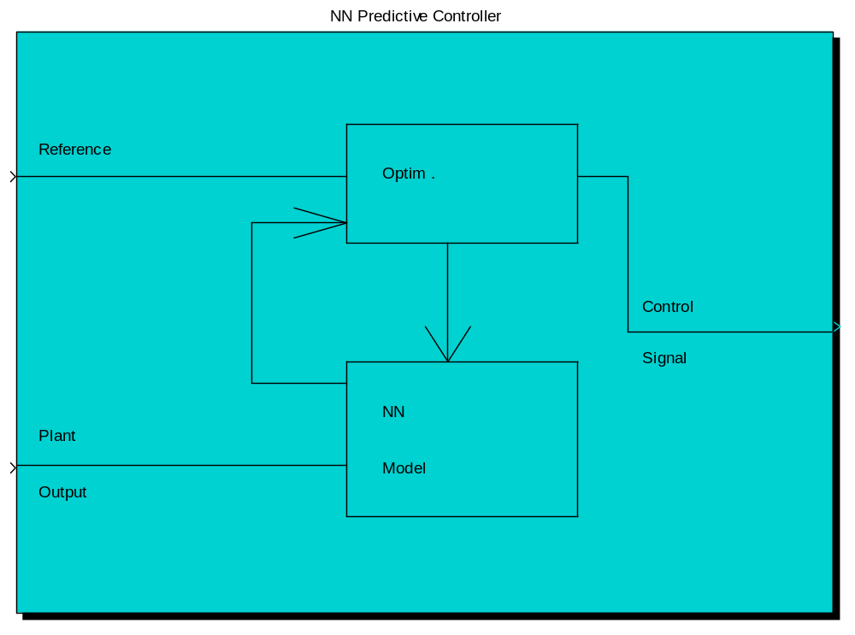
ANN training in Matlab

Slide 30
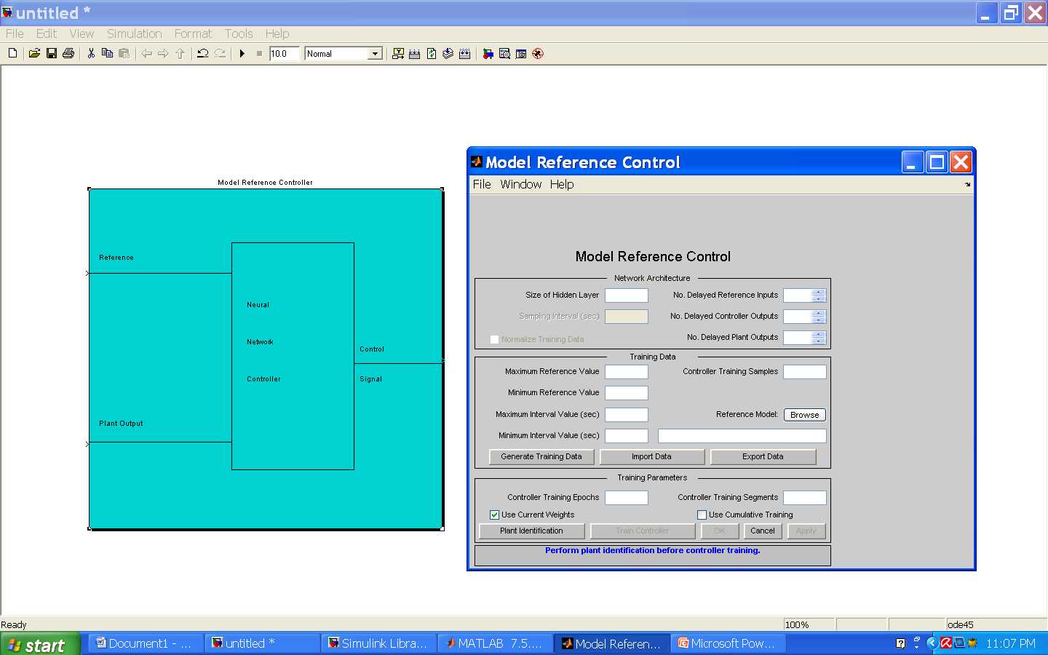
ANN cont’d …..

Slide 31
Steps for training the ANN in Matlab
Before training the controller, a neural network plant model must first be correctly identified. If it have not previously identified the plant, then click the Plant Identification button, which will open an identification window.
The controller training algorithm needs the following parameters

Slide 32
ANN Project Lifecycle
Task identification and design
Feasibility
Data Coding
Network Design
Data Collection
Data Checking
Training and Testing
Error Analysis
Network Analysis
System Implementation

Slide 33
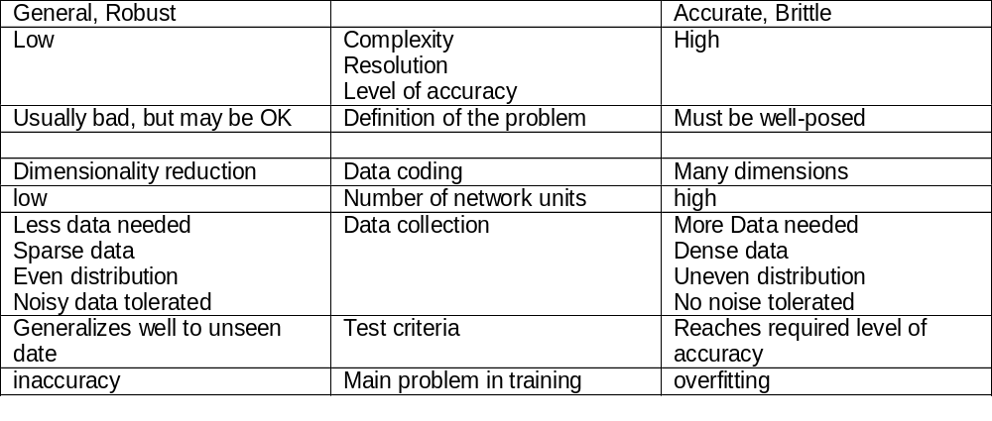
ANN Design Tradeoffs
A good design will find a balance between these two extremes!

Slide 34
Modeling the Neuron: Capabilities
Humans and Neural Nets are both:
  Good at pattern recognition
  Bad at mathematical calculation
  Good at compressing lots of information into a yes/no decision
  Taught via training period
TLUs win because neurons are slow
Wetware wins because we have a cheap source of billions of neurons

Slide 35
Do ANNs model neuron structures?
No: Hundreds of types of specialized nerons, only one TLU
No: Weights to neural threshold controlled by many neurotransmitters, not just one
Yes: Most of the complexity in the neuron is devoted to sustaining life, not information processing
Maybe: There is no real method for backpropagation in the brain. Instead, firing of neurons increases connection strength

Slide 36
High Level: Agent Architecture
Our minds are composed of a series of non-intelligent agents
The hierarchy, interconnections, and interactions between the agents creates our intelligence
There is no one agent in control
We learn by forming new connections between agents
We improve by dealing with agents at a higher level, ie creating mental ‘scripts’

Slide 37
Learning Meaning
Uniframing: Combining several descriptions into one
Accumulating: Collecting incompatible descriptions
Reformulating: modifying a description’s character
Transforming: bridging between structures and functions or actions

Slide 38
Neural Networks: Conclusions
Neural Networks are a powerful tool for:
  Pattern recognition
  Generalizing to a problem
  Machine learning
Training Neural Networks
  Can be done, but exercise great care
  Still has room for improvement
Understanding and creating consciousness?
  Still working on it :

Slide 39
REFERENCES
Stamatios V. Kartalopoulos, “Understanding Neural Networks and Fuzzy Logic”, IEEE press.
Limin Fu, “Neural Networks in Computer intelligence”, MIT press.
S.N. Sivanandam, S. Sumathi, & S.N. Deepa, “ Introduction to neural networks using Matlab”, TMH publication.
D. W. Patterson, “Introduction to Artificial Intelligence and Expert systems”, PHI publication.
www.wikipedia.com

Slide 40


