Slide 1
T-DPSOM: An Interpretable Clustering Method for Unsupervised Learning of Patient Health States
A Deep Learning Approach for ICU Patient Monitoring
Presented by: Vaibhav Sachdeva
Date: 5/6/2025

Slide 2
Motivation
ICU patients generate complex multivariate time series data
Need for interpretable models to monitor, cluster, and predict health states
DPSOM improves SOM by combining interpretability and T-DPSOM adds temporal forecasting.
Notes:
Accurately clustering patient health states from complex, high-dimensional medical data is a challenging task.
Traditional clustering methods often fail in two key areas: interpretability and handling temporal dynamics.
Most traditional methods do not adequately capture the temporal evolution of patient health states, which is critical to monitoring disease progression and predicting outcomes.

Slide 3
Key Concepts
Self-Organizing Maps (SOMs)
Deep Probabilistic Clustering SOM (DPSOM)
Temporal DPSOM (T-DPSOM)
Acute Physiology And Chronic Health Evaluation (APACHE) score

Slide 4
Methodology
Self-Organizing Maps (SOM): An artificial neural network used for unsupervised clustering of high-dimensional data.
Dynamic and Probabilistic Extensions: Enhancements to the SOM framework to handle temporal patient data and model uncertainty.
Transformation Layer: Maps the cluster results to meaningful healthcare parameters, improving interpretability.

Slide 5
Scope
Present
Present a novel way to fit SOMs with probabilistic cluster assignments (PSOM)
Implement
Implement proposed new deep architecture for probabilistic clustering (DPSOM) using a VAE
Leverage
Leverage extending of architecture to cluster and forecast clinical states in time series (T-DPSOM).

Slide 6
Forecasting Patient Trajectories
LSTM predicts future latent states
Trajectories show health progression or deterioration
Useful for early warning and intervention

Slide 7
Coding Environment
Quad core Linux machine on GCP
RAM 192G
Python 3.11.11
Installer – Conda and requirements file
LLM : Chat GPT 4

Slide 8
Data Access
MIMC , MNIST database
eICU collaborative research database.
Access requirements for eICU data
Directly from eICU website
Sign the Data Use Agreement (DUA) required for sensitive medical data

Slide 9
Data Description
Data include vital signs, laboratory measurements, medications, APACHE components, care plan information, admission diagnosis, patient history, timestamped diagnoses from a structured problem list, and similarly chosen treatments.
Data from each patient is collected into a common warehouse only if certain “interfaces” are available.
Each interface is used to transform and load a certain type of data: vital sign interfaces incorporate vital signs, laboratory interfaces provide measurements on blood samples, and so on.
It is important to be aware that different care units may have different interfaces in place, and that the lack of an interface will result in no data being available for a given patient, even if those measurements were made in reality.
The data is provided as a relational database, comprising multiple tables joined by keys

Slide 10
Self Organizing Maps (SOM)
They project high-dimensional data onto a lower-dimensional grid (typically 2D), where similar data points are mapped to nearby nodes.
As a part of static SOM - the paper describes embedding discrete SOM clusters into the latent space of an autoencoder, enabling the learning of nonlinear data manifolds.
Each input is mapped to the closest prototype (SOM unit), and the decoder reconstructs the input from the selected prototype.
SOM prototypes are trained using a differentiable soft-assignment mechanism and a SOM loss enforcing neighborhood structure.

Slide 11
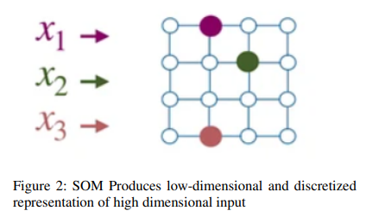
SOM Components
Encoder: Compresses input into a latent space.
SOM Prototypes: Learnable embeddings arranged in a grid.
Soft Assignment: Input is softly assigned to all SOM units, stronger for closer units.
SOM Loss: Encourages topologically close SOM units to encode similar inputs.
Decoder: Reconstructs the input from the SOM prototype.

Slide 12
DPSOM
DPSOM (Deep Probabilistic Self-Organizing Map) is a deep learning model that combines an autoencoder with a self-organizing map (SOM) in the latent space using novel way of fitting SOMs with probabilistic cluster assignments, which we call Probabilistic SOM (PSOM).
Then deep architecture, the Deep Probabilistic SOM (DPSOM), which jointly trains a Variational Encoder (VAE) and a PSOM to achieve an interpretable discrete representation while exhibiting state-of-the-art clustering performance.

Slide 13
T-DPSOM
T-DPSOM (Temporal Deep Prob. Self-Organizing Map) is an extension of DPSOM that integrates a recurrent neural network (e.g., GRU) to model temporal sequences, enabling interpretable and topology-preserving clustering of time-series data in an unsupervised manner.

Slide 14
Model Overview
T-DPSOM = DPSOM + Temporal Modeling
Deep latent representation with Variational encoders (VAE)
Temporal transitions modeled with LSTM
2D interpretable map via SOM

Slide 15
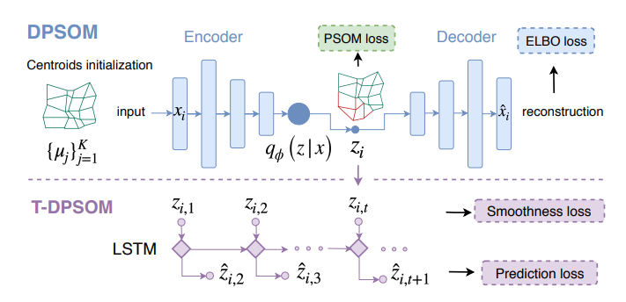
Architecture Diagram
VAE
Notes:
LSTM – Long Short-Term Memory
Probabilistic Self-Organizing Map (PSOM) Loss

Slide 16
Clustering Results
SOM grid shows distinct health states
Probabilistic assignments indicate uncertainty.
Clusters correlate with clinical outcomes.

Slide 17
Ablation
SOM loss removed. Purely temporal VAE.
The code was developed using LLM.
Testing done locally with limited test data.

Slide 18
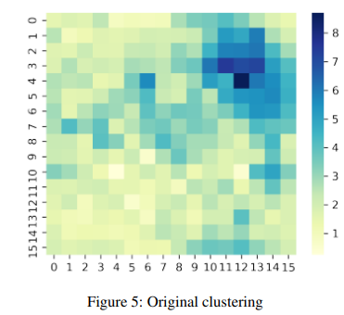
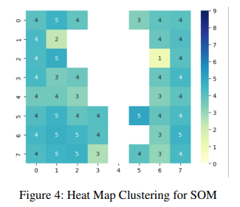
Visualization Example
Above given are
Heat Map clustering for SOM from reproduced results showing two groups.
Clustering with large data set from original paper

Slide 19
Interpretability and Clinical Value
2D grid supports visual monitoring
Helps identify risk groups and transitions
Clinician trust through explainability

Slide 20
Conclusion
T-DPSOM provides interpretable, probabilistic clustering
Adds temporal modeling for forecasting
Promising tool for ICU decision support

Slide 21
Related Links
Final project github page https://github.com/vaibhavait04/dlh2025_T_DPSOM_final_project/tree/master
Original paper https://dl.acm.org/doi/10.1145/3450439.3451872
eICU data: https://physionet.org/content/eicu-crd/2.0/
eICU Database access details: https://eicu-crd.mit.edu/
Original author github page: https://github.com/ratschlab/dpsom
https://mds.inf.ethz.ch/team/detail/julia-vogt

