Slide 1
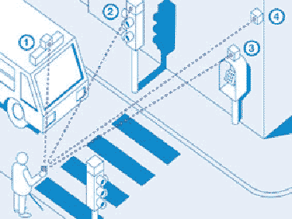
Traffic Light
Car
Pedestrian
Light
Mr. Bean
Pedestrian
Crossing

