Slide 1
Serial Interface For Mica2Dot
Vaibhav
(vaibhav@cse.ucsc.edu)

Slide 2
TinyOS
It’s a component based OS for sensor network platforms like mica, mica2, avrmote, mica2dot, mica128, rene2.
It supports sensor boards like basicb, micasb, micawb, micawbdot, pnimag, omnisound, ultrasound, sounderdot.
The best to take a look at is read the source code from recent CVS snapshot. Introductory details are at http://webs.cs.berkeley.edu/tos.
It makes extensive use of nesC – a great introduction to it is at http://webs.cs.berkeley.edu/tos/papers/nesc.pdf

Slide 3
Mica2Dot
The hardware specification of mica2dot from TinyOS kernel gives
  // uart assignments
  TOSH_ASSIGN_PIN(UART_RXD0, E, 0);
  TOSH_ASSIGN_PIN(UART_TXD0, E, 1);
The UART is 0-3v from the micro-controller board. To change this to RS232 (9v) we need a serial IC like MAX232.

Slide 4
Mica2Dot Serial Interface
A serial interface is essential to be able to hook-up commercial alcohol sensors to the board.
Attach the connector board mica2dot and get VCC, GND, URX and UTX out.
Feed these to the MAX232 chip which in turn is connected to a serial female connector.

Slide 5
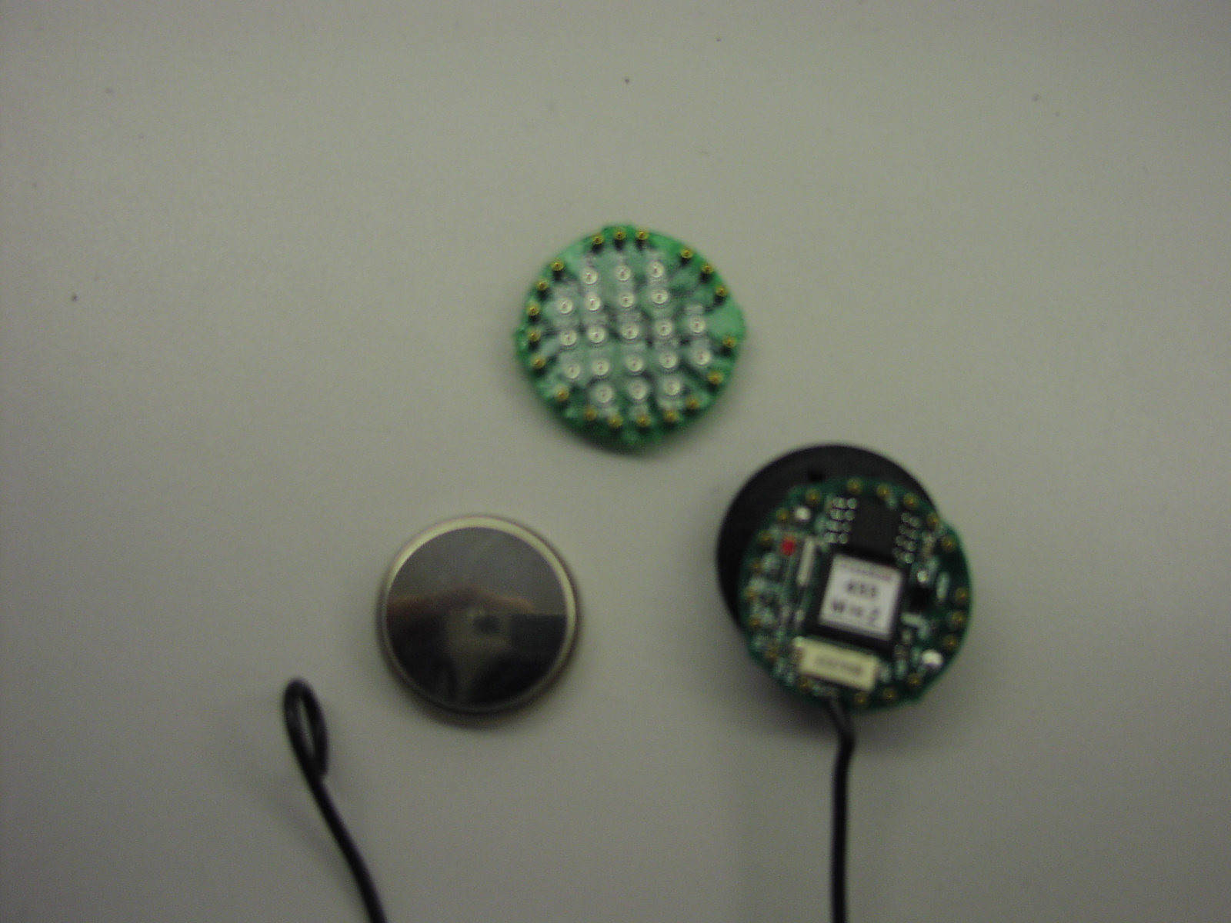
Mica2Dot Serial Interface
VCC
Connector
Board
(goes on top of mica2dot)
GND
UTX
URX
Mica2Dot

Slide 6
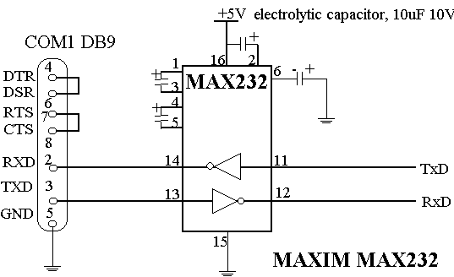
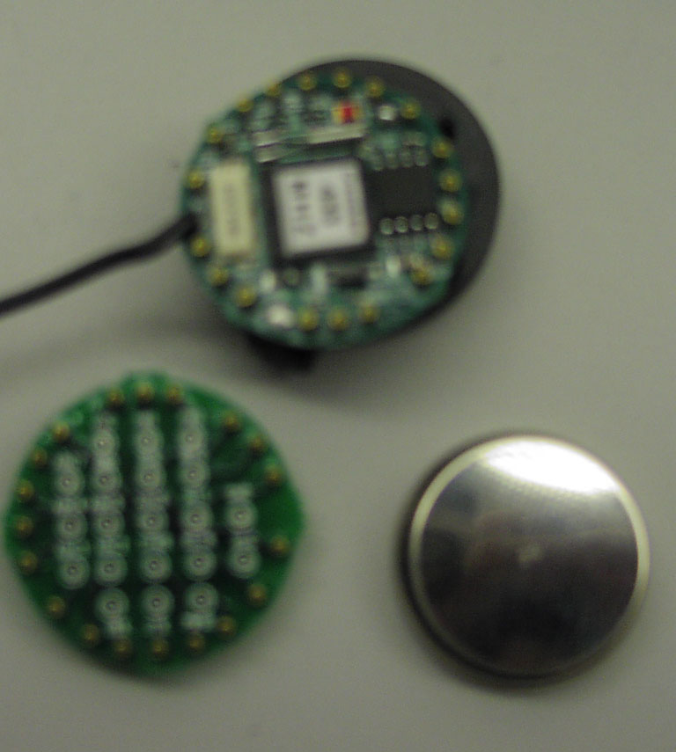
Block Diagram
VCC
Mica2Dot
With
Connector
Board
UTX
URX
GND

Slide 7
Over to Putting It Together Now!!
Thanks.

