Slide 1

Department of Computer Science & Engineering
Artificial Intelligence & Machine Learning
A.P. Shah Institute of Technology G. B. Road, Kasarvadavli, Thane(W), Mumbai-400615
UNIVERSITY OF MUMBAI
Academic Year 2023-2024

Slide 2

Mini Project
Quiz System

Slide 3
Quiz system
Computer Science & Engineering Artificial Intelligence and Machine Learning
By
Vivek Dalvi (22106108)
Yash Desai(22106005)
Vaibhav Bura(22106067)
Pratik Dhas(22106063)
Under the Guidance of Prof. Sayali Badhan

Slide 4
index
Introduction
Objectives
Block Diagram
Tools/Software, Languages used
Implementation
Conclusion
References

Slide 5
Introduction:
A Quiz System is a computer-based tool designed to assess knowledge, skills, or abilities through a series of questions or tasks.
It's commonly used in education, training, and entertainment.
Participants answer questions, and their responses are usually scored automatically.
Quiz Systems can be customized for various purposes, including learning assessments, trivia games, employee training, and more.
They offer a fun and interactive way to engage users while evaluating their knowledge or skills.

Slide 6

OBJECTIVES:
The quiz system proposed in this project aims to facilitate the user friendly environment that reduces the manual effort.
Providing an online comprehensive solution to manage quiz system where the individuals are participating in a team.
It also simplifies the task and reduce the paper work.
The system is very user friendly and is anticipated that functions of the quiz system will be easily accessed by administrators, academics, students and applicants.
Hence the quiz system has been designed to remove all the deficiency from which the present system is suffering.

Slide 7
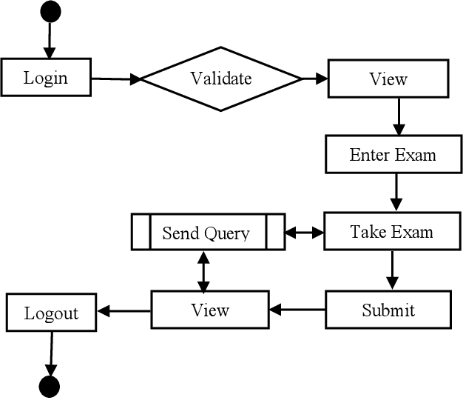
BLOCK DIAGRAM
QUIZ SYSTEM

Slide 8
DESCRIPTION OF BLOCK DIAGRAM
1. Login:
- This block represents the initial step where users log in with their credentials (username and password).
- It is the entry point to the quiz system.
2. Validate:
- After logging in, the system validates the user's credentials to ensure they have the necessary permissions to access the quiz.
3. View:
- Once validated, the user can view available quizzes. This block provides a list of quizzes the user can choose from.
4. Enter Exam:
- When a user selects a quiz, this block allows them to enter the chosen exam or quiz. It prepares the environment for the quiz to begin.
5. Take Exam:
- This block represents the main quiz interface where users answer questions and interact with the quiz content.

Slide 9
6. Submit:
- After completing the quiz, the user can submit their answers for evaluation. This block handles the submission process.
7. View (again):
- Users can view their quiz results or feedback on their performance in this block.
8. Send Query:
- If a user has any queries or issues, this block allows them to send a message or query for support or clarification.
9. Logout:
- Finally, the user can log out of the system to end their session securely.

Slide 10




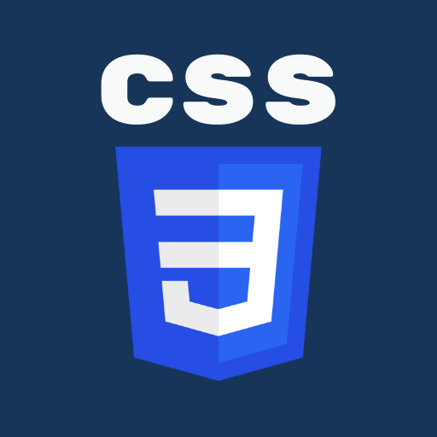
TOOLS & LANGUAGES USED:
Python
FIREBASE
JAVASCRIPT
CSS
HTML

Slide 11
1. Operating System:
Choose an operating system for your development environment, such as Windows, macOS, or Linux
2. Web Development Tools:
Text Editor or Integrated Development Environment (IDE). You can use tools like Visual Studio Code, Sublime Text or JetBrains’ IDEs for coding.
3. Database Management:
Our project involves storing user data or questions, we need a database server like MySQL, PHP or MongoDB and Firebase.
4. Programming Languages and Frameworks:
* Backend: Choose a programming language and framework like MySQL, JavaScript and PHP.
* Frontend: Use HTML, CSS, and JavaScript for the user interface and login page will be look more attractive.
5. Quiz Platform Software:
You may need to develop your own quiz platform or use existing solutions like Moodle, Canvas, or create a custom solution using your chosen programming stack.

Slide 12
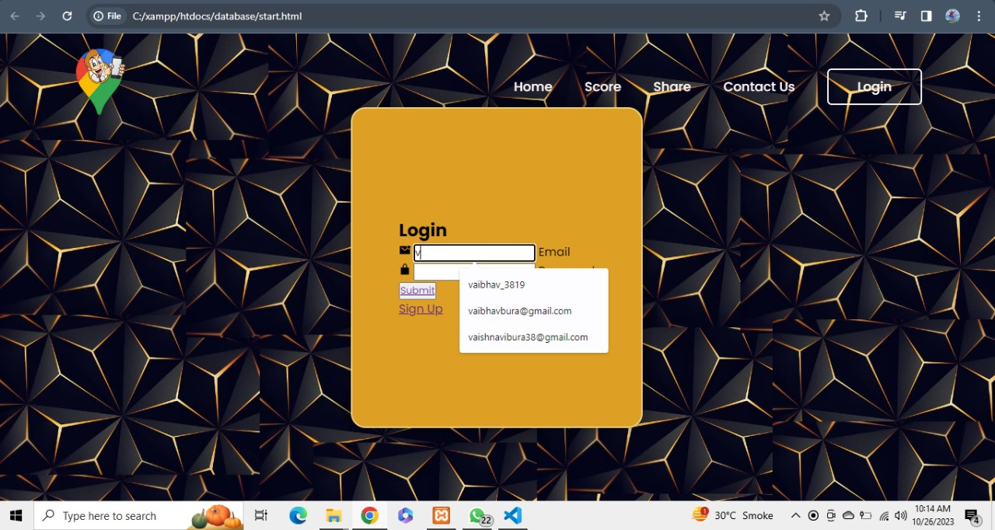
IMPLEMENTATION

Slide 13
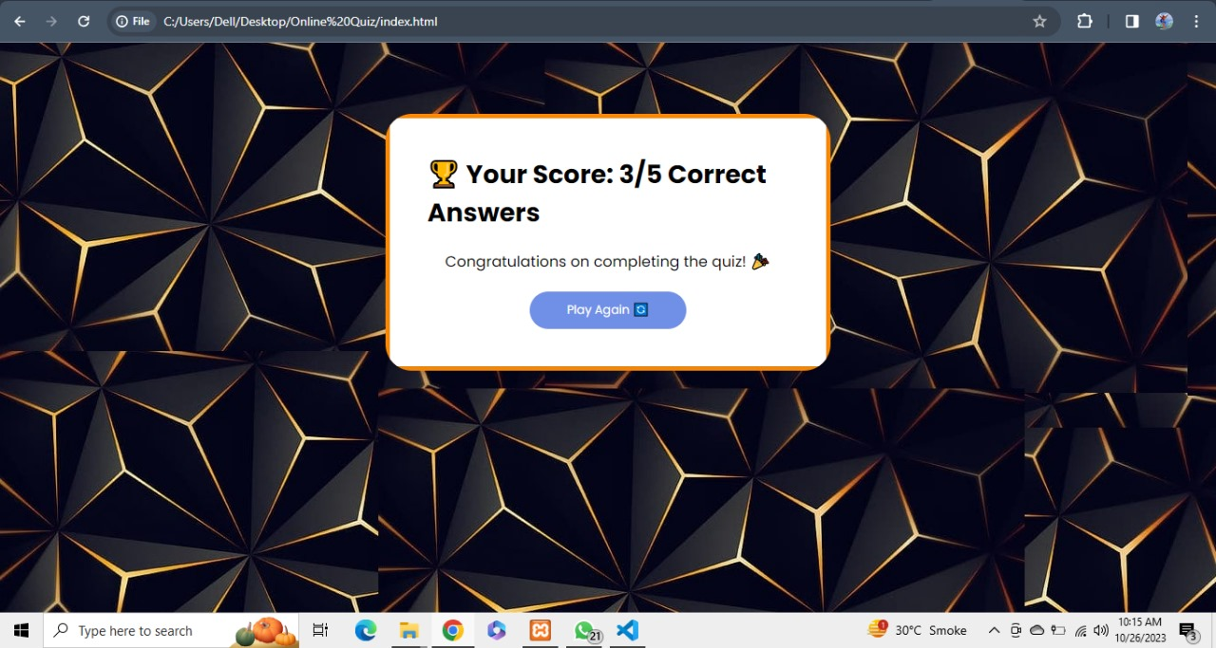

Slide 14
Conclusion
In Summary, the Quiz System is a versatile digital tool that enhances learning and assessment. It offers customization, scalability, security, and extending its relevance beyond education to corporate training and entertainment. This system exemplifies the fusion of technology and education, shaping innovative learning experience in the digital age.

Slide 15
REFERENCES
https://ieeexplore.ieee.org/document/10127578/[1]
https://ieeexplore.ieee.org/document/8769530/[2]
https://ieeexplore.ieee.org/xpl/conhome/9453798/proceeding[3]

Slide 16
THANK YOU!

