Slide 1

Final Year Project (Midterm) July2026-December2026

Slide 2
Multimodal AI Framework for OCR-Based Digitization and Intelligent Retrieval of Government Documents
Supervisor
Sumit Kumar, Assistant Professor (CSE)
Programme
B.Tech. CSE- Specialization in AI & ML
Team Members
Vaibhav Chugh (23csu327)
Srivatsan Raghavan (23csu302)
DEPARTMENT OF COMPUTER SCIENCE AND ENGINEERING
School of Engineering and Technology | The NorthCap University, Gurugram

Slide 3
Description of the Broad Topic
OCR &
Document AI
NLP &
Semantic Search
Vector DB
& RAG
Multimodal AI
(Mini VLM)
Workflow
Orchestration
Reading scanned and image-based pages
Meaning-based matching, not keywords
ChromaDB evidence + grounded generation
Tables, forms, stamps and layout
LangChain / LangGraph, session state
Government departments publish notifications, schemes, circulars, policy documents, forms and guidelines that carry eligibility rules, deadlines and procedures.
These archives mix ordinary text with scanned pages, tables, stamps, figures and multi-column layouts- a large share has no searchable text layer at all.
The project builds a multimodal, multilingual framework that digitizes such documents and answers natural-language questions from them, with source and page traceability.
Phase I (mid-term): multilingual text-only RAG foundation. Phase II (final): OCR, Mini VLM multimodal understanding and within-session conversational querying.

Slide 4
Feasibility Study
Technical
Established libraries, vector databases, vision-language models and LLM APIs cover every component. The modular design lets each stage be built and tested independently, and Phase II reuses working Phase-I modules.
Operational
Staff upload documents through the existing Admin interface without technical knowledge; citizens interact only through natural-language questions.
Economic
Built mainly on open-source OCR and embedding models. Gemini API usage is kept low through prompt and context-length optimisation.
Time
Incremental two-phase schedule: the RAG foundation is delivered by mid-term, leaving OCR, multimodal processing and evaluation for the final submission.
Session context
Within-session context needs only session/workflow state, not a second vector database. A separate conversation-history store remains an optional advanced extension.

Slide 5
Existing Solutions / Literature Review
Work / Area | Contribution | Relevance to this project
Lewis et al. (2020) Retrieval-Augmented Generation | Combines retrieval with generation for knowledge-intensive tasks | Core RAG design underlying the whole pipeline
Islam et al. (2017) OCR survey | Surveys OCR methods, error sources and challenges | Basis for Phase-II scanned-document digitization
Huang et al. (2022) LayoutLMv3 | Joint text, image and layout pre-training for Document AI | Motivates the Mini VLM multimodal extension
Asai et al. (2022) Evidentiality-guided generation | Ties generated content to its supporting evidence | Grounding and source/page traceability
Chirkova et al. (2024) Multilingual RAG | Retrieval and generation across languages | Multilingual queries with same-language answers
Rathee et al. (2026) Test-time corpus feedback | Feedback from the corpus to improve retrieval at inference | Informs future retrieval-quality improvements
Each line of work solves only part of the problem; the project integrates them for government documents.

Slide 6
GAPS in Existing Solutions / Literature Review
Existing approach | Limitation | Project response / phase
Traditional OCR | Recognition errors, and the original page layout is lost | Phase II- OCR with image preprocessing
Keyword search | Misses synonyms and paraphrased citizen queries | Phase I- embeddings + semantic retrieval
Text-only RAG (Phase I) | Assumes machine-readable input; ignores tables, images, stamps and layout | Phase II- Mini VLM multimodal extension
Generic Document AI models | Not tuned to the noise, layout conventions or vocabulary of government paperwork | Phase II- domain-adapted pipeline
Basic RAG pipelines | Can retrieve irrelevant chunks or answer without sufficient grounding | Phase I / refinement- document & page metadata
Limited conversational and adaptive capabilities | Follow-up questions require context, and existing systems have limited adaptation to user feedback and domain-specific terminology. | Phase II- within-session conversational context + feedback-driven self-learning using a domain dictionary and self-recurring agent
Phase-II opportunity: extend the working multilingual RAG pipeline with OCR-based digitization and Mini VLM understanding, keeping the same traceability guarantees.

Slide 7
Problem Statement
To develop a multimodal AI framework that digitizes and processes heterogeneous government documents using text extraction and OCR, constructs searchable semantic representations, supports multilingual natural-language queries, uses visual-language understanding for relevant document content, retrieves evidence, generates grounded responses through a structured RAG workflow, provides document/page traceability, and supports within-session conversational querying.
1 Digitize
2 Represent
3 Retrieve
4 Generate
Text extraction and OCR turn scanned, image-based pages into machine-readable content.
Cleaning, language detection, chunking and multilingual embeddings stored in ChromaDB with metadata.
Semantic Top-K similarity search returns the evidence chunks that match the user's question.
Gemini answers only from retrieved evidence, in the user's language, with document and page cited.

Slide 8
Objectives
1
Study government-document retrieval, OCR, RAG and multimodal approaches, and identify the technical and research gaps.
2
Design an architecture combining digitization, semantic retrieval and grounded generation.
3
Develop an OCR-based pipeline converting scanned and image-based government documents into machine-readable text.
4
Investigate Mini VLM visual-language understanding for tables, figures and layout-dependent content.
5
Extend the multilingual embedding and ChromaDB retrieval pipeline to incorporate multimodal representations.
6
Build a RAG question-answering system orchestrated through LangChain / LangGraph.
7
Support within-session conversational follow-up; keep cross-session memory explicitly out of scope.
8
Evaluate OCR accuracy, retrieval quality and answer correctness against the Phase-I text-only baseline.

Slide 9
GANTT Chart- Phase I (Mid-Term)
Activity | W1 3–9 Aug | W2 10–16 Aug | W3 17–23 Aug | W4 24–30 Aug | W5 31 Aug–6 Sep | W6 7–13 Sep | W7 14–20 Sep | Status
Problem & requirement analysis |  |  |  |  |  |  |  | Completed
Problem statement & objectives |  |  |  |  |  |  |  | Completed
Literature survey & existing systems |  |  |  |  |  |  |  | Completed
Research gap identification |  |  |  |  |  |  |  | Completed
Proposed solution & scope |  |  |  |  |  |  |  | Completed
System architecture & pipeline design |  |  |  |  |  |  |  | Completed
Technology selection & feasibility |  |  |  |  |  |  |  | Completed
Git/GitHub setup & document ingestion |  |  |  |  |  |  |  | Completed
Cleaning, chunking, embeddings, ChromaDB |  |  |  |  |  |  |  | Completed
Retrieval, RAG pipeline & Flask GUI |  |  |  |  |  |  |  | Completed
Testing & debugging |  |  |  |  |  |  |  | Ongoing
Mid-term report & presentation |  |  |  |  |  |  |  | Ongoing
Phase I schedule: 3 August 2026 – 20 September 2026. OCR, Mini VLM, LangChain/LangGraph and evaluation are Phase-II activities.

Slide 10
Responsibility Chart
Activity / Work package | Vaibhav Chugh | Srivatsan Raghavan
Problem analysis & literature survey | Support | Lead
Architecture & pipeline design | Lead | Support
Document ingestion & preprocessing | Support | Support
Chunking, embeddings & ChromaDB | Lead | Support
Retrieval & RAG generation | Lead | Support
Flask admin / user interface | Lead | Support
LangChain / LangGraph orchestration | Support | Support
Testing & evaluation | Support | Lead
Report, documentation & presentation | Support | Lead
Lead = primary owner and deliverable holder; Support = contributes and reviews.

Slide 11
Annexure I
Front page of plagiarism report provided by guide

Slide 12
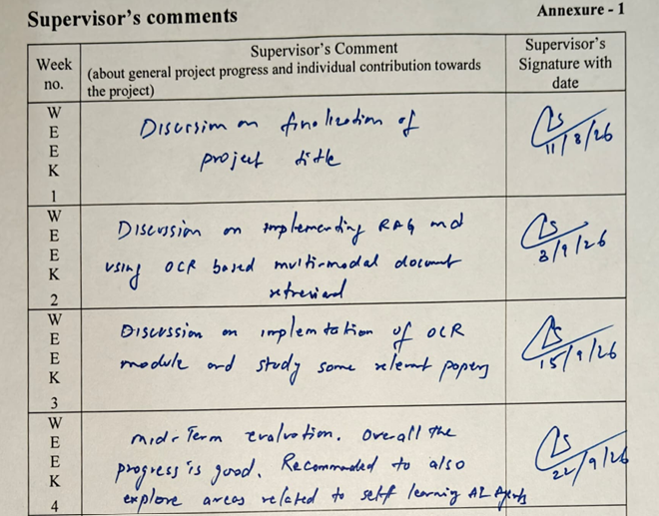
Annexure II
Screenshot of mentor’s mail / comments by guide

