Slide 1
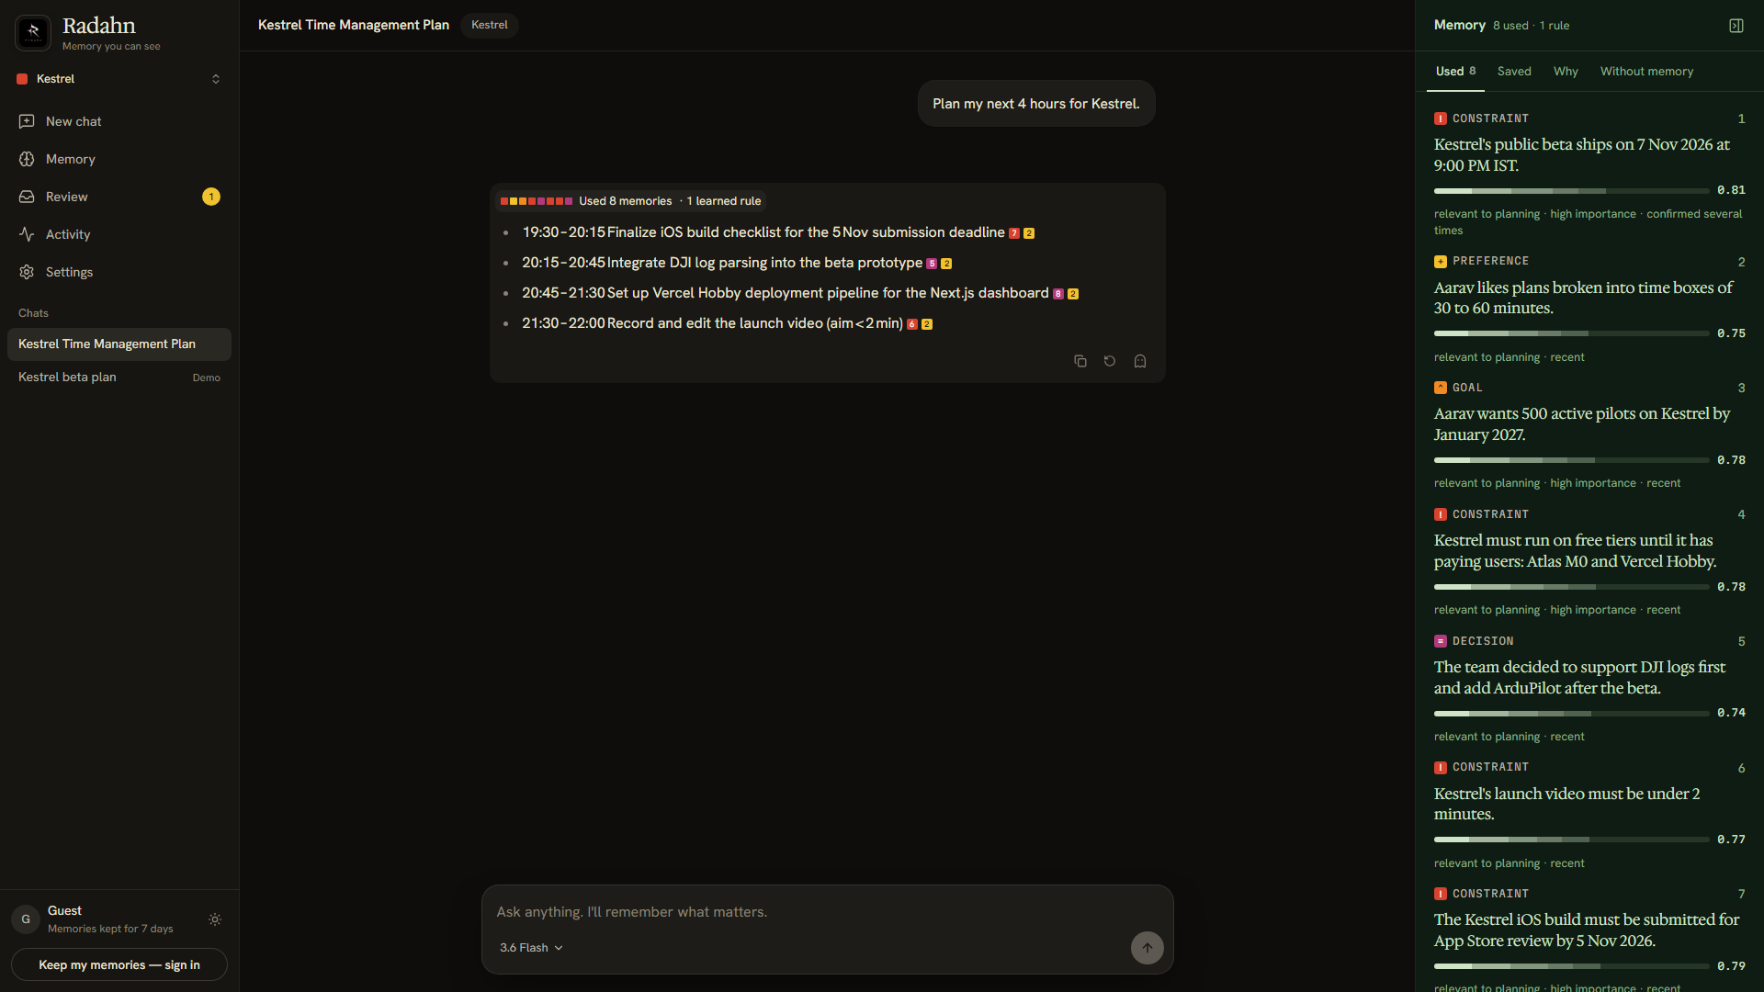
Radahn
An AI agent whose memory you can see, steer and trust.
radahn-ai.vercel.app
Try it as a guest. No sign-up.
Team Trident
Vaibhav Chauhan · Akash Biswas · Madhura Saravade
UNCHARTED HACKATHON · NEXUS
Notes:
Radahn is a personal AI agent whose memory you can see, steer and trust. It's live at radahn-ai.vercel.app and you can try it as a guest in one click.

Slide 2
THE PROBLEM
Assistants remember you. Invisibly.
You can’t see what it kept
You can’t see why it changed an answer
You can’t fix one wrong fact
Memory is a hidden list of notes or summaries.
No receipts: which fact shaped which line, and how much.
Old and new facts pile up; correcting one means starting over.
The problem isn’t forgetting. It’s memory you can’t inspect or steer.
Radahn · radahn-ai.vercel.app
02 / 10
Notes:
Every assistant now says it remembers you. But you can't see what it kept, why it changed an answer, or fix one wrong fact without starting over.

Slide 3
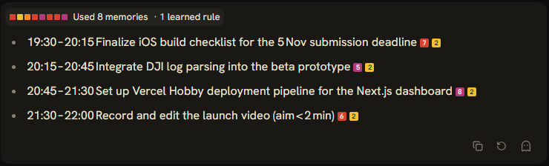
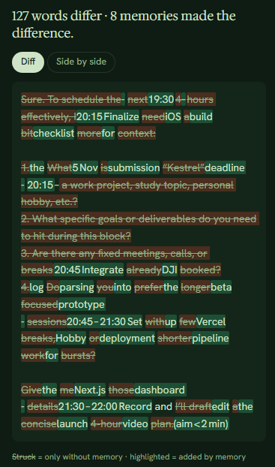
THE CORE IDEA
Every answer shows its receipts
Coloured squares cite the exact memory behind each line.
One click asks again with memory off and highlights what changed.
WITHOUT MEMORY → DIFF
Radahn · radahn-ai.vercel.app
03 / 10
Notes:
This is the core idea: memory visibly changes the next answer. Each line cites its memory, and the Without-memory diff shows exactly what memory added.

Slide 4
PRODUCT
What it does, in four verbs
01
02
Remembers
Recalls and explains
Small typed memories from every chat: preferences, decisions, deadlines, feedback.
Finds what matters for this message and shows the score behind every pick.
03
04
Corrects with history
Forgets for real
A changed fact becomes history, never overwritten. Rewind to any earlier moment.
Forget deletes. Expiry is automatic. Secrets are never stored.
Radahn · radahn-ai.vercel.app
04 / 10
Notes:
These map directly to the agentic-memory brief: remember, retrieve and explain, update and correct, and forget.

Slide 5
WRITE PATH
How a memory is written
01
02
03
04
05
06
Privacy
pre-scan
Extract
Policy gate
Reconcile
Transaction
Live event
secrets removed before any model sees them
a small model proposes candidate memories
sensitive → Review; unsure → asks you
add · confirm · supersede · skip
one current value per fact, history kept
change stream updates every screen
add
confirm
supersede
skip
Runs after the reply, so it never slows you down. First memory lands ≈ 2 s later.
Radahn · radahn-ai.vercel.app
05 / 10
Notes:
Secrets never reach the model; sensitive items wait for consent; a partial unique index makes one current value per fact a database guarantee.

Slide 6
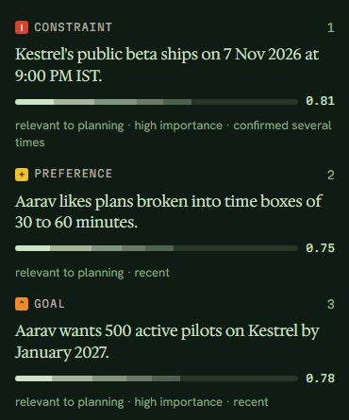
RECALL
How a memory is found
Meaning
FUSE → SCORE → TOP 8
vector search
0.55 relevance
0.15 recency
0.15 importance
0.10 confidence
Keywords
Atlas Search
Time
only for past questions
Weak matches dropped, near-duplicates removed.
Links
shared people and things
Every number is stored and shown in the Why tab, so every answer can be explained.
Radahn · radahn-ai.vercel.app
06 / 10
Notes:
Two stages: broad retrieval across four channels, then a focused re-rank. The weights favour relevance; recency uses a per-type half-life.

Slide 7
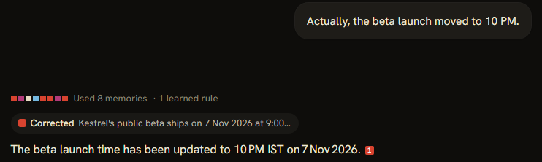
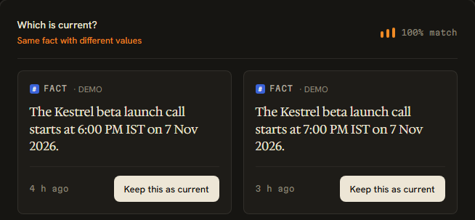

DIFFICULT CASES
The hard cases, handled
CORRECTION → OLD VALUE KEPT AS HISTORY
CONTRADICTIONS PUT TO YOU, NOT GUESSED
Expiry: stops at the set time; MongoDB TTL deletes it.
Forget: deleted for good; only a content-free event remains.
SECRETS BLOCKED BEFORE THE MODEL SEES THEM
Radahn · radahn-ai.vercel.app
07 / 10
Notes:
Correction with history, contradictions, expiry, hard forget, and secrets: all five work on production.

Slide 8
REFLECTION
It learns how you like answers
“That study plan was too long to use.”
LEARNED RULE · WITH EVIDENCE
When Aarav asks for a plan, give at most 5 bullets, each with a time box.
“Just the bullets, please.”
“A 12-step plan at 2 AM is overwhelming.”
Next plan: short, time-boxed, and the reply shows “1 learned rule”. The Without-memory diff proves the change.
FEEDBACK, REMEMBERED THREE TIMES
Radahn · radahn-ai.vercel.app
08 / 10
Notes:
Repeated feedback becomes an explicit strategy backed by evidence. Behaviour changes over time, and you can see it.

Slide 9
ARCHITECTURE
Built on MongoDB Atlas
Vector Search
Atlas Search
TTL indexes
Transactions
meaning, filtered by user and project
exact names and codes
automatic expiry
corrections never half-done
Partial unique index
Change streams
Aggregations
Schema validation
one current value per fact
live UI and agents
Activity stats and insights
every memory well-formed
Next.js on Vercel → MongoDB Atlas → Gemini + Groq models · one database for it all
Radahn · radahn-ai.vercel.app
09 / 10
Notes:
One database does everything memory needs; no second store to keep in sync. At scale: shard by user, dedicated search nodes, vector quantization.

Slide 10
RESULTS
Measured on production
20/20
31/31
1.0
0
≈ 0.5 s
live memory tests
rule checks
recall@5
secrets stored
recall time
LIMITS
NEXT
Free tiers only. Extraction is an AI and can err, so every save is visible and reversible.
A reranking model, shared team memory, importing existing notes.
Try it: radahn-ai.vercel.app
Team Trident Vaibhav Chauhan (U25EV012) · Akash Biswas (U25EV048) · Madhura Saravade (U25EV038)
Radahn · radahn-ai.vercel.app
10 / 10
Notes:
Hosted evaluation on production: 20 of 20 live cases, 31 of 31 rule checks, recall at 5 of 1.0, zero secrets stored, recall in about half a second. Try it as a guest.

