Slide 1
UNCHARTED 2026 · MONGODB STUDENT HACKATHON · TRACK 1: AGENTIC MEMORY
Radahn
A personal AI agent whose memory you can see, steer, and trust.
LIVE DEPLOYMENT: https://radahn-ai.vercel.app (Zero-auth Guest mode ready for testing)
PUBLIC REPOSITORY: https://github.com/vaibhavcodesx/radahn
TECH STACK: Next.js 16 + Tailwind v4 + MongoDB Atlas + Gemini 3.5/3.6 + Groq

Slide 2
01 / THE PROBLEM
Most assistants forget you between tabs. The rest remember you in secret.
Amnesia by Default
Standard AI chats start from scratch every conversation. Users repeat their preferences, stack constraints, and deadlines endlessly. Context windows are temporary.
The Black Box of Memory
When memory is bolted onto agents, it happens invisibly in prompt caches. Users cannot see what was stored, cannot inspect why an answer changed, and cannot remove stale assumptions.
The Missing Contract
Production-grade agentic memory requires transparency: visible inline citations, inspectable recall scores, and total user steerability (correct, expire, forget).

Slide 3
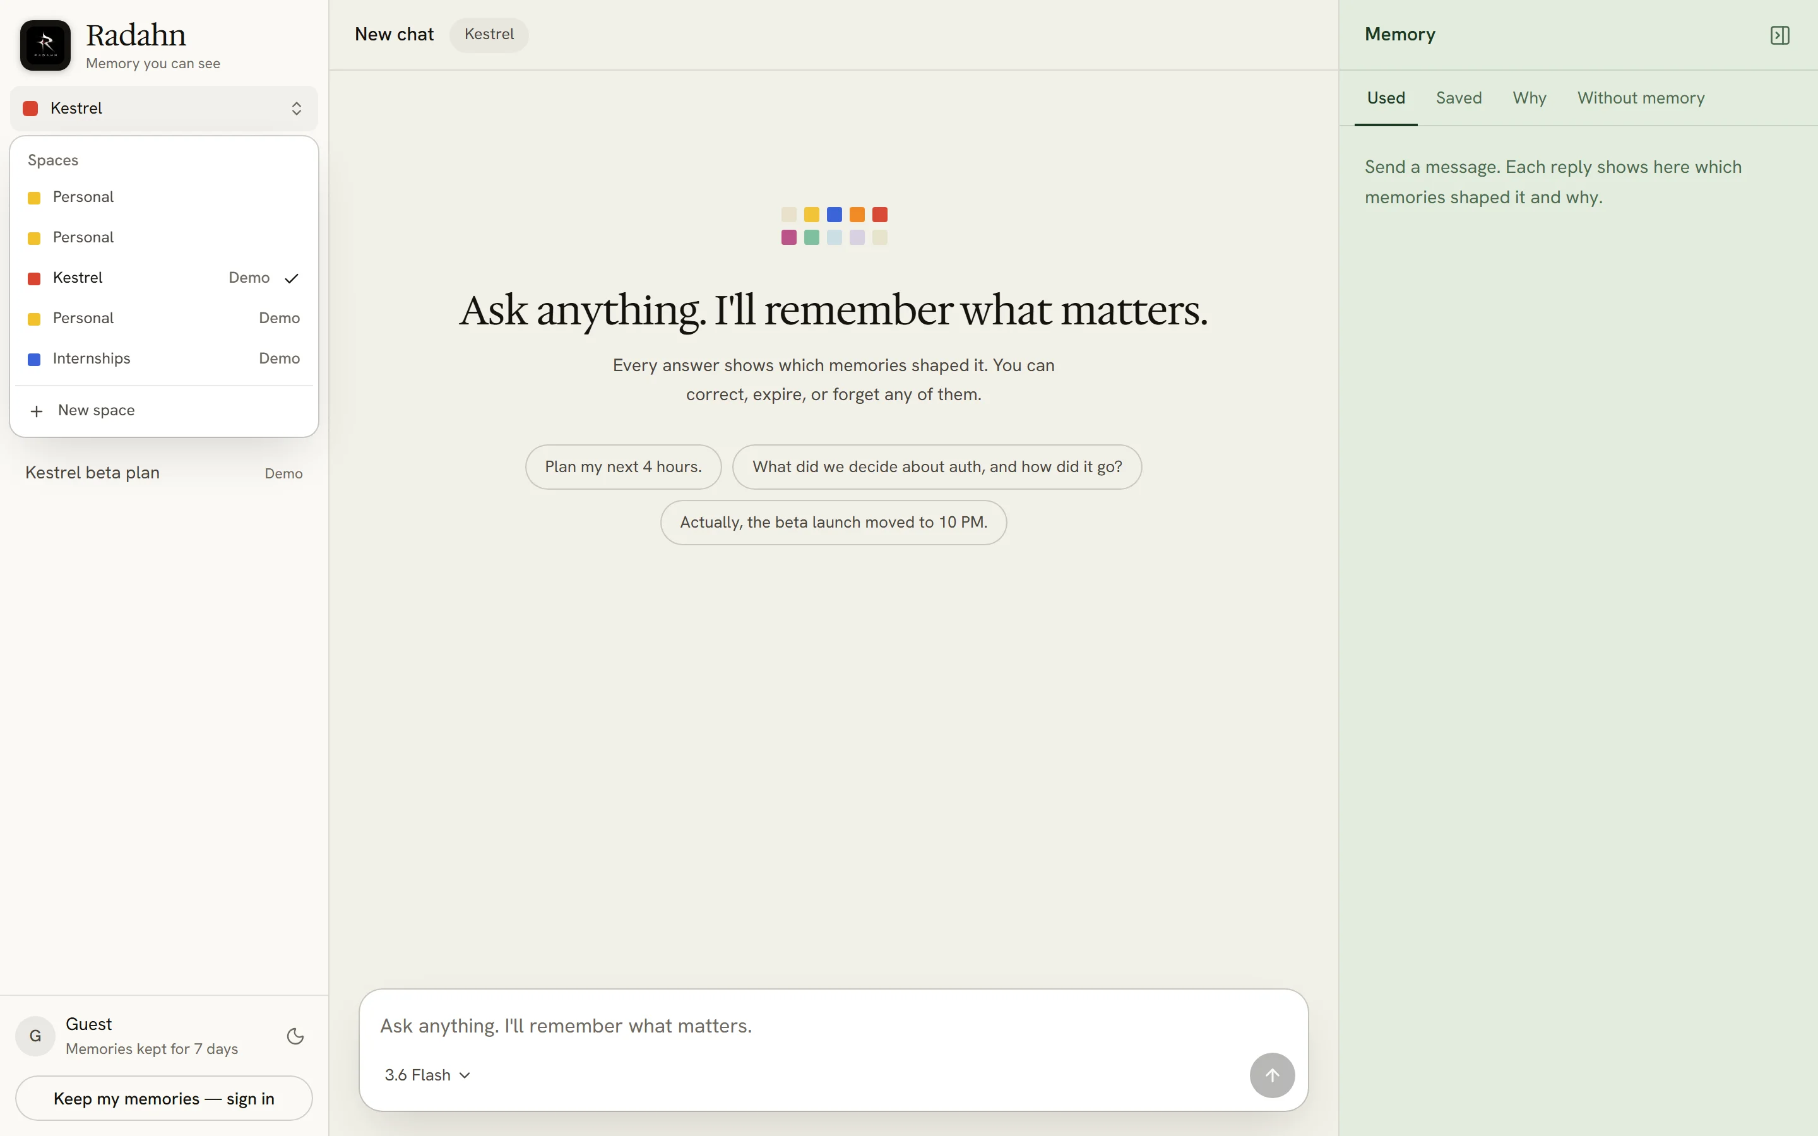
02 / THE SOLUTION
An agent with visible, steerable long-term memory on MongoDB Atlas.
Visible Citations
Every reply cites exact memories that shaped it. Click citations to inspect underlying units and multi-channel score breakdowns.
Complete Steerability
Review held items, correct facts with automatic superseding history, set minute-level TTL expiry, or permanently forget on command.
Database-Enforced Truth
Atlas unique indexes guarantee single source of truth; pre-scan gates intercept secrets before storage; zero hallucinated recall.

Slide 4
03 / DEMO RUN
Tested live with Aarav Mehta — building Kestrel with two friends.
The four-beat evaluation path tested seamlessly on production.
Beat 1: Instant Entry & Demo Seeding
Enter as guest -> Load demo memories. Seeds 38 typed memories across Kestrel, Personal, and Internships spaces with 768-d vector embeddings.
Beat 2: Recall & The Ghost Diff
Prompt: 'What is our launch plan for Kestrel?' Radahn cites Kestrel's 7 Nov 9 PM IST beta constraint, Aarav's 5-bullet preference, and 500 pilots goal. 'Without memory' shows live word-level diff.
Beat 3: Hard Cases Handled Live
Correction: 'Actually, the beta launch moved to 10 PM.' (Superseded with history chain). Sensitive memory held in Review. Credentials blocked by privacy gate.
Beat 4: Atlas & Realtime Reflection
Explore memories in Atlas with 'As of' time travel. Watch live SSE change stream events in Activity, and trigger 'Reflect now' to consolidate feedback into strategies.

Slide 5
04 / ARCHITECTURE
Atomic extraction, deterministic privacy gates, and transactional reconcile.
1. Stream & Gate
User turn streams from client. Deterministic regex & Shannon entropy pre-scan gate blocks keys/passwords before LLM or DB ingestion.
2. Atomic Extraction
Gemini 3.5 Flash-Lite extracts atomic candidate statements with typed Whitney block metadata (kind, space, confidence, slot).
3. Reconcile Engine
ADD (new fact) · CONFIRM (log boost) · SUPERSEDE (points old to new) · SKIP (deduplicates). Sensitive facts held for review.
4. Atlas Transaction
Multi-document ACID transaction writes to `memories` and emits to `memory_events`. MongoDB Change Streams notify UI via SSE.

Slide 6
05 / RECALL ENGINE
Four parallel channels fused by rank, re-scored transparently, budgeted to 8.
Four Parallel Recall Channels
1. Atlas Vector Search
768-d cosine vector search (gemini-embedding-2), pre-filtered by ownerId, spaceKey, and active status.
2. Atlas Search (Lexical)
Full-text Lucene search for exact keywords, acronyms, and codes ('Next.js', 'Vercel', 'Kestrel').
3. Temporal Recency Window
Recency decay calibrated to memory type half-life and explicit time queries.
4. Linked Entities Graph
Graph-lite entity linking across shared subjects and referenced items.
Scoring Formula & Budgeting
final = 0.55 * relevance(RRF) + 0.15 * recency + 0.15 * importance + 0.10 * confidence + type_boost
Reciprocal Rank Fusion (RRF)
Fuses rank positions across all 4 channels without scale bias.
MMR Re-Ranking
Maximal Marginal Relevance (lambda = 0.7) eliminates near-duplicate candidates.
Strict Budgeting
Threshold at 0.35; capped at top 8 memories injected into system prompt.
Complete Audit Trace
Every candidate score, channel contribution, and decision saved to DB for inspection.

Slide 7
06 / RELIABILITY
Enforced with database guarantees rather than prompt suggestions.
CORRECTION: Beta launch moved to 10 PM. Reconcile engine marks old record outdated, writes active replacement.
MongoDB Enforcer: Partial unique index {ownerId, spaceKey, slotKey} active. Guaranteed single truth.
EXPIRY: Remind me before Monday. Stops recalling past expiresAt, purged by background cleaner.
MongoDB Enforcer: TTL index on purgeAt. Automatic physical cleanup without custom cron infrastructure.
FORGET: Forget my dietary preferences. Hard delete of statement and vector embedding.
MongoDB Enforcer: deleteOne on memories collection + content-free audit tombstone in memory_events.
CONTRADICTIONS: Disagreeing statements detected during ingestion. Review page presents options side by side.
MongoDB Enforcer: Recommendation Card UI lets user pick winning memory; winner supersedes loser.
PRIVACY INTERCEPT: Catches simulated API keys, passwords, OTPs before LLM or DB ingestion.
MongoDB Enforcer: Regex and Shannon entropy pre-scan gate; sensitive items routed to Review queue.

Slide 8
07 / LEARNING
Turning conversation history into learned agent behaviours.
Reflection Pipeline
1. Gather Unreflected Feedback
Collects raw feedback, corrections, and explicit preferences since last checkpoint.
2. Topic Clustering
Groups observations by task domain (e.g. planning, formatting, coding).
3. Synthesis & Consolidation
Synthesizes recurring guidance into generalized behavioural rules.
4. Write Learned Strategies
Stores high-level strategies in memories with vector embeddings.
Learned Strategy in Production
Observed User Feedback
User repeatedly asks: 'keep it concise', 'bullet points only', 'shorter plans'.
Synthesized Strategy
"When Aarav asks for a plan, give at most 5 bullets, each with a time box."
Live Agent Adaptation
Automatically recalled in future planning queries. Directly governs the Kestrel launch roadmap without prompting.

Slide 9
08 / MONGODB STACK
Eight native MongoDB Atlas capabilities powering a zero-infrastructure backend.
Document Model & $jsonSchema
Typed memories, confidence scores, and lifecycle states in a strictly validated schema.
Atlas Vector Search
768-d vector index with pre-filters on ownerId, spaceKey, status, and type.
Atlas Search (Lucene)
Full-text lexical search capturing exact tokens that vector embeddings miss.
TTL Indexes
Automatic physical expiration on purgeAt without custom cron jobs.
Partial Unique Index
{ownerId, spaceKey, slotKey} active guarantees one source of truth under concurrent writes.
Multi-Document Transactions
Atomic updates across memories and memory_events ensure zero corrupted state.
Change Streams
Watches memory_events to stream real-time SSE to browser write chips and Activity feed.
Aggregation Pipelines
Real-time analytics for memory distribution, recall hit rates, and weekly corrections.

Slide 10
09 / BENCHMARKS
Hosted production verification on MongoDB Atlas M0 + Gemini / Groq.
20 / 20
Live Test Cases Passed
100% pass across write-add, correction chains, cold-index recall, explicit forget.
31 / 31
Deterministic Checks
100% pass for privacy gate, prompt injection resistance, reconcile ops, TTL grace.
0
Secrets Stored
100% interception of simulated API keys, credentials, tokens, and sensitive cards.
1.0
Recall@5 Precision
Top 5 retrieved candidates captured 100% of ground-truth test units.
566 ms
Recall Latency (p50)
Cold-path recall including query vector embedding and multi-channel rank fusion.
1.96 s
First Memory Write (p50)
From completion of chat stream to committed event in MongoDB change stream.

Slide 11
10 / ROADMAP
Honest evaluation today and clear enterprise architecture tomorrow.
Current Limitations (Free Tier)
Quota Boundaries
Gemini free tier has rate limits. Mitigated with resilient multi-model hedging (3.6 Flash -> Groq GPT-OSS 120B -> 3.5 Flash-Lite).
Probabilistic Extraction
LLMs can miss subtle nuances; mitigated by making every memory visible, editable, and reversible in the UI.
Guest Lifetime
Anonymous demo sessions expire in 7 days unless linked to a Google account.
Enterprise Scale Architecture
Horizontal Sharding on ownerId
Because every query is strictly scoped by ownerId, 100% of user queries target a single shard without cross-node fanout.
Dedicated Search Nodes
Separates vector and full-text indexing from core transactional nodes for sub-50ms latency under high load.
Vector Quantization
Scalar/int8 quantization reduces index RAM by 75%, scaling to millions of memories per cluster.

Slide 12
11 / TEAM & AGENTS
Built in 24 hours for UNCHARTED 2026 by three humans and three agents.
HUMAN BUILDERS: Vaibhav & Teammates
Product direction, MongoDB schema design, eval benchmark harness, and end-to-end judge validation.
THREE-AGENT PAIR PROGRAMMING COLLABORATION:
Claude Code (Lead): App Router architecture, chat orchestration, Better Auth, and integration merges.
Codex (Engine): Memory engine, privacy gate, 4-channel recall, scoring algorithm, reflection pipelines, and eval harness.
Antigravity (Experience): Public landing page, real production screenshots, Review/Activity/Settings polish, presentation deck, and demo video kit.
LIVE PRODUCT: https://radahn-ai.vercel.app · REPO: https://github.com/vaibhavcodesx/radahn

