Slide 1
Lending Club Case study
Name: Vaibhav Dandge
Email: vaibhavdandge03@gmail.com
GitHub: https://github.com/vaibhavdandge/

Slide 2
Problem Statement:
You work for a consumer finance company which specialises in lending various types of loans to urban customers.
When the company receives a loan application,
the company has to make a decision for loan approval based on the applicant’s profile.
Two types of risks are associated with the bank’s decision:
If the applicant is likely to repay the loan, then not approving the loan results in a loss of business to the company
If the applicant is not likely to repay the loan, i.e. he/she is likely to default, then approving the loan may lead to a financial loss for the company

Slide 3
Data understanding
shape loan data -(39717, 111)
INFO
RangeIndex: 39717 entries, 0 to 39716
Columns: 111 entries, id to total_il_high_credit_limit
dtypes: float64(74), int64(13), object(24)
memory usage: 33.6+ MB
None

Slide 4
Data Cleaning
There are several columns which are single valued.
They cannot contribute to our analysis in any way. So we have to remove them.
Now we have 5 rows and 48 columns aout of which some correspond to the post approval of loan
our main goal is to find customers which likely to be defaulter or not.
We are analyzing the customer details and the driving factors of loan defaulting before approving loan. So we can safely remove the columns / variables corresponding to that scenario.

Slide 5
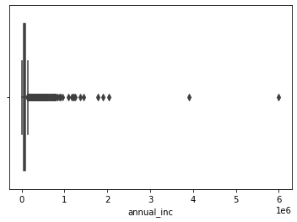
Outlier Treatment

Slide 6
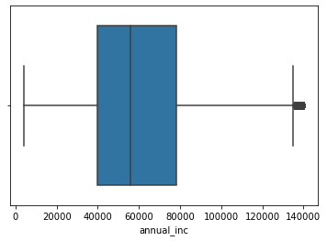
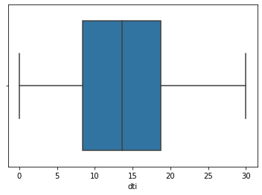
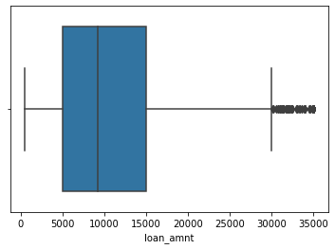

Slide 7
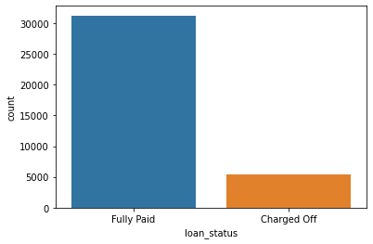
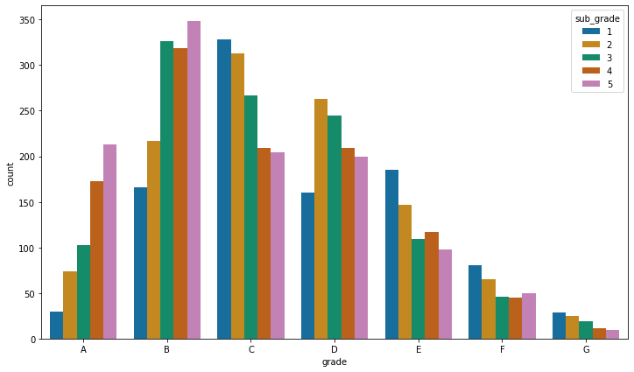
Visualizing Categorical Data As we already have grade column, extracting only subgrade (int level value) from the sub_grade variable We are analyzing and visualizing only the defaulter data. So subsetting the data while plotting only for 'Charged Off' loan_status for below plots

Slide 8
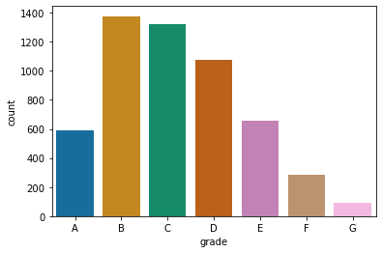

Slide 9
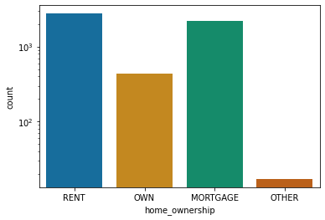

Slide 10
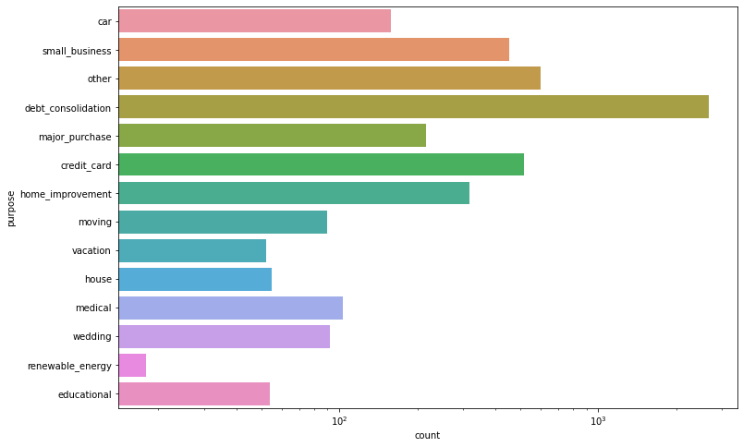

Slide 11
Observations
The above analysis with respect to the charged off loans.
There is a more probability of defaulting when :
Applicants taking loan for 'home improvement' and have income of 60k -70k
Applicants whose home ownership is 'MORTGAGE and have income of 60-70k
Applicants who receive interest at the rate of 21-24% and have an income of 70k-80k
Applicants who have taken a loan in the range 30k - 35k and are charged interest rate of 15-17.5 %
Applicants who have taken a loan for small business and the loan amount is greater than 14k
Applicants whose home ownership is 'MORTGAGE and have loan of 14-16k
When grade is F and loan amount is between 15k-20k
When employment length is 10yrs and loan amount is 12k-14k
When the loan is verified and loan amount is above 16k For grade G and interest rate above 20%
Applicants who applied and defaulted have no significant difference in loan_amounts.
Which means that applicants applying for long term has applied for more loan.

